Slide 1
Measurement:
Techniques, Strategies, and Pitfalls
Nick Feamster
CS 7260
February 7, 2007

Slide 2
Internet Measurement
Process of collecting data that measure certain phenomena about the network
  Should be a science
  Today: closer to an art form
Key goal: Reproducibility
“Bread and butter” of networking research
  Deceptively complex
  Probably one of the most difficult things to do correctly

Slide 3
Types of Data
Active
Passive
traceroute
ping
UDP probes
TCP probes
Application-level “probes”
  Web downloads
  DNS queries
Packet traces
  Complete
  Headers only
  Specific protocols
Flow records
Specific data
  Syslogs …
  HTTP server traces
  DHCP logs
  Wireless association logs
  DNSBL lookups
  …
Routing data
  BGP updates / tables, ISIS, etc.

Slide 4
Outline: Tools and Pitfalls
Aspects of Data Collection
  Precision: At what granularity are measurements taken?
  Accuracy: Does the data capture phenomenon of interest?
  Context: How was the data collected?
Tools
  Active
    Ping, traceroute, etc.
    Accuracy pitfall example: traceroute
  Passive
    Packet captures (e.g., tcpdump, DAG)
    Flow records (e.g., netflow)
    Routing data (e.g., BGP, IS-IS, etc.)
    Context pitfall example: eBGP multihop data collection

Slide 5
Outline (continued)
Strategies
  Cross validate
    consistency checks
    multiple “overlapping” measurements
  Examine Zeroth-Order
Database as secret weapon
Other considerations
  Anonymization and privacy
  Maintaining longitudinal data

Slide 6
Active Measurement

Slide 7
How Traceroute Works
Send packets with increasing TTL values
TTL=1
TTL=2
TTL=3
ICMP “time exceeded
Nodes along IP layer path decrement TTL
When TTL=0, nodes return “time exceeded” message

Slide 8
Problems with Traceroute
Can’t unambiguously identify one-way outages
  Failure to reach host : failure of reverse path?
ICMP messages may be filtered or rate-limited
IP address of “time exceeded” packet may be the outgoing interface of the return packet
TTL=1
TTL=2
TTL=3

Slide 9
Famous Traceroute Pitfall
Question: What ASes does traffic traverse?
Strawman approach
  Run traceroute to destination
  Collect IP addresses
  Use “whois” to map IP addresses to AS numbers
Thought Questions
  What IP address is used to send “time exceeded” messages from routers?
  How are interfaces numbered?
  How accurate is whois data?

Slide 10
More Caveats: Topology Measurement
Routers have multiple interfaces
Measured topology is a function of vantage points
Example: Node degree
  Must “alias” all interfaces to a single node (PS 2)
  Is topology a function of vantage point?
    Each vantage point forms a tree
    See Lakhina et al.

Slide 11
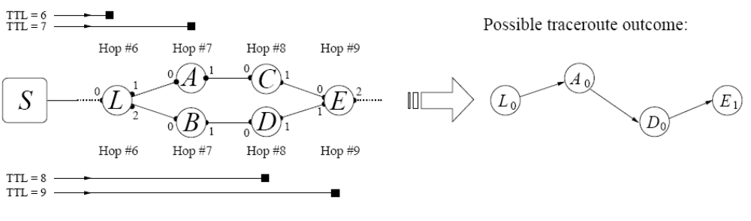
Less Famous Traceroute Pitfall
Host sends out a sequence of packets
  Each has a different destination port
  Load balancers send probes along different paths
    Equal cost multi-path
    Per flow load balancing
Question: Why won’t just setting same port number work?
Soule et al., “Avoiding Traceroute Anomalies with Paris Traceroute”, IMC 2006

Slide 12
Designing for Measurement
What mechanisms should routers incorporate to make traceroutes more useful?
  Source IP address to “loopback” interface
  AS number in time-exceeded message
  ??

Slide 13
Routing Data
IGP
BGP
  Collection methods
    eBGP (typically “multihop”)
    iBGP
  Table dumps: Periodic, complete routing table state (direct dump from router)
  Routing updates: Continuous, incremental, best route only
iBGP session

Slide 14
BGP Routing Updates: Example
TIME: 07/06/06 19:49:52
TYPE: BGP4MP/STATE_CHANGE
PEER: 18.31.0.51 AS65533
STATE: Active/Connect
TIME: 07/06/06 19:49:52
TYPE: BGP4MP/STATE_CHANGE
PEER: 18.31.0.51 AS65533
STATE: Connect/Opensent
TIME: 07/06/06 19:49:52
TYPE: BGP4MP/STATE_CHANGE
PEER: 18.31.0.51 AS65533
STATE: Opensent/Active
TIME: 07/06/06 19:49:55
TYPE: BGP4MP/MESSAGE/Update
FROM: 18.168.0.27 AS3
TO: 18.7.14.168 AS3
WITHDRAW
12.105.89.0/24
64.17.224.0/21
64.17.232.0/21
66.63.0.0/19
89.224.0.0/14
198.92.192.0/21
204.201.21.0/24
Accuracy issue: Old versions of Zebra would not process updates during a table dump…buggy timestamps.

Slide 15
The Importance of Context:
Case Studies with Routing Data

Slide 16
Context Pitfall: AS-Level Topologies
Question: What is the Internet’s AS-level topology?
Strawman approach
  Routeviews routing table dumps
  Adjacency for each pair of ASes in the AS path
Problems with the approach?
  Completeness: Many edges could be missing. Why?
    Single-path routing
    Policy: ranking and filtering
    Limited vantage points
  Accuracy
  Coarseness

Slide 17
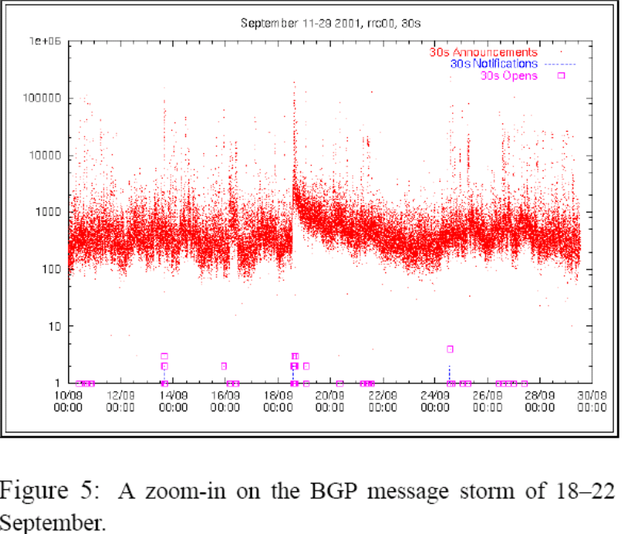
Context Pitfall: Routing Instability
Question: Does worm propagation cause routing instability?
Strawman approach:
  Observe routing data collected at RIPE RIRs
  Correlate routing update traffic in logs with time of worm spread
  Finding: Lots of routing updates at the time of the worm sprreading!
  (Bogus) conclusion: Worm spreading causes route instability
Cowie et al., “Global Routing Instabilities Triggered by Code Red II and Nimda Worm Attacks”
Missing/Ignored Context: Instability + eBGP multihop …

