Slide 1
Measurement II:
Strategies, Pitfalls, Platforms
Nick Feamster
CS 7260
February 12, 2007

Slide 2
Internet Measurement
Process of collecting data that measure certain phenomena about the network
  Should be a science
  Today: closer to an art form
Key goal: Reproducibility
“Bread and butter” of networking research
  Deceptively complex
  Probably one of the most difficult things to do correctly

Slide 3
The Importance of Context:
Case Studies with Routing Data

Slide 4
Context Pitfall: AS-Level Topologies
Question: What is the Internet’s AS-level topology?
Strawman approach
  Routeviews routing table dumps
  Adjacency for each pair of ASes in the AS path
Problems with the approach?
  Completeness: Many edges could be missing. Why?
    Single-path routing
    Policy: ranking and filtering
    Limited vantage points
  Accuracy
  Coarseness

Slide 5
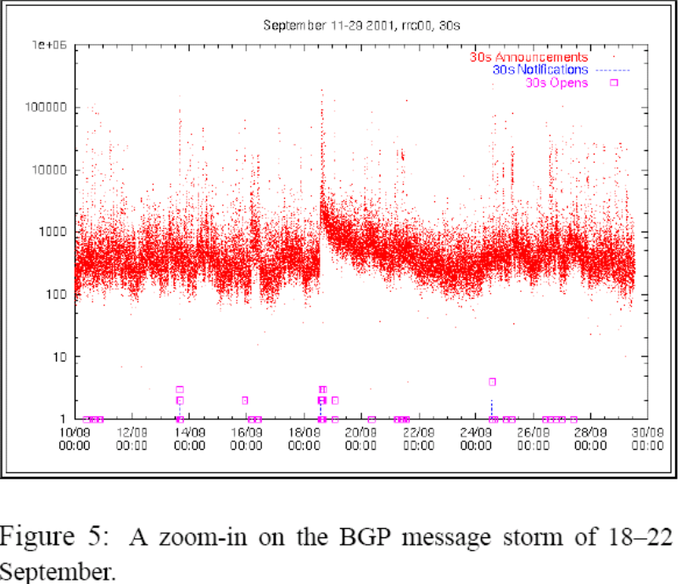
Context Pitfall: Routing Instability
Question: Does worm propagation cause routing instability?
Strawman approach:
  Observe routing data collected at RIPE RIRs
  Correlate routing update traffic in logs with time of worm spread
  Finding: Lots of routing updates at the time of the worm sprreading!
  (Bogus) conclusion: Worm spreading causes route instability
Cowie et al., “Global Routing Instabilities Triggered by Code Red II and Nimda Worm Attacks”
Missing/Ignored Context: Instability + eBGP multihop …

Slide 6
Strategy: Examine the Zeroth-Order
Paxson calls this “looking at spikes and outliers”
More general: Look at the data, not just aggregate statistics
  Tempting/dangerous to blindly compute aggregates
  Timeseries plots are telling (gaps, spikes, etc.)
  Basics
    Are the raw trace files empty?
      Need not be 0-byte files (e.g., BGP update logs have state messages but no updates)
    Metadata/context: Did weird things happen during collection (machine crash, disk full, etc.)

Slide 7
Strategy: Cross-Validation
Paxson breaks cross validation into two aspects
  Self-consistency checks (and sanity checks)
  Independent observations
    Looking at same phenomenon in multiple ways
What are some other examples of each of these?

Slide 8
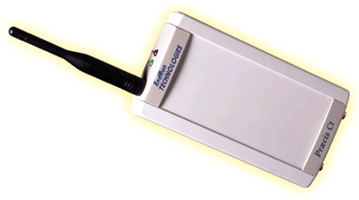
Example Sanity Checks
Is time moving backwards?
  PS1’s IGP packet trace
  Paxson’s probing example
  Typical cause: Clock synchronization issues
Has the the speed of light increased?
  E.g., 10ms cross-country latencies
Do values make sense?
  IP addresses that look like 0.0.1.2 indicate bug

Slide 9
BGP Routing Updates: Example
TIME: 07/06/06 19:49:52
TYPE: BGP4MP/STATE_CHANGE
PEER: 18.31.0.51 AS65533
STATE: Active/Connect
TIME: 07/06/06 19:49:52
TYPE: BGP4MP/STATE_CHANGE
PEER: 18.31.0.51 AS65533
STATE: Connect/Opensent
TIME: 07/06/06 19:49:52
TYPE: BGP4MP/STATE_CHANGE
PEER: 18.31.0.51 AS65533
STATE: Opensent/Active
TIME: 07/06/06 19:49:55
TYPE: BGP4MP/MESSAGE/Update
FROM: 18.168.0.27 AS3
TO: 18.7.14.168 AS3
WITHDRAW
12.105.89.0/24
64.17.224.0/21
64.17.232.0/21
66.63.0.0/19
89.224.0.0/14
198.92.192.0/21
204.201.21.0/24
Accuracy issue: Old versions of Zebra would not process updates during a table dump…buggy timestamps.

Slide 10
Cross-Validation Example
Traceroutes captured in parallel with BGP routing updates
Puzzle
  Route monitor sees route withdrawal for prefix
  Routing table has no route to the prefix
  IP addresses within prefix still reachable from within the IP address space (i.e., traceroute goes through)
Why?
  Collection bugs … or
  Broken mental model of routing setup

Slide 11
Databases: Secret Weapon
Easy way to get lots of summary statistics
  Regular first-order stats (cf. Paxson’s recommendation)
    Latest timestamp, number of updates, etc.
  Cross-validation becomes easier (quick and dirty SQL)
  Joint analysis of diverse datasets is a common need
Caveats!
  Insertion must be done properly
    Always, always save raw data
  Beware the table join

Slide 12
Horror Story #1: Buggy Postprocessing
Example RON Monitoring Logs
Logs maintained at each host
Files collected and merged to compute one-way delays
1103659228.224614 S 14b13270 0 8 18.7.14.168 66.26.83.103
1103659228.252509 R 14b13270 1 8 18.7.14.168 66.26.83.103
1103659229.388441 S 55a4b9a1 0 8 18.7.14.168 192.249.24.10
1103659229.611096 R 55a4b9a1 1 8 18.7.14.168 192.249.24.10
1103659231.200177 S bf1207a0 0 8 18.7.14.168 12.46.129.20
1103659231.270053 R bf1207a0 1 8 18.7.14.168 12.46.129.20
1103659233.109900 S 55e244c0 0 8 18.7.14.168 112.12.8.0
1103659234.308722 S 8ba24c76 0 8 18.7.14.168 18.97.168.219
If corresponding ends of logfile missing: set receive time to zero.
“Does the extra effort matter?” (Paxson)
What if the log files don’t match up in time properly?
What about missing log files?

Slide 13
Horror Story #2: Buggy Insertion
Raw files pulled to archive
  Archive stores directories month-by-month
  Files named by unixtime (start,end)
  Files pulled into directory by month
Insertion into DB: one archive directory at a time
Question: What about files that traverse multiple months?

Slide 14
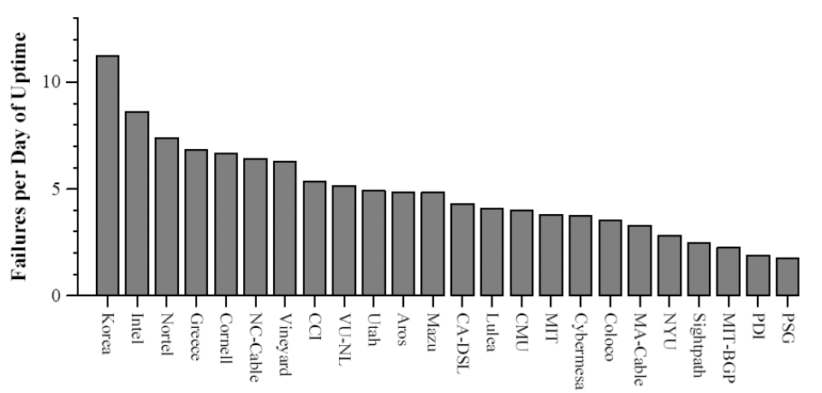
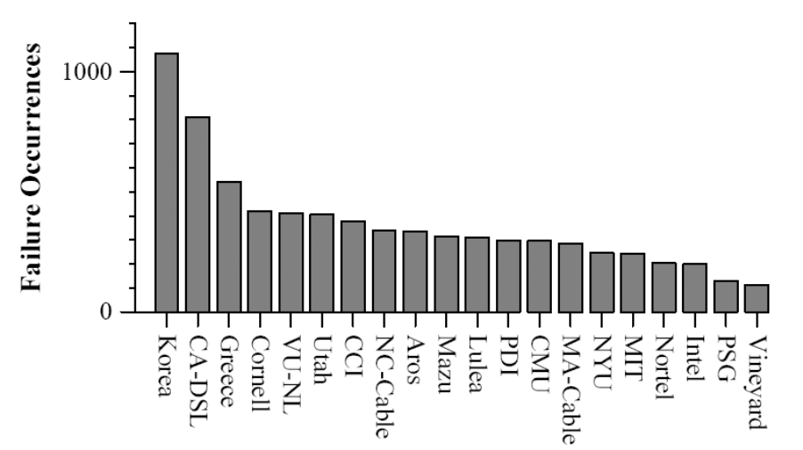
Horror Story #3: Join Queries
Final Version
Submitted Version
select srchost.name, dsthost.name, count(*) from hosts as srchost, hosts as dsthost, outages where srchost.ip=outages.src and dsthost.ip=outages.dst …

Slide 15
Anonymization
Similar questions arise here as with accuracy
Researchers always want full packet captures with payloads
  …but many questions can be answered without complete information
Privacy / de-anonymization issues

Slide 16
Longitudinal Studies
Extremely valuable
Extremely hard to maintain
  Requires constant babysitting (disks fill up, programs/OSes upgraded, IP addresses change, etc.)
A few pointers
  Store all mappings that are not invariant
  Regular regression, backup, first-order stats
  Paxson’s “master script” idea can help with regression

Slide 17
Passive Measurement

Slide 18
Two Main Approaches
Packet-level Monitoring
  Keep packet-level statistics
  Examine (and potentially, log) variety of packet-level statistics. Essentially, anything in the packet.
  Timing
Flow-level Monitoring
  Monitor packet-by-packet (though sometimes sampled)
  Keep aggregate statistics on a flow

Slide 19
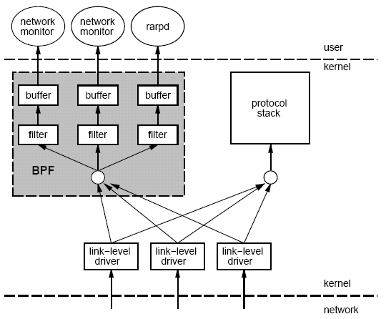
Packet Capture: tcpdump/bpf
Put interface in promiscuous mode
Use bpf to extract packets of interest
Accuracy Issues
Packets may be dropped by filter
  Failure of tcpdump to keep up with filter
  Failure of filter to keep up with dump speeds
Question: How to recover lost information from packet drops?

Slide 20
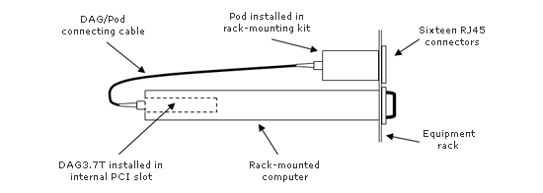
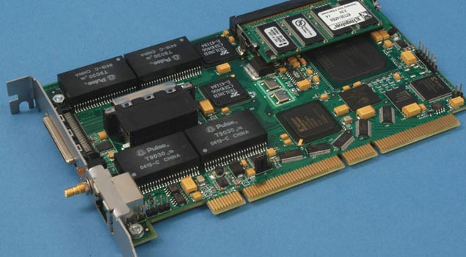
Packet Capture on High-Speed Links
Example: Georgia Tech OC3Mon
Rack-mounted PC
Optical splitter
Data Acquisition and Generation (DAG) card
Source: endace.com

Slide 21
Traffic Flow Statistics
Flow monitoring (e.g., Cisco Netflow)
  Statistics about groups of related packets (e.g., same IP/TCP headers and close in time)
  Recording header information, counts, and time
More detail than SNMP, less overhead than packet capture
  Typically implemented directly on line card

Slide 22
What is a flow?
Source IP address
Destination IP address
Source port
Destination port
Layer 3 protocol type
TOS byte (DSCP)
Input logical interface (ifIndex)

Slide 23

Cisco Netflow
Basic output: “Flow record”
  Most common version is v5
  Latest version is v10 (RFC 3917)
Current version (10) is being standardized in the IETF (template-based)
  More flexible record format
  Much easier to add new flow record types
Core Network
Collector
(PC)
Collection and Aggregation
Approximately 1500 bytes
20-50 flow records
Sent more frequently if traffic increases

Slide 24
Flow Record Contents
Basic information about the flow…
Source and Destination, IP address and port
Packet and byte counts
Start and end times
ToS, TCP flags
…plus, information related to routing
Next-hop IP address
Source and destination AS
Source and destination prefix

Slide 25
Aggregating Packets into Flows
flow 1
flow 2
flow 3
flow 4
Criteria 1: Set of packets that “belong together”
  Source/destination IP addresses and port numbers
  Same protocol, ToS bits, …
  Same input/output interfaces at a router (if known)
Criteria 2: Packets that are “close” together in time
  Maximum inter-packet spacing (e.g., 15 sec, 30 sec)
  Example: flows 2 and 4 are different flows due to time

Slide 26
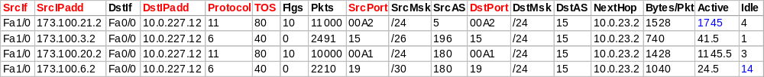

Netflow Processing
Create and update flows in NetFlow Cache
Inactive timer expired (15 sec is default)
Active timer expired (30 min (1800 sec) is default)
NetFlow cache is full (oldest flows are expired)
RST or FIN TCP Flag
Expiration
Aggregation?
No
Yes
e.g. Protocol-Port Aggregation Scheme becomes
Export Version
Non-Aggregated Flows – export Version 5 or 9
Aggregated Flows – export Version 8 or 9
Transport Protocol
Export
Packet
Payload
(flows)
Header

Slide 27
Reducing Measurement Overhead
Filtering: on interface
  destination prefix for a customer
  port number for an application (e.g., 80 for Web)
Sampling: before insertion into flow cache
  Random, deterministic, or hash-based sampling
  1-out-of-n or stratified based on packet/flow size
  Two types: packet-level and flow-level
Aggregation: after cache eviction
  packets/flows with same next-hop AS
  packets/flows destined to a particular service

Slide 28
Packet Sampling
Packet sampling before flow creation (Sampled Netflow)
  1-out-of-m sampling of individual packets (e.g., m=100)
  Create of flow records over the sampled packets
Reducing overhead
  Avoid per-packet overhead on (m-1)/m packets
  Avoid creating records for a large number of small flows
Increasing overhead (in some cases)
  May split some long transfers into multiple flow records
  … due to larger time gaps between successive packets
time
not sampled
timeout
two flows

Slide 29
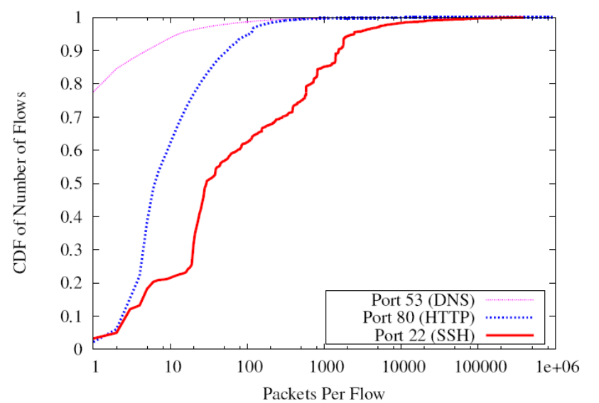
Problems with Packet Sampling
Determining size of original flows is tricky
  For a flow originally of size n, the size of the sampled flow follows a binomial distribution
  Extrapoliation can result in big errors
  Much research in reducing such errors
  (upcoming lectures)
Flow records can be lost
Small flows may be eradicated entirely

Slide 30
Sampling: Flow-Level Sampling
Sampling of flow records evicted from flow cache
  When evicting flows from table or when analyzing flows
Stratified sampling to put weight on “heavy” flows
  Select all long flows and sample the short flows
Reduces the number of flow records
  Still measures the vast majority of the traffic
Flow 1, 40 bytes
Flow 2, 15580 bytes
Flow 3, 8196 bytes
Flow 4, 5350789 bytes
Flow 5, 532 bytes
Flow 6, 7432 bytes
sample with 0.1% probability
sample with 100% probability
sample with 10% probability

Slide 31
Accuracy Depends on Phenomenon
Even naïve random sampling probably decent for capturing the existence of large flows
Accurately measuring other features may require different approaches
  Sizes of large flows
  Distribution of flow sizes
  Existence of small flows (coupon collection)
  Size of small flows
  Traffic “matrix”

Slide 32
Routing Data
IGP
BGP
  Collection methods
    eBGP (typically “multihop”)
    iBGP
  Table dumps: Periodic, complete routing table state (direct dump from router)
  Routing updates: Continuous, incremental, best route only
iBGP session

Slide 33
Evaluation Strategies and Platforms

Slide 34
Other Measurement Tools
Scriptroute (http://www.scriptroute.org/)
  Write new probing tools/techniques, etc.
  More on PS 2

Slide 35
Evaluation Strategies
Simulation
  Ns2, SSFNet
  Advantages: Control
Emulation
  Emulab
  Advantages: Real software, more realistic conditions
Wide-area Deployment
  VINI
  Simultaneous operation, sharing
  Advantages: Ability to carry real traffic
Next Lecture: Comparisons of these different evaluation strategies

Slide 36
PlanetLab: Distributed Services
Key challenge: Isolation
Slice: Set of VMs are treated as a single entity (distributed virtualization)
Isolation at system call level (vservers)
  Shared filesystem, memory, etc.
Network virtualization: safe raw sockets
  Must be bound to a specific port

Slide 37
Virtualization
Advantages
  Simultaneous access to shared physical resources
Disadvantages
  Requires scheduling
  Not running on “raw” hardware. May not see similar performance as the “real” network/system

Slide 38
PlanetLab for Network Measurement
Nodes are largely at academic sites
  Other alternatives: RON testbed (disadvantage: difficult to run long running measurements)
Repeatability of network experiments is tricky
  Proportional sharing
    Minimum guarantees provided by limiting the number of outstanding shares
  Work-conserving CPU scheduler means experiment could get more resources if there is less contention

Slide 39
PlanetLab for Network Architecture
New components must be virtualized
  Interfaces
  Links
Support for forwarding traffic over virtual links
Stock and custom routing software

Slide 40
VINI Overview
Bridge the gap between “lab experiments”
and live experiments at scale.
?
Emulation
VINI
Simulation
Small-scale
experiment
Live
deployment
Runs real routing software
Exposes realistic network conditions
Gives control over network events
Carries traffic on behalf of real users
Is shared among many experiments

Slide 41

Goal: Control and Realism
Topology
Control
  Reproduce results
  Methodically change or relax constraints
Realism
  Long-running services attract real users
  Connectivity to real Internet
  Forward high traffic volumes (Gb/s)
  Handle unexpected events
Arbitrary, emulated
Actual network
Traffic
Synthetic or traces
Real clients, servers
Network Events
Inject faults, anomalies
Observed in operational network
Traffic
Synthetic or traces
Real clients, servers
Notes:
Scientifically, what’s the point of such an infrastructure?

Slide 42

Fixed Physical Infrastructure
Notes:
Concretely, what is VINI
Overlays!
Aggregate Gb/s
Topology, IP address, BGP peering

Slide 43
Shared By Many Parties
Notes:
Virtual nodes
Isolation between experiments (e.g., CPU reservation)

Slide 44
Supports Arbitrary Virtual Topologies
Notes:
P2P connectivity
Unique interfaces visible to each virtual node

Slide 45
Why Is This Difficult?
Creation of virtual nodes
  Sharing of resources
  Creating the appearance of multiple interfaces
  Arbitrary software
Creation of virtual links
  Expose underlying failures of links
  Controlled link failures
  Arbitrary forwarding paradigms
Embedding virtual topologies
  Support for simultaneous virtual experiments
  Must map onto available resources, account, etc.

Slide 46
PL-VINI: Prototype on PlanetLab
First experiment: Internet In A Slice
  XORP open-source routing protocol suite
  Click modular router
Expose issues that VINI must address
  Unmodified routing (and other) software on a virtual topology
  Forwarding packets at line speed
  Illusion of dedicated hardware
  Injection of faults and other events

Slide 47
PL-VINI: Prototype on PlanetLab
PlanetLab: testbed for planetary-scale services
Simultaneous experiments in separate VMs
  Each has “root” in its own VM, can customize
Can reserve CPU, network capacity per VM
Node
Mgr
Local
Admin
VM₁
VM₂
VM_{n}
…
PlanetLab node
Virtual Machine Monitor (VMM)
(Linux++)

Slide 48
Requirements: Independence from IP
UML
Forwarding cannot depend on IP
New Routers
and Protocols
XORP
(routing protocols)
eth0
eth1
eth2
eth3
Control
Data
Packet
Forward
Engine
UmlSwitch
element
Tunnel table
Click

Slide 49
Demonstration
planetlab6.csail.mit.edu
planetlab1.csail.mit.edu
planetlab4.csail.mit.edu
1
2
1
3
planetlab3.csail.mit.edu

