Slide 1
CDT 375-Week8
SW Design – OO Design & UML
Sukanya Ratanotayanon
Ref: Material from Hans Van Vliet’s Software Engineering Principles and Practice &
Susan E. Sim’s slides for INF111 & Ian Sommerville’s Software Engineering

Slide 2
Overview
Introduction
Software Design Principle
Object-Oriented (OO) Concept
UML Notations
  Sequence Diagrams
  Class Diagrams
  State Machine Diagrams
OO Design Metho

Slide 3
Software Design
Decompose system into parts
  Each parts has lower complexity
Design is a trial-and-error process
  No definite formulas or rules
  Only principles and guidelines
The process is not the same as the outcome of that process

Slide 4
Desired Properties
Those that make software easy to maintain and reuse
  Simplicity
  Clear separation of concerns
  Locality of information

Slide 5
Design principles
Abstraction
  Process
  Data
Modularity
  Coupling
  Cohesion
Hierarchical structure

Slide 6
Abstraction
Process abstraction: natural consequence of stepwise refinement: name of procedure denotes sequence of actions
  Find hierarchy in the program’s control structure
    May results in programs with high coupling
abstraction
subproblems
time

Slide 7
Abstraction
data abstraction: aimed at finding a hierarchy in the data
application-oriented
data structures
simpler data
structure
general
data structures

Slide 8
Modularity
Structural criteria which tell us something about individual modules and their interconnections
Cohesion and coupling
  Cohesion: the glue that keeps a module together
    High = Good
  Coupling: the strength of the connection between modules
    High = Bad

Slide 9
What Do We Want?
Strong cohesion & Weak coupling
Why?
  Simple interfaces
  Simpler communication
  Simpler correctness proofs
  Changes influence other modules less often
  Reusability increases
  Comprehensibility improves

Slide 10
Information Hiding
Each module has a secret
Design involves a series of decision
  for each such decision, consider who needs to know and who can be kept in the dark
Information hiding is strongly related to
  Abstraction: if you hide something, the user may abstract from that fact
  Coupling: the secret decreases coupling between a module and its environment
  Cohesion: the secret is what binds the parts of the module together

Slide 11
OO Concepts
Objects are abstractions of real-world or system entities and manage themselves.
Objects are independent and encapsulate state and representation information.
  Information Hiding
System functionality is expressed in terms of object services.
Shared data areas are eliminated. Objects
communicate by message passing.
Objects may be distributed and may execute
sequentially or in parallel.

Slide 12
Objects and Object Classes
Objects are entities in a software system which represent instances of real-world and system entities.
Object classes are templates for objects. They may be used to create objects.
Object classes may inherit attributes and services from other object classes.

Slide 13
Coupling Between Object Classes
Two classes are coupled if a method of one class uses a method or state variable of another class
Many classes are coupled: something is wrong

Slide 14
Lack of Cohesion of a Class
Cohesion = glue that keeps the module (class) together
If all methods use the same set of state variables: OK, & that is the glue
If some methods use a subset of the state variables, and others use another subset, the class lacks cohesion
Two methods in the same set share at least one state variable

Slide 15
Unified Modeling Language - UML
UML
  Is a semi-formal visual modeling language
  Standard Notations for describing object-oriented designs
  Structure Diagrams
    Class Diagram, Object Diagram, Package Diagram, Etc.
  Behavior Diagrams
    Sequence Diagram, State Diagram, Etc.

Slide 16
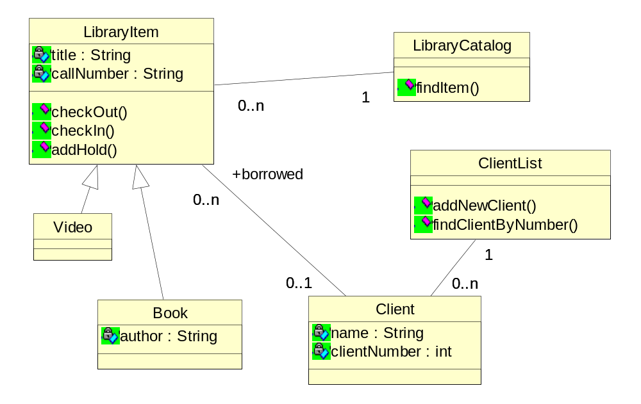
Class Diagram

Slide 17
Different Uses for Class Diagrams
Different levels of abstraction
Domain
  Things and relationships out in the world
Specification
  High-level design
Implementation
  Prescriptions for code

Slide 18
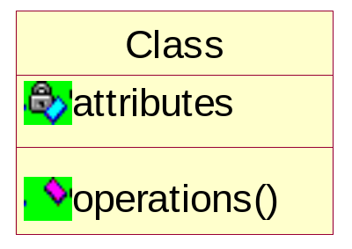

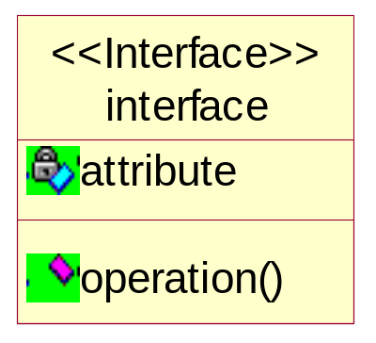
Class Diagrams
Name
  Name:type
Attributes
  visibility name: type multiplicity = default {property-string}
Operations
  visibility name (parameter-list) : return-type {property-string}
  direction name: type = default

Slide 19
Attribute Syntax
visibility name: type multiplicity = default {property-string}
  Optional visibility: + public, - private, # protected
  Name: the name of this attribute
  Optional type: data type of this attribute
  Optional default: initial value of attribute
  Optional property string: OCL, e.G. Ordered, readonly
Examples:
  firstName
  -middleName
  lastName: String
  -age: int = 0
  birthSign: String = "Gemini"

Slide 20
Property String
Any information that cannot be expressed in the diagram notation can be included as text
  Example: constraints
Example:
  customerNumber: int { >=0 }
All diagram elements can be annotated with constraints
  Natural language text
  Object Constraint Language

Slide 21
Operation Syntax
Examples:
  getFirstName()
  +getMiddleName(): String
  -setLastName(name: String)
  +paintPortrait(inout c: Canvas, subject: Person)

Slide 22
Property Strings on Operations
Sequential
  Only one call to a method within an instance
Concurrent
  Multiple simultaneous calls to a method within an instance may occur
Guarded
  Multiple simultaneous calls to a method within an instance may occur but only one at a time will be executed
Isquery
  Operation doesn’t change the value of any attributes

Slide 23
Associations
1
*
leftRole
rightRole
Relations between classes
Roles
  analogous to names of instance variables
Multiplicities
  0, 1, *, 0..1, 1..*, 5..6, and so on
  says how many objects each object knows
  would be realized through arrays, Sets, Lists, and so on
Navigability
  bidirectional: each class references the other
  unidirectional: A knows B, but B doesn’t know A
  no arrow heads: means either “bidirectional” or “not specified

Slide 24
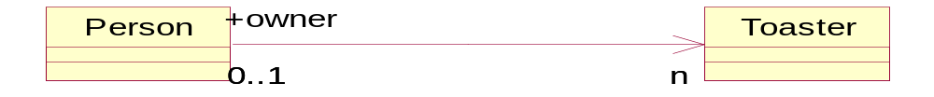
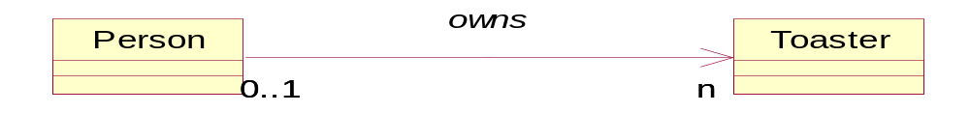
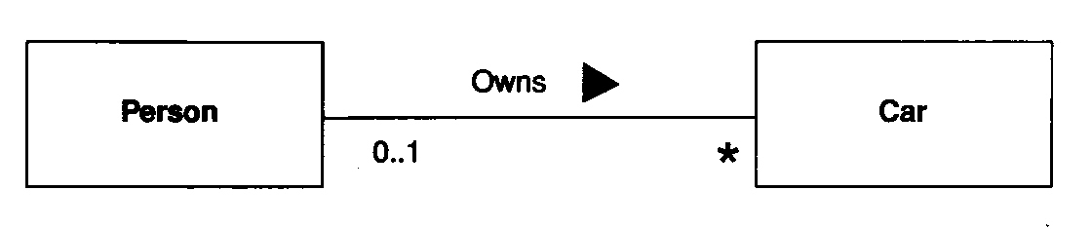
Association Name vs. Role Names

Slide 25
Inheritance
Generalization
  Correspond to the Java keyword "extends"
  Generalizations are drawn with a solid line and a white triangular arrow touching the superclass.
Realization
  Correspond to the Java keyword "implements"
  Realizations are drawn with a dashed line and a white triangular arrow touching the interface.
UML itself is not restricted to single inheritance

Slide 26
Class Diagram

Slide 27
Types of Associations
Composition = Black diamond: parts are created with the whole and stay with exactly one whole until both are destroyed together.
Aggregation = White diamond: parts can join the whole and later leave; one part could be part of more than one whole.
  Some operations will be recursively applied to the parts of a whole

Slide 28
Association Type: Composition
A composition is a strong kind of aggregation
    if the aggregate is destroyed, then the parts are destroyed as well
    “has a”
*
*
*
*
Toaster
*
Slot
Engine
*
Piston
Book
*
Pages

Slide 29
Association Type: Aggregation
Aggregations are special associations that represent ‘part-whole’ relationships.
    The ‘whole’ side is often called the assembly or the aggregate
    “is part of”
*
*
*
Company
*
Employees
*
*
*
*
*
Club
*
Members
Swarm
*
Bees

Slide 30
When to use an aggregation
As a general rule, you can mark an association as an aggregation if the following are true:
  You can state that
    the parts ‘are part of’ the aggregate
    or the aggregate ‘is composed of’ the parts
  When something owns or controls the aggregate, then they also own or control the parts
Use with care

Slide 31
Some Mnemonics
Generalization = is-a
Composition = has-a
Aggregation = part-of
Examples:
  Toaster is-a Appliance
  Toaster has-a slot
  Member is part-of club

Slide 32
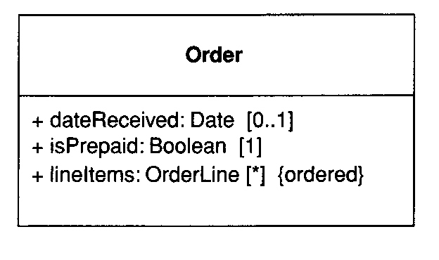
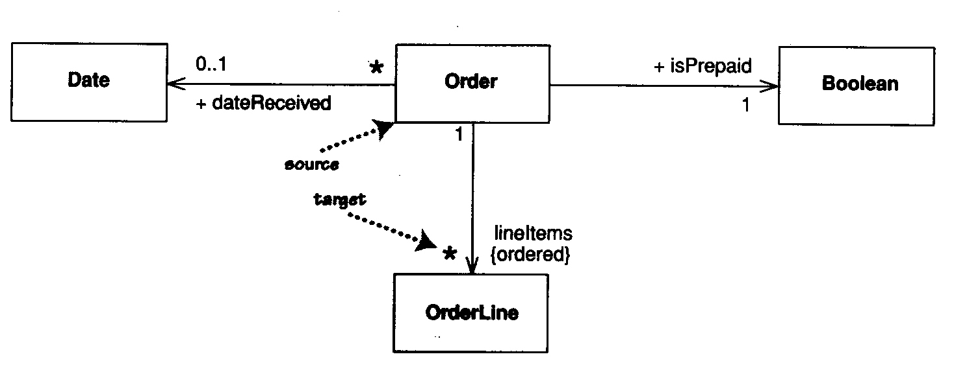
Associations and Properties
Associations are another way of representing properties

Slide 33
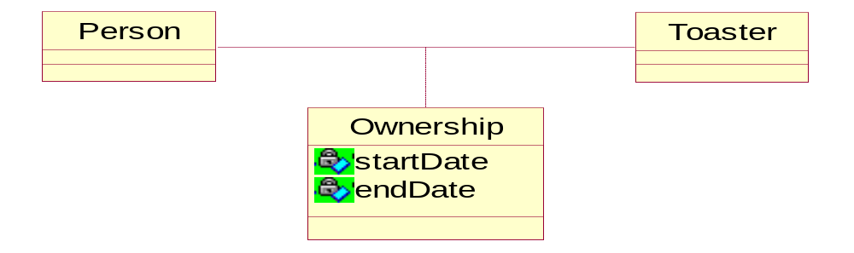
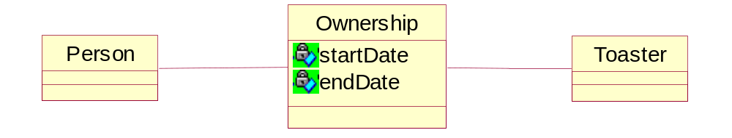
Association Classes
When you want to add properties or operations to an association, use an association class.
  Frequently simpler to promote associate class to full class

Slide 34
Object Diagrams
Show instantiation or specification of classes
Associated with a particular use or instance of the model
Differences between Classes and Objects
  Name:class is underlined
  Attributes and operations included as needed
  Fields have data added
Useful for showing interactions between interfaces, abstract classes, etc.
  Where functionality is not clear until instantiation

Slide 35
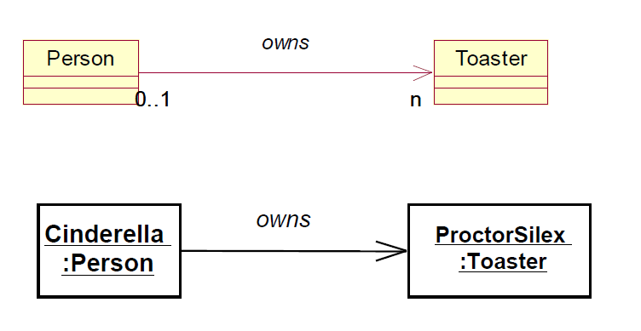
Example: Class to Object Diagrams

Slide 36
Package Diagrams
Package is a grouping construct
  Most commonly used for class diagrams, but can be used with any UML diagram or elements
  Used to create a hierarchy or higher level of abstraction
  Corresponds to package in Java
Each package represents a namespace
  Like Java, can have classes with same name in different packages

Slide 37
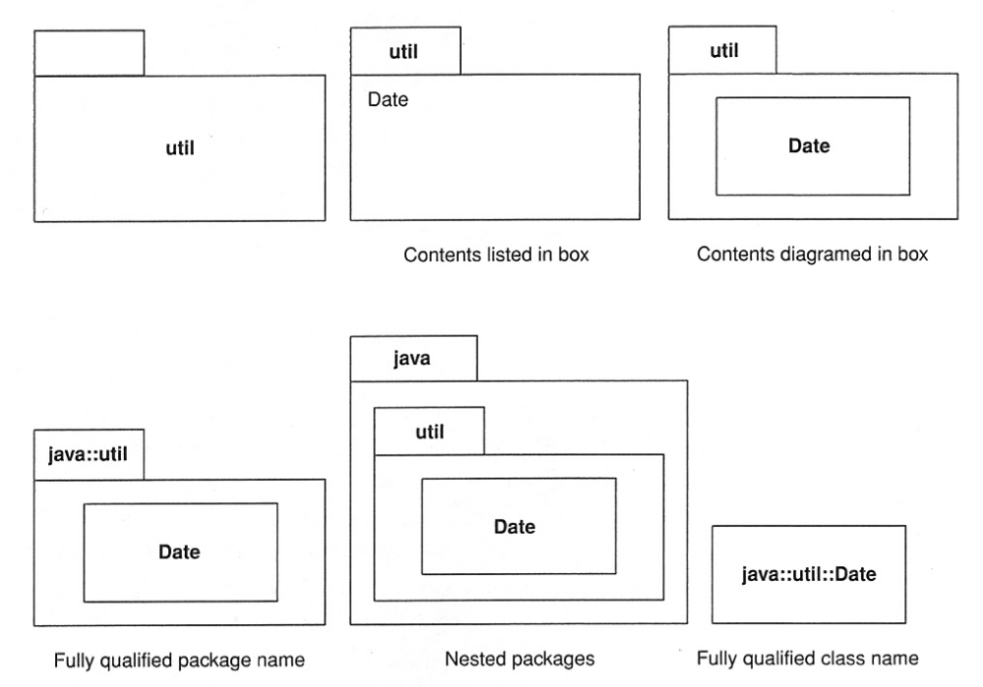
Example – Package Diagrams

Slide 38
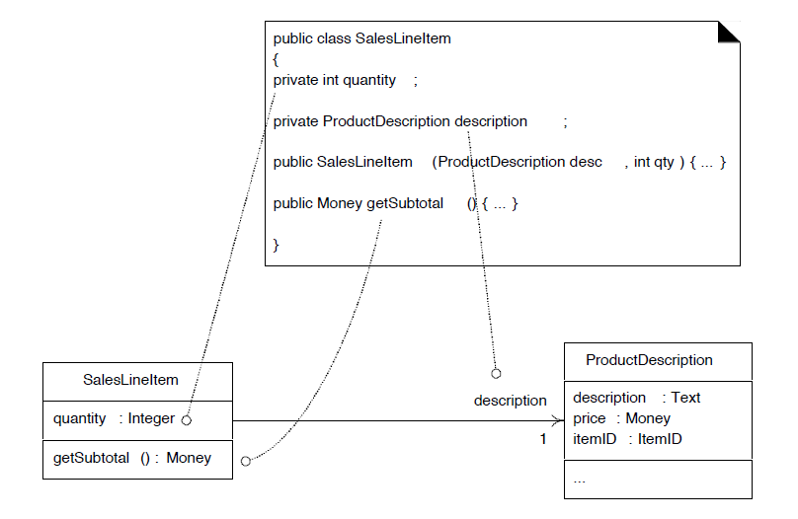
Code To UML

Slide 39
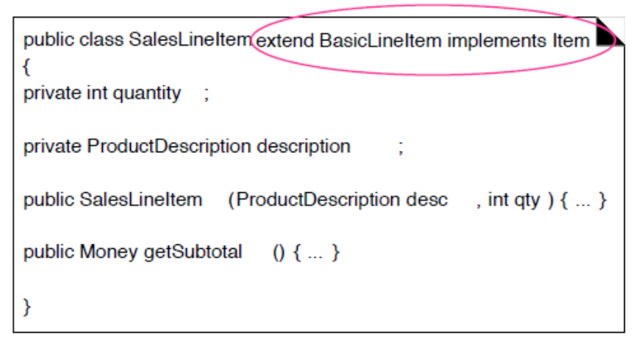
Code To UML

Slide 40
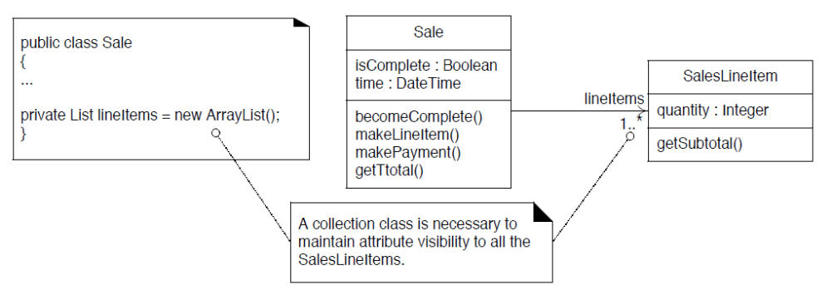
Code To UML

Slide 41
UML – Sequence Diagrams
System Sequence Diagrams
  For showing the interaction actors and the software system
  Next step in modeling after writing use cases
Object Sequence Diagrams
  For showing the interaction between objects
  Next step in designing classes and objects, after high-level design (architecture, packages, initial classes)

Slide 42
UML – Sequence Diagrams
Elements of Sequence Diagrams
  Objects
    Life lines: time goes from top to bottom
  Messages
    Analogous to method calls in a program
    Can have parameters
    Return messages
  Looping Constructs

Slide 43
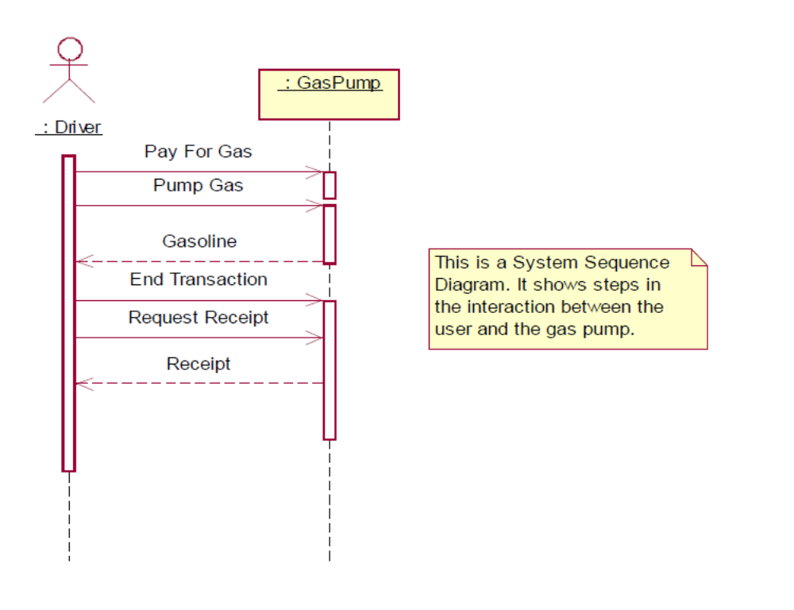
Sequence Diagrams - Example

Slide 44
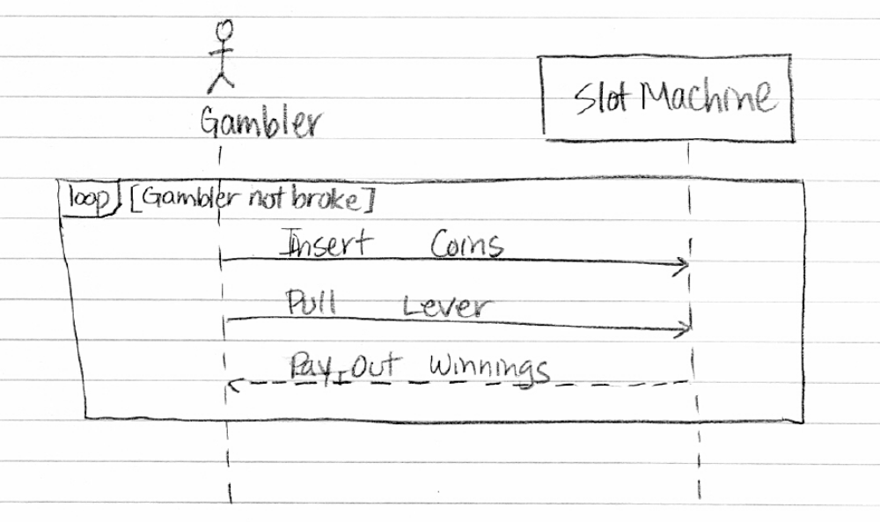
Sequence Diagrams - Example

Slide 45
Objects
Lined up along the top
  May be several instances of one class
Defines columns
Life lines
  Time goes from top to bottom
Activation Bars
  Boxes on life lines show if object is active

Slide 46
Messages
Analogous to method calls in a program
  Can have parameters
Synchronous messages
  Calling object waits for call to complete
Asynchronous messages
  Calling object does not wait for call to complete
Special messages
  new — shown by position of object
  delete — shown through big X
Return messages
Self-calls

Slide 47
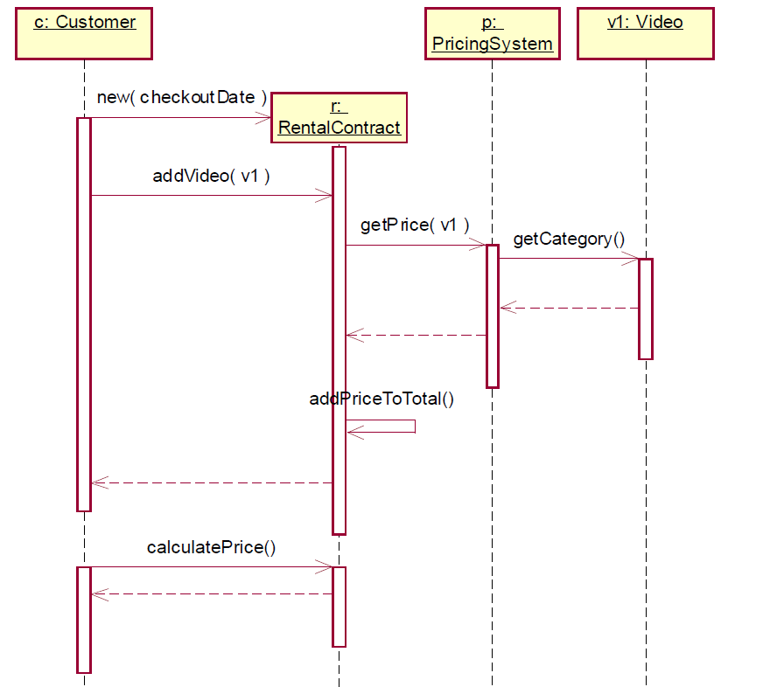
Object Sequence Diagrams

Slide 48
Activity Diagrams
Used to show sequential and parallel activities in a process
  Useful for modeling business processes, workflows, data flows, and complex logic
  Not used to show computation of equations

Slide 49
Activity Diagrams
Business process for processing an online DVD order.
There are three parties involved processing an online DVD order:
  Shipping, Online Sales, and Accounting.
The process starts when The Online Sell Unit receives information of an order of DVDs from a user. Then to complete the order, the DVD Store needs to charge the credit card of the user and needs to deliver the DVD. To charge the credit card, Online Sales will send the credit card information of the user to Accounting, who will then validate and process the credit card. To deliver the DVD, Shipping will first fill the order. Then based on the delivery option selected by the user, the DVD is either delivered at a normal speed or is rushed delivered. Once the DVD is delivered and the credit card is charged, the order is closed.

Slide 50
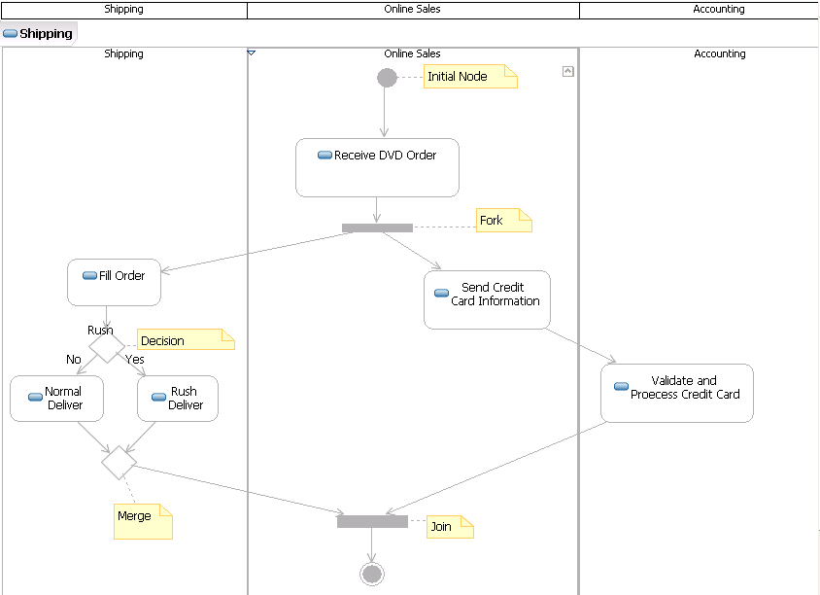
Activity Diagrams

Slide 51
State Machine Diagram
Resembles finite state machines, but:
  Usually allows for local variables of states
  Has external inputs and outputs
  Allows for hierarchical states

Slide 52
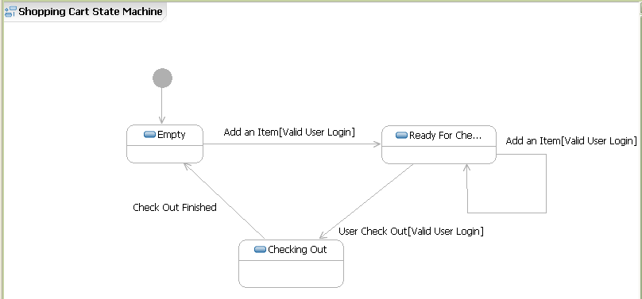
State Diagrams

Slide 53
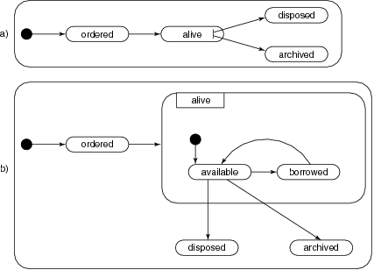
State Diagrams

Slide 54
OOAD methods
three major steps:
1 identify the objects
2 determine their attributes and services
3 determine the relationships between objects

Slide 55
(Part of) problem statement
Design the software to support the operation of a public library. The system has a number of stations for customer transactions. These stations are operated by library employees. When a book is borrowed, the identification card of the client is read. Next, the station’s bar code reader reads the book’s code. When a book is returned, the identification card isnot needed and only the book’s code needs to be read.

Slide 56
Candidate objects
software
library
system
station
customer
transaction
book
library employee
identification card
client
bar code reader
book’s code

Slide 57
Carefully consider candidate list
Eliminate implementation constructs, such as “software”
Replace or eliminate vague terms: “system” ⇒ “computer”
Equate synonymous terms: “customer” and “client” ⇒ “client”
Eliminate operation names, if possible (such as “transaction”)
Be careful in what you really mean: can a client be a library employee? Is it “book copy” rather than “book”?
Eliminate individual objects (as opposed to classes). “Book’s code” ⇒ attribute of “book copy”

Slide 58
Relationships
From the problem statement:
  employee operates station
  station has bar code reader
  bar code reader reads book copy
  bar code reader reads identification card
Tacit knowledge:
  library owns computer
  library owns stations
  computer communicates with station
  library employs employee
  client is member of library
  client has identification card

Slide 59
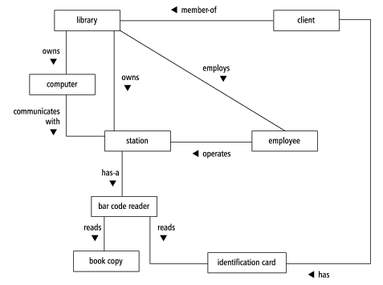
Result: initial class diagram

Slide 60
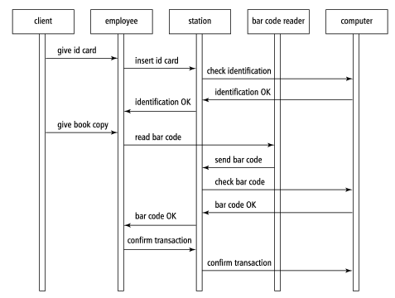
Sequence diagram

Slide 61
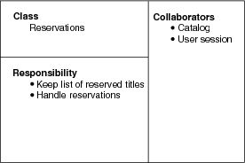
CRC: Class, Responsibility, Collaborators

Slide 62
GRASP
OOD
  Principles or Patterns
Creator
(Information) Expert
Controller

Slide 63
Creator
Who can create object A?
B if
  B is a Container of A
  B records A
  B has A’s initialization data

Slide 64
(Information) Expert
How to assign responsibilities to objects?
  Who know about A, given a key?
Whoever have information needed to fullfill them
  With low coupling

Slide 65
Controller
UI should not know about application logic (business logic)
What first object beyond UI layer receives and coordinates a system operation?
Assign to an object representing one of these roles
  An object representing the overall system
  Root object, or a device that software is running
  An objects representing a use case

