Slide 1
Introduction to Llama API

Slide 2
Agenda
1
Introduction to Llama API
2
What is Llama API?
3
Architecture of Llama API
4
Getting Started with Llama API
5
Authentication and Security
6
Core Functionalities of Llama API
7
Error Handling and Debugging
8
Performance Optimization
9
Integration with Other Services
10
Real-world Applications of Llama API
11
Future of Llama API
12
Conclusion and Q&A

Slide 3



Introduction to Llama API
Overview, Purpose, Importance
Comprehensive Overview
Llama API serves as a vital tool for developers, allowing for seamless integration with diverse applications, enhancing functionality and user experience.
Purposeful Integration
Designed to bridge various technologies and platforms, the Llama API facilitates interaction and data exchange, resulting in a more cohesive ecosystem.
Significance in Development
The emergence of Llama API signifies a paradigm shift in software development, enabling greater innovation and collaboration among developers and users alike.
Notes:
In this first slide of our presentation, we will delve into the Llama API, examining its purpose and the importance it holds within the software development landscape. An integral part of modern applications, Llama API helps streamline the interaction between systems, promoting innovation and efficiency across multiple industries. As we move forward, we will explore its specific features, use cases, and the architecture that supports its functionality.

Slide 4



What is Llama API?
Definition, Key Features, Use Cases
Definitive Framework
Llama API is a robust framework that allows developers to build, deploy, and manage applications efficiently, leveraging RESTful principles for ease of use.
Key Features
Incorporating key features such as real-time data processing, high scalability, and flexibility across programming languages makes Llama API a versatile choice.
Diverse Use Cases
From simplifying eCommerce transactions to enhancing data analytics tools, Llama API caters to various industries, driving unparalleled growth and efficiency.
Notes:
Now that we have introduced the concept of the Llama API, we will clarify specifically what it entails. We will emphasize the significance of its definition, which often encompasses its role as a robust framework facilitating the development lifecycle. Next, we will touch upon its key features that set it apart from traditional APIs, and finally, we will highlight the diverse use cases that illustrate its practicality across numerous sectors.

Slide 5



Architecture of Llama API
Components, Data Flow, Interaction with Other Systems
Component Structure
The Llama API architecture consists of several components including endpoints, authentication layers, data handlers, and user interfaces, which work in unison to deliver functionality.
Data Flow Dynamics
Data flows through various pipelines, from external requests to response generation, optimizing for performance and reliability across multiple platforms.
System Interactivity
Designed for extensive interconnectivity, Llama API engages seamlessly with third-party services, enhancing its capabilities through interaction and integration.
Notes:
Next, we will explore the underlying architecture of the Llama API, dissecting its core components and their functionality. Understanding the architecture is crucial to harnessing its full potential. We will discuss the data flow dynamics that enable efficient processing of requests and responses. Additionally, we will highlight the interactive nature of Llama API, which facilitates communication with other systems, bringing added value to users.

Slide 6


Getting Started with Llama API
Installation, Setup, Configuration
Installation Process
The installation process is straightforward, involving essential steps to ensure seamless integration with existing systems and frameworks, thereby reducing entry barriers for developers.
Setup Essentials
Configuring Llama API after installation involves setting environment variables, API keys, and dependencies, ensuring that new users quickly achieve operational readiness.
Configuration Best Practices
Adhering to best practices during configuration can significantly enhance performance and security, paving the way for a robust application environment.
Notes:
As we delve deeper, we will focus on the practical aspects of using the Llama API, beginning with how to get started. We will walk through the installation process, setting up the API correctly to ensure smooth functionality. Following this, we'll delve into best practices for configuration that not only improve performance but also ensure the security of the integrated systems.

Slide 7



Authentication and Security
API Keys, OAuth, Best Practices
API Key Management
API keys serve as the primary mechanism for identifying users, requiring effective management strategies to avoid unauthorized access and ensure data integrity.
OAuth Implementation
Implementing OAuth allows for secure delegated access, enabling users to grant limited access to their data without sharing credentials, strengthening overall security.
Security Best Practices
Establishing robust security best practices is vital to maintaining the integrity of APIs, including regular audits, rate limiting, and secure data transmission.
Notes:
The essence of any successful API lies in its security protocols. In this slide, we will emphasize the importance of authentication and security in the usage of Llama API. We will discuss the management of API keys as a first line of defense and explore the implementation of OAuth to enable more sophisticated and secure access controls. Our discussion will further extend into identifying best practices for ensuring a secure environment for API operations.

Slide 8



Core Functionalities of Llama API
Endpoints, Methods, Data Formats
Defined Endpoints
Llama API offers well-defined endpoints that cater to specific functions, enabling seamless interaction and retrieval of desired information with minimal friction.
Versatile Methods
Supporting both RESTful and GraphQL methods, Llama API facilitates flexible data interactions, allowing developers to choose the best approach for their application needs.
Supported Data Formats
Flexibility in data formats, such as JSON and XML, allows Llama API to cater to diverse programming environments and developer preferences, enhancing usability.
Notes:
In exploring the core functionalities of the Llama API, we will break down the essential components that define its operation. We will scrutinize the various endpoints available to developers, elucidating how they enable specific operations. Furthermore, we will discuss the methods supported by Llama API, highlighting the adaptability it provides through RESTful and GraphQL approaches. The variety of supported data formats will also be covered, as they are key to enhancing the API's versatility across different programming environments.

Slide 9
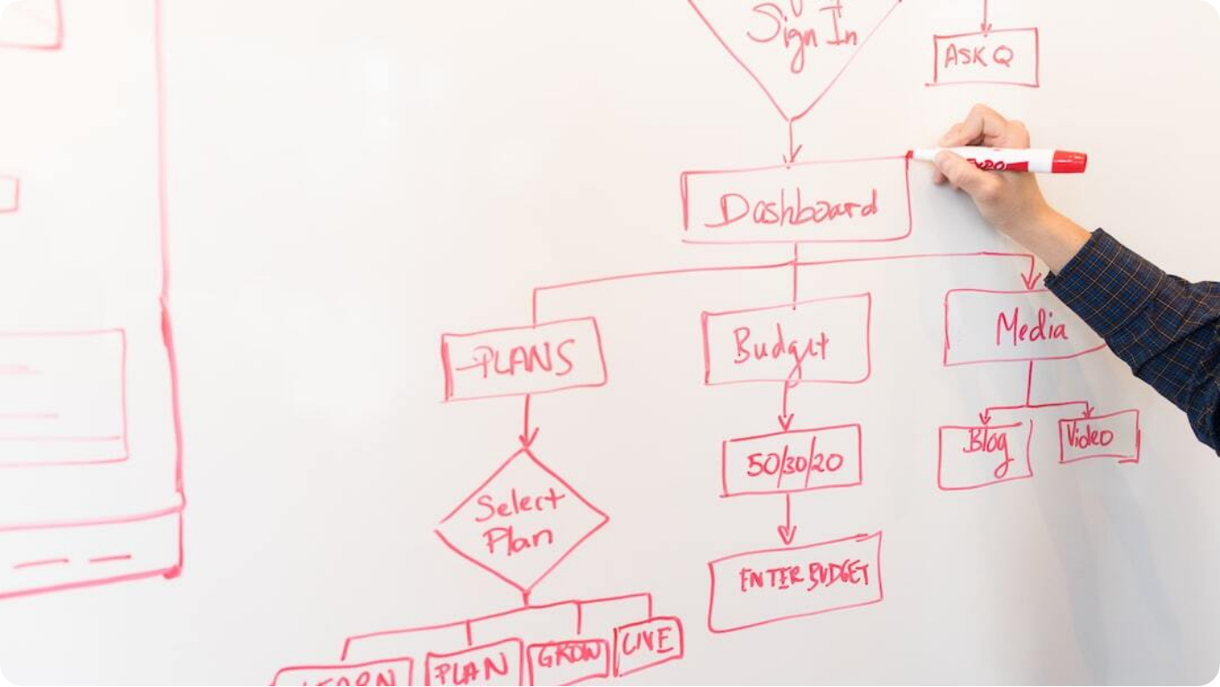
Error Handling and Debugging
Common Errors, Troubleshooting, Logging
Common Error Scenarios: Recognizing common error scenarios, such as authentication failures and rate limiting issues, aids developers in swiftly diagnosing problems and enhancing user experience.
Effective Troubleshooting: Implementing effective debugging practices enables rapid identification of issues, paving the way for efficient resolutions and maintaining application stability.
Logging Mechanisms: Robust logging practices are crucial for monitoring API performance, aiding in understanding failure patterns, and implementing necessary improvements.
Photo by Christina @ wocintechchat.com on Unsplash
Notes:
Next, we will tackle the often-overlooked aspect of error handling and debugging. Being equipped to identify and resolve errors is essential for any developer using the Llama API. We will discuss common error scenarios you might encounter while working with the API, along with proactive troubleshooting strategies to expedite resolutions. Lastly, we will stress the importance of logging mechanisms as they offer valuable insights into performance issues and provide a historical context for debugging efforts.

Slide 10



Performance Optimization
Best Practices, Caching, Load Balancing
Best Optimization Practices
Establishing best practices, such as minimizing payload size and optimizing request rates, lays the foundational groundwork for efficient API performance.
Caching Techniques
Incorporating caching strategies can drastically reduce latency and enhance overall application responsiveness, providing a better user experience.
Load Balancing Strategies
Employing load balancing techniques ensures even distribution of requests across server instances, maintaining performance levels during peak usage times.
Notes:
In this segment, we will shift our focus to performance optimization strategies for the Llama API. Understanding and implementing best practices for optimization can significantly enhance the responsiveness and efficiency of applications utilizing the API. We will discuss various caching techniques that can minimize data retrieval times and ensure applications run smoothly. Additionally, we will explore load balancing strategies that allow us to handle high volumes of requests effectively, ensuring stability and reliability.

Slide 11


Integration with Other Services
Third-party APIs, Webhooks, Data Exchange
Third-party Integration
Llama API's modularity fosters seamless integration with third-party APIs, allowing users to expand functionality and leverage existing services efficiently.
Utilizing Webhooks
Implementing webhooks allows for real-time synchronization of data between systems, promoting immediate responses to external events without manual intervention.
Effective Data Exchange
Structured data exchange protocols ensure smooth interoperability between applications, enhancing the overall user experience and broadening application scope.
Notes:
As we deepen our exploration of the Llama API, we will discuss its capabilities in integrating with other services. This includes seamless interactions with third-party APIs that allow for enhanced functionality and service expansion. We will also introduce the concept of webhooks, which enable real-time data synchronization and automation in response to events. Furthermore, we will emphasize the importance of adopting effective data exchange protocols for achieving smooth interoperability across various application ecosystems.

Slide 12



Real-world Applications of Llama API
Case Studies, Success Stories, Industry Use Cases
Practical Case Studies
Analyzing real-world case studies provides insights into how organizations successfully leverage the Llama API to solve problems and enhance their services.
Success Stories
Showcasing success stories from various industries illustrates the versatility and effective application of Llama API in diverse settings.
Industry Applications
Llama API is utilized across multiple industries, from finance to healthcare, showcasing its adaptable architecture and capabilities in addressing unique challenges.
Notes:
To illustrate the number of possibilities that the Llama API brings, we will present various real-world applications backed by concrete case studies. These examples will serve to highlight how organizations across different sectors have successfully harnessed the Llama API to enhance their services and solve complex problems. By sharing these success stories, we can appreciate the API's versatility and understand its invaluable contributions to various industries.

Slide 13



Future of Llama API
Upcoming Features, Roadmap, Community Contributions
Anticipated Features
The roadmap includes anticipated features based on user feedback and emerging trends, aiming to enhance functionality and user satisfaction in future updates.
Development Roadmap
A clear developmental roadmap outlines the timeline for upcoming updates and features, assuring users of ongoing improvements to the Llama API.
Community Involvement
Encouraging community contributions promotes a collaborative atmosphere while yielding innovative ideas and solutions for continuous improvements.
Notes:
Looking ahead, we will discuss the exciting features and updates planned for the future of Llama API. This segment will include insights into the anticipated developments that stem from community feedback, as well as a transparent roadmap detailing timelines for feature releases. We will explore the importance of community contributions in catalyzing innovation and creating a more robust, user-friendly API that meets the evolving needs of developers and end-users.

Slide 14



Conclusion and Q&A
Summary of Insights
We will recap the primary insights discussed throughout the presentation, summarizing the value proposition and functionalities of Llama API.
Key Takeaways
Identifying the key takeaways from today’s session will reinforce our understanding and application of the Llama API in real-world scenarios.
Open Floor for Questions
We invite attendees to engage in an interactive Q&A session, fostering discussion and clarifying any remaining queries regarding the Llama API.
Notes:
As we conclude our presentation on the Llama API, we will encapsulate the key insights and takeaways into a succinct summary. This will allow us to bridge any gaps in understanding while highlighting core functionalities and value propositions of the API. Following the recap, we encourage an interactive Q&A session where participants can ask questions, share thoughts, and engage in discussions that will deepen their grasp of what the Llama API has to offer.

