Slide 1


Library Management System

Slide 2

Now that libraries have so many collections, they desperately need a system to help them add books, manage books and student information.

Slide 3
Our system has many functions, and we will introduce them one by one.
Submitted By
Fearlessness
composed
Alvin（姜燕辉）No. R8J9400058
Arthur（吴水海）No. R8J9400043
Burton（杨孟霖）No. R8J9400048
Dronames（周思宇）No. R8J9400057
Charles（周煜程）No. R8J9400060
StartDate：01 May 2019
EndDate：19 May 2019

Slide 4
Library management system
Login module
Student file management module
Book information management module
Retrieval module
Time management module
Book loan and return module
Tool module

Slide 5
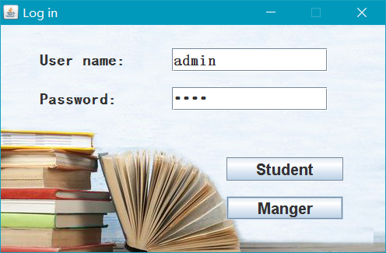
The first is the login interface, which can use different user names and passwords to login the administrator interface or the student interface.

Slide 6
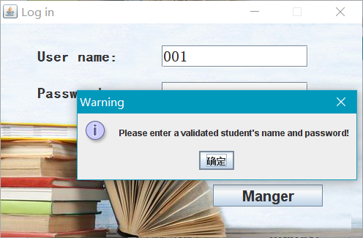
If you enter the wrong username and password, there will be problems logging in.

Slide 7
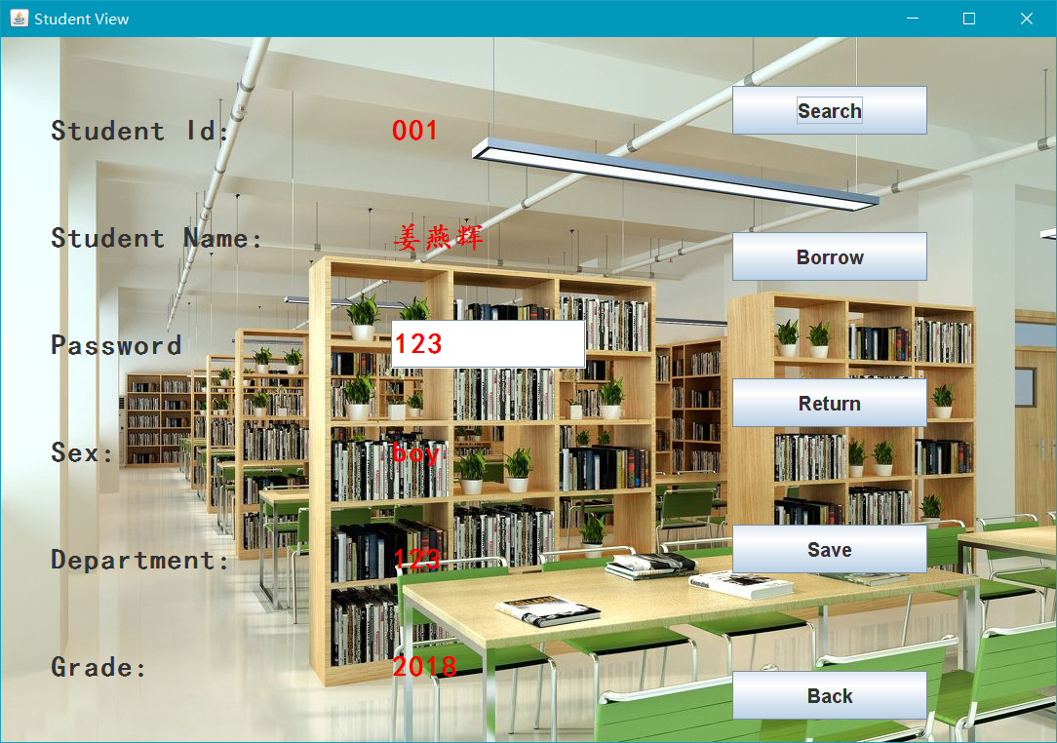
This is the login screen for students. They can change their passwords by themselves. This interface also allows him to query books, borrow, return and other operations.

Slide 8
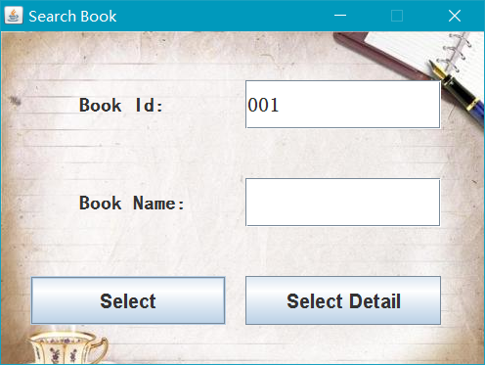
As long as there are books in the database, you can see them through this interface.

Slide 9
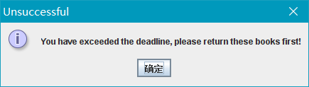
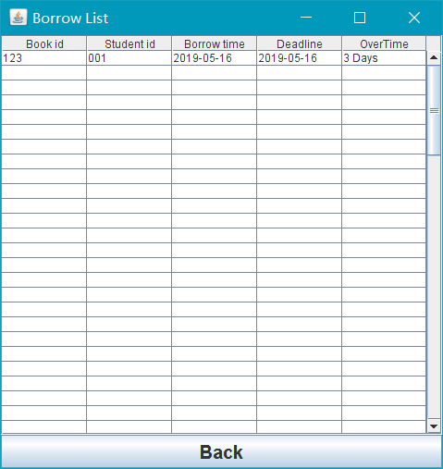
However, if you have a prior bad loan history, there will be some different hints.

Slide 10
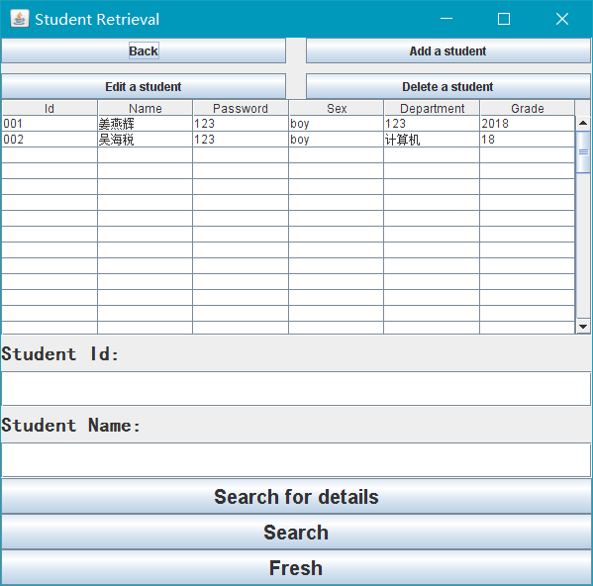
This is the administrator login screen, although it looks a little humble, but it is very functional.In addition to the operation of students, administrators can also modify the basic personal information of students, add book information and so on.

Slide 11
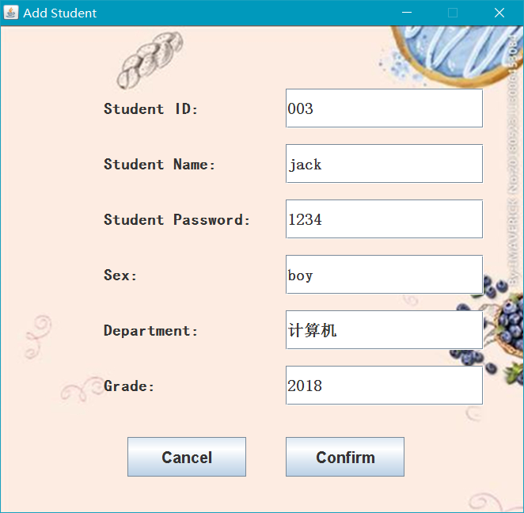
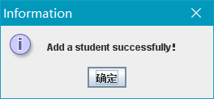
Enter the information and you will see the following screen.

Slide 12
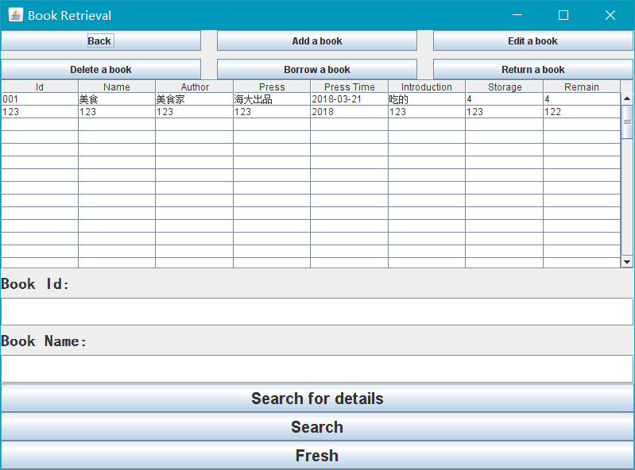
This interface is used to allow administrators to add book information. After refreshing, students will see the update of books in the front end.

