Slide 1

DAY OF DATA PORTLAND 2026
AI at the Gates
Full-Day Precon · The DBA's Guide to Surviving in an LLM World
Presenters
Event
Jonathan Stewart + Kevin Feasel
Day of Data Portland 2026
Notes:
Welcome to AI at the Gates, the DBA's guide to surviving in an LLM world. This is a full-day pre-con for people who work with databases and have little or no AI background, so nobody needs prior experience with models. Kevin and Jonathan are presenting together. Cover the room logistics here: when the breaks and lunch are, and where to get the slides and the demo code. Then go to introductions.
REHEARSAL CHECK: Friday's break and lunch times (spec open item). The slides-and-code link is github.com/feaselkl/AI-at-the-Gates (also on 7.10).

Slide 2
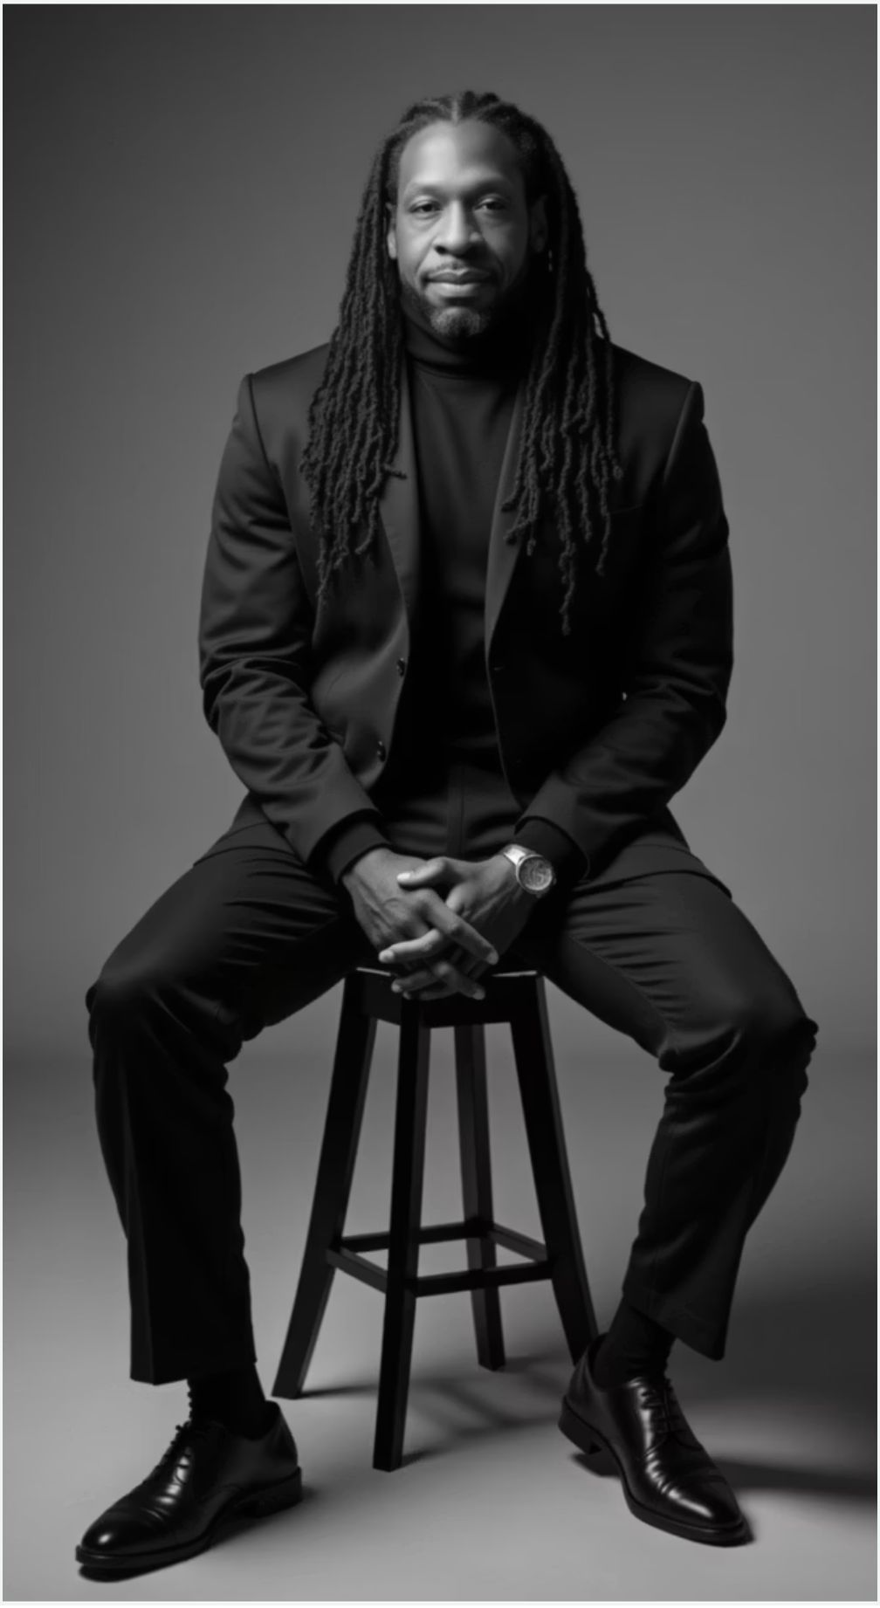


Principal Analytics Consultant
About Me
I help data teams adopt AI without getting burned, and I build the tooling I'm about to show you.
Creator/Founder: SQLBites Community
01
Building the next generation of data practitioners.
02
Migrating Enterprises to Fabric
Real production migrations across healthcare, finance, retail, and manufacturing.
03
Hundreds of Technical Talks Globally
International speaker on data architecture and analytics engineering.

Slide 3


Kevin Feasel · Microsoft MVP · Catallaxy Services
The Actual Presenter
Kevin specializes in T-SQL and Python development, machine learning, and pulling rabbits out of hats on demand.
Curated SQL + TriPASS
01
Lead contributor to Curated SQL; president of the Triangle Area SQL Server Users Group.
02
Author
PolyBase Revealed (Apress, 2020) and Finding Ghosts in Your Data (Apress, 2022).
03
Raleigh, NC
Found cycling the triangle trails whenever the weather's nice enough.
Notes:
Kevin Feasel, Microsoft MVP, proprietor of Catallaxy Services, LLC. Lead contributor to Curated SQL (curatedsql.com) and president of TriPASS, the Triangle Area SQL Server Users Group (meetup.com/tripass). Author of PolyBase Revealed (Apress, 2020) and Finding Ghosts in Your Data (Apress, 2022). Lives in Raleigh, NC. The title plays off the slide before it; keep this to 30 seconds. The morning covers how models work, vectors, and vectors in SQL Server, with RAG right after lunch.
--- JONATHAN'S NOTES (v16, kept) ---
Kevin Feasel is the proprietor of Catallaxy Services, LLC. Lead contributor to Curated SQL (curatedsql.com), president of TriPASS (meetup.com/tripass), author of PolyBase Revealed and Finding Ghosts in Your Data. Resident of Durham, NC.

Slide 4
What you'll leave with
01
02
03
04
05
Vectors
SQL Server
Agents
RAG
Leadership
What vector data is, and why it isn't scary.
How to store and search vectors in SQL Server, and a plan for a pilot in your own shop.
How to work with AI agents, and where they go wrong.
How to build a basic RAG system over your own documents.
How to talk to leadership about all of it: what's possible and what isn't.
Notes:
These are the five things the day is built around. If a slide doesn't serve one of them, it isn't in the deck. The first two take the morning: what vectors are, then working with them in SQL Server, ending with a step-by-step plan for a pilot. The order of the day differs a little from this list: RAG comes right after lunch, before agents, because it builds directly on the vector material. The last section is about making the case to leadership, and it uses what you see in the demos today as its evidence.

Slide 5
The ledger
WORKED
BROKE
Rows added after each demo.
Rows added after each demo.
Every demo today adds to this. At the end of the day, it's your evidence.
Notes:
Every demo today ends with a row or two on this ledger, in one column or both. Only things that happen on screen today go in: no industry statistics, no predictions, no stories from somewhere else. We show it at the end of sections 1, 3, 4, and 5, with that section's new rows highlighted. In the last section, the whole ledger goes on screen and we use it to answer the question every boss is asking: can we replace people with this? First, though, how these models work.

Slide 6

Chapter 1
How these models work
The basics of how generative AI works
Notes:
Section 1 covers just enough about how language models work to make the rest of the day make sense. No SQL Server in this section: everything runs in a browser or on a small local model. The ideas to land are that a model predicts the next token, over and over; that it reads tokens and has a limited context window; and that it can be fluent, confident, and wrong. It ends with the temperature demo and the first rows on the ledger.
--- JONATHAN'S NOTES (v16, kept) ---
Block 1 (8:30-10:00, ~90 min). 1.1-1.4 presented by Kevin Feasel; 1.5 Convincing the Boss by Jonathan. Goal: build a mental model of generative AI grounded in things data pros already understand, so the SQL Server 2025 vector work in Block 4 feels like an obvious next step. Deliberate constraint: NO SQL Server / T-SQL in 1.1-1.4. concept-and-intuition only, free browser/local tools. Demo spine: TensorFlow Playground, a tokenizer web app, a small local chat model via Ollama, the TensorFlow Embedding Projector (loaded with Wake County data).

Slide 7

You don't build models. You own the data they use.
Store, secure, serve, and query it: squarely a data-platform job.
Notes:
This frames the day. Nobody here needs to train a model. What you own is the data models read and the data they produce: storing it, securing it, serving it, and querying it. That's a data-platform job, and it's already yours. Every section today answers the same question one step further: how does the model get your context? Vectors turn your data into something a model can search. With RAG, you find the context and hand it over. With MCP, the model looks it up itself. Agents act on what they find. Next: what a model actually does with the text you give it.
--- JONATHAN'S NOTES (v16, kept) ---
Slide 1.1.5. Image: a DBA at the gate between 'AI apps' and 'the data', holding the keys. Sets up the rest of the day.
Slide text moved here: You don't need to train models. You need to store, secure, serve, and query the data they produce and consume. That is squarely a data-platform job.

Slide 8

Generation is next-token prediction, repeated
Predict the next token, append it, predict again.
Everything so far
Next token
A paragraph
Notes:
An LLM does one thing. Given everything so far, it predicts the next token, which is roughly a word or a piece of one (tokens get their own slide shortly). It appends that token and predicts again. A paragraph is that loop run many times. Hold on to this idea, because it explains most of what you'll see today. The model sounds fluent because it has seen a lot of fluent text. It can also be confidently wrong, because the likeliest next token isn't checked against anything. On the next slide, the room does the predicting.
--- JONATHAN'S NOTES (v16, kept) ---
Slide 1.1.3. DEMO (no tech, 30 sec): put a half-sentence on screen. 'The health inspector walked into the kitchen and immediately noticed the...'. and have the room call out the next word. That's what the model does, at scale. Image: a sentence with a blinking 'next word?' slot and candidate words with probability bars.
Slide text moved here: An LLM fundamentally predicts the next token given everything so far. Do that over and over and you get a paragraph. This one idea explains most of the behavior you see with language models.

Slide 9

Guess the Next Word
WHEN IN THE COURSE OF __________
Notes:
No model on screen. Ask the room to finish the line. Most people will call out "human events." That's all a model does: predict the likeliest next token, over and over. The room got it right because it has seen that sentence many times; so has the model. Nobody looked anything up. The answer came from familiarity with the pattern, and that's also why a model can be confidently wrong when the pattern points somewhere false. We come back to that two slides from now.
REHEARSAL CHECK: Kevin confirms this reading of the slide (the spec marks it as "my reading; Kevin to confirm").

Slide 10

Models see tokens, not characters or words
Text splits into subword chunks, each mapped to a number.
Notes:
Before the model sees anything, text is split into tokens, and each token maps to a number. Think of it as an encoding step with a lookup table. Common words are usually a single token; unusual words break into several. Demo, about two minutes, browser only: open a tokenizer such as tiktokenizer.vercel.app, paste an ordinary sentence and watch it split, then paste an odd word or one of your own long table names and watch it fragment. Tokens matter on the next slide, because that's the unit the context window is measured in.
--- JONATHAN'S NOTES (v16, kept) ---
Slide 1.2.3. DEMO: a tokenizer web app (e.g. tiktokenizer). paste a sentence, watch it split; paste an odd word and watch it fragment. Image: a sentence broken into colored token chips, each with an ID.
Slide text moved here: Before anything else, text is split into tokens (subword chunks), and each token maps to a number. It's just another encoding step, like a lookup table. Common words are one token; unusual words break into several.

Slide 11

How many tokens it can hold in mind at once
The context window is working memory. Go past it and the start is forgotten; bigger windows cost more.
Notes:
The context window is the model's working memory, measured in tokens: your prompt, whatever you paste in, and the conversation so far. Go past it and the start gets cut off or forgotten. Bigger windows cost more. The DBA analogy on the slide is a batch or buffer: what fits before you spill to disk. This is why choosing what the model sees comes up all day. RAG, in section 4, is a way to fill a limited window with only the passages that answer the question. Drop this slide if the section is running long.
--- JONATHAN'S NOTES (v16, kept) ---
Slide 1.2.4. Image: a sliding window over a long scroll of tokens; text outside the window grayed out.

Slide 12

Fluent, confident, and sometimes wrong
It learns language patterns, not verified facts. Verify your results.
Notes:
This follows directly from next-token prediction. The model learned patterns of language. When the most plausible next tokens add up to a wrong answer, you get a wrong answer in the same confident tone as a right one. That's a hallucination. For a DBA it looks like a column that doesn't exist, or a status value that sounds right but isn't in the data. You'll see exactly that in section 5, when a model given the tables but not the real values invents a severity of 'Critical' and the query returns nothing. Verify the output every time.
--- JONATHAN'S NOTES (v16, kept) ---
Slide 1.2.5. Foreshadows Block 2 governance and Block 3 'context is king'. Image: a confident quote bubble with a small 'citation needed' stamp.
Slide text moved here: An LLM learns patterns of language, not a database of verified facts. So it can produce fluent, confident, wrong answers ('hallucinations') simply by predicting plausible next tokens. Verify your results.

Slide 13

The most literal, overconfident junior you've ever hired
And the fastest. Writing a clear spec is a skill you already have.
Notes:
A working model for the rest of the day: treat the LLM like a new junior. It's fast, it takes your words literally, and it sounds just as sure when it's wrong. It fills any gap in your request with a guess. You already know how to manage someone like that. Write a clear spec, give them the schema and the real values, and review what comes back. Section 5 turns this into a prompt structure and shows the before and after live. Next: the settings that change how the model picks its words.
--- JONATHAN'S NOTES (v16, kept) ---
Block 3 open (3.1). An LLM is the most literal, fastest, most overconfident junior you've ever onboarded. You already write specs for junior devs every day - this is that same engineering discipline, pointed at a new target.
Slide text moved here: An LLM is the most literal, most overconfident junior you've ever onboarded, and the fastest. You already write specs for junior devs every day. Technical work needs technical prompting, and writing a clear spec is a skill you already have.

Slide 14
The dials that shape output
After the model ranks the next-token options, these decoding parameters decide how it picks.
1
2
Temperature
Top-p
How random or creative the pick is. Low is focused and repeatable; high is varied and surprising.
How wide a pool of candidate tokens to sample from. A narrow pool is safe; a wide pool is adventurous.
Notes:
The model ranks the candidate next tokens. These two settings decide how it picks from that ranking. Temperature sets how random the pick is: at 0 it takes the top choice every time, and higher values give lower-ranked tokens a chance. Top-p sets how wide a pool of candidates it samples from. For queries and code you want low; for brainstorming, higher is fine. One recent change: reasoning models, such as the GPT-5 series in Azure OpenAI, don't accept temperature or top_p at all. The dials still apply to ordinary chat models, including the llama3.2 model in the next demo.
--- JONATHAN'S NOTES (v16, kept) ---
Slide 1.2.6. Image: a temperature dial from 'boring/deterministic' to 'wild/creative' with sample outputs at each end.

Slide 15
Demo: temperature in action
TEMPERATURE = 0 · FOCUSED
TEMPERATURE ~ 1 · CREATIVE
Same prompt, run twice
Same prompt, run twice
01
01
02
Same answer every time
02
Different answer each run
03
Repeatable: what you want for code
03
Varied: good for brainstorming
Same model, same prompt. Only the temperature changes.
Notes:
Local and offline. File: `src/demo/block1/temperature_demo.py`. It needs Ollama running with a small chat model, `llama3.2:1b`; Harrier only does embeddings, so it can't run this one. Setup is in `src/demo/block1/README.md`; pull the model before the session.
Run `python3 src/demo/block1/temperature_demo.py`. It sends one prompt (a punny name for a taco food truck) twice at temperature 0 and twice at temperature 1.
Beats:
1. Temperature 0: both runs return the same name.
2. Temperature 1: the names differ.
3. Same model, same prompt; only the dial moved. If you're asking for a query, you want the first behavior.
If the two temperature-1 runs happen to match, rerun with `--runs 3`. Set up section 2 here: embeddings have no temperature, and the same text gives the same vector every time. Both results go on the ledger next.
--- JONATHAN'S NOTES (v16, kept) ---
Slide 1.2.7. DEMO (local, offline): a small chat model via Ollama. Gentle non-SQL prompt, e.g. 'Suggest a name for a food truck', at temp 0 vs ~1, run twice each. Prep: Harrier is embedding-only. pull a small chat model first (ollama pull llama3.2:1b). LM Studio works too.

Slide 16
The ledger
WORKED
BROKE
At temperature 0, the same prompt gave the same answer.
At high temperature, the same prompt gave a different answer each run.
The first two rows, from the temperature demo.
Notes:
The first two rows, both from the temperature demo. Slides like "fluent, confident, and sometimes wrong" don't add rows; only what happened on screen goes on the ledger. Why is varied output under Broke? It's fine for brainstorming, but if you ask for the same query twice, you want the same query twice. The setting is under your control, at least on chat models that accept it. Next: what an embedding is, and why vector data isn't scary.

Slide 17

Chapter 2
Vectors without fear
What a vector is, and how similarity search works
Notes:
This section is the first outcome on the list: nobody leaves afraid of vector data. Still no SQL Server. We use the browser and the same Harrier embedding model that the SQL Server demos use in section 3. By the end, everyone should be able to say what an embedding is, what "close" means for two vectors, and why vector search is usually approximate. Section 3 puts all of it in a table.

Slide 18

An embedding turns data into a vector that captures meaning
Similar things land near each other in number space.
Notes:
An embedding takes a piece of data, usually text, and returns a fixed-length list of numbers. What makes those numbers useful is that things with similar meaning get similar lists, so they land near each other. A comment saying "fridge too warm" and one saying "improper cold holding" end up close even though they share no words. Semantic search, RAG, and recommendations all rest on that one property. You don't need to know what any single number means. What matters is the distance between two vectors, which is two slides from now.
--- JONATHAN'S NOTES (v16, kept) ---
Slide 1.3.1. Image: the word 'kitchen' flowing into a bracketed list of numbers, then a dot on a 2D map near related words.
Slide text moved here: An embedding turns a word, sentence, code snippet, or row into a fixed-length vector (a list of numbers) that captures its meaning. The key property: similar things land near each other in that number space. This single idea powers semantic search, RAG, and recommendations.

Slide 19
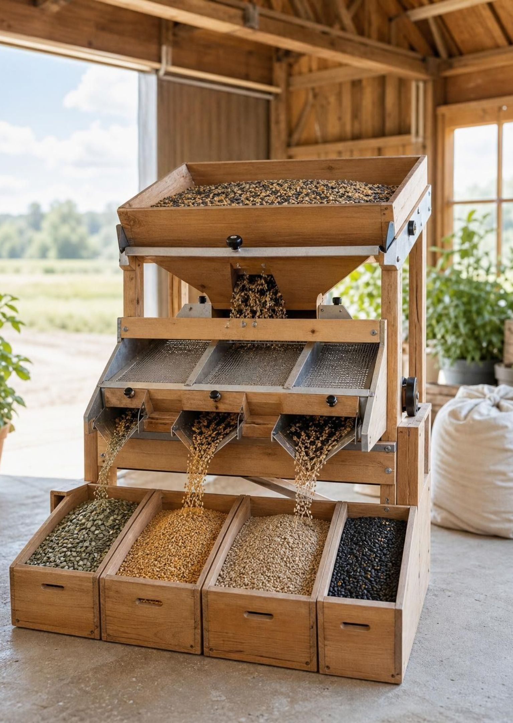
An embedding model produces the vector
Text in, fixed-size floats out. You don't set the numbers by hand.
Notes:
The vectors come from an embedding model, a neural network trained so that things that mean the same land close together. Nobody sets the numbers by hand. Text goes in, and a fixed-size vector of floating-point numbers comes out. The model we use today is Harrier, running locally through Ollama, and its vectors have 1,024 dimensions. The same model produced the Projector data you're about to see and the embeddings in SQL Server in section 3, so everything you see this morning shares one embedding space.
--- JONATHAN'S NOTES (v16, kept) ---
Slide 1.3.2. Image: a black-box 'embedding model' with text in and a vector out; several inputs clustering by topic. The Harrier model we use is 1024-dim.
Slide text moved here: A neural network called an embedding model produces vectors. We feed in text and get back fixed-size vectors of floating-point numbers. It was trained so that things that mean the same end up close; you don't set the numbers by hand. You can embed text, code, and even database rows the same way.

Slide 20

Do the two arrows point the same direction?
Cosine similarity: same direction means similar; perpendicular means unrelated.
Notes:
"How similar are these two things?" becomes "how close are their vectors?" Draw two arrows from the same origin. Cosine similarity asks whether they point the same way: a small angle means similar, and a right angle means unrelated. Keep it to two arrows; this isn't a math lesson. Flag one thing now, because it trips people up in section 3: SQL Server's VECTOR_DISTANCE with 'cosine' returns a distance, so a smaller number means more similar. If you're used to scores where bigger is better, flip it.
--- JONATHAN'S NOTES (v16, kept) ---
Slide 1.3.3. Image: two arrows from an origin. a tight angle ('similar') vs a wide angle ('different'). Keep it to two arrows, not a math lesson.
Slide text moved here: 'How similar are two things?' becomes 'how close are their vectors?' We can use cosine similarity to calculate this. In plain terms, do the vectors (represented as arrows with direction and magnitude) point the same way? The same direction means similar, whereas perpendicular (orthogonal) means unrelated.

Slide 21

DEMO
Vector Differences
king minus man plus woman lands near queen. Directions mean something.
projector.tensorflow.org
Notes:
Browser only, nothing to install: projector.tensorflow.org with its built-in word vectors. Notes are in `src/demo/block1/README.md`.
Beats:
1. Search "king" and show its nearest neighbors.
2. The analogy: king minus man plus woman lands near queen.
3. The point: directions in the space carry meaning, and nobody programmed that in. The model learned it from text.
Expect the question of how all those dimensions fit in a 3D picture. They don't: the Projector flattens them to three for display, so treat the picture as a rough map. The neighbor list is the part to trust.
REHEARSAL CHECK: How you show king minus man plus woman in the Projector UI. I couldn't confirm it does vector arithmetic directly; if it doesn't, show it with a custom projection or describe it instead of demoing it. That the Projector's neighbor list is computed on the full vectors, not the 3D view, before saying "the neighbor list is the part to trust".
--- JONATHAN'S NOTES (v16, kept) ---
Slide 1.3.4. DEMO part A. Projector screenshot with king/queen/man/woman highlighted in the 3D cloud.
Slide text moved here: In the TensorFlow Embedding Projector (projector.tensorflow.org) with built-in word vectors, search 'king' and show its nearest neighbors. Then the famous analogy: king minus man plus woman lands near queen. Directions in the space actually mean something.

Slide 22

DEMO
Wake County, NC food inspection data
Comments about the same issue cluster together: the basis of semantic search.
Notes:
Now our own data: Wake County, NC food-inspection violation comments, embedded ahead of time with Harrier. `src/demo/block1/embed_violations.py` writes `vectors.tsv` and `metadata.tsv` (3,000 comments by default). The files are git-ignored, so generate them before the session; the steps are in `src/demo/block1/README.md`.
Beats:
1. In the Projector, click Load, then load `vectors.tsv` and `metadata.tsv`.
2. Set Color by to severity.
3. Click a point and read its neighbors. Temperature and cold-holding comments sit together, pests are somewhere else, and cleanliness is somewhere else again.
4. Find a neighbor that shares no keywords with the comment you clicked. That's semantic search, with no database involved.
Ledger row, shown with section 3: comments about the same problem clustered together with no keywords in common.
REHEARSAL CHECK: In rehearsal, pick and note one specific comment whose neighbors share no keywords with it, so beat 4 doesn't depend on finding one live.
Slide text moved here: Now load precomputed embeddings of Wake County food-inspection violation comments into the Projector. Notice how comments about specific issues cluster together. This is the basis of semantic search.

Slide 23
Why a data pro should care
KEYWORD SEARCH · FINDS THE WORDS YOU TYPED
SEMANTIC SEARCH · FINDS THE MEANING
Matches exact terms
Matches intent, not just tokens
01
01
02
'fridge too warm' misses 'improper cold holding'
02
'fridge too warm' finds 'improper cold holding'
03
Synonyms slip through the cracks
03
Also powers dedup, clustering, and RAG
Notes:
This is the payoff for a data person. Keyword search finds the words you typed. A search for "fridge too warm" misses every comment that says "improper cold holding," and synonyms slip through. Semantic search compares meaning, so it finds them. It gets closer to the question the user meant to ask. The same vectors also help with near-duplicate detection, grouping similar records, and RAG, which is section 4. Semantic search doesn't replace keyword search; section 3 covers combining the two.
--- JONATHAN'S NOTES (v16, kept) ---
Slide 1.3.6. Image: two search bars over the same data. keyword (misses the synonym) vs semantic (finds it).

Slide 24
Vectors aren't the data you usually store
RELATIONAL STORAGE · BUILT FOR EXACT ANSWERS
VECTOR STORAGE · BUILT FOR SIMILARITY
Equality, ranges, B-tree seeks
JOINs on keys
'Find equal'
High-dimensional, no exact match
Closeness, not equality
'Find the closest'
Notes:
Relational storage is built to find the row that equals something: equality, ranges, B-tree seeks, joins on keys. A Harrier vector has 1,024 dimensions and almost never matches another vector exactly, so the question becomes "find the closest." An ordinary B-tree index doesn't help with that. It needs different storage and a different kind of index, which is why SQL Server 2025 added a VECTOR data type and vector indexes. Section 3 covers both.
--- JONATHAN'S NOTES (v16, kept) ---
Slide 1.4.1. Image: a neat keyed table beside a fuzzy cloud of points. Contrast the two questions they answer.

Slide 25

Trade a sliver of accuracy for a huge speed-up
ANN searches a nearby neighborhood instead of everything. Recall measures what it finds.
Notes:
Exact search, kNN, works like a table scan: compare the query with every vector and sort. It's always right, and it gets slower as the table grows. Approximate search, ANN, uses an index to look only in the likely neighborhood. It's much faster, and sometimes it misses a row exact search would have returned. Recall measures that: of the true top 10, how many did the index find? Don't take "a little" on faith. In section 3 we measure recall on the demo data, including the worst single query. Microsoft's rule of thumb, which also comes back in section 3: exact search is fine under about 50,000 vectors.
--- JONATHAN'S NOTES (v16, kept) ---
Slide 1.4.2. Image: left. a query point with lines to every dot ('exact, slow'); right. lines to just a nearby neighborhood ('approximate, fast'). Recall introduced gently here; it returns in depth in Block 4.
Slide text moved here: Exact nearest-neighbor compares your query to every vector, which is accurate but won't scale well. Approximate search (ANN) compares against a nearby neighborhood instead of everything, giving up a little accuracy for a large speed-up. Recall is the fraction of the true closest items ANN actually finds. Embeddings are already an approximation of meaning, so a small loss is often acceptable. Section 3 shows how to measure it.

Slide 26
Three knobs we can control
1
2
3
Dimensions
Distance metric
Index type
How long the vector is. More dimensions = more nuance but also more storage.
How you measure closeness: cosine similarity, Euclidean distance, and dot product.
How we can organize vectors for fast approximate search.
Notes:
Three choices sit behind every vector store. Dimensions are set by the embedding model you pick; Harrier gives 1,024. More dimensions can capture more nuance and take more storage, and section 3 does that storage math. The distance metric is how you measure closeness. Every demo today uses cosine. The index type is how vectors get organized for approximate search, and SQL Server uses DiskANN. In SQL Server you name the metric both when you build the index and when you search, so use the same one in both places.
--- JONATHAN'S NOTES (v16, kept) ---
Slide 1.4.3. Image: three small cards. a ruler (dimensions), an angle/measure (metric), a little graph/cluster sketch (index).

Slide 27
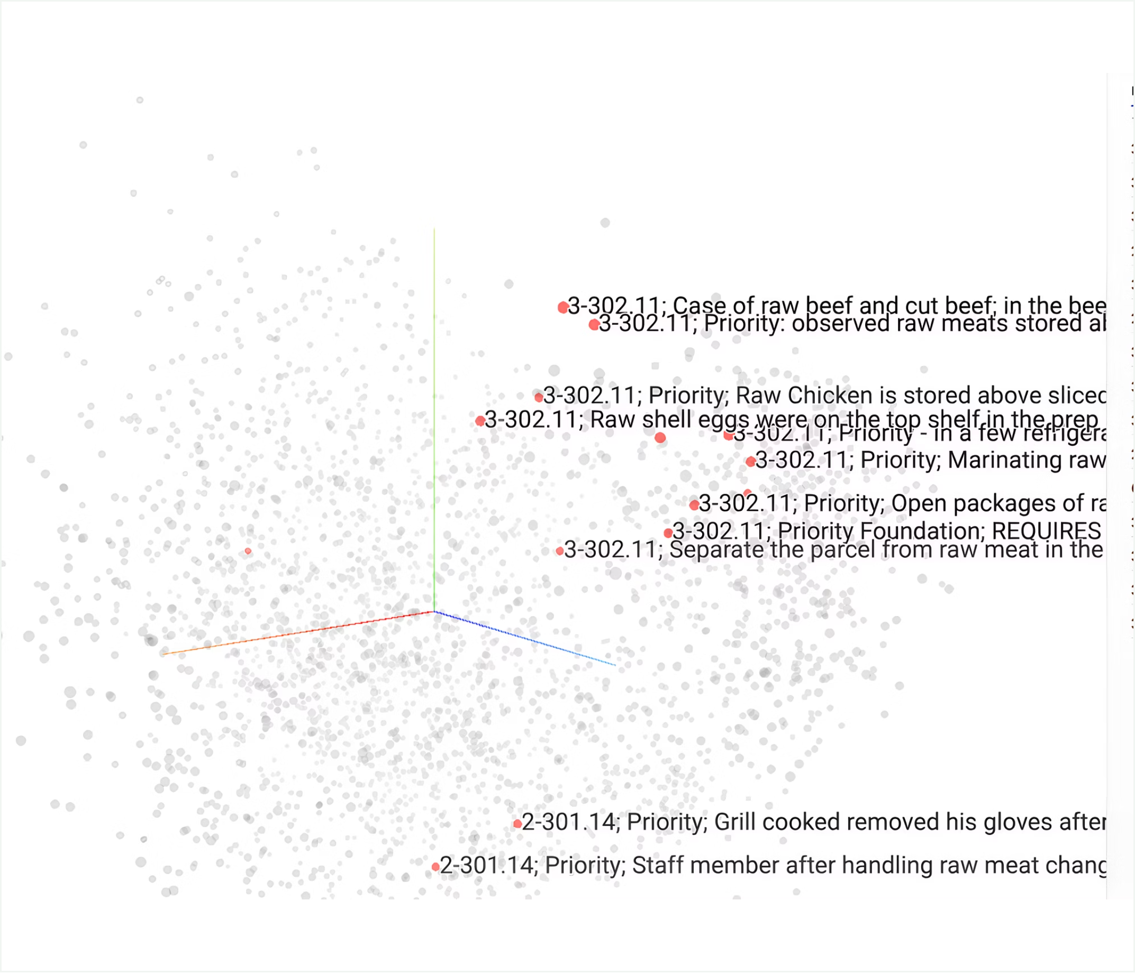
You've already seen approximate similarity search
Click a point, get its nearest neighbors: the same request a vector index answers.
Notes:
Go back to the Projector neighbors view from the Wake County demo. Clicking a point and getting its nearest neighbors is the same request a vector index answers in SQL Server: given this vector, find the closest ones. You've already done it in a browser, with no database. Drop this slide if the section is running long.
REHEARSAL CHECK: Whether the Projector's neighbor list is approximate or exact. If it's exact, retitle the slide "You've already seen nearest-neighbor search" and drop "approximate" from the notes.

Slide 28
Text, tokens, embeddings, similarity, storage
One chain to remember for every AI-data feature today.
1
2
3
4
5
Text
Tokens
Embeddings
Similarity
Storage
Notes:
Sections 1 and 2 on one slide. Text becomes tokens, an embedding model turns them into a vector, vectors get compared by distance, and the vectors and the search over them live in your database. Every AI-data feature later today is a piece of this chain. RAG is search over stored vectors with a model on the end, and the agents in section 5 build on that. There's no ledger slide here; this section's row joins section 3's. Next: section 3 takes the chain into SQL Server 2025, starting with the VECTOR column.
--- JONATHAN'S NOTES (v16, kept) ---
Slide 1.W. Image: the five-link chain assembled, each link an icon from this block. Bridges into 1.5 Convincing the Boss (Jonathan).
Slide text moved here: One chain to remember, and you can reason about every AI-data feature for the rest of the day: text becomes tokens, tokens become embeddings (vectors), vectors are compared by similarity, and similarity gets stored and searched.

Slide 29

Chapter 3
Vectors in SQL Server
Your database just became an AI workload. What do we do next?
Notes:
This section runs about 80 minutes, and lunch follows it. Section 2 showed what vectors are. This section is about storing and searching them in SQL Server 2025, and it ends with a seven-step plan for a pilot in your own shop. The order: the VECTOR column and exact search, approximate indexes and recall, what is GA and what is still preview, where else vectors can live, the demo, measuring recall, search patterns, and running it in production. Then the plan and this section's ledger rows. The demos call an embedding model running on the laptop. That's for convenience; the same scripts work against Azure OpenAI or OpenAI with a change to the model registration.
--- JONATHAN'S NOTES (v16, kept) ---
Block 4 (1:00, 2:15, ~75 min). Presented by Kevin Feasel. Four stops: (A) how vector indexes think, (B) where vectors live, (C) how we query them, (D) how we run them in production. Two live demos. Target platform: SQL Server 2025 (17.x).

Slide 30

What actually changes in your day job?
Embeddings, vector search, and in-database AI calls are now built into SQL Server 2025: yours to size, secure, back up, and tune.
Notes:
The question for this section: what changes in your day job? Once the database stores embeddings and calls a model, sizing, security, backup, and tuning for that workload land on the DBA. The scope here is running these workloads, not every piece of syntax. Expect someone to ask early whether this is production-ready. Some of it is GA and some is still preview, and 3.7 has the exact split, so defer the question until then. Handoff: start with the column itself.
--- JONATHAN'S NOTES (v16, kept) ---
[Concept] Opener. Frame the DBA's question for the whole block: what changes in my day job? Honest scope: operating these workloads, not exhaustive syntax. Image: castle gate (title callback). data flowing through the gate.

Slide 31

An embedding is just an array of floats in a VECTOR(n) column
The new question: how do you quickly find the closest rows among millions?
Notes:
An embedding is a fixed-length array of numbers, and SQL Server 2025 stores it in a VECTOR(n) column. The type is GA. Each element is a 4-byte float by default, and a column can hold 1 to 1,998 dimensions. Half-precision (float16) vectors go up to 3,996 dimensions, but they're preview. The demo columns are VECTOR(1024) because the Harrier model returns 1,024 numbers for each piece of text. The dimension count has to match the model, so changing models means re-embedding. Keep it concrete for a room that thinks in rows and columns: the row has one more column, and it's a big one. Handoff: given a query vector, how do you find the closest rows?
--- JONATHAN'S NOTES (v16, kept) ---
[SS2025 GA] VECTOR data type and 1, 1998 float32 dimension range. Keep it concrete. this audience thinks in rows and columns. Image: a row morphing into [0.12,-0.04,0.88,…] then a magnifying glass over a cloud of dots.
Slide text moved here: Each element is a 4-byte single-precision float by default, and the number of dimensions is fixed per column. The new question: given a query vector, how do you quickly find the closest rows among millions?

Slide 32
Exact kNN computes VECTOR_DISTANCE to every row, sorts, takes top N
~50,000 vectors: below this, exact search is fine (or when a filter shrinks the set below that).
Microsoft's rule of thumb
A table scan plus a per-row distance: predictable, precise, and expensive.
Notes:
Exact k-nearest-neighbors: compute VECTOR_DISTANCE from the query vector to every row, sort, and take the top N. VECTOR_DISTANCE is GA and supports cosine, dot product, and Euclidean distance. It's a scan plus one distance calculation per row, so the cost grows with the row count, but the answer is exact and the plan is predictable. The 50,000 figure at the bottom is Microsoft's published rule of thumb. It counts candidate vectors, so a WHERE clause that cuts a big table down to a small set makes exact search the right tool again. Queries A and C in the demo are exact searches. Handoff: past that size, you trade exactness for speed.
--- JONATHAN'S NOTES (v16, kept) ---
[SS2025 GA] VECTOR_DISTANCE + the kNN pattern. The ~50k figure is Microsoft's published recommendation. Image: brute-force visual. one query point with lines to every other point.
Slide text moved here: This requires a table scan plus a per-row distance computation. This makes exact kNN predictable, precise, and expensive.

Slide 33

A vector index returns approximate results
Unlike every B-tree you've tuned, an 'index seek' no longer means 'exact results.'
Notes:
Name this shift out loud. Every index this room has tuned returns exact results. A vector index doesn't: it quickly returns rows that are probably among the nearest. Recall measures how close it got, as the share of the true top N that the index returned. A recall of 1.0 means the same rows exact search would return. The 0.95 to 0.99 range is usually fine because embeddings are already an approximation of meaning. Nobody has to take that range on faith: 3.12 and 3.13 measure recall on the demo data. Handoff: how these indexes are built.

Slide 34
Styles of Vector Indexes
Family | Shape | Memory | Recall / cost | Used by
IVFFlat | Cluster + probe nearest few | Cheaper | Recall sensitive to probes; fast build | pgvector
HNSW | Multi-layer proximity graph | Memory-resident | Excellent recall; costly build/update | pgvector, Pinecone, Weaviate, Qdrant, Cosmos DB
DiskANN | Single graph, SSD-resident | Low (SSD) | Billion-scale on modest RAM | SQL family, Cosmos DB, Azure PostgreSQL
DiskANN is the only vector index type in the SQL Server family.
Notes:
Three index families, compared on what a DBA cares about: memory, build cost, and recall. IVFFlat clusters the vectors and searches the nearest few clusters. It builds fast, and its recall depends on how many clusters you probe. HNSW is a layered graph kept in memory, with excellent recall and costly builds and updates. DiskANN is a single graph kept on SSD, so you can index far more vectors than fit in RAM and still get low latency. It balances memory, CPU, and I/O, a trade-off anyone who tunes storage knows. DiskANN is the one to understand, because it's the only type the SQL Server family offers. Cosmos DB has it too, and so does Azure Database for PostgreSQL, through the pg_diskann extension (GA). Handoff: do you need an index at all?
--- JONATHAN'S NOTES (v16, kept) ---
Compare on four axes DBAs care about: build time, memory footprint, recall, update cost. Likely a screenshot-and-keep slide. keep it clean. DiskANN attribution [SS2025 Preview]/[Azure]; IVFFlat+HNSW [Non-MS].

Slide 35
Index or brute force?
1
2
3
< ~50k candidate vectors
Large + latency-sensitive
Selective filter present?
Exact kNN with VECTOR_DISTANCE. No index needed.
ANN via a vector index (DiskANN).
The filter may shrink the set enough that exact search wins again.
SQL Server reality check: SQL Server 2025 has far fewer tuning knobs than pgvector or Cosmos DB. Most tuning is choosing exact vs approximate and getting filters right.
Notes:
Three questions decide it. Under about 50,000 candidate vectors: exact kNN with VECTOR_DISTANCE, no index. Large and latency-sensitive: a DiskANN index searched with VECTOR_SEARCH. A selective filter: it may shrink the set enough that exact search wins again. The exact path is GA; the index path is preview. SQL Server 2025 gives you few knobs. CREATE VECTOR INDEX takes METRIC and TYPE. It accepts MAXDOP but ignores it, which is a documented known issue. A VECTOR_SEARCH whose METRIC differs from the index's falls back to exact kNN, with a warning. So most of the tuning is choosing exact or approximate and getting the filters right. Handoff: what's GA and what isn't.
--- JONATHAN'S NOTES (v16, kept) ---
[SS2025 GA] exact path; [SS2025 Preview] index path + the METRIC/TYPE/MAXDOP knob set. Image: a flowchart with one decision diamond.

Slide 36
What's in SQL Server 2025
Capability | Status
VECTOR(n) type + vector scalar functions | GA
Exact kNN via VECTOR_DISTANCE (cosine | dot | euclidean) | GA
CREATE VECTOR INDEX (DiskANN) + VECTOR_SEARCH (ANN) | Preview (needs PREVIEW_FEATURES = ON)
AI_GENERATE_EMBEDDINGS / AI_GENERATE_CHUNKS / CREATE EXTERNAL MODEL | GA (needs an endpoint)
float16 (half-precision) vectors, up to 3,996 dims | Preview
Preview features ship today, but you have to turn them on (PREVIEW_FEATURES = ON).
Notes:
This is the status slide; people will photograph it. GA in SQL Server 2025: the VECTOR type and its functions, exact kNN with VECTOR_DISTANCE, and AI_GENERATE_EMBEDDINGS, AI_GENERATE_CHUNKS, and CREATE EXTERNAL MODEL. Preview, behind PREVIEW_FEATURES: CREATE VECTOR INDEX, VECTOR_SEARCH, and float16 vectors. The embedding functions need two things the type doesn't: an HTTPS model endpoint, and the server option "external rest endpoint enabled", which the first demo script turns on. Running a local ONNX model instead of an endpoint is still preview and Windows-only. If someone asks whether they can run preview features in production, the useful answer for a pilot: everything here works for one, and exact search is GA if you need to stay off preview. Handoff: the rest of the SQL family is ahead.
--- JONATHAN'S NOTES (v16, kept) ---
Each row tagged. Index/search/embeddings/float16 all confirmed preview-gated in SS2025. Image: a GA/Preview status board. green checks vs amber 'preview' badges.

Slide 37
The Microsoft SQL family
Platform | Vectors | Preview flag? | Notes
SQL Server 2025 | Type + functions; index/search preview | Yes | Behind PREVIEW_FEATURES
Azure SQL Database | GA | No flag needed | Leads on newest index features
Fabric SQL Database | GA | No flag needed | Same modern caps as Azure SQL DB
Azure SQL Managed Instance | GA (Always-up-to-date) | Update-policy gated | SS2025 / Always-up-to-date policy
Full DML, iterative filtering, and advanced quantization: only Azure SQL Database, Fabric SQL Database, and Managed Instance (Always-up-to-date).
Notes:
Same engine family, different versions of the vector index. Azure SQL Database and SQL database in Fabric have vector indexes and VECTOR_SEARCH GA, with no flag. Managed Instance is GA on the Always-up-to-date update policy; on the SQL Server 2025 policy it behaves like SQL Server 2025, so preview. The difference is the index version. SQL Server 2025 ships the earlier one. The latest one adds full DML on indexed tables, iterative filtering, quantization, an optimizer that chooses between ANN and kNN, and sys.dm_db_vector_indexes. It also replaces VECTOR_SEARCH's TOP_N parameter, now deprecated, with SELECT TOP (N) WITH APPROXIMATE. If asked when SQL Server 2025 gets the latest version: we have no date, so don't guess. Handoff: what the earlier version means for your loads.
--- JONATHAN'S NOTES (v16, kept) ---
[SS2025 Preview] / [Azure SQL DB / Fabric] / [Azure other]. Highlight the 'latest index version' nuance. it leads in Azure/Fabric first. Image: capability matrix with check/partial/X.

Slide 38

Plan your ETL around the read-only index
SQL Server 2025's index is read-only after creation. Drop and re-create it whenever you load data.
Notes:
This is the most important operational caveat in the section. SQL Server 2025 has the earlier index version, and it comes with four rules. The table is read-only once the index exists. You need at least 100 rows before you build it. The table needs a clustered primary key on an int column. And filters run after the search, not during it (3.15 covers that). So every load becomes: drop the index, load and embed, rebuild. Azure SQL Database and Fabric have an option, ALLOW_STALE_VECTOR_INDEX, that keeps old-version indexed tables writable; SQL Server 2025 doesn't have it. The demo database is in this state right now: both vector indexes exist, so FoodInspectionViolation is read-only. Handoff: before the demo, where else vectors can live.
--- JONATHAN'S NOTES (v16, kept) ---
[SS2025 Preview] read-only + 100-row constraints; [Azure SQL DB / Fabric] for the latest-version features. This is the single most important operational caveat in Section B.
Slide text moved here: SQL Server 2025 ships the earlier vector-index version, which is read-only after index creation, needs ≥ 100 rows before building, and requires a clustered primary key on an int column. Full DML support (INSERT/UPDATE/DELETE/MERGE with live maintenance), iterative filtering, and advanced quantization are currently only in Azure SQL DB, Fabric, and Managed Instance (Always-up-to-date). Plan to drop and re-create this index whenever you load more data.

Slide 39
In-database vs dedicated store: decide
Data gravity | Do the vectors describe rows already in SQL Server? Co-location avoids a sync pipeline.
Transactional consistency | Must embeddings stay atomically in sync with source rows? In-DB wins.
Operational burden | One engine to back up / secure / patch vs two.
Scale & latency | Billions of vectors at sub-10ms may justify a dedicated store.
Cost model & team skills | What are you paying for today? What does your team already know?
Recommendation: for most DBA-owned workloads where vectors annotate existing relational data, keep them in SQL Server / Azure SQL. Reach for a dedicated store only when scale or latency proves you must.
Notes:
The default recommendation, stated plainly: if the vectors describe rows you already keep in SQL Server, keep them there. You skip a sync pipeline, the embeddings stay consistent with their source rows, and there's one engine to back up, secure, and patch. A dedicated store earns its place at the far end of scale and latency, such as billions of vectors at low latency. The two new lines are for people whose data already lives elsewhere. Cosmos DB also offers quantizedFlat and flat indexes, and can shard DiskANN by partition key, one graph per key value, which helps with multi-tenant isolation. pgvector is open source. If someone asks about Pinecone, Weaviate, Qdrant, Milvus, or Elasticsearch: they can be better at pure vector work, and each is another system to back up, test, and plan RPO and RTO for. Don't rank them. Handoff: the demo.
--- JONATHAN'S NOTES (v16, kept) ---
[Concept] decision criteria are platform-neutral. State the recommendation plainly. Image: a balance scale. 'keep it in the database' vs 'add a dedicated store'.
Slide text moved here: Already on Cosmos DB? It has DiskANN too, set through a JSON index policy and billed in RUs. Already on PostgreSQL? pgvector offers HNSW and IVFFlat; Azure Database for PostgreSQL adds DiskANN (pg_diskann).

Slide 40

DEMO
Working with vector indexes in SQL Server 2025
Exact kNN, a DiskANN index, and approximate search over Wake County violation comments.
Notes:
Setup is in src/demo/block4/README.md: Harrier on Ollama behind the TLS proxy, because CREATE EXTERNAL MODEL only accepts HTTPS endpoints. Run these in order:
1. src/demo/block4/10_create_external_model.sql: enable external REST endpoints, register Harrier as an external model, smoke test. The result is an array of 1,024 numbers.
2. src/demo/block4/20_generate_embeddings.sql: show it, don't run it. Embedding was done ahead of time: 2,000 of about 311,000 violation comments. The vector indexes already exist, so its UPDATEs would fail. Point out the batch loop and the blank-text skip, and tell why the skip is there: an empty string fails the statement with Msg 31744, and that takes the whole batch of 2,000 with it.
3. src/demo/block4/30_create_vector_index.sql: CREATE VECTOR INDEX with METRIC and TYPE, then the query on sys.vector_indexes.
4. src/demo/block4/40_vector_search.sql: Query A is exact kNN over inspection narratives. Query B is VECTOR_SEARCH over violation comments for "rodent or pest activity in the kitchen": roach, fly, and mouse comments come back that share none of those words with the question. Query C filters to Raleigh, then runs exact kNN. B' (commented out) shows the SELECT TOP (N) WITH APPROXIMATE form used on Azure.
Ledger rows from this demo: the pest result (Worked); the blank-text failure and the read-only table (Broke). To put both Broke rows on screen instead of telling them, run SELECT AI_GENERATE_EMBEDDINGS(N'' USE MODEL HarrierEmbeddings); (Msg 31744, "The JSON path for embeddings could not be found in the response.") and try one UPDATE on FoodInspectionViolation (Msg 42231, "Data modification statement failed because table 'FoodInspectionViolation' has a vector index on it."). Both were tested on the demo container on 2026-11-01. A string of spaces does NOT fail; it gets a vector, so use the empty string.
REHEARSAL CHECK: 30_create_vector_index.sql drops and rebuilds both indexes; decide in rehearsal whether to run it live or only show it.

Slide 41
Is the index giving the right answers?
01
02
03
04
A vector index is approximate. It can return different rows than a full scan would.
Measure it: run the same queries both ways and compare the top 10.
Recall@10 = how many of the exact top 10 the index also found, divided by 10.
Measure on your real data at your real size. Recall changes as the table grows.
Notes:
This is the check you run before you tell anyone the pilot works. A vector index is approximate, so measure it against exact search. On SQL Server 2025 that's simple to set up: VECTOR_DISTANCE is exact and VECTOR_SEARCH uses the index, so you run the same query both ways and compare the top 10. Measure at your real size, because a number from 2,000 rows says little about 2 million. Watch out for ties. Violation comments repeat word for word, identical text gets an identical vector, and when several comments tie for 10th place, the two lists can pick different rows from the tie. Counting row IDs alone would call that a miss. The script reports both a naive measure (INTERSECT of row IDs) and a tie-aware one. Handoff: the demo.

Slide 42
Demo: measuring recall
25 sample rows · Recall@10
Worst single query
One question
0.97
0.70
8 of the top 10
“rodent or pest activity in the kitchen”: rows in both the index’s and the exact search’s lists.
Notes:
File: src/demo/block4/50_recall_check.sql. Run it after 30_create_vector_index.sql; it takes about 5 seconds.
Part A needs no endpoint. It picks 25 evenly spaced embedded rows, uses each row's own vector as the query, and compares the index's top 10 with the exact top 10, leaving the query row out. It returns id_recall, tie_recall, and the worst single query, then lists the queries where the two lists differed.
Part B embeds the pest question from 40_vector_search.sql and shows both lists side by side. A row with in_both = 0 was found by only one method.
The slide numbers were measured on 2026-11-01 on the 2,000-row demo set. Rerun before the session and update the slide if the embedded set has changed.
The question to leave with the room: is 0.97 good enough? That depends on what the search is for, and it's a call for someone who knows the data. It goes on the ledger as Broke because 8 of 10 isn't 10 of 10. Handoff: search patterns beyond a single query.
On the 2026-11-01 run, id_recall and tie_recall were both 0.97, so either is right to quote; the 0.70 worst query is from the tie-aware column.

Slide 43
Pure vector vs hybrid search
PURE VECTOR
HYBRID
Rank purely by semantic similarity
Great for 'find things about this'
Fumbles exact tokens: SKUs, codes, names
Vector similarity + full-text (BM25) in one query
Keyword side is precise on rare jargon
Often more relevant than either one alone
Pure vector search fumbles exact tokens (product codes, person names, rare jargon), where keyword search excels.
Notes:
Pure vector search ranks by meaning, which is how query B found the pest comments. It fumbles exact tokens: product codes, people's names, rare jargon. Keyword search with full-text is precise on exactly those. Hybrid runs both in one query and merges the results. Full-text search is GA in SQL Server 2025; the vector side is GA with VECTOR_DISTANCE and preview with VECTOR_SEARCH. A quick test for whether your pilot needs hybrid: write down a few real questions that contain a code or a name, and see whether vector search alone finds the right rows. Handoff: filtering has its own trap.
--- JONATHAN'S NOTES (v16, kept) ---
[SS2025 GA] full-text; [SS2025 Preview] vector side of hybrid. Image: a Venn diagram. semantic vs keyword, overlap = hybrid.

Slide 44
Filtered search and the post-filter trap
POST-FILTER (THE TRAP)
ITERATIVE FILTERING (THE FIX)
Run ANN top-N first, THEN filter
Apply WHERE during the graph search, not after
1
1
Filtered-out rows used up your top-N slots
Returns a full, correct result set
2
2
You're left with almost nothing, hurting recall.
Only in Azure SQL DB, Fabric, and MI (Always-up-to-date)
3
3
SQL Server 2025 doesn't support iterative filtering. Workaround: apply the non-vector filters first, then run exact kNN over the rows that remain.
Notes:
With post-filtering, the index finds its top N first and the WHERE clause runs afterward. If most of those N fail the filter, you get back far fewer rows than you asked for, and the ones you lost may have been the best matches inside the filter. Iterative filtering applies the filter during the graph search and returns a full result. It's part of the latest index version: Azure SQL Database, Fabric, and Managed Instance on Always-up-to-date. SQL Server 2025 only post-filters. The workaround is query C in 40_vector_search.sql: filter on metadata first, then run exact kNN with VECTOR_DISTANCE over what's left. When the filter is selective, that's the faster plan anyway. Handoff: combining two ranked lists.
--- JONATHAN'S NOTES (v16, kept) ---
[Concept] the post-filter recall problem; [Azure SQL DB / Fabric] iterative filtering availability; [SS2025 GA] the exact-over-filtered fallback. Image: before/after top-10 lists.

Slide 45

You can't just add a distance score and a BM25 score
Reciprocal Rank Fusion merges two ranked lists by rank position, not raw score.
Benchmarks consistently show hybrid + ranking beats either method alone for relevance.
Notes:
A cosine distance and a full-text rank are on different scales, so you can't add them. Reciprocal Rank Fusion ignores the raw scores and uses each row's position in each list, with a weight per list if you want to favor semantic or keyword results. In SQL, that's VECTOR_DISTANCE or VECTOR_SEARCH for one list and FREETEXTTABLE for the other, combined by rank. RRF stays in the database and needs no extra model. If someone asks about re-ranking with a model such as Cohere Rerank: a second model scores the top few results, which is more precise but adds an external call, with its latency and cost. Use it on the top K, not the whole result set. This is the first slide to drop if the section runs long. Handoff: getting embeddings into the table.
--- JONATHAN'S NOTES (v16, kept) ---
[Concept] RRF mechanics; [SS2025 GA]/[Azure other] SQL/EF Core implementations. Image: two ranked lists feeding an RRF funnel. show rank numbers, not scores.
Slide text moved here: They aren't on the same scale. Reciprocal Rank Fusion (RRF) fuses two ranked lists using each item's rank position (not raw score), with per-list weights to favor semantic or keyword results. In the SQL family, combine VECTOR_DISTANCE / VECTOR_SEARCH with full-text search’s FREETEXTTABLE function.

Slide 46
Batch vs real-time embedding generation
BATCH
REAL-TIME
CROSS APPLY AI_GENERATE_CHUNKS + AI_GENERATE_EMBEDDINGS over a table
Efficient for bulk / backfill
Schedule it
Embed on insert / update
Fresh immediately
Per-row external model latency
Staleness is your new maintenance job: when source text changes, its embedding is wrong until regenerated. You own the refresh: triggers, CDC, or scheduled jobs.
Notes:
Two ways to fill the embedding column. Batch: run AI_GENERATE_EMBEDDINGS over the table on a schedule, which is what 20_generate_embeddings.sql does, 2,000 rows at a time. Real-time: embed on insert or update, so new rows are searchable at once, at the cost of a model call for every row. On SQL Server 2025 there's a catch: a vector-indexed table is read-only, so real-time embedding only works on a table without a vector index. Either way, you own staleness. When the text changes, its embedding is wrong until you regenerate it, and the refresh can come from triggers, CDC, or a scheduled job. The functions are GA and work with Azure OpenAI, OpenAI, and Ollama endpoints. A local ONNX model is still preview and Windows-only. Handoff: how big this gets.
--- JONATHAN'S NOTES (v16, kept) ---
[SS2025 Preview] AI_GENERATE_EMBEDDINGS / AI_GENERATE_CHUNKS / CREATE EXTERNAL MODEL (Azure OpenAI, OpenAI, Ollama, local ONNX). Image: a timeline with a red 'stale' window between text edit (T1) and embedding refresh (T2).

Slide 47
Capacity planning: do the vector math
Quantity | Value | Why it matters
1024-dim float32 vector | 4,104 bytes | 4,096 payload + 8-byte header
SQL data page | 8,060 bytes | → about one vector per page
1536-dim (ada-002) row | ~6 KB | Vectors don't pack like INTs
10M rows @ 1536-dim | ~60 GB | Vector payload BEFORE index overhead
float16 (preview) | halves storage | Up to 3,996 dims, at some recall cost
Embeddings frequently dwarf the source rows. Size data + log + backups accordingly and pick the smallest dimension count that meets your needs.
Notes:
Do this math before the pilot. A 1,024-dimension float32 vector is 4,096 bytes of payload plus an 8-byte header, 4,104 bytes. A data page holds 8,060 bytes, so that's about one vector per page. At 1,536 dimensions (OpenAI's ada-002), a row is about 6 KB, and 10 million rows come to about 60 GB before any index overhead. Float16 halves the storage and allows up to 3,996 dimensions, at some recall cost, and it's preview. Embeddings often outweigh the rows they describe, so size data, log, and backups for them, and pick the smallest dimension count that does the job. Step 7 of the pilot plan uses this slide. Handoff: when to build the index.
--- JONATHAN'S NOTES (v16, kept) ---
[SS2025 GA] byte sizes + 8,060-byte page fact; 10M-row figure is arithmetic from those; [SS2025 Preview] float16. Image: 'what fits on a page'. hundreds of INTs vs one 1024-dim vector.

Slide 48

Build after bulk load: the index gate closes behind you
DiskANN is SSD-resident. SQL Server 2025 ignores MAXDOP on CREATE VECTOR INDEX, so set it at server or database level.
Notes:
The order for any load: bulk load the rows, generate the embeddings, build the index last. Once the index exists the table is read-only, so adding data later means dropping the index, loading and embedding, then rebuilding, with at least 100 rows in place. Plan that window into the ETL schedule. DiskANN keeps its graph on SSD, so memory pressure is much lower than with an in-memory HNSW index over the same data. Build time grows with row count and parallelism. SQL Server 2025 ignores MAXDOP on CREATE VECTOR INDEX (a known issue), so set MAXDOP at the server or database level before a big build. This is the second slide to drop if the section runs long; 3.9 already makes the read-only point. Handoff: running it day to day.
--- JONATHAN'S NOTES (v16, kept) ---
[SS2025 Preview] MAXDOP, 100-row minimum, read-only-after-build; [Concept] DiskANN memory profile. Image: an ETL timeline with the read-only window shaded.
Slide text moved here: DiskANN is SSD-resident, so RAM pressure is far lower than an in-memory HNSW index of the same data. Build time scales with row count and parallelism. Known issue: SQL Server 2025 ignores MAXDOP on CREATE VECTOR INDEX, so set it at the server or database level.

Slide 49
Running it: monitoring and backup
MONITOR
BACK UP AND RECOVER
sys.vector_indexes: index type, distance metric, build parameters.
Extended Events ai_generate_embeddings_summary and external_rest_endpoint_summary: status codes, errors, model name.
The model endpoint is a new dependency. Watch latency, throttling, failures.
Recall can drift as data changes. Rerun the recall check on a sample.
Vectors back up with the table. The model doesn't.
Pin the embedding model and its version, or stored vectors become useless.
Keep the CREATE EXTERNAL MODEL and credential scripts in your runbook.
TRUNCATE is blocked on a vector-indexed table: drop the index, truncate, reload, rebuild.
Query Store, wait stats, and your existing tools still apply: vector queries show up as ordinary query plans.
Notes:
Most of this is familiar: vector queries show up as ordinary plans, so Query Store and wait stats still work. Three things are new. sys.vector_indexes shows what you built. The two Extended Events, which are GA, track calls to the model endpoint. And that endpoint is a dependency: if it slows down, throttles, or fails, so does every embedding call. The two-space comment from the demo was one of those failures. On the latest index version only, sys.dm_db_vector_indexes also shows background maintenance. For backup: vectors are columns, so they back up with the table. The model itself lives at an endpoint you don't back up. If the model or its version changes, new query vectors stop matching the stored ones, so pin both. For DR: vector indexes aren't replicated to subscribers, can't be partitioned, and can't be deployed with a DacPac; BACPAC works from DacFx 170.5.96.
REHEARSAL CHECK: Old 86 contradicted itself on whether a backup carries the external model's credentials. The merged text avoids the claim; confirm the restore behavior before answering that question on stage.

Slide 50
Your pilot, step by step
1
Pick one table with text people already search, and the questions they ask of it.
2
Pick an embedding model and an HTTPS endpoint.
3
Embed in batches. Skip blank text. Log what fails.
4
Search with exact kNN first. Under about 50,000 rows, you may never need an index.
5
If you index: build it last. On SQL Server 2025 the table goes read-only, and it needs an int clustered primary key.
6
Measure recall against exact search on a sample.
7
Time the embedding run, then do the math for the full table.
Notes:
Each step points back to something from this section. Step 1 is the data-gravity argument from 3.10. Step 2 is 3.7 and the first demo script; the endpoint has to be HTTPS. Step 3 is 3.17 and 20_generate_embeddings.sql, where one empty string would fail a whole batch. Step 4 is 3.3 and 3.6. Step 5 is 3.9 and 3.19. Step 6 is 3.12 and 50_recall_check.sql. Step 7 is the capacity math from 3.18, plus a measured rate. The demo's own runs, on a laptop with a Radeon 780M GPU: about 70,000 inspection narratives took about 3 hours, a little under 400 rows a minute, while about 311,000 short violation descriptions took 1 hour 40 minutes. Text length matters as much as row count, so time your own model on your own text. Handoff: the ledger.
REHEARSAL CHECK: The timings come from the comments in 20_generate_embeddings.sql; confirm they were Harrier runs on the laptop you'll present from.

Slide 51
The ledger
WORKED
BROKE
At temperature 0, the same prompt gave the same answer.
Violation comments about the same problem clustered together with no keywords in common.
"rodent or pest activity in the kitchen" found roach, fly, and mouse comments that share none of those words with the question.
At high temperature, the same prompt gave different answers each run.
An empty string doesn't come back as NULL. It fails the statement (Msg 31744), and in a batch UPDATE that one row fails the whole batch.
Once indexed, the table went read-only. Adding rows means drop the index, embed, rebuild.
For the pest question, the index's top 10 matched the exact top 10 on 8 of 10 rows. Across 25 sample rows, recall was 0.97; the worst single query was 0.70.
Section 1 rows carried over (gray). Sections 2 and 3 rows are new.
Notes:
The two section 1 rows carry over; the highlighted rows are new. The first came from the Embedding Projector in section 2, the rest from this section's demos. Read the new rows briefly, and for each Broke row, point out who caught it: a person who knew to look. Everything here happened on screen today; none of it is an industry statistic. Spend a moment on the recall row. 8 of 10 may be fine for finding similar comments and not fine for every use, and deciding which is a job for someone who knows the data. Then lunch. After lunch, section 4 puts these vectors to work: find the passages that answer a question, and hand only those to the model.
REHEARSAL CHECK: The empty-string row is on-screen only if the one-line call in the 3.11 notes is run live; if it isn't, drop the row. Recall numbers are from 2026-11-01 on the 2,000-row set; rerun 50_recall_check.sql before Friday and update this slide and 3.13 together.

Slide 52

Chapter 4
RAG
You find the relevant context and hand it to the model.
Notes:
Welcome back from lunch. The morning answered one question: how does a model get your context? Section 3's answer was to turn your data into vectors a model can search. This section takes the next step: find the passages that answer a question and hand only those to the model. That's RAG. By the end you'll have seen a basic RAG pipeline built entirely in T-SQL, and a way to test whether its retrieval finds the right documents before anyone trusts its answers. Section 5 takes one more step, where the model looks things up itself.

Slide 53

Retrieval Augmented Generation (RAG)
Find the passages that answer a question, and hand only those to the model.
Notes:
The name describes the steps. Retrieve: search your documents for the passages closest to the question. Augment: put those passages into the prompt. Generate: the model writes the answer from them. The documents that pay off first are the ones your team already wrote: runbooks, incident logs, schema docs. Everything in the retrieve step is what you did with violation comments in section 3, aimed at documents instead. Next we put it in DBA terms.
Slide text moved here: Section 3 turned your data into vectors. RAG puts them to work: find the passages that answer a question, and hand only those to the model.

Slide 54
What RAG is, in DBA terms
01
02
03
04
The gap
Retrieve
Augment
The payoff
The model has never seen your shop's documents. Ask about your failover runbook and it guesses confidently.
Embed your docs into vectors. At question time, vector search for the closest passages.
Prepend those passages to the prompt and tell the model to answer from them.
Custom results with no fine-tuning or model training. A lookup feeding a prompt.
Notes:
If it helps the room, think of RAG as a WHERE clause on meaning whose results get pasted into the prompt. The model hasn't learned anything new; it's reading what you handed it. Two consequences worth saying out loud. First, the model is told to answer from the passages, and it usually does, but that's an instruction the model can still ignore. Second, there's no training step: when a runbook changes, you re-embed that document's chunks and the next answer reflects it. Likely question: why not fine-tune instead? Fine-tuning bakes the content into the model, so every document change means another training run. RAG is a lookup you can update the same day.
--- JONATHAN'S NOTES (v16, kept) ---
5.3 RAG (Kevin Feasel's section). Jonathan-drafted from the outline so we can see it render; KF to revise. No em-dashes per house rule.

Slide 55



Turn tribal knowledge into context
Runbooks
Incident logs
The failover, restore, and on-call steps that live in a wiki nobody opens until 2am.
Post-mortems and ticket history. What broke, why, and what fixed it.
Schema docs
Deploy notes
Data dictionary, naming conventions, the why behind that weird column.
Release steps, config, the gotchas one engineer remembers.
Notes:
These four are where the useful text in a data team usually lives. Ask the room where their failover runbook is and when someone last opened it. The demo corpus is six documents of this kind: five runbooks (availability group failover, backup and restore, blocking and deadlocks, index maintenance, tempdb contention) and one post-mortem of a failed nightly ETL run. Start with documents people already go looking for and that are mostly current. An out-of-date runbook gives out-of-date answers, and that's on the list of failures at the end of this section. Drop this slide if the section runs long.
--- JONATHAN'S NOTES (v16, kept) ---
5.3 RAG (Kevin Feasel's section). Jonathan-drafted from the outline so we can see it render; KF to revise. No em-dashes per house rule.

Slide 56
Chunking: finding context in large files
Why chunk
Embeddings match passages, not whole docs. Too big and the match goes fuzzy. Too small and you lose the context.
Size
Aim for a few hundred tokens, one idea per chunk. Split on headings and procedures, never mid-sentence.
Overlap
Carry 10 to 15 percent overlap so a thought split across a boundary still retrieves cleanly.
Metadata
Tag each chunk with source, date, and system, to filter the search and cite the answer.
Notes:
Embeddings match passages, so a whole runbook as one vector matches everything a little and nothing well. The demo uses AI_GENERATE_CHUNKS in SQL Server 2025 with the simplest option: fixed 800-character chunks with 15 percent overlap, roughly 150 to 200 tokens each. Be honest about that: fixed-size chunks can cut mid-sentence or mid-procedure, which is what the overlap is there to soften, and splitting on headings would do better. Each chunk keeps its document name and order, which is the metadata the answer cites. When answers are bad, look at chunking and retrieval before you blame the model; slide 4.7 shows how to measure that.
--- JONATHAN'S NOTES (v16, kept) ---
5.3 RAG (Kevin Feasel's section). Jonathan-drafted from the outline so we can see it render; KF to revise. No em-dashes per house rule.

Slide 57
A minimal RAG pipeline
1
2
3
Load
Chunk
Embed
Gather the docs you trust. Start with one runbook, not the whole wiki.
Split per the rules on the last slide. Keep the metadata.
Run each chunk through an embedding model.
4
5
Store
Retrieve and stuff
Vectors land in SQL Server 2025 or Cosmos DB.
Vector search the question, prepend the top matches, generate an answer using an LLM.
You ran steps 3 and 4 in section 3.
Notes:
Map each step to a demo script. Load is `01_load_docs.sql`, which inserts the runbook text into a table. Chunk and embed happen together in `02_index.sql`, one INSERT ... SELECT. Store is a VECTOR(1536) column on the chunk table, with no vector index: about 18 chunks is far below the roughly 50,000 vectors where an index starts to pay off, so exact search is the right tool. Retrieve and stuff is `03_rag.sql`: embed the question, take the four closest chunks by cosine distance, join them into one context string, and send that with the question to the chat model. One rule people miss: embed the question with the same model you used for the chunks.
--- JONATHAN'S NOTES (v16, kept) ---
5.3 RAG (Kevin Feasel's section). Jonathan-drafted from the outline so we can see it render; KF to revise. No em-dashes per house rule.

Slide 58
Demo: RAG over sample DB docs
WITHOUT RAG · ASK IT COLD
WITH RAG · GROUND IT FIRST
Generic, training-data answer
Invents your runbook steps
Confident, and wrong where it counts
Cites the source document
Reflects your current docs
Says 'not in the docs' if there are no relevant results.
Notes:
Files: `src/demo/block5/tsql/00_setup.sql` through `03_rag.sql`. Setup (Foundry endpoint, deployments, key placeholders) is in `src/demo/block5/README.md`. Run 00 to 02 before the session and walk through them; run 03 live.
1. `02_index.sql`: one statement chunks and embeds every document. The last query shows the chunk, embedded, and document counts.
2. `03_rag.sql` with the default question about the nightly load and the full log. It's worded the way a user would ask, and the answer should cite failed-nightly-etl-postmortem.md. Show the `retrieved_context` column so the room sees what the model was given.
3. Change `@question` to one from the README list, such as the frozen app, and rerun.
4. Uncomment the out-of-scope question in the script and rerun. The model should say it doesn't know. Then show `retrieved_context`: four chunks came back anyway. The "I don't know" came from the system prompt's instruction, not from retrieval. That sets up 4.7. A Python version of the same pipeline is in `src/demo/block5/python/rag.py` if anyone asks.
REHEARSAL CHECK: The scripts have no run without RAG. Decide how to show the left column (ask a chat model the same question cold, or talk through it).
--- JONATHAN'S NOTES (v16, kept) ---
Demo over sample database documentation. 5.3 RAG (Kevin Feasel's section). Jonathan-drafted from the outline so we can see it render; KF to revise. No em-dashes per house rule.

Slide 59
Test retrieval before you trust the answers
An answer is only as good as the chunks retrieval found.
01
02
03
Write the key
Rerun on change
Track two numbers
Write down 10 to 20 real questions, and for each one, the document that should answer it.
Run them after every change: chunk size, overlap, model, top-k, or the documents.
Right document in the top k, and right document at rank 1.
Notes:
This is the RAG version of the recall check from section 3. There, we compared the index with exact search. Here, we compare retrieval with an answer key you wrote yourself. Word the questions the way a user would ask them, not the way the runbook is written, because that's the case that matters. Include at least one question no document answers, and watch how close its best match is. The test never calls the chat model, so it's cheap to run as often as you like. Next, the script that does this.

Slide 60
Demo: testing retrieval
Question | Expected document | Rank | In top 4
[fill] | [fill] | [fill] | [fill]
[fill] | [fill] | [fill] | [fill]
[fill] | [fill] | [fill] | [fill]
[fill] | [fill] | [fill] | [fill]
[fill] | [fill] | [fill] | [fill]
[fill] | [fill] | [fill] | [fill]
[fill] | [fill] | [fill] | [fill]
Results from 04_eval.sql. The Foundry run fills this table.
Notes:
File: `src/demo/block5/tsql/04_eval.sql`. Run it after `02_index.sql`. It embeds seven test questions, six with a known source document and one about Kafka retention that no document covers, and never calls the chat model.
1. First result set: one row per question with the rank of the right document, whether it made the top 4 that `03_rag.sql` sends to the model, and what actually came back first and how close.
2. Second result set: the score to track from run to run, found in the top k and found at rank 1.
3. Point at the Kafka row's best distance next to the in-scope questions'. The 2026-11-01 test run used the local Harrier model, not Foundry: 6 of 6 at rank 1, and the out-of-scope question's best distance was 0.595 against 0.344 to 0.540 for the real questions. That gap is too small to set a cutoff on. **[fill]** with the Foundry run. If the Foundry run arrives too late, show the table without numbers and run the script live.
REHEARSAL CHECK: Kevin runs `04_eval.sql` against Foundry before Friday and fills in the numbers here and on 4.10.

Slide 61





Where RAG goes wrong
It retrieves the wrong chunk, so the answer is confidently about something else.
The document is out of date, so the answer is out of date.
Nothing answers the question, but retrieval still returns its closest matches.
A chunk splits a list of steps, so the answer gets half the procedure.
Retrieval doesn't know who's asking. If a document is in the index, anyone can get it back.
Notes:
Tie each one to what the room saw. The test questions on 4.8 catch the first one. The second needs a process: when a runbook changes, reload and re-embed it. The third happened on screen: the out-of-scope question still got four chunks. The fourth is the risk of the fixed-size chunks in our demo. The last one is the one DBAs should own. Row-level security or per-user filtering on the chunk table is the fix; the model won't do it for you.

Slide 62
The ledger
WORKED
BROKE
Every one of 6 test questions found its runbook at rank 1. [fill] with the Foundry run.
Asked about something no runbook covers, the model said it didn't know instead of making something up. [fill] from the live run of the out-of-scope question in 03_rag.sql.
For a question no runbook covers, retrieval still handed the model four chunks. Retrieval always returns its top k, whether or not any answer the question.
The out-of-scope question's best match was nearly as close as a real answer's (0.595 vs 0.540), so distance alone can't tell "no answer" from "weak answer". [fill] with Foundry's numbers, or drop this row if Foundry separates them clearly.
Rows from sections 1 to 3 carry over; the full list is on the ledger in full. New rows above.
Notes:
Read the new rows. The two that matter go together: the model said "I don't know" because the system prompt told it to, while retrieval handed it four chunks regardless. Retrieval has no notion of "nothing here". The first-row numbers come from a run with the local Harrier model standing in for Foundry on 2026-11-01; replace them with the Foundry run. If a row didn't happen on screen today, drop it. So far we've found the context and handed it to the model. In section 5 the model looks it up itself, and then acts on it.
REHEARSAL CHECK: Confirm or drop each **[fill]** row after the Foundry run and rehearsal.

Slide 63
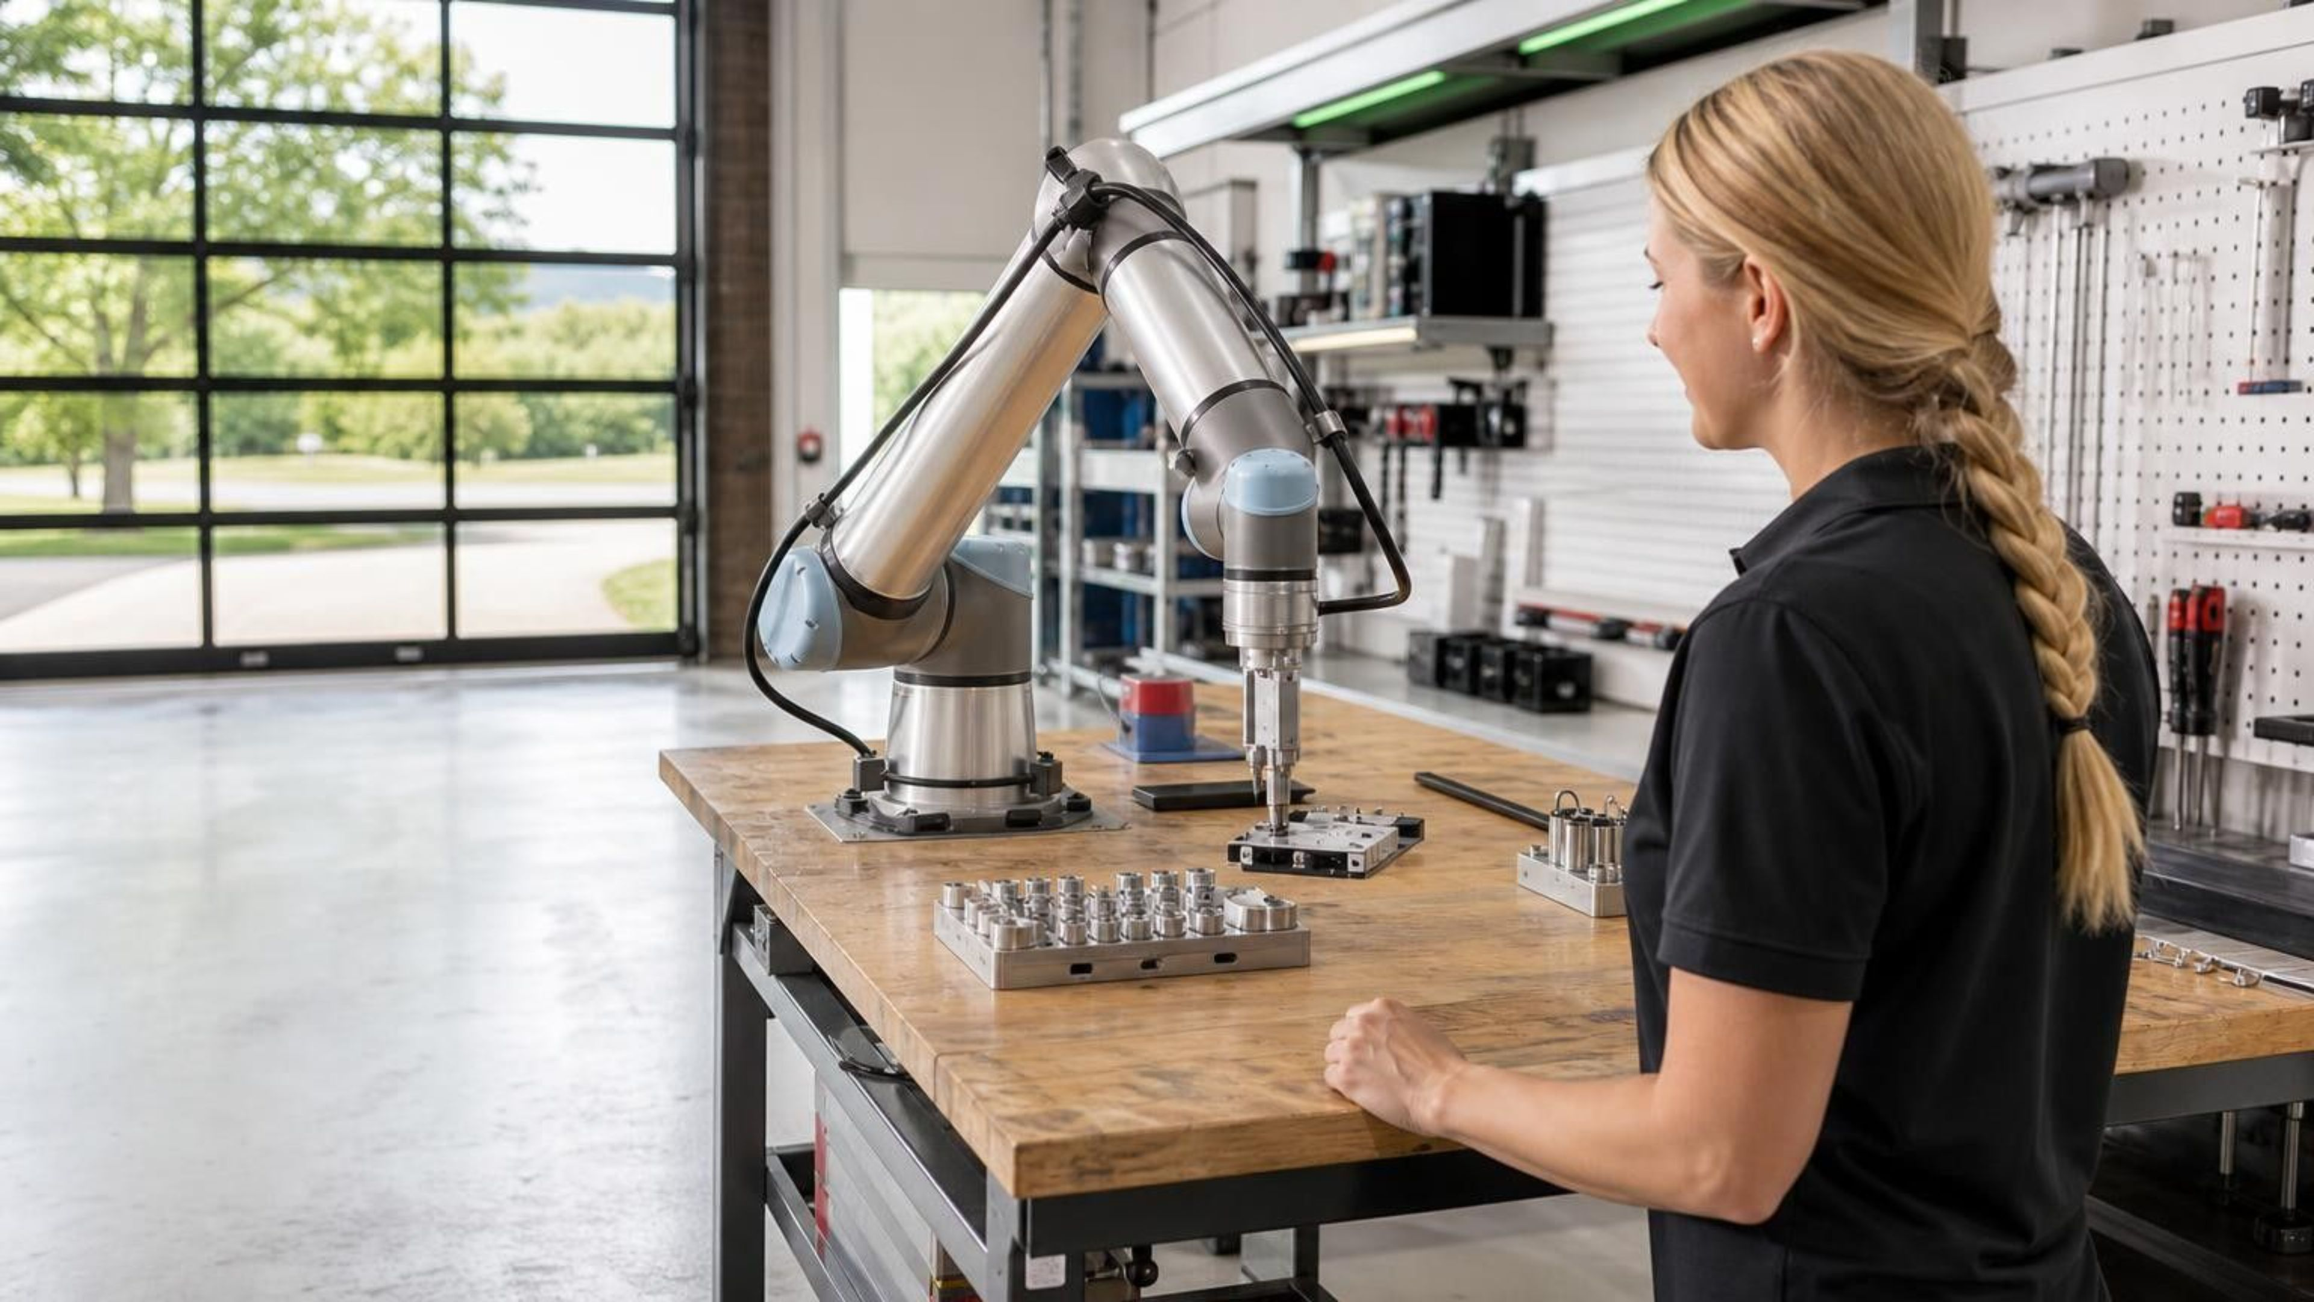
Chapter 5
Agents: the good and the bad
The model looks things up itself, then acts.
Notes:
This section takes the thread one step further. In RAG, we found the context and handed it to the model. Here the model looks things up itself, and then acts on what it finds. We go in five steps, each giving the model more reach: what to settle before you hand it anything, how to brief it, how to pair with it, letting it fetch its own context, and letting it run queries. Then we cover how to guard it. Every demo in this section adds rows to the ledger, and this section adds more "Broke" rows than any other. Keep both columns in mind; the last section uses them.

Slide 64

The gap between what we do and what we know
Who's pasted a production schema into ChatGPT? Keep your hand up if you know what that vendor may do with it.
Notes:
Ask it as a show of hands, then the second half. Most hands go up for the first question and most come down for the second. Don't shame anyone; nearly everyone in the room has done it, including us. The point: before we give a model any more reach, we need to know where our data goes when we type. The rest of this part covers where the prompt travels, what's at risk, which tier of tool fits which data, and what a usable AI policy says. Those decisions come first because everything later in this section hands the model more of your data and more access.
--- JONATHAN'S NOTES (v16, kept) ---
Block 2 open. Show of hands: who's pasted a production schema into ChatGPT? Keep it up if you know exactly what that vendor may do with it. That gap is the whole talk.

Slide 65
Where your prompt actually goes
01
02
03
04
Your Machine
Vendor Servers
Training Corpus
The Local Path
The prompt (schema, query plan, sample rows) leaves here the moment you hit enter.
May be logged, retained, and human-reviewed for quality.
On consumer tiers, your data can train the next model. Functionally: you emailed it to a stranger.
Run a local model (Ollama, Phi) and the prompt never leaves your network. The box you control.
Notes:
Walk the four boxes left to right. The prompt, with whatever schema, plan, or sample rows you pasted, leaves your machine when you hit enter. On the vendor's side it may be logged, retained, and read by people reviewing quality. On consumer tiers it can end up training the next model. The fourth box is the way out: a model that runs on your own hardware. We aren't covering local models today beyond this mention, but the temperature demo this morning ran llama3.2 on the laptop through Ollama, so you've already seen one. Likely question: "Does the enterprise tier train on my data?" The next slides cover the tiers.
--- JONATHAN'S NOTES (v16, kept) ---
Diagram - walk the 3 stops. Your Machine (prompt leaves the moment you hit enter) → Vendor Servers (logged, retained, human-reviewed) → Training Corpus (consumer tiers can train the next model on it).

Slide 66
What's actually at risk
PII | The obvious one: names, MRNs, card numbers.
Schema as IP | Your data model is a competitive asset.
Embedded credentials | Connection strings in the sample you pasted for help.
Business logic | The procs you paste to "refactor" encode how the business runs.
Inference | Even anonymized rows leak distributions, cardinalities, and naming.
Notes:
Five kinds of exposure. PII is the one everyone thinks of. The other four are easy to miss: your schema is intellectual property; sample code often carries connection strings; the procedures you paste for a refactor describe how the business runs; and even anonymized rows reveal distributions, cardinalities, and naming conventions. Inference is the one to slow down on. Removing names doesn't remove what the data says about your business. If the section is running long, skip this slide; 5.4 and 5.5 carry the decisions.
--- JONATHAN'S NOTES (v16, kept) ---
What's actually at risk, beyond the obvious PII: schema as IP (your data model is a competitive asset), embedded credentials in the sample you pasted, and business logic in the procs you 'refactor'.

Slide 67
Capability vs. control: match the tier to the task
1
2
Consumer Cloud
Enterprise Cloud
Best models, worst data terms. Assume prompts are retained and train the next model unless you've opted out.
Foundry, Azure OpenAI, Copilot, Claude Team/Enterprise. Same models; no training, data residency, audit. The sweet spot.
3
4
Local / Self-Hosted
The rule
Ollama, Phi, Llama. Data never leaves your network. Weaker models, your hardware, your ops burden.
Match the tier to the sensitivity of the task. You're trading capability for control.
Notes:
Three tiers and a rule. Consumer cloud has the best models and the worst data terms: assume prompts are kept and used for training unless you've opted out. Enterprise cloud (Foundry, Azure OpenAI, Copilot, Claude Team or Enterprise) runs the same models under a contract: no training on your data, data residency, and audit. Local or self-hosted keeps data on your network, at the cost of weaker models and running it yourself. The rule is to pick per task, by how sensitive the data is. One tier for everything means either leaking data or giving up capability you didn't need to. "Claude for Work" was an older umbrella name; Anthropic sells this tier as the Team and Enterprise plans. Next: classifying the data is what decides the tier.
--- JONATHAN'S NOTES (v16, kept) ---
Three tiers. Consumer cloud: best model, worst terms - assume prompts are retained unless you opted out. Enterprise: same model, contractual boundaries (no training, residency, audit). Local: full control, weaker model. Classify the data FIRST; the tier falls out.

Slide 68
Your AI use policy
Approved tools and tiers: which assistants and licenses are allowed, which are banned.
Data classification decides the tier. Some data may never be pasted, whatever the tier.
A person reviews AI output before production.
No production write access: read-only by default, guardrails on anything that runs.
Sign-off and logging: who approved, who used it for what, who owns the result.
A sanctioned path. A policy that only says "no" sends people to tools you can't see.
Regime | Data in scope | Before you prompt
HIPAA | US health data | A BAA. Consumer tiers don't offer one.
PCI-DSS | Card payments | Keep card data out of the prompt entirely.
GDPR | EU personal data | A DPA, data residency, no training, and right to erasure.
Notes:
This is the checklist to take back to work. Start with the data, not the tool: classify it, and the classification tells you which tier is allowed. The three regimes on the slide are examples. HIPAA needs a business associate agreement, which consumer tiers don't offer. Card data should never be in a prompt. GDPR brings residency and erasure. Two items on this list come back later in this section. "Read-only by default" is how SSMS Agent mode ships (5.19). "No production write access" is exactly what the perf-triage demo (5.18) doesn't follow, on purpose. The last item matters most in practice. If the only approved answer is "no", people use their personal accounts and you lose sight of it. Next: once you know what you're allowed to send, how to brief the model well.

Slide 69
R-C-T-C-O: the anatomy of an effective prompt
Role
"You are a senior SQL Server DBA who writes set-based T-SQL." Sets vocabulary and standards.
Context
Schema, version, volumes, conventions, and what you've tried.
Task
One clear verb, one clear deliverable.
Constraints
"Set-based, no cursors. Runs on SQL Server 2019. Parameterized." How you encode your standards.
Output format
"Just the T-SQL." "A table of options with tradeoffs." Saves a round trip.
Notes:
Remember the overconfident junior from the first section. You already write specs for juniors; a prompt is a spec. Five parts: the role sets vocabulary and standards; context is schema, version, volumes, conventions, and what you've tried; the task is one verb and one deliverable; constraints are your standards written down ("set-based, no cursors, runs on SQL Server 2019"); output format saves a round trip. Everyone writes role and task without thinking about it. Context, constraints, and output format are where the results improve, and they're the parts people skip. The prompt makeover in a few slides adds them one at a time so you can see what each one fixes.
--- JONATHAN'S NOTES (v16, kept) ---
The recipe - R-C-T-C-O: Role, Context, Task, Constraints, Output. Role and Task are easy. Context, Constraints, and Output are what separate amateur from professional results.

Slide 70

The model can't see your database, so show it the relevant slice
Paste the DDL, a few sample rows, relationships, and row counts.
Notes:
The model has never seen your database. Without your schema it invents table and column names that look right and don't exist. You'll see that in the first step of the makeover. What to paste: the CREATE TABLE statements with keys and indexes, a few sample rows, the relationships, and rough row counts. For a big schema, include the tables that matter and summarize the rest. This sits right after the data-handling slides for a reason: paste the slice your policy allows, into a tier that's approved for it. Later in this section MCP removes the pasting step, and the model reads the schema itself.
--- JONATHAN'S NOTES (v16, kept) ---
Slide 3.2.1. Image: a CREATE TABLE snippet + 3 sample rows flowing into the model. Direct callback to Block 1. without schema it confidently invents plausible-but-wrong column names.
Slide text moved here: Paste the relevant DDL (CREATE TABLE plus keys and indexes), a few sample rows, and note the relationships and row counts. If you have a big schema, include only the tables that matter and summarize the rest.

Slide 71
Reason first, then iterate
1
2
Chain-of-thought
The correction loop
Make it restate the requirement, list tables and grain, and identify join keys before it writes SQL. Catch the wrong assumption before it bakes into code.
The first answer is a draft. Read it, spot the wrong assumption, add the missing context, ask again. Exactly how you'd mentor a junior.
Notes:
Two habits. First, before it writes any SQL, have it restate the requirement, list the tables and their grain, and name the join keys. A wrong assumption is cheap to fix in that list and expensive to find once it's in a query. Second, treat the first answer as a draft. Read the output, find the wrong assumption, add the context that was missing, and ask again. That's how you'd mentor a junior, and it's the loop the next demo runs four times. If the section is running long, skip this slide and make both points during the demo.
--- JONATHAN'S NOTES (v16, kept) ---
Reason first. Chain-of-thought: make it restate the requirement, list tables and grain, identify join keys BEFORE writing SQL - catch the wrong assumption before it bakes into code. First answer is always a draft. (3.2, SQL-specific, is Kevin's.)

Slide 72
Demo: the prompt makeover
V1 · NO CONTEXT · FIRST TRY
V4 · FULL ANATOMY · FINAL FORM
Invents tables and columns; not even valid T-SQL
The room spots the invented names
Simultaneously confident and useless
Role + schema + domain values + constraints + house style
Derived-table count, OUTER APPLY TOP (1) for the score
Production-quality, correct results verified against data
Same model throughout. Only the prompt changed.
Notes:
Files: `src/demo/block3/prompt-makeover-offline.md` (pre-captured outputs, the default), `src/demo/block3/claude-code-online.md` (live in Claude Code), and `src/demo/block3/schema.sql` (the schema handed over at v2). Setup is in `src/demo/block3/README.md`. Use a capable model, not the laptop's llama3.2:1b. The task never changes: restaurants with the most critical violations in the last 12 months, with the count and the most recent score, worst first.
- v1, no context: about 2 minutes. Show the query and let the room find what's wrong. The tables don't exist and LIMIT isn't T-SQL.
- v2, role and schema: right tables, but it guesses `Severity = 'Critical'`. 0 rows. The values are Core, Priority, and Priority Foundation.
- v3, the Severity values and a date window: a naive join to every inspection turns BASS LAKE DRAFT HOUSE's 5 critical violations into 165.
- v4, correctness constraints and house style: a derived-table count and OUTER APPLY TOP (1) for the score. Correct. Ledger: v2 and v3 go in Broke, v4 in Worked. Keep `'Critical'` in mind; it comes back in the SSMS demo.
--- JONATHAN'S NOTES (v16, kept) ---
Slide 3.2.5. DEMO / interactive. Open with the ~2-min 'spot the hallucination' hook: show a confident, wrong query generated with no schema; let the room find the bug; reveal that schema context fixes it. Main segment. the prompt makeover, pre-captured for reliability. Fixed task: 'Find the restaurants with the most critical violations in the last 12 months, with the count and their most recent inspection score, worst first.' (Wake County). v1 invents columns; v2 (+role+schema) guesses Severity='Critical' → 0 rows (real values Core/Priority/Priority Foundation); v3 (+domain values+window) JOIN fans out 5 → 165; v4 (+correctness+house style) is correct. Use a CAPABLE model. NOT the laptop's llama3.2:1b (that's Block 1's temperature demo). Variants in src/demo/block3/ (Kevin's repo): claude-code-online.md + prompt-makeover-offline.md. Default to offline for a guaranteed arc.

Slide 73




Pair programming: the loop
You specify
It drafts
1
R-C-T-C-O. You drive.
2
Fast, literal, often 80% there.
You correct
4
You review
Add the missing context, re-ask, repeat.
3
Every line, like a pull request, because it is one.
Notes:
The makeover was this loop with one prompt. Day to day it looks like pair programming: you specify, using R-C-T-C-O; it drafts, fast and often most of the way there; you review every line the way you'd review a pull request; you correct by adding what was missing and asking again. Your work shifts from typing to specifying and reviewing. That only pays off if the review happens. A draft that's 80% right and merged unread is a bug you shipped faster. Next: what the remaining 20% usually looks like.
--- JONATHAN'S NOTES (v16, kept) ---
Block 5 open (5.1). The real loop: you specify (R-C-T-C-O, you drive) → it drafts (fast, literal, ~80% there) → you review every line like a pull request, because it is one → you correct. Your job moves from typing to specifying and reviewing. A promotion, only if you actually review.
The recipe –
R-C-T-C-O:
Role,
Context,
Task,
Constraints,
Output.
Role and Task are easy. Context, Constraints, and Output are what separate amateur from professional results.

Slide 74
When AI gets it wrong: the five failure modes
Hallucinated objects
Invents DMVs, system functions, columns, hints that don't exist.
Plausible-but-wrong logic
A join at the wrong grain duplicates rows; NOT IN with NULLs.
Version-mismatched syntax
A feature your SQL Server version doesn't have.
Confidently wrong perf advice
Suggests an index that already exists, or one that hurts the workload.
It never says "I don't know"
It always produces something. Read the plan, check row counts at every grain.
Notes:
Five ways it goes wrong, and the room has already seen two. Hallucinated objects was v1 of the makeover. Plausible-but-wrong logic was v3: the join at the wrong grain that turned 5 into 165. Version-mismatched syntax is the one the Learn MCP demo addresses shortly. Confidently wrong performance advice shows up in the perf-triage demo, where it suggests an index you should check before you build. The fifth is the hardest habit to break: it always produces something. The RAG demo's prompt told the model to say it didn't know; left alone, it rarely does. Read the plan and check row counts at every grain. Trust it per task, the way you'd trust a new hire: more on the work it has got right before, less on anything new.
--- JONATHAN'S NOTES (v16, kept) ---
Five failure modes: hallucinated objects (fake DMVs, columns, hints), plausible-but-wrong logic (wrong join grain → duplicate rows; NOT IN with NULLs), version-mismatched syntax, confident-wrong, and stale patterns. People who get burned trust it too much, too early. Trust is earned per task.

Slide 75
Demo: requirements to stored procedure
UNDER-SPECIFIED PROMPT
R-C-T-C-O APPLIED
"Write a proc to dedupe customers"
Mediocre draft, guessed columns
A grain bug that duplicates rows
Schema + constraints + output format
Better draft
Spot the bug, correct it, verify row counts, live
Notes:
Two passes at the same request. First, the under-specified prompt: "Write a proc to dedupe customers." It produces a mediocre draft with guessed column names and a grain bug that returns duplicate rows. Let the room look for the bug before you point at it. Second, the same request with R-C-T-C-O applied: the schema, the constraints, and the output format. The draft is better. Then find the bug in it, correct it, and check the row counts live. The point is the failure modes from the last slide, happening on screen. Seeing a duplicate-row bug come out of a confident draft sticks better than any list. Ledger: the grain bug goes in Broke.
REHEARSAL CHECK: This demo has no folder in the repo. Confirm where the prompts and the customer table live (WakeCountyFood has no customer table). Fill the ledger row for the grain bug from rehearsal (what it was, and the row counts before and after).
--- JONATHAN'S NOTES (v16, kept) ---
DEMO (5.1). Under-specified 'write a proc to dedupe customers' → mediocre draft, guessed columns, a real grain bug → duplicate rows. Then R-C-T-C-O applied → spot the bug, correct it, verify row counts, live. Show, don't tell - it lands 10x harder. Runbook: demos/5.1-RUNBOOK-live.md

Slide 76
Grain: what one row means
Grain is what one row of a table stands for.
01
02
03
Two grains
The join
The sum
OrderHeader has one row per order. OrderLine has one row per line on that order.
Join them, and each order header total repeats once per line.
Add up a header total after that join and every order is counted more than once.
Notes:
Plain-words setup for the grain-bug clip, so nobody needs the term before the demo. The next clip starts with a draft procedure that looks fine and runs without an error.
In this data an order has about 3.5 lines on average, which is why the wrong total comes out around four times too big.

Slide 77
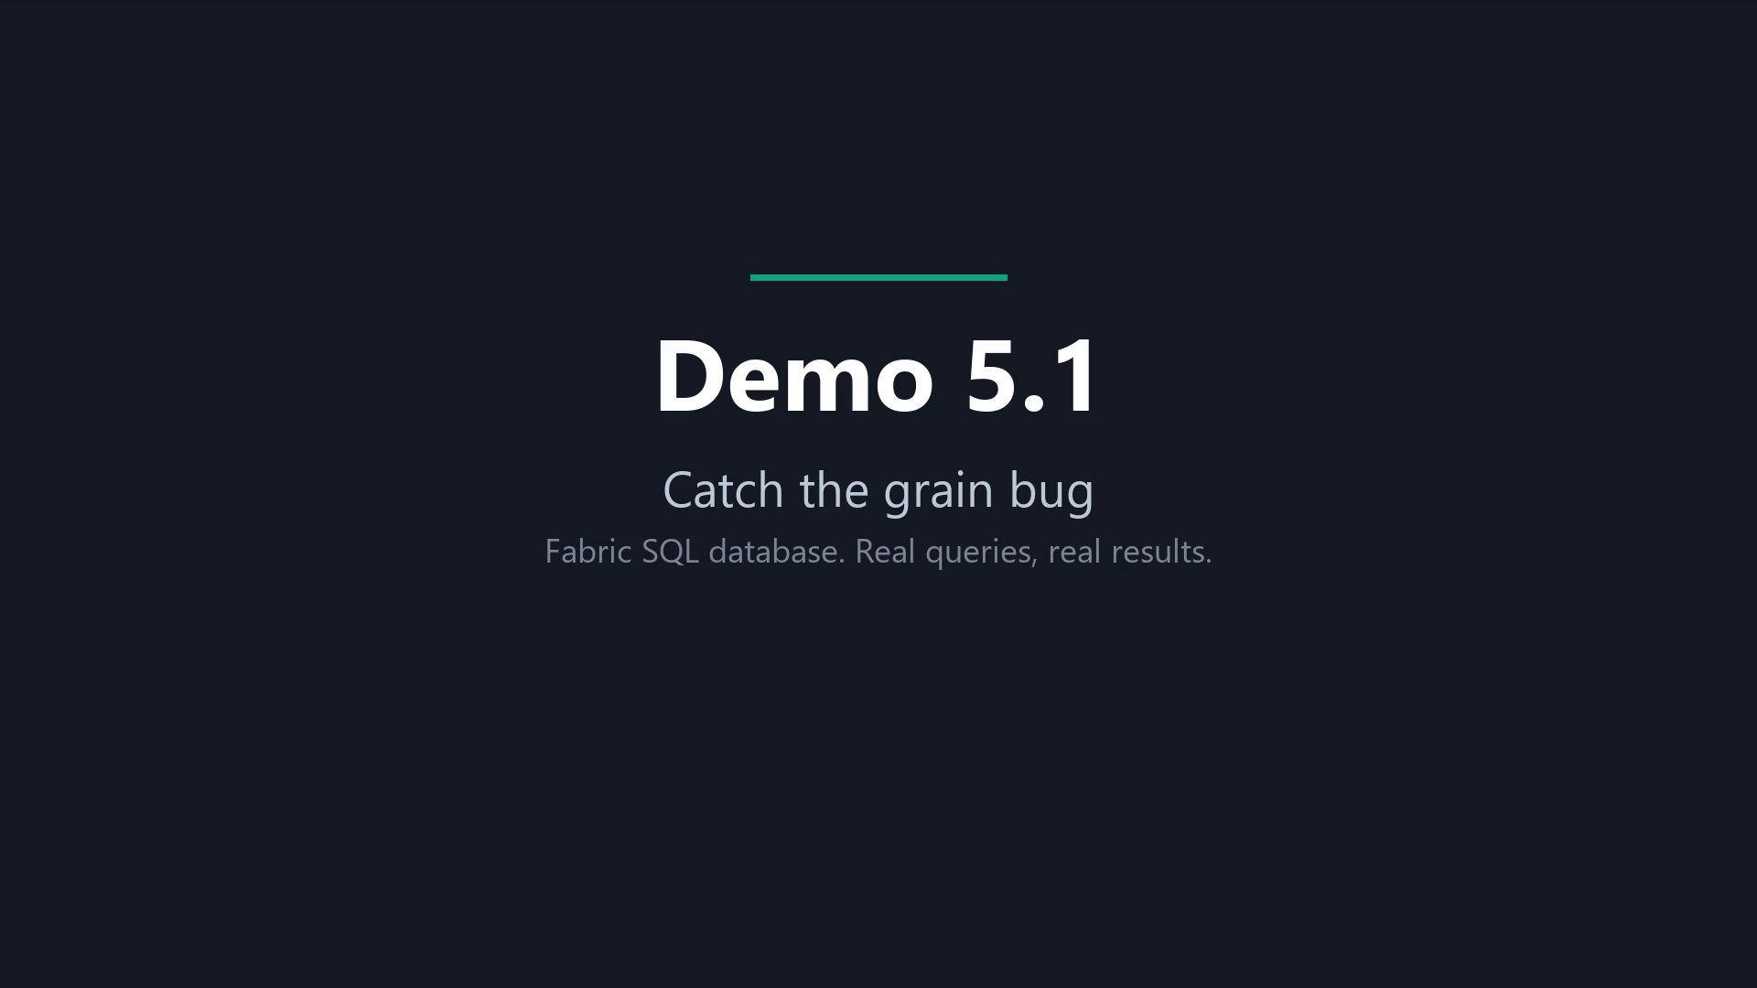
Demo: catch the grain bug
Notes:
Recording of the grain-bug demo against SQLBites_DB (schema distributor). About 3 minutes.
Beat 1 runs the draft procedure: 137 rows summed for Jan/Enterprise, $110,592.02. Beat 2 is the grain check: $6,759,456.26 against $1,529,293.53, a factor of 4.42, with 1,944 orders becoming 6,805 rows. Beat 3 hands the bug to the model (14 seconds on the real run), which rewrites it to sum LineAmt and count distinct orders. Beat 4 runs the model’s version: Jan/Enterprise is now 43 orders and $29,020.55, and the year totals $1,529,293.53.
The 4.4 factor is revenue-weighted; the plain average is 3.5 lines per order. Do not call them identical.

Slide 78
What you saw: the grain bug
Draft total
True total
Too big by
$6,759,456.26
$1,529,293.53
4.42×
The draft summed the header total across the join.
The AI’s rewrite sums the line amount and counts distinct orders, matching the check.
1,944 orders became 6,805 rows.
January, Enterprise: 137 rows and $110,592.02 became 43 orders and $29,020.55.
Notes:
Every number here is on screen in the clip. The 4.42 factor is revenue-weighted; the plain average is 3.5 lines per order, so do not call them identical.
The draft procedure was shown as a draft. The AI’s part was the rewrite.
The year totals $1,529,293.53, matching the check.

Slide 79

Stop pasting your schema. Let it look things up.
MCP turns "let me paste my schema" into "go look it up yourself."
Notes:
This is the next step in the day's thread. With vectors, we turned the data into something searchable. With RAG, we found the right passages and handed them to the model. In the makeover, we pasted the schema and the Severity values by hand. MCP lets the model go and get that context itself. That's convenient, and it changes the risk. A model that can look things up has a connection to something, and that connection has permissions. Keep that in mind for the next few slides.
--- JONATHAN'S NOTES (v16, kept) ---
Pivot to MCP (5.2). Every good answer in the last section, you hand-fed the context - and chores don't get done. MCP turns 'here, let me paste my schema' into 'go look it up yourself': the AI fetches context itself, always schema-aware, no babysitting.
Slide text moved here: Every good answer so far, you hand-fed the context. MCP turns "here, let me paste my schema" into "go look it up yourself": the AI fetches the context it needs, without you pasting it in.

Slide 80
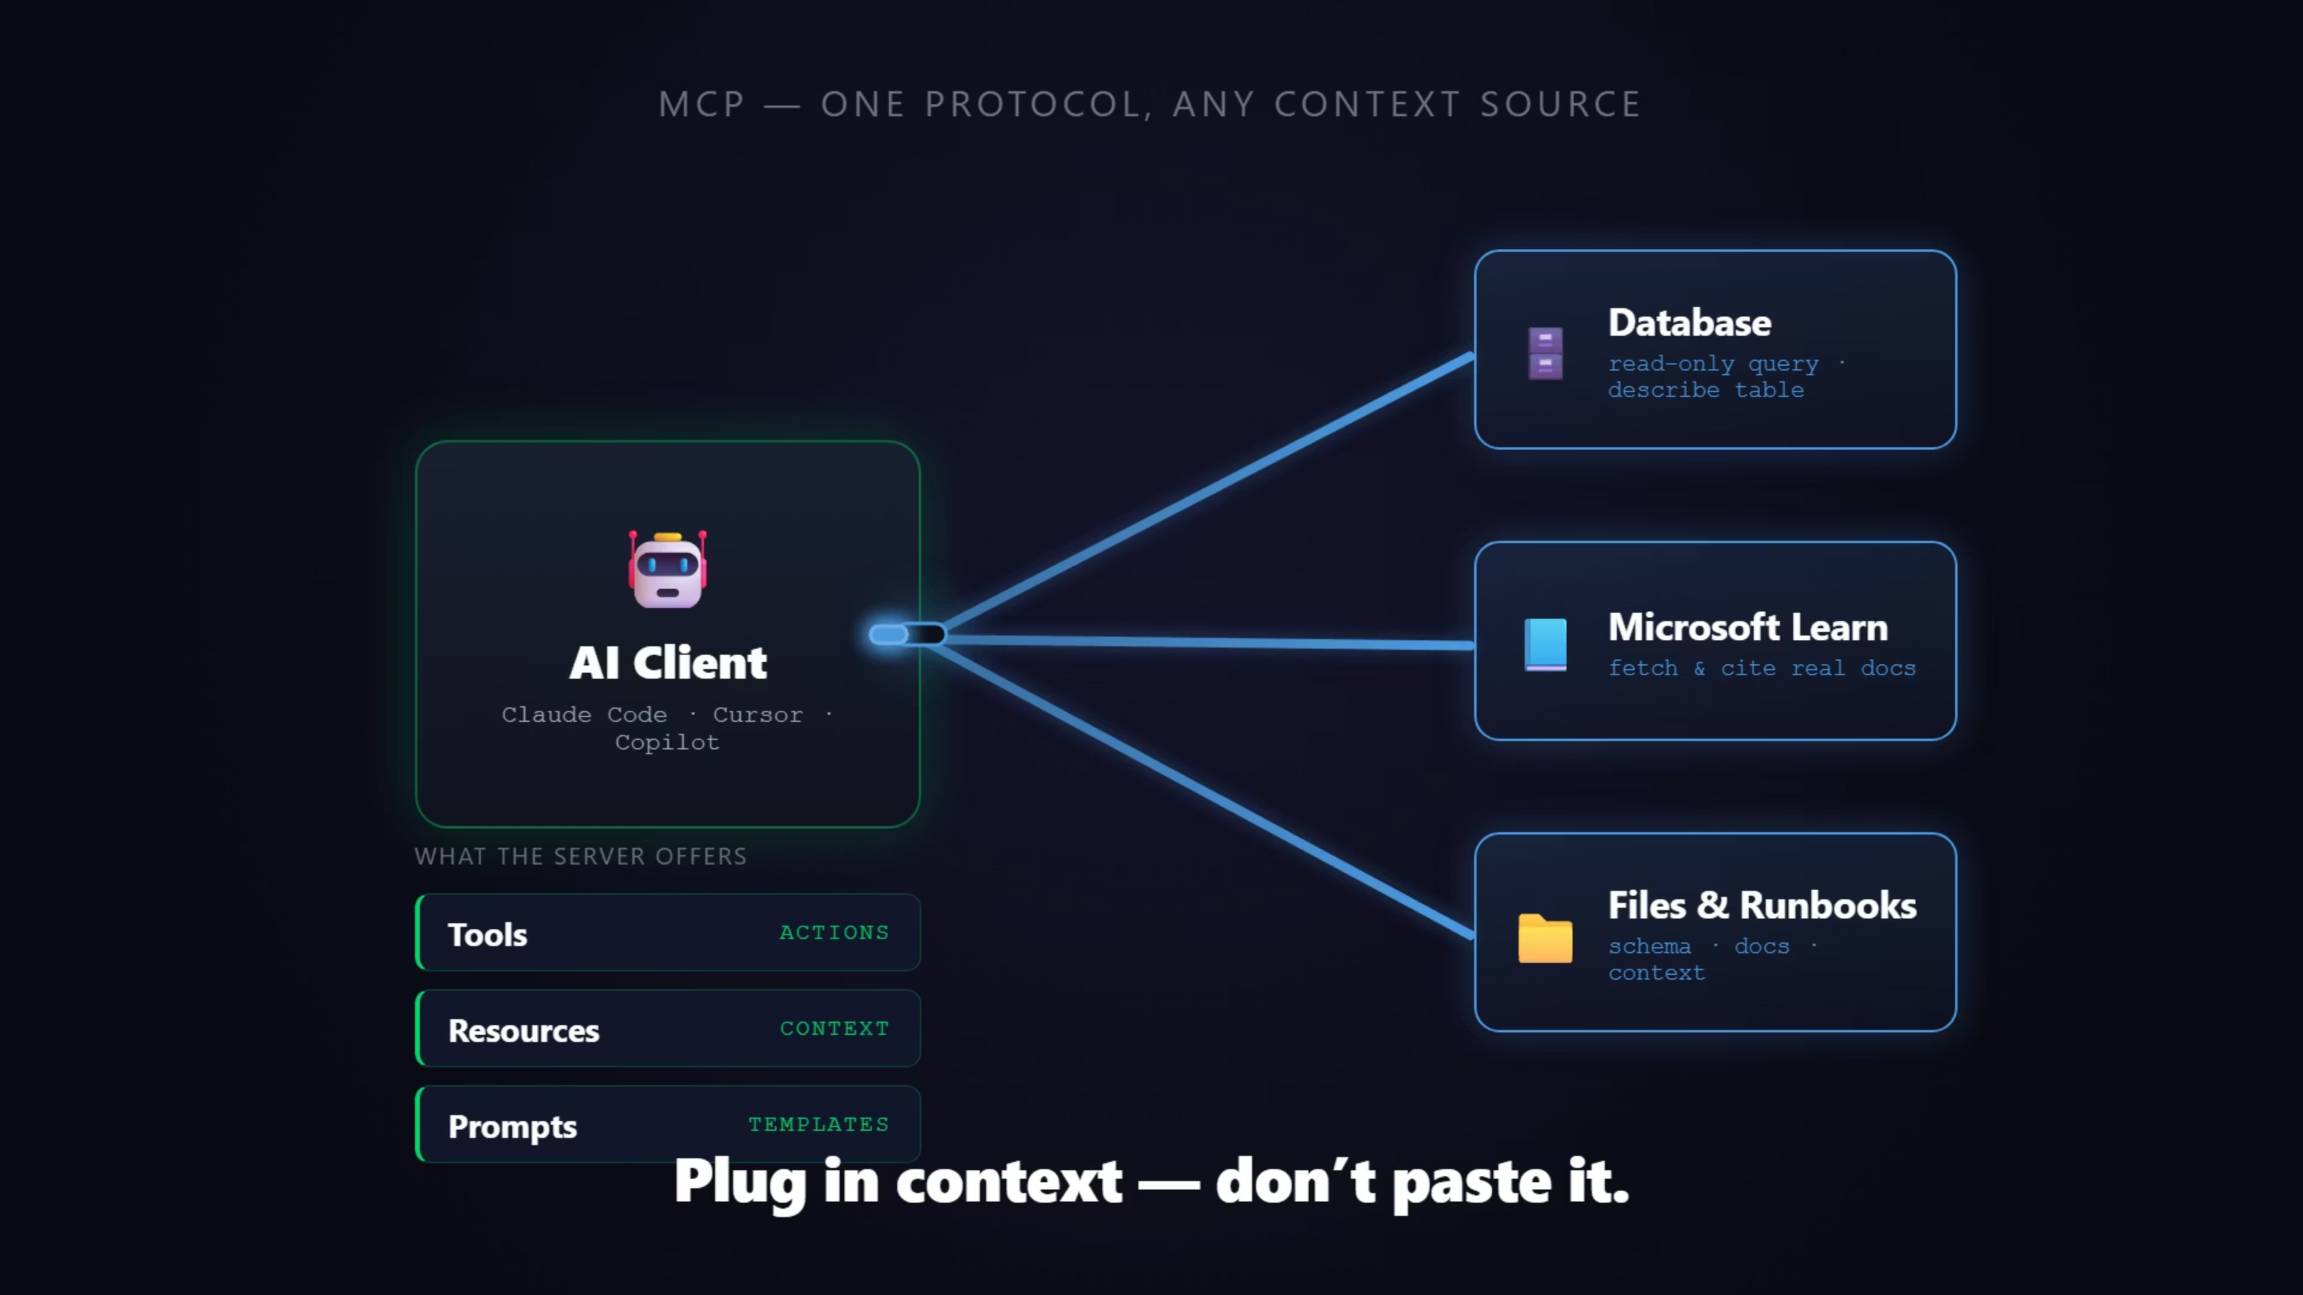
Notes:
Click to play; it runs about 24 seconds. Talk over it rather than reading the screen. MCP is one standard way for an AI client to plug into servers. One client, many servers: a database, Microsoft Learn, your files and runbooks. A server can offer three things:
- Tools: functions the AI can call, such as running a read-only query or describing a table.
- Resources: data the AI can read, such as docs, schema, or runbooks.
- Prompts: reusable prompt templates the server provides. Asset: `images/mcp-usb-c.mp4` (poster `images/mcp-usb-c.png`), embedded play-on-click.
--- JONATHAN'S NOTES (v16, kept) ---
PLAY ON CLICK. click the video to start it; narrate over it, don't read the screen. Animates the 'MCP: USB-C for AI context' idea: the opening line 'One standard. Any server. The AI just plugs in.' holds long enough to read, then a central AI Client hub appears and Database / Microsoft Learn / Files & Runbooks MCP servers slide in and snap into a single USB-C port via cables; finally the three capabilities light up. Tools (ACTIONS), Resources (CONTEXT), Prompts (TEMPLATES). closing on 'Plug in context. don't paste it.' 24s. Asset: images/mcp-usb-c.mp4 (poster images/mcp-usb-c.png), embedded play-on-click; re-render via the remotion mcp-usb-c template if the visuals change.

Slide 81
Demo: the Microsoft Learn MCP server
WITHOUT MCP
WITH LEARN MCP
Version-specific SQL Server question
Model guesses or hedges
The hallucination failure mode from earlier in this section
Fetches and cites the real doc
Same model, same question
No creds, no data leaves: safe to run live
Notes:
Same model, same question, asked twice. Pick a question that depends on the SQL Server version. Without MCP, the model guesses or hedges. With the Learn MCP server connected, it fetches the documentation page and cites it. A good question from today's material: "In SQL Server 2025, can I insert rows into a table that has a vector index?" The answer is no: SQL Server 2025 ships the earlier vector index version, which makes the table read-only. The newer version, which allows changes, is in Azure SQL Database, Fabric, and Managed Instance on the Always-up-to-date policy. The room saw the read-only behavior this morning. This one is safe to run live: no credentials, and none of your data goes anywhere. The only change between the two runs is that the model can now look things up. Ledger: Worked, it looked up and cited the doc instead of guessing.
REHEARSAL CHECK: This demo has no folder in the repo. Confirm the client (Claude Code or VS Code), that the Learn MCP server is configured on the presenting laptop, and the question you'll ask. It needs internet. Have screenshots of both runs in case the venue Wi-Fi fails.
--- JONATHAN'S NOTES (v16, kept) ---
DEMO (5.2). A version-specific SQL Server question. Without MCP: the model guesses or hedges - the hallucination mode from 5.1. With the Learn MCP server: same model, same question, but it fetches and cites the real doc. No creds, nothing leaves - safe to run live. Runbook: demos/5.2-RUNBOOK-live.md

Slide 82

Ask a question where old training would be wrong
A model’s training data has a date. Documentation keeps changing after it.
An MCP server gives the AI a tool to fetch the current page instead of guessing.
This one is Microsoft Learn’s. It is public, hosted, and needs no sign-in.
The question: what is the exact OPENJSON syntax with an explicit WITH schema, and is it supported in Fabric SQL database?
Notes:
Lead-in to the Learn MCP clip. MCP itself is introduced on the earlier “USB-C for AI context” slide. The folder in the clip registers only the Learn server, so nothing else is on screen.

Slide 83
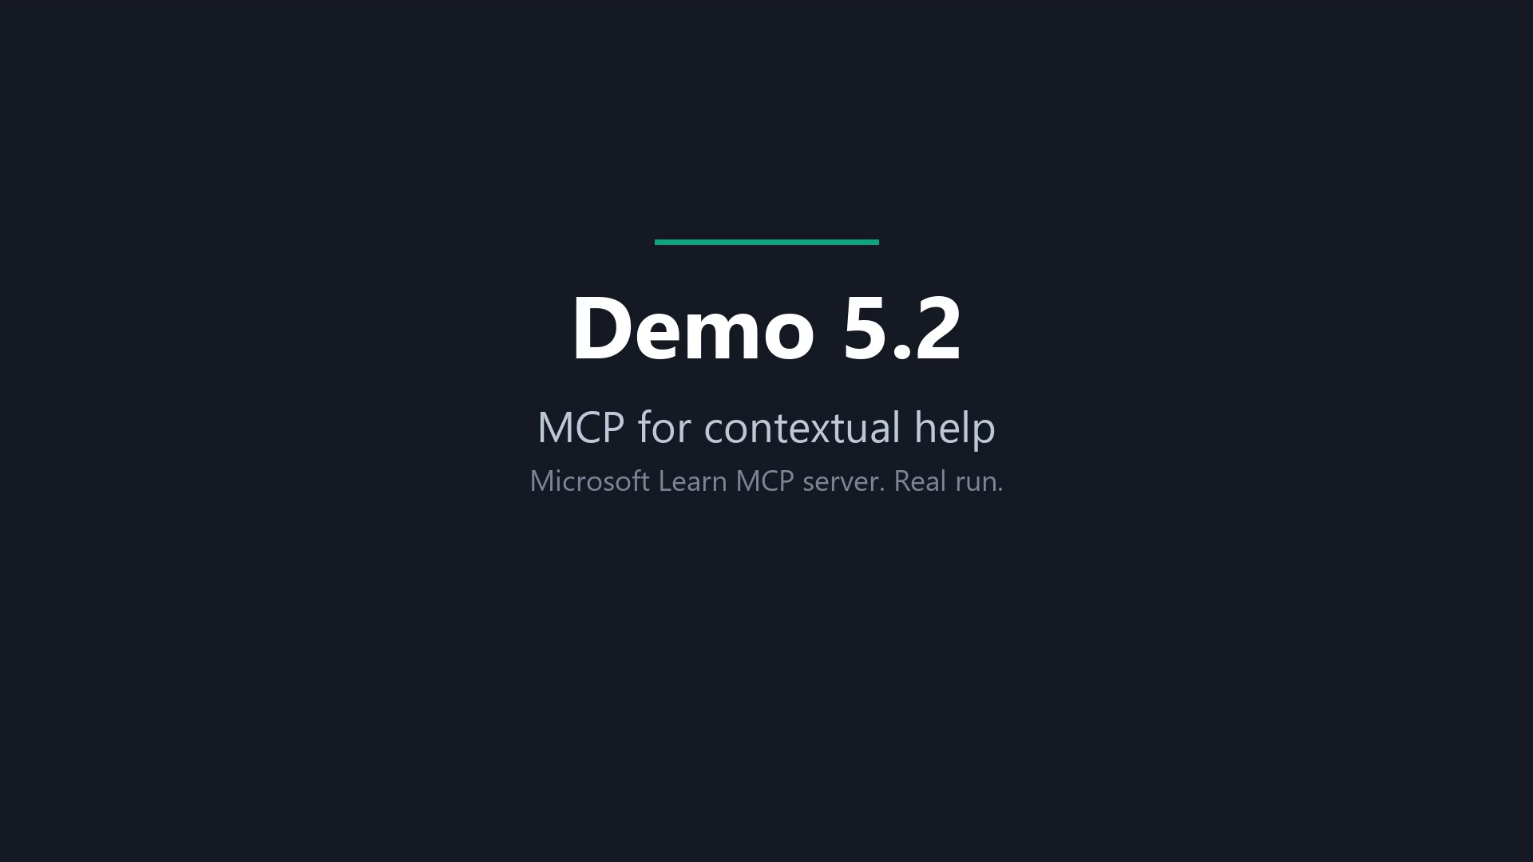
Demo: the Microsoft Learn MCP server
Notes:
Recording: one real run with only the Microsoft Learn MCP server connected. About 1.5 minutes.
The model called microsoft_docs_fetch and microsoft_docs_search, then answered with the OPENJSON WITH syntax, a CROSS APPLY example, and the “Applies to” banner showing Fabric SQL database support. It also flagged compatibility level 130. Tool results are abridged on screen; the answer is shown in full.

Slide 84
What you saw: the docs, fetched live
01
02
03
04
It called two tools on the Learn server: fetch the OPENJSON page, and search for Fabric support.
It answered with the WITH syntax and a CROSS APPLY example.
It read the Applies to list: SQL database in Microsoft Fabric is on it.
It also flagged the compatibility level 130 requirement.
Notes:
These four points are all in the model’s answer in the clip. Tool results are abridged on screen; the answer is shown in full.

Slide 85
Database MCP servers: power and risk
THE POWER
THE RISK
Connect the AI to your actual metadata: tables, columns, procs, indexes. "Write me a proc" uses your names instead of guessed ones.
Once a server touches your database: is it read-only? Which credential does it use? What's the blast radius?
Notes:
The Learn server reads public docs. Point an MCP server at your database and two things change. The model sees your tables, columns, procedures, and indexes, so the v1 problem from the makeover goes away. And now something is connected to your database with a credential. Three questions for any database MCP server: is it read-only, which login does it use, and what is the most damage it could do? One example: Microsoft's SQL MCP Server is built on Data API builder (1.7 and later). It's driven by configuration, uses role-based access, and deliberately doesn't turn natural language into SQL. Next: the model stops only reading and starts running queries against your database.
--- JONATHAN'S NOTES (v16, kept) ---
Database MCP servers - power and risk. The power: connect the AI to your real metadata; the schema-blind problem is gone. The risk: the moment a server touches your DB - read-only? which credential? what's the blast radius? That's the cliffhanger into Block 6.

Slide 86
AI-assisted performance tuning, and its guardrails
WHERE IT HELPS
VERIFY BEFORE YOU TRUST
Copilot Agent mode in SSMS 22 or VS Code pulls waits + plans
Triages unfamiliar waits
Drafts index / rewrite candidates, explains queries
Treat suggestions as conjectures, not truth
Don't paste sensitive schema / PII into public LLMs
It doesn't know your SLAs or why that 'redundant' index exists
Notes:
Where it helps: Agent mode in SSMS or VS Code pulls the waits and plans itself, explains waits you haven't seen before, and drafts index and rewrite candidates. Give it the plan, not only the SQL. Optimization, refactoring, and diagnosis all improve when the model sees the execution plan or wait stats along with the query. Where to be careful: it can't see your data distribution or statistics, so treat every suggestion as a hypothesis to test. Don't paste sensitive schema or PII into a public model; an in-tenant tool is the safer choice inside governance boundaries. And it doesn't know your SLAs or why that "redundant" index exists. Next: an agent given a slow query and full access to the database.
REHEARSAL CHECK: The left image on this slide was a placeholder in June. Swap in a real Copilot screenshot (03 or 04 from the SSMS shot list would work).
--- JONATHAN'S NOTES (v16, kept) ---
[SS2025 GA] GitHub Copilot in SSMS (listed in 'What's new in SQL Server 2025'). Reinforce thinking-partner-not-oracle. Left image is a PLACEHOLDER. swap for a real Copilot screenshot.

Slide 87

DEMO
Tuning a slow query via generative AI
Check the AI's diagnosis against the waits and the plan, then prove the fix.
Notes:
Files: `src/demo/block4/perf-triage/10_slow_query.sql` (the slow query), `20_capture_diagnostics.sql` (waits and the actual plan), `30_fixed_query.sql` (the tuned version). Both prompts and the expected findings are in the folder's README. Say this on stage before you start: Claude Code connects to the container as `sa`.
1. Run `10_slow_query.sql`. Read the business question aloud while it spins, about 58 seconds of CPU.
2. Prompt 1 (diagnose, change nothing): waits first, then the plan. It should find PAGELATCH_EX on top, then CXSYNC_PORT and CXSYNC_CONSUMER, and no PAGEIOLATCH, so not an I/O problem. The plan shows scans, two Index Spools, and DOP 8. About 362 logical reads against 58 seconds of CPU: cheap reads, expensive query. Root cause: three non-SARGable predicates.
3. Prompt 2 (fix and prove it): date range instead of YEAR(), IN instead of LIKE, OUTER APPLY with a clean HSISID predicate. About 58,000 ms down to about 290 ms of CPU, same 6,256 rows, EXCEPT both ways returns nothing.
4. It also suggests an index. Decide that with numbers. On the demo container the vector index has made FoodInspectionViolation read-only, so that index can't be added now anyway. Then say the uncomfortable part. Good work, done with the keys to everything. Next: the same kind of agent inside SSMS, and how to give it its own identity and rules. Ledger: the CPU numbers in Worked, "connected as sa" in Broke. Workflow B in the README is the fallback when the agent must not touch the database.
REHEARSAL CHECK: Fill the ledger row with the live CPU numbers. The subtitle box (TextBox 59) was the same color as the background in June. Make it visible or delete it in the generator.

Slide 88





Agents in SSMS
SSMS 22 has a Copilot Agent mode (GA in 22.10.2) that runs queries itself instead of only suggesting them.
It's read-only by default.
You can make it run as a lower-privilege user (EXECUTE AS; needs IMPERSONATE).
Rules per database: a CONSTITUTION.md or AGENTS.md stored as an extended property.
Admins can turn Agent mode off by policy and limit which MCP servers it may use.
Notes:
GitHub Copilot in SSMS is GA since 22.4.1. Agent mode arrived in preview in 22.7 and is GA in 22.10.2. Agent mode runs the queries itself, after an approval prompt. Microsoft's docs say plainly that the approval prompt is not a security boundary; SQL Server permissions are. Read-only is the default. Writes need READ_WRITE set in mcp.json. By default it runs as whoever is signed in. A CONSTITUTION.md on the database, stored as an extended property, can name an `agentExecuteAsUser`, and SSMS then wraps every Copilot query in EXECUTE AS that user. The signed-in user needs IMPERSONATE on it, or Copilot won't run queries in that database at all. Admins can disable Agent mode with the Visual Studio ADMX templates and restrict MCP servers with an allow list in GitHub's Copilot policies.
Demo: `src/demo/block4/ssms-agent/`. Setup, prompts, and the full beat list are in its README. Run `90_reset.sql` first so beat 1 starts clean. Live is about 8 minutes; screenshots (5.19a) about 2.
- Beat 1, as you: ask for the Raleigh restaurants with the most critical violations in 2025. Show the approval prompt. Watch what it does with "critical": checks the Severity values, or guesses `'Critical'` like v2 of the makeover. Then ask it to create an index. Read-only mode shouldn't run it. Everything it did run, it ran as `sa`.
- Beat 2: run `10_constitution.sql`. Show `agentExecuteAsUser: CopilotReader`, the house rules (the same facts the makeover typed by hand), and the column DENY on inspector names.
- Beat 3, new chat: same question. It should use Priority and Priority Foundation unprompted and match `20_prove_it.sql` (TACOS MI TIERRA CALIENTE, 9). Ask for inspector names: Msg 230. Ask who it's running as: CopilotReader. Finish with `90_reset.sql`. If Copilot misbehaves, run `20_prove_it.sql` to show the same checks by hand. Ledger: beat 1's handling of "critical"; beat 3's Priority values and Msg 230 in Worked. This is the answer to the perf-triage demo: same kind of agent, but now its reach is something you configured. Next: building your own guarded MCP server, then the guardrail stack.
REHEARSAL CHECK: Live or screenshots. Live needs the time from the drop-if-long list (5.3, 5.8, 5.20). The three "Verify in rehearsal" items in the demo README: how the UI shows a statement READ_ONLY won't run; whether Copilot reads metadata as you or as CopilotReader; whether a new chat picks up the constitution without restarting SSMS. Fill the beat 1 ledger row: did it check the Severity values or guess 'Critical'?

Slide 89

Demo: Agent mode in SSMS (screenshots)
Placeholder for the short version. Kevin captures these in rehearsal; check each for account names, emails, and server names before adding.
01-agent-mode.png
02-approval.png
03-critical-as-you.png
04-read-only-index.png
05-constitution.png
06-critical-as-reader.png
07-denied.png
08-running-as.png
Notes:
Walk the shots in order, about 15 seconds each. 1 and 2: Agent picked in the mode dropdown, and the approval prompt on its first query. The prompt confirms intent; it doesn't limit anything. 3: what it did with "critical" while running as us. 4: the CREATE INDEX it proposed and didn't run, because Agent mode is read-only by default. 5: the constitution, with `agentExecuteAsUser: CopilotReader` and the house rules. 6: same question, now using Priority and Priority Foundation with nobody typing them. 7: the inspector question hitting Msg 230. The rule in the constitution asks nicely; the column DENY is what stops it. 8: running as CopilotReader, signed in as the presenter.
REHEARSAL CHECK: Screenshots don't exist yet; Kevin captures them in rehearsal. Check each for a GitHub account name, email address, or server name before it goes on a slide.

Slide 90
It's 50 lines, not magic
Instantiate a server, register one resource (the schema) and one tool (run a read-only query), and wire a least-privilege connection.
const server = new McpServer({ name: "sqlserver-mcp", version: "0.1.0" });
server.resource("schema", "db://schema", async () => ({
contents: [{ text: await getInformationSchema() }]
}));
…
The tool's description is part of the prompt: good descriptions = correct use.
Start from a scaffold and fill in the pieces.
Notes:
An MCP server for your database is small. Five steps: create the server and declare what it offers; register the schema as a resource, read from INFORMATION_SCHEMA or the sys views; register a run_select tool that runs a read-only query and returns rows; connect with a parameterized, least-privilege login; add it to .mcp.json and confirm the client connects. The tool's description is part of the prompt. A clear description is how the model knows when and how to call it. Registering a tool is the easy part. Making it safe is the next slide. If the section is running long, skip this slide and go straight to the guardrail stack.
REHEARSAL CHECK: Where the server code behind this slide and the 5.22 demo lives; it isn't in this repo.
--- JONATHAN'S NOTES (v16, kept) ---
It's 50 lines, not magic. In 5.2 you watched the AI fetch its own context - here's the whole trick: instantiate a server, register one resource (the schema) and one tool (run a read-only query), wire a least-privilege connection. The tool's DESCRIPTION is part of the prompt. Scaffold-and-fill beats typing 200 lines live. (6.1 vibe-code demo: demos/6.1-RUNBOOK-live.md)
Slide text moved here: You just watched the AI fetch its own context. Here's the whole trick.

Slide 91
The guardrail stack: six layers
Read-only by default | db_datareader login. The model can't DROP what its credential can't DROP.
SELECT-only at the boundary | Parse the statement; reject anything that isn't a SELECT. Allowlist identifiers.
Caps + timeouts | Row cap and query timeout so the AI can't melt the box.
Credential hygiene | Secrets out of code and out of the prompt. Errors never leak connection strings.
Prompt injection via results | Returned data can contain instructions. Know it's a class of attack.
An external hook | A Claude Code hook fires on every tool call: a second gate that doesn't trust the server. Test that it blocks.
Notes:
Six layers, because any one of them can fail. Read-only by default: the model can't drop what its login can't drop. That's what CopilotReader was in the SSMS demo, and what the perf-triage demo skipped by connecting as `sa`. SELECT-only at the boundary: the server parses the statement and rejects anything else. Caps and timeouts: a row cap and a query timeout, so one bad query can't take the server down. Credential hygiene: secrets stay out of code and out of the prompt, and errors don't echo connection strings. Prompt injection: returned data can contain instructions. A violation comment is free text someone else typed; an agent reading it reads whatever is in it. An external hook: a Claude Code hook checks every tool call and doesn't trust the server. Test that it blocks. The next demo shows the stack refusing something.
--- JONATHAN'S NOTES (v16, kept) ---
The guardrail stack - not one check. Read-only login (the model can't DROP what its credential can't). SELECT-only parse at the boundary, allowlist identifiers. Caps + timeouts so it can't melt the box. Plus the external hook. Any one layer can fail; the stack still holds. That's demo vs production.

Slide 92
What a hook is
01
02
03
04
Before the tool
Exit codes
Outside the model
Test it
A small script your AI tool runs just before it uses a tool.
Exit code 2 blocks it. Exit code 1 only warns, and the call goes through.
The model cannot talk its way past it.
A hook only protects you if it actually fires.
Notes:
New slide, before the guarded-server demo. The guard in the demo is a PreToolUse hook: Claude Code runs it before every call to the run_select tool and passes it the tool input as JSON.
The point to land is the exit code. Exit 2 blocks the call. Exit 1 shows a warning and lets the call through, which is the classic way a hook exists but protects nothing.
Next: the demo shows three layers around one tool: this hook, the server check, and the database permissions.

Slide 93
Demo: it works AND it refuses
IT WORKS
IT REFUSES
01
01
Natural-language question
Ask for something destructive
02
02
AI calls run_select against the real DB
External hook blocks it first
03
03
Real rows come back
SELECT-only guard would've caught it too
Notes:
Two halves, same server. It works: ask a question in plain English. The AI calls run_select against the database, and rows come back. It refuses: ask for something destructive. The external hook blocks it before it reaches the server, and the SELECT-only check would have caught it too. Spend as long on the refusal as on the success. A guardrail you've only seen in a diagram is a claim; one the room watched block a request is evidence. Ledger: Worked, the guarded server refused the destructive request.
REHEARSAL CHECK: This demo has no folder in the repo. Confirm where the server and hook live, which client runs it, and the exact destructive request you'll type.
--- JONATHAN'S NOTES (v16, kept) ---
DEMO (6.2). It works: natural-language question → AI calls run_select against the real DB → real rows. It refuses: ask for something destructive → the external hook blocks it first (the SELECT-only guard would've caught it too). Show the REFUSAL, not just the success - that's the credibility moment. Runbook: demos/6.2-RUNBOOK-live.md

Slide 94
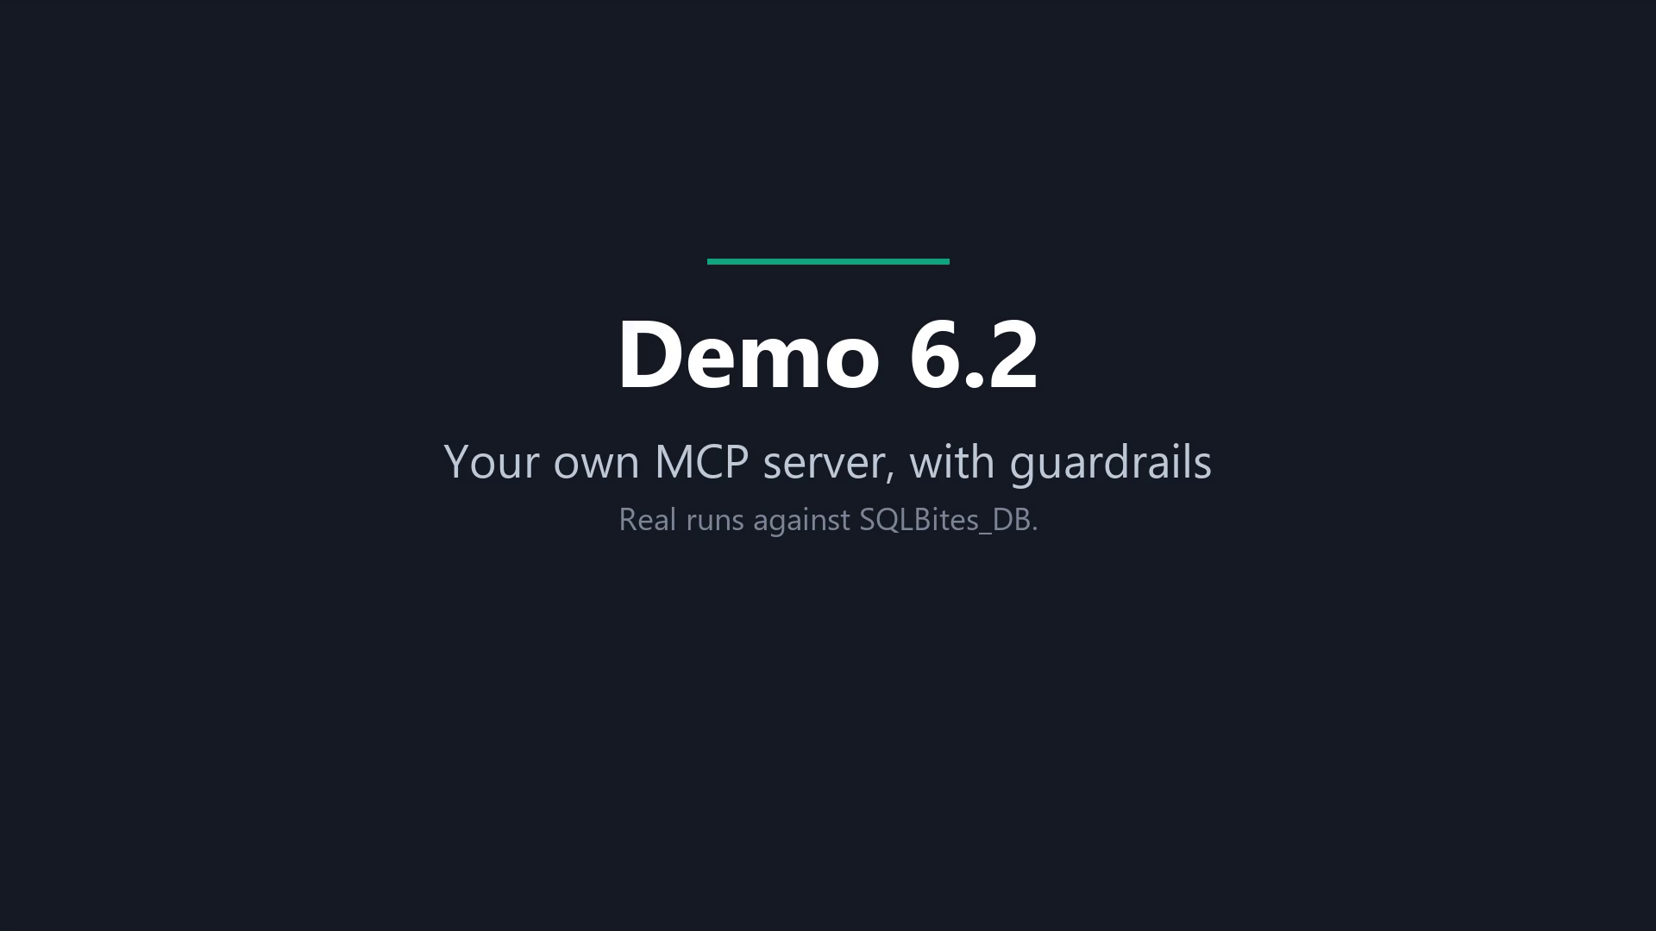
Demo: the guarded MCP server
Notes:
Recording: the guarded MCP server, run for real. About 5 minutes. The model talks to the real sqlbitesdb MCP server, which connects to SQLBites_DB as a read-only reader account.
Beat 1, a real question: it discovered the schema, then answered the top-5 accounts question. Top row Vital Orbit Consulting, SMB, $345,789.65 (430 orders).
Beat 2, layer 1 (the external hook): with the hook on, the model declined to send the destructive query at all on all three attempts, including when told it was a protected test. That is the “well-behaved model” point. So the clip then runs the hook by hand: the destructive call exits 2 with BLOCKED by external hook, and an ordinary SELECT exits 0.
Beat 3, layer 2 (hook off): the model did send SELECT 1; DROP TABLE OrderLine to run_select, and the server answered Only a single statement is allowed (no ; stacking).
Beat 4, layer 3: connected directly as the reader, an UPDATE on OrderHeader is denied by the database, and the row counts are unchanged.

Slide 95
What you saw: three layers around one tool
A real question: it ranked the top 5 accounts. First: Vital Orbit Consulting, SMB, $345,789.65.
1
2
3
The hook
The server
The database
The model refused the destructive query on its own. Run by hand, the hook exits 2 on the DROP and 0 on a plain SELECT.
With the hook off, the model sent it, and the server answered: Only a single statement is allowed.
The reader account’s UPDATE was denied. The table still has 4,000 orders.
Notes:
Say the honest part about layer 1: with the hook on, the model never sent the destructive query (three attempts), so the clip shows the hook by hand to prove the exit codes. The model refusing is not the point; the point is that the hook, the server and the database each stop it independently.

Slide 96

The most dangerous guardrail is the one nobody tests
One of my ~90 checks had been silently dead for weeks. Test that your 'no' actually fires.
Notes:
I run about 90 checks across my AI tooling. While preparing this talk I found one whose blocking rule had stopped working weeks earlier. Nothing told me. It still looked like a guardrail, and it protected nothing. That's the point right after a demo where a guardrail worked: guardrails fail too, quietly. The refusal you just saw only counts because we tested it. Put "does the block still fire?" on a schedule, the same way you test restores. This one doesn't go on the ledger. It happened before today, not on screen.
REHEARSAL CHECK: Jonathan: confirm the story details as you'll tell them (what the check was, how you found it). The deck has no more than what's on the slide.
--- JONATHAN'S NOTES (v16, kept) ---
THE war story. I run ~90 governance checks across my AI tooling. Prepping this talk I found one whose blocking rule had been silently dead for weeks - looked like a guardrail, protected nothing. The most dangerous guardrail is the one everyone believes works. Sets up the video.
Slide text moved here: I run about 90 governance checks across my AI tooling. Preparing this talk, I found one whose blocking rule had been silently dead for weeks. It looked like a guardrail and protected nothing. Test that your 'no' actually fires.

Slide 97

Model + context + guardrail + where users already are
Test that the guardrail actually fires, and watch the blast radius.
Notes:
Every useful agent setup has the same four parts: a model, your context, a guardrail, and a place your users already work. The SSMS demo had all four. Perf triage had three; the guardrail was missing, which is why it ran as `sa`. My two cautions: test that the guardrail fires, because I've had one that didn't. And know the blast radius: what's the worst this login, this tool, this agent can do if it's wrong? A guardrail is code, and it needs the same testing as the code it protects. Next: what this section added to the ledger.
--- JONATHAN'S NOTES (v16, kept) ---
The reusable recipe: a model + YOUR context + a guardrail + a place users already are. Once you see it, you can invent the fifth tool yourself. This is how I run ~90 hooks. Two hard-won cautions: test that the guardrail actually fires, and watch the blast radius.
Slide text moved here: A model, your context, a guardrail, and a place users already are. The SSMS demo followed that recipe: Copilot, a constitution, a low-privilege user, inside the tool DBAs already use. Two cautions I learned the hard way: test that the guardrail actually fires, and watch the blast radius.

Slide 98
The ledger
WORKED
BROKE
With the schema, the Severity values, and the constraints, the same model wrote a correct query. (Prompt makeover, v4)
With the Learn MCP server, the model looked up and cited the documentation instead of guessing.
The agent found the slow query’s root cause and cut it from about 28,800 ms to about 186 ms of CPU, with the same 6,256 rows.
[fill] SSMS, as you: whether Agent mode checked the Severity values or guessed 'Critical'.
With the constitution in place, it used Priority and Priority Foundation with nobody typing them.
Asked for inspector names, it hit a permission error from SQL Server (Msg 230), not a polite refusal.
The guarded MCP server refused the destructive request.
Given the tables but not the Severity values, the model guessed Severity = 'Critical', a value that doesn't exist. 0 rows. (Prompt makeover, v2)
A naive join turned 5 violations into 165. (Prompt makeover, v3)
The AI’s draft summed the header total across the join: $6,759,456 against a true $1,529,293.53, 4.4 times too high. 1,944 orders became 6,805 rows.
It did that connected as sa.
Rows from sections 1 to 4 carry over; the full list is on the ledger in full.
Notes:
Read the new rows quickly; the room saw every one of them. Point out the pattern. The "Broke" rows are mostly the model working from too little context or with too much access. The "Worked" rows mostly came after someone supplied the context or set the limits: the Severity values, the constitution, the low-privilege user, the SELECT-only server. The guardrail story from 5.23 isn't here because it didn't happen today. Next section: what to tell leadership, using this ledger as the evidence.
REHEARSAL CHECK: Fill the three [fill] rows in rehearsal (grain bug, SSMS beat 1, perf-triage CPU numbers).

Slide 99
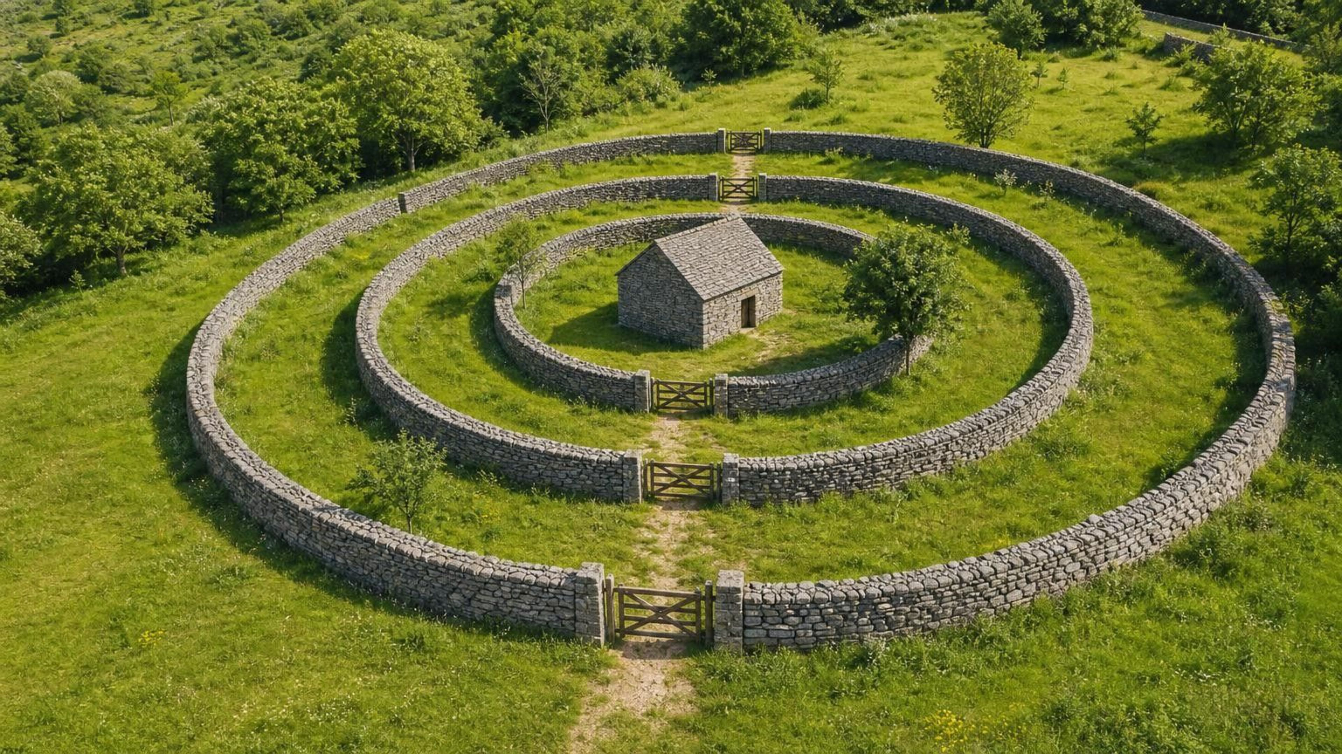
Chapter 6
Governing agents
Three walls between an agent and your data
Notes:
New section, added for Portland. Section 5 showed what agents can do. This section is about what stops them from doing damage, and what you do afterward. The answer is three walls: a gate that blocks a dangerous command before it runs, an account that isn’t allowed to run it, and a way to get the data back.
The material comes from Jonathan’s MiTechCon session, “Your AI Agent Just Ran DELETE Without WHERE. Now What?”, delivered 29 Oct 2026. About 25 minutes with all clips; every clip can be skipped without breaking the thread.

Slide 100
An agent had access, so it used it
An agent is an AI that runs commands for you instead of only suggesting them. In early 2026, a Terraform auto-approve command run through an AI agent wiped out a team’s production infrastructure.
Nothing stopped it. Nothing limited it. Nothing could undo it.
01
02
03
A gate
A limit
A way back
Stops the command before it runs.
An account that isn't allowed to run it.
Getting the data back.
Notes:
Start with the story, then define the word: an agent is the thing that executes, not just suggests. Everything in section 5 that ran a query was an agent.
Source for the incident: the engineer’s own write-up on aishippingblog.com, dated 6 Mar 2026, attributed to Alexey Grigorev. It was checked through a summarizer on 27 Oct, not read verbatim. The title card on the terraform destroy clip says February 2026 and the write-up is dated March, so the slide says “early 2026”. Confirm the date before you say a month. The title card on the terraform destroy clip says February 2026; the write-up is dated March, so the slide says “early 2026”. Confirm the date before you say a month. It says a Terraform auto-approve command wiped out all production infrastructure, but not whether the destroy had a confirmation prompt. It also says Claude advised keeping the two projects separate and the engineer went ahead. Be ready for that question.
The close of the slide is the outline of the section: nothing stopped it (wall 1, the gate), nothing limited it (wall 2, the account), nothing could undo it (wall 3, recovery).

Slide 101
Wall 1: a gate that blocks the command
PLAIN WORDS
A hook is a small script the agent tool runs before each command. If the script exits with code 2, the command is blocked.

Slide 102
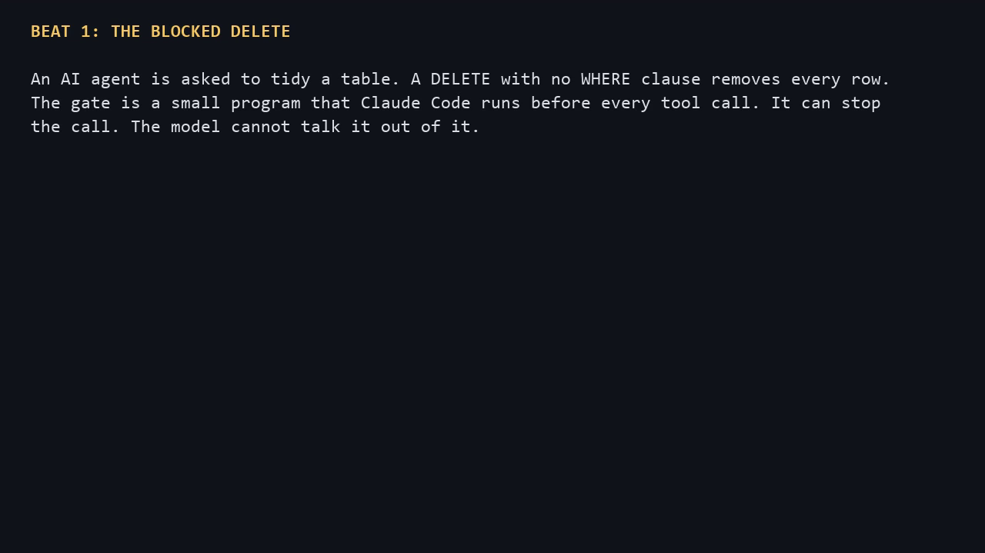
Wall 1: a gate that blocks the command
Notes:
Clip, 29 seconds. The agent in the clip is scripted; the gate is the real one (destructive-gate.js, a PreToolUse hook). Say that on stage. What to point at: the hook sees the command before it runs, and exit code 2 is what blocks it. Unparseable input fails closed, so a hook that can’t read the call blocks it. The gate added about 50 ms on average per call in the 27 Oct measurements (averages 45.0, 62.2 and 47.1 ms across three runs, with other work running). Re-measure on the stage laptop if you quote it.

Slide 103
Wall 1: a gate that blocks the command
WHAT YOU SAW
The agent tried a DELETE with no WHERE clause. The gate blocked it before it reached the database.
Scripted agent, real gate.

Slide 104
Wall 1: it covers more than SQL
PLAIN WORDS
terraform destroy deletes everything a Terraform project built.

Slide 105
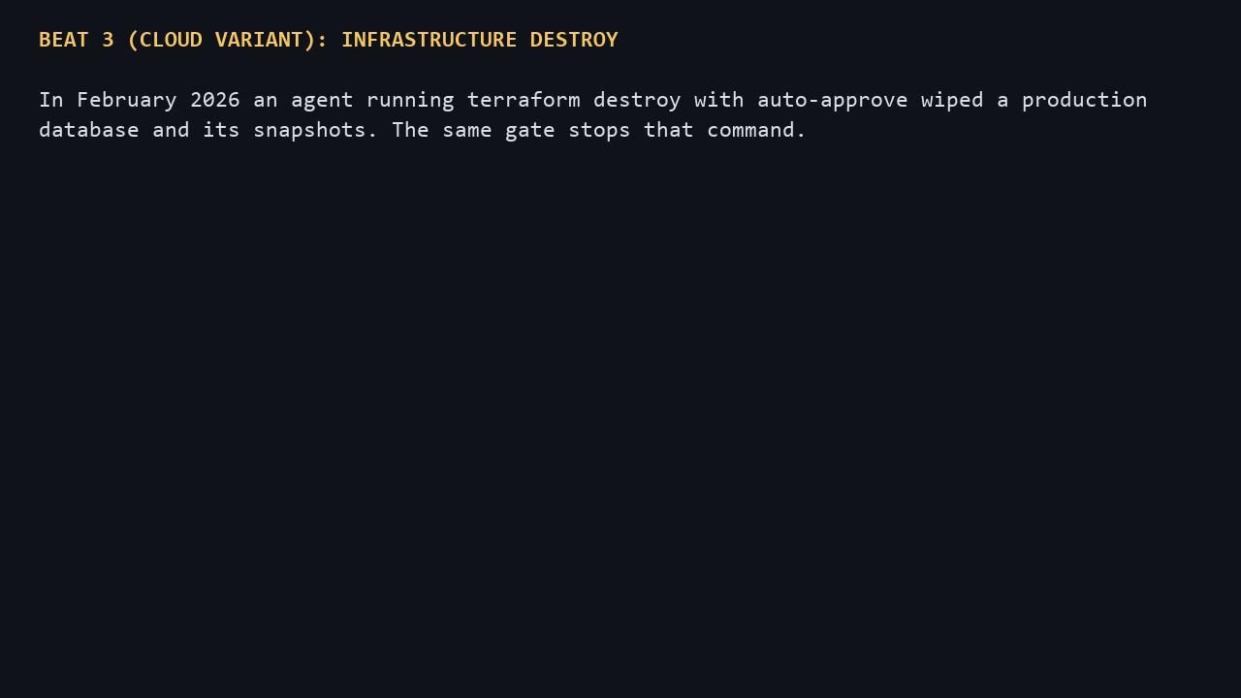
Wall 1: it covers more than SQL
Notes:
Clip, 24 seconds. Callback to the opening story: this is the command that wiped out the team’s infrastructure. Scripted agent, real gate. The eight categories: unqualified DELETE, TRUNCATE, DROP, terraform or tofu destroy, git push --force, recursive forced removal, credential and secrets files, and Fabric or OneLake destructive tools. The hidden clips after the thank-you slide show all eight and the OneLake case.

Slide 106
Wall 1: it covers more than SQL
WHAT YOU SAW
The same gate blocked terraform destroy. It checks eight kinds of destructive command, not only SQL.
Scripted agent, real gate.

Slide 107
A tripwire, not a vault
The gate matches the exact words of a command. A command it can’t read passes.
It can miss: SQL built from pieces (‘DEL’ + ‘ETE’), a DELETE inside a stored procedure, a script run with sqlcmd -i, a raw REST call, code that opens its own connection, UPDATE without WHERE.
On its 83 scored test cases it blocked nothing it shouldn’t and missed nothing it models. The gaps are listed separately.
The gate makes misuse visible. The account has to make it impossible.
Notes:
Be honest about the limits; the room will trust the rest more. The gate is fast and deterministic, and it matches exact words. Anything that hides the words from it passes. The gaps come straight from the repo’s threat model (docs/threat-model.md). It lists eight rows: string-built dynamic SQL, DELETE inside a stored procedure, sqlcmd -i file.sql, raw REST DELETE, code that opens its own connection, MERGE ... THEN DELETE, UPDATE without WHERE, and anything outside Claude Code. The run sheet says seven documented gaps; the table has eight rows because the last one is a scope limit, not a test case. Say “documented gaps” and don’t quote a number unless you’ve recounted. The test suite: 83 scored cases, 0 false positives, 0 false negatives, run 27 Oct. That is the corpus the gate models; it says nothing about the gaps. Each gap has a different thing that actually stops it, and in almost every row it is database permissions. That is wall 2.

Slide 108
Wall 2: the account says no
PLAIN WORDS
Least privilege means the agent’s account is only allowed what its job needs.

Slide 109

Wall 2: the account says no
Notes:
Clip, 37 seconds. Fabric warehouse DeleteGateDemo, table dbo.ReportingFact. The first half is a screen capture of the admin running DENY DELETE. The second half is a rendering of the real output from a Python session signed in as the service principal agent-svc-demo; it is not a screen capture. Say so. The real result was Msg 373: “The DELETE permission or external policy action ‘.../Tables/Rows/Delete’ was denied on the object ‘ReportingFact’.” The count afterward was 7,006. (An earlier draft guessed error 229; that was wrong.) The account had been granted SELECT, INSERT, UPDATE and DELETE first, then DENY DELETE. INSERT and UPDATE were granted but not tested. Tie back to Kevin’s SSMS demo: CopilotReader and the column DENY (Msg 230) are the same idea. A permission stops the agent. A polite rule in a prompt does not.

Slide 110
Wall 2: the account says no
WHAT YOU SAW
An admin ran DENY DELETE on the table. The agent’s account tried to delete and SQL answered Msg 373. The table still had 7,006 rows.
Second half: a rendering of the real output, not a screen capture.

Slide 111
Wall 3: getting the data back
PLAIN WORDS
Time travel means querying a table as it was at an earlier moment. A clone is a new table made from the old one at that moment.

Slide 112
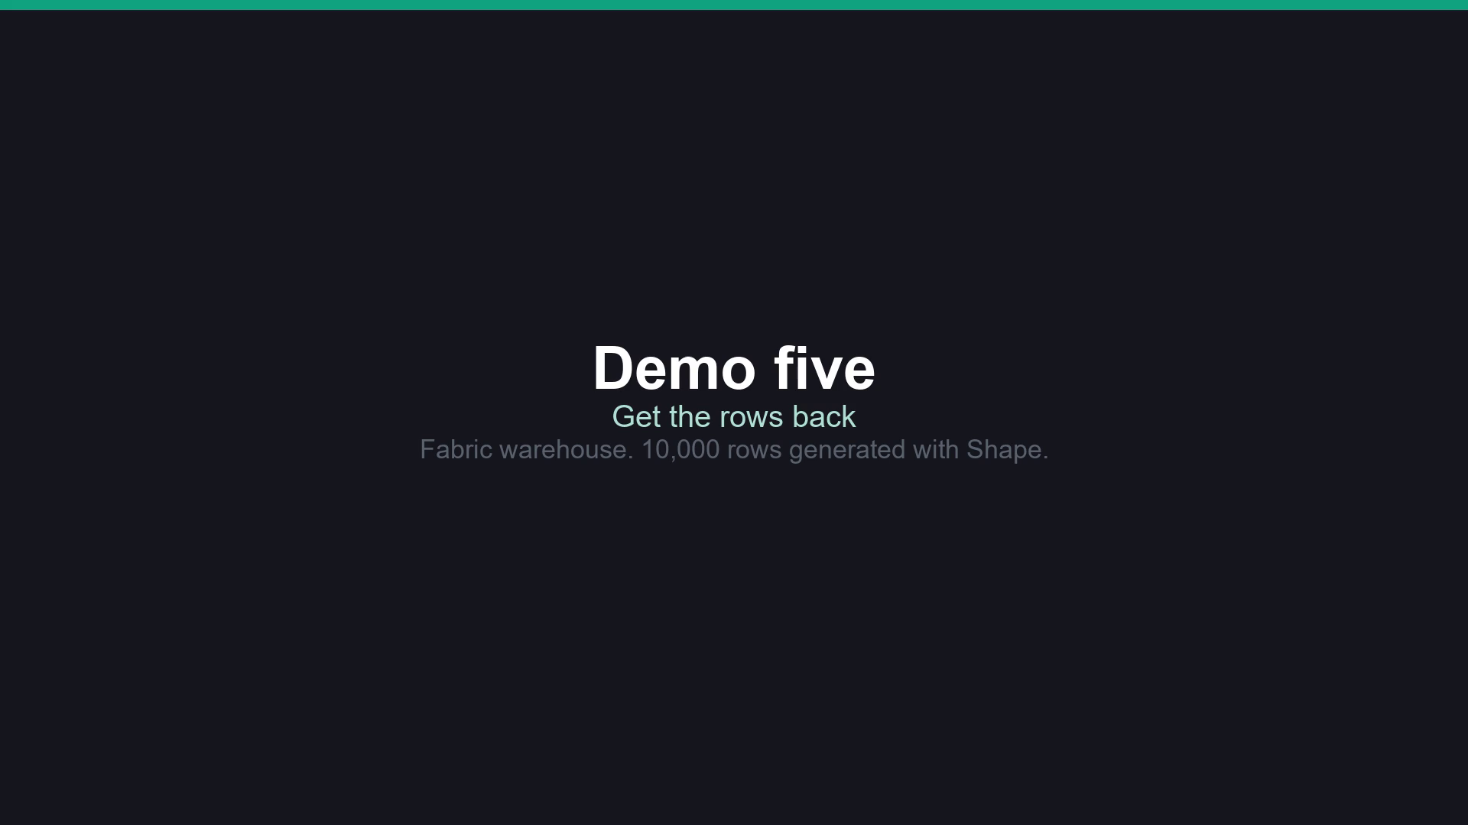
Wall 3: getting the data back
Notes:
Clip, 71 seconds. A screen capture of the Fabric SQL editor from 27 Oct. 10,000 rows, a DELETE of Region = ‘East’ removed 2,994 and left 7,006, time travel as of 2026-10-27T16:31:53 UTC returned 10,000, and CREATE TABLE AS CLONE OF at that time counted 10,000. The original table is not refilled in the clip. Retention: the Fabric pages say 30 days by default (1 to 120); the CREATE TABLE AS CLONE OF reference page still says seven. Check your own warehouse with SELECT time_travel_retention_period_days FROM sys.databases before quoting a number. The Fabric data-retention page is marked preview. Other platforms: restore points, snapshots and point-in-time restore exist elsewhere, with different defaults by edition. Slide 25 of the MiTechCon deck covers AWS, Snowflake and Databricks (read through a summarizer, not verbatim); use it only if someone asks.

Slide 113
Wall 3: getting the data back
WHAT YOU SAW
A scoped DELETE removed 2,994 of 10,000 rows (Region = ‘East’). Queried as of a time before the delete, the table returned 10,000. A clone at that time counted 10,000.
Screen capture, Fabric SQL editor.

Slide 114





Controls to ask your platform team for
Read-only by default: SSMS Agent mode only writes when READ_WRITE is set in mcp.json.
Run it as a low-privilege user: agentExecuteAsUser makes SSMS wrap every query in EXECUTE AS, and the signed-in user needs IMPERSONATE.
Rules per database: a CONSTITUTION.md or AGENTS.md stored as an extended property.
Admins can turn Agent mode off by policy and limit which MCP servers it may use.
A SQL MCP server built on Data API builder is role-based and has no natural-language-to-SQL by design.
Notes:
This slide is the take-home list for the platform team. Every item is a switch someone has to set; none of it is on by accident. The first four come from Kevin’s SSMS material (see the Agents in SSMS slide in section 5): Copilot Agent mode is GA in SSMS 22.10.2, read-only by default, agentExecuteAsUser needs IMPERSONATE, CONSTITUTION.md and AGENTS.md live in extended properties, and admins can disable Agent mode with the Visual Studio ADMX templates and restrict MCP servers with an allow list in GitHub’s Copilot policies. The last item is from Kevin’s verified-facts list: the Microsoft SQL MCP Server is Data API builder 1.7+ or 2.0, config-driven, role-based access, and intentionally has no natural-language-to-SQL. REHEARSAL CHECK: the SSMS 22.10.2 release notes say “Query execution permissions are now determined by the connected SQL account’s permissions.” Not yet checked against the agentExecuteAsUser story. Confirm before presenting this slide and the SSMS demo.

Slide 115
The ledger
WORKED
BROKE
The gate blocked a DELETE with no WHERE before it ran.
The gate blocked terraform destroy.
After DENY DELETE, the agent’s account got Msg 373 and the table kept its 7,006 rows.
Queried as of a time before the delete, the table returned all 10,000 rows, and a clone at that time counted 10,000.
Until the DENY, the agent’s account could delete rows; it had been granted DELETE.
A scoped DELETE removed 2,994 of 10,000 rows, and the table stayed short until we recovered them.
Section 6 rows. The clips use a scripted agent with the real gate; say so when you read them.
Notes:
New rows from the three walls. Read the Worked rows briefly, then the Broke rows. Every Broke row has the same cause: the agent had more reach than it needed, and nothing was in place to undo the damage. Everything here was on screen in the clips; none of it is an industry statistic. The first two Worked rows come from clips with a scripted agent and the real gate. The Msg 373 row second half is a rendering of real output. Say that if asked.

Slide 116
Governance checklist
Gate dangerous commands before they run, and remember the gate can miss.
01
Give every agent its own account with only the permissions its job needs.
02
Decide how you will get data back before you need to: retention window, restore points, clones.
03
Turn on the platform controls: read-only default, run-as user, per-database rules, policy to disable.
04
Test each wall. A guardrail nobody has tested is a guess.
05
Next: how to take all of this to your boss.
Notes:
Five things to take back. Each maps to a slide in this section: the gate, the account, the way back, the platform controls, and testing. This is also the bridge into the next section: when leadership asks what stops an agent from doing damage, this checklist is the answer, and the ledger is the evidence that it works. The last item echoes “the most dangerous guardrail is the one nobody tests” from section 5.

Slide 117
CHAPTER SEVEN
07
TALKING TO LEADERSHIP
Notes:
"06" and "CHAPTER SIX" stay; they match the new order. This is the last section, and it's the one people will use on Monday. All day the ledger has collected what worked and what broke on screen. Now it becomes evidence for the conversation with your boss, including the question every boss is asking: can agents replace the data team? We answer it with the ledger, not with our opinions. Then we build the pitch for a pilot.

Slide 118
The ledger, in full (1 of 4)
WORKED
BROKE
SECTION 1: HOW THESE MODELS WORK
SECTION 1: HOW THESE MODELS WORK
At temperature 0, the same prompt gave the same answer.
At high temperature, the same prompt gave different answers each run.
SECTIONS 2 AND 3: VECTORS
SECTIONS 2 AND 3: VECTORS
Violation comments about the same problem clustered together with no keywords in common.
"rodent or pest activity in the kitchen" found roach, fly, and mouse comments that share none of those words with the question.
An empty string doesn't come back as NULL. It fails the statement (Msg 31744), and in a batch UPDATE that one row fails the whole batch.
Once indexed, the table went read-only. Adding rows means drop the index, embed, rebuild.
For the pest question, the index's top 10 matched the exact top 10 on 8 of 10 rows. Across 25 sample rows, recall was 0.97, and the worst single query was 0.70.
Notes:
Everything here happened on screen today. No industry statistics, no hypotheticals. Don't read every row; the room saw them. Point at three rows people will remember: the model guessing 'Critical', 5 rows becoming 165, and the agent doing good work while connected as `sa`. Then ask the room what pattern they see in the right-hand column. Hold the answer for the next slide. Before the session, resolve every **[fill]** row and drop any row whose demo didn't run today: if a row didn't happen in front of this room, it doesn't belong here. REHEARSAL CHECK: Resolve all **[fill]** rows in rehearsal. The section 3 recall numbers were measured 2026-11-01 on 2,000 embedded comments; rerun `50_recall_check.sql` if the embedded set changes.

Slide 119
The ledger, in full (2 of 4)
WORKED
BROKE
SECTION 4: RAG
SECTION 4: RAG
Every one of 6 test questions found its runbook at rank 1. [fill] with the Foundry run.
Asked about something no runbook covers, the model said it didn't know instead of making something up. [fill] from the live run.
For a question no runbook covers, retrieval still handed the model four chunks. Retrieval always returns its top k.
The out-of-scope question's best match was nearly as close as a real answer's (0.595 vs 0.540), so distance alone can't tell "no answer" from "weak answer". [fill] with Foundry's numbers, or drop.
Notes:
See the previous slide’s notes.

Slide 120
The ledger, in full (3 of 4)
WORKED
BROKE
SECTION 5: AGENTS
SECTION 5: AGENTS
With the schema, real values, and constraints, the same model wrote a correct query.
With the Learn MCP server, the model looked up and cited the real doc instead of guessing.
Given the tables but not the real values, the model guessed Severity = 'Critical', a value that doesn't exist; the query returned 0 rows.
A naive join turned 5 rows into 165.
The AI’s draft summed the header total across the join: $6,759,456 against a true $1,529,293.53, 4.4 times too high. 1,944 orders became 6,805 rows.
Notes:
See the previous slide’s notes.

Slide 121
The ledger, in full (4 of 4)
WORKED
BROKE
SECTION 5: AGENTS
SECTION 5: AGENTS
The agent found the slow query’s root cause and cut it from about 28,800 ms to about 186 ms of CPU, with the same 6,256 rows.
[fill] SSMS Agent mode, first run: Worked if it checked the real Severity values, Broke if it guessed 'Critical'.
With the constitution in place, it used Priority and Priority Foundation with nobody typing them.
Asked for inspector names, it hit a permission error from SQL Server (Msg 230), not a polite refusal.
The guarded MCP server refused the destructive request.
It did that connected as sa.
Notes:
See the previous slide’s notes.

Slide 122
Can agents replace the data team?
WHAT THE AGENTS DID WELL TODAY
WHAT NEEDED A PERSON
drafting queries
finding similar text
looking up docs
a first diagnosis of a slow query
knowing 'Critical' isn't a real value
spotting 5 rows becoming 165
deciding whether 0.97 recall is good enough
noticing the agent ran as sa
owning the result when it's wrong
Notes:
The answer comes from the ledger, not from us. Give the left column its due: the agents changed how fast the work went, and pretending otherwise costs you credibility with the people in 7.3. Then look at the Broke rows. Nearly every one needed someone who knew the data or the system to notice it, and none of the agents flagged its own mistake. Ask the room which column their job is in. That's the answer to take back to a boss who asks about replacing the team: the work gets faster, and someone still has to know when it's wrong.

Slide 123
The four people you're selling to
01
02
The True Believer
The Terrified
Saw a demo, wants AI on the roadmap yesterday. Danger: budget without direction.
Convinced it'll leak PII or DROP a table. These people often work in security and can become your best ally.
03
04
The Burned
Already Using It
Lived through big data and blockchain. Their skepticism is earned.
Pasting prod schemas into ChatGPT right now. Say no and you just stop knowing about it.
Notes:
You don't need to win an argument with any of these people. Give each one what they need to say yes, and today gave you most of it. The True Believer gets a bounded pilot with a measurement plan, so the budget has a direction. The Terrified get the guardrails from section 5: read-only by default, a lower-privilege login, a guarded MCP server. Bring them in early; security people make good allies. The Burned get the ledger, Broke column included, which is evidence rather than a pitch. The people already using it get a sanctioned path, because a flat "no" just means you stop hearing about it. --- JONATHAN'S NOTES (v16, kept) --- Block 1 close (1.5). Walk the 4 buyer types fast: True Believer, Terrified, Burned, Skeptic. Don't defeat them - give each the one thing they need to say yes. The Terrified (often security) becomes your best ally.

Slide 124
The two ways AI initiatives die
OVER-PROMISE
OVER-FEAR
"It'll write all our T-SQL."
First wrong answer in prod kills the project
You own the blame
"We can't use it. Data-leak risk."
Competitors ship faster
Your team uses it in the shadows anyway
vs.
Notes:
Over-promise first. "It'll write all our T-SQL" didn't survive today: the model guessed a value that doesn't exist until it had the schema, the real values, and the constraints. If you promise more than the ledger shows, the first wrong answer in production ends the project and you own it. Over-fear fails more quietly: the team uses public tools anyway, and you lose both the speed and the visibility. The way between them is to promise only what you can measure, which is what the pilot pitch on the next slide is built around. --- JONATHAN'S NOTES (v16, kept) --- Two ways AI initiatives die. Over-promise: 'it'll write all our T-SQL' → first wrong answer in prod kills it, you own the blame. Over-fear: 'too risky' → team uses it in the shadows anyway. Sell leverage, not magic.

Slide 125
The pilot pitch
The painful problem, in their units: hours, tickets, risk.
1
A small pilot: one table or one set of documents, one set of test questions.
2
How you'll measure it: recall and retrieval hits (you saw both today), plus the time it saves, measured in the pilot.
3
The risks and your guardrails, stated first.
4
The ask: time, budget, or access, and when you'll report back.
5
Notes:
This replaces two older slides that said much the same thing. Point 1: name the pain in the boss's units, for example a three-hour ticket that takes 45 minutes with review. Point 2: pick something boring and bounded, low-stakes and frequent, with a fixed timebox such as 30 days. Point 3 is the part most pitches leave out, and you already have the measurement plan: recall against exact search from section 3, retrieval hits from the section 4 test questions. Point 4: lead with the risks, before anyone asks, and name the guardrails from section 5. Point 5: ask for the next small step, never a platform. Time saved wasn't measured on stage today (the perf-triage numbers are query CPU time, not staff time), which is why the slide puts it in the pilot.

Slide 126
“
Bring the hard questions into the room early
The boss trusts the most credible person in the room, and that's rarely the most excited one. Be the person who has already thought about what could go wrong, and say it before anyone asks.
Notes:
The hard questions are coming either way: what happens when it's wrong, what data leaves the building, who reviews the output. Raise them yourself and you set the terms. You have answers from today. When it's wrong: the 'Critical' guess, and the test questions that would catch it. What it can reach: the agent ran as `sa`, and section 5 showed how to run it as a lower-privilege user instead. How good is good enough: 0.97 recall is a number someone has to accept on purpose. Drop this slide if the section runs long. --- JONATHAN'S NOTES (v16, kept) --- 1.5 handoff. You win by being the most CREDIBLE person in the room, not the most excited - the one who already thought about what breaks. That is exactly the bridge into Security (Block 2).

Slide 127
Your AI adoption roadmap
PHASE 1
PHASE 2
PHASE 3
PHASE I · 01 — This Week
PHASE II · 02 — This Quarter
PHASE III · 03 — The Horizon
Use an assistant for one boring task. Stand up the Learn MCP server. Run AI code review by hand. Build evidence.
Propose an AI use policy. Build your first DB MCP server with guardrails. Run one measured pilot: one table or one set of docs.
Vector search and AI-assisted operations become routine. Your role shifts toward governing what the AI can see and do.
Notes:
Phase I is things you can do this week without asking anyone. The Learn MCP server needs no credentials and sends none of your data. Phase II needs a sign-off: the AI use policy from section 5, a database MCP server with the guardrails you saw, and one measured pilot built the way 7.5 describes. Phase III is a direction; present it as one, without dates. The thread through all three: every phase should leave you with evidence, the same kind as the ledger, for the next conversation with leadership. --- JONATHAN'S NOTES (v16, kept) --- Roadmap - walk the 3 horizons. This Week: use an assistant for one boring task, stand up the Learn MCP server, run AI code review by hand - build evidence. This Quarter: propose the AUP, build your first DB MCP server with guardrails, pilot one DIY tool. The Horizon. Then play the animated version (next slide).

Slide 128
“
Do one thing Monday. Have a result to show.
Do one thing Monday, the smallest useful thing from today, and have a result to show. Pick your one thing before you leave the room.
Notes:
Ask everyone to pick one thing now, before the questions. Give them options from today: compare exact and indexed search on one table and measure recall; write ten test questions for your own runbooks; set up the Learn MCP server; draft the AI use policy; set SSMS Agent mode to run as a lower-privilege user. Keep it small enough to finish. Whatever result you get is your first ledger row. --- JONATHAN'S NOTES (v16, kept) --- Final CTA. Do ONE thing Monday - the smallest useful thing from today - and have a result to show. That's how this goes from a conference you attended to a capability your team has. Pick your one thing before you leave the room.

Slide 129
Questions? Let's talk.
Q.01
Q.02
Q.03
Your security stance
Running a vector or RAG pilot
Prompting for your workload
Q.04
Q.05
Standing up an MCP server
Where to start Monday
Notes:
Both of us take questions. The five prompts on the slide are starters if the room is quiet; "where to start Monday" usually gets things going. Repeat each question before answering so the whole room hears it. If a question needs a demo rerun or a long answer, offer to take it at the break or after the session. Questions about a specific shop's data or policy are better answered one on one.

Slide 130
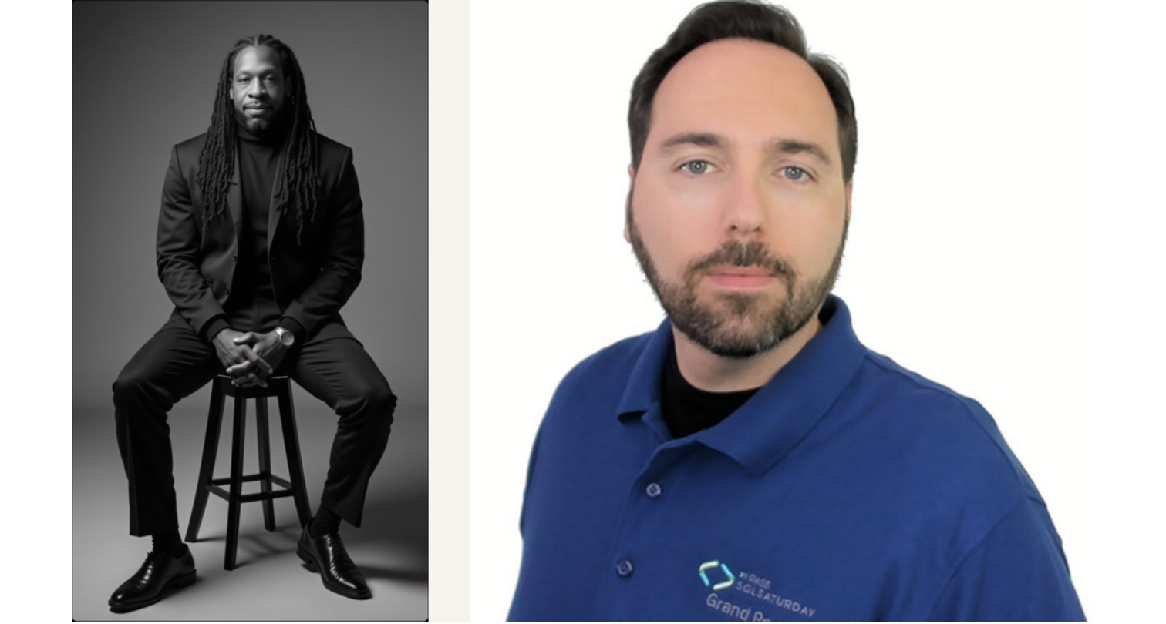

Thank You.
Jonathan Stewart · Kevin Feasel
Jonathan Stewart — sqlbites.net | Kevin Feasel — Catallaxy Services · curatedsql.com
Slides and demo code: github.com/feaselkl/AI-at-the-Gates
Notes:
Thank the room for the whole day, and thank the Day of Data Portland organizers and volunteers. Our contact details are on the slide; invite people to reach out with what they try on Monday, including what breaks. Remind them the demo scripts are in the repo with a README per demo.

