Slide 1
SCENIC CITY SUMMIT 2026
AI at the
Gates
Full-Day Precon · The DBA's Guide to Surviving in an LLM World
JONATHAN STEWART + KEVIN FEASEL · SCENIC CITY SUMMIT 2026

Slide 2


AI AT THE GATES: THE DBA'S GUIDE TO SURVIVING IN AN LLM WORLD
SLIDE 02
About Me.
Principal Analytics Consultant · Sound BI
I help data teams adopt AI without getting burned — and I build the tooling I'm about to show you.
01
Creator/Founder: SQLBites Community
Building the next generation of data practitioners.
02
Migrating Enterprises to Fabric
Real production migrations across healthcare, finance, retail, and manufacturing.
03
Hundreds of Technical Talks Globally
International speaker on data architecture and analytics engineering.

Slide 3


AI AT THE GATES: THE DBA'S GUIDE TO SURVIVING IN AN LLM WORLD
SLIDE 03
The Actual Presenter.
Kevin Feasel · Microsoft MVP · Catallaxy Services
Kevin specializes in T-SQL and Python development, machine learning, and pulling rabbits out of hats on demand.
Curated SQL + TriPASS
01
Lead contributor to Curated SQL; president of the Triangle Area SQL Server Users Group.
Author
02
PolyBase Revealed (Apress, 2020) and Finding Ghosts in Your Data (Apress, 2022).
Raleigh, NC
03
Found cycling the triangle trails whenever the weather's nice enough.
Notes:
Kevin Feasel is the proprietor of Catallaxy Services, LLC. Lead contributor to Curated SQL (curatedsql.com), president of TriPASS (meetup.com/tripass), author of PolyBase Revealed and Finding Ghosts in Your Data. Resident of Durham, NC.

Slide 4
01
CHAPTER ONE
FOUNDATIONS
The basics of how generative AI works
Notes:
Block 1 (8:30-10:00, ~90 min). 1.1-1.4 presented by Kevin Feasel; 1.5 Convincing the Boss by Jonathan. Goal: build a mental model of generative AI grounded in things data pros already understand, so the SQL Server 2025 vector work in Block 4 feels like an obvious next step. Deliberate constraint: NO SQL Server / T-SQL in 1.1-1.4 — concept-and-intuition only, free browser/local tools. Demo spine: TensorFlow Playground, a tokenizer web app, a small local chat model via Ollama, the TensorFlow Embedding Projector (loaded with Wake County data).

Slide 5
“
AI AT THE GATES: THE DBA'S GUIDE TO SURVIVING IN AN LLM WORLD
SLIDE 05
Intuition first, mechanics later
By the end of this block, you'll gain an intuitive understanding of embeddings and vectors. The SQL Server database mechanics arrive after lunch.
Notes:
Slide 0.1. The promise + reassurance for the room. Low-intimidation on-ramp. Image idea: the castle-gate motif from the title with a friendly road leading in.

Slide 6
AI AT THE GATES: THE DBA'S GUIDE TO SURVIVING IN AN LLM WORLD
SLIDE 06
Block 1 roadmap — text to storage
01
The AI timeline in terms you know: rules, machine learning, deep learning.
How we got here
02
What a network actually does, tokens, context windows, and why it hallucinates.
Neural nets & LLMs
03
Embeddings
Extracting meaning as a list of numbers.
04
The data platform angle: similarity, approximate search, and the knobs.
Vector storage
Notes:
Slide 0.2. Reuse this as a progress map / section divider so the gentle pace stays visible.

Slide 7
AI AT THE GATES: THE DBA'S GUIDE TO SURVIVING IN AN LLM WORLD
SLIDE 07
Three eras of systems development
Rules-based systems
Machine learning
Deep learning and LLMs
Humans hand-write the logic. Think a giant CASE expression or stored procedure. Being predictable and brittle, these don’t scale to fuzzy problems.
Instead of writing rules, you show examples and the system learns the pattern, like fitting a curve to data.
Many-layered networks that learn rich patterns from massive text. The transformer (2017) made this scale.
1
2
3
Each new era didn't replace the last; it added a new way to turn data into decisions.
Notes:
Slide 1.1.1. Three-lane timeline ribbon: rulebook -> scatter-plot-with-fit-line -> stack of layers. Familiar icons, no math.

Slide 8
AI AT THE GATES: THE DBA'S GUIDE TO SURVIVING IN AN LLM WORLD
SLIDE 08
Why generative AI is different from BI
WHAT YOU DO TODAY
THE NEW CAPABILITY
BI / ANALYTICS
GENERATIVE AI
01
Summarizes known, structured data
01
Produces new content, such as text, code, and images
02
vs.
02
Deterministic queries
Works from unstructured input
03
03
Probabilistic: same prompt can generate different results
Same input → same answer
Neither replaces the other. GenAI adds a new tool to the box but it doesn't retire your pivot tables.
Notes:
Slide 1.1.2. Side-by-side: a tidy dashboard vs a free-text answer bubble. Label deterministic vs probabilistic.

Slide 9
“
AI AT THE GATES: THE DBA'S GUIDE TO SURVIVING IN AN LLM WORLD
SLIDE 09
Generation is next-token prediction, repeated
An LLM fundamentally predicts the next token given everything so far. Do that over and over and you get a paragraph. This one idea explains most of the behavior you see with language models.
Notes:
Slide 1.1.3. DEMO (no tech, 30 sec): put a half-sentence on screen — 'The health inspector walked into the kitchen and immediately noticed the...' — and have the room call out the next word. That's what the model does, at scale. Image: a sentence with a blinking 'next word?' slot and candidate words with probability bars.

Slide 10
“
AI AT THE GATES: THE DBA'S GUIDE TO SURVIVING IN AN LLM WORLD
SLIDE 11
Guess the Next Word
WHEN IN THE COURSE OF __________
Notes:
Slide 1.1.5. Image: a DBA at the gate between 'AI apps' and 'the data', holding the keys. Sets up the rest of the day.

Slide 11
AI AT THE GATES: THE DBA'S GUIDE TO SURVIVING IN AN LLM WORLD
SLIDE 10
Inflection points that matter for data work
PHASE I · 2013
PHASE II · 2017
PHASE III · '20-'22
PHASE IV · NOW
Word embeddings
The transformer
Models go mainstream
Vectors in the database
1
2
3
4
Vector search in the data platform, the new technique for string search in the database.
word2vec turns words into vectors and 'meaning as numbers' is born.
'Attention Is All You Need' defined the architecture behind every modern LLM.
GPT-3 and then ChatGPT put LLMs in everyone's hands.
Notes:
Slide 1.1.4. Same timeline as 1.1.1 with these four pins highlighted; the last pin points at a database icon. Fact-check: word2vec Mikolov et al. 2013; transformer Vaswani et al. 2017; GPT-3 2020; ChatGPT Nov 2022.

Slide 12
“
AI AT THE GATES: THE DBA'S GUIDE TO SURVIVING IN AN LLM WORLD
SLIDE 11
You don't build models. You own the data they use.
You don't need to train models. You need to store, secure, serve, and query the data they produce and consume. That is squarely a data-platform job.
Notes:
Slide 1.1.5. Image: a DBA at the gate between 'AI apps' and 'the data', holding the keys. Sets up the rest of the day.

Slide 13
“
AI AT THE GATES: THE DBA'S GUIDE TO SURVIVING IN AN LLM WORLD
SLIDE 12
What a neural network actually does: function approximation
Given inputs, a network learns to produce the right outputs by adjusting many small numbers ('weights') to fit examples. Picture a mixing board with thousands of dials. Training nudges the dials until the examples come out right. 'Deep' just means many layers of these adjustable units.
Notes:
Slide 1.2.1. Image: a mixing board / bank of dials morphing into a layered node diagram. Keep it math-free.

Slide 14
“
AI AT THE GATES: THE DBA'S GUIDE TO SURVIVING IN AN LLM WORLD
SLIDE 13
(DEMO) Watching a Neural Network Learn
In the TensorFlow Playground (playground.tensorflow.org) we pick the two-clusters dataset, hit run, and watch the decision boundary form. Add or remove neurons to show capacity change. The point: nobody hand-wrote the boundary. The network learned it from examples.
Notes:
Slide 1.2.2. DEMO (browser, no install). Screenshot the Playground mid-train with the boundary forming. Pre-open the tab.

Slide 15
“
AI AT THE GATES: THE DBA'S GUIDE TO SURVIVING IN AN LLM WORLD
SLIDE 14
Models see tokens, not characters or words
Before anything else, text is split into tokens--subword chunks--and each token maps to a number. It's just another encoding step, like a lookup table. Unusual words fragment into several tokens, whereas common words are one.
Notes:
Slide 1.2.3. DEMO: a tokenizer web app (e.g. tiktokenizer) — paste a sentence, watch it split; paste an odd word and watch it fragment. Image: a sentence broken into colored token chips, each with an ID.

Slide 16
“
AI AT THE GATES: THE DBA'S GUIDE TO SURVIVING IN AN LLM WORLD
SLIDE 15
How many tokens it can hold in mind at once
The context window is the model's working memory. Go past it and the start gets truncated or forgotten. The downside: bigger windows cost more.
The DBA analogy: the set of rows you can fit in one batch or buffer before you spill to disk.
Notes:
Slide 1.2.4. Image: a sliding window over a long scroll of tokens; text outside the window grayed out.

Slide 17
“
AI AT THE GATES: THE DBA'S GUIDE TO SURVIVING IN AN LLM WORLD
SLIDE 16
Fluent, confident, and sometimes wrong
An LLM learns patterns of language, not a database of verified facts. So it can produce fluent, confident, wrong answers ('hallucinations') simply by predicting plausible next tokens. Never trust output blindly. Verify your results.
Notes:
Slide 1.2.5. Foreshadows Block 2 governance and Block 3 'context is king'. Image: a confident quote bubble with a small 'citation needed' stamp.

Slide 18
AI AT THE GATES: THE DBA'S GUIDE TO SURVIVING IN AN LLM WORLD
SLIDE 17
The dials that shape output
Temperature
Top-p
How random or creative the pick is. Low temperature → focused and repeatable; high → varied and surprising.
How wide a pool of candidate tokens to sample from before choosing. Narrow pool → safe; wide pool → adventurous.
1
2
After the model ranks the next-token options, these decoding parameters decide how it actually picks.
Notes:
Slide 1.2.6. Image: a temperature dial from 'boring/deterministic' to 'wild/creative' with sample outputs at each end.

Slide 19
AI AT THE GATES: THE DBA'S GUIDE TO SURVIVING IN AN LLM WORLD
SLIDE 18
Demo: temperature in action
TEMPERATURE = 0
TEMPERATURE ~ 1
FOCUSED
CREATIVE
01
01
Same prompt, run twice
Same prompt, run twice
02
vs.
02
Same answer every time
Different answer each run
03
Repeatable — what you want for code
03
Varied — good for brainstorming
Use the same model and prompt, changing only these dials.
Notes:
Slide 1.2.7. DEMO (local, offline): a small chat model via Ollama. Gentle non-SQL prompt, e.g. 'Suggest a name for a food truck', at temp 0 vs ~1, run twice each. Prep: Harrier is embedding-only — pull a small chat model first (ollama pull llama3.2:1b). LM Studio works too.

Slide 20
“
AI AT THE GATES: THE DBA'S GUIDE TO SURVIVING IN AN LLM WORLD
SLIDE 19
An embedding turns data into a vector that captures meaning
An embedding turns a word, sentence, code snippet, or row into a fixed-length vector (a list of numbers) that captures its meaning. The magic property: similar things land near each other in that number space. This single idea powers semantic search, RAG, and recommendations.
Notes:
Slide 1.3.1. Image: the word 'kitchen' flowing into a bracketed list of numbers, then a dot on a 2D map near related words.

Slide 21
“
AI AT THE GATES: THE DBA'S GUIDE TO SURVIVING IN AN LLM WORLD
SLIDE 20
An embedding model produces the vector
Another neural network, known as an embedding model, produces vectors. We feed in text and get back fixed-sized vectors of floating-point numbers. It was trained so that things meaning the same end up close; you don't set the numbers by hand. You can embed text, code, and even database rows the same way.
Notes:
Slide 1.3.2. Image: a black-box 'embedding model' with text in and a vector out; several inputs clustering by topic. The Harrier model we use is 1024-dim.

Slide 22
“
AI AT THE GATES: THE DBA'S GUIDE TO SURVIVING IN AN LLM WORLD
SLIDE 21
Do the two arrows point the same direction?
'How similar are two things?' becomes 'how close are their vectors?' We can use cosine similarity to calculate this. In plain terms, do the vectors (represented as arrows with direction and magnitude) point the same way? The same direction means similar, whereas perpendicular (orthogonal) means unrelated.
Notes:
Slide 1.3.3. Image: two arrows from an origin — a tight angle ('similar') vs a wide angle ('different'). Keep it to two arrows, not a math lesson.

Slide 23
“
AI AT THE GATES: THE DBA'S GUIDE TO SURVIVING IN AN LLM WORLD
SLIDE 22
DEMO: Vector Differences
In the TensorFlow Embedding Projector (projector.tensorflow.org) with built-in word vectors, search 'king' and show its nearest neighbors. Then the famous analogy: king minus man plus woman lands near queen. Directions in the space actually mean something.
Notes:
Slide 1.3.4. DEMO part A. Projector screenshot with king/queen/man/woman highlighted in the 3D cloud.

Slide 24
“
AI AT THE GATES: THE DBA'S GUIDE TO SURVIVING IN AN LLM WORLD
SLIDE 23
DEMO: Wake County, NC food inspection data
Now load precomputed embeddings of Wake County food-inspection violation comments into the Projector. Notice how comments about specific issues cluster together. This is the basis of semantic search.
Notes:
Slide 1.3.5. DEMO part B — the thread that ties 1.3/1.4 to Block 4. Prep: generate vectors.tsv + metadata.tsv offline with the Harrier model via Ollama; load client-side with the Projector's Load button. Sample a few thousand comments so the cloud is readable.

Slide 25
AI AT THE GATES: THE DBA'S GUIDE TO SURVIVING IN AN LLM WORLD
SLIDE 24
Why a data pro should care
FINDS THE WORDS YOU TYPED
FINDS THE MEANING
KEYWORD SEARCH
SEMANTIC SEARCH
01
01
Matches exact terms
Matches intent, not just tokens
02
'fridge too warm' misses 'improper cold holding'
vs.
02
'fridge too warm' finds 'improper cold holding'
03
03
Unlocks dedup, clustering, and RAG
Synonyms slip through the cracks
Semantic search helps us answer the question your users actually intended to ask.
Notes:
Slide 1.3.6. Image: two search bars over the same data — keyword (misses the synonym) vs semantic (finds it).

Slide 26
AI AT THE GATES: THE DBA'S GUIDE TO SURVIVING IN AN LLM WORLD
SLIDE 25
Vectors aren't the data you usually store
BUILT FOR EXACT ANSWERS
BUILT FOR SIMILARITY
RELATIONAL STORAGE
VECTOR STORAGE
01
01
Equality, ranges, B-tree seeks
High-dimensional, no exact match
02
vs.
02
JOINs on keys
Closeness, not equality
03
03
'Find equal'
'Find the closest'
Vectors are about similarity, not exact results. These are different problems with different storage needs.
Notes:
Slide 1.4.1. Image: a neat keyed table beside a fuzzy cloud of points. Contrast the two questions they answer.

Slide 27
“
AI AT THE GATES: THE DBA'S GUIDE TO SURVIVING IN AN LLM WORLD
SLIDE 26
Trade a sliver of accuracy for a huge speed-up
Exact nearest-neighbor compares your query to every vector, which is accurate but won’t scale well. Approximate search (ANN) is clever about what to compare, trading a tiny bit of accuracy for a massive speed-up. Recall is the fraction of the true closest items ANN actually finds. Embeddings are already an approximation of meaning, so 'close enough' really is close enough.
Notes:
Slide 1.4.2. Image: left — a query point with lines to every dot ('exact, slow'); right — lines to just a nearby neighborhood ('approximate, fast'). Recall introduced gently here; it returns in depth in Block 4.

Slide 28
AI AT THE GATES: THE DBA'S GUIDE TO SURVIVING IN AN LLM WORLD
SLIDE 27
Three knobs we can control
Dimensions
Distance metric
Index type
How long the vector is. More dimensions = more nuance but also more storage.
How you measure closeness. Common measurements include cosine similarity, Euclidean distance, and dot product.
How we can organize vectors for fast approximate search.
1
2
3
Three dials behind every vector store.
Notes:
Slide 1.4.3. Image: three small cards — a ruler (dimensions), an angle/measure (metric), a little graph/cluster sketch (index).

Slide 29
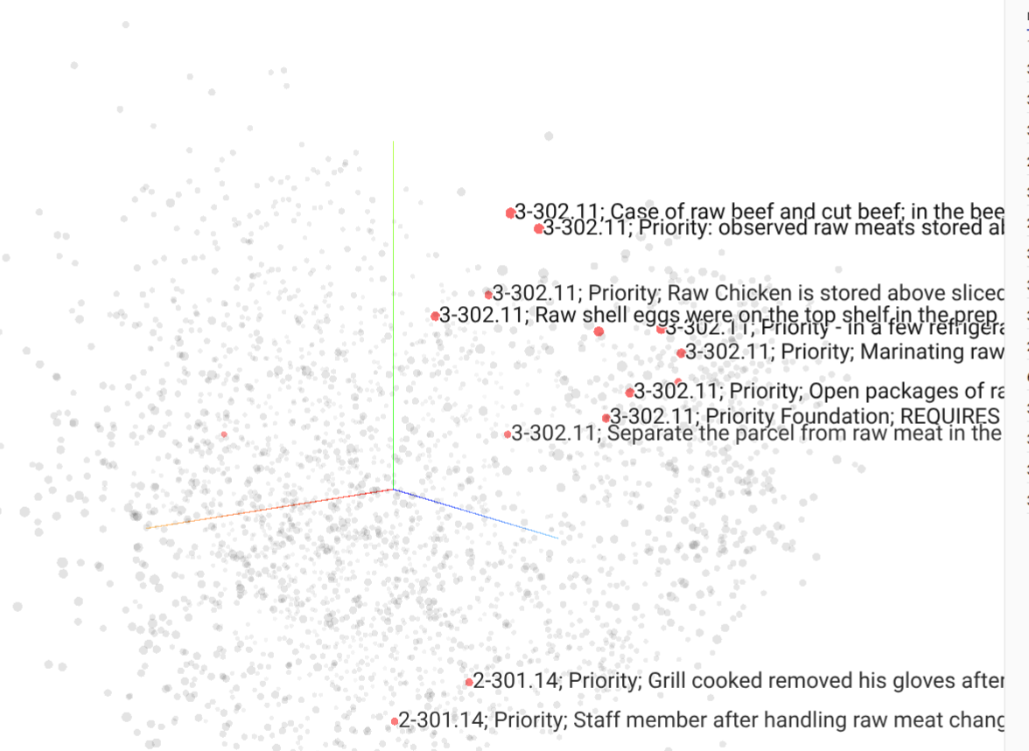
“
AI AT THE GATES: THE DBA'S GUIDE TO SURVIVING IN AN LLM WORLD
SLIDE 28
You've seen approximate similarity search already!
Notes:
Slide 1.4.4. DEMO (light). Callout over the earlier Projector neighbors view: 'this is ANN.'

Slide 30
“
AI AT THE GATES: THE DBA'S GUIDE TO SURVIVING IN AN LLM WORLD
SLIDE 29
From dots in a browser to rows in your database
You now understand vectors, similarity, ANN, and the three knobs. We’ll see later how SQL Server 2025 stores them (the VECTOR type), indexes them (DiskANN), and searches them. Best of all, we can query it all using T-SQL. The leap from 'dots in a browser' to 'rows in your database' is (hopefully) smaller than it looked at 8:00!
Notes:
Slide 1.4.5. Image: the browser dot-cloud morphing into a database table with a vector column; a bridge labeled 'Block 4.'

Slide 31
“
AI AT THE GATES: THE DBA'S GUIDE TO SURVIVING IN AN LLM WORLD
SLIDE 30
Text → tokens → embeddings → similarity → storage
One chain to remember, and you can reason about every AI-data feature for the rest of the day: text becomes tokens, tokens become embeddings (vectors), vectors are compared by similarity, and similarity gets stored and searched.
Notes:
Slide 1.W. Image: the five-link chain assembled, each link an icon from this block. Bridges into 1.5 Convincing the Boss (Jonathan).

Slide 32
AI AT THE GATES: THE DBA'S GUIDE TO SURVIVING IN AN LLM WORLD
SLIDE 31
The four people you're selling to
The True Believer
The Terrified
The Burned
Already Using It
Convinced it'll leak PII or DROP a table. These people are often working for cybersecurity and can become your best ally.
Lived through big data and blockchain. Skepticism earned, not irrational.
Pasting prod schemas into ChatGPT right now. Say no and you just stop knowing about it.
Saw a demo, wants AI on the roadmap yesterday. Danger: budget without direction.
1
2
3
4
Your job isn't to defeat them. Your job is to give each one the specific thing they need to say yes.

Slide 33
AI AT THE GATES: THE DBA'S GUIDE TO SURVIVING IN AN LLM WORLD
SLIDE 32
The two ways AI initiatives die
OVER-PROMISE
OVER-FEAR
01
01
"It'll write all our T-SQL."
"We can't use it — data-leak risk."
02
First wrong answer in prod → project dead
vs.
02
Competitors ship faster
03
03
Your team uses it in the shadows anyway
You own the blame
Don't sell magic. Sell leverage. Magic gets you one budget cycle. Leverage gets you a program.

Slide 34
AI AT THE GATES: THE DBA'S GUIDE TO SURVIVING IN AN LLM WORLD
SLIDE 33
The convince-the-boss playbook
01
Lead with the risk slide, not the demo
Name the data, compliance, and accuracy risks — and your mitigations — first.
02
Pick a boring, bounded first win
One painful, low-stakes, high-frequency task. Boring = low blast radius = easy yes.
03
"3-hour ticket → 45 minutes with review." Hours and tickets, not vibes.
Quantify in their units
04
Show the guardrails before they ask
Human-in-the-loop, no prod write, enterprise tier, an AUP. This unlocks the budget.
05
Ask for a pilot, not a platform
30 days, one team, one task, one success metric. Reversible and cheap.

Slide 35
“
AI AT THE GATES: THE DBA'S GUIDE TO SURVIVING IN AN LLM WORLD
SLIDE 34
Bring the hard questions into the room early
You don't convince the boss by being the most excited person in the room — you convince them by being the most credible. The person who already thought about what could go wrong. Which is exactly what we do next: security.

Slide 36
02
CHAPTER TWO
TOOLING + SECURITY

Slide 37
“
AI AT THE GATES: THE DBA'S GUIDE TO SURVIVING IN AN LLM WORLD
SLIDE 36
The gap between what we do and what we know
Who's pasted a production schema into ChatGPT? Now keep your hand up if you know exactly what that vendor is allowed to do with it. That gap is the whole talk.

Slide 38
AI AT THE GATES: THE DBA'S GUIDE TO SURVIVING IN AN LLM WORLD
SLIDE 37
Where your prompt actually goes
Your Machine
Vendor Servers
01
02
The prompt — schema, query plan, sample rows — leaves here the moment you hit enter.
May be logged, retained, and human-reviewed for quality.
Training Corpus
The Local Path
03
04
On consumer tiers, your data can train the next model. Functionally: you emailed it to a stranger.
Run a local model (Ollama, Phi) and none of this happens — the prompt never leaves your network. The fourth box is the one you control.

Slide 39
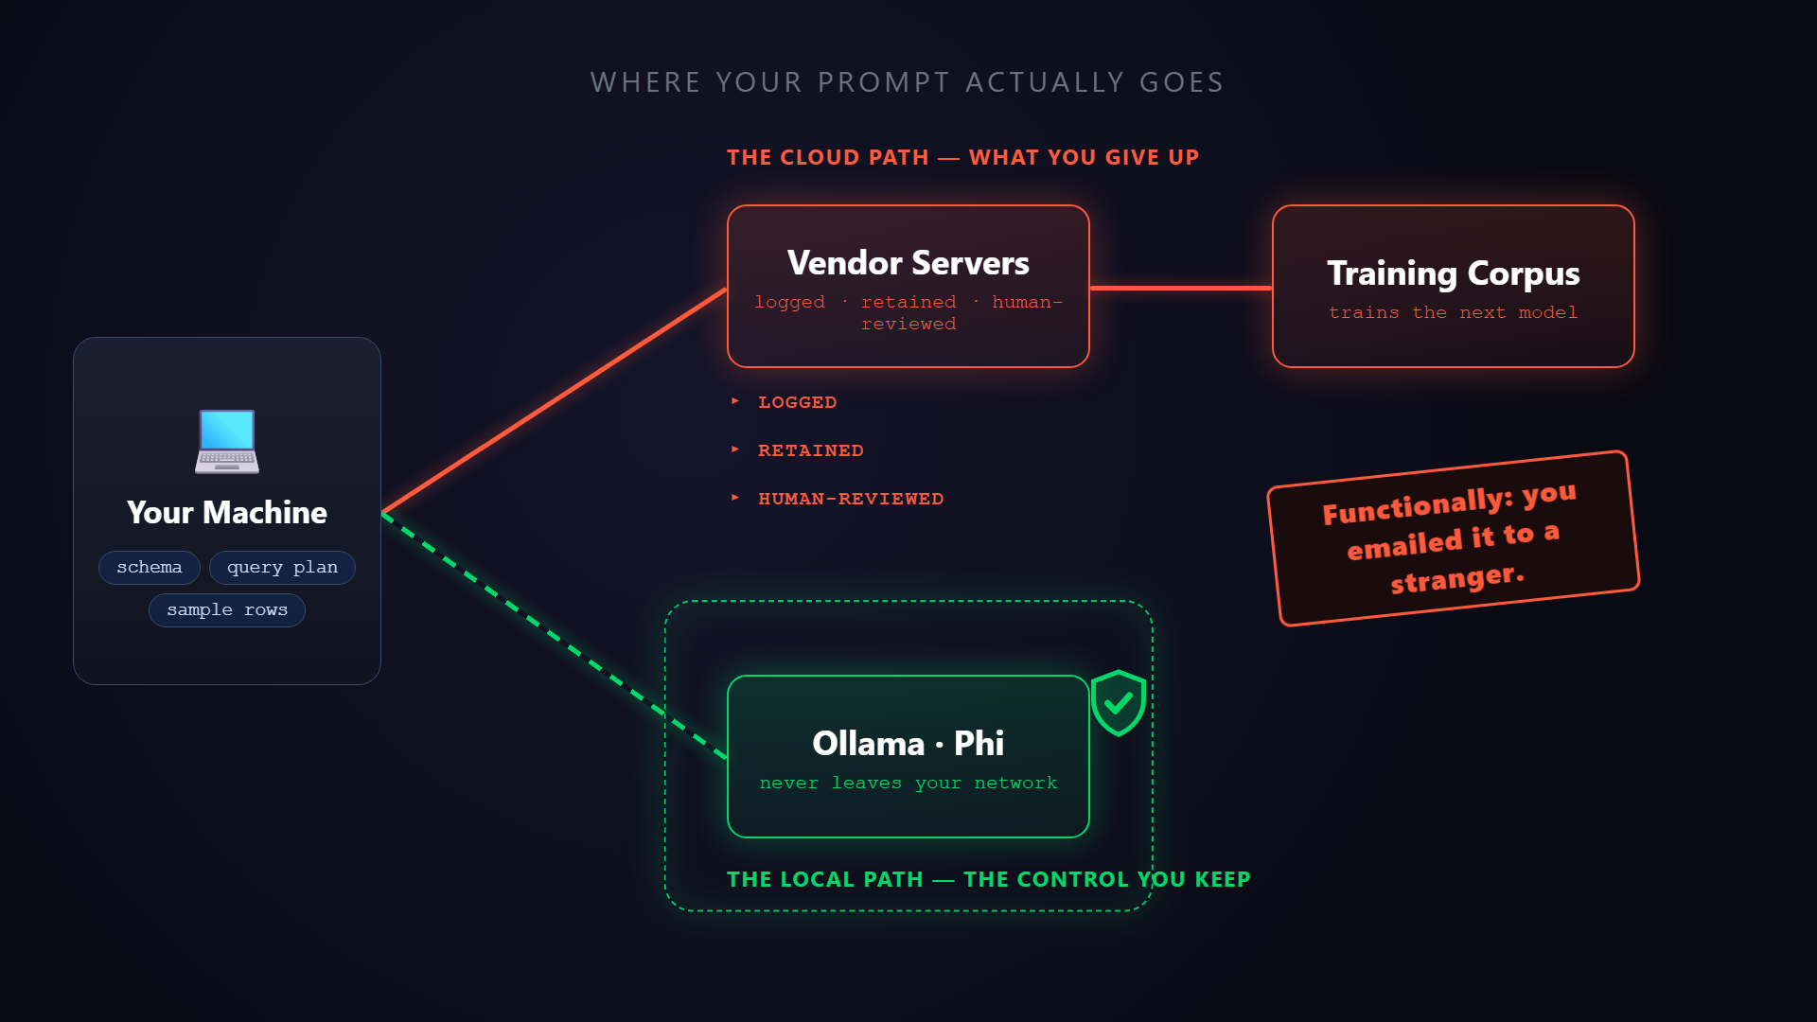
Notes:
▶ PLAY ON CLICK — click the video to start it; narrate over it, don't read the screen. This animates the static 'Where your prompt actually goes' diagram you just walked: the prompt (schema · query plan · sample rows) leaves Your Machine, travels the cloud lane to Vendor Servers (LOGGED · RETAINED · HUMAN-REVIEWED) and on into a Training Corpus — landing the 'functionally, you emailed it to a stranger' beat — contrasted with the contained local lane (Ollama · Phi) that never leaves your network, ending on 'the box you control'. 30s. If short on time, cut after the training-corpus stamp (~20s). Asset: images/data-leakage-flow.mp4 (poster images/data-leakage-flow.png), embedded play-on-click; re-render via the remotion data-leakage-flow template if the visuals change.

Slide 40
AI AT THE GATES: THE DBA'S GUIDE TO SURVIVING IN AN LLM WORLD
SLIDE 39
What's actually at risk
01
PII
The obvious one — names, MRNs, card numbers.
02
Schema as IP
Your data model is a competitive asset.
03
Embedded credentials
Connection strings in the sample you pasted for help.
04
The procs you paste to "refactor" encode how the business runs.
Business logic
05
Even anonymized rows leak distributions, cardinalities, and naming.
Inference

Slide 41
AI AT THE GATES: THE DBA'S GUIDE TO SURVIVING IN AN LLM WORLD
SLIDE 40
Capability vs. control — match the tier to the task
Consumer Cloud
Enterprise Cloud
Local / Self-Hosted
The rule
Match the tier to the sensitivity of the task. Don't pick one tier for everything — you're trading capability for control.
Best models, worst data terms. Assume your prompts are retained — and train the next model — unless you've explicitly opted out.
Foundry, Azure OpenAI, Copilot, Claude for Work. Same models, contractual boundaries: no training, data residency, audit. The sweet spot.
Ollama, Phi, Llama. Data never leaves your network. Weaker models, your hardware, your ops burden — the air-gapped answer.
1
2
3
4
Classify the data first — the tier, and the tool, fall out of that.

Slide 42
AI AT THE GATES: THE DBA'S GUIDE TO SURVIVING IN AN LLM WORLD
SLIDE 41
Corporate AI use policy — the checklist
01
Approved tools + tiers
Which assistants, which licenses — and which are banned.
02
Data classification rules
What may never be pasted, regardless of tier.
03
Human-in-the-loop mandate
AI output is reviewed before it touches prod. Always.
04
No prod write access
Read-only by default; guardrails on anything that executes.
05
Logging + accountability
Who used what, for what. Who owns the outcome.
06
A sanctioned path
A policy that just says "no" creates invisible shadow-IT risk.

Slide 43
AI AT THE GATES: THE DBA'S GUIDE TO SURVIVING IN AN LLM WORLD
SLIDE 42
Compliance: classify first, then choose the tier
REGIME
WHAT IT GOVERNS
WHAT YOU NEED
The rulebook
The data in scope
Before you prompt
HIPAA
A BAA — consumer tiers don't offer one
PHI handling & processors
US HEALTH DATA
PCI-DSS
Keep card data away from the prompt entirely
Cardholder data scope
CARD PAYMENTS
GDPR
DPA, data residency, no-training, right-to-erasure
Personal data & residency
EU PRIVACY
The tool decision falls out of the data classification — not the other way around.

Slide 44
“
AI AT THE GATES: THE DBA'S GUIDE TO SURVIVING IN AN LLM WORLD
SLIDE 43
The most dangerous guardrail is the one nobody tests
I run ~90 governance checks across my AI tooling. Prepping this talk I found one whose blocking rule had been silently dead for weeks — it looked like a guardrail and protected nothing. The most dangerous guardrail is the one everyone believes is working. Test that your 'no' actually fires.

Slide 45
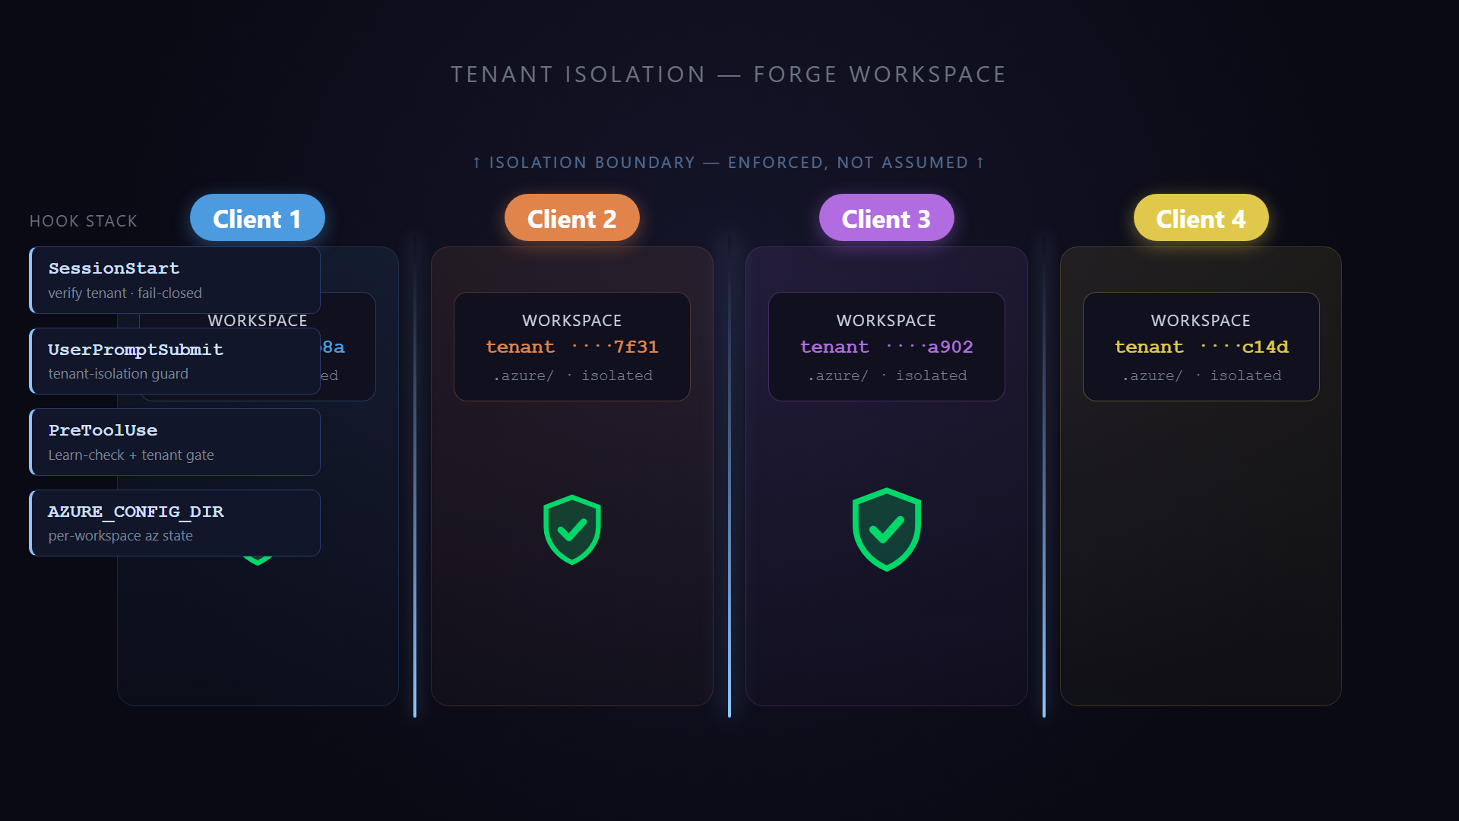
Notes:
▶ PLAY ON CLICK — click the video to start it; let it run under your narration (don't read the screen). This is the payoff for the war-story you just told: ~90 governance checks, and the one that mattered was a hook that actually fires. The 39s clip shows client lanes assembling (profile → workspace → tenant), isolation walls glowing, the hook-enforcement stack dropping in (SessionStart / UserPromptSubmit / PreToolUse / AZURE_CONFIG_DIR), then a contamination attempt firing from one lane toward another and getting BLOCKED at the wall — ending on the payoff shields. Section 2.1 is content-dense: if short on time, click and cut after the BLOCK beat (~32s). Asset: images/guardrail-isolation.mp4 (poster images/guardrail-isolation.png), embedded play-on-click; re-render the clip via the remotion guardrail-isolation template if the visuals change.

Slide 46
AI AT THE GATES: THE DBA'S GUIDE TO SURVIVING IN AN LLM WORLD
SLIDE 45
There is no best tool — only the best tool for the task
Chat Assistants
AI-Native Editors
CLI Agents
How to choose
Claude Code, Copilot CLI, aider. Plan → act → check, right in your terminal. Highest ceiling — and most capable of doing real damage.
Sensitivity first, then scope, then context, then loop speed. The enterprise tier you already pay for usually breaks the tie.
ChatGPT, Claude, Gemini. Great at drafting and explaining — but blind to your schema, and they'll invent DMVs and system views that don't exist.
Cursor, Windsurf. See the whole project at once — multi-file SQL, migration scripts, a repo of procs and views.
1
2
3
4
Anyone who tells you one tool wins everything is selling something.

Slide 47
AI AT THE GATES: THE DBA'S GUIDE TO SURVIVING IN AN LLM WORLD
SLIDE 46
The 4-question decision framework
01
What data touches this? Sets your tier — and can veto everything below.
Sensitivity
02
Scope
One snippet, a whole project, or a multi-step build?
03
Does it need to see your schema/repo? Then you've left the chat window.
Context it needs
04
Copy-paste 40 times a day? Graduate to an editor or CLI agent.
Loop speed
Sensitivity first, always — ask it before you fall in love with a tool.

Slide 48
AI AT THE GATES: THE DBA'S GUIDE TO SURVIVING IN AN LLM WORLD
SLIDE 47
Demo: schema-blind vs. context-aware
WITHOUT CONTEXT
WITH CONTEXT
SCHEMA-BLIND CHAT
CONTEXT-AWARE AGENT
01
01
Same prompt: find duplicate rows by business key
Sees the real schema
02
02
Guesses the column names
vs.
Uses real column names + types
03
03
Confident, runnable, wrong
Previews the MCP punchline →
Context is the whole game. Hold that thought for Block 5.

Slide 49
AI AT THE GATES: THE DBA'S GUIDE TO SURVIVING IN AN LLM WORLD
SLIDE 48
Evaluating any new tool — 6 questions
01
Data handling
Where does my data go? No-training tier, DPA/BAA, residency? If this fails, stop here.
02
Fit to task + context
Real frequent pain, and can it see the context it needs?
03
Accuracy + verifiability
Can I check the output, or is it a black box?
04
Integration cost
Fits SSMS/VS Code/CLI, or demands a new workflow?
05
Vendor viability
Will this exist in 18 months?
06
Lock-in + exit
If it dies or triples price, how hard to leave? Score the exit first.
Adoption is easy. Reversal is expensive. Score the exit before you score the features.

Slide 50
AI AT THE GATES: THE DBA'S GUIDE TO SURVIVING IN AN LLM WORLD
SLIDE 49
What to ask before you adopt
ASK VENDORS
ASK OSS COMMUNITIES
01
01
Do you train on my data on my tier?
Last commit date?
02
02
Show me the DPA/BAA
Issue response time?
vs.
03
03
Where does inference run?
Bus factor — one maintainer or a team?
04
04
What happens to my data if I cancel?
Security-disclosure process?
Watch how they answer: crisp = mature; hand-wavy = not.

Slide 51
03
CHAPTER THREE
PROMPT ENGINEERING

Slide 52
“
AI AT THE GATES: THE DBA'S GUIDE TO SURVIVING IN AN LLM WORLD
SLIDE 51
The most literal, overconfident junior you've ever hired
An LLM is the most literal, fastest, most overconfident junior you've ever onboarded. You already write specs for junior devs every day. Technical work needs technical prompting. That’s an engineering discipline you already have, pointed at a new target.

Slide 53
AI AT THE GATES: THE DBA'S GUIDE TO SURVIVING IN AN LLM WORLD
SLIDE 52
R-C-T-C-O — the anatomy of an effective prompt
01
Role
"You are a senior SQL Server DBA who writes set-based T-SQL." Sets vocabulary and standards.
02
Context
Schema, version, volumes, conventions, and what you've tried.
03
Task
One clear verb, one clear deliverable.
04
Constraints
"Set-based, no cursors. Runs on SQL Server 2019. Parameterized." How you encode your standards.
05
Output format
"Just the T-SQL." "A table of options with tradeoffs." Saves a round trip.
Role and Task are easy. Context, Constraints, and Output differentiate amateur- versus professional-level outcomes.

Slide 54
AI AT THE GATES: THE DBA'S GUIDE TO SURVIVING IN AN LLM WORLD
SLIDE 53
Zero-shot vs. few-shot
ZERO-SHOT
FEW-SHOT
01
01
Just ask
Give 1-3 worked examples
02
vs.
02
Common, well-understood tasks
Match a specific style or pattern
03
Start here. Don't over-engineer from the get-go
03
Your naming, your error-handling template
Describe the what and show the how. Are you writing a paragraph about your style? Paste an example instead.

Slide 55
AI AT THE GATES: THE DBA'S GUIDE TO SURVIVING IN AN LLM WORLD
SLIDE 54
Reason first, then iterate
Chain-of-thought
The correction loop
Make it restate the requirement, list tables and grain, and identify join keys before it writes SQL. Catch the wrong assumption before it bakes into code.
First answer is a draft. Read output → spot the wrong assumption → add the missing context → re-ask. Exactly how you'd mentor a junior.
1
2

Slide 56
“
AI AT THE GATES: THE DBA'S GUIDE TO SURVIVING IN AN LLM WORLD
SLIDE 56
The model can't see your database, so show it the relevant slice
Paste the relevant DDL (CREATE TABLE plus keys and indexes), a few sample rows, and note the relationships and row counts. If you have a big schema, include only the tables that matter and summarize the rest.
Notes:
Slide 3.2.1. Image: a CREATE TABLE snippet + 3 sample rows flowing into the model. Direct callback to Block 1 — without schema it confidently invents plausible-but-wrong column names.

Slide 57
AI AT THE GATES: THE DBA'S GUIDE TO SURVIVING IN AN LLM WORLD
SLIDE 57
Generation, optimization, refactoring
Generation
Optimization
Refactoring
Role + schema + a precise task + the output format you want. The first draft is usually 80% there.
Paste the query AND its execution plan or wait stats. Then,ask for improvements with the reasoning, not just a rewrite.
'Rewrite this cursor as set-based.' 'Modernize to window functions.' 'Make this SARGable.'
1
2
3
Each capability gets dramatically better when you hand over the plan, not just the SQL.
Notes:
Slide 3.2.2. Image: three labeled arrows — generate / optimize / refactor — off one query block.

Slide 58
“
AI AT THE GATES: THE DBA'S GUIDE TO SURVIVING IN AN LLM WORLD
SLIDE 58
Troubleshooting Issues with a LLM
Paste the error text or the plan (XML or screenshot) plus context. Then, ask for the likely cause and fix.
Warning: models can't see your data distribution or statistics, so treat what it says as a conjecture you should test. Don’t treat it like the final word.
Notes:
Slide 3.2.3. Image: an error message / plan -> a 'likely cause + fix' bubble with a small 'verify' stamp. Previews Block 4's Copilot tuning demo.

Slide 59
AI AT THE GATES: THE DBA'S GUIDE TO SURVIVING IN AN LLM WORLD
SLIDE 59
Administrative-task prompts and guardrails
WHERE IT HELPS
NON-NEGOTIABLE
USE IT FOR
GUARDRAILS
01
01
Never paste secrets, connection strings, or PII
Drafting a backup strategy
02
Index recommendations to evaluate
vs.
02
Validate every suggestion against your SLAs and edition
03
Capacity-planning math
03
It doesn't know why that 'redundant' index exists
04
Writing runbooks
Useful for the boring admin grind — as long as the guardrails are loud and you stay the one accountable. [-> Block 2]
Notes:
Slide 3.2.4. Image: an admin checklist with caution tape across the 'paste secrets' row. Reinforces Block 2 governance.

Slide 60
AI AT THE GATES: THE DBA'S GUIDE TO SURVIVING IN AN LLM WORLD
SLIDE 60
Demo: the prompt makeover
V1 — NO CONTEXT
V4 — FULL ANATOMY
BEFORE
AFTER
01
01
Invents tables and columns; not even valid T-SQL
Role + schema + domain values + constraints + house style
02
02
vs.
Derived-table count, OUTER APPLY TOP (1) for the score
The 'spot the hallucination' hook
03
03
Production-quality, correct — verified against the data
Confident — and useless
Same model throughout — the prompt carried the improvement. Each added layer of context prevents exactly the bug at that step.
Notes:
Slide 3.2.5. DEMO / interactive. Open with the ~2-min 'spot the hallucination' hook: show a confident, wrong query generated with no schema; let the room find the bug; reveal that schema context fixes it. Main segment — the prompt makeover, pre-captured for reliability. Fixed task: 'Find the restaurants with the most critical violations in the last 12 months, with the count and their most recent inspection score, worst first.' (Wake County). v1 invents columns; v2 (+role+schema) guesses Severity='Critical' -> 0 rows (real values Core/Priority/Priority Foundation); v3 (+domain values+window) JOIN fans out 5 -> 165; v4 (+correctness+house style) is correct. Use a CAPABLE model — NOT the laptop's llama3.2:1b (that's Block 1's temperature demo). Variants in src/demo/block3/ (Kevin's repo): claude-code-online.md + prompt-makeover-offline.md. Default to offline for a guaranteed arc.

Slide 61
“
AI AT THE GATES: THE DBA'S GUIDE TO SURVIVING IN AN LLM WORLD
SLIDE 61
Role - Context - Task - Constraints - Output — and verify everything
Remember the recipe: Role, Context, Task, Constraints, Output format. Context is the highest-leverage ingredient; few-shot enforces your house style; chain-of-thought rescues complex logic. Next, Blocks 4-5 put these prompts to work inside the tools — Copilot in SSMS, MCP, and pair programming. [-> Block 5]
Notes:
Slide 3.W. Image: the recipe card with a bridge to 'the tools' (Blocks 4-5). The reusable DB prompt recipe card ships as a handout. Hands back toward the tooling track.

Slide 62
04
CHAPTER FOUR
DATABASE ADMINISTRATION IN A GENERATIVE AI WORLD
Your database just became an AI workload — now operate it.
Notes:
Block 4 (1:00–2:15, ~75 min). Presented by Kevin Feasel. Four stops: (A) how vector indexes think, (B) where vectors live, (C) how we query them, (D) how we run them in production. Two live demos. Target platform: SQL Server 2025 (17.x).

Slide 63
“
AI AT THE GATES: THE DBA'S GUIDE TO SURVIVING IN AN LLM WORLD
SLIDE 63
What actually changes in your day job?
Embeddings, vector search, and in-database AI calls are now first-class SQL Server features — which means they're now YOUR problem to size, secure, back up, and tune. For the next 75 minutes we focus on operating these workloads. Syntax lives in the demos.
Notes:
[Concept] Opener. Frame the DBA's question for the whole block: what changes in my day job? Honest scope: operating these workloads, not exhaustive syntax. Image: castle gate (title callback) — data flowing through the gate.

Slide 64
AI AT THE GATES: THE DBA'S GUIDE TO SURVIVING IN AN LLM WORLD
SLIDE 64
Block 4 roadmap
How vector indexes think
Approximate search, recall, and the index families — a DBA's mental model.
0A
0B
What SQL Server 2025 shipped, the SQL family, Cosmos DB, and the wider field.
Where vectors live
0C
Pure vs hybrid, filtered search, ranking, and embedding generation.
How we query them
How we run them in production
Capacity, monitoring, backup, tuning — plus AI-assisted triage.
0D
Two demos along the way: create/query a vector index, and let GenAI triage a real performance problem.
Notes:
[Concept] Reuse this as a progress map on the section dividers within the block.

Slide 65
“
AI AT THE GATES: THE DBA'S GUIDE TO SURVIVING IN AN LLM WORLD
SLIDE 65
An embedding is just an array of floats in a VECTOR(n) column
Recap from Block 1. Each element is a 4-byte single-precision float by default; dimensions are fixed per column (1–1998 for float32). The new question: given a query vector, how do I find the closest rows — fast — when I have millions of them?
Notes:
[SS2025 GA] VECTOR data type and 1–1998 float32 dimension range. Keep it concrete — this audience thinks in rows and columns. Image: a row morphing into [0.12,-0.04,0.88,…] then a magnifying glass over a cloud of dots.

Slide 66
“
AI AT THE GATES: THE DBA'S GUIDE TO SURVIVING IN AN LLM WORLD
SLIDE 66
Exact k-NN computes VECTOR_DISTANCE to every row, sorts, takes top N
A table scan plus a per-row distance computation — predictable, precise, and expensive. You don't always need an index: reach for exact search first when the working set is small, or when a WHERE predicate trims the candidate set.
Microsoft's rule of thumb: exact search is fine under ~50,000 vectors (or when a filter shrinks the set below that).
Notes:
[SS2025 GA] VECTOR_DISTANCE + the kNN pattern. The ~50k figure is Microsoft's published recommendation. Image: brute-force visual — one query point with lines to every other point.

Slide 67
“
AI AT THE GATES: THE DBA'S GUIDE TO SURVIVING IN AN LLM WORLD
SLIDE 67
A vector index returns approximate results
This is unlike every B-tree you've tuned — 'index seek' no longer means 'exact'. Recall = the fraction of the true top-N neighbors the approximate search actually returned (1.0 = identical to exact). It's acceptable because embeddings are already lossy approximations of meaning, so recall ~0.95–0.99 usually changes nothing the user notices.
Notes:
[Concept] Name the mindset shift out loud. Recall definition and the ANN tradeoff are platform-neutral, consistent with Microsoft docs. Image: two near-identical result lists (Exact vs Approx) + a small recall gauge.

Slide 68
AI AT THE GATES: THE DBA'S GUIDE TO SURVIVING IN AN LLM WORLD
SLIDE 68
The vector index family — correctly attributed
FAMILY
SHAPE
MEMORY
RECALL / COST
USED BY
IVFFLAT
Cluster + probe nearest few
Recall sensitive to probes; fast build
Cheaper
pgvector
[NON-MS]
HNSW
Multi-layer proximity graph
Excellent recall; costly build/update
pgvector, Pinecone, Weaviate, Qdrant
Memory-resident
[NON-MS]
DISKANN
Single graph, SSD-resident
Billion-scale on modest RAM
SQL Server 2025, Azure SQL, Cosmos DB
Low (SSD)
[SS2025 PREVIEW] / [AZURE]
Standing correction: SQL Server 2025 shipped vectors and the whole MS SQL family uses DiskANN ONLY. IVFFlat/HNSW are pgvector / dedicated-DB concepts — taught as a model, attributed correctly.
Notes:
Compare on four axes DBAs care about: build time, memory footprint, recall, update cost. Likely a screenshot-and-keep slide — keep it clean. DiskANN attribution [SS2025 Preview]/[Azure]; IVFFlat+HNSW [Non-MS].

Slide 69
“
AI AT THE GATES: THE DBA'S GUIDE TO SURVIVING IN AN LLM WORLD
SLIDE 69
You don't have to size your buffer pool to hold the entire vector index
DiskANN's defining property: the graph is SSD-resident with minimal memory use, so you can index far more vectors than fit in RAM while holding high QPS and low latency. It balances memory / CPU / I/O — a familiar tradeoff triangle for anyone who tunes storage. Contrast with HNSW's in-memory assumption.
Notes:
[Concept] DiskANN's SSD/low-memory design is documented by Microsoft and originates in Microsoft Research. Image: a Memory–CPU–I/O triangle with HNSW pinned to 'Memory' and DiskANN in the middle.

Slide 70
AI AT THE GATES: THE DBA'S GUIDE TO SURVIVING IN AN LLM WORLD
SLIDE 70
Index or brute force?
< ~50k candidate vectors
Large + latency-sensitive
Selective filter present?
Exact k-NN with VECTOR_DISTANCE. No index needed.
ANN via a vector index (DiskANN).
The filter may shrink the set enough that exact search wins again.
1
2
3
Reality check: CREATE VECTOR INDEX exposes only METRIC, TYPE='DiskANN', and MAXDOP — far fewer knobs than pgvector or Cosmos. Most tuning is choosing exact vs approximate and getting filters right.
Notes:
[SS2025 GA] exact path; [SS2025 Preview] index path + the METRIC/TYPE/MAXDOP knob set. Image: a flowchart with one decision diamond.

Slide 71
AI AT THE GATES: THE DBA'S GUIDE TO SURVIVING IN AN LLM WORLD
SLIDE 71
What SQL Server 2025 actually shipped
CAPABILITY
STATUS
VECTOR(N) TYPE + VECTOR SCALAR FUNCTIONS
GA
EXACT K-NN VIA VECTOR_DISTANCE (COSINE | DOT | EUCLIDEAN)
GA
CREATE VECTOR INDEX (DISKANN) + VECTOR_SEARCH (ANN)
Preview — needs PREVIEW_FEATURES = ON
AI_GENERATE_EMBEDDINGS / AI_GENERATE_CHUNKS / CREATE EXTERNAL MODEL
Preview — + endpoint config
FLOAT16 (HALF-PRECISION) VECTORS, UP TO 3,996 DIMS
Preview
GA features are safe to design production around today. Preview features ship but are subject to change and must be explicitly enabled.
Notes:
Each row tagged. Index/search/embeddings/float16 all confirmed preview-gated in SS2025. Image: a GA/Preview status board — green checks vs amber 'preview' badges.

Slide 72
AI AT THE GATES: THE DBA'S GUIDE TO SURVIVING IN AN LLM WORLD
SLIDE 72
The Microsoft SQL family
PLATFORM
VECTORS
PREVIEW FLAG?
NOTES
SQL SERVER 2025
Type + functions; index/search preview
Yes
Behind PREVIEW_FEATURES
AZURE SQL DATABASE
Available
No flag needed
Leads on newest index features
SQL DATABASE IN FABRIC
Same modern caps as Azure SQL DB
Available
No flag needed
AZURE SQL MANAGED INSTANCE
SS2025 / Always-up-to-date policy
Available
Update-policy gated
The latest index version — full DML, iterative filtering, advanced quantization — is Azure SQL DB / Fabric ONLY today.
Notes:
[SS2025 Preview] / [Azure SQL DB / Fabric] / [Azure other]. Highlight the 'latest index version' nuance — it leads in Azure/Fabric first. Image: capability matrix with check/partial/X.

Slide 73
“
AI AT THE GATES: THE DBA'S GUIDE TO SURVIVING IN AN LLM WORLD
SLIDE 73
Plan your ETL around the read-only index
SQL Server 2025's current vector-index version is effectively read-only after index creation, and you need ≥ 100 rows before building. The latest version with full DML support (INSERT/UPDATE/DELETE/MERGE with live maintenance), iterative filtering, and advanced quantization is currently Azure SQL DB / Fabric only. Build the index AFTER bulk load; rebuild after large changes.
Notes:
[SS2025 Preview] read-only + 100-row constraints; [Azure SQL DB / Fabric] for the latest-version features. This is the single most important operational caveat in Section B.

Slide 74
AI AT THE GATES: THE DBA'S GUIDE TO SURVIVING IN AN LLM WORLD
SLIDE 74
Azure Cosmos DB for vectors
DiskANN + quantizedFlat + flat
Quantization + sharded DiskANN
RU-based cost model
Tuned via a JSON index policy, not T-SQL.
One graph per partition-key value — ideal for multitenant isolation and noisy-neighbor protection.
Not core/memory — a different mental model for capacity planning.
1
2
3
When it fits: your operational data already lives in Cosmos DB and you want search co-located with it.
Notes:
[Azure other] DiskANN/quantizedFlat, vectorIndexShardKey, and the RU model verified against Cosmos DB docs. Image: multitenant lanes each with their own small DiskANN graph.

Slide 75
AI AT THE GATES: THE DBA'S GUIDE TO SURVIVING IN AN LLM WORLD
SLIDE 75
Beyond Microsoft: the rest of the field
In-database
Managed search
Dedicated vector DBs
pgvector (incl. Azure Database for PostgreSQL) — HNSW + IVFFlat, open source, in the engine.
Azure AI Search — vector + hybrid + semantic ranking. A search service, not a database.
Pinecone, Weaviate, Qdrant, Milvus. Purpose-built, HNSW-centric, excellent at pure vector scale.
1
2
3
Honest framing: these are specialized and often excellent — but each is another system to secure, sync, and back up.
Notes:
[Non-MS] / [Azure other]. One comparison slide so attendees can talk to stakeholders, then back to SQL. Avoid implying a ranking. Image: a logo grid in three buckets.

Slide 76
AI AT THE GATES: THE DBA'S GUIDE TO SURVIVING IN AN LLM WORLD
SLIDE 76
In-database vs dedicated store: decide
01
Data gravity
Do the vectors describe rows already in SQL Server? Co-location avoids a sync pipeline.
02
Transactional consistency
Must embeddings stay atomically in sync with source rows? In-DB wins.
03
Operational burden
One engine to back up / secure / patch vs two.
04
Scale & latency
Billions of vectors at sub-10ms may justify a dedicated store.
05
Cost model & team skills
RU vs core licensing; does your team already run SQL Server?
Recommendation: for most DBA-owned workloads where vectors annotate existing relational data, keep them in SQL Server / Azure SQL. Reach for a dedicated store only when scale or latency proves you must.
Notes:
[Concept] decision criteria are platform-neutral. State the recommendation plainly. Image: a balance scale — 'keep it in the database' vs 'add a dedicated store'.

Slide 77
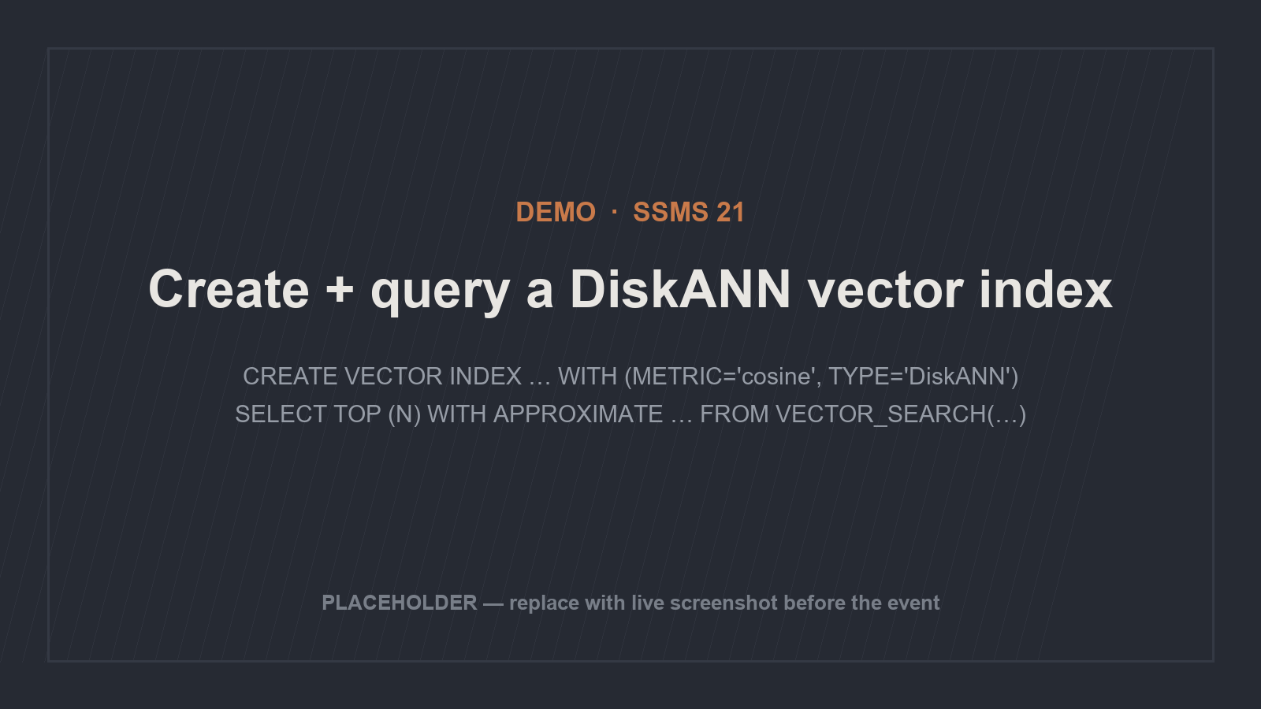
Notes:
▶ DEMO [SS2025 Preview]. Setup beats (syntax live): enable PREVIEW_FEATURES; create a VECTOR column; CREATE VECTOR INDEX … WITH (METRIC='cosine', TYPE='DiskANN'); query with SELECT TOP (N) WITH APPROXIMATE … FROM VECTOR_SEARCH(…) ORDER BY distance. Point to watch: the optimizer picks DiskANN-vs-kNN automatically; FORCE_ANN_ONLY exists to override. Flag the preview switch on screen. PLACEHOLDER image — swap for a live SSMS 21 capture before the event.

Slide 78
AI AT THE GATES: THE DBA'S GUIDE TO SURVIVING IN AN LLM WORLD
SLIDE 78
Pure vector vs hybrid search
PURE VECTOR
HYBRID
01
01
Vector similarity + full-text (BM25) in one query
Rank purely by semantic similarity
02
02
vs.
Keyword side is precise on rare jargon
Great for 'find things about this'
03
03
Fumbles exact tokens — SKUs, codes, names
Best of both for real relevance
Hybrid exists because pure vector search fumbles exact tokens — product codes, person names, rare jargon — where keyword search is exact.
Notes:
[SS2025 GA] full-text; [SS2025 Preview] vector side of hybrid. Image: a Venn diagram — semantic vs keyword, overlap = hybrid.

Slide 79
AI AT THE GATES: THE DBA'S GUIDE TO SURVIVING IN AN LLM WORLD
SLIDE 79
Filtered search and the post-filter trap
POST-FILTER (THE TRAP)
ITERATIVE FILTERING (THE FIX)
01
01
Apply WHERE during the graph search, not after
Run ANN top-N first, THEN filter
02
02
Filtered-out rows used up your top-N slots
vs.
Returns a full, correct result set
03
03
You're left with almost nothing — recall silently wrecked
Latest index version — Azure SQL DB / Fabric
On SQL Server 2025 today: when filters are highly selective, exact k-NN over the filtered set is often the safer, simpler choice.
Notes:
[Concept] the post-filter recall problem; [Azure SQL DB / Fabric] iterative filtering availability; [SS2025 GA] the exact-over-filtered fallback. Image: before/after top-10 lists.

Slide 80
“
AI AT THE GATES: THE DBA'S GUIDE TO SURVIVING IN AN LLM WORLD
SLIDE 80
You can't just add a distance score and a BM25 score
They aren't on the same scale. RRF fuses two ranked lists using each item's rank position (not raw score), with per-list weights to favor semantic or keyword results. In the SQL family it's T-SQL (combine VECTOR_DISTANCE / VECTOR_SEARCH with full-text); EF Core ships Rrf and FullTextScore helpers.
Benchmarks consistently show hybrid + ranking beats either method alone for relevance.
Notes:
[Concept] RRF mechanics; [SS2025 GA]/[Azure other] SQL/EF Core implementations. Image: two ranked lists feeding an RRF funnel — show rank numbers, not scores.

Slide 81
AI AT THE GATES: THE DBA'S GUIDE TO SURVIVING IN AN LLM WORLD
SLIDE 81
Re-ranking strategies
RRF RE-RANKING
SEMANTIC RE-RANKING
01
01
Cheap, rank-based, no extra model
Cross-encoder / late-interaction model (e.g. Cohere Rerank)
02
02
Good default
vs.
Higher precision
03
03
Stays inside the database
External model call — more latency + cost
Use semantic re-ranking to polish the top-K, not the whole result set.
Notes:
[Concept] RRF; [Azure other]/[Non-MS] Cohere Rerank integration with Azure SQL / SS2025. Image: two-stage pipeline 'retrieve top 50 (cheap)' → 're-rank top 10 (expensive)'.

Slide 82
AI AT THE GATES: THE DBA'S GUIDE TO SURVIVING IN AN LLM WORLD
SLIDE 82
Batch vs real-time embedding generation
BATCH
REAL-TIME
01
01
CROSS APPLY AI_GENERATE_CHUNKS + AI_GENERATE_EMBEDDINGS over a table
Embed on insert / update
02
02
vs.
Fresh immediately
Efficient for bulk / backfill
03
03
Schedule it
Per-row external model latency
The staleness problem is your new maintenance job: when source text changes, its embedding is wrong until regenerated. You own the refresh strategy — triggers, CDC, or scheduled jobs.
Notes:
[SS2025 Preview] AI_GENERATE_EMBEDDINGS / AI_GENERATE_CHUNKS / CREATE EXTERNAL MODEL (Azure OpenAI, OpenAI, Ollama, local ONNX). Image: a timeline with a red 'stale' window between text edit (T1) and embedding refresh (T2).

Slide 83
AI AT THE GATES: THE DBA'S GUIDE TO SURVIVING IN AN LLM WORLD
SLIDE 83
Capacity planning: do the vector math
QUANTITY
VALUE
WHY IT MATTERS
1024-DIM FLOAT32 VECTOR
4,104 bytes
4,096 payload + 8-byte header
SQL DATA PAGE
8,060 bytes
→ one vector per page; big, off-row
1536-DIM (ADA-002) ROW
~6 KB
Vectors don't pack like INTs
10M ROWS @ 1536-DIM
~60 GB
Vector payload BEFORE index overhead
FLOAT16 (PREVIEW)
halves storage
Up to 3,996 dims, at some recall cost
Embeddings frequently dwarf the source rows. Size data + log + backups accordingly; pick the smallest dimension that meets quality.
Notes:
[SS2025 GA] byte sizes + 8,060-byte page fact; 10M-row figure is arithmetic from those; [SS2025 Preview] float16. Image: 'what fits on a page' — hundreds of INTs vs one 1024-dim vector.

Slide 84
“
AI AT THE GATES: THE DBA'S GUIDE TO SURVIVING IN AN LLM WORLD
SLIDE 84
Build after bulk load — the index gate closes behind you
DiskANN is SSD-resident, so RAM pressure is far lower than an in-memory HNSW index of the same data. Build time scales with row count and parallelism — MAXDOP is your lever in CREATE VECTOR INDEX.
Two gotchas to schedule around (SS2025 current version): ≥ 100 rows required before build, and the table is read-only after index creation. Build after bulk load; rebuild after large changes.
Notes:
[SS2025 Preview] MAXDOP, 100-row minimum, read-only-after-build; [Concept] DiskANN memory profile. Image: an ETL timeline with the read-only window shaded.

Slide 85
AI AT THE GATES: THE DBA'S GUIDE TO SURVIVING IN AN LLM WORLD
SLIDE 85
Monitoring: new metrics, a new dependency
sys.vector_indexes
Extended Events
External REST dependency
Recall drift
As data grows/changes, an approximate index's recall can degrade. Sample-validate over time. [Concept]
Index type, distance metric, build parameters / version. [GA catalog view]
ai_generate_embeddings_summary, external_rest_endpoint_summary — status codes, errors, model name. [Preview]
In-DB embedding calls hit a model endpoint — monitor latency, throttling, failures as database health. [Preview]
1
2
3
4
Query Store, wait stats, and your existing tooling still apply — vector queries show up as ordinary query plans.
Notes:
[SS2025 GA] sys.vector_indexes; [SS2025 Preview] the XEvents; [Concept] recall drift. The external endpoint is the genuinely new operational surface. Image: a dashboard with two new tiles — 'endpoint latency' and 'recall %'.

Slide 86
AI AT THE GATES: THE DBA'S GUIDE TO SURVIVING IN AN LLM WORLD
SLIDE 86
Backup, recovery, and reproducibility
Vectors back up for free
They're just columns — normal backup/restore covers them. A real advantage of keeping vectors in-DB.
01
02
EXTERNAL MODEL defs + credentials
Database-scoped credentials, managed identity / Arc config — backups don't fully capture these.
03
Pin the embedding model + version
Restoring data is useless if you can't reproduce embeddings with the SAME model later.
TRUNCATE is blocked
On vector-indexed tables: drop the index, truncate, reload (≥100 rows), rebuild.
04
Your recovery runbook needs three things backups won't hand you: model definitions, credentials, and the model version.
Notes:
[SS2025 Preview] TRUNCATE restriction + external-model/credential dependency; [Concept] backup coverage + model-version reproducibility. Image: a backup checklist with three easy-to-forget sticky notes.

Slide 87
AI AT THE GATES: THE DBA'S GUIDE TO SURVIVING IN AN LLM WORLD
SLIDE 87
Performance tuning for vector query patterns
kNN vs ANN plan choice
The optimizer picks based on query shape; the FORCE_ANN_ONLY hint overrides it.
01
Metric must match the index
A VECTOR_SEARCH whose METRIC differs from the index falls back to exact kNN (with a warning). A silent perf footgun.
02
03
Selective filters favor exact search; non-selective ones favor the index (see Section C).
Filter placement
What's reassuringly familiar: it's still query plans, statistics, I/O, and waits. Your instincts transfer.
Notes:
[SS2025 Preview] FORCE_ANN_ONLY + metric-fallback behavior; [Concept] filter placement. Image: a query plan contrasting kNN (index scan + distance compute) vs an ANN plan — see ph-query-plan-knn-vs-ann.png if you want it as a visual.

Slide 88
AI AT THE GATES: THE DBA'S GUIDE TO SURVIVING IN AN LLM WORLD
SLIDE 88
AI-assisted performance tuning — and its guardrails
WHERE IT HELPS
VERIFY BEFORE YOU TRUST
01
01
Copilot in SSMS 21 reads wait stats + plans
Treat suggestions as hypotheses, not truth
02
02
Triages unfamiliar waits
vs.
Don't paste sensitive schema / PII into public LLMs
03
03
Drafts index / rewrite candidates, explains queries
It doesn't know your SLAs or why that 'redundant' index exists
Tie back to Block 2 governance: prefer in-tenant Copilot inside your data-governance boundaries; validate against your workload before applying.
Notes:
[SS2025 GA] GitHub Copilot in SSMS (listed in 'What's new in SQL Server 2025'). Reinforce thinking-partner-not-oracle. Left image is a PLACEHOLDER — swap for a real Copilot screenshot.

Slide 89
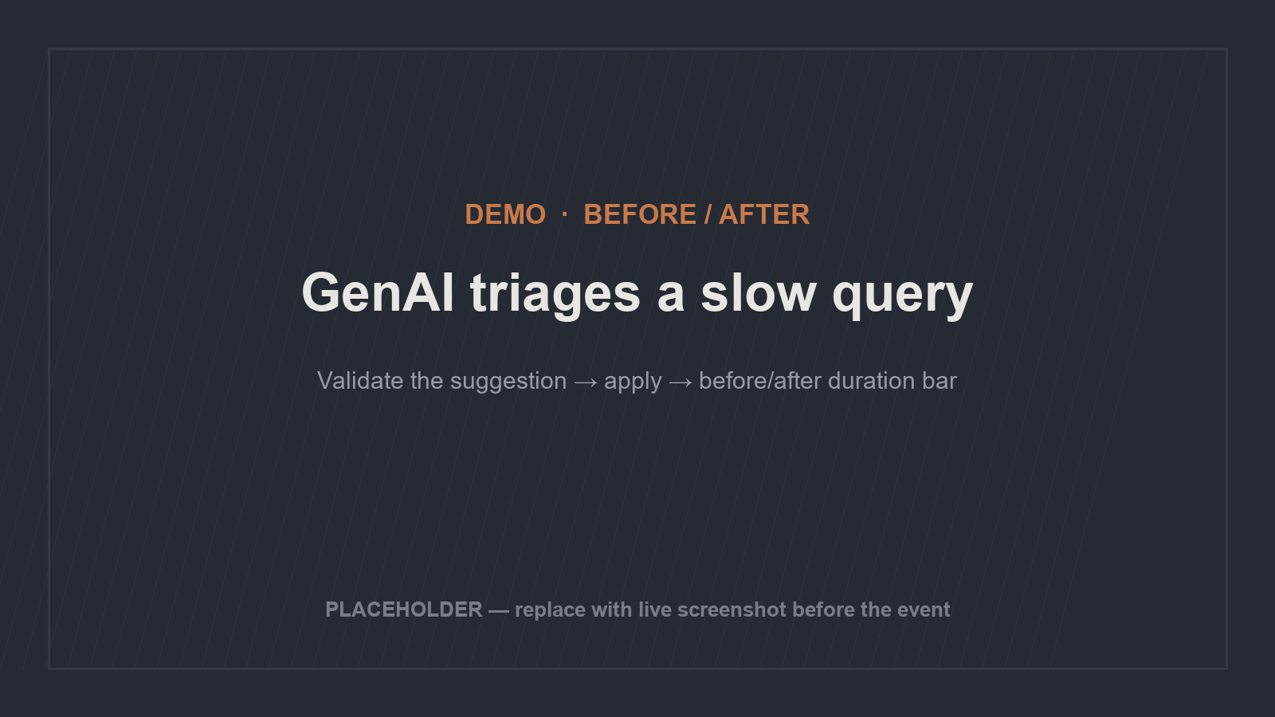
Notes:
▶ DEMO [SS2025 GA]. Arc (narration, not syntax): present a slow vector/relational query → ask Copilot in SSMS to analyze waits + plan → it proposes an index or rewrite → VALIDATE the suggestion and show before/after. Emphasize the validation step on screen — model the disciplined behavior. PLACEHOLDER image — replace with a real before/after capture.

Slide 90
AI AT THE GATES: THE DBA'S GUIDE TO SURVIVING IN AN LLM WORLD
SLIDE 90
Block 4 takeaways — and the bridge to Block 5
01
Approximate, not exact
Vector 'seek' no longer means exact. Mind recall.
02
Type + kNN are GA; index / search / embeddings are preview behind a flag.
Vectors are real today
03
SSD-resident, low memory; newest index features land in Azure SQL DB / Fabric first.
The family is DiskANN
04
Big and perishable
Plan storage, refresh, and an external-endpoint dependency you now monitor.
05
Keep them in the database
Unless scale or latency forces a dedicated store.
Block 4 was running AI workloads. Block 5 is building with them — pair programming and MCP servers for database development.
Notes:
[Concept] summary of the tagged claims above. Hands off to Jonathan for Block 5 (5.1 pair programming). Image: the Block 4 roadmap with all four stops complete, track extending toward Block 5.

Slide 91
05
CHAPTER FIVE
DATABASE DEVELOPMENT

Slide 92
AI AT THE GATES: THE DBA'S GUIDE TO SURVIVING IN AN LLM WORLD
SLIDE 92
Pair programming: the real loop
01
You specify
R-C-T-C-O. You drive.
02
It drafts
Fast, literal, often 80% there.
03
You review
Every line, like a pull request — because it is one.
04
Add the missing context, re-ask, repeat. Not dictation, not autopilot.
You correct
Your job moves from typing to specifying and reviewing. That's a promotion — but only if you actually review.

Slide 93
AI AT THE GATES: THE DBA'S GUIDE TO SURVIVING IN AN LLM WORLD
SLIDE 93
Where it earns its keep
Generation
Review + refactoring
Unit tests
Procs, CRUD, views, parameterized queries — feed it the schema and the first draft is 80% there.
"Cover empty input, nulls, duplicate keys, happy path." It enumerates the edge cases you'd forget.
"Find the perf anti-patterns." "Explain this 200-line proc I inherited." Often the bigger win.
1
2
3

Slide 94
AI AT THE GATES: THE DBA'S GUIDE TO SURVIVING IN AN LLM WORLD
SLIDE 94
When AI gets it wrong — the five failure modes
01
Hallucinated objects
Invents DMVs, system functions, columns, hints that don't exist.
02
Plausible-but-wrong logic
Wrong grain on a join → duplicate rows; NOT IN with NULLs.
03
Version-mismatched syntax
A feature your SQL Server version doesn't have.
04
Confidently wrong perf advice
Suggests an index that already exists, or one that hurts the workload.
05
It will always produce something. Read the plan, check row counts at every grain.
It never says "I don't know"
The people who get burned trust it too much, too early. Trust is earned per task — like a new hire.

Slide 95
AI AT THE GATES: THE DBA'S GUIDE TO SURVIVING IN AN LLM WORLD
SLIDE 95
Demo: requirements → stored procedure
UNDER-SPECIFIED PROMPT
R-C-T-C-O APPLIED
01
01
"Write a proc to dedupe customers"
Schema + constraints + output format
02
02
Mediocre draft, guessed columns
vs.
Better draft
03
03
Spot the bug, correct it, verify row counts — live
A real grain bug → duplicate rows
The failure-mode point lands 10x harder shown than told.

Slide 96
“
AI AT THE GATES: THE DBA'S GUIDE TO SURVIVING IN AN LLM WORLD
SLIDE 96
Stop pasting your schema. Let it look things up.
Every good answer in the last section, you hand-fed the context — and chores don't get done. MCP turns "here, let me paste my schema" into "go look it up yourself": the AI fetches context itself, always schema-aware, without you babysitting it.

Slide 97
AI AT THE GATES: THE DBA'S GUIDE TO SURVIVING IN AN LLM WORLD
SLIDE 97
MCP: USB-C for AI context
Tools
Resources
01
02
Functions the AI can invoke — run a read-only query, describe a table.
Data the AI can read — docs, schema, runbooks.
Prompts
The pattern
03
04
Reusable prompt templates the server offers.
Every component connects — together they form the pattern.

Slide 98
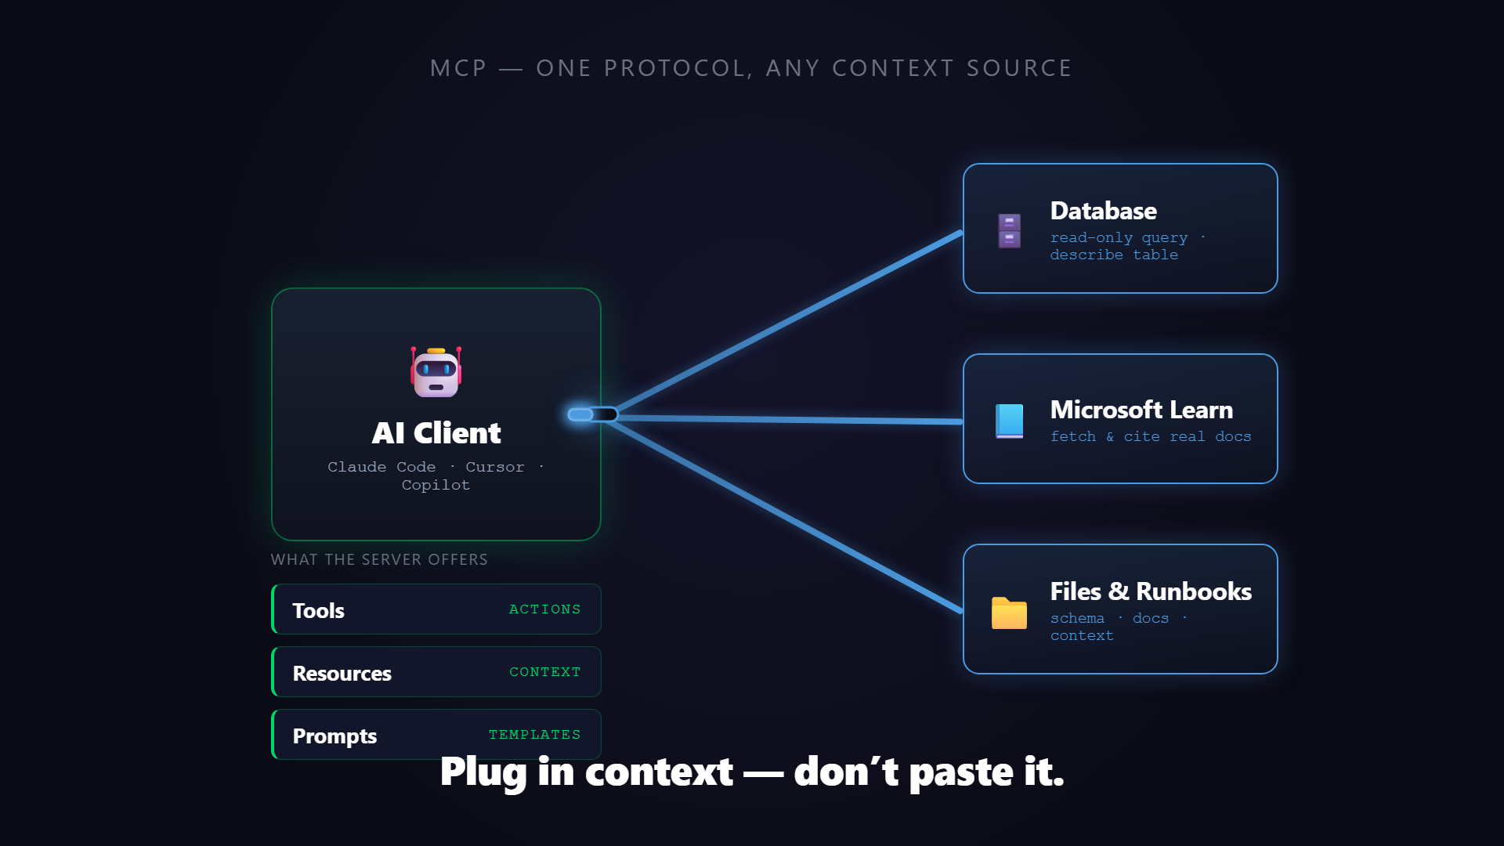
Notes:
▶ PLAY ON CLICK — click the video to start it; narrate over it, don't read the screen. Animates the 'MCP: USB-C for AI context' idea: the opening line 'One standard. Any server. The AI just plugs in.' holds long enough to read, then a central AI Client hub appears and Database / Microsoft Learn / Files & Runbooks MCP servers slide in and snap into a single USB-C port via cables; finally the three capabilities light up — Tools (ACTIONS), Resources (CONTEXT), Prompts (TEMPLATES) — closing on 'Plug in context — don't paste it.' 24s. Asset: images/mcp-usb-c.mp4 (poster images/mcp-usb-c.png), embedded play-on-click; re-render via the remotion mcp-usb-c template if the visuals change.

Slide 99
AI AT THE GATES: THE DBA'S GUIDE TO SURVIVING IN AN LLM WORLD
SLIDE 99
Demo: the Microsoft Learn MCP server
WITHOUT MCP
WITH LEARN MCP
01
01
Version-specific SQL Server question
Fetches and cites the real doc
02
02
Model guesses or hedges
vs.
Same model, same question
03
03
The hallucination failure mode from 5.1
No creds, no data leaves — safe to run live
The only difference is it can now look it up. That's MCP.

Slide 100
AI AT THE GATES: THE DBA'S GUIDE TO SURVIVING IN AN LLM WORLD
SLIDE 100
Database MCP servers — real power, real risk
The power
The risk
Connect the AI to your actual metadata — tables, columns, procs, indexes. "Write me a proc" uses real names. The schema-blind problem? Gone.
The moment a server touches your DB: read-only? which credential? what's the blast radius? That's the cliffhanger for the build block.
1
2

Slide 101
06
CHAPTER SIX
BUILD YOUR OWN TOOLS

Slide 102
“
AI AT THE GATES: THE DBA'S GUIDE TO SURVIVING IN AN LLM WORLD
SLIDE 102
The 20-minute utility you'd never have built
Rename 400 columns, parse a gnarly log, reformat an export. Vibe coding: describe what you want in plain English, the AI writes it, you test it, you ship it. You don't have to be a developer to direct one anymore. It's also where people ship confident garbage — I'll show you both.

Slide 103
AI AT THE GATES: THE DBA'S GUIDE TO SURVIVING IN AN LLM WORLD
SLIDE 103
Choose your tool — match it to the job
Conversational / Agentic
AI-Native Editors
Browser App-Builders
Match it to the job
Claude, Claude Code. "Build me this script" end-to-end. Best for a throwaway utility you'll run once and toss.
Cursor, Windsurf. Project-scale work you'll maintain — with git history and whole-repo context.
Bolt, Replit, v0. Lowest barrier — describe an app, get a running app. Great for a quick tool for a business user.
Throwaway → conversational. Something you'll maintain → editor + git. A quick app → browser builder. The job picks the tool.
1
2
3
4

Slide 104
AI AT THE GATES: THE DBA'S GUIDE TO SURVIVING IN AN LLM WORLD
SLIDE 104
Vibe coding best practices
01
Describe outcomes, not implementation
"Find duplicate customers by email, output a CSV." You own the what; it owns the how.
02
Work in small steps
One capability at a time. Test each before adding the next.
03
Run it on realistic input. You are the QA; the AI won't tell you it's wrong.
Test rigorously
04
Course-correct early
Fixing drift at step 2 is cheap; at step 8 it's a tangle.
05
You decide what gets built and whether it's right. The AI is the hands, not the brain.
Stay the architect

Slide 105
AI AT THE GATES: THE DBA'S GUIDE TO SURVIVING IN AN LLM WORLD
SLIDE 105
When vibe coding isn't enough
01
Complex business logic
The more domain nuance, the more it guesses wrong.
02
Performance-critical paths
Fine for a one-off; risky for something hammering prod.
03
If you can't tell whether the output is correct, it's dangerous, not magic.
Unfamiliar domains
04
Auth, secrets, prod writes — vibe-code the draft, review like your job depends on it.
Security-sensitive code
05
Code you didn't write and don't understand is code you can't maintain.
The maintenance trap

Slide 106
AI AT THE GATES: THE DBA'S GUIDE TO SURVIVING IN AN LLM WORLD
SLIDE 106
It's 50 lines, not magic
In 5.2 you watched the AI fetch its own context. Here's the whole trick: instantiate a server, register one resource (the schema) and one tool (run a read-only query), wire a least-privilege connection.
const server = new McpServer({ name: "sqlserver-mcp", version: "0.1.0" });
server.resource("schema", "db://schema", async () => ({
contents: [{ text: await getInformationSchema() }]
}));
…
· The tool's description is part of the prompt — good descriptions = correct use.
· Scaffold-and-fill beats typing 200 lines live and praying.
The tutorial teaches you to register a tool. Production teaches you to ship one safely.

Slide 107
AI AT THE GATES: THE DBA'S GUIDE TO SURVIVING IN AN LLM WORLD
SLIDE 107
The build, in five steps
01
Instantiate + declare capabilities
Spin up the server, announce what it offers.
02
Register the schema resource
INFORMATION_SCHEMA / sys.* as readable context.
03
Register run_select
Execute a read-only query, return rows.
04
Wire the connection
Parameterized, least-privilege login.
05
Add to .mcp.json + connect
The client launches it; confirm the handshake.

Slide 108
AI AT THE GATES: THE DBA'S GUIDE TO SURVIVING IN AN LLM WORLD
SLIDE 108
The guardrail stack — not one check
01
Read-only by default
db_datareader login. The model can't DROP what its credential can't DROP.
02
SELECT-only at the boundary
Parse the statement; reject anything that isn't a SELECT. Allowlist identifiers.
03
Caps + timeouts
Row cap and query timeout so the AI can't melt the box.
04
Credential hygiene
Secrets out of code and out of the prompt. Errors never leak connection strings.
05
Prompt injection via results
Returned data can contain instructions. Know it's a class of attack.
06
An external hook
A Claude Code hook fires on every tool call — a second gate that doesn't trust the server. Test that it actually blocks.
Any one layer can fail; the stack still holds. That's the difference between a demo and production.

Slide 109
AI AT THE GATES: THE DBA'S GUIDE TO SURVIVING IN AN LLM WORLD
SLIDE 109
Demo: it works AND it refuses
IT WORKS
IT REFUSES
01
01
Natural-language question
Ask for something destructive
02
02
AI calls run_select against the real DB
vs.
External hook blocks it first
03
03
SELECT-only guard would've caught it too
Real rows come back
Show the refusal, not just the success — that's the credibility moment.

Slide 110
AI AT THE GATES: THE DBA'S GUIDE TO SURVIVING IN AN LLM WORLD
SLIDE 110
Four more things you can build
Slack / Teams support bot
Runbook assistant
AI in CI/CD
Text-to-SQL for business
A second reviewer on every migration. AI advises; a human still approves.
First-line DBA support that never sleeps — backed by your MCP server.
Ask your runbooks questions. Tribal knowledge outlives the person who leaves.
High value, highest care — governed models only, never raw prod.
1
2
3
4

Slide 111
“
AI AT THE GATES: THE DBA'S GUIDE TO SURVIVING IN AN LLM WORLD
SLIDE 111
Model + context + guardrail + where users already are
A model + your context + a guardrail + a place users already are. Once you see the recipe, you can invent the fifth yourself. This is how I run ~90 hooks across my setup — and two hard-won cautions: test that the guardrail actually fires, and watch the blast radius. A guardrail is code; it earns the same testing as the thing it guards.

Slide 112
AI AT THE GATES: THE DBA'S GUIDE TO SURVIVING IN AN LLM WORLD
SLIDE 112
Your AI adoption roadmap
PHASE I · 01
PHASE II · 02
PHASE III · 03
This Week
This Quarter
The Horizon
1
2
3
Use an assistant for one boring task. Stand up the Learn MCP server. Run AI code review by hand. Build evidence.
Propose the AUP. Build your first DB MCP server with guardrails. Pilot one DIY tool on one team.
Vectors normal, AI-assisted ops routine, context layers standard. Your role shifts to governing AI-augmented systems.

Slide 113
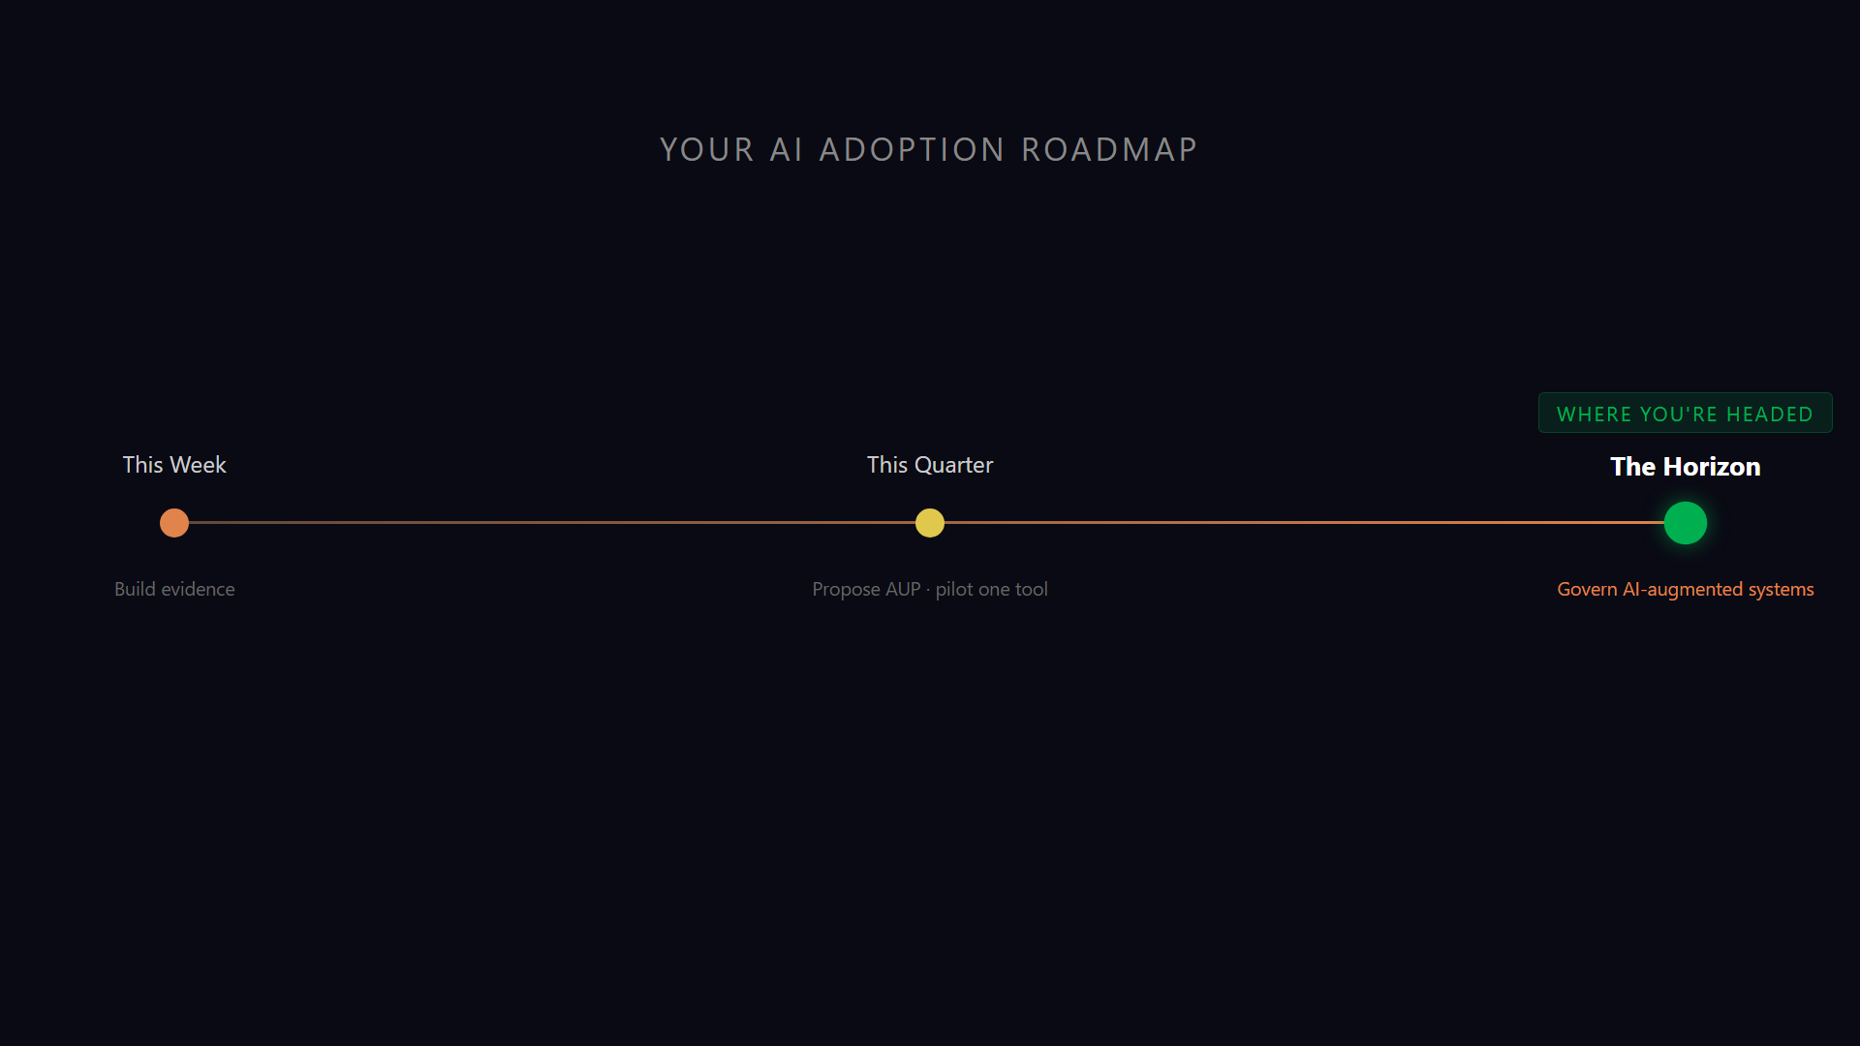
Notes:
▶ PLAY ON CLICK — the animated version of the roadmap you just walked. The line draws left-to-right through This Week → This Quarter → The Horizon, landing on the green 'Where you're headed' milestone. Closer-energy beat: it visually says 'you have a phased plan' — the exact business-case feeling to leave them with before 'Building the case for leadership.' ~10s; click, let it finish, then advance. Asset: images/adoption-roadmap.mp4 (poster images/adoption-roadmap.png), rendered from the remotion wave-timeline template — re-render via that template if the phases change.

Slide 114
AI AT THE GATES: THE DBA'S GUIDE TO SURVIVING IN AN LLM WORLD
SLIDE 114
Building the case for leadership
01
The painful problem
Named in their units — hours, tickets, risk.
02
The bounded pilot
One team, one task, 30 days.
03
The guardrails
How you make sure it can't hurt you.
04
The measured result
Before/after, not a TED talk.
05
The ask
The next bounded step — not a platform.
You now have the evidence, the governance story, and a phased plan. That is the business case.

Slide 115
“
AI AT THE GATES: THE DBA'S GUIDE TO SURVIVING IN AN LLM WORLD
SLIDE 115
Do one thing Monday. Have a result to show.
Do one thing Monday — the smallest useful thing from today — and have a result to show. That's how this goes from a conference you attended to a capability your team has. Pick your one thing before you leave the room.

Slide 116
AI AT THE GATES: THE DBA'S GUIDE TO SURVIVING IN AN LLM WORLD
SLIDE 116
Questions? Let's talk.
Q.01
Q
Your security stance
Q.02
Q
Picking the right tool
Q.03
Q
Prompting for your workload
Q.04
Q
Standing up an MCP server
Q.05
Q
Where to start Monday

Slide 117

AI AT THE GATES: THE DBA'S GUIDE TO SURVIVING IN AN LLM WORLD
SLIDE 117
Thank You.
Jonathan Stewart · Kevin Feasel
Jonathan Stewart — Sound BI · sqlbites.net | Kevin Feasel — Catallaxy Services · curatedsql.com

