Slide 1
Pick Your Poison: Choosing the Right Edition of SQL Server
Kevin Feasel
Catallaxy Services

Slide 2

Kevin
Feasel
Catallaxy Services
I run Catallaxy Services and curate Curated SQL, and I wrote Finding Ghosts in Your Data.
Slides, scripts and handouts for this session: https://csmore.info/on/editions

Slide 3
Motivation
Every edition choice costs you something: Enterprise costs money, Standard costs capability, Express costs headroom, and the free developer editions cost you compliance risk.
There is no free lunch here, so the goal is not to find the "best" edition. It is to choose deliberately and know what you gave up. On top of this, SQL Server 2025 introduces new considerations that affect these trade-offs.

Slide 4
Before We Start
I am not a licensing representative and this is not legal advice.
When real money is on the line, confirm with your licensing partner before you sign anything.

Slide 5
Agenda
The 2025 Edition Landscape
The Limits that Actually Bite
The Second Axis: License Type
Counting Cores and Staying Compliant
Changing Editions
When the Answer Isn't an Edition
The Decision Framework

Slide 6
The 2025 Lineup
Edition | Capacity | Notes
Enterprise | OS maximum | Full feature set
Standard | 4 sockets / 32 cores, 256 GB | Basic AGs only
Enterprise Developer | OS maximum | Free, non-production
Standard Developer | Matches Standard | NEW in 2025
Evaluation | OS maximum | 180 days
Express | 1 socket / 4 cores, 1,410 MB | 50 GB max database
Web | Discontinued in 2025

Slide 7
The Developer Editions Got Renamed
Developer edition is now Enterprise Developer.
Standard Developer is new in 2025 and carries the Standard feature set, so you can certify against what you will actually run in production.
If your dev/test estate or install automation references "Developer," it needs attention.

Slide 8
What Standard Actually Gained
Compute: lesser of 4 sockets or 32 cores (was 24)
Buffer pool: 256 GB (was 128 GB)
Resource Governor, with full Enterprise functionality
Power BI Report Server use rights
The asterisk: 256 GB is buffer pool only. Add to that columnstore segment cache (32GB) and memory-optimized data size per database (32 GB each).

Slide 9
Express Grew Up
Maximum database size raised from 10 GB to 50 GB.
Express with Advanced Services is discontinued. Base Express now includes everything it offered: SSDT, machine learning integration, and full-text search.
This meaningfully changes the ISV and embedded-application calculus.

Slide 10
Web Edition Is Gone
Web edition is discontinued in SQL Server 2025. The upgrade path is Enterprise or Standard.
Web was primarily a SPLA product, so the people genuinely affected are hosting and service providers rather than typical enterprises.

Slide 11
The Biggest Change Is Reporting
On-premises reporting consolidates under Power BI Report Server. No new SSRS versions will ship. SSRS 2022 is the last, supported through January 11, 2033.
The licensing part is the real news: PBIRS use rights now extend to Standard edition under any license type. Previously this required Enterprise plus active Software Assurance.
Also gone: DQS, MDS, and Reporting Services upgrades are all unsupported on 2025.

Slide 12
Demo Time
Notes:
Demo 1 -- Scripts/01, Parts 1 to 4. THREE windows: 1433 Standard, 1434 Enterprise, 1435 Express, all connected and tested BEFORE the session. Part 2 is the capacity beat and Express is the star -- cpu_count vs scheduler_count shows a cap being enforced, while Standard and Enterprise come back IDENTICAL. Say that out loud: the 32-core ceiling does not bind here and will not bind for most of their workloads either. Part 3 proves the six features are really in Contoso. ASK FOR GUESSES on how many block a move to Standard before running Part 4. Part 4 is the reveal: all six come back, and the real answer to the Part 3 question is zero. The DMV over-reports. ~4 minutes. Part 5 is NOT part of this demo -- save it for the AI slide in Section 3.

Slide 13
Agenda
The 2025 Edition Landscape
The Limits that Actually Bite
The Second Axis: License Type
Counting Cores and Staying Compliant
Changing Editions
When the Answer Isn't an Edition
The Decision Framework

Slide 14
High Availability Is the Dividing Line
2025 did not move this.
Standard gets basic availability groups only: two replicas, one database, non-readable secondary.
Always On AGs, contained AGs, and distributed AGs remain Enterprise-only. FCI is capped at two nodes on Standard versus sixteen on Enterprise.
If you were waiting for 2025 Standard to give you real availability groups, it did not.

Slide 15
The Footnote That Ruins Your Warehouse
Batch mode degree of parallelism is limited to 2 on Standard and 1 on Express.
This is why "we bought Standard and our columnstore warehouse is slow" is a real support call.
Notes:
Batch mode DOP capped at 2 on Standard. This is a footnote in a Microsoft feature table and it is worth more than most of the checkboxes above it. VERIFIED on identical 16-core hardware: Enterprise ran the same aggregate at DOP 16, Standard at DOP 2. Demo 3 shows it live, so plant the seed here. Note for the demo: at 1M rows the query is too cheap to go parallel on its own, so script 03 forces it with the documented ENABLE_PARALLEL_PLAN_PREFERENCE hint -- say so out loud rather than letting someone think you rigged it.

Slide 16
Other Enterprise-Only Limits Worth Knowing
Maintenance windows: online and resumable index operations, online schema change, online page and file restore, fast recovery
Data warehouse: star join optimizations, parallel query processing on partitioned tables, global batch aggregation
Scale: read-ahead, advanced scanning, AVX-512, memory-optimized TempDB metadata, NUMA-aware large pages
Operations: parallel index maintenance, parallel consistency check (DBCC)

Slide 17
The Surprise: AI Is Not an Edition Feature
Native vector data type, DiskANN vector indexing, external models, local ONNX models, embedding generation, chunking.
All of it runs on Express.
Edition is not what gates AI in 2025. The PREVIEW_FEATURES database-scoped configuration is. Functionality like DiskANN indexing, local ONNX models, fuzzy string matching, and change event streaming all require it.

Slide 18
Agenda
The 2025 Edition Landscape
The Limits that Actually Bite
The Second Axis: License Type
Counting Cores and Staying Compliant
Changing Editions
When the Answer Isn't an Edition
The Decision Framework

Slide 19
Your Edition Is No Longer the Only Axis
Two shops both running Enterprise 2025 can have different feature sets based on how they pay.
Three ways to hold a license:
Perpetual license only
License with Software Assurance or a SQL Server subscription
Pay-as-you-go through Azure Arc
Notes:
New concept for almost everyone. Slow down here. The one-sentence version: two shops both running Enterprise 2025 can have different feature sets depending on whether they carry SA. If that does not land, the next three slides do not either.

Slide 20
What SA or a Subscription Actually Buys
Gated behind SA or subscription via Azure Arc:
Best Practices Assessment
Point-in-time restore and automated backups to local storage
Automatic updates, monitoring, client connection summary
Extended Security Update subscription
Plus the licensing benefits: free version upgrades, the HA/DR passive replica benefit, unlimited virtualization, license-by-VM, and the 180-day dual-use benefit.

Slide 21
Pay-As-You-Go Is a Real Third Option
Per-core, per-hour, metered through Azure with no upfront license purchase.
Watch the Linux caveats:
No automatic passive replica detection, so every instance bills as active
Core count derived from the OS environment
No connected-user verification on readable secondaries

Slide 22
What This Does to the Math
The comparison was never just Enterprise versus Standard. It is edition × license type.
Enterprise without Software Assurance has no "passive" replica benefit, no unlimited virtualization, no free version upgrades, and no Arc assessment, PITR, or automated backups.
Standard with SA gets all of those, and in 2025 it also gets Power BI Report Server.
Price the pair, not the edition.

Slide 23
Agenda
The 2025 Edition Landscape
The Limits that Actually Bite
The Second Axis: License Type
Counting Cores and Staying Compliant
Changing Editions
When the Answer Isn't an Edition
The Decision Framework

Slide 24
How to Count Cores
Four-core minimum per operating system environment
Hyperthreading counts on VMs, but not on physical deployments
Containers and Kubernetes follow the same vCore rules
Enterprise under Server + CAL is not available for new agreements and caps at 20 cores per instance
Notes:
The four-core minimum surprises people with small VMs. Hyperthreading counting on VMs but not physical is the one people get wrong in both directions. Server + CAL is legacy-only -- mention it and move on unless someone bites.

Slide 25
The Passive Replica Trap
Your free passive secondary is not free without Software Assurance.
This is a common accidental-noncompliance finding, and it is easy to walk into: someone stands up a DR replica, nobody checks the SA status, and the exposure sits there until an audit.
Unlimited virtualization has the same shape: it requires Enterprise plus SA.

Slide 26
Are You Using What You Pay For?
sys.dm_db_persisted_sku_features lists edition-restricted features persisted in a database. It is the right place to start.
But it misleads in both directions. It still reports partitioning, compression, columnstore, In-Memory OLTP and CDC — all Standard features since 2016 SP1. Six "blockers" that block nothing.
And zero rows would not mean safety either. It answers "will it restore," never "will it work."

Slide 27
Demo Time
Notes:
Demo 2 -- Scripts/02. The Monday-morning demo. Part 1 is the hook and it is slightly uncomfortable: the audit immediately flags the demo environment itself, because two of the three instances are Developer editions. Lean into it -- that is exactly how a 'temporary' dev box becomes a licensing violation. Then the Contoso vs ContosoStaging contrast: one database is stuffed with features, the other has none, and the DMV can barely tell them apart. Part 4 returns nothing because there is no AG here; say so plainly rather than pretending. ~4 minutes. Mention the dbatools script in the repo while this runs.

Slide 28
Agenda
The 2025 Edition Landscape
The Limits that Actually Bite
The Second Axis: License Type
Counting Cores and Staying Compliant
Changing Editions
When the Answer Isn't an Edition
The Decision Framework

Slide 29
Upgrading Is the Easy Direction
Setup → Maintenance → Edition Upgrade, or /ACTION=EditionUpgrade from the command line.
On a failover cluster instance, running it on one node is sufficient. The Database Engine does not take resources offline, but you must restart the instance or fail over afterward.
You can upgrade to 2025 from: SQL Server 2014 SP3, 2016 SP3, 2017, 2019, and 2022.
Notes:
Fast. This is the easy half and the room does not need convincing. The FCI detail is the only genuinely useful nugget -- one node is enough, but you must restart or fail over afterward.

Slide 30
There Is No In-Place Downgrade
Downgrading means: back up everything including system databases, move master/model/msdb aside, fully uninstall, restart, reinstall with the same instance name, patch, then restore.
Budget real downtime. The step-by-step runbook is in the handout.

Slide 31
And the Restore Is the Easy Part
The pre-flight check reports three blockers. The restore to Standard succeeds anyway. Every row is there.
Then your maintenance window stops fitting, your columnstore queries drop from DOP 16 to DOP 2, and your availability group is gone.
None of that is persisted in a data file, so none of it shows up in the DMV.

Slide 32
Demo Time
Notes:
Demo 3 -- Scripts/03, the payoff. Part 1 is pre-run on Enterprise; the backup should already exist on the shared volume. Live: show the DMV reporting three blockers, run the restore, let it SUCCEED anyway, then run the online index rebuild and let it FAIL on screen. Then the DOP comparison. ~2 minutes. VERIFIED error text, Msg 1712: 'Online index operations can only be performed in Enterprise edition of SQL Server or Azure SQL Edge.' Exactly two errors should appear, both intentional. REHEARSE THIS -- confirm the text is legible and the plan DOP difference is visible from the back.

Slide 33
Agenda
The 2025 Edition Landscape
The Limits that Actually Bite
The Second Axis: License Type
Counting Cores and Staying Compliant
Changing Editions
When the Answer Isn't an Edition
The Decision Framework

Slide 34
In PaaS There Are No Editions
Azure SQL Database has service tiers, not editions. The question becomes tier and sizing.
Azure SQL Database: General Purpose, Business Critical, Hyperscale (now the recommended default for new OLTP and HTAP workloads)
Azure SQL Managed Instance: GP, Next-gen GP (GA November 2025), Business Critical
SQL Server on Azure VM: editions apply exactly as on-premises
SQL database in Fabric: a different model again, and moving fast
Naming trap: the DTU model's "Standard" tier has nothing to do with Standard edition.

Slide 35
Azure Hybrid Benefit Does the Conversion
AHB turns "which edition do I own" into "what can I run in Azure":
This benefit requires Software Assurance.
You own | You get
1 Standard core | 1 General Purpose core
1 Enterprise core | 1 Business Critical core
1 Enterprise core | 4 General Purpose cores

Slide 36
Enterprise Features that Just Come Included
Business Critical ships a readable secondary replica, giving you effectively twice the vCores and memory for the same price if you can split read-write from read-only traffic.
On-premises, that readable secondary is an Enterprise-only Always On capability.
Managed Instance also has a license-free DR benefit: you can designate a secondary as DR-only and skip vCore licensing on it.

Slide 37
The Hybrid Middle Ground
The Managed Instance link feature uses distributed availability group technology and works on Standard as well as Enterprise in 2025.
A Standard shop can offload reads or establish DR to Azure without buying Enterprise.
Notes:
Genuinely underused and often the cheapest answer to 'we need a readable secondary.' The MI link works on Standard, not just Enterprise. Worth emphasizing for anyone who just decided they need Enterprise for HA.

Slide 38
Agenda
The 2025 Edition Landscape
The Limits that Actually Bite
The Second Axis: License Type
Counting Cores and Staying Compliant
Changing Editions
When the Answer Isn't an Edition
The Decision Framework

Slide 39
The Framework
Work the questions in this order:
Should this be on-premises at all?
What are the HA/DR requirements?
What is the capacity ceiling and which cap actually binds?
Do you need on-premises reporting?
What license type do you hold?
Then, and only then, budget.

Slide 40
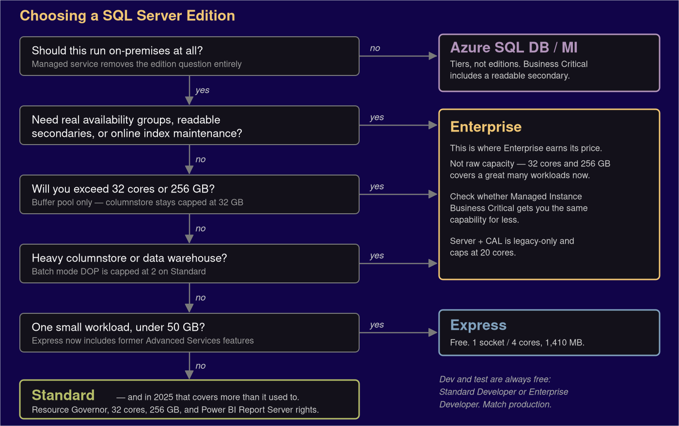
The Framework

Slide 41
When Enterprise Earns Its Price
Usually high availability, online maintenance, or data warehouse parallelism.
Rarely raw capacity: 32 cores and 256 GB covers a great many workloads that used to force the upgrade.
2025 Standard is now sufficient in places 2022 Standard was not. Re-run the decision if you last made it before the release.

Slide 42
Common Mistakes
Buying Enterprise "just in case we need it"
Assuming 2025 Standard got real availability groups
Ignoring Express limits until production
Letting Developer edition drift into production use
Treating edition as a purchasing decision made after the architecture

Slide 43
Wrapping Up
Edition choice is an architecture decision, not a purchasing decision. Make it before you design the solution.
Key takeaways:
2025 Standard gained capacity and Resource Governor, not availability groups
The reporting change may be worth more than the engine changes
License type is now a second axis alongside edition
Upgrades are in-place. Downgrades are not.

Slide 44


Slide 45


Kevin Feasel
Slides, scripts and handouts: https://csmore.info/on/editions
@feaselkl
feasel@catallaxyservices.com
https://csmore.info

