Slide 1

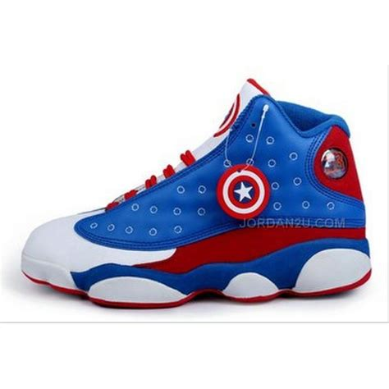
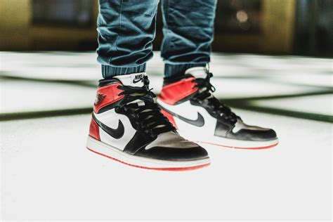
SWAG SHOP
THE LATEST AND GREATEST CLOTHING COLLECTION

Slide 2
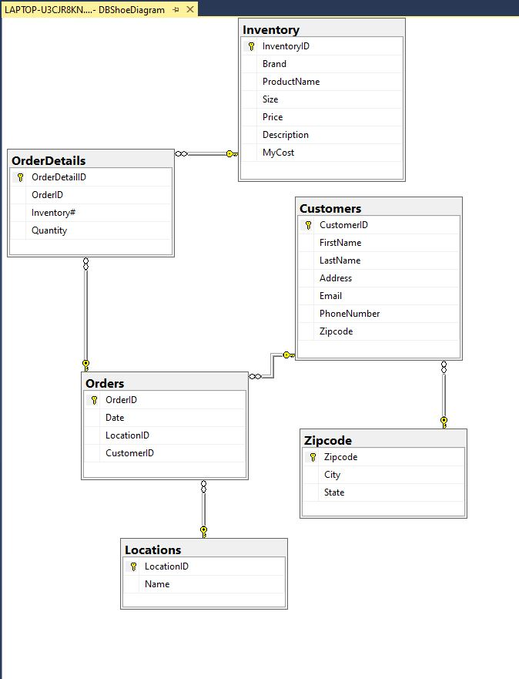

Database Diagrams

Slide 3

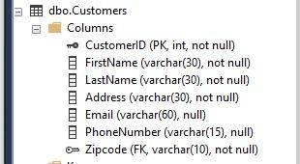
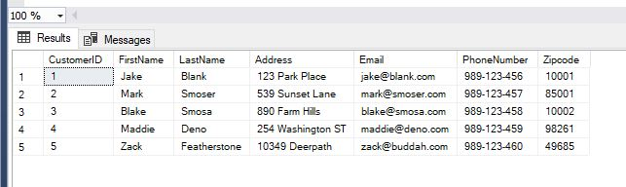
Customer Tables

Slide 4
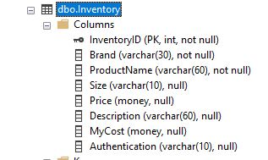
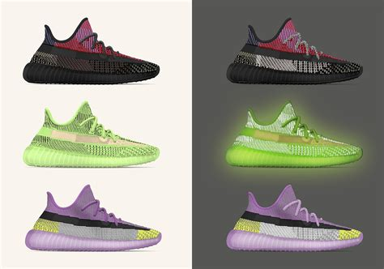
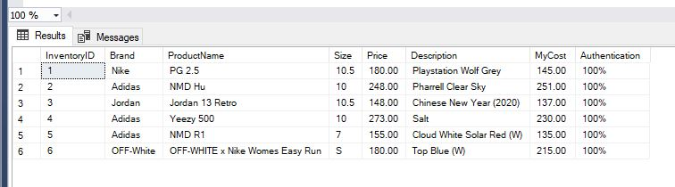
Inventory Table

Slide 5

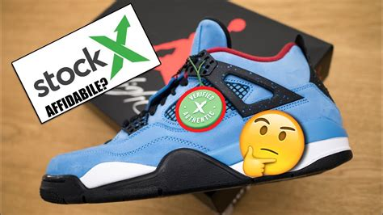
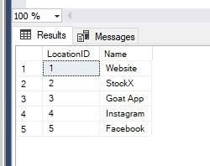
Locations Table

Slide 6

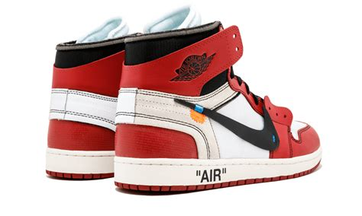
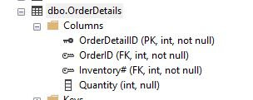
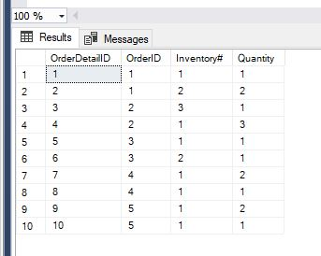
OrderDetails Table

Slide 7
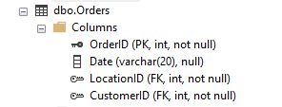

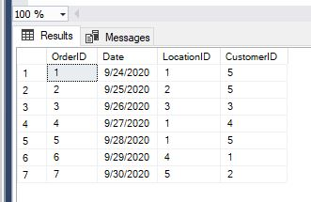
Orders Table

Slide 8

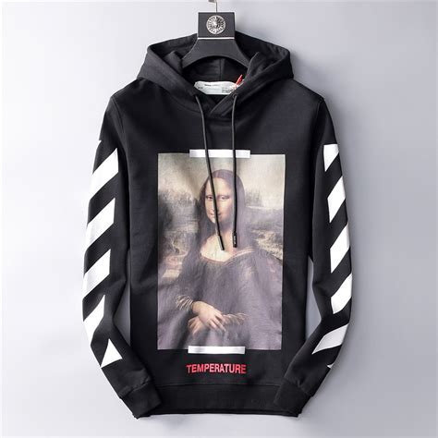
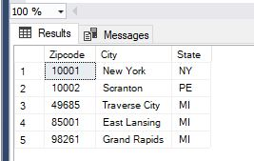
Zipcode Table

Slide 9
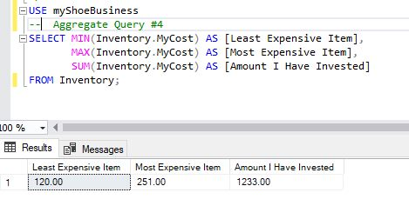

Summary Query #1
In this summary query I am displaying my most expensive items along with the least expensive items I have available. I also include the total amount that I have invested in order to purchase the products.

Slide 10
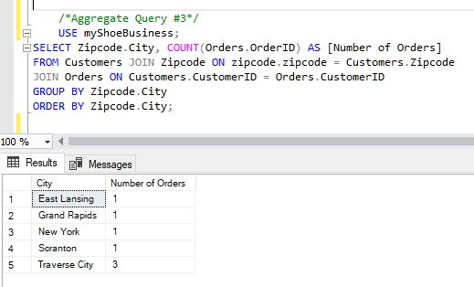
Summary Query #2
In this query I am displaying where my customers are ordering from by displaying the amount of orders from each city.
This will help any future marketing events that will be hosted in person; with the data we can see where we should host the events.

Slide 11
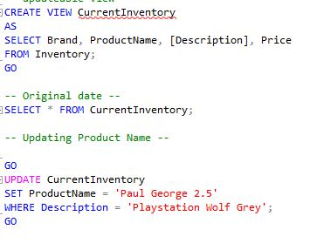
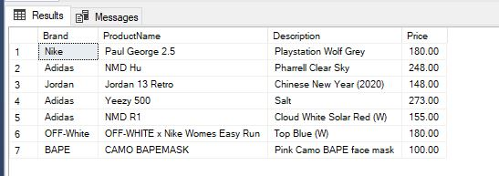
Current Inventory View
This view is updateable and displays the current inventory that’s in stock. It is updateable so that new inventory can be added, and sold inventory can be dropped.

Slide 12
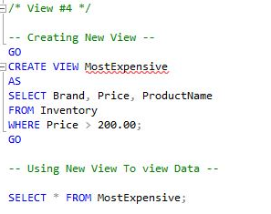

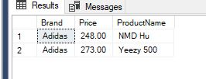
Most Expensive View
In this view that I created, I am Displaying the most expensive items that we have within the data base or in Inventory.

Slide 13
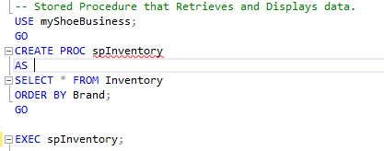
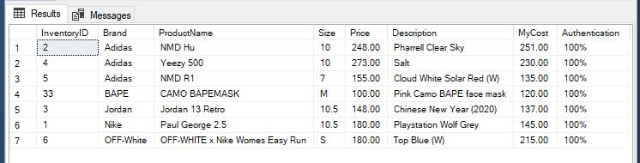
Stored Procedure Inventory

Slide 14
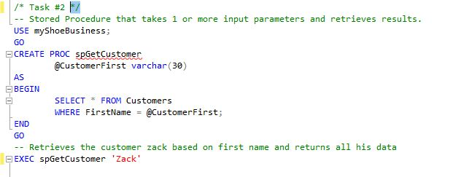

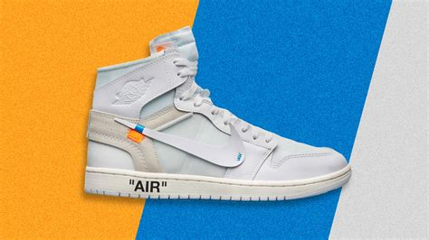
Stored Procedure Get Customer

Slide 15
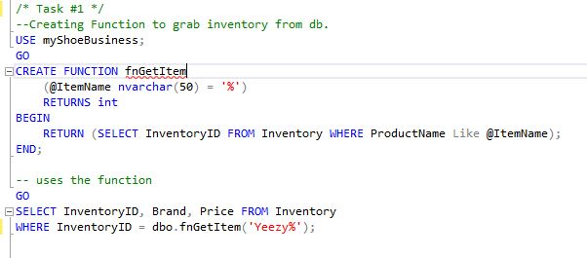
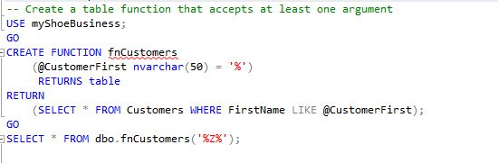



Functions
This function displays a specific inventory items data.
This function displays the info for a specified customer.

Slide 16

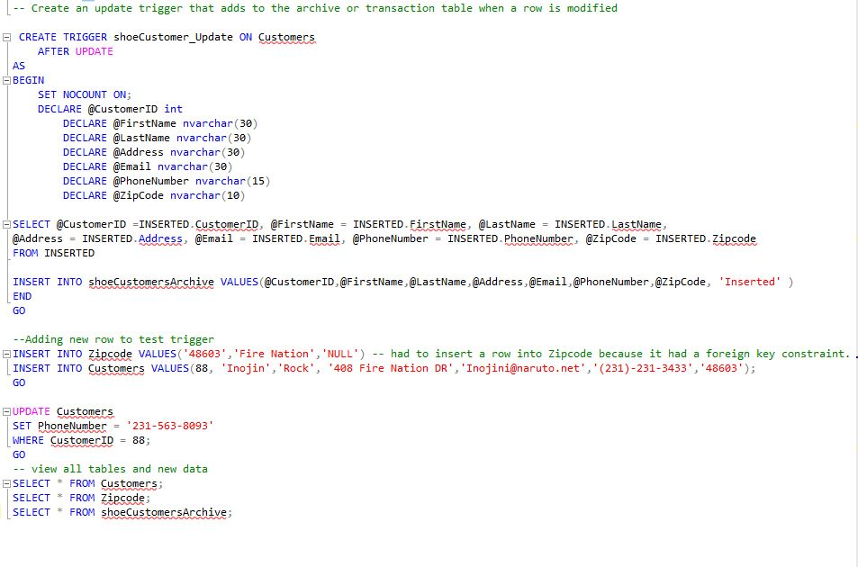
Update Trigger

Slide 17
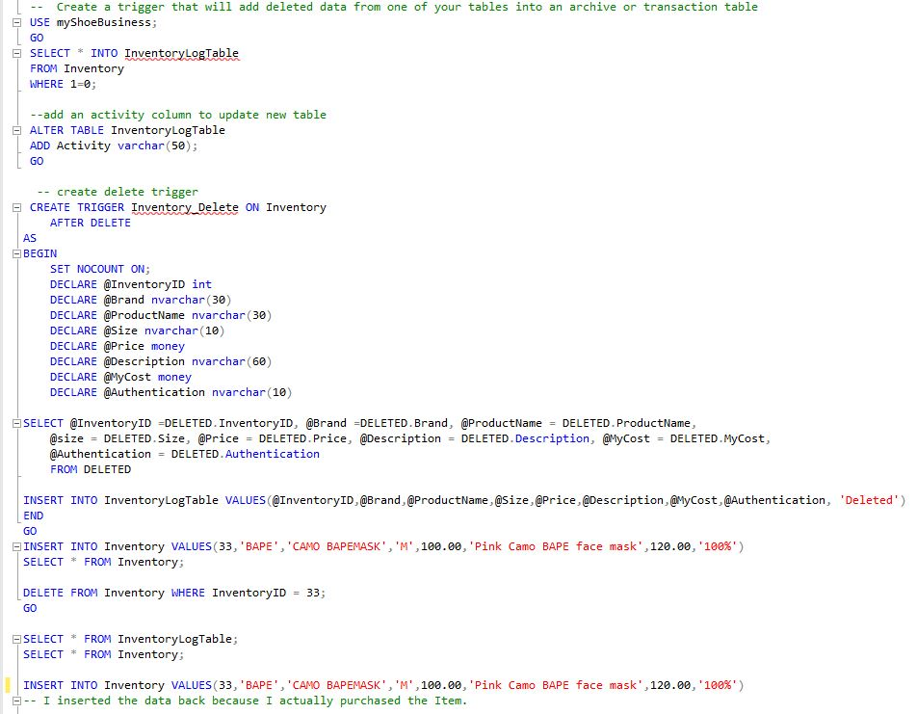

Adding and Deleting Inventory Trigger

Slide 18
What Went Well
I loved doing this project! I seemed to fly through it because I really understood the purpose of what we were doing and how to implement my work into the real world.
I was able to connect it with a project that I was currently working on, and that made it the project seem like something I wanted to do and not something I had to turn in for a grade.

Slide 19
Problems
I only had 1 problem when working on this project. I found it hard using the triggers difficult, not the concept itself but making sure that it had a purpose and actually did something crucial for my database.
In the end updating and deleting inventory triggered data to be added to a new table and I was satisfied with the end results.

Slide 20
What did I learn?
Everything about the project was new to me. I have never had the opportunity to construct my own personal database and learned how to do so.
I also learned how to create table views which was a new concept and one that I liked the most.

Slide 21
Future Plans
Because I used all real items and based the database off of an already started project that I am doing in my own time, I hope to increase the size of my database and add new products as I buy them.
I haven't yet sold anything because it is a personal private collection, but maybe one day it will turn into something real.

Slide 22


THE END

