Slide 1
COMP3211 PROJECT
ANDREW WONG (z5206677) | GABRIEL TAY WEI CHERN (z5216632) | LINDSAY SMALL (z5232920) | MALAVIKA PASUPATI (z5209390) | QUYNH BOI PHAN (z5205690)

Slide 2
1.
SCHEMATIC
ASIP DESIGN

Slide 3
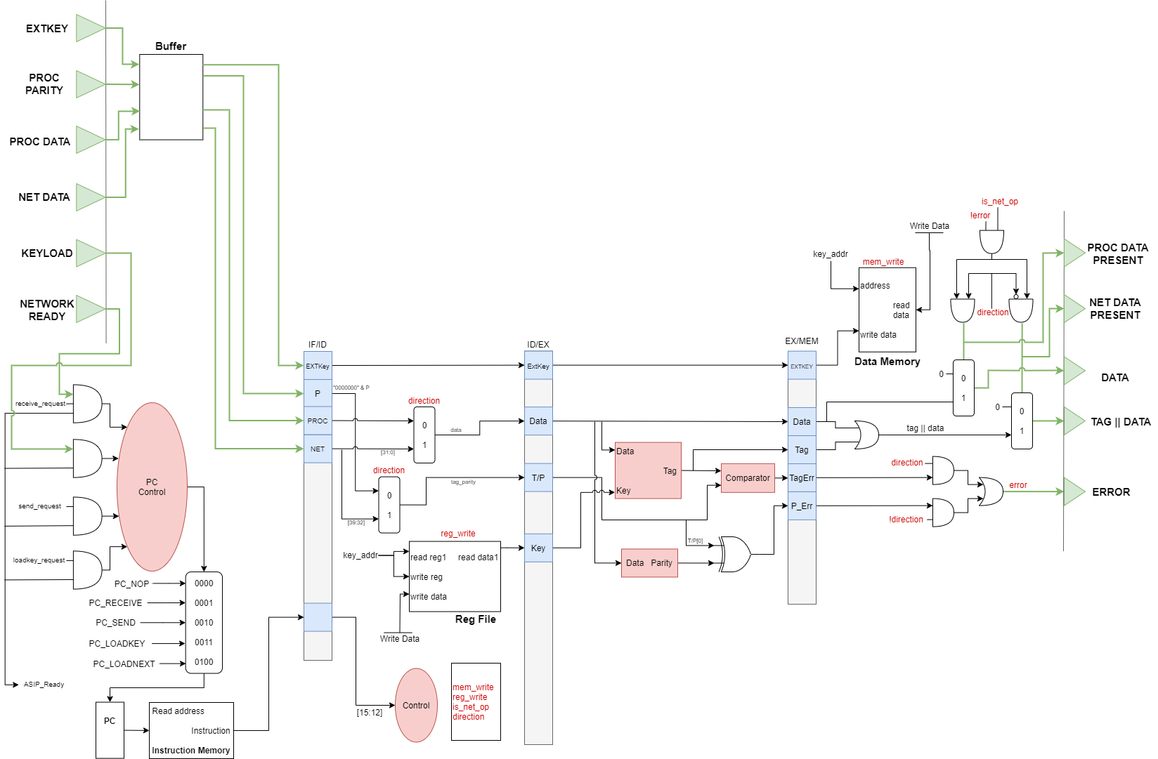
BLOCK DIAGRAM

Slide 4
I/O REGISTERS
Input
External Key [7:0]
Processor Data [31:0]
Network Data [39:0]
Processor Parity Bit
Output
Tag || Data [39:0]
Data [31:0]
Flags
ASIP Ready
Network Ready
Load Key (Loadext Request)
Send Request
Receive Request
Error
Net Data Present
Proc Data Present

Slide 5
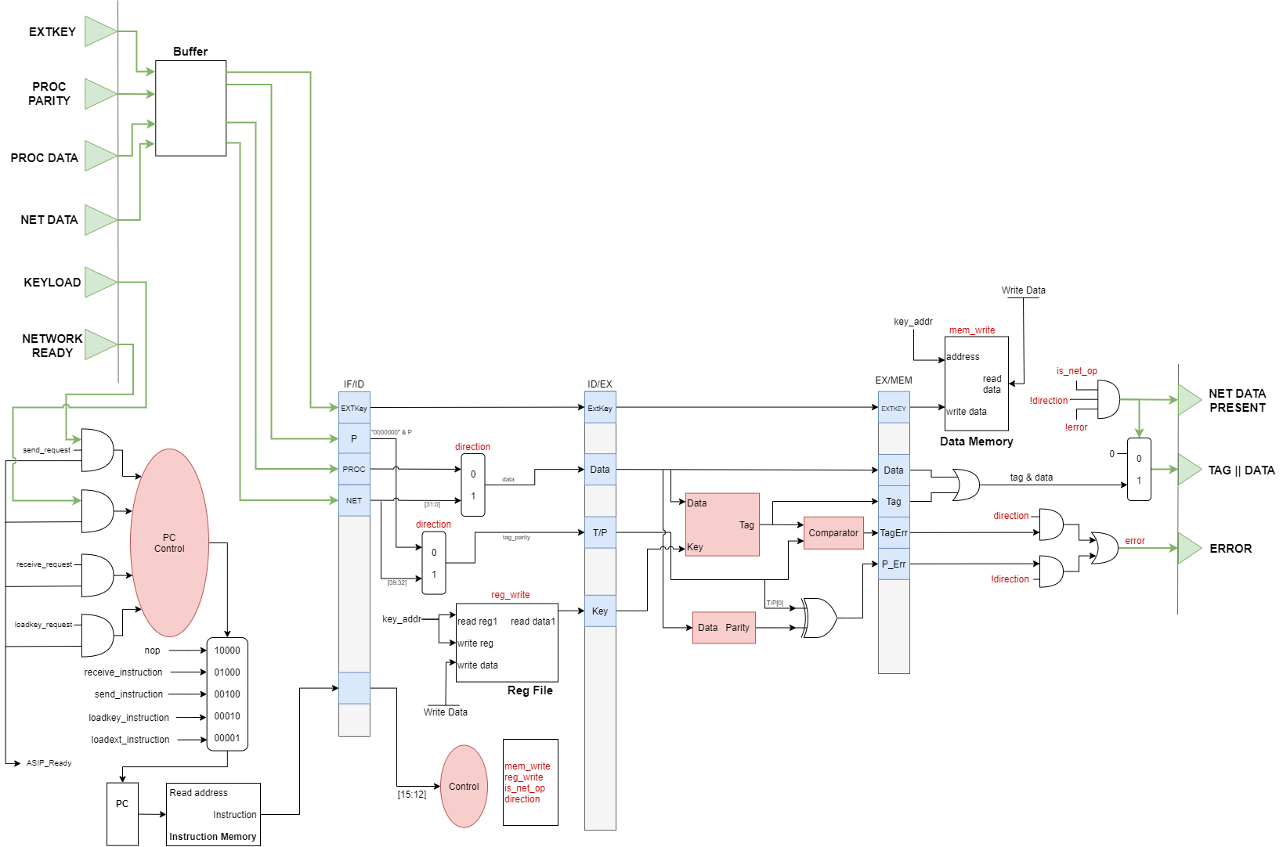
IF STAGE - OTHER COMPONENTS
PC
Sends the address to read in the instruction memory.
MUX
Changes PC value based PC Control.
PC Control
Alters PC based on incoming requests and ready states of ASIP and network.
Instruction Memory
Memory of the instructions that needs to be executed.

Slide 6
IF STAGE - INPUTS AND BUFFER REGISTER
Buffer Register
Store incoming data to account for jump delay.

Slide 7
IF/ID PIPELINE INPUTS
IF/ID Pipeline Inputs
External Key
Parity Bit
Processor and Network Data
Instruction Memory

Slide 8
ID STAGE - COMPONENTS
Control
Sends control signals to the ASIP.
RegFile
Reads the constant address key_addr to output the key data. The same address is used when a new key data is given.
Direction MUXes
Selects data to use for the process
When LOW: use processor data and parity
When HIGH: use network data
Notes:
FIX DIAGRAM - SOMETHING WRONG WITH KEYSELECT

Slide 9
ID/EX PIPELINE INPUTS
ID/EX Pipeline Inputs
Control Signals:
mem_write
reg_write
is_net_op
direction
Data
Tag + Parity bit
External Key (From IF/ID)
Secret Key

Slide 10
EX STAGE - COMPONENTS
Tag Generator
Generate a tag from the key and data given.
Parity
Get the parity bit from the data. This is then compared with the received parity bit from the processor to see if they are the same.
Comparator
Compares the tag generated by the tag generator to the tag given by the network.

Slide 11
EX/MEM PIPELINE INPUTS
EX/MEM Pipeline Inputs
Control Signals
mem_write
reg_write
is_net_op
direction
Tag
TagErr (Tag error)
P_err (Parity bit error)
P (Parity bit)
Data (From ID/EX)
External Key (From ID/EX)

Slide 12
MEM STAGE - SIGNALS
Direction
Indication of the data’s direction.
When LOW: Network → Processor System
When HIGH: Processor System → Network
Error
The error signal is HIGH when the parity bits or the tags are not the same, indicating that there is a software error or an integrity attack.
is_net_op
The is_net_op signal is HIGH if the current operation is a send or receive operation.

Slide 13
MEM STAGE - COMPONENTS AND OUTPUTS
Data Memory
Outputs data from key_addr. Data from key_addr can only be overwritten if mem_write is HIGH.
TAG || DATA MUX
Allows data to be sent only if conditions are met by the AND operation (is_net_op, !direction, and !error)

Slide 14
2.
ISA
Instructions and Signals

Slide 15
ARGUMENT FORMULATION
0x[A][B][C][D]
opcode
don’t care

Slide 16
INSTRUCTIONS
OP_SEND
Send data and tag to network
OP_RECEIVE
Receive data from network
OP_LOADKEY
Load key from data memory to secret register.
Hardcoded to load from data #0
OP_LOADEXT
Load key from external port into data memory
Hardcoded to store to data #0

Slide 17
OPERANDS
OP_SEND
Net Data
OP_RECEIVE
Proc Data
OP_LOADKEY
N/A
OP_LOADEXT
EXTKEY

Slide 18
PC CONTROL
PC will jump to the instruction needed to be executed instead of using PC + 1
PC Control determines which instruction to jump to:
Utilises request signals to determine jump location
ASIP needs to be ready before any jumps is made

Slide 19
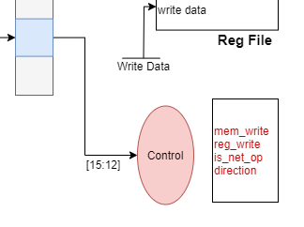
CONTROL SIGNAL INPUTS
opcode (instruction [15:12])
Contains the command needed to be executed by the ASIP

Slide 20
CONTROL SIGNALS - OUTPUTS
mem_write
Overwrites the data of the original secret key used in the ASIP when HIGH.
reg_write
Writes the data of the secret key onto the register of key_addr.
is_net_op
Indicates if the current operation is a network (send data/receive data) operation or not.
direction
Indication of the data’s direction.
LOW: Network → Processor System
HIGH: Processor System → Network

Slide 21
3.
HDL MODEL
Runthrough of the code

Slide 22
4.
TESTBENCH
Testbenches created to ensure validity of components and hence system

Slide 23
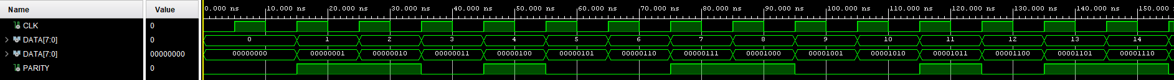
PARITY CHECKING
Each bit of the input port is XOR'd together. The resulting bit is used as the parity bit.
e.g. 00001011 0 ^ 0 ^ 0 ^ 0 ^ 1 ^ 0 ^ 1 ^ 1 = 1, so the parity bit is 1
e.g. 10100101 1 ^ 0 ^ 1 ^ 0 ^ 0 ^ 1 ^ 0 ^ 1 = 0, so the parity bit is 0

Slide 24
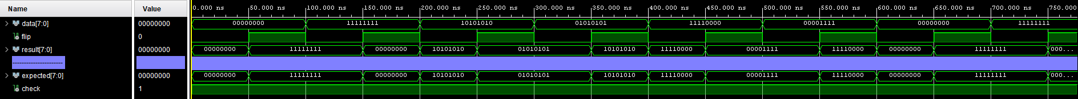
BLOCK FLIP - CASES TESTED
No bits flipped (0000)
D should remain the same throughout
All bits flipped (1111)
All bits of D should be flipped throughout
Flipping parts of D (0001, 0011, 0111, 1111, 0101, 1010)
Only sections of D should be flipped e.g. in 0101 case, D[23:16] and D[7:0] should be flipped whereas D[31:34] and D[15:8] remains the same.

Slide 25

ROTATE LEFT SHIFT - CASES TESTED
No shift (000 000 000 000)
D should remain the same throughout
Rotate shift left by 1 (001 001 001 001)
All bits of D should be shifted to the left by 1.
Rotate shift left by 4 (100 100 100 100)
All bits of D should be shifted to the left by 4.
Rotate shift left by 7 (111 111 111 111)
All bits of D should be shifted to the left by 7.

Slide 26
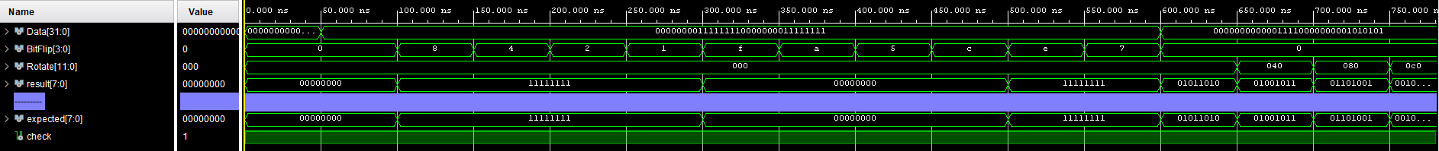
TAG GENERATION
Test different data inputs without bit flip and rotation:
All 0’s
0’s in D[31:34] and D[15:8], 1’s in D[23:16] and D[7:0]
Test different bit flip combinations without rotation:
Cases are similar as before
Test different rotate left shift combinations without bit flip:
Cases are similar as before

Slide 27
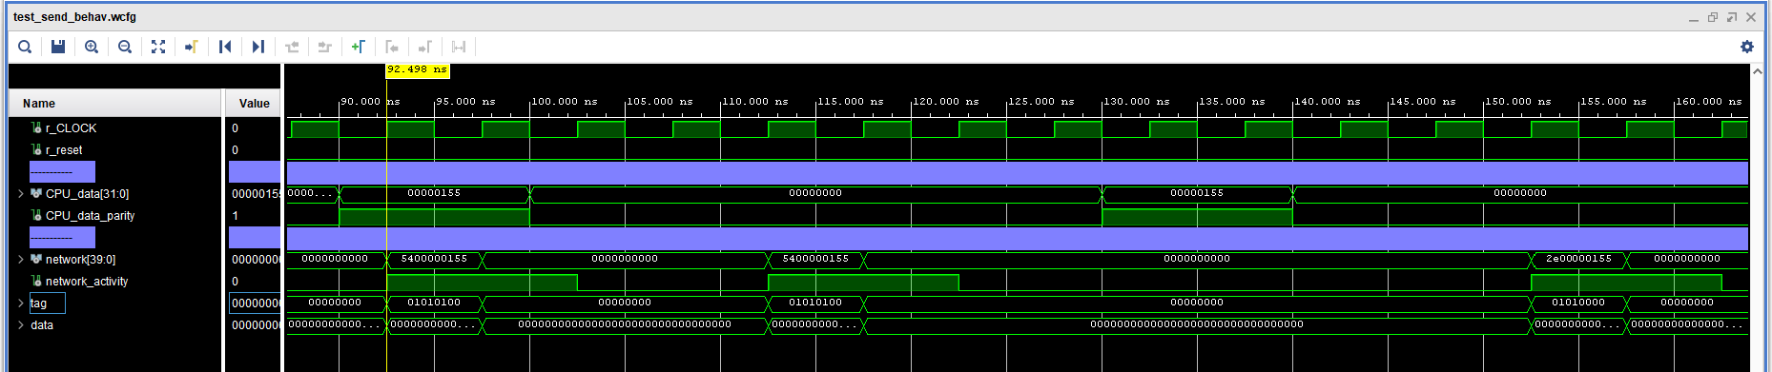
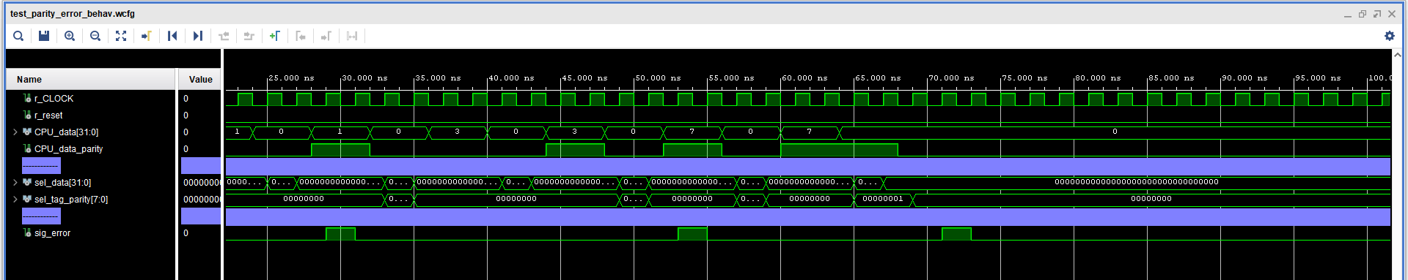
ASIP Integration Test - Sending, Secret, Parity Soft Error
After updating the secret key
Alerts for soft errors (parity)

Slide 28
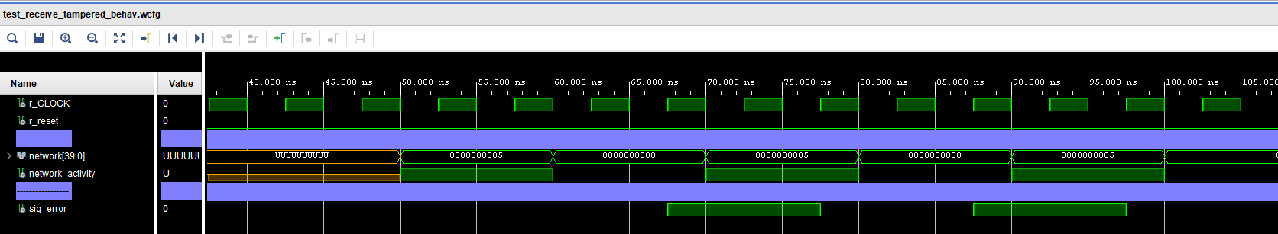
ASIP Integration Test - Receiving tampered data (tag mismatch)

Slide 29
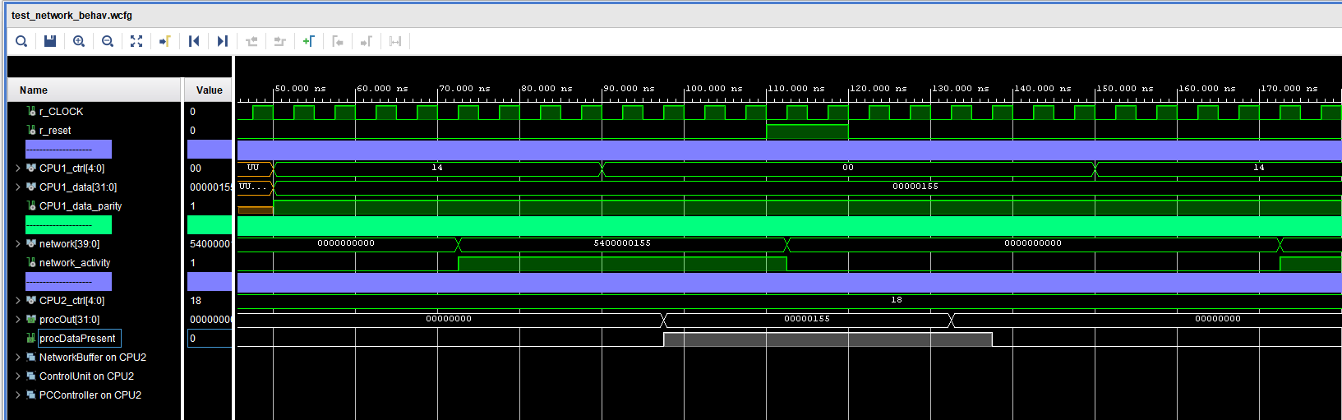
ASIP Integration Test - Basic Simulated Network (Send / Receive)
CPU1 Sends data
CPU2 Receives data

Slide 30
5.
PERFORMANCE
Performance of the system

Slide 31
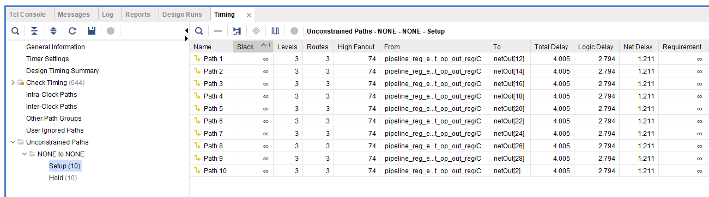
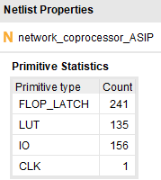
PERFORMANCE
Latency
Component Count

Slide 32
6.
IMPROVEMENTS
Improvements to be made with our current system

Slide 33
IMPROVEMENTS
PROBLEM: The chip of the processor system must be changed if the tag formula changes.
Break structure down to more basic reusable instructions for a more flexible design.
Only firmware would be changed if the tag generation algorithm were to change.
PROBLEM: User is assumed to load the key before doing any other commands
Improve the PC control system and instruction memory - on system starts up, an init command will initialise the data required before the user can use the system.

Slide 34
7.
REFLECTIONS
Reflecting on the process of building the ASIP

Slide 35
Reflections
Task delegation and overall collaboration
Delegate task evenly so the ASIP could be consistently worked on and improved.
Design several ASIP structures, discussed and compared. This can be a collaborative effort but implementation is difficult to distribute.
Communication
Difficulties communicating online.
Many had commitments outside the project.
More frequent meetings to address each other’s queries.
Was confused with parts, needed clarification from the tutor.
Took away time to work on project.

Slide 36
THANKS!
ANY QUESTIONS?

