Slide 1
Preliminary Design Review
FISH & CHIPS FeatherCraft Integrated Structural Housing & Computer, Hardware Interface Processing Suite
Team: Larry Burkey, Jorge Cervantes, Lewis Gillis, Evan Graser, Andrei Iskra,
Megan Howard, Taylor Maurer, Davis Peterson, Maggie Williams
Customer: Michael Brown
Advisor: Joe Tanner
Notes:
Notes:
Adhesive slide still needs to get fixed.

Slide 2
PROJECT MOTIVATION
Commercialization of International Space Station provides a launch opportunity not only to cubesats but larger 100 kg spacecraft
Spacecraft are launched on ISS cargo resupply missions, allowing for soft-stowed configuration and less stress on structure in launch environment
Surrey Satellite Technology US plans to offer the FeatherCraft system as a cost-effective platform for payloads of 45 kg or less.
Project Overview
Design Overview
Risks
Testing & Verification
Project Planning
Requirements & CPEs
Notes:
In recent years, the commercialization of the ISS has allowed the opportunity for not only university cubesats but also larger spacecraft to be launched from the ISS. This opporunity is unique in that the spacecraft can be “soft-stowed” in a ISS cargo bay for a resupply mission, meaning it could be wrapped in foam, and experience much less stress than during a normal launch. Surrey Satellite Technology plans to capitilize on this by creating a lightweight satellite platform with a 5kg structure and offering more mass to later integrated payloads.

Slide 3
PROJECT STATEMENT:
The 5 kg FeatherCraft structure shall provide support for a 100 kg total mass commercial spacecraft with reduced structural manufacturing time and materials cost, and enable the spacecraft to survive launch to and deployment from the ISS for a nadir facing mission.
Project Overview
Design Overview
Risks
Testing & Verification
Project Planning
Requirements & CPEs
Notes:
Overall, the goal for this 5kg structure is to provide support for a 100 kg total mass spacecraft while reducing structural manufacturing time and materials costs, and to enable the spacecraft to survive launch to the ISS, deploy from the ISS, and perform a nadir-facing mission

Slide 4
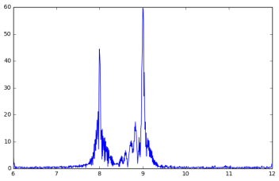
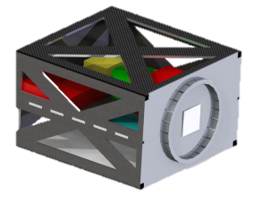
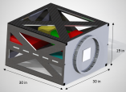
CONOPS:
1. Select suitable lightweight material and create design for structure
2. Fabricate structural test model
3. Design and build data acquisition system to verify structure’s behavior is as modeled
4. Test structural test model on a vibration table with mass loadings
5. Analyze accelerometer data and verify requirements are met
Project Overview
Design Overview
Risks
Testing & Verification
Project Planning
Requirements & CPEs
Notes:
The concept of operations for the design team begins by selecting a lightweight material and creating a design of the structure that would provide mounting locations for other spacecraft components and meeting all other requirements. This structure will also be modelled for its performance during launch, simulated by a vibration table. Next, a structural test model will be fabricated from the design material if the budget allows or from a similar material which could still validate the computer model. Meanwhile, a data acquisition system with will be designed and created to be used during the vibration test to collect accelerometer data which would validate the model. This vibration test will be performed with mass analogs for the propulsion plate, solar panels, avionics, and payload, and this data will be analyzed through the designed data processing system to verify requirements.

Slide 5
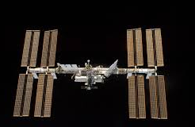
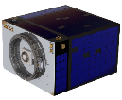
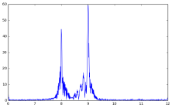


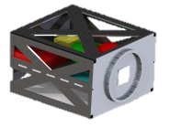

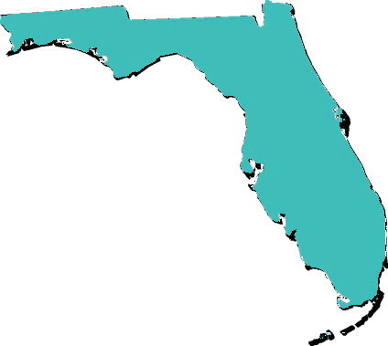

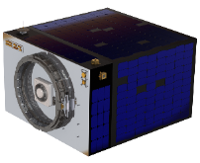
CONOPS:
1. Select suitable lightweight material and create design for structure
2. Fabricate structural test model
3. Design and build data acquisition system to verify structure’s behavior is as modeled
4. Test structural test model on a vibration table with mass loadings
5. Analyze accelerometer data and verify requirements are met
9. Interface with the Kaber Deployment System and deploy from the JEM airlock
10. Possible Orbit Raising
Maneuver and 5 year mission lifetime
6. Final testing and integration with avionics and other bus components
7. Integrate with payload and ISS resupply vessel
8. Launch to ISS
Project Overview
Design Overview
Risks
Testing & Verification
Project Planning
Requirements & CPEs
Notes:
In the scope of Surrey’s entire project, the structure and vibration test data of the design team will be used for further testing and refining, before being integrated with the avionics and bus components. This bus will be integrated to various payloads and then be wrapped in foam and strapped inside the cargo bay of a ISS resupply vessel. After being launch to the ISS, the spacecraft will be moved by an astronaut to within the Kaber volume and placed inside the JEM airlock, where the Kaber system is grabbed by the Special Purpose Dextrous Manipulator or SPDM, then Kaber system deploys the FeatherCraft in the retrograde direction from the ISS. The spacecraft can then perform orbit raising maneuvers and execute a nadir-facing mission for 5 years.

Slide 6
Design solution

Slide 7
Design Solution
This is a top level description of the overall outcome of your design efforts. It should show what the whole system looks like, its key parameters (dimen
sions, mass, data rates, etc.), what the major elements or subsystems are, and most importantly, how it works. Include a functional block diagram.
This provides the context and terminology for more detailed descriptions later in the presentation.
Project Overview
Design Overview
Risks
Testing & Verification
Project Planning
Requirements & CPEs

Slide 8
FUNCTIONAL BLOCK DIAGRAM:
Material Selection
Spacecraft component mounting capabilities (propulsion, solar arrays, avionics, payload)
KEY
Structure Design
Acquired
Radiator Plate
Designed and Built
Same material as design or similar to verify FEM model
Provided
Designed
Structural Test Model
Spacecraft component mounting capabilities (mass analogs of propulsion, solar arrays, avionics, payload)
Radiator Plate or similar material to verify FEM model
Project Overview
Design Overview
Risks
Testing & Verification
Project Planning
Requirements & CPEs
Notes:
Functionally, our structure design will incorporate a lightweight material with sufficient strength and stiffness, it will provide mounting capibilities for other spacecraft components, and it will incorporate a structural radiator plate which will dissipate 100 W of heat. This design is manufactured as a structural test model, and will have mounting capabilities and structural qualities similar to that of the design, but may be made of a different material to reduce cost and may have a different mass.

Slide 9
FUNCTIONAL BLOCK DIAGRAM:
KEY
DAQ System
DAQ System
Acquired
Real time Power Spectral Density (PSD) Display and Limit checking
Designed and Built
3-axis Accel
3-axis Accel
Provided
3-axis Accel
A/D
Conversion
Accel Channels
Designed
Data Storage
Payload and avionics mass simulators
Structural Test Model
Propulsion Plate mass simulator
Vibration Table
ON/OFF Vibe switch
Project Overview
Design Overview
Risks
Testing & Verification
Project Planning
Requirements & CPEs
Notes:
The data acquisition system will be brought to the vibration test facility and be able to provide nearly real-time power spectral density plots and check user-input limits to verify safety during the test. The structural test model will be strapped to the vibration table with a propulsion plate, payload, and avionics mass analogs integrated with the structure. The accelerometers will be attached to the structure, then it will undergo a vibration test at a NASA-specified vibration profile. During the test, this data will be transferred through the DAQ for the realtime plots as well as stored data files compatible with excel.

Slide 10
Critical Project Elements

Slide 11
Critical Project Elements
FR1 Mass of structure below 5 kg while surviving launch to the ISS (FR3.1)
Support and mounting positions for other spacecraft components (FR 4)
Manufacturing Time and Cost below required values (FR 2)
Vibration Test Table Acquisition (DR 5.2)
Support of up to 60 accelerometer channels in DAQ system (DR 5.6.1.1)
Project Overview
Design Overview
Risks
Testing & Verification
Project Planning
Requirements & CPEs

Slide 12
Design REquirements

Slide 13
FUNCTIONAL REQUIREMENTS
FR 1 | The Feathercraft structure design shall have a mass of less than 5 kg.
FR 2 | The Feathercraft structure design shall reduce manufacturing time and material cost from SST-US’s typical spacecraft estimates.
FR 3 | FeatherCraft Structure shall be designed to deploy from the ISS.
FR 4 | FeatherCraft structure design shall interface with SST-US-provided spacecraft components and mission design.
FR 5 | An equivalent manufactured STM of the FeatherCraft structure design shall be used to demonstrate the feasibility of the FeatherCraft structure through a random vibration test to the requirements of NASA GEVS documentation.
Project Overview
Design Overview
Risks
Testing & Verification
Project Planning
Requirements & CPEs

Slide 14
FR 1 met through material selection and analysis
Structure consists of carbon fiber sheets, adhesive attachments,
Analysis calculations show a current mass of _
All differences between design and STM will be noted and all components of STM weighed
Requirement | Required Value | Current Value | Margin
Structure design must weigh less than 5 kg | 5 kg | _ | _ | Requirement Met
Project Overview
Design Overview
Risks
Testing & Verification
Project Planning
Requirements & CPEs

Slide 15
FR 2 met through analysis
Manufacturing estimates performed from small-scale manufacturing for testing
Requirement | Required Value | Current Value | Margin
DR 2.1: Material shall cost less than $20,000 | $20,000 | _ | _ | Requirement Met
DR 2.2: Manufacturing and assembly shall take 9 months | 9 months | _ | _ | Requirement Met
DR 2.3: Manufacturing and assembly labor shall cost less than $80,000 | $80,000 |  |  | Requirement Met
Project Overview
Design Overview
Risks
Testing & Verification
Project Planning
Requirements & CPEs

Slide 16
FR 3 and FR 4 met through analysis
ANSYS model created assuming…
Next slides show more detail on…
Requirement | Required Value | Current Value | Margin
DR 3.1.1: Structure design will not show visible damage after simulating vibration profile | _ | _ | _ | Requirement Met
FR 4: Structure design shall support spacecraft components | _ | _ | _ | Requirement Met
Project Overview
Design Overview
Risks
Testing & Verification
Project Planning
Requirements & CPEs

Slide 17
ANSYS model vibration simulation
Slides showing expected modes of failure but how we don’t expect any of these
Project Overview
Design Overview
Risks
Testing & Verification
Project Planning
Requirements & CPEs

Slide 18
FR 4 met through analysis and small scale testing
Adhesive used for all components except one solar panel shall use VELCRO…
Requirement | Required Value | Current Value | Margin
DR 4.1-4.5 Structure design shall mount all spacecraft components | _ | _ | _ | Requirement Met
DR 4.7 Structure design shall survive for five years in space environment verified by heritage only. | _ | _ | _ | Requirement Met
Project Overview
Design Overview
Risks
Testing & Verification
Project Planning
Requirements & CPEs

Slide 19
Adhesive Small Scale Testing
How we verified glue actually works
Project Overview
Design Overview
Risks
Testing & Verification
Project Planning
Requirements & CPEs

Slide 20
FR 5 met through small scale testing and analysis
Manufacturing of structural test model identical to structure design (maybe talk about budget)
Assembly plan on slide _
Requirement | Required Value | Current Value | Margin
DR 5.1 Structural test model shall be created | _ | _ | _ | Requirement Met
DR 5.3 Structural test model shall support similar spacecraft loads as design | _ | _ | _ | Requirement Met
Project Overview
Design Overview
Risks
Testing & Verification
Project Planning
Requirements & CPEs

Slide 21
FR 5 met through small scale testing and analysis
Vibration table
Test now funded by Surrey
Requirement | Required Capabilities | Facility Capabilities
DR 5.2 Structural test model shall be tested on vibration table. | 20-2000 Hz random vibe Support 100 kg |  | Requirement Met
Project Overview
Design Overview
Risks
Testing & Verification
Project Planning
Requirements & CPEs

Slide 22
FR 5 met through small scale testing and analysis
Data acquisition system…
Detailed DAQ system design on slide _
Requirement | Required Value | Current Value | Margin
DR 5.6.1 DAQ system shall be capable of transferring data from 20 triaxial accelerometers at one time | _ | _ | _ | Requirement Met
DR 5.6.4 DAQ system shall display power spectral density plots in quasi-real time | _ | _ | _ | Requirement Met
Project Overview
Design Overview
Risks
Testing & Verification
Project Planning
Requirements & CPEs

Slide 23
DAQ System Capabilities
Detail on how DAQ system meets speed requirements, data display requirements…
Project Overview
Design Overview
Risks
Testing & Verification
Project Planning
Requirements & CPEs

Slide 24
Critical Project Elements

Slide 25
Risk Matrix:
Provide a risk matrix, showing identified risks and an assessment of their likelihood and severity of consequences to the success of the project. These risks must be credible and specific to your project.
An cogent discussion of risks is one of the ways that your understanding of the project and how it works is conveyed to the review board
Project Overview
Design Overview
Risks
Testing & Verification
Project Planning
Requirements & CPEs

Slide 26
Risk Matrix:
One slide with table
A few short slides with detail on biggest risks
Project Overview
Design Overview
Risks
Testing & Verification
Project Planning
Requirements & CPEs

Slide 27
Testing : Verification and VALIDATION

Slide 28
Verification and Validation
Describe how the design will be verified against predictive models through characterization testing. Use diagrams to convey the test set up, the facilities and equipment needed, and how the test works.
Describe the measurements to be made, and key measurement issues (resolution, sampling rate, etc.)
Show how the selected sensors, instruments, data acquisition, test fixtures, etc. provide the required capabilities.
TEST PLAN
Project Overview
Design Overview
Risks
Testing & Verification
Project Planning
Requirements & CPEs

Slide 29
General Testing Overview
Project Overview
Design Overview
Risks
Testing & Verification
Project Planning
Requirements & CPEs

Slide 30
Description of Facility
Project Overview
Design Overview
Risks
Testing & Verification
Project Planning
Requirements & CPEs

Slide 31
Data Acquisition System
Project Overview
Design Overview
Risks
Testing & Verification
Project Planning
Requirements & CPEs

Slide 32
Software
Project Overview
Design Overview
Risks
Testing & Verification
Project Planning
Requirements & CPEs

Slide 33
PROJECT PLANNING

Slide 34
Organization Chart:
Project Overview
Design Overview
Risks
Testing & Verification
Project Planning
Requirements & CPEs

Slide 35
Work Breakdown Structure:
Project Overview
Design Overview
Risks
Testing & Verification
Project Planning
Requirements & CPEs

Slide 36
Work Plan:
Project Overview
Design Overview
Risks
Testing & Verification
Project Planning
Requirements & CPEs

Slide 37
Cost Plan:
Project Overview
Design Overview
Risks
Testing & Verification
Project Planning
Requirements & CPEs

Slide 38
Test Plan:
Project Overview
Design Overview
Risks
Testing & Verification
Project Planning
Requirements & CPEs

Slide 39
Back-up Slides

Slide 40
DR 4.6 met through analysis
Radiation stuff, assumptions
Requirement | Required Value | Current Value | Margin
DR 4.6 Radiator shall dissipate 100 W of heat | _ | _ | _ | Requirement Met

