Slide 1

Rayleigh Tutorial
Module 1: Building and Porting the Code

Slide 2
In This Module:
Code requirements/porting considerations
Compile the code
Conduct an accuracy test

Slide 3
Before WE BEGIN:
Open a TWO terminal windows and log onto the research computing tutorial-login node (NOTE –X):
$ ssh –X user00XX@tutorial-login.rc.colorado.edu
Within BOTH windows, ssh to scompile:
$ ssh –X scompile

Slide 4
Bulding the CODE (WINDOW 1):
In the projects directory.
$ git clone git@bitbucket.org:feathern/rayleigh.git
Before we can build the code, we have to load some modules.
On Summit, module load order is IMPORTANT:
First load the compiler
Next load the MPI implementation
Finally, load anything else

Slide 5
Code Requirements: (install these before Building Rayleigh)
Fortran 2003 and C++ compilers
BLAS
LAPack
FFTW version 3.x or later
MPI
* Intel’s MKL provides interfaces to BLAS, LAPack, and FFTW

Slide 6
Building THE CODE (Window 1):
RUN THIS:
$ module load intel
$ module load impi
$ module load mkl
$ cd rayleigh
$ ./build_rayleigh CU
The executable (“rayleigh”) will be placed in /projects/user00XX/rayleigh/build

Slide 7
Porting to new machines:
Create a new Makefile_NAME and place it in the rayleigh/Makefiles directory
$ ./build_rayleigh NAME
See examples in Rayleigh/Makefiles:
Intel Compiler : Makefile_Pleiades
IBM Compiler : Makefile_Mira
GNU Compiler : Makefile_CIG

Slide 8
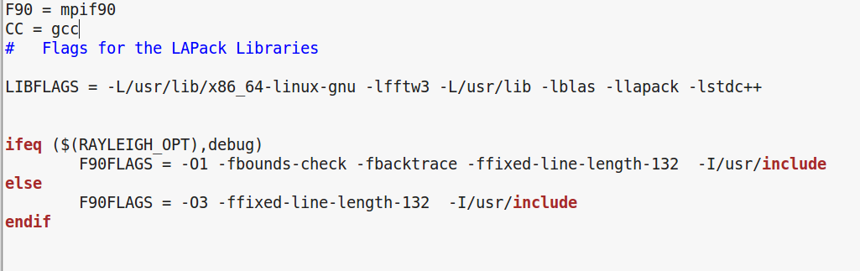
Makefile Customization
From rayleigh/Makefiles/Makefile_CIG
Link BLAS, LAPack, FFTW
Compiler Specific Flags
“Include” directories
RAYLEIGH_OPT1 is passed through build_rayleigh
Also RAYLEIGH_OPT2 and RAYLEIGH_OPT3

Slide 9
Using build_Rayleigh flags:
TRY THIS:
$ ./build_rayleigh CU debug
Sets $RAYLEIGH_OPT1 to debug
Enables debugging flags in Makefile_CIG
NO DEBUGGING FOR NOW PLEASE!
RERUN THIS:
$ ./build_rayleigh CU

Slide 10
OUR FIRST run: Prepwork (WINDOW 2)
We will run the code in WINDOW 2 from the scratch directory.
Change to scratch directory and create module1 subdirectory:
$ cd /scratch/summit/user00XX
$ mkdir module1
$ cd module 1
Summit Scratch
10 TB default (can be increased)
Wiped every 90 days (PERIOD)
No touching … or whining
Softlink the executable.
$ export RADIR=/projects/user00XX/rayleigh
$ ln –s $RADIR/build/rayleigh .

Slide 11
OUR FIRST run: Prepwork (WINDOW 2)
Each simulation requires an input file (run parameters)
Grab this file from input_examples:
$ cd /scratch/summit/user00XX/module1
$ cp $RADIR/input_examples/c2001_case0_minimal .
Rayleigh expects its input to be named “main_input”
Rename the file to “main_input”
$ mv c2001_case0_minimal main_input
Let’s edit main_input
$ nano main_input
..etc..

Slide 12
Quick Nano survival tips
We will use nano as our editor of choice
To open a file from shell prompt: nano filename
Some useful commands from within nano:
ctrl + o - save changes
ctrl + x - exit
ctrl + k - cut
ctrl + u - paste

Slide 13
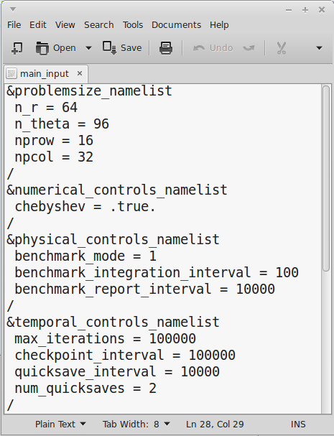
Main_input
Instructions from the user
Flags override defaults
Grouped into namelists
Namelists control different aspects of the simulation.

Slide 14
Main_input
Modify these values …
nprow = 8
npcol = 8
max_iterations = 30000
… and save.
Ctrl+o
Ctrl+x

Slide 15
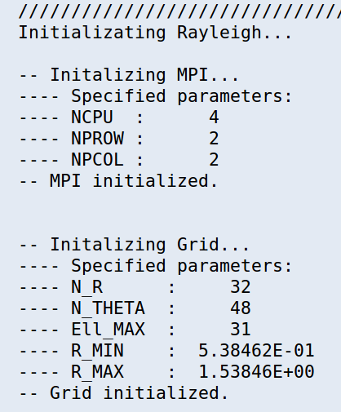
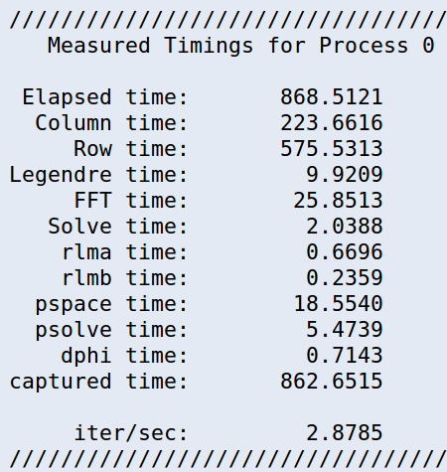
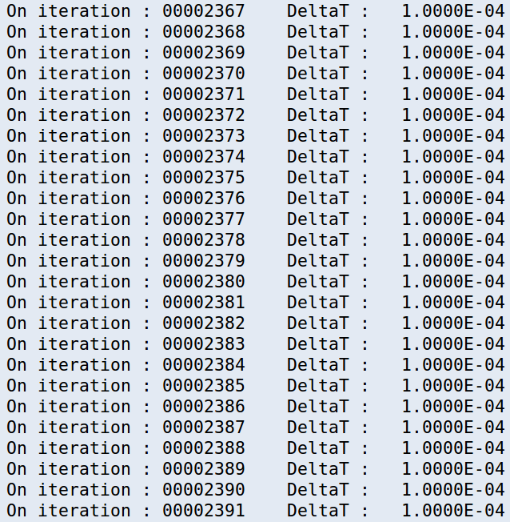
OUR FIRST run (WINDOW 2)
$ cp /projects/feathern/rayleigh_script .
$ sbatch rayleigh_script
$ more slurm*
Run the code…
You will see:
Completion:
Timing Info
Startup:
Preamble
Middle:
Timestep Info
…while we’re waiting…

Slide 16
In-Situ Benchmarking
Fully nonlinear, but low-Re
Steady-state with rotating pattern
Predefined set of analyses
When porting: run a benchmark!
Vr
Equatorial Plane
Benchmark Inputs
Boussinesq: Christensen et al. 2001, PEPI, 128, 25
c2001_case0_minimal (hydro)
c2001_case1_minimal (MHD)
Cheap!
Spherical Shell
Anelastic: Jones et al., 2011, Icarus, 216, 120
input_examples/j2011_hydro_steady_minimal
input_examples/j2011_mhd_steady_minimal

Slide 17
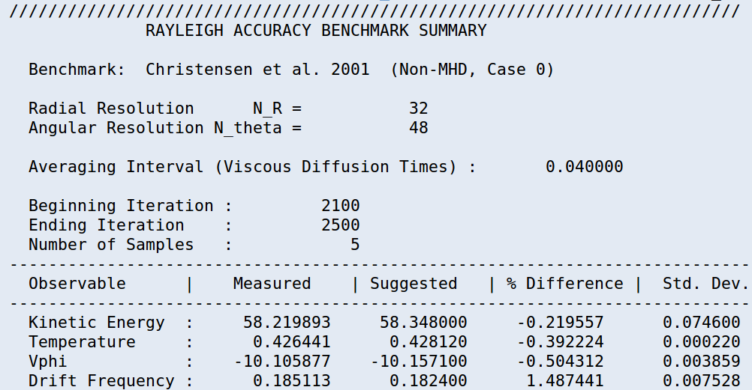
Check your results
$ more Benchmark_Reports/00030000
Normally % Difference will be well under 1%
This example is not equilibrated -- need ~ 30,000 time steps
Questions?

