Slide 1

Rayleigh Tutorial
Module 5: Diagnostic Outputs

Slide 2
Before WE BEGIN:
Create a directory named module5
Copy c2001_case0_input to module5/main_input
DELETE benchmark_mode = 1
TURN Magnetism ON and magnetic_init_type = 7
Set to run for 50 time steps
Set n_theta = 48
Softlink rayleigh to module5 directory

Slide 3
In This Module:
Overview of Diagnostic Mechanics
Diagnostic Types
Diagnostic Quantities & Menu System
NOTE: We cover plotting/analysis in Module 6

Slide 4
Rayleigh diagnostics: Overview
Rayleigh performs a number of in-situ diagnostics
Reduces disk usage and post-processing
In-situ diagnostics represent varying degrees of slicing and averaging
Controlled via the output namelist
Each diagnostic stored in dedicated directory
All outputs respect 2-D domain decomposition
Many use MPI-IO

Slide 5
Rayleigh diagnostics: MECHANICS
Examine the output_namelist in main_input
The prefix indicates the diagnostic TYPE
This is a particular TYPE of analysis that MAY be performed
&output_namelist
XXXX_values = 1, 2, 3, 64
XXXX_frequency = 100
XXXX_nrec = 10

Slide 6
Rayleigh diagnostics: MECHANICS
VALUES indicates WHAT should be analyzed in THIS fashion
Numbers are code for physical quantities selected from menu
In this example, we are analyzing the three velocity components (1,2,3) and temperature or entropy (64)
&output_namelist
XXXX_values = 1, 2, 3, 64
XXXX_frequency = 100
XXXX_nrec = 10

Slide 7
Rayleigh diagnostics: MECHANICS
FREQUENCY indicates HOW OFTEN we perform THIS analysis
Units are in time steps
In this example, we perform our analysis of velocity and temperature once every 100 time steps
&output_namelist
XXXX_values = 1, 2, 3, 64
XXXX_frequency = 100
XXXX_nrec = 10

Slide 8
Rayleigh diagnostics: MECHANICS
NREC indicates HOW MANY analyses are saved to one file
In this example, 10 analyses are saved within each file.
We generate a new file every 1000 time steps (nrec*freq)
&output_namelist
XXXX_values = 1, 2, 3, 64
XXXX_frequency = 100
XXXX_nrec = 10

Slide 9
Exercise:
Before we go any further, let’s try this out
Modify these portions (only) of main_input
Run your code
&output_namelist
globalavg_frequency = 2
globalavg_nrec = 10
shellavg_frequency = 5
shellavg_nrec = 5

Slide 10
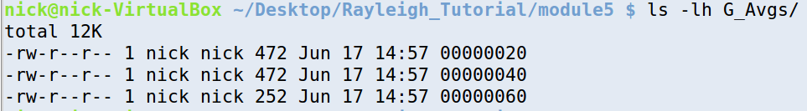
Globalavg diagnostics are stored in G_Avgs
Examine the contents of that directory
Recall that
We output every 2nd time step
We stored 10 records per file
00000020 contains time steps:
2, 4, 6, 8, 10, 12, 14, 16, 18, 20
00000060 contains time steps: 42, 44, 46, 48, 50

Slide 11
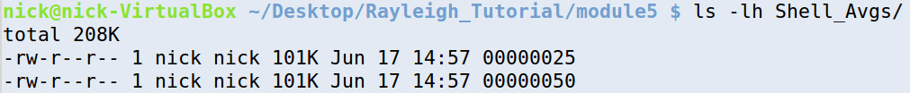
Shellavg diagnostics are stored in Shell_Avgs
Examine the contents of that directory
Recall that
We output every 5th time step
We stored 5 records per file
00000025 contains time steps:
5, 10, 15, 20, 25
00000050 contains time steps: 30, 35, 40, 45, 50

Slide 12
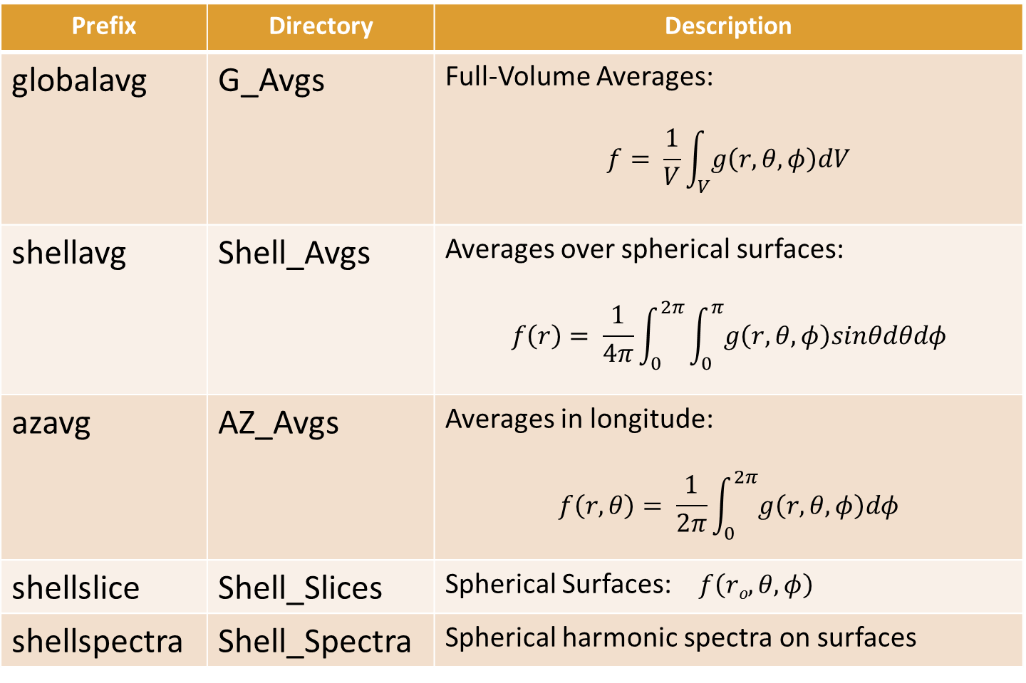
DIAGNOSTIC TYPES:
Prefix | Directory | Description
globalavg | G_Avgs | Full-Volume Averages: $$f= \frac{1}{V}\int_{V}{g\left(r,θ,φ\right)dV}$$
shellavg | Shell_Avgs | Averages over spherical surfaces: $$f\left(r\right)= \frac{1}{4π}\int_{0}^{2π}{\int_{0}^{π}{g\left(r,θ,φ\right)sinθdθdφ}}$$
azavg | AZ_Avgs | Averages in longitude: $$f\left(r,θ\right)= \frac{1}{2π}\int_{0}^{2π}{g\left(r,θ,φ\right)dφ}$$
shellslice | Shell_Slices | Spherical Surfaces: $f\left(ro,θ,φ\right)$
shellspectra | Shell_Spectra | Spherical harmonic spectra on surfaces

Slide 13
Shell Slices and Shell SPectra
Shell Slices and Shell Spectra have an additional line that needs to be specified:
&output_namelist
shellslice_levels = 3,16,32,48,62
shellspectra_levels = 16,32,48
This line specifies the INDICES of radii at which spherical surfaces or spectra are taken
Index 1 corresponds to the upper boundary
In our example, index 64 corresponds to the lower boundary

Slide 14
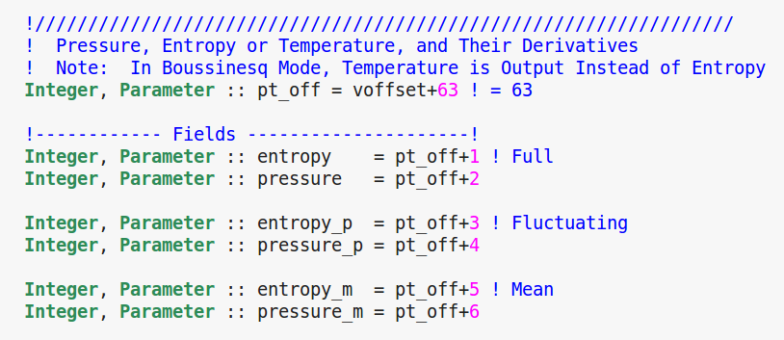
DIAGNOSTIC MENU codes:
Documentation in prep, but for now, examine:
rayleigh/physics/Diagnostics_Base.F90
This is the code menu system. How do we read it?
Pressure code:
pressure = pt_off + 2
pt_off = 63
pressure = 65
Entropy code:
entropy = pt_off + 1
pt_off = 63
pressure = 64
See input examples for guidance!

Slide 15
Useful Menu Codes
Quantity | Code
Vr | 1
V_{θ} | 2
V_{φ} | 3
Radial Mass Flux | 55
θ-Mass Flux | 56
Temperature/Entropy | 64
Pressure | 65
Kinetic Energy | 125
Axisymmetric V_{φ} - KE | 132
Br | 401
B_{θ} | 402
B_{φ} | 403
Magnetic Energy | 475
Axisymmetric B_{φ} - ME | 482
Final Thoughts
Many possible outputs …
Only specified quantities are calculated
Different diagnostics types can be used with different code combinations
Try to sync your outputs
so that infrequent outputs
are written at same time as
frequent outputs…

Slide 16
Useful Menu Codes
Quantity | Code
Vr | 1
V_{θ} | 2
V_{φ} | 3
Radial Mass Flux | 55
θ-Mass Flux | 56
Temperature/Entropy | 64
Pressure | 65
Kinetic Energy | 125
Axisymmetric V_{φ} - KE | 132
Br | 401
B_{θ} | 402
B_{φ} | 403
Magnetic Energy | 475
Axisymmetric B_{φ} - ME | 482
Exercise
Modify global averages:
Include magnetic energy
Modify shell averages:
Include magnetic energy
Modify shell slices:
Include B-field
Add additional radial levels
Output every 25th timestep
2 records per file
Run the code

