Slide 1
MPI Session 2: Point-to-Point Communication
Nick Featherstone
CU Research Computing

Slide 2
Outline
Overview
Blocking Communication
Non-blocking Communication

Slide 3
Message passing
Most natural and efficient paradigm for distributed-memory systems
Two-sided, send and receive communication between processes
Efficiently portable to shared-memory or almost any other parallel architecture:
“assembly language of parallel computing” due to universality and detailed, low-level control of parallelism

Slide 4
More on message passing
Provides natural synchronization among processes (through blocking receives, for example), so explicit synchronization of memory access is unnecessary
Sometimes deemed tedious and low-level, but thinking about locality promotes
good performance,
scalability,
Portability
Dominant paradigm for developing portable and scalable applications for massively parallel systems

Slide 5
Message sending and receiving
Which process is sending the message?
Where is the data on the sending process?
What kind of data is being sent?
How much data is there?
Which process is going to receive the message?
Where should the data be stored on the receiving process?
What amount of data is the receiving process prepared to accept?

Slide 6
Blocking send
call MPI_SEND(
message, e.g., my_partial_sum,
count, number of values in msg
data_type, e.g, MPI_DOUBLE_PRECISION,
destination, e.g., myid + 1
tag, some info about msg, e.g., store it
communicator, e.g., MPI_COMM_WORLD,
ierr error tag (return value) )
All arguments are inputs (except ierr).

Slide 7
Fortran MPI Data Types
MPI_CHARACTER
MPI_COMPLEX, MPI_COMPLEX8, also 16 and 32
MPI_DOUBLE_COMPLEX
MPI_DOUBLE_PRECISION
MPI_INTEGER
MPI_INTEGER1, MPI_INTEGER2, also 4 and 8
MPI_LOGICAL
MPI_LOGICAL1, MPI_LOGICAL2, also 4 and 8
MPI_REAL
MPI_REAL4, MPI_REAL8, MPI_REAL16
Numbers = numbers of bytes
Somewhat different in C—see text or Google it

Slide 8
C MPI Datatypes
MPI_CHAR 8-bit character
MPI_DOUBLE 64-bit floating point
MPI_FLOAT 32-bit floating point
MPI_INT 32-bit integer
MPI_LONG 32-bit integer
MPI_LONG_DOUBLE 64-bit floating point
MPI_LONG_LONG 64-bit integer
MPI_LONG_LONG_INT 64-bit integer
MPI_SHORT 16-bit integer
MPI_SIGNED_CHAR 8-bit signed character
MPI_UNSIGNED 32-bit unsigned integer
MPI_UNSIGNED_CHAR 8-bit unsigned character
MPI_UNSIGNED_LONG 32-bit unsigned integer
MPI_UNSIGNED_LONG_LONG 64-bit unsigned integer
MPI_UNSIGNED_SHORT 16-bit unsigned integer
MPI_WCHAR Wide (16-bit) unsigned character

Slide 9
Blocking?
MPI_send
does not return until the message data and envelope have been buffered in matching receive buffer or temporary system buffer.
can complete as soon as the message was buffered, even if no matching receive has been executed by the receiver.
MPI buffers or not, depending on availability of space
non-local: successful completion of the send operation may depend on the occurrence of a matching receive.

Slide 10
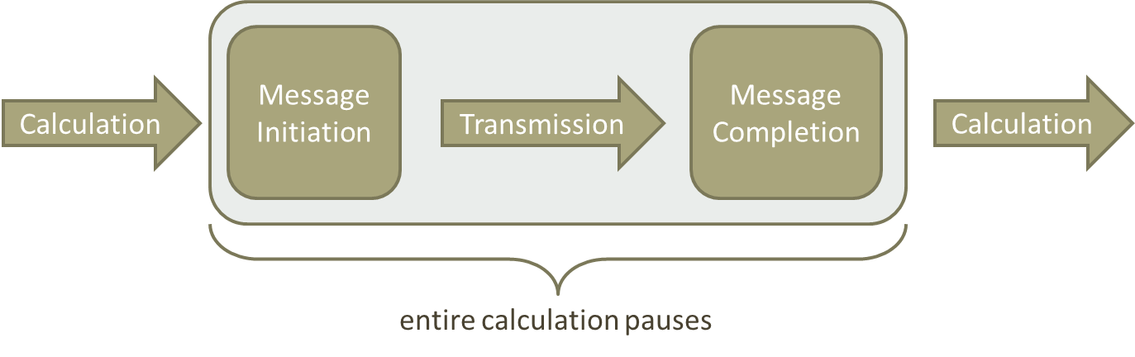
Blocking Communication: Program Flow
Programs written using blocking sends & receives possess portions similar to schematic below:

Slide 11
Blocking receive
Process must wait until message is received to return from call.
Stalls progress of program BUT
blocking sends and receives enforce process synchronization
so enforce consistency of data

Slide 12
Blocking receive
call MPI_RECV(
message, e.g., my_partial_sum,
count, number of values in msg
data_type, e.g, MPI_DOUBLE_PRECISION,
source, e.g., myid - 1
tag, some info about msg, e.g., store it
communicator, e.g., MPI_COMM_WORLD, status, info on size of message received
ierr )

Slide 13
The arguments
outputs: message, status
count*size of data_type determines size of receive buffer: --too large message received gives error,
--too small message is ok
status must be decoded if needed
MPI_Get_Count(status, datatype, ierror)
status(MPI_SOURCE) status.MPI_SOURCE
status(MPI_TAG) status.MPI_TAG
status(MPI_ERROR) status.MPI_ERROR

Slide 14
Wildcards
MPI_ANY_SOURCE
MPI_ANY_TAG
Send must send to specific receiver
Receive can receive from arbitrary sender

Slide 15
Example Program
Some examples of point-to-point communication:
MPI/session2/examples/mpi_messages.{f90,cpp}
Start an interactive session (if not already active):
sinteractive –N1 –n24 - - reservation=csdms
Build and run the code with 24 cores:
module load intel impi
mpi{f90,cc} mpi_messages.{f90,cpp} –o mpi_messages.out
mpirun –np 24 ./mpi_messages.out

Slide 16
Deadlock
If (my_rank == 0):
send( to rank N)
receive( from rank N)
If (my_rank == N):
receive( from rank 0)
send( to rank 0)
Good Code
(mpi_messages.{f90,cpp})
Bad Code
If (my_rank == 0):
send( to rank N)
receive( from rank N-1)
If (my_rank == N):
send( to rank 0)
receive( from rank 0)
Communication hangs

Slide 17
Deadlock
If (my_rank == 0):
send( to rank N)
receive( from rank N)
If (my_rank == N):
receive( from rank 0)
send( to rank 0)
Quick Exercise:
Induce a deadlock in your program by swapping the order of one send/receive pair
If (my_rank == 0):
send( to rank N)
receive( from rank N-1)
If (my_rank == N):
send( to rank 0)
receive( from rank 0)

Slide 18
Non-Blocking Send & Receive
Same syntax as MPI_Send() and MPI_Recv()
Addition of a request handle argument.
Calls return immediately
Data in the buffer (send and receive) may not be accessed until operation is complete.
Send and receive are completed by
MPI_Test
MPI_Wait

Slide 19
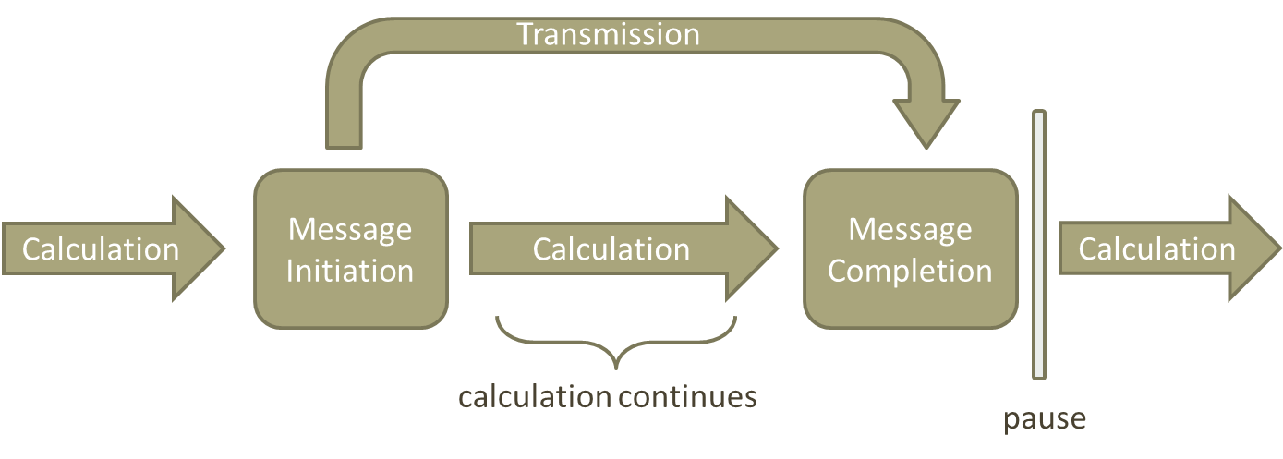
Non-Blocking Communication: Program Flow
Programs written using ISends & IReceives possess portions that are schematically similar to:

Slide 20
MPI_ISEND (buf, cnt, dtype, dest, tag, comm, request, ierr)
Same syntax as MPI_SEND with the addition of a request handle
Request is a handle (int in Fortran; MPI_Request in C) used to check for completeness of the send
This call returns immediately
Data in buf may not be accessed until the user has completed the send operation
The send is completed by a successful call to MPI_TEST or a call to MPI_WAIT

Slide 21
MPI_IRECV(buf, cnt, dtype, source, tag, comm, request, ierr)
Same syntax as MPI_RECV except status is replaced with a request handle
Request is a handle (int in Fortran MPI_Request in C) used to check for completeness of the recv
This call returns immediately
Data in buf may not be accessed until the user has completed the receive operation
The receive is completed by a successful call to MPI_TEST or a call to MPI_WAIT

Slide 22
MPI_WAIT (request, status, ierr)
Request is the handle returned by the non-blocking send or receive call
Upon return, status holds source, tag, and error code information
This call does not return until the non-blocking call referenced by request has completed
Upon return, the request handle is freed
If request was returned by a call to MPI_ISEND, return of this call indicates nothing about the destination process

Slide 23
MPI_WAITALL (count, requests, statuses, ierr)
requests is an array of handles returned by non-blocking send or receive calls
count is the number of requests
This call does not return until all non-blocking call referenced by requests have completed
Upon return, statuses hold source, tag, and error code information for all the calls that completed
Upon return, the request handles stored in requests are all freed

Slide 24
Example Program
Some examples of non-blocking communication:
MPI/session2/examples/mpi_messages.{f90,cpp}
Build and run the code with 24 cores:
module load intel impi
mpi{f90,cc} mpi_imessages.{f90,cpp} –o mpi_imessages.out
mpirun –np 24 ./mpi_imessages.out

Slide 25
MPI_Waitall
If (my_rank == 0):
isend( to rank N)
ireceive( from rank N)
MPI_waitall()
If (my_rank == N):
ireceive( from rank 0)
isend( to rank 0)
MPI_waitall()
Good Logic
(mpi_imessages.{f90,cpp})
Only processes sending and receiving call waitall
Bad Logic
If (my_rank == 0):
isend( to rank N)
ireceive( from rank N-1)
If (my_rank == N):
isend( to rank 0)
ireceive( from rank 0)
MPI_waitall()
Processes not sending and receiving call waitall…

Slide 26
MPI_Waitall
If (my_rank == 0):
isend( to rank N)
ireceive( from rank N)
MPI_waitall()
If (my_rank == N):
ireceive( from rank 0)
isend( to rank 0)
MPI_waitall()
Good Logic
(mpi_imessages.{f90,cpp})
Only processes sending and receiving call waitall
Bad Logic
If (my_rank == 0):
isend( to rank N)
ireceive( from rank N-1)
If (my_rank == N):
isend( to rank 0)
ireceive( from rank 0)
MPI_waitall()
Quick Exercise:
Mimic this bad logic to “break” your program
Processes not sending and receiving call waitall…

