Slide 1
Gaussian
Inflows generated with gaussian distribution
Scenario 0: basic conditions with added some ferry passengers traffic.
Scenario 1: alternative policy, one of the port gates is closed, forcing trucks to reroute.

Slide 2
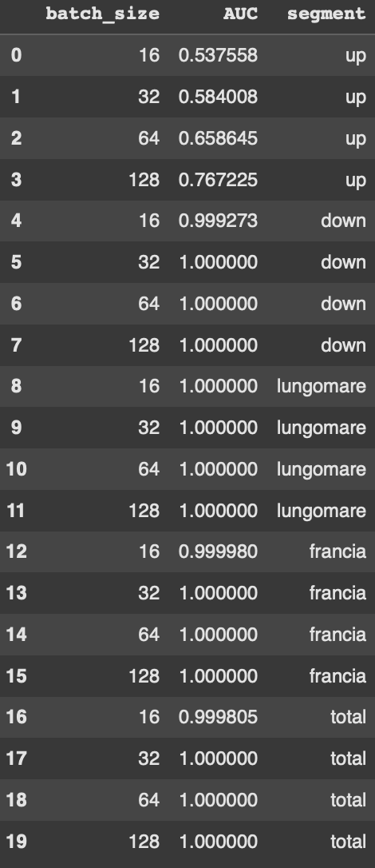
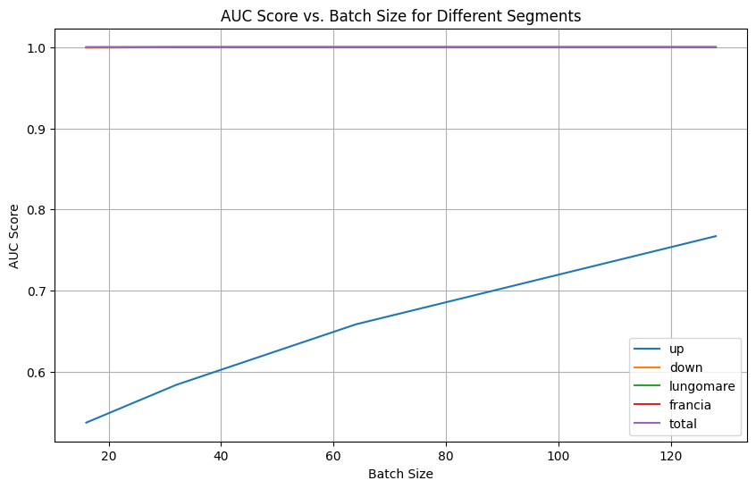
Gaussian

Slide 3
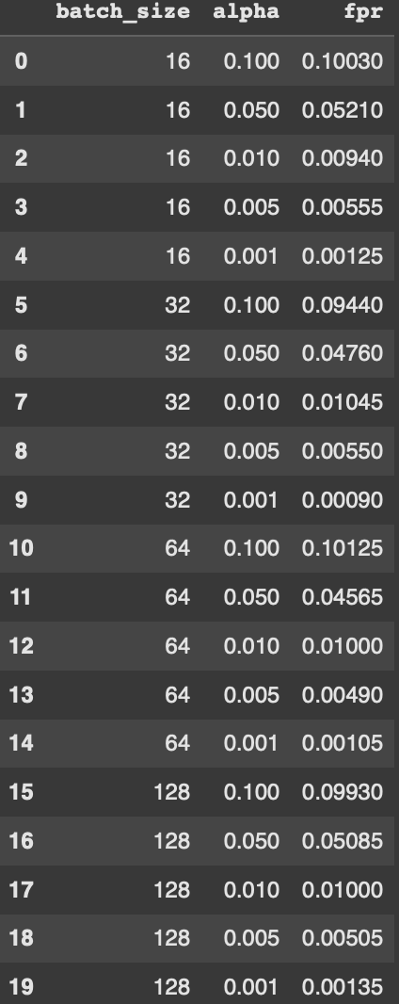
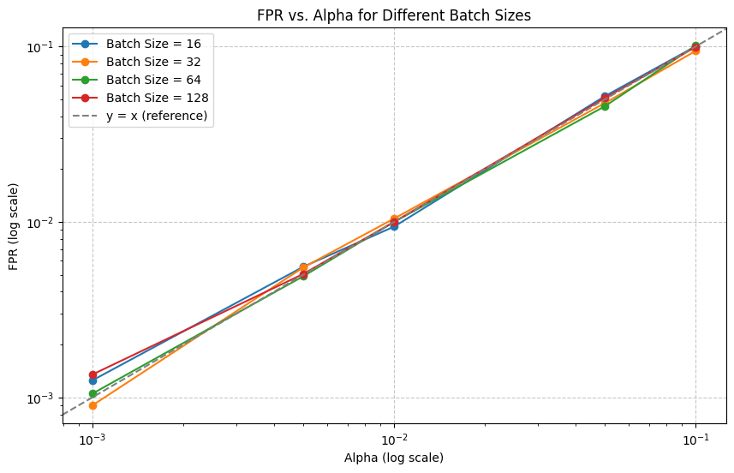
Gaussian | Total (21 variables)
OBS: FPR here is the averaged FPR of the two scenarios

Slide 4
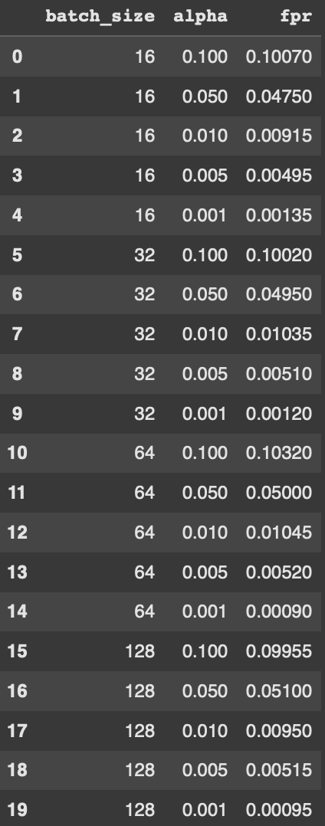
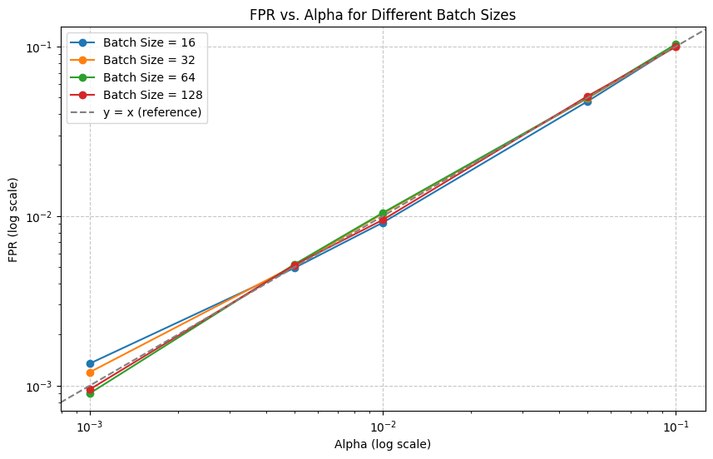
Gaussian | Elicoidale Upstream (6 variables)
OBS: FPR here is the averaged FPR of the two scenarios

Slide 5
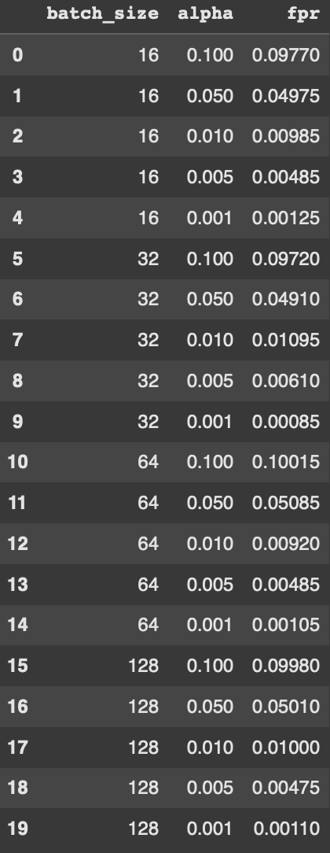
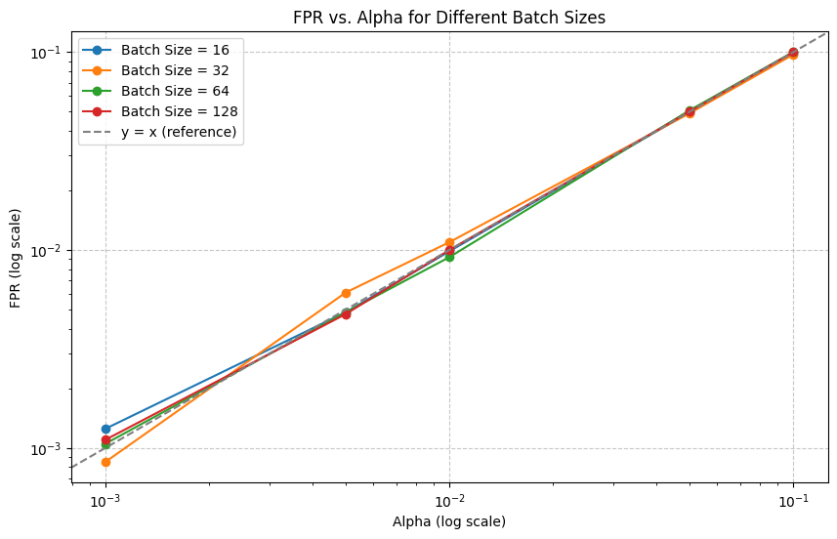
Gaussian | Elicoidale Downstream (6 variables)
OBS: FPR here is the averaged FPR of the two scenarios

Slide 6
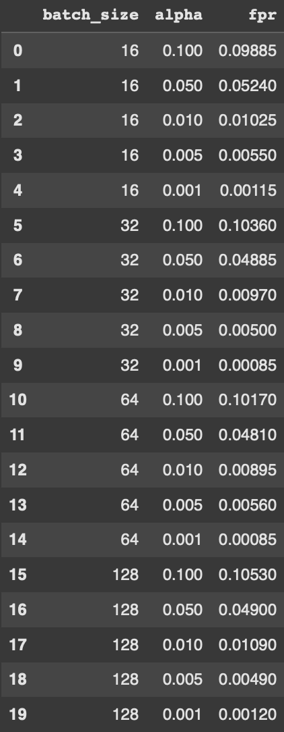
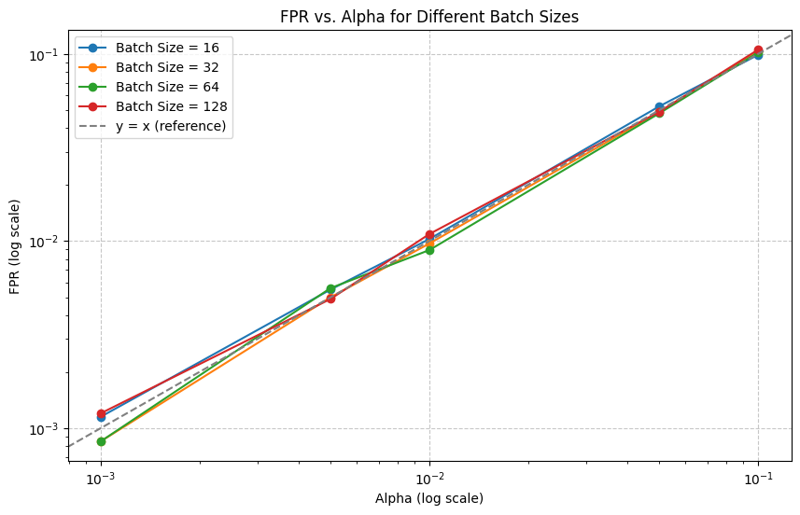
Gaussian | Lungomare Canepa (6 variables)
OBS: FPR here is the averaged FPR of the two scenarios

Slide 7
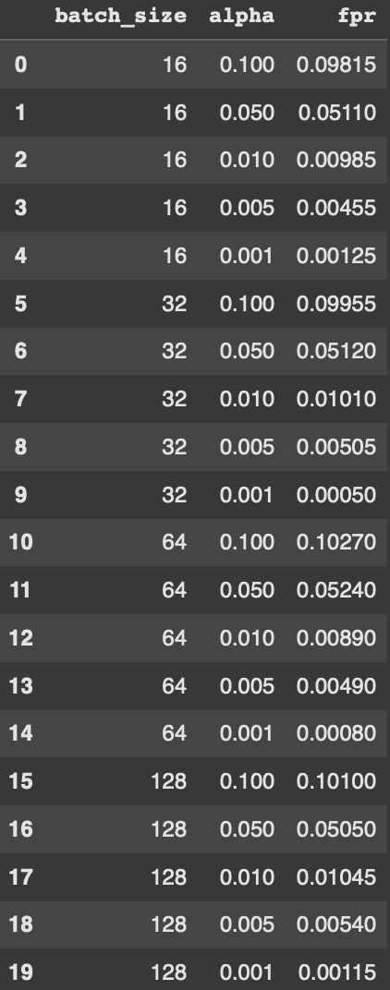
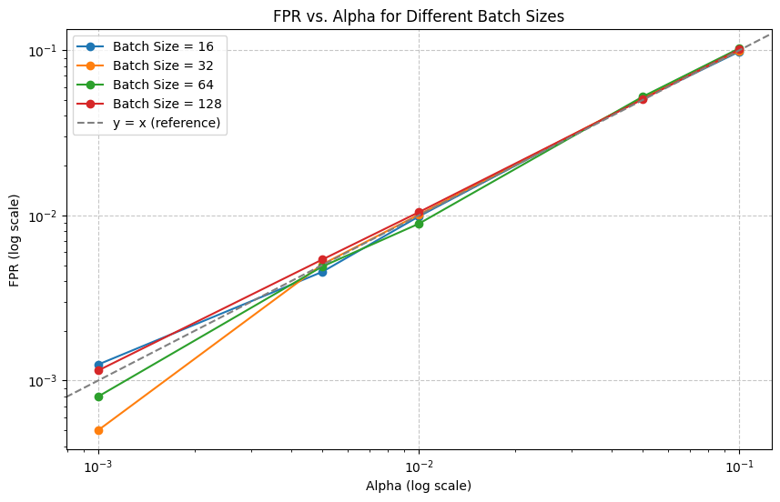
Gaussian | Via di Francia (3 variables)
OBS: FPR here is the averaged FPR of the two scenarios

Slide 8
Uniform
Inflows generated with uniform distribution
Scenario 0: basic conditions with added some ferry passengers traffic.
Scenario 1: alternative policy keeping the basic scenario and changed slightly the timing of two traffic lights.

Slide 9
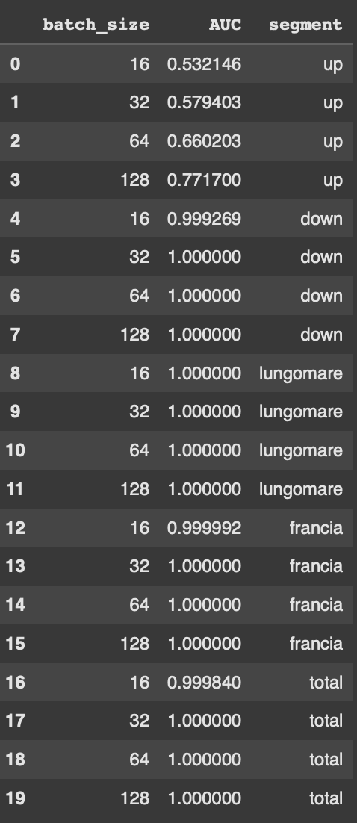
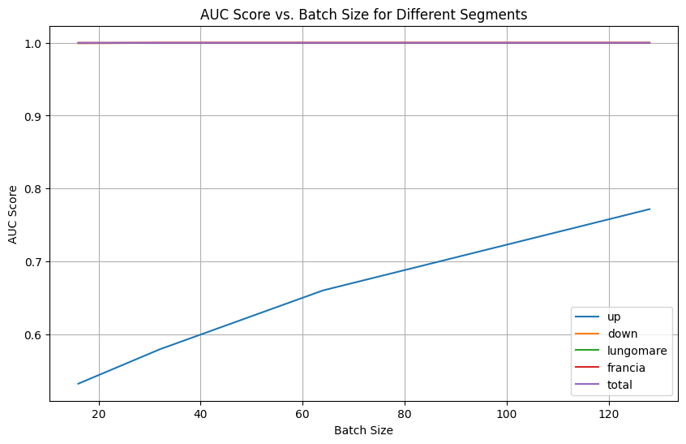
Uniform

Slide 10
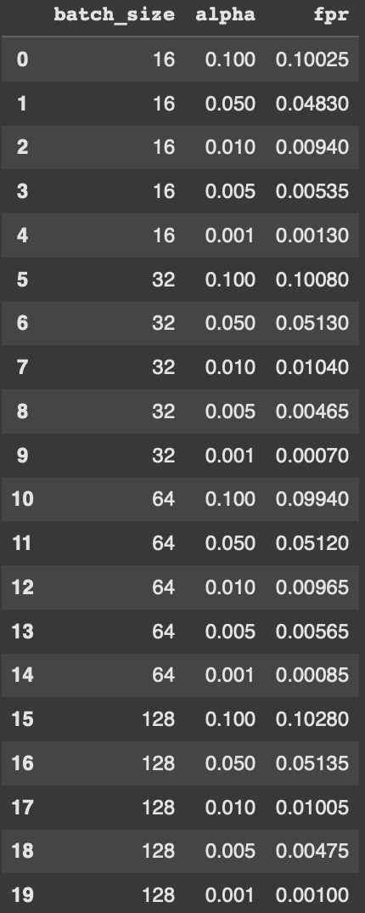
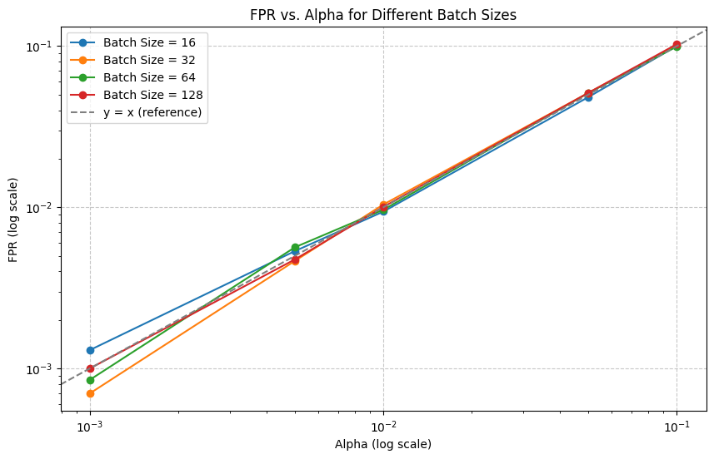
Uniform | Total (21 variables)
OBS: FPR here is the averaged FPR of the two scenarios

Slide 11
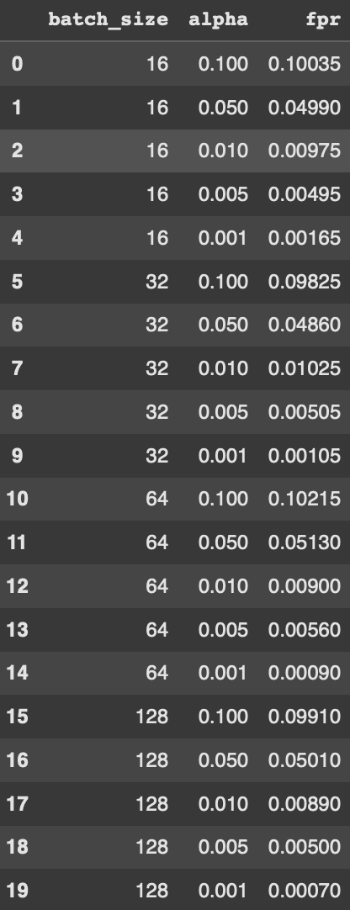
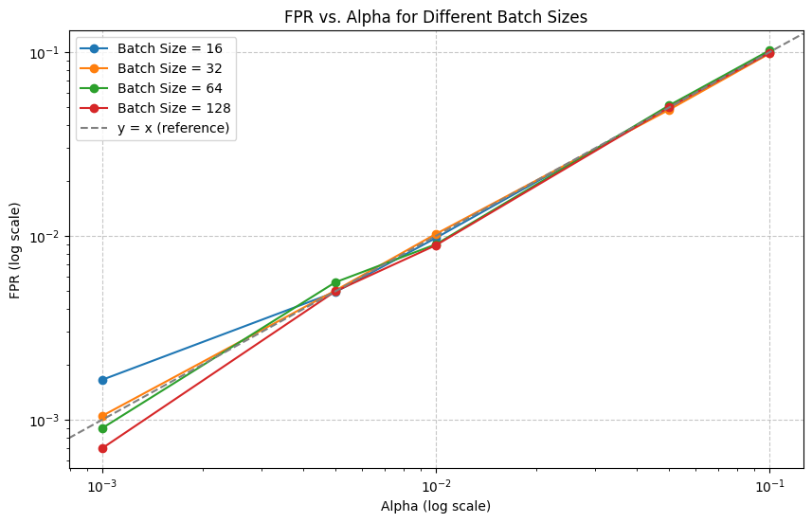
Uniform | Elicoidale Upstream (6 variables)
OBS: FPR here is the averaged FPR of the two scenarios

Slide 12
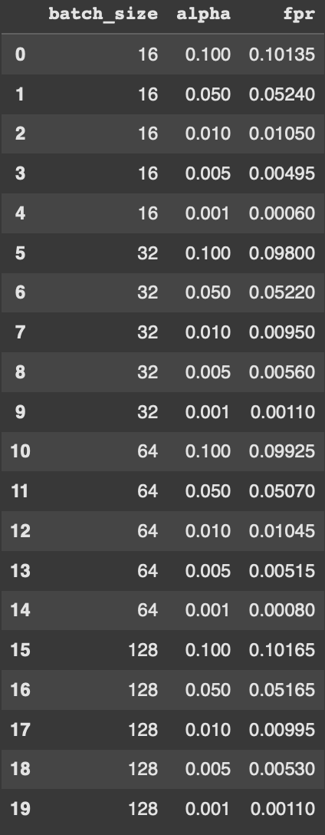
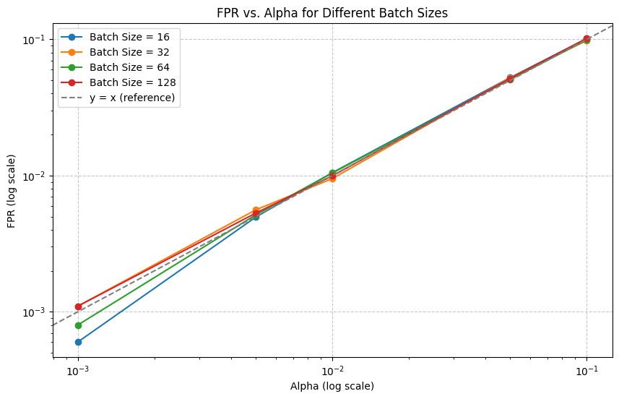
Uniform | Elicoidale Downstream (6 variables)
OBS: FPR here is the averaged FPR of the two scenarios

Slide 13
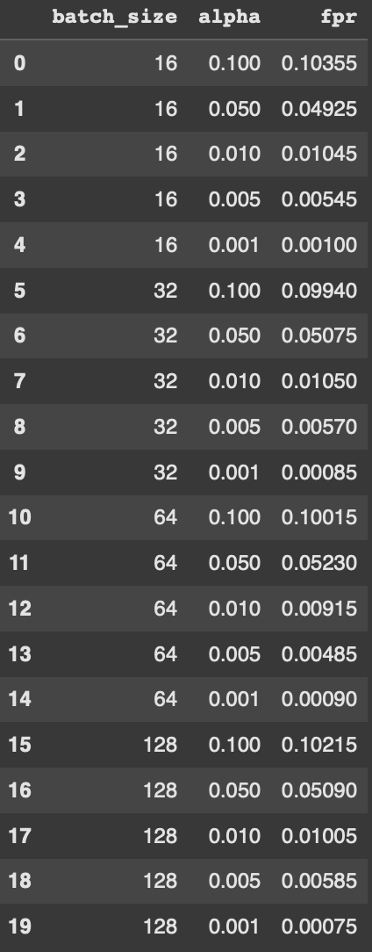
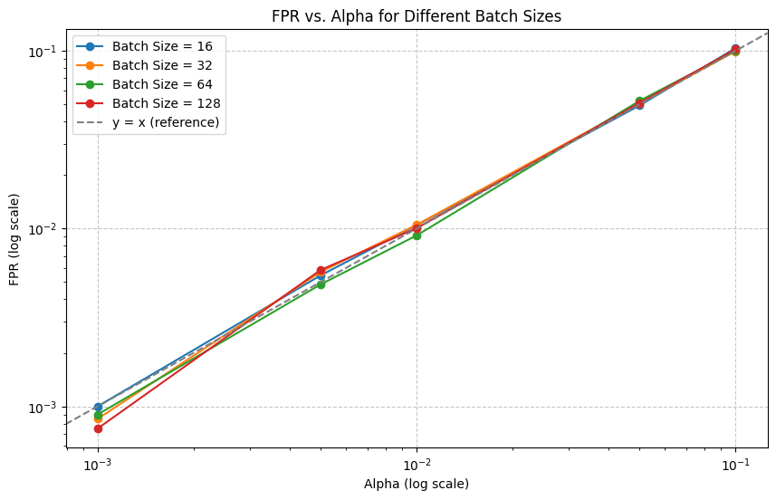
Uniform | Lungomare Canepa (6 variables)
OBS: FPR here is the averaged FPR of the two scenarios

Slide 14
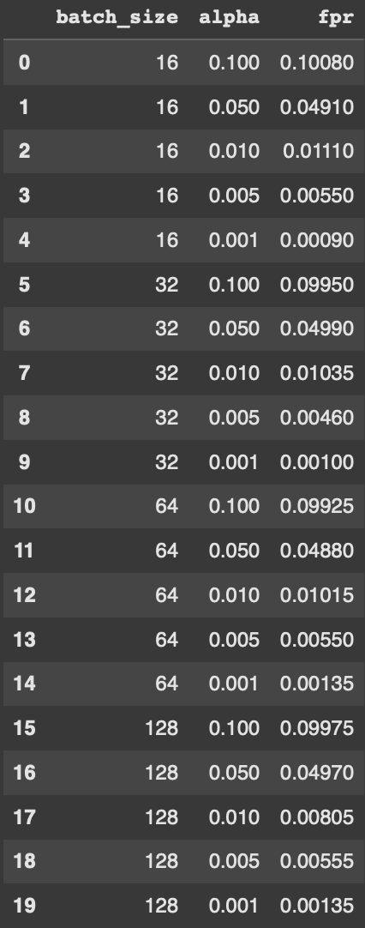
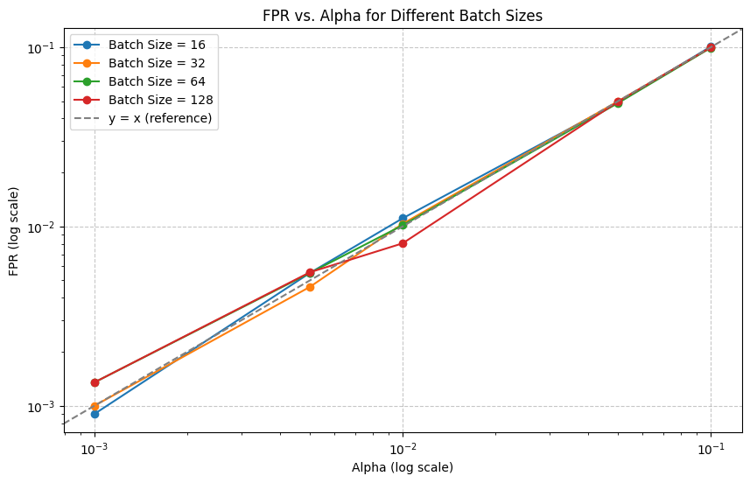
Uniform | Via di Francia (3 variables)
OBS: FPR here is the averaged FPR of the two scenarios

Slide 15
Multimodal
Uniform (70%)
+
Uniform in “weekend” conditions (30%)
Scenario 0: basic conditions with added some ferry passengers traffic.
Scenario 1: alternative policy keeping the basic scenario and changed slightly the timing of two traffic lights.

Slide 16
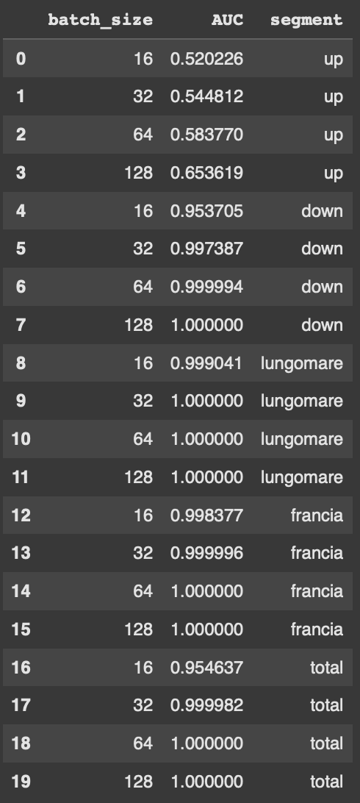
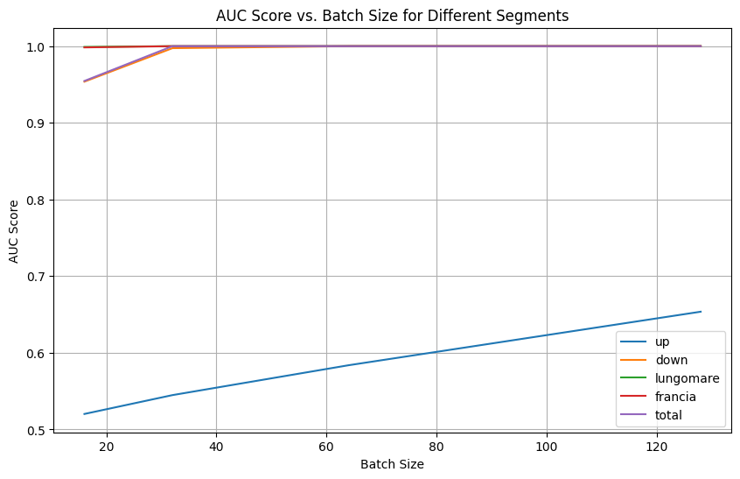
Multimodal: uniform (70%) + weekend (30%)

Slide 17
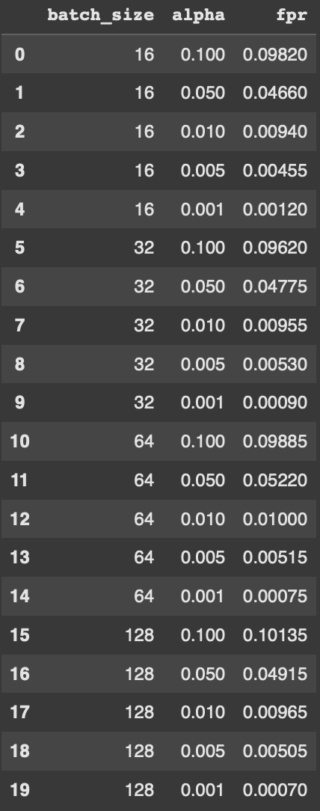
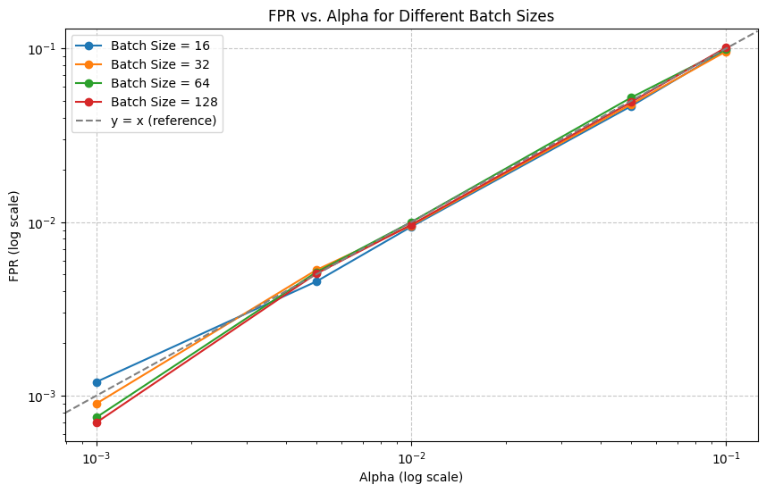
Multimodal: uniform (70%) + weekend (30%) | Total (21 variables)
OBS: FPR here is the averaged FPR of the two scenarios

Slide 18
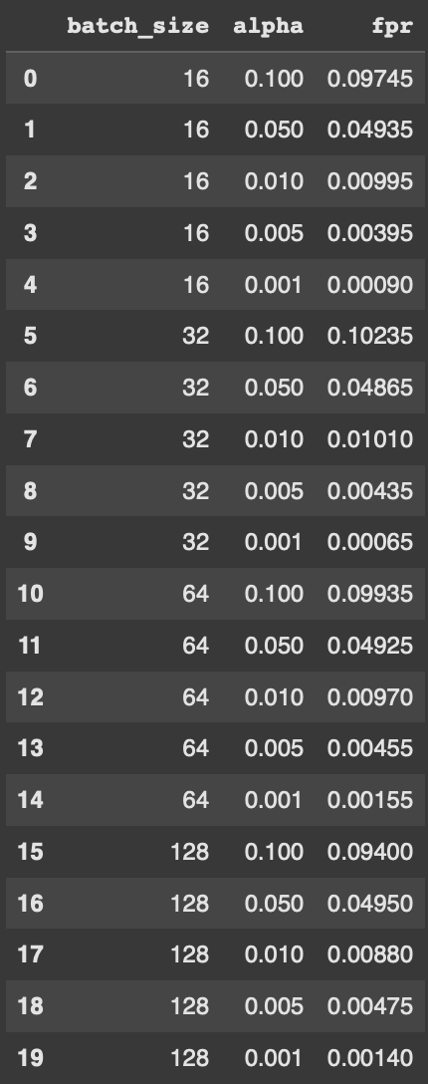
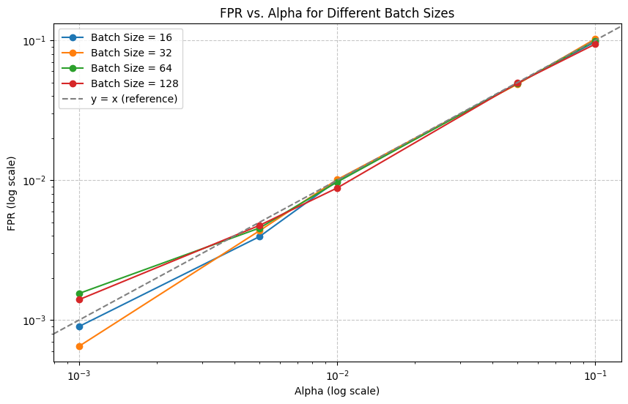
Multimodal: uniform (70%) + weekend (30%) | Elicoidale Upstream (6 variables)
OBS: FPR here is the averaged FPR of the two scenarios

Slide 19
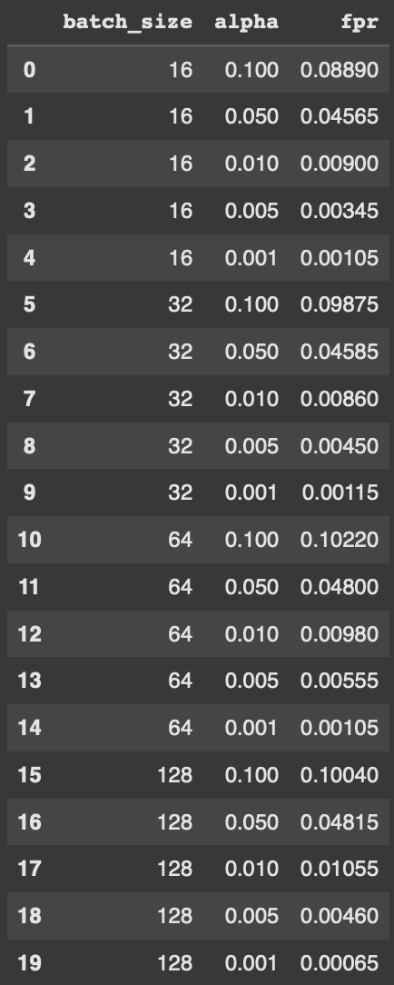
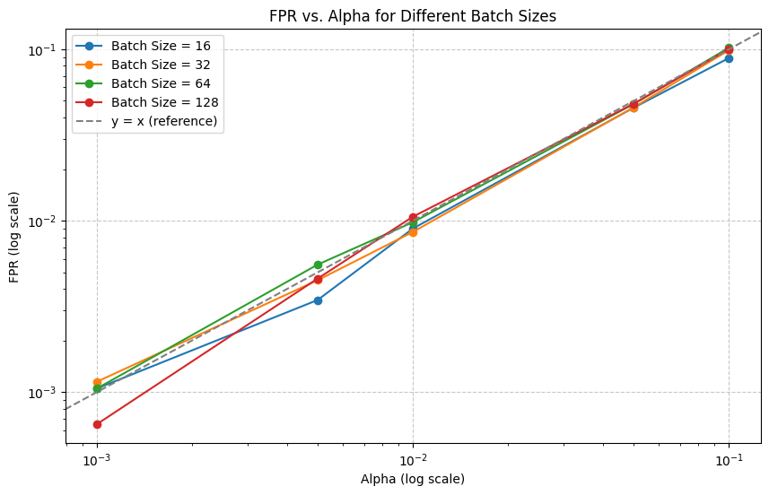
Multimodal: uniform (70%) + weekend (30%) | Elicoidale Downstream (6 variables)
OBS: FPR here is the averaged FPR of the two scenarios

Slide 20
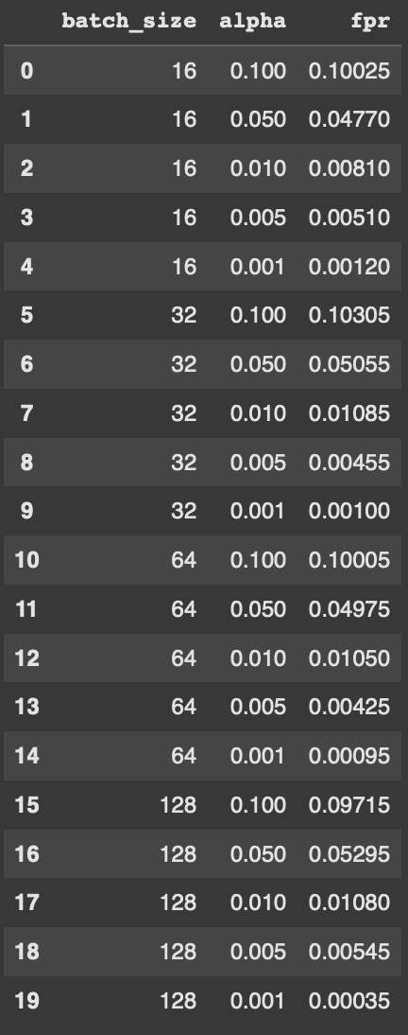
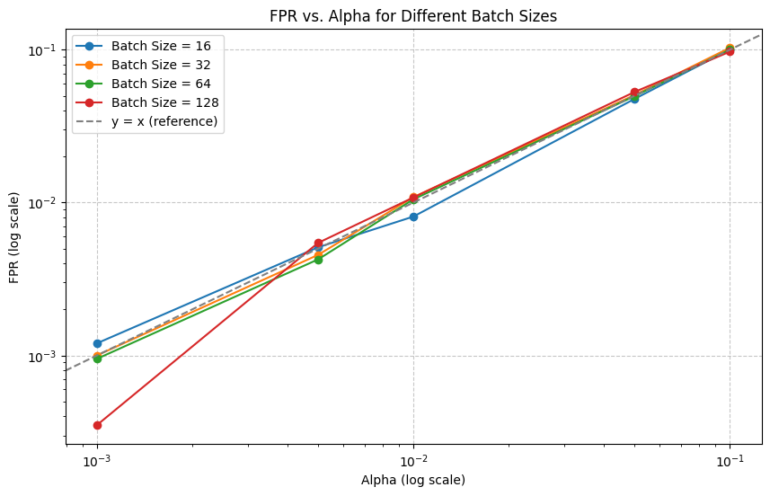
Multimodal: uniform (70%) + weekend (30%) | Lungomare Canepa (6 variables)
OBS: FPR here is the averaged FPR of the two scenarios

Slide 21
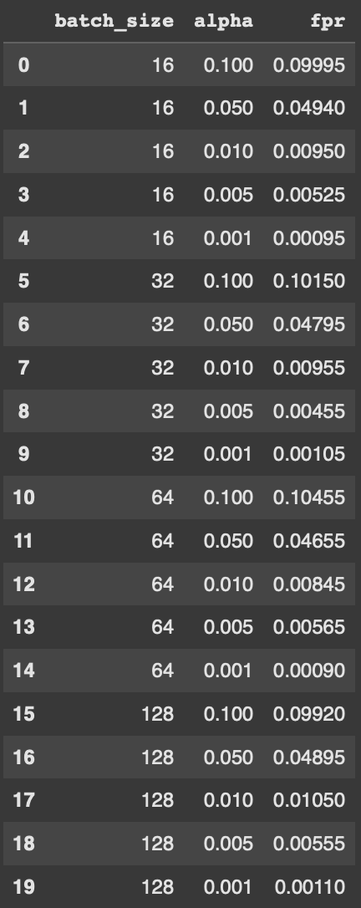
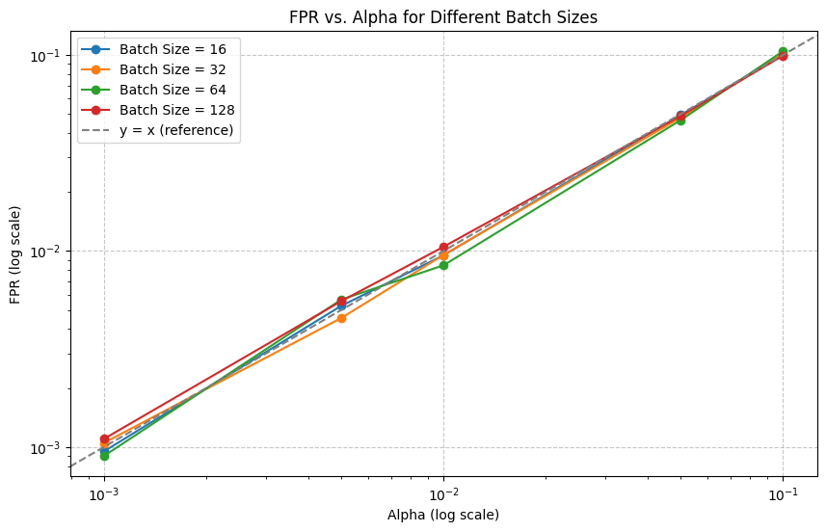
Multimodal: uniform (70%) + weekend (30%) | Via di Francia (3 variables)
OBS: FPR here is the averaged FPR of the two scenarios

Slide 22
Multimodal
Uniform (50%)
+
Uniform in “weekend” conditions (50%)
Scenario 0: basic conditions with added some ferry passengers traffic.
Scenario 1: alternative policy keeping the basic scenario and changed slightly the timing of two traffic lights.

Slide 23
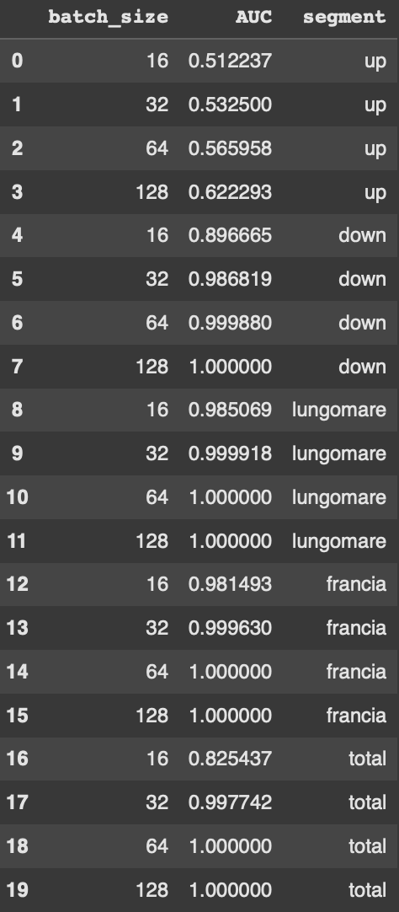
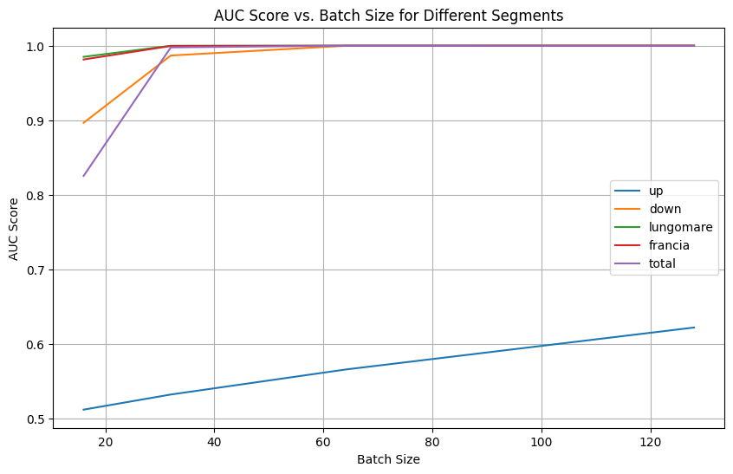
Multimodal: uniform (50%) + weekend (50%)

Slide 24
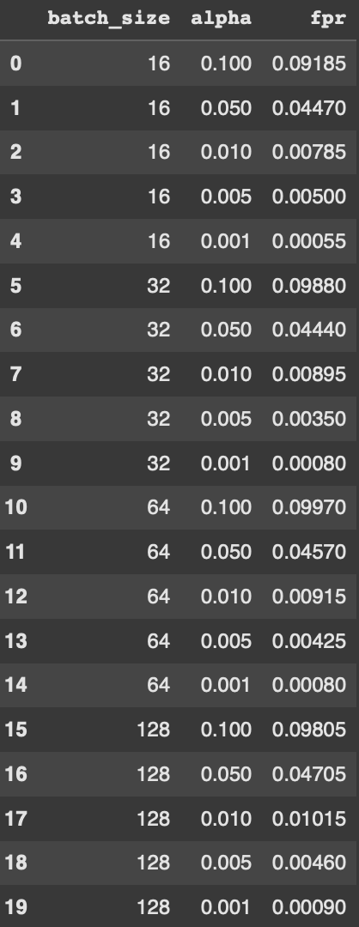
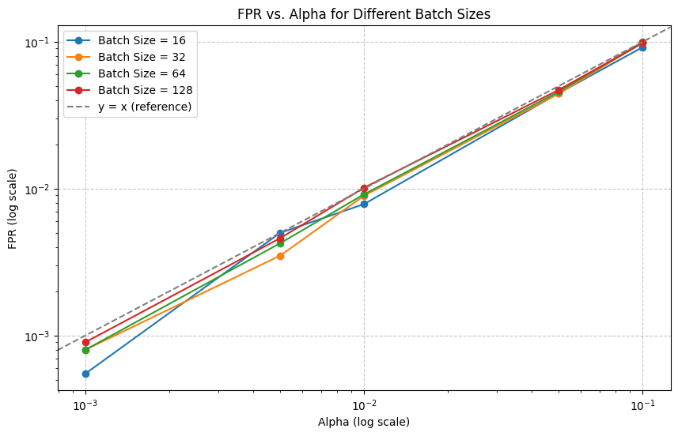
Multimodal: uniform (50%) + weekend (50%) | Total (21 variables)
OBS: FPR here is the averaged FPR of the two scenarios

Slide 25
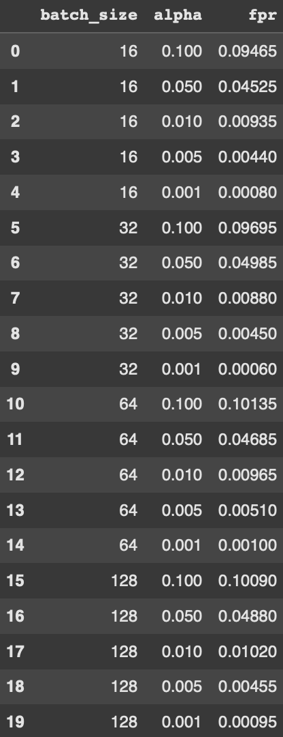
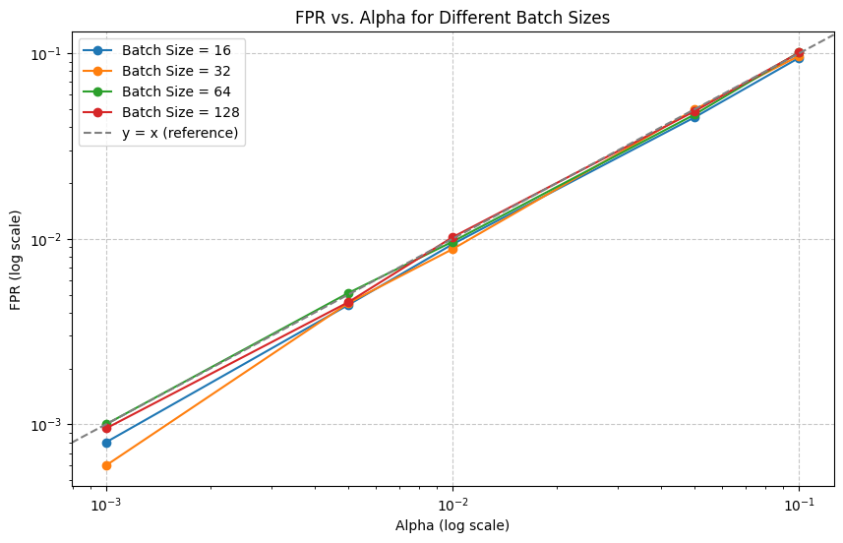
Multimodal: uniform (50%) + weekend (50%) | Elicoidale Upstream (6 variables)
OBS: FPR here is the averaged FPR of the two scenarios

Slide 26
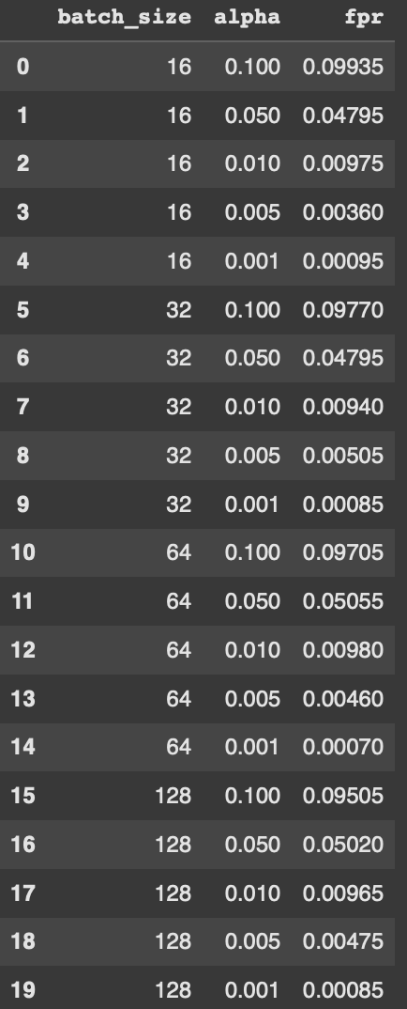

Multimodal: uniform (50%) + weekend (50%) | Elicoidale Downstream (6 variables)
OBS: FPR here is the averaged FPR of the two scenarios

Slide 27
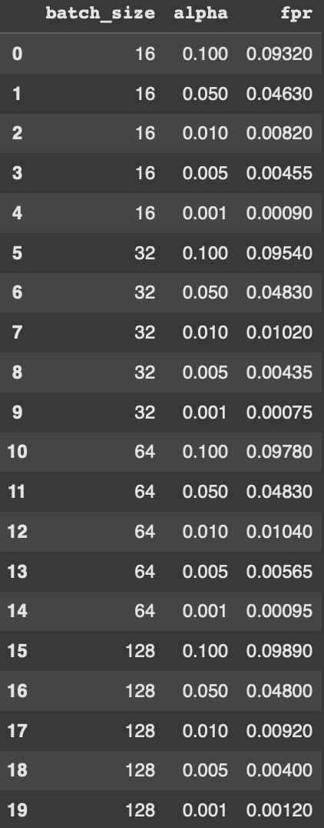
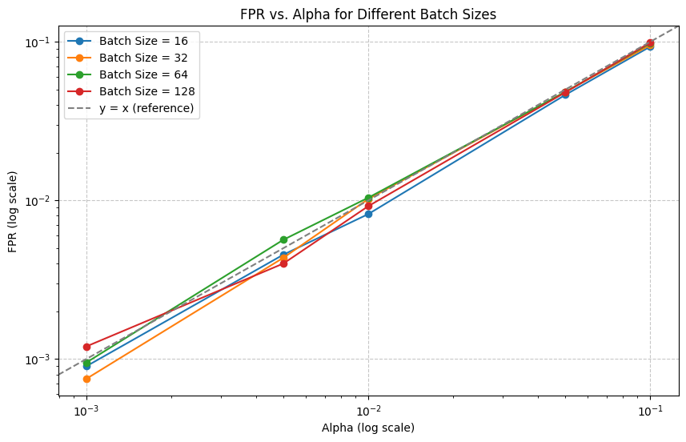
Multimodal: uniform (50%) + weekend (50%) | Lungomare Canepa (6 variables)
OBS: FPR here is the averaged FPR of the two scenarios

Slide 28
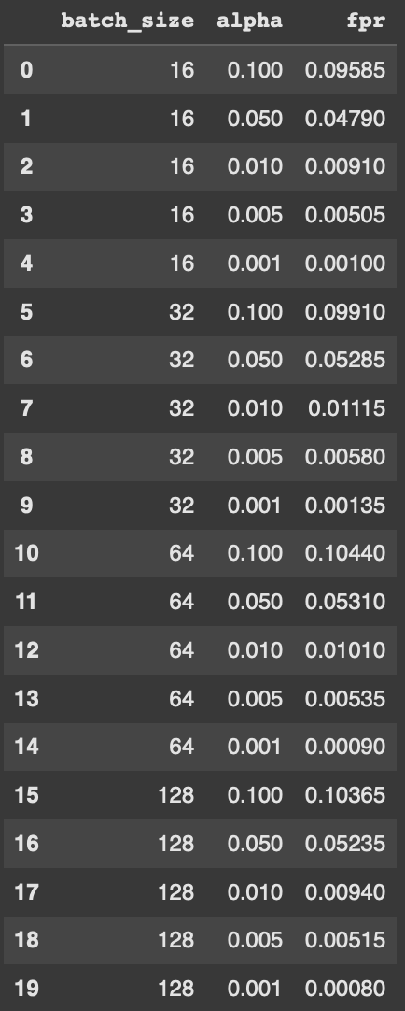
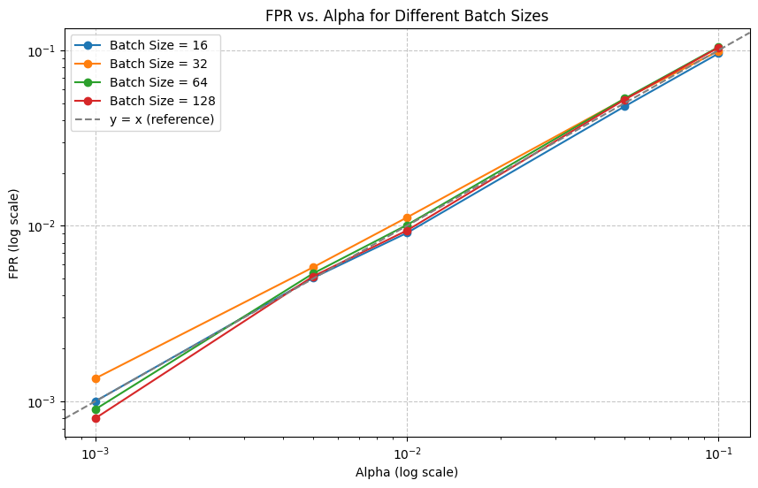
Multimodal: uniform (50%) + weekend (50%) | Via di Francia (3 variables)
OBS: FPR here is the averaged FPR of the two scenarios

