Slide 1
QuantTree EWMA
Report of Results

Slide 2
Generating Sequences
Explanation on how the training data and sequences are generated

Slide 3
Sequence Generation (1/2) - Inputs
Scenario 0
d
Φ₀
s
For each iteration of the experiments (each time we run quantree), we shuffles the indexes of these vectors, from which we generate the sequences (next slide).
Scenario 1
d
Φ₁
s
d is the number of dimensions/variables
s is the number of samples/days
Φ₀ is the distribution of scenario 0
Φ₁ is the distribution of scenario 1

Slide 4
Sequence Generation (2/2) - Outputs
N
s - N
d
Φ₀
Φ₀
Sequence 0 (no change and non overlapping with training data)
Training data
(same for both sequences)
Sequence 1 (with change)
d
Φ₀
Φ₁
s
N
N is the moment where the change happens, from which we start to monitor on QuanTree EWMA.
d is the number of dimensions/variables in the sequence
s is the number of samples/days
Φ₀ is the distribution of scenario 0
Φ₁ is the distribution of scenario 1

Slide 5
Sanity Check
Artificially generated data to check implementation
Scenario 0 → Scenario 1
The distribution under Scenario 0 is gaussian and under Scenario 1 is poisson.

Slide 6
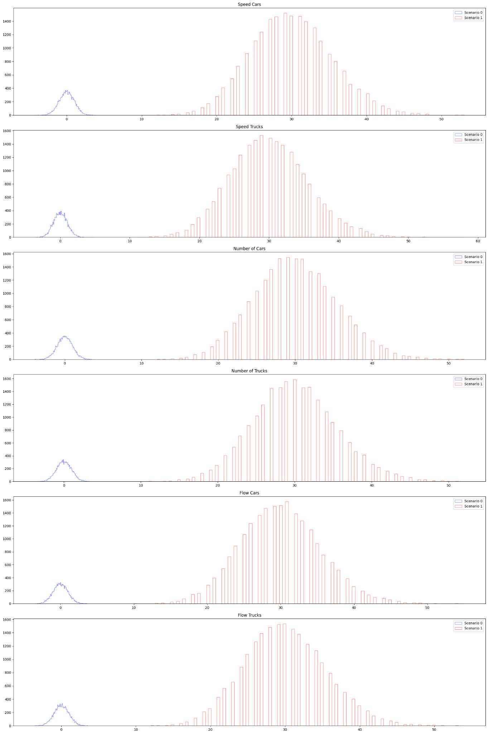
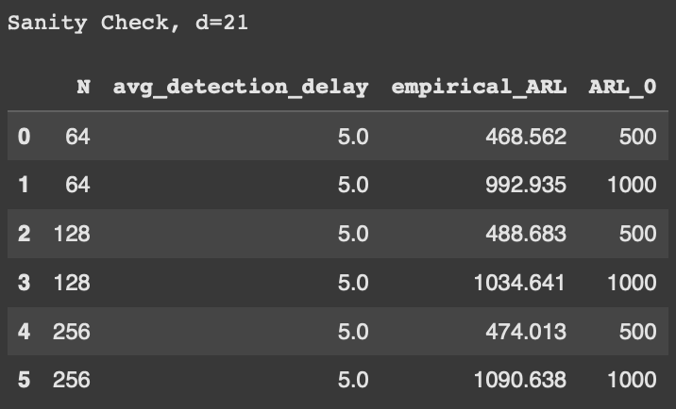
Sanity check (d=21), qtree ewma (K=32)

Slide 7
Multimodal Poisson
Inflows generated with poisson distribution
Multimodal: Weekday (50%) + Weekend (50%)
Minimal change between scenarios.
Scenario 0 → Scenario 1
The change is minimal: 5 seconds longer in a single red phase of a single traffic light.
Here we do add a gaussian noise (0 mean, 0.001 sigma) to the variables “flow cars” or “flow trucks”

Slide 8
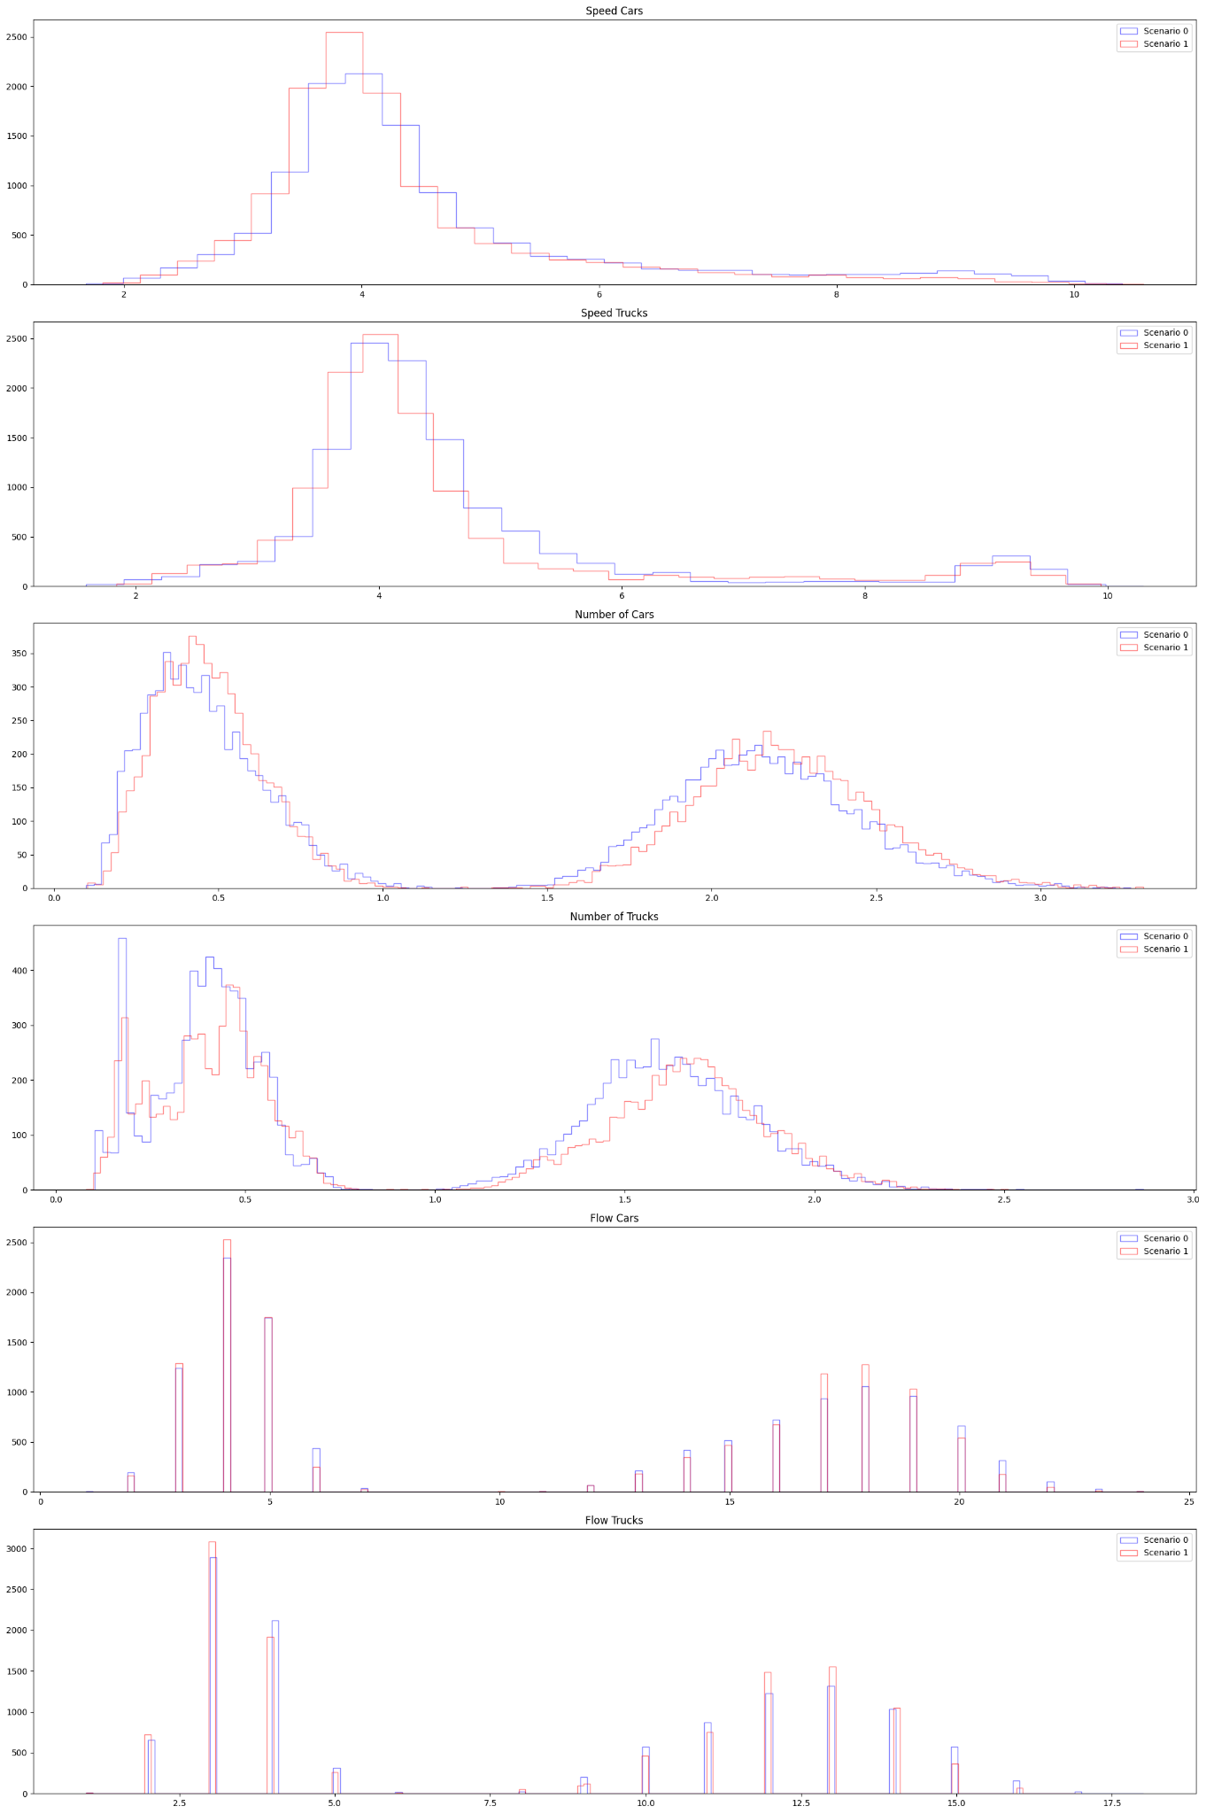
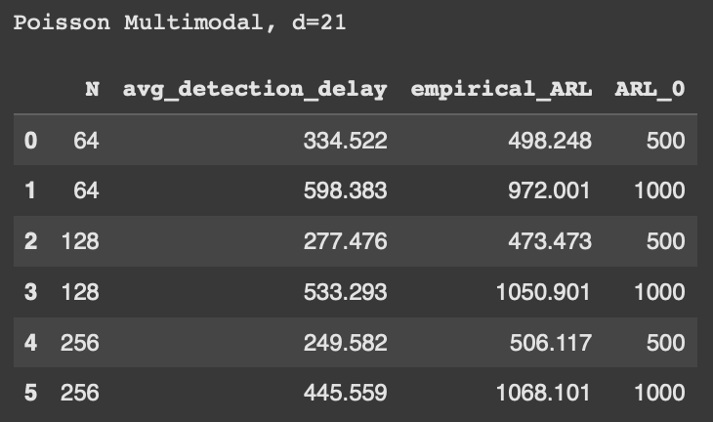
Multimodal Poisson (d=21), qtree ewma (K=32)

Slide 9
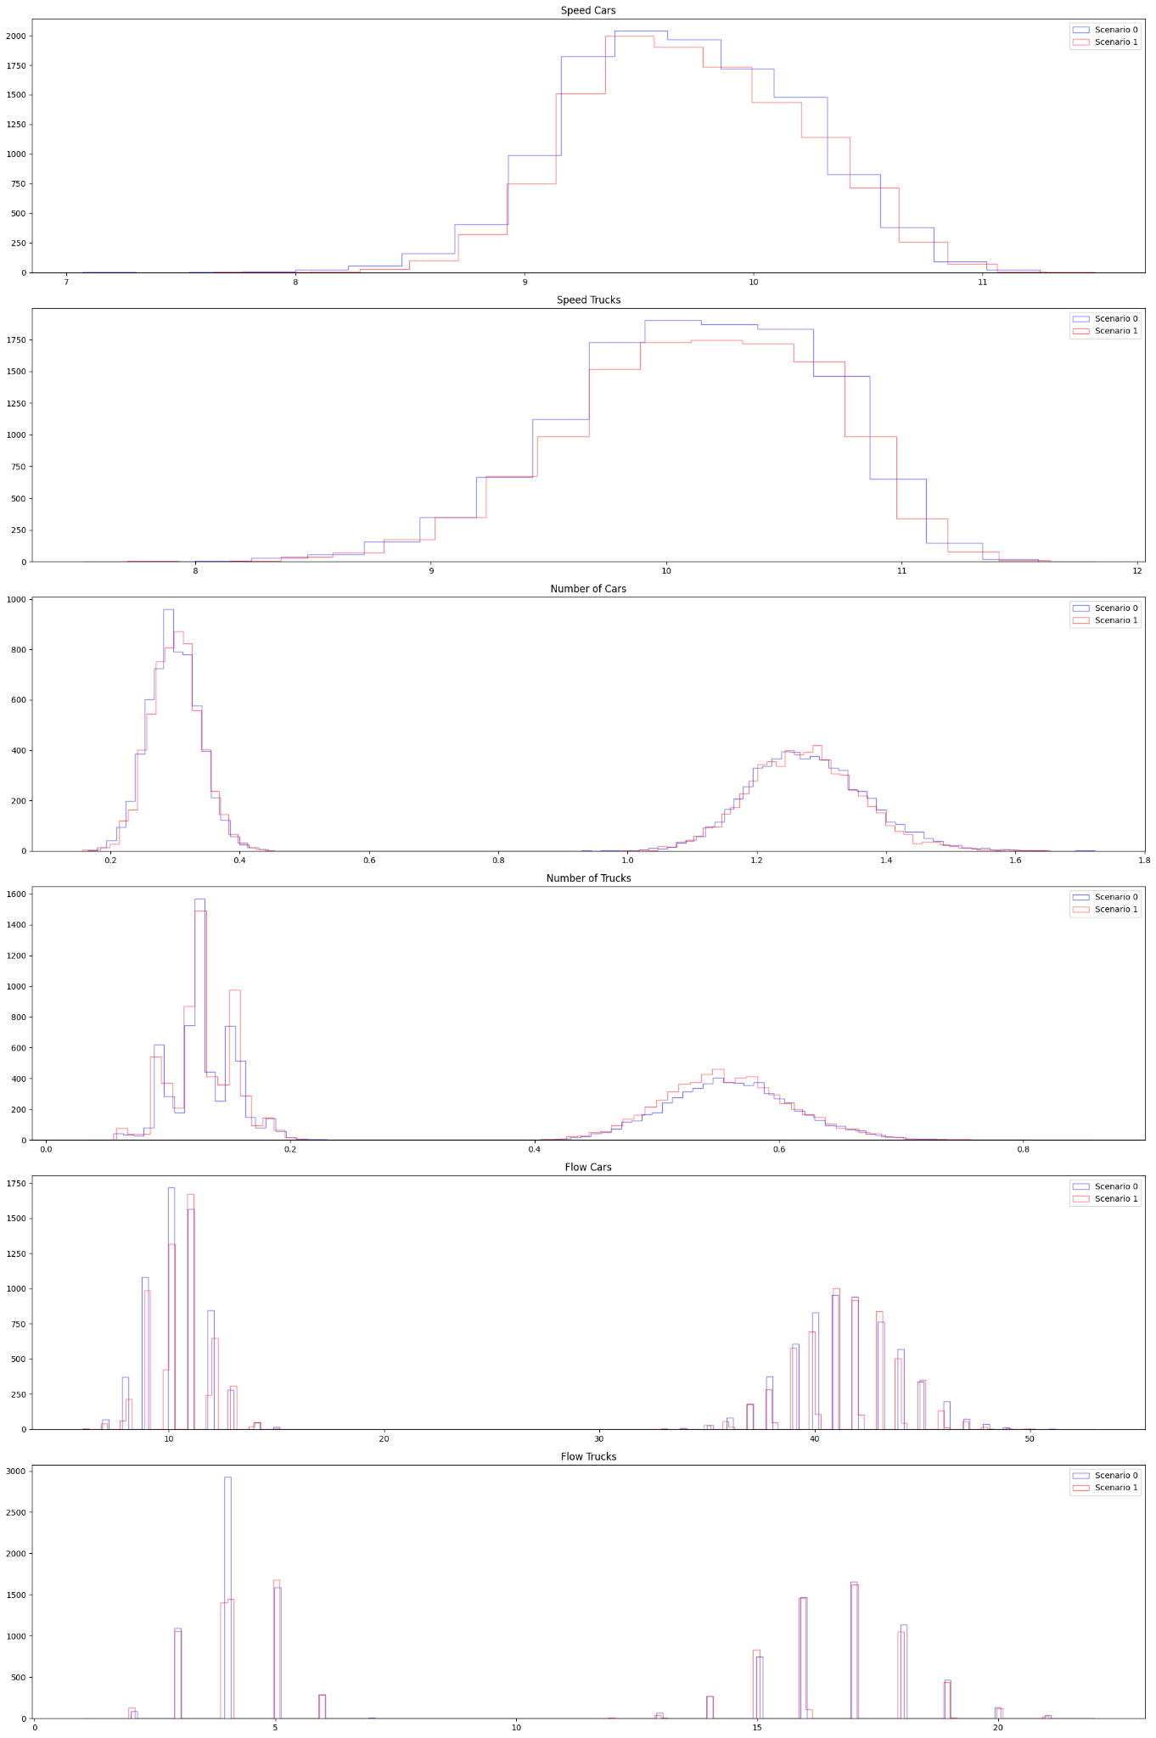
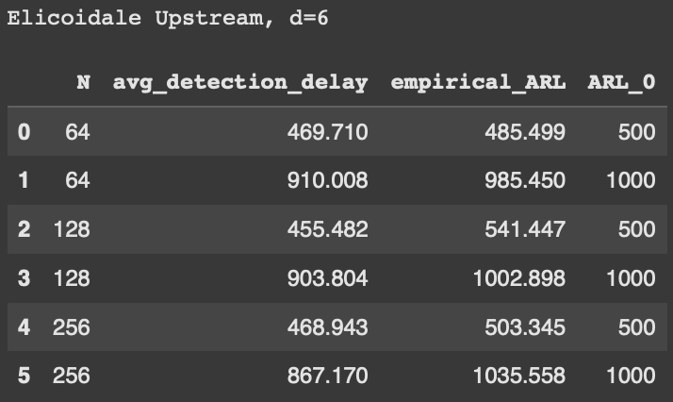
Multimodal Poisson | Elicoidale Upstream (d=6), qtree ewma (K=32)

Slide 10
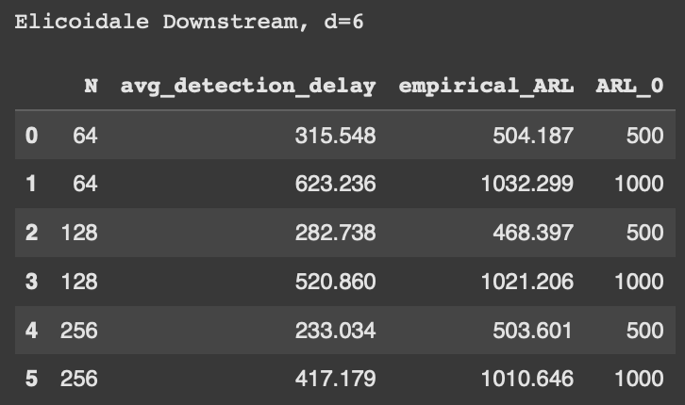
Multimodal Poisson | Elicoidale Downstream (d=6), qtree ewma (K=32)

Slide 11
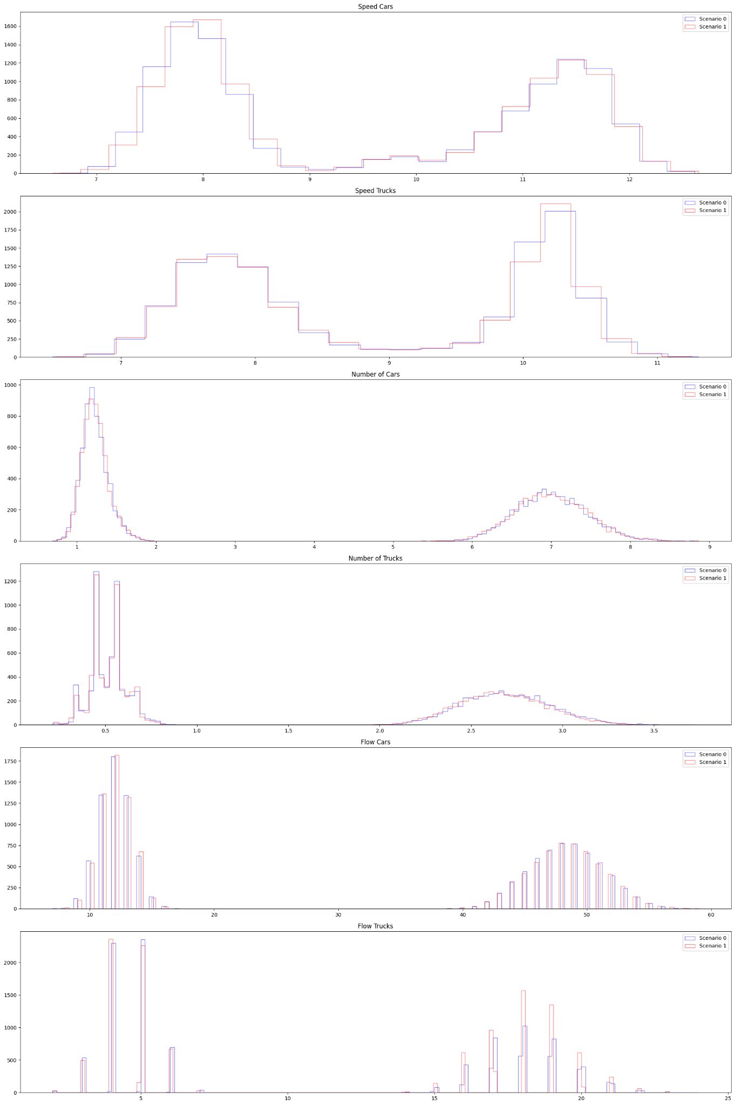
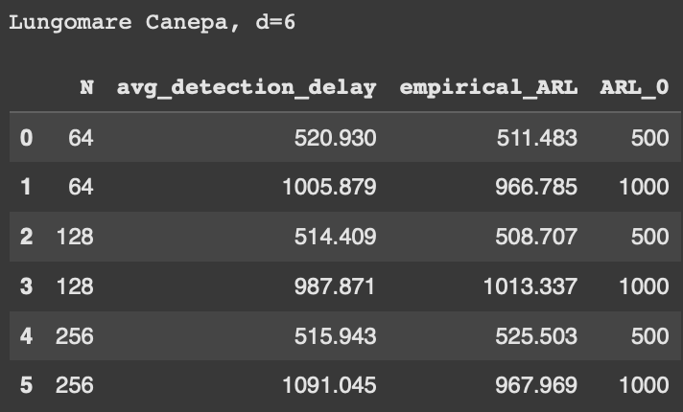
Multimodal Poisson | Lungomare Canepa (d=6), qtree ewma (K=32)

Slide 12
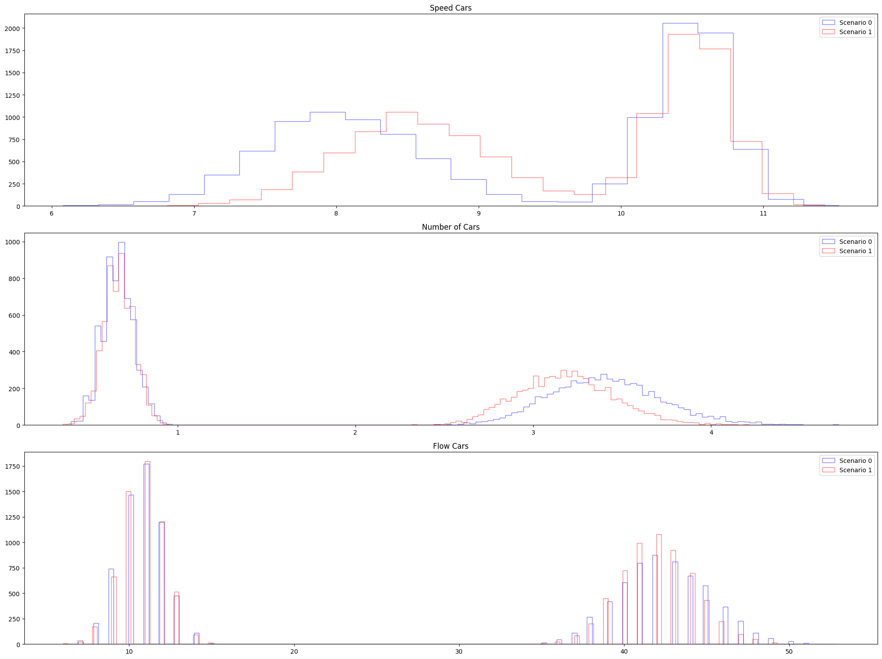
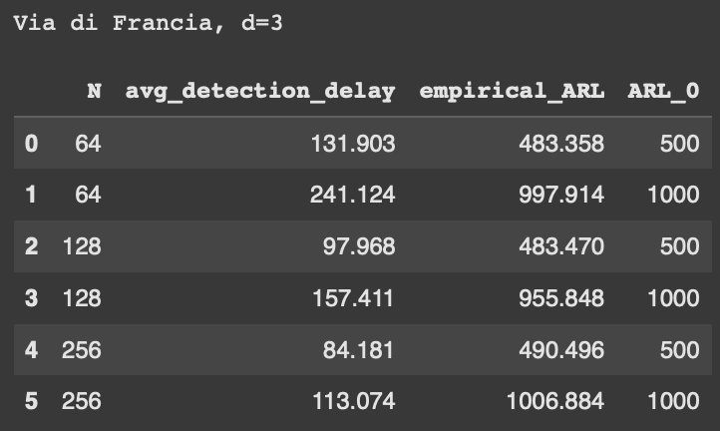
Multimodal Poisson | Via di Francia (d=2), qtree ewma (K=32)

Slide 13
Multimodal Uniform
Uniform (50%)
+
Uniform in “weekend” conditions (50%)
Medium change between scenarios.
Scenario 0: basic conditions with added some ferry passengers traffic.
Scenario 1: alternative policy keeping the basic scenario and changed slightly the timing of two traffic lights.
Here we do add a gaussian noise (0 mean, 0.001 sigma) to the variables “flow cars” or “flow trucks”

Slide 14
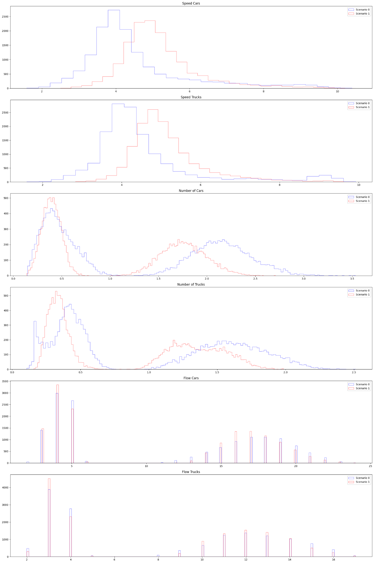
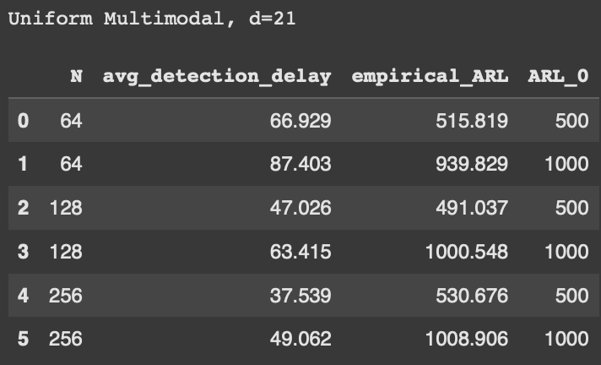
Multimodal Uniform (d=21), qtree ewma (K=32)

Slide 15
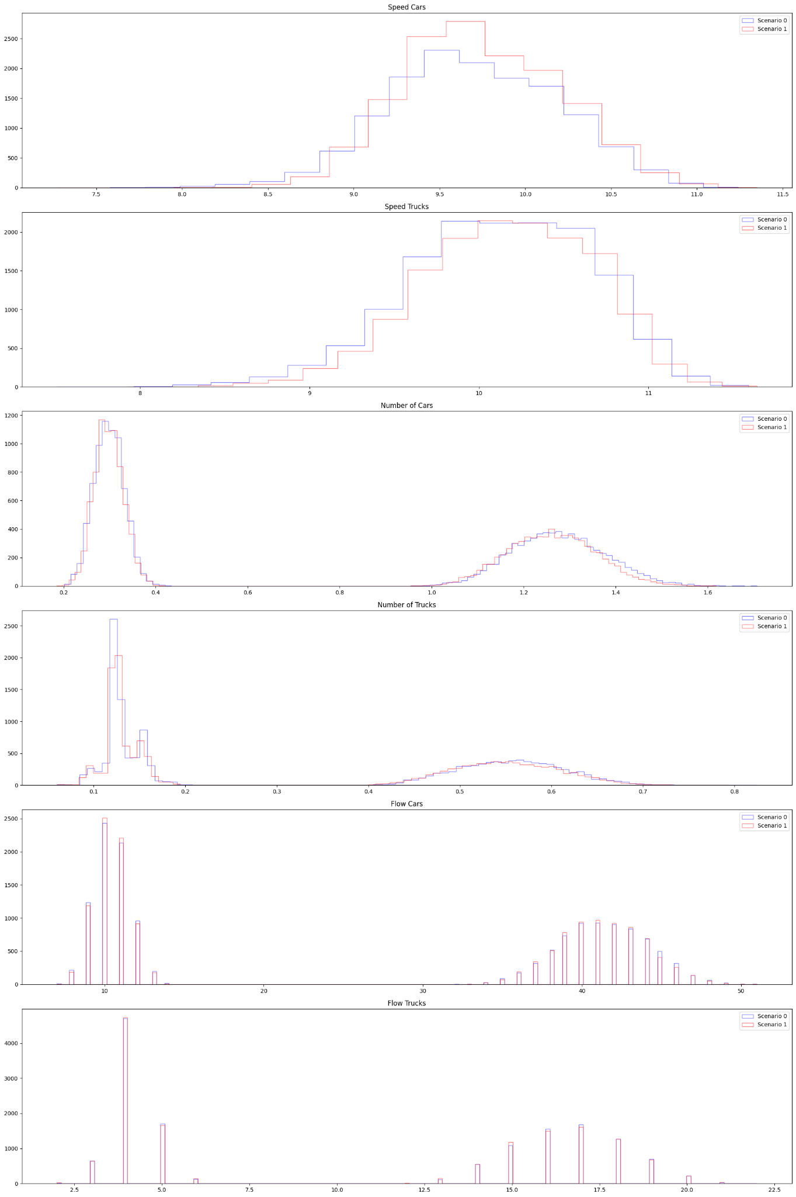
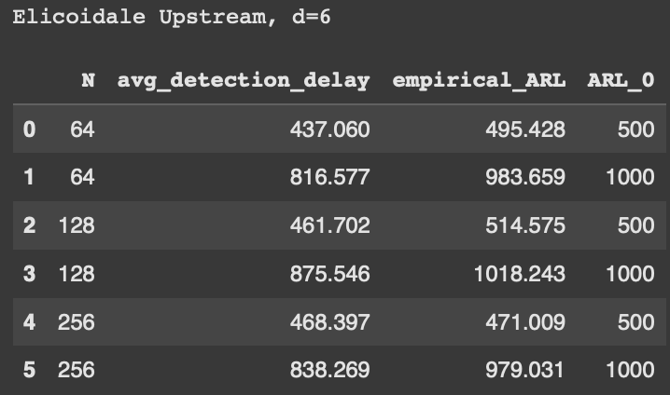
Multimodal Uniform | Elicoidale Upstream (d=6), qtree ewma (K=32)

Slide 16
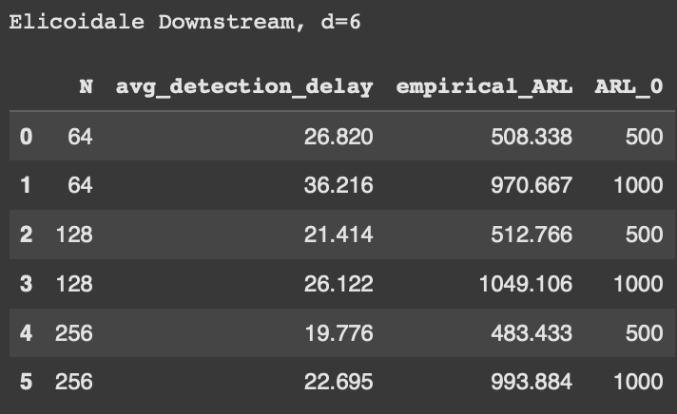
Multimodal Uniform | Elicoidale Downstream (d=6), qtree ewma (K=32)

Slide 17
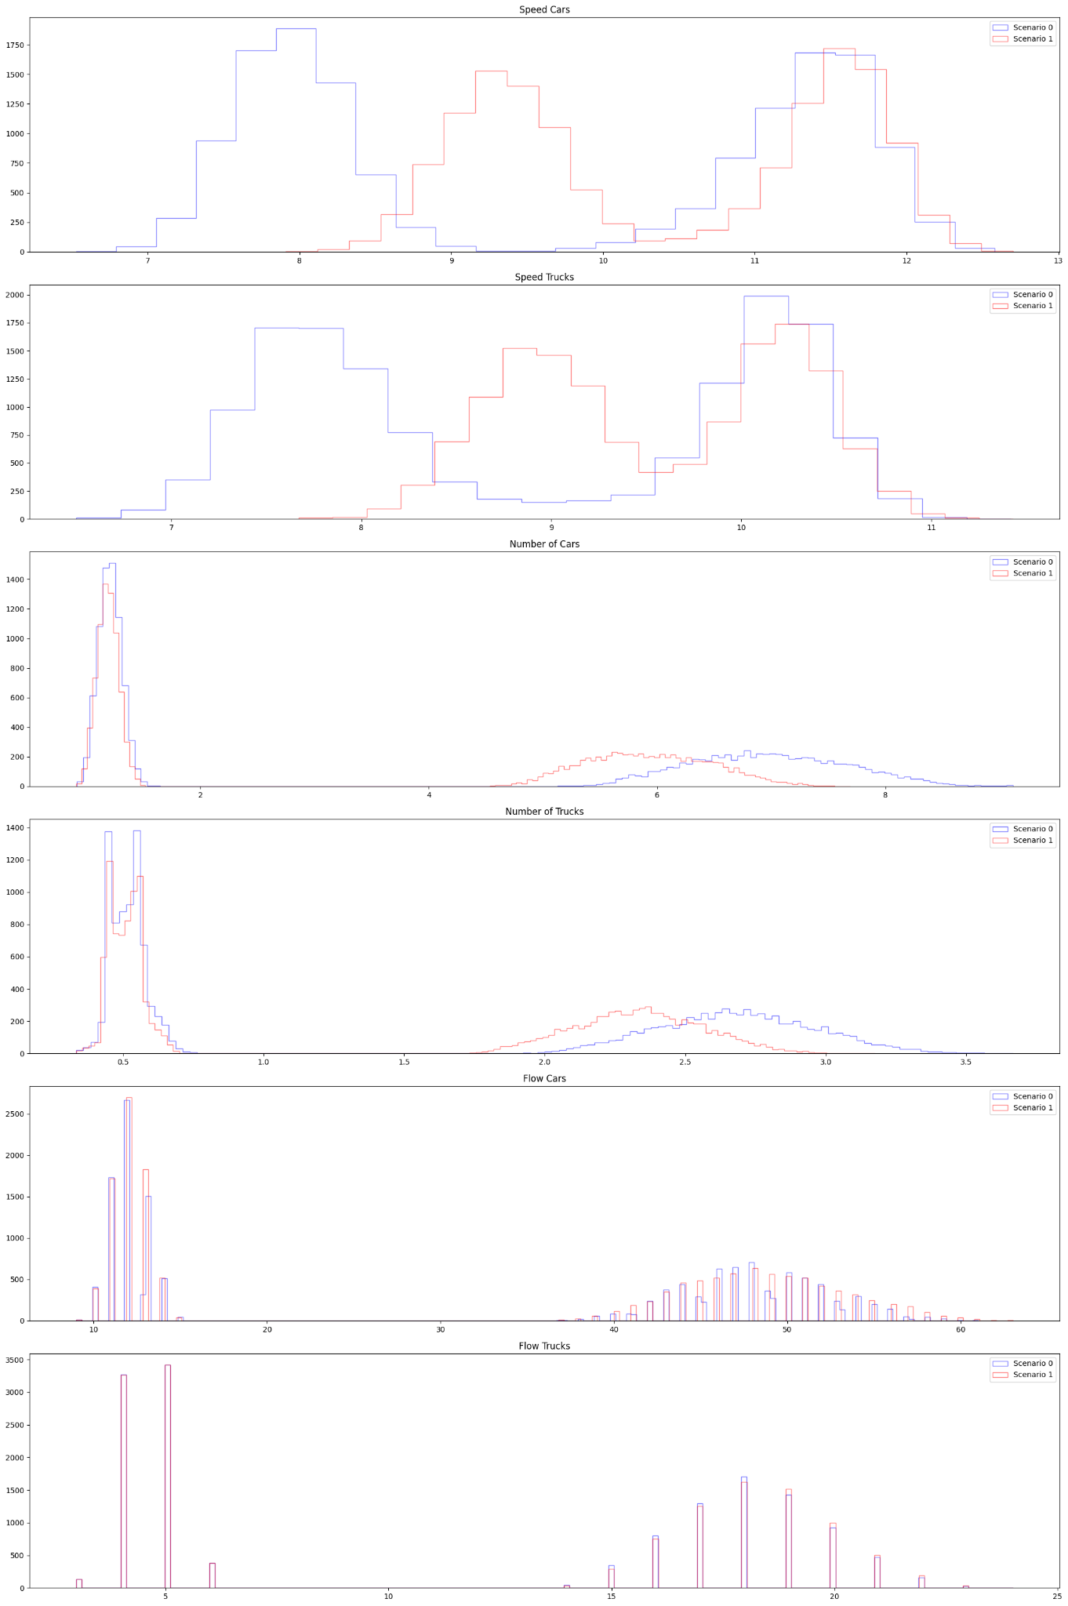
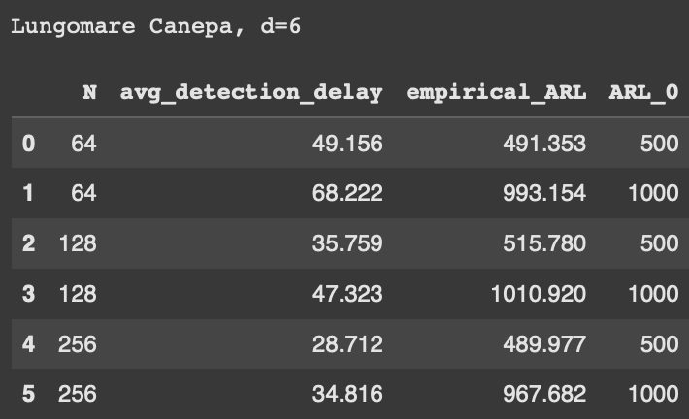
Multimodal Uniform | Lungomare Canepa (d=6), qtree ewma (K=32)

Slide 18
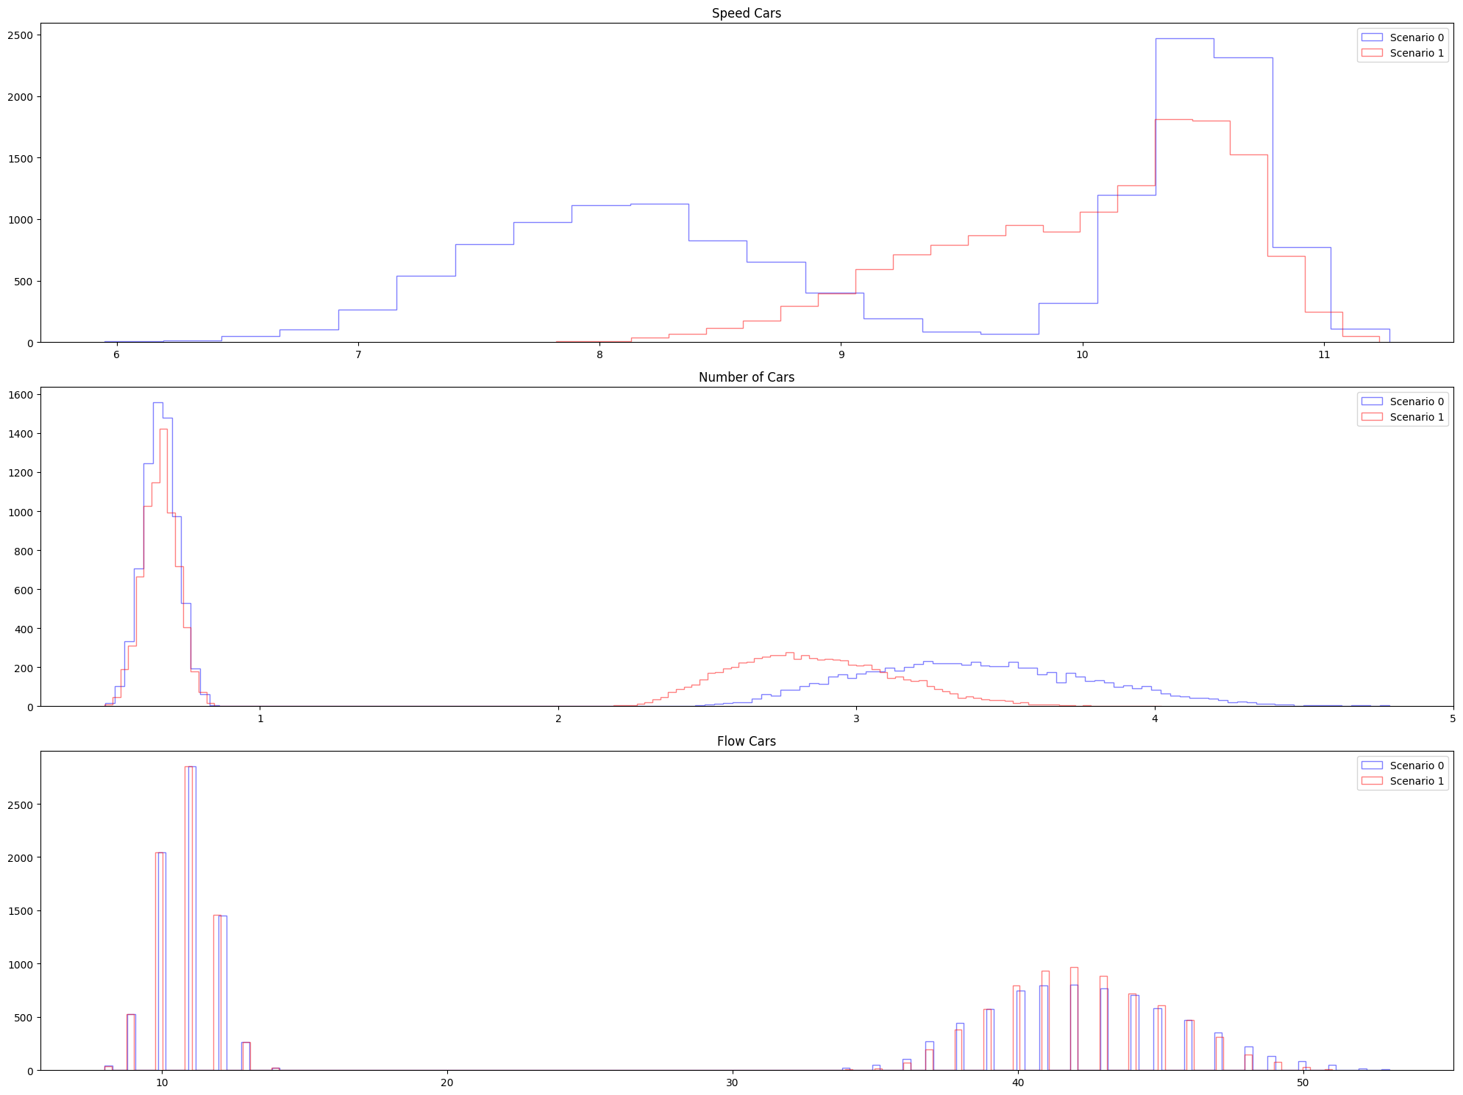
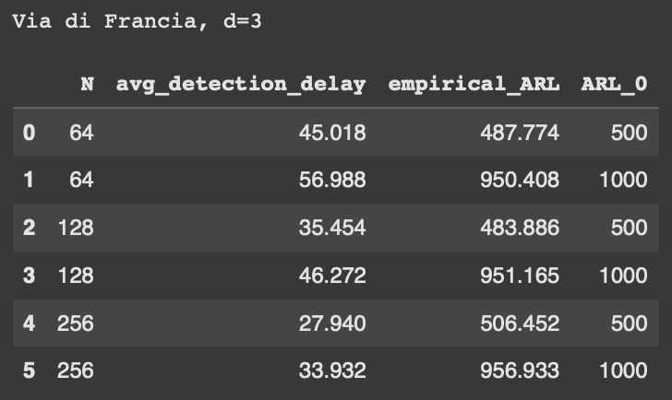
Multimodal Uniform | Via di Francia (d=3), qtree ewma (K=32)

Slide 19
Gaussian
Inflows generated with gaussian distribution
Bigger change between scenarios.
Scenario 0: basic conditions with added some ferry passengers traffic.
Scenario 1: alternative policy, one of the port gates is closed, forcing trucks to reroute.
Here we do add a gaussian noise (0 mean, 0.001 sigma) to the variables “flow cars” or “flow trucks”

Slide 20
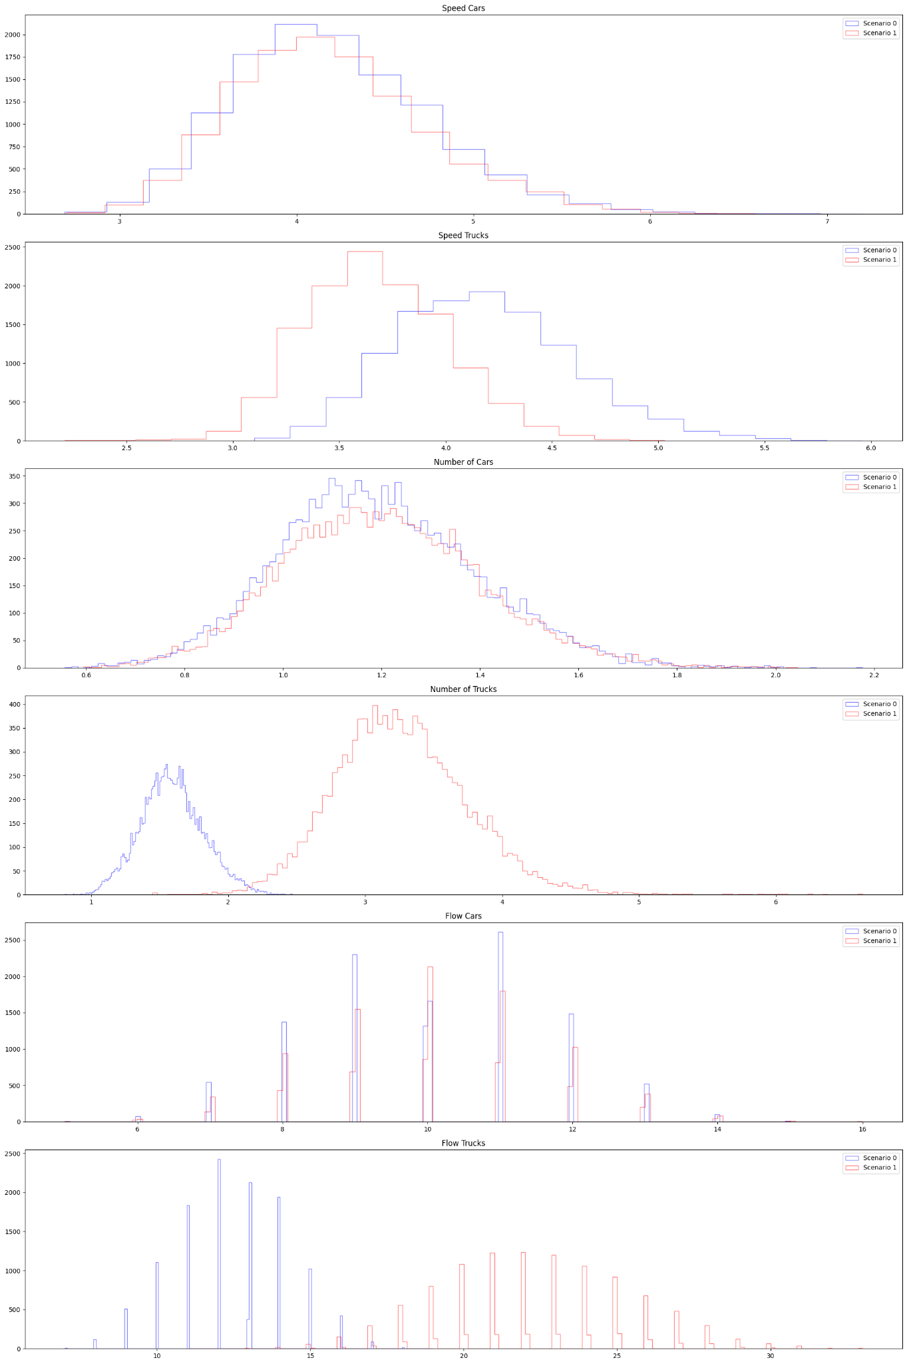
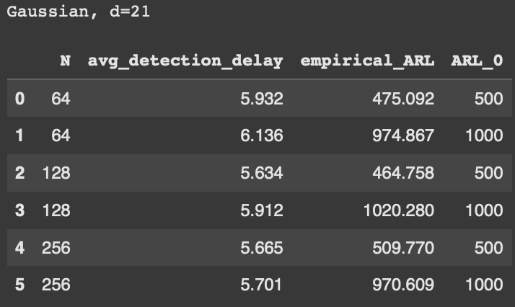
Gaussian (d=21), qtree ewma (K=32)

Slide 21
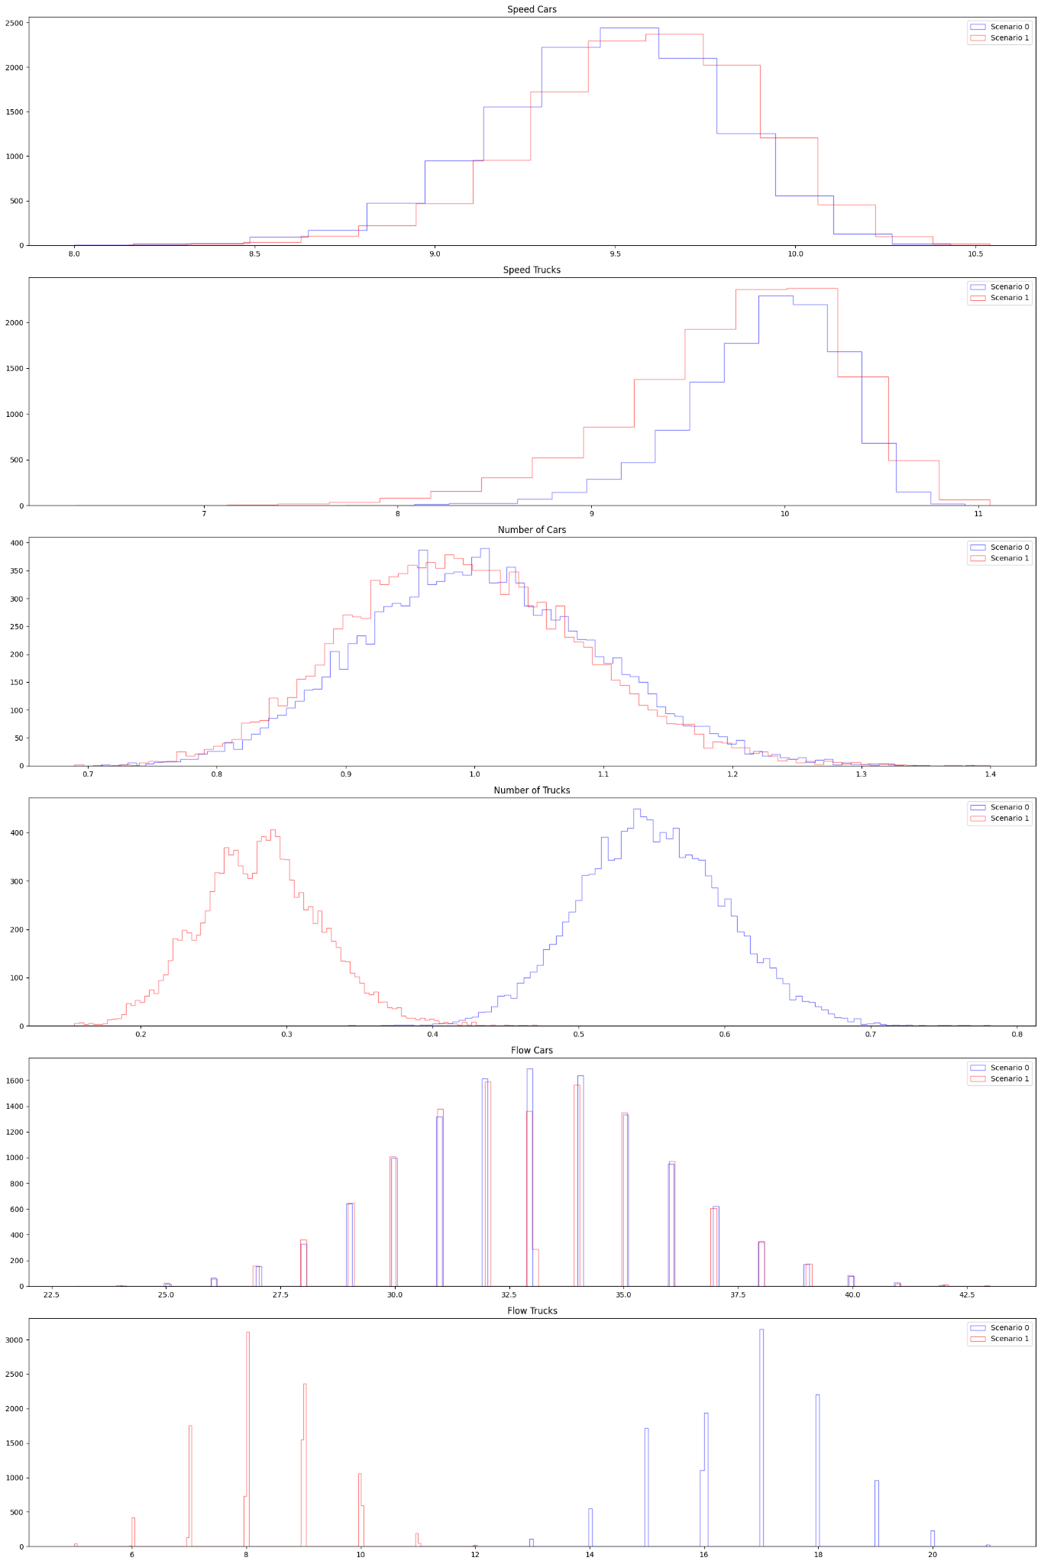
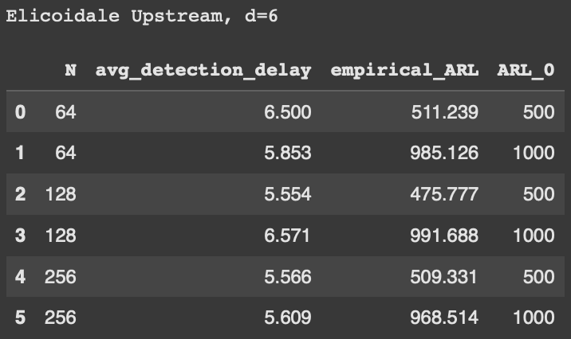
Gaussian | Elicoidale Upstream (d=6), qtree ewma (K=32)

Slide 22
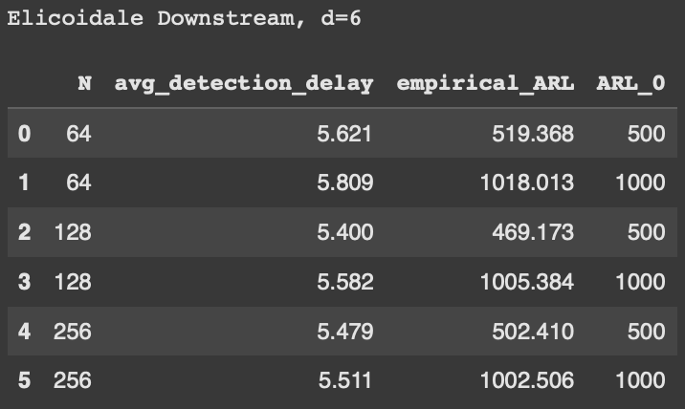
Gaussian | Elicoidale Downstream (d=6), qtree ewma (K=32)

Slide 23
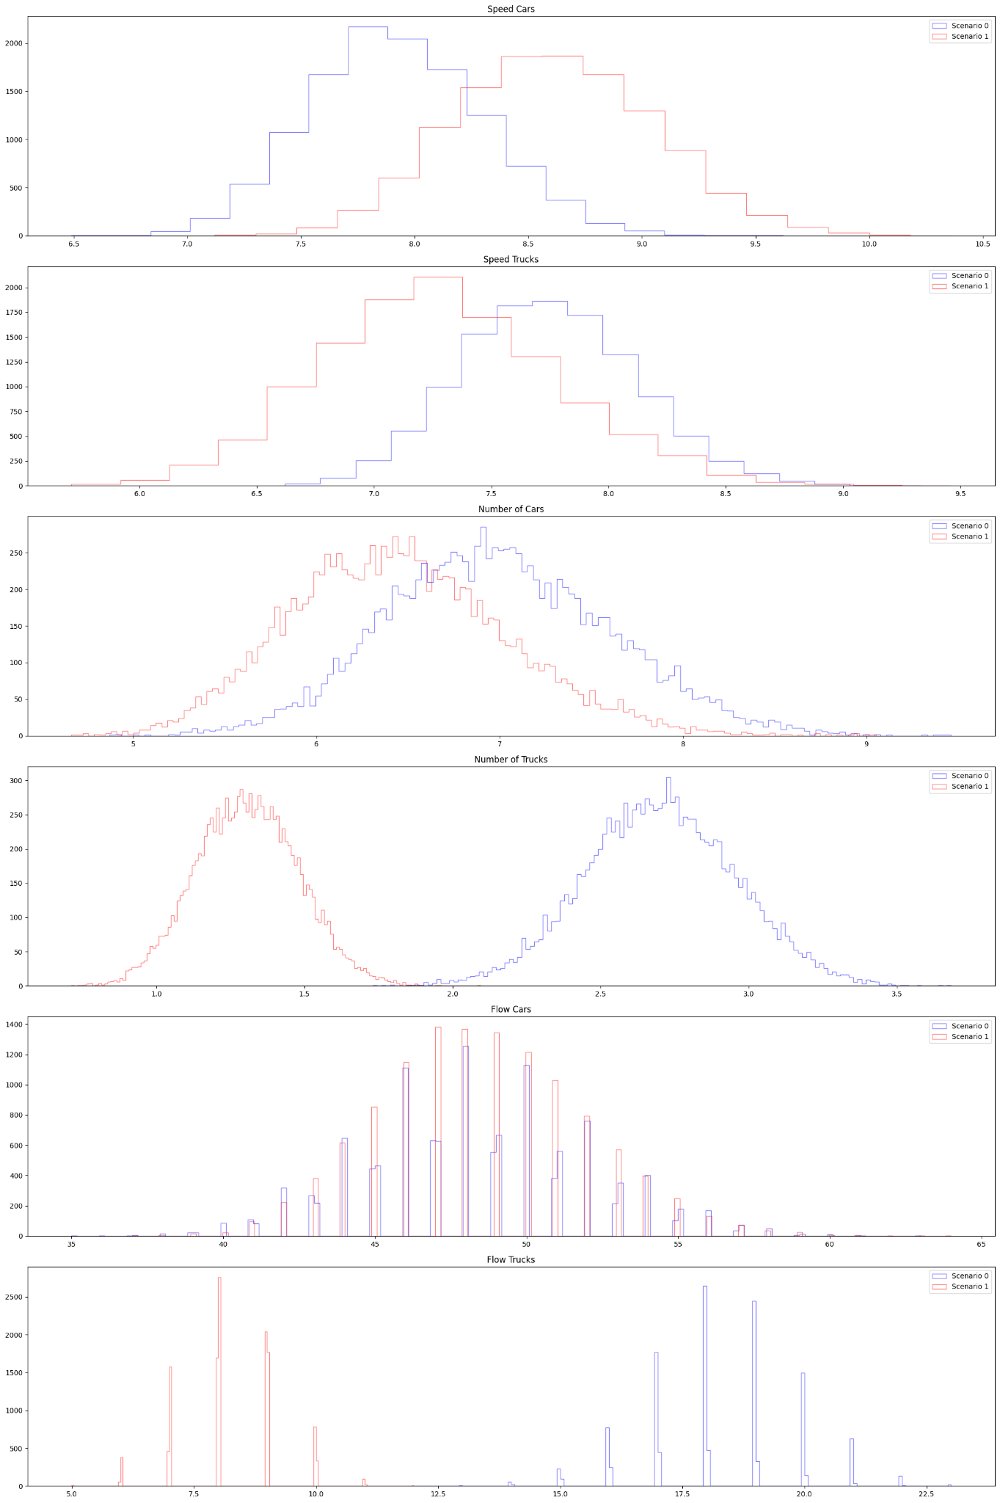
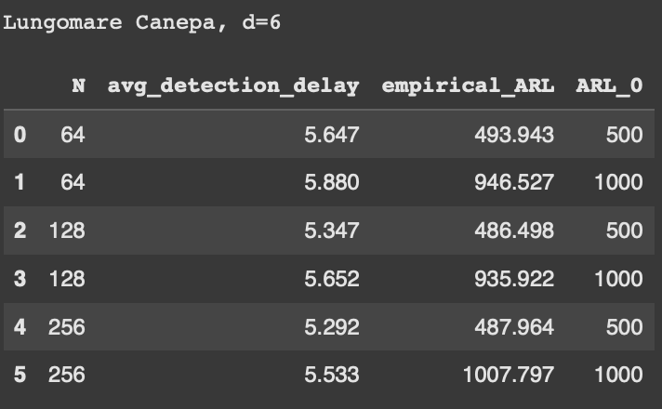
Gaussian | Lungomare Canepa (d=6), qtree ewma (K=32)

Slide 24
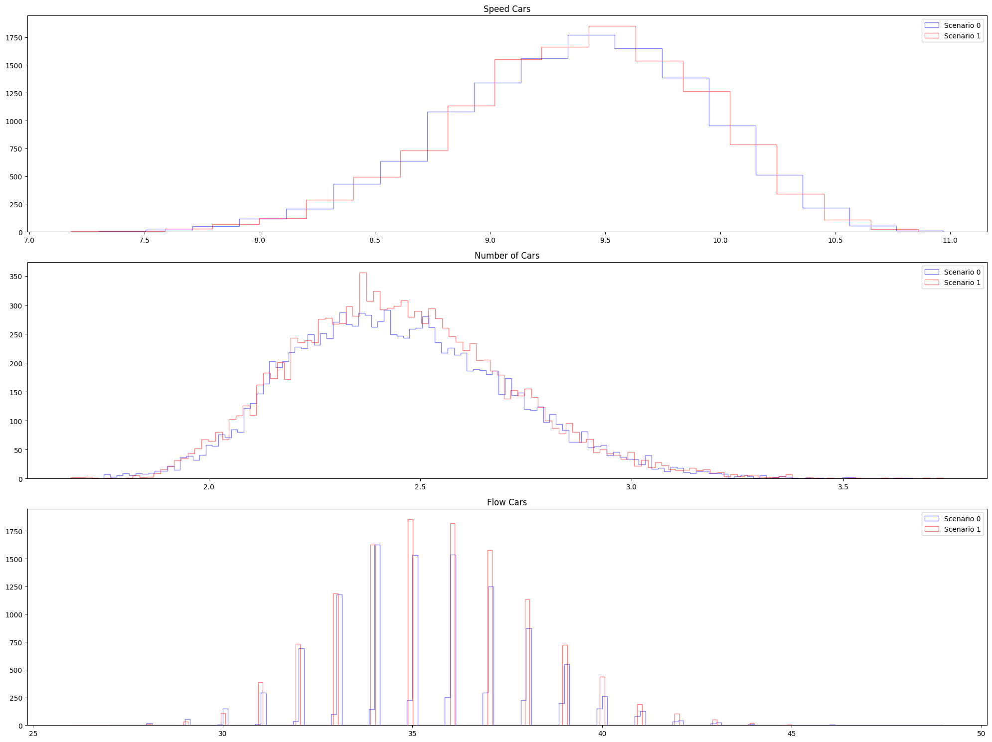
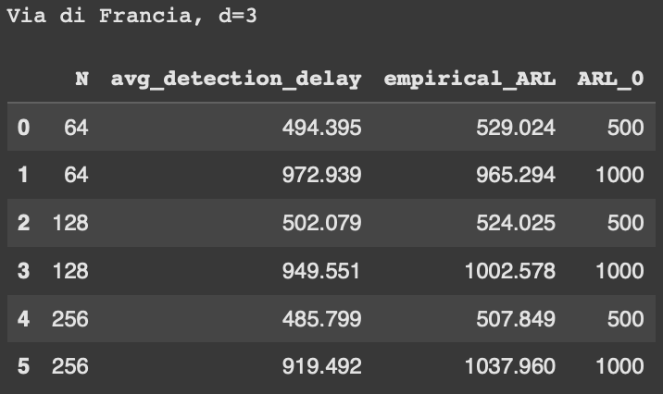
Gaussian | Via di Francia (d=3), qtree ewma (K=32)

