Slide 1
Multimodal Poisson
Inflows generated with poisson distribution
Multimodal: Weekday (50%) + Weekend (50%)
Scenario 0 → Scenario 1
The change is minimal: 5 seconds longer in a single red phase of a single traffic light.

Slide 2
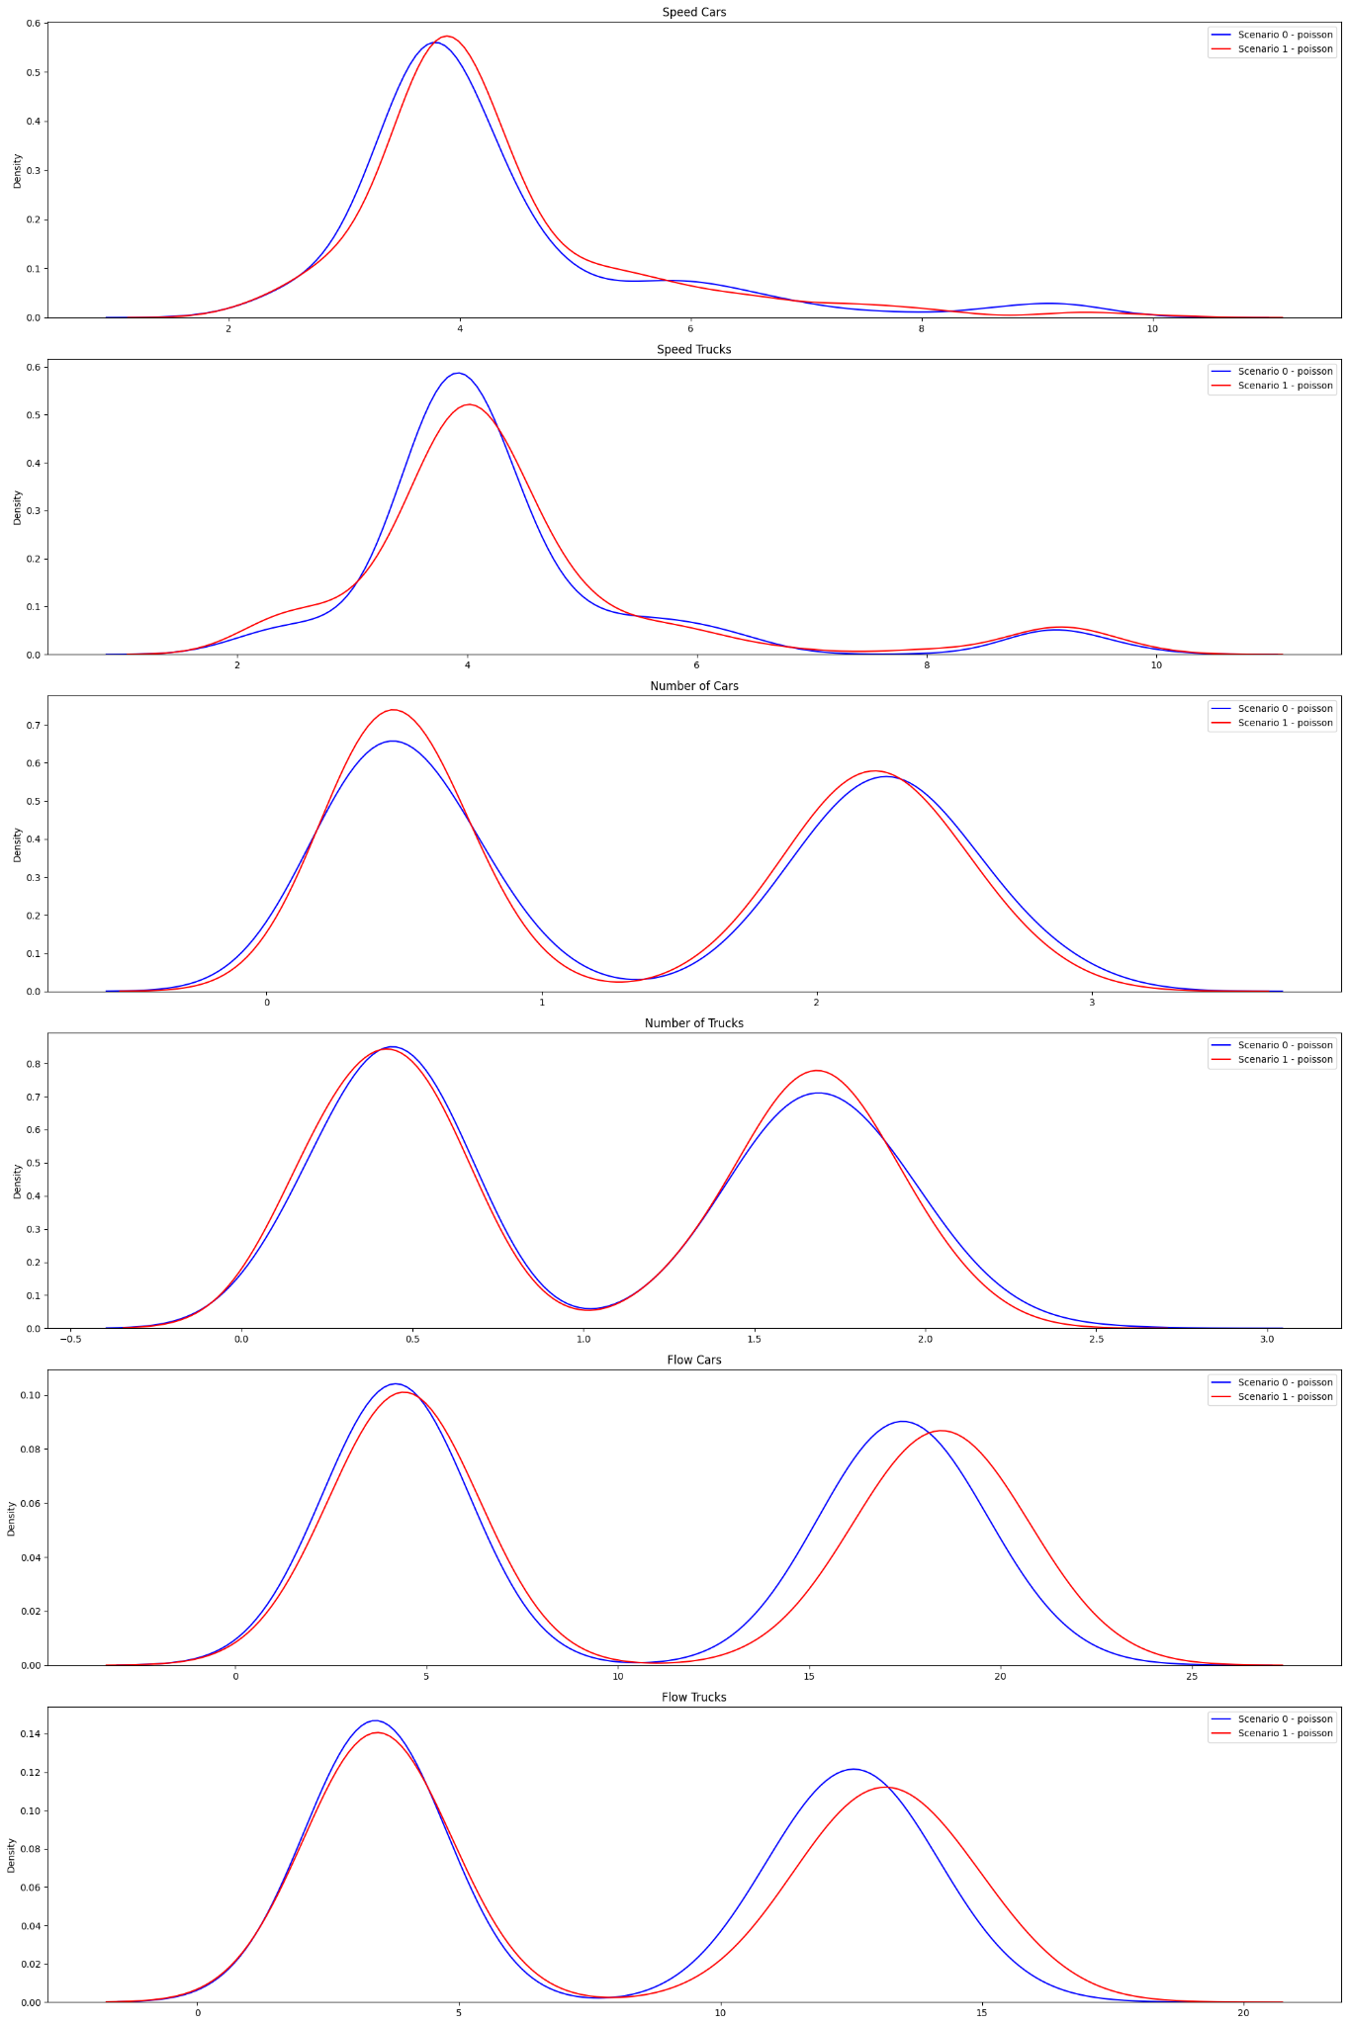
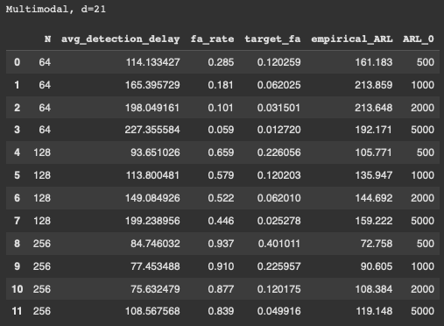
Multimodal Poisson (d=21), qtree ewma (K=32)

Slide 3
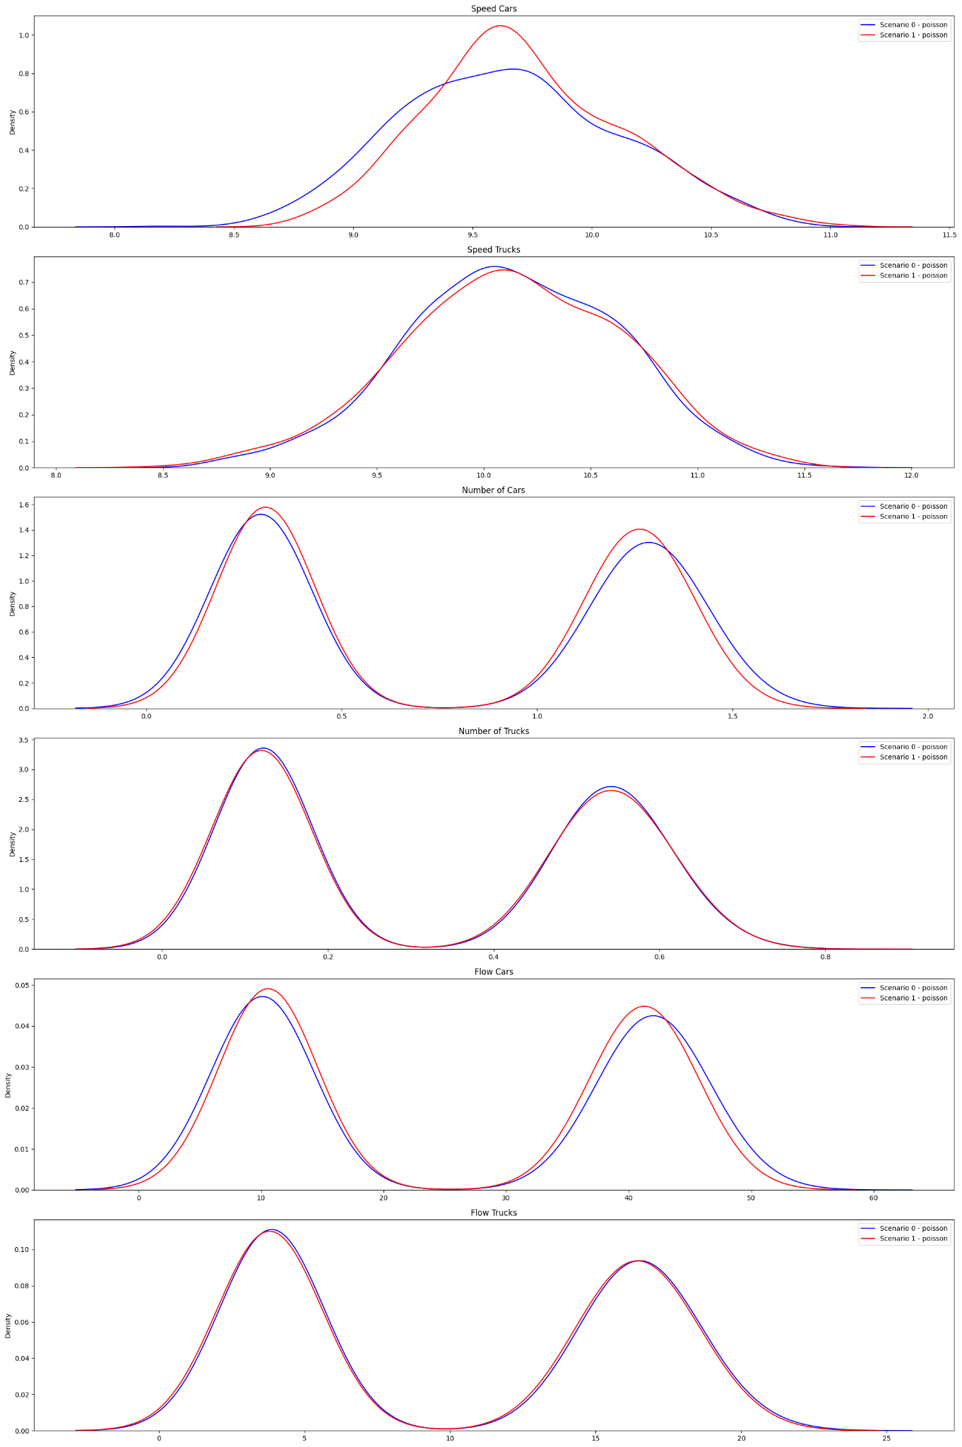
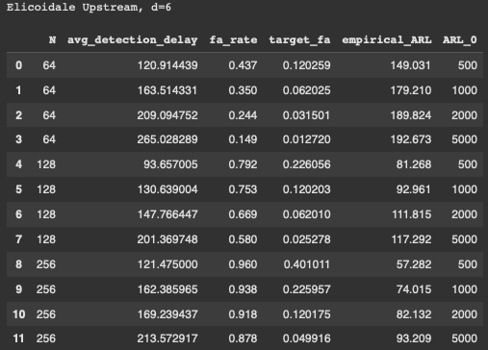
Multimodal Poisson | Elicoidale Upstream (d=6), qtree ewma (K=32)

Slide 4
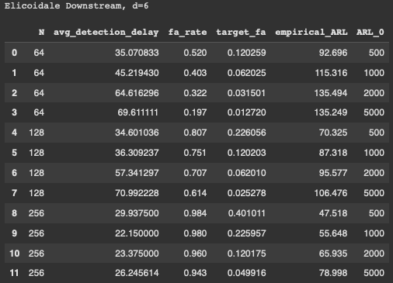
Multimodal Poisson | Elicoidale Downstream (d=6), qtree ewma (K=32)

Slide 5
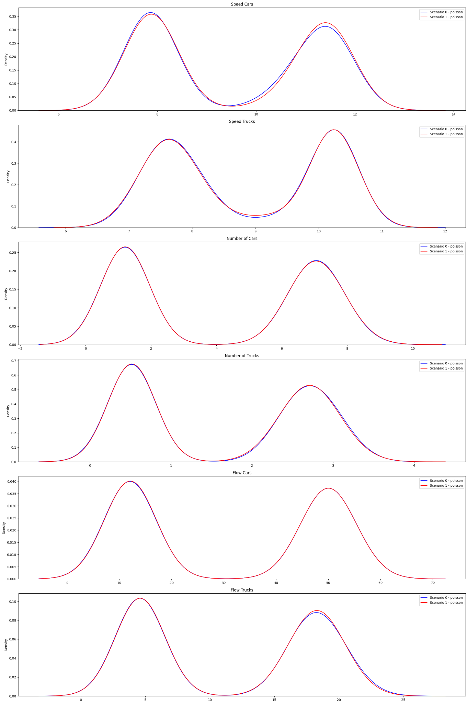
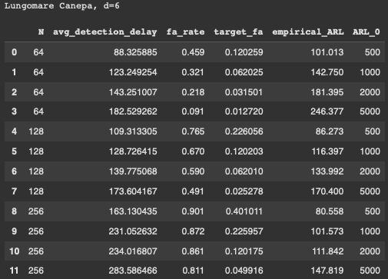
Multimodal Poisson | Lungomare Canepa (d=6), qtree ewma (K=32)

Slide 6
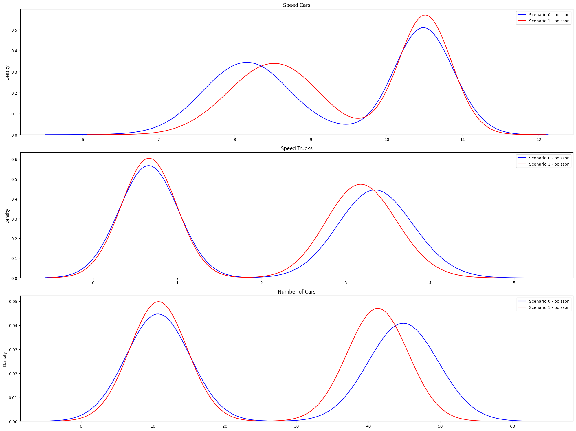
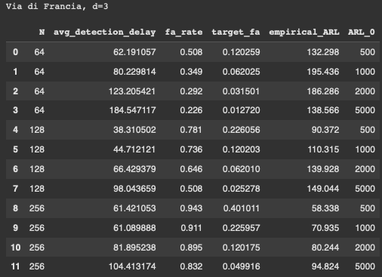
Multimodal Poisson | Via di Francia (d=3), qtree ewma (K=32)

Slide 7
Multimodal Uniform
Uniform (50%)
+
Uniform in “weekend” conditions (50%)
Scenario 0: basic conditions with added some ferry passengers traffic.
Scenario 1: alternative policy keeping the basic scenario and changed slightly the timing of two traffic lights.

Slide 8
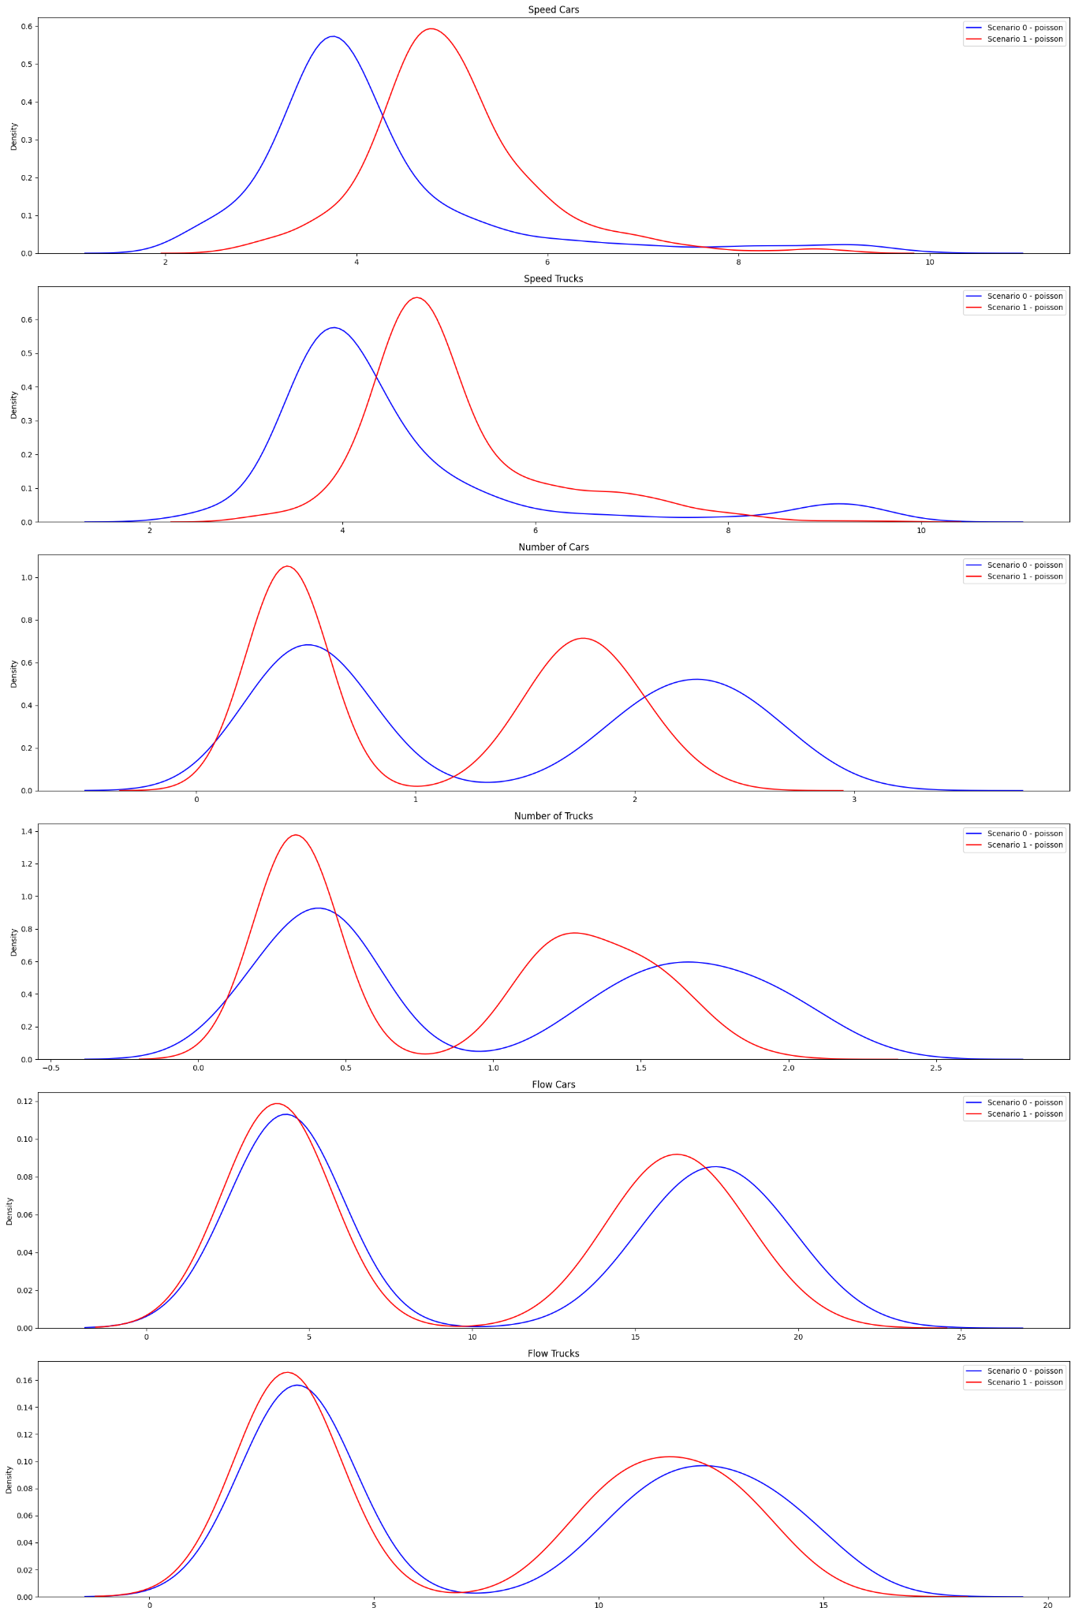
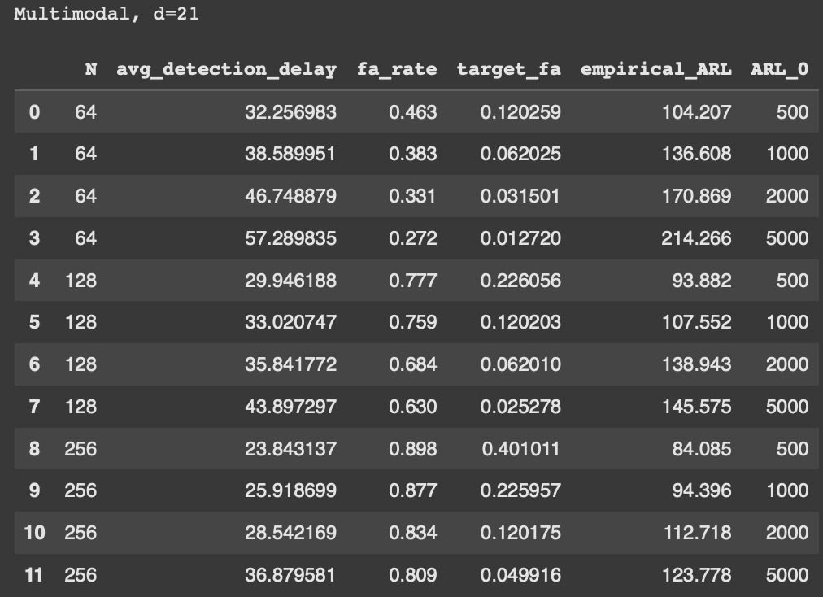
Multimodal Uniform (d=21), qtree ewma (K=32)

Slide 9
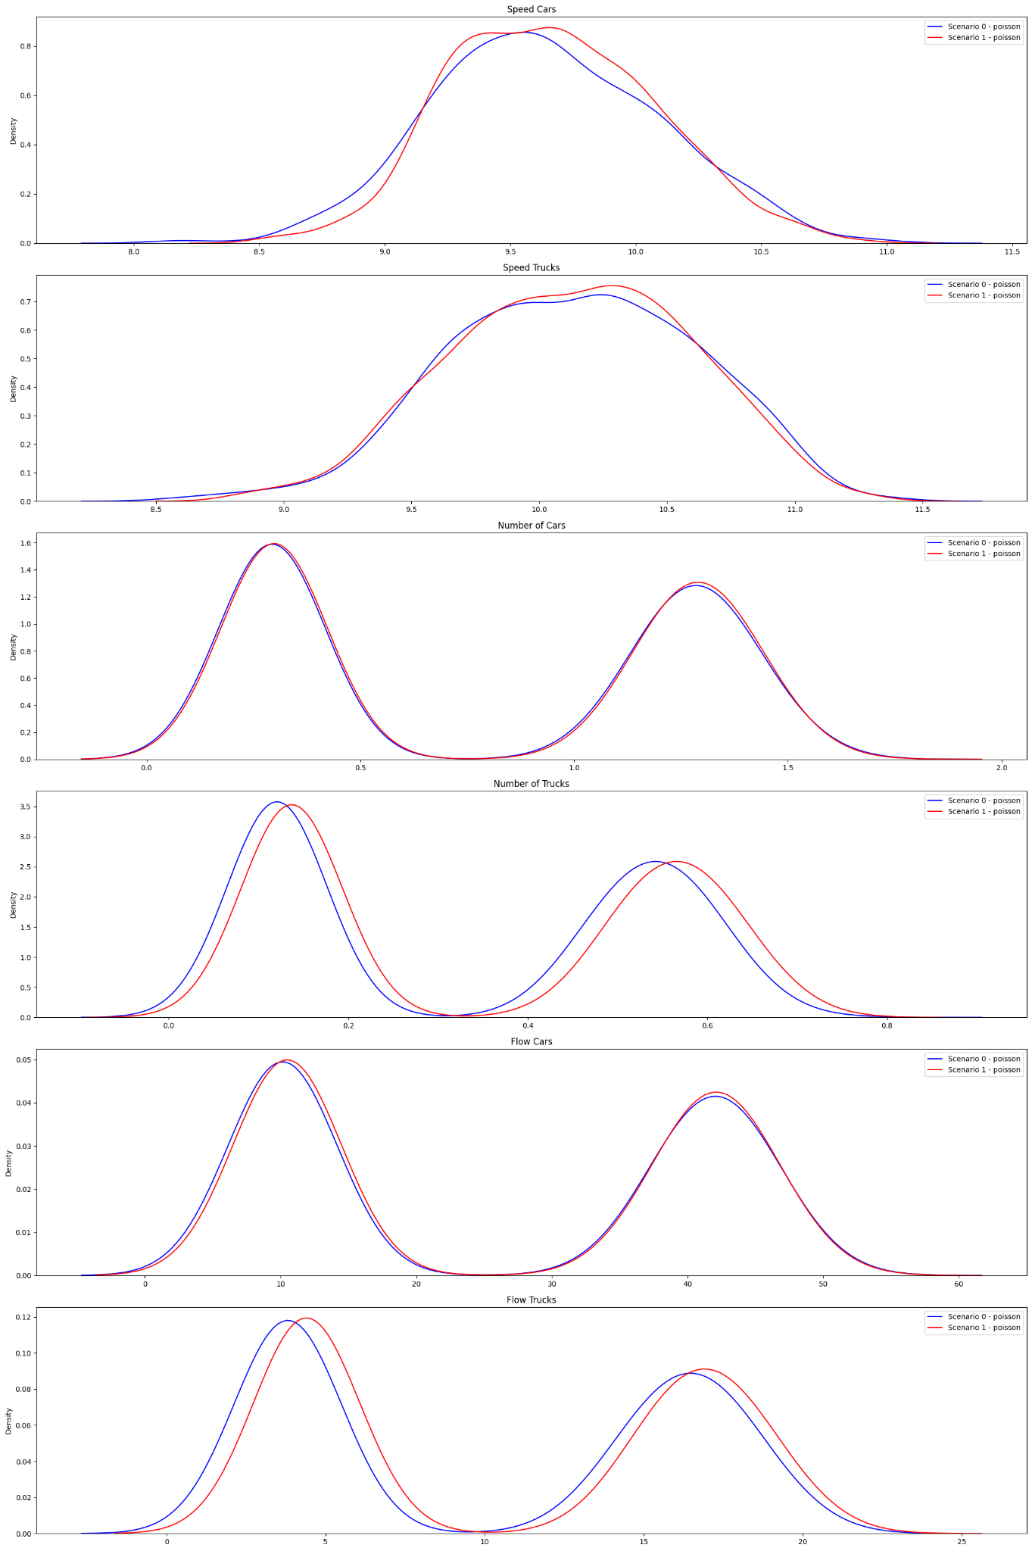
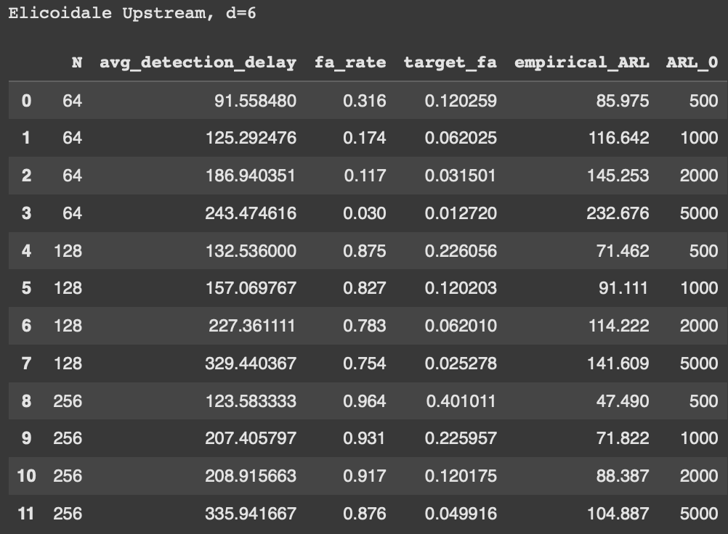
Multimodal Uniform | Elicoidale Upstream (d=6), qtree ewma (K=32)

Slide 10
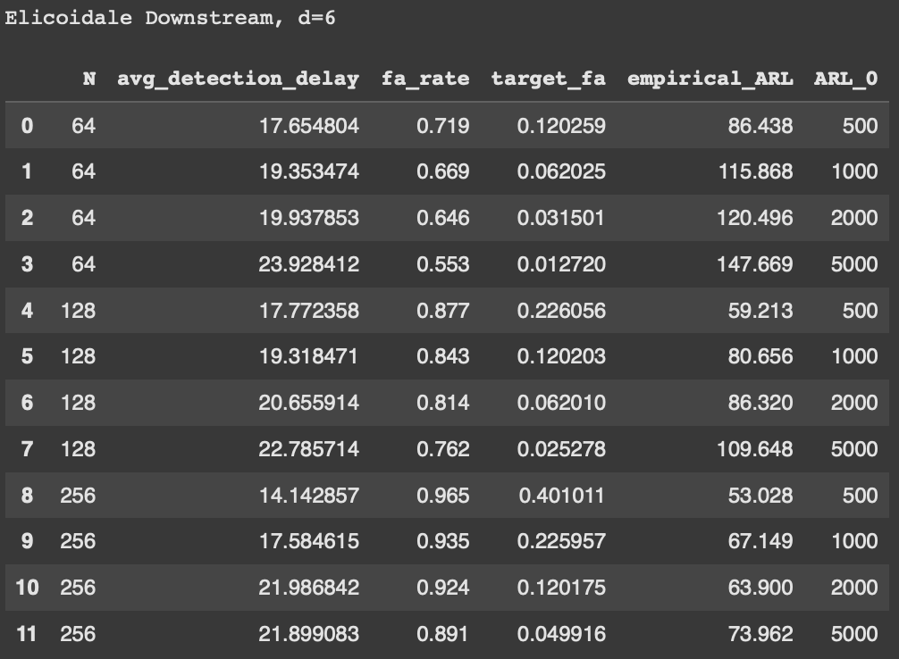
Multimodal Uniform | Elicoidale Downstream (d=6), qtree ewma (K=32)

Slide 11
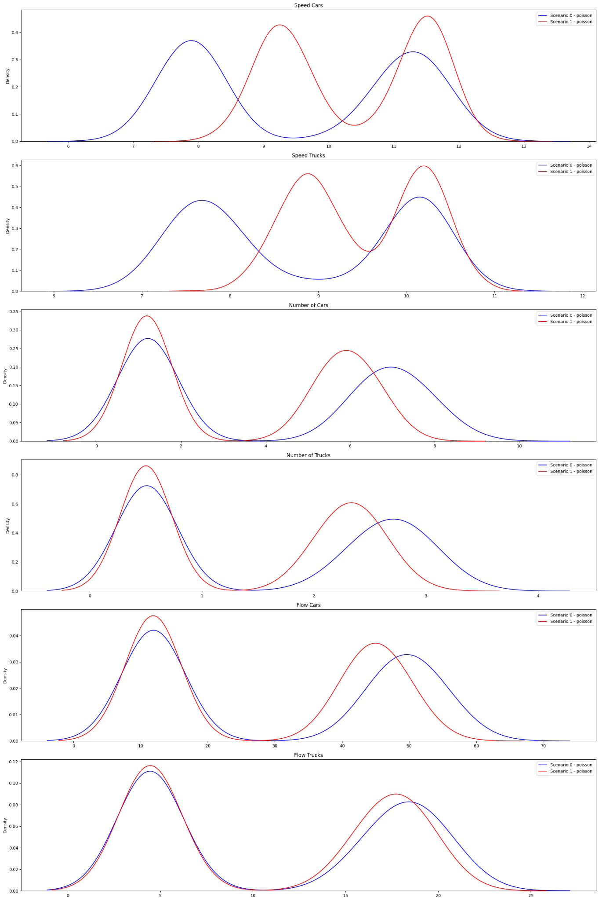
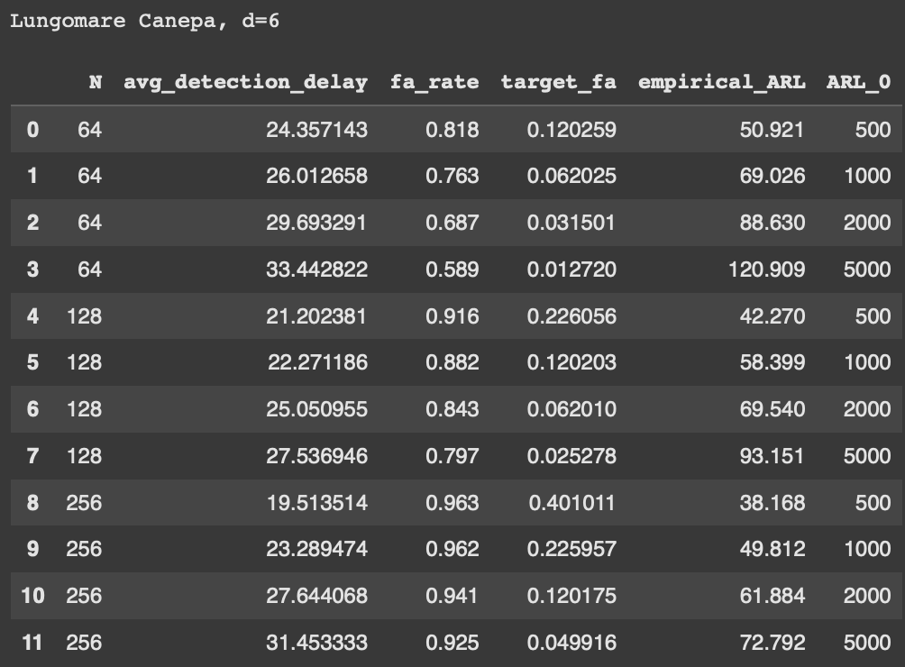
Multimodal Uniform | Lungomare Canepa (d=6), qtree ewma (K=32)

Slide 12
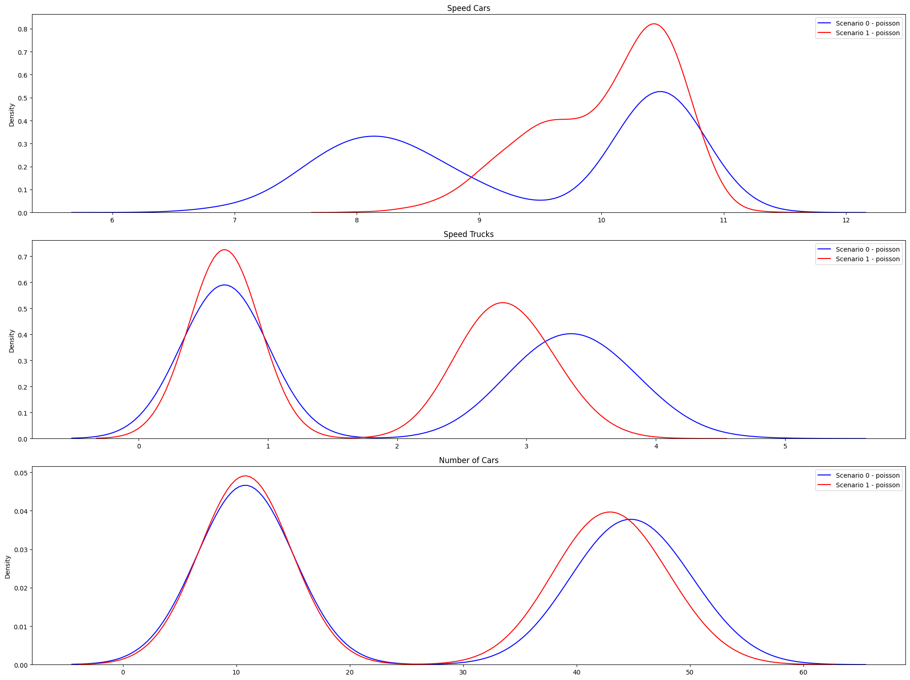
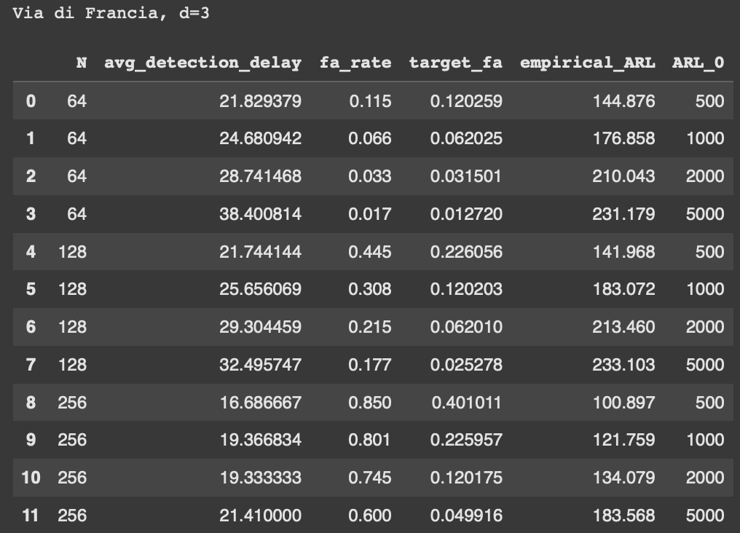
Multimodal Uniform | Via di Francia (d=3), qtree ewma (K=32)

Slide 13
Gaussian
Inflows generated with gaussian distribution
Scenario 0: basic conditions with added some ferry passengers traffic.
Scenario 1: alternative policy, one of the port gates is closed, forcing trucks to reroute.

Slide 14
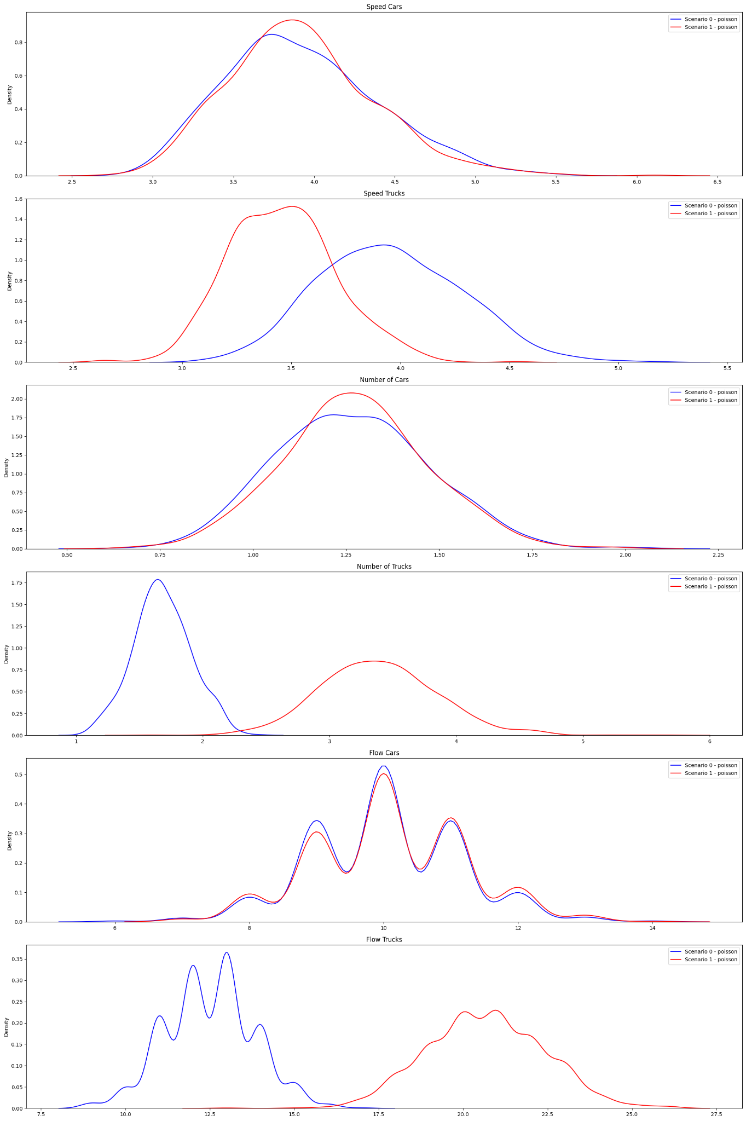
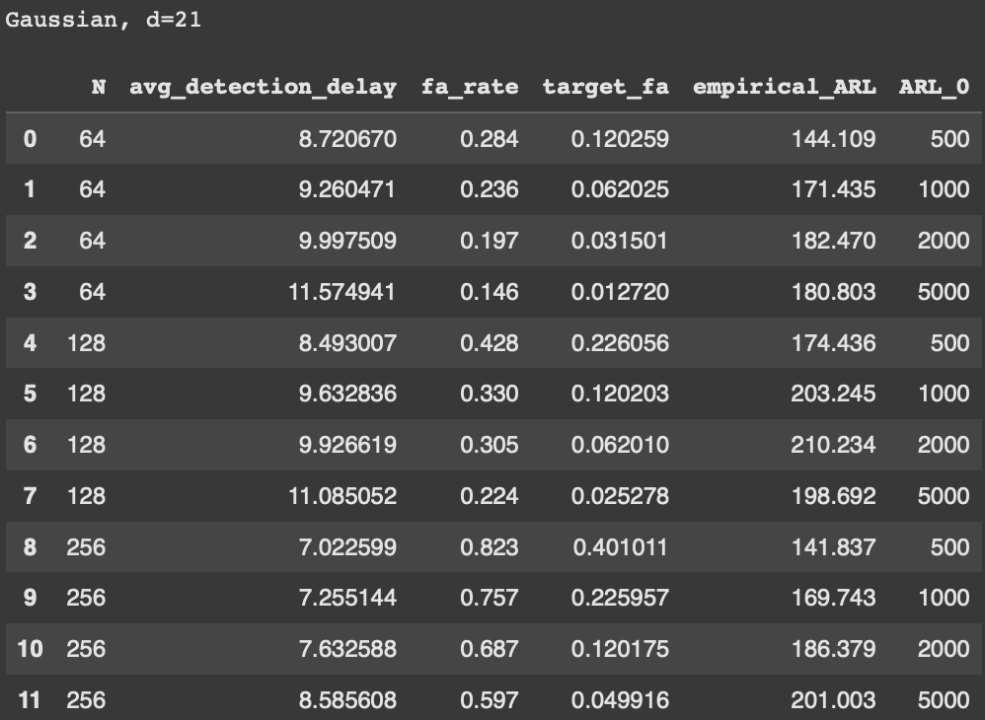
Gaussian (d=21), qtree ewma (K=32)

Slide 15
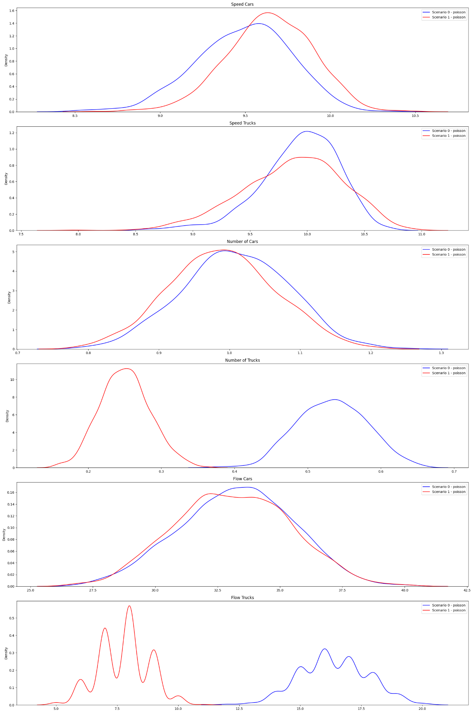
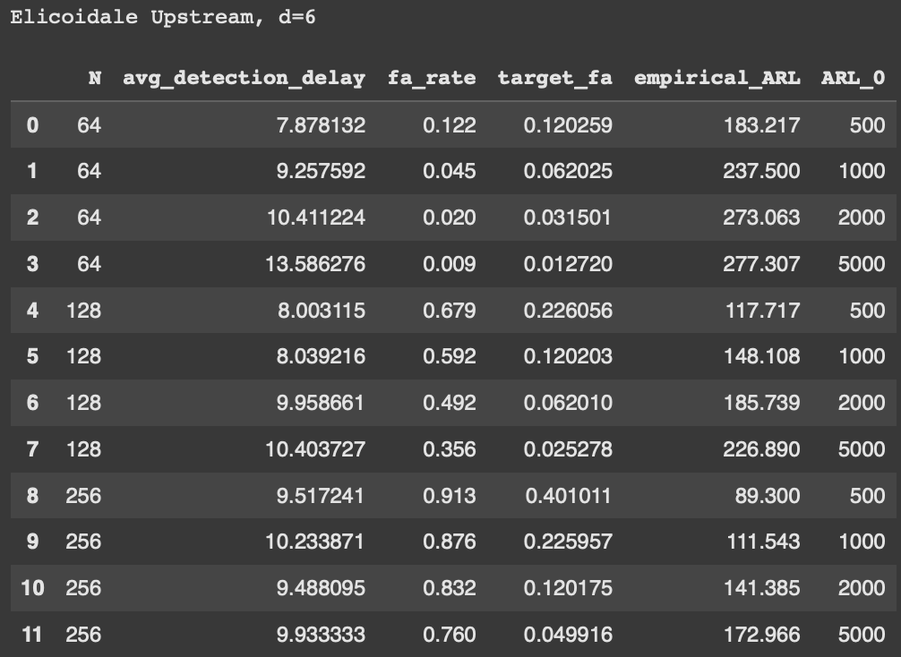
Gaussian | Elicoidale Upstream (d=6), qtree ewma (K=32)

Slide 16
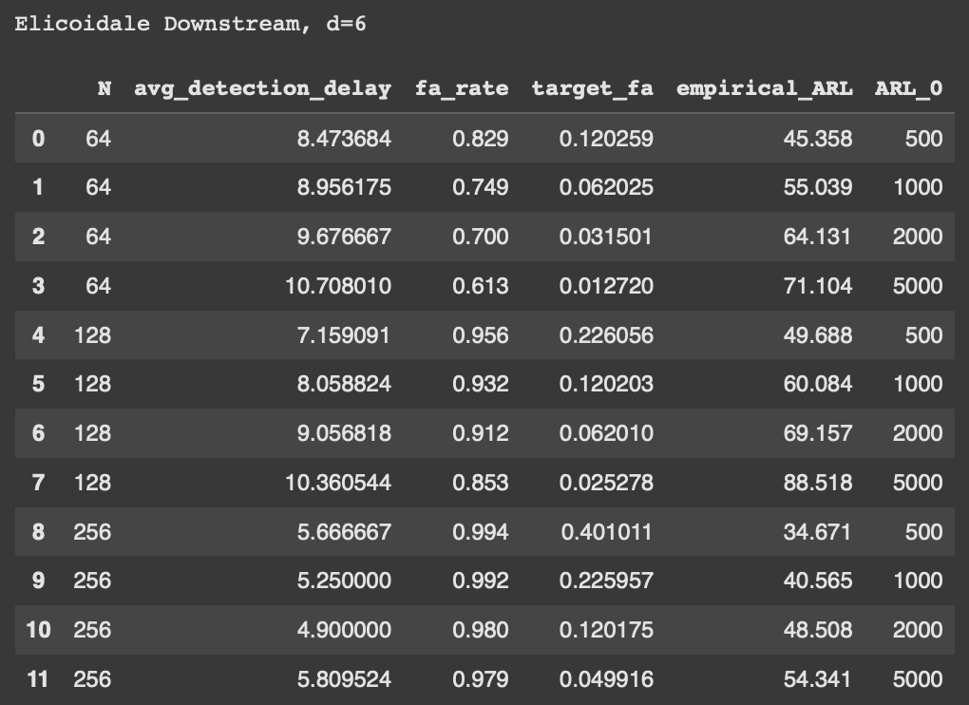
Gaussian | Elicoidale Downstream (d=6), qtree ewma (K=32)

Slide 17
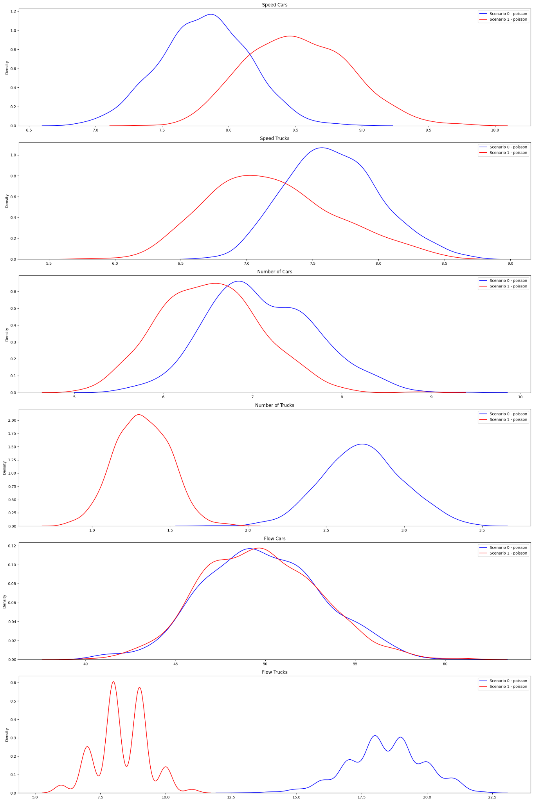
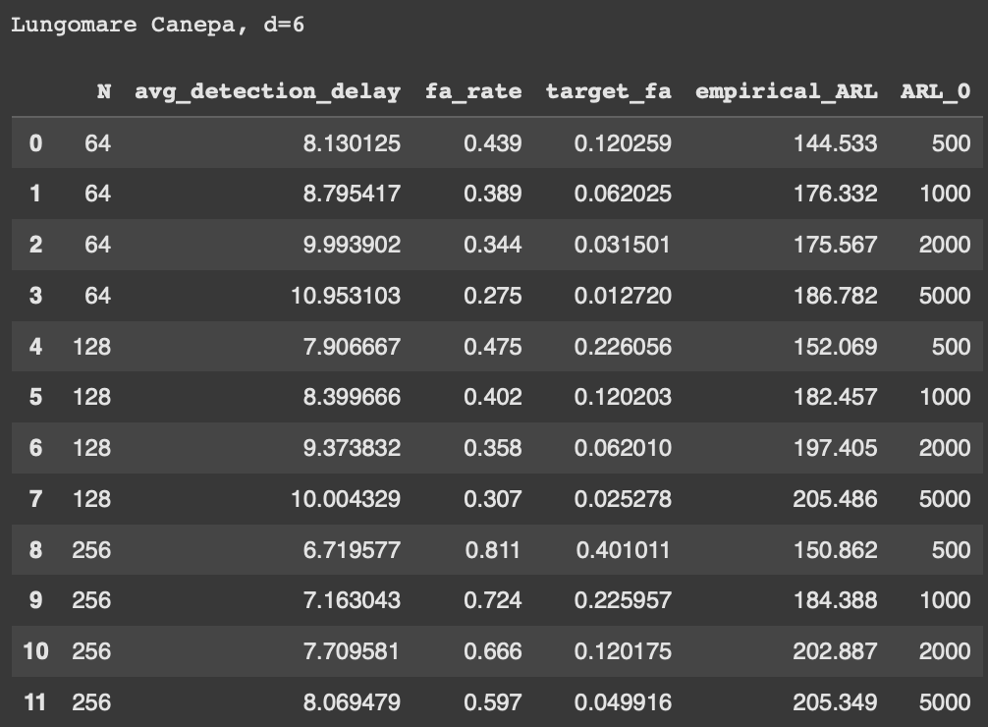
Gaussian | Lungomare Canepa (d=6), qtree ewma (K=32)

Slide 18
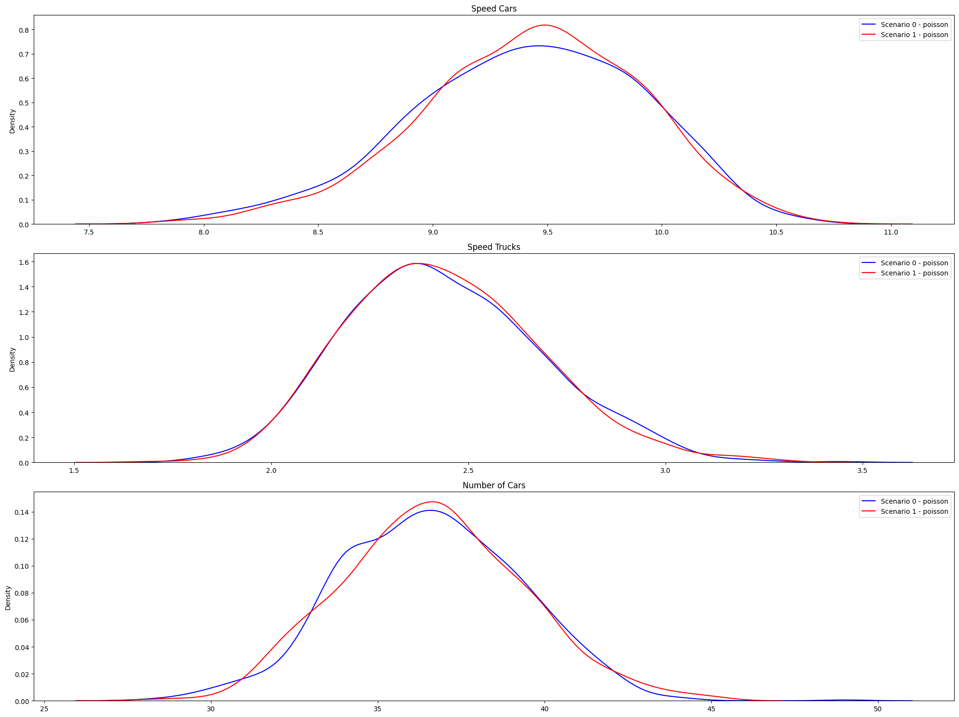
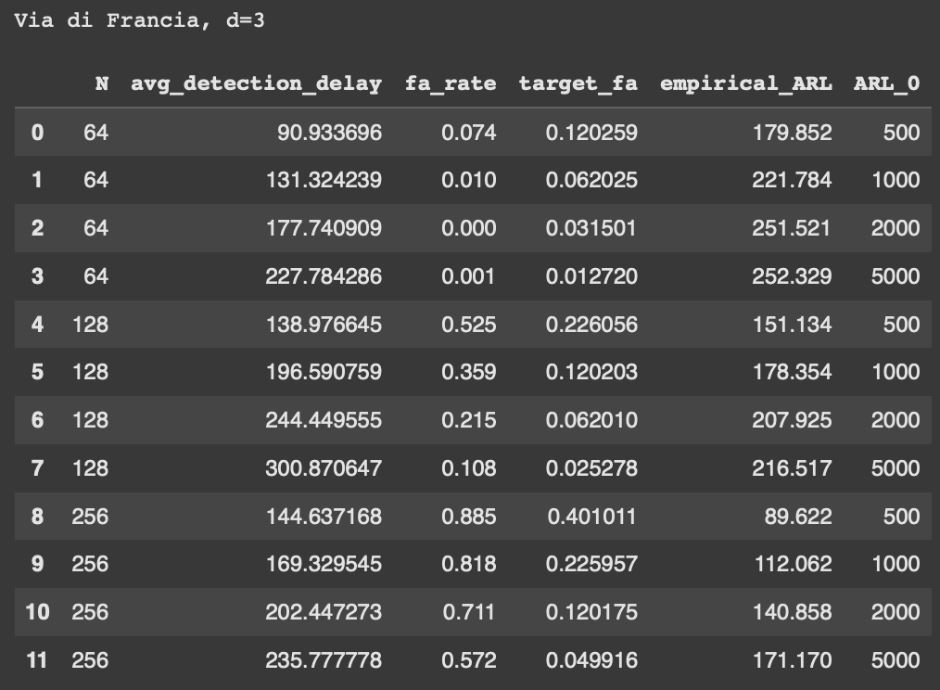
Gaussian | Via di Francia (d=3), qtree ewma (K=32)

