Slide 1


Slide 2
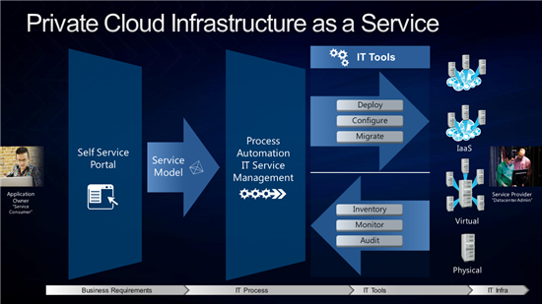
Overview of Cloud Computing at the Highest Level
Cloud computing has been around for a very long time. However, cloud computing as an infrastructure is different from Dropbox and OneDrive.
Cloud computing used to be a private sector only idea. Until this year, no government had really explored the benefits and challenges of cloud computing
In a nutshell, cloud computing takes the services and management of technology off the hands of the client and allows the client to choose what level of support and features they need.

Slide 3
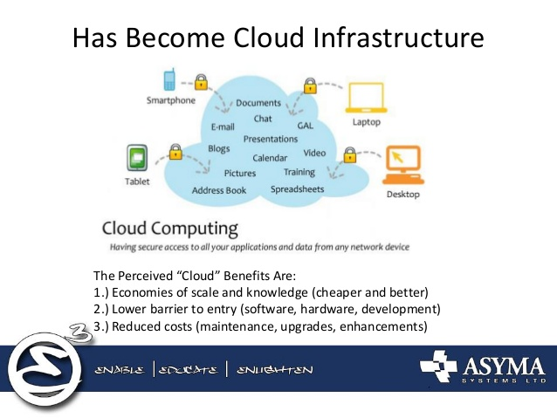
Benefits

Slide 4
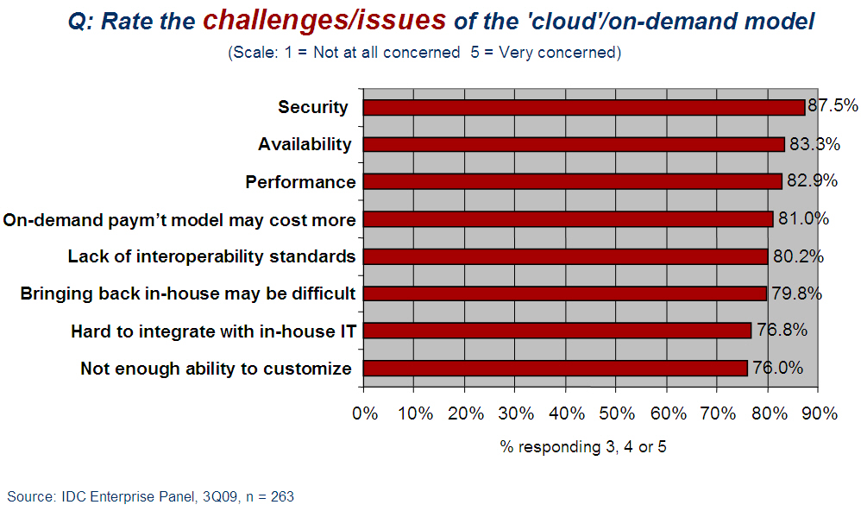
Challenges- Governments face additional challenges that business’ do not.

Slide 5
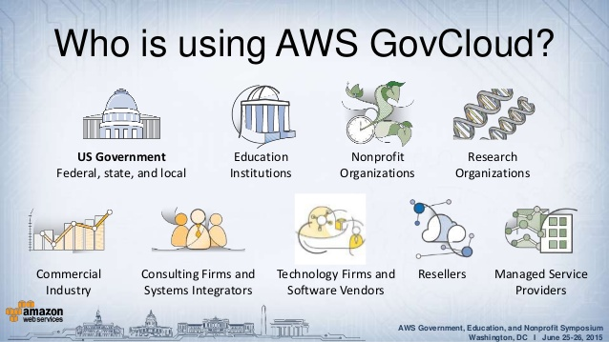
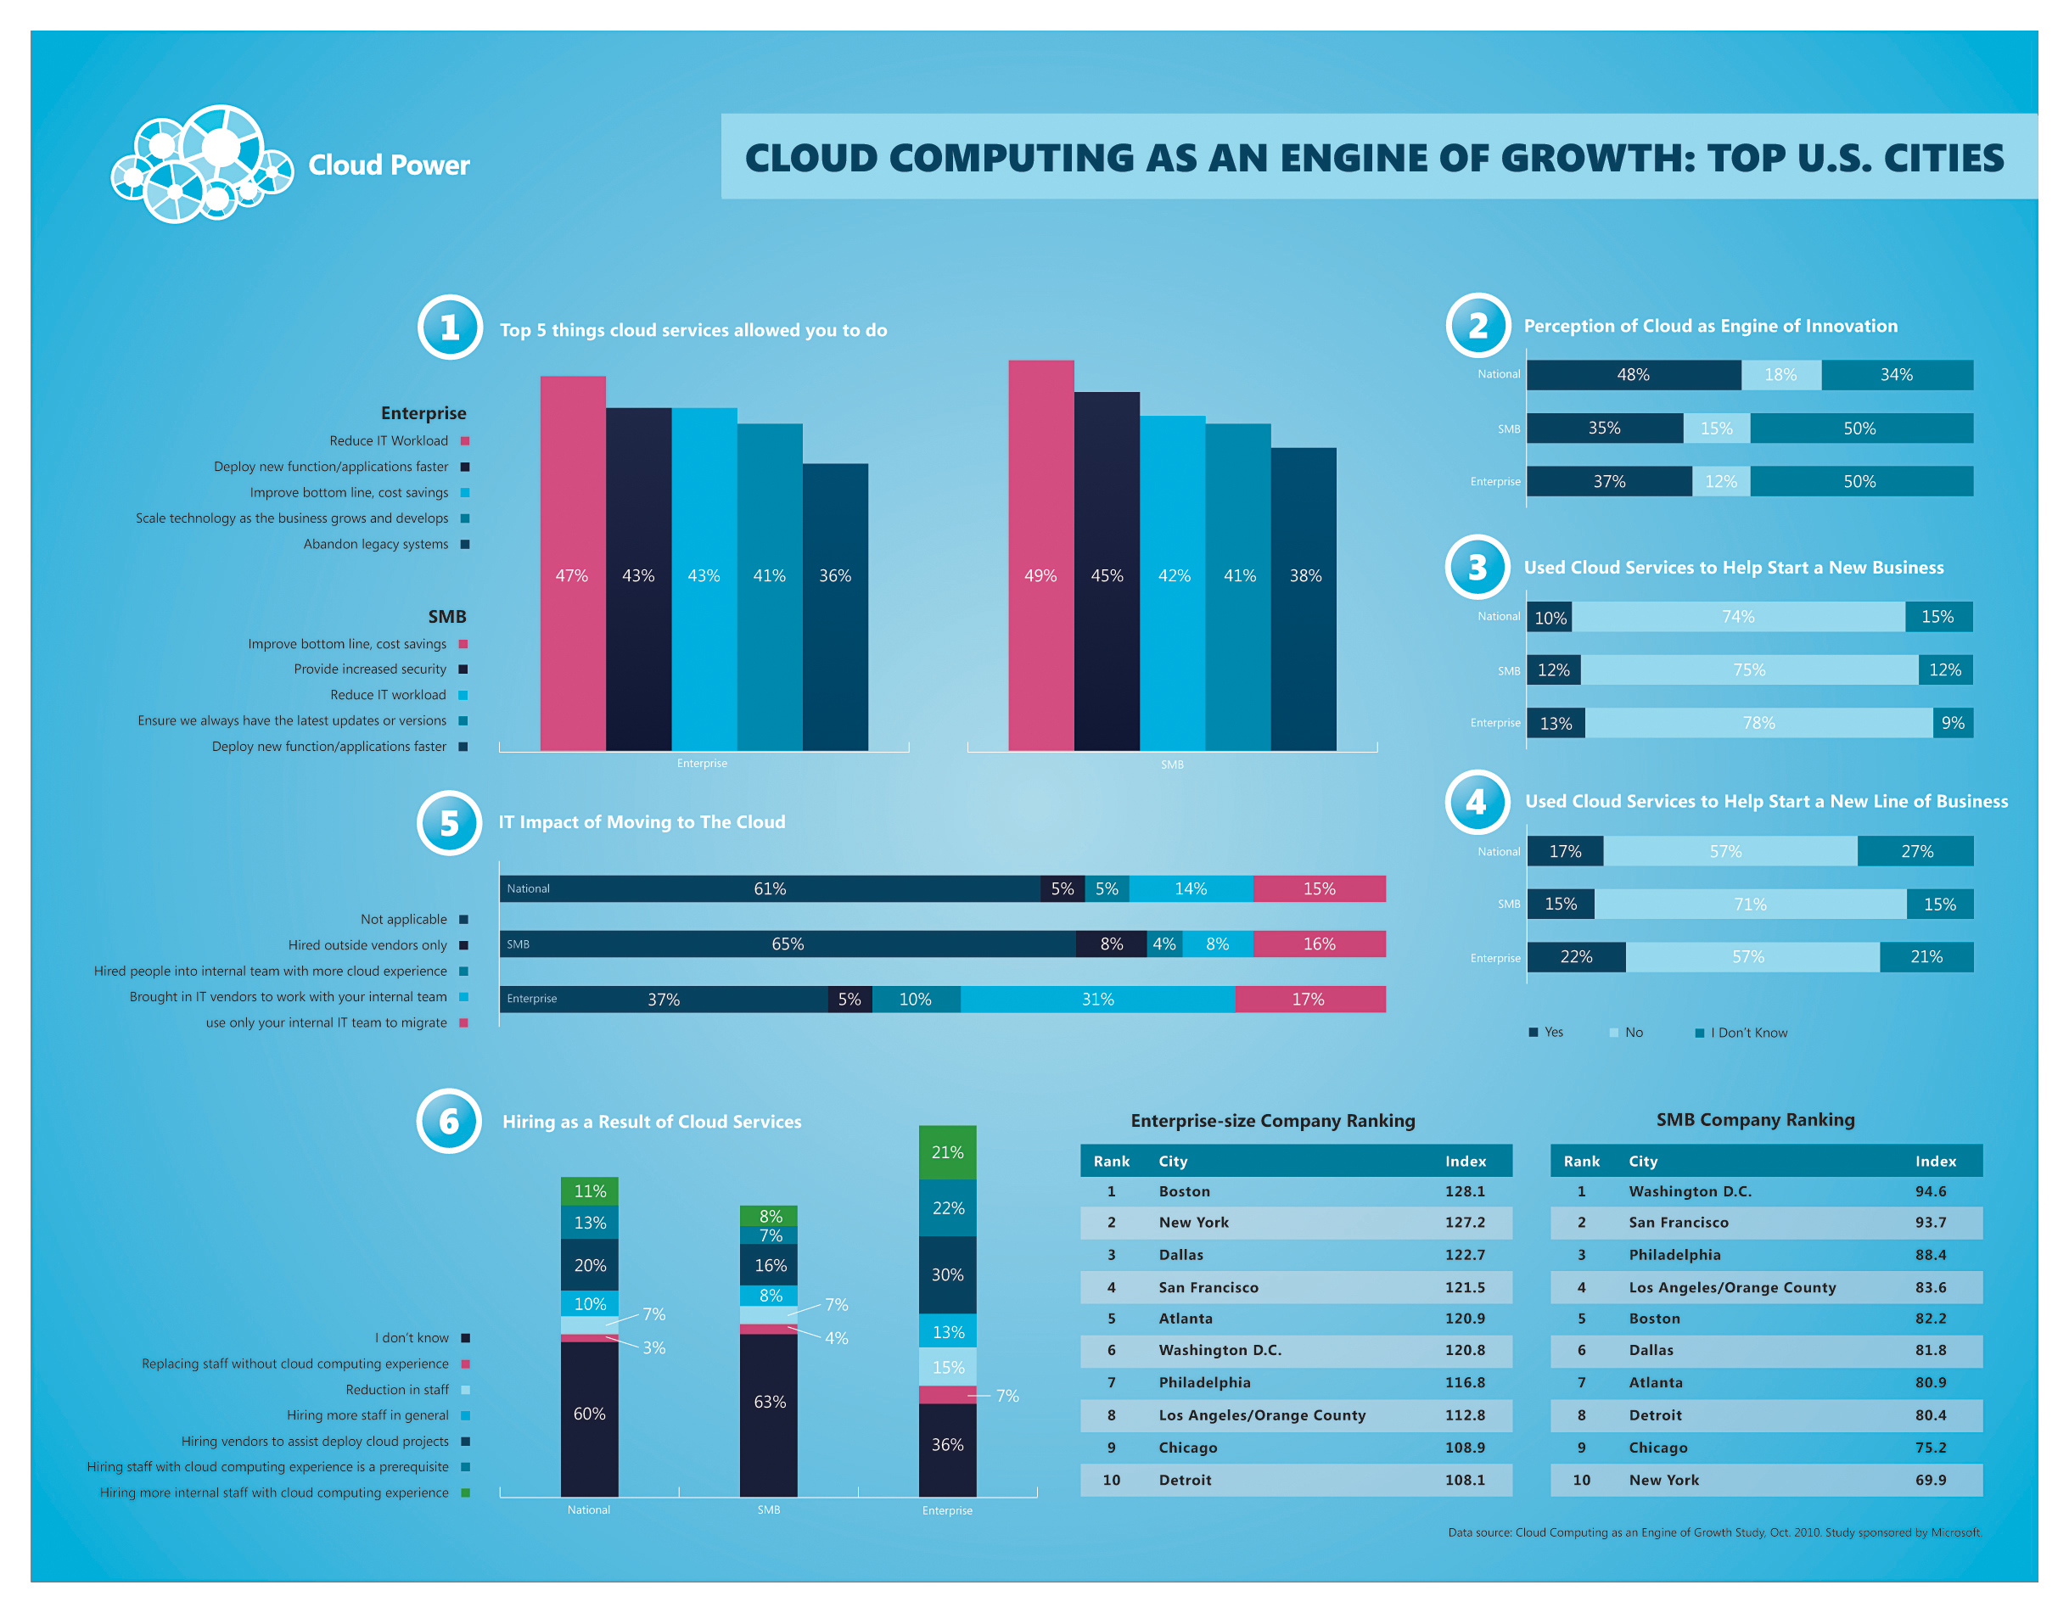
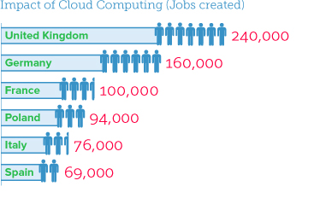
Examples

Slide 6
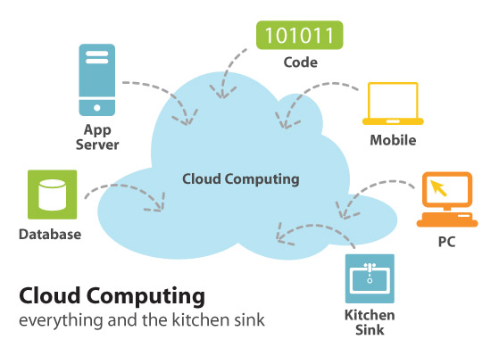
Code

Slide 7
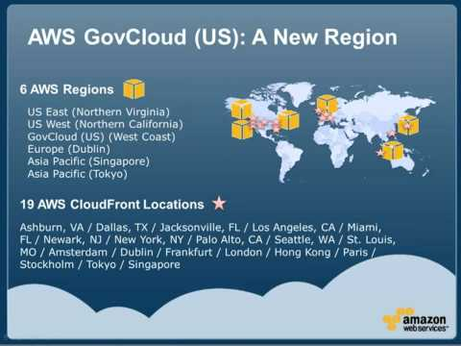

AWS GovCloud- Amazon’s solution for the United States Government
Amazon and Microsoft both have solutions which provide a way for governments to utilize the power and flexibility of cloud computing.

