Slide 1
Introduction to Big Data & Hadoop

Slide 2
Outline
What id Big data? And why it matters?
What are the Challenges of BigData?
What are technologies support Bigdata?
What is Hadoop? Why Hadoop?
History of Hadoop
Use cases of Hadoop
RDBMS vs Hadoop
When to use and When to not Use Hadoop?
Hadoop Ecosystem

Slide 3
Big Data
Big data describes the large volume of data – both structured and unstructured that inundates a business on a day-to-day basis
Why Big data Matters?
It’s not the amount of data that’s important. It’s what organizations do with the data that matters.
Big data can be analyzed for insights that lead to better decisions and strategic business moves.

Slide 4
Challenges for Processing
The challenges are
Data capture
Data storage
Data analysis
Data visualization.

Slide 5
Technologies support Bigdata
Hadoop, HDFS, Hive, Pig etc
Cloudera
Skytree
Other NoSql DB’s
Apache Mahout, SPARQL, etc

Slide 6
Why Hadoop?
Hadoop is an open-source software framework for storing data and running applications on clusters of commodity hardware.
It provides massive storage for any kind of data, enormous processing power and the ability to handle virtually limitless concurrent tasks or jobs

Slide 7
Hadoop History
As the World Wide Web grew in the late 1900s and early 2000s, search engines and indexes were created to help locate relevant information amid the text-based content. In the early years, search results were returned by humans. But as the web grew from dozens to millions of pages, automation was needed. Web crawlers were created, many as university-led research projects, and search engine start-ups took off (Yahoo, AltaVista, etc.).
One such project was an open-source web search engine called Nutch – the brainchild of Doug Cutting and Mike Cafarella. They wanted to return web search results faster by distributing data and calculations across different computers so multiple tasks could be accomplished simultaneously. During this time, another search engine project called Google was in progress. It was based on the same concept – storing and processing data in a distributed, automated way so that relevant web search results could be returned faster.
In 2006, Cutting joined Yahoo and took with him the Nutch project as well as ideas based on Google’s early work with automating distributed data storage and processing. The Nutch project was divided – the web crawler portion remained as Nutch and the distributed computing and processing portion became Hadoop (named after Cutting’s son’s toy elephant). In 2008, Yahoo released Hadoop as an open-source project. Today, Hadoop’s framework and ecosystem of technologies are managed and maintained by the non-profit Apache Software Foundation (ASF), a global community of software developers and contributors.

Slide 8
Why is Hadoop important?
Ability to store and process huge amounts of any kind of data, quickly. With data volumes and varieties constantly increasing, especially from social media and the Internet of Things (IoT), that's a key consideration.
Computing power. Hadoop's distributed computing model processes big data fast. The more computing nodes you use, the more processing power you have.
Fault tolerance. Data and application processing are protected against hardware failure. If a node goes down, jobs are automatically redirected to other nodes to make sure the distributed computing does not fail. Multiple copies of all data are stored automatically.
Flexibility. Unlike traditional relational databases, you don’t have to pre-process data before storing it. You can store as much data as you want and decide how to use it later. That includes unstructured data like text, images and videos.
Low cost. The open-source framework is free and uses commodity hardware to store large quantities of data.
Scalability. You can easily grow your system to handle more data simply by adding nodes. Little administration is required.

Slide 9
What are the challenges of using Hadoop?
Map Reduce programming is not a good match for all problems. It’s good for simple information requests and problems that can be divided into independent units, but it's not efficient for iterative and interactive analytic tasks. Map-Reduce is file-intensive. Because the nodes don’t intercommunicate except through sorts and shuffles, iterative algorithms require multiple map-shuffle/sort-reduce phases to complete. This creates multiple files between Map-Reduce phases and is inefficient for advanced analytic computing.
There’s a widely acknowledged talent gap. It can be difficult to find entry-level programmers who have sufficient Java skills to be productive with Map-Reduce. That's one reason distribution providers are racing to put relational (SQL) technology on top of Hadoop. It is much easier to find programmers with SQL skills than Map-Reduce skills. And, Hadoop administration seems part art and part science, requiring low-level knowledge of operating systems, hardware and Hadoop kernel settings.
Data security. Another challenge centers around the fragmented data security issues, though new tools and technologies are surfacing. The Kerberos authentication protocol is a great step toward making Hadoop environments secure.
Full-fledged data management and governance. Hadoop does not have easy-to-use, full-feature tools for data management, data cleansing, governance and metadata. Especially lacking are tools for data quality and standardization.

Slide 10
UseCases of Hadoop
Data Storage
NetApp
NetApp collects diagnostic data from its storage systems deployed at customer sites. This data is used to analyze the health of NetApp systems.
Problem:
NetApp collects over 600,000 data transactions weekly, consisting of unstructured logs and system diagnostic information. Traditional data storage systems proved inadequate to capture and process this data.
Solution:
A Cloudera Hadoop system captures the data and allows parallel processing of data.
Hadoop Vendor:
Cloudera
Cluster/Data size:
30+ nodes; 7TB of data / month

Slide 11
UseCases of Hadoop …
Financial Services
Dodd-Frank Compliance at a bank
A leading retail bank is using Cloudera and Datameer to validate data accuracy and quality to comply with regulations like Dodd-Frank
Problem:
The previous solution using Teradata and IBM Netezza was time consuming and complex, and the data mart approach didn’t provide the data completeness required for determining overall data quality.
Solution:
A Cloudera + Datameer platform allows analyzing trillions of records which currently result in approximately one terabyte per month of reports. The results are reported through a data quality dashboard.
Hadoop Vendor:
Cloudera + Datameer
Cluster/Data size:
20+ nodes; 1TB of data / month

Slide 12
UseCases of Hadoop …
Health Care
Storing and processing Medical Records
Problem:
A health IT company instituted a policy of saving seven years of historical claims and remit data, but its in-house database systems had trouble meeting the data retention requirement while processing millions of claims every day
Solution:
A Hadoop system allows archiving seven years’ claims and remit data, which requires complex processing to get into a normalized format, logging terabytes of data generated from transactional systems daily, and storing them in CDH for analytical purposes
Hadoop vendor:
Cloudera
Cluster/Data size:
10+ nodes pilot; 1TB of data / day

Slide 13
UseCases of Hadoop …
Telecoms
China Mobil Guangdong
Problem:
Storing billions of mobile call records and providing real time access to the call records and billing information to customers. Traditional storage/database systems couldn't scale to the loads and provide a cost effective solution
Solution:
HBase is used to store billions of rows of call record details. 30TB of data is added monthly
Hadoop vendor:
Intel
Hadoop cluster size:
100+ nodes

Slide 14
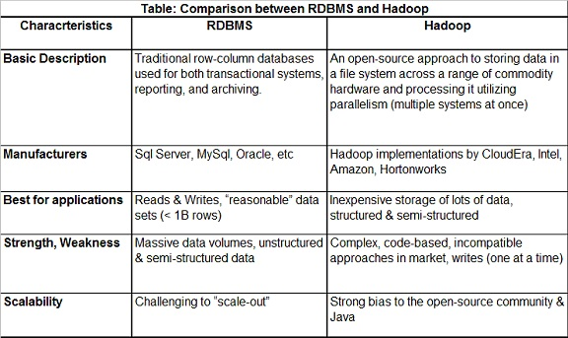
RDBMS vs Hadoop

Slide 15
When Not To Use Hadoop
Real Time Analytics
Not a Replacement for Existing Infrastructure
Multiple Smaller Datasets
Where Security is the primary Concern?
Notes:
List<Integer> is a parameterized type, parameterized by the type argument <Integer>
the Arrays.asList method returns a fixed-size list backed by an array; it can take “vararg” arguments
forEach is a method that takes as input a function and calls the function for each value on the list
Note the absence of type declarations in the lambda; the Java 8 compiler does type inference
Java 8 is still statically typed
Braces are not needed for single-line lambdas (but could be used if desired).

Slide 16
When To Use Hadoop
Data Size and Data Diversity
Future Planning
Multiple Frameworks for Big Data
Lifetime Data Availability
Notes:
Note: braces are needed to enclose a multiline lambda expression

Slide 17
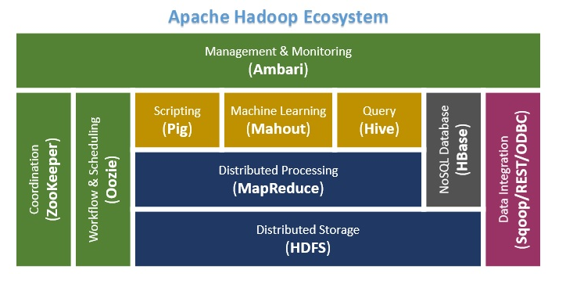
Hadoop Ecosystem

Slide 18
Questions
?

