Slide 1
YARN architecture and usage
-Mathan raj Thangaraj

Slide 2
Agenda
What is YARN?
Anatomy of YARN
Resource requests
Application Lifespan
MapReduce-v1 vs YARN
Scheduling in YARN
YARN scheduling
FIFO
Capacity Scheduling
Fair scheduling
Q & A

Slide 3
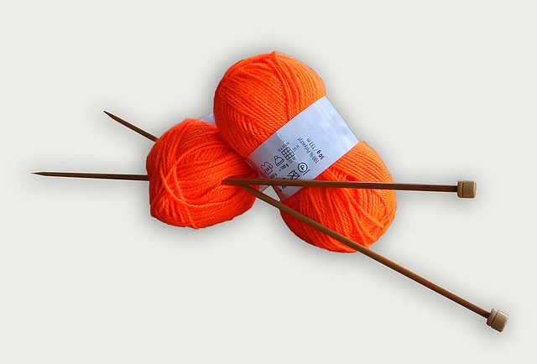
What is YARN?

Slide 4
What is YARN?
YARN:
“Yet Another Resource Negotiator”
← Not this ☺

Slide 5
What is YARN? (contd..)
Provides API to interact with the Cluster resources (storage, CPU and memory, etc..)
Most of the times these APIs are used by other applications, very rarely we see direct use by the client application

Slide 6
What is YARN? (contd..)
YARN Applications
( set 2 )
YARN Applications
( set 1 )
Compute
Storage
Pig
Hive
Crunch
Others..
MapReduce
Spark
Tez
Others..
YARN
HDFS and HBASE

Slide 7
Anatomy of YARN
YARN contains a Resource manager - one per cluster. This will control and manages the use of resources across the clusters
Node managers running in each node of the the cluster. This will launch and monitor containers.
Container – uses a predefined set of resources (memory, CPU, etc) to execute a specific process. Sometimes this could be a simple Unix process.

Slide 8
Anatomy of YARN (contd..)
Client Application
Resource Manager
Node Manager
Submit YARN
Start container
Client Node
Resource Manager Node
Launch
Allocate additional resources + heartbeat
Container
Application Process
Node Manager Node

Slide 9
Resource Requests
YARN has flexible model for resource requests. The request can contain details like CPU, memory & locality.
SPARK – ask for fixed executers upfront
Map Reduce – upfront for Map task and later request for reduce tasks.
YARN tries to honor the locality request – same node, if not possible rack local. If that too is not possible any node in cluster.

Slide 10
Application Lifespan
YARN application life span can vary from few seconds to even months. Applications are categorized NOT by length, but how they relate to user jobs.
One application per user job: Simplest approach. Used by MapReduce
One application per user session or workflow: Useful to cache intermediate results, facilitates container re-use. Used by SPARK.
Long running application shared by different users: used to run daemon application to listen to client request and launch required nodes quickly. Quick response time. Used by Apache Slider, Apache Impala.

Slide 11
MapReduce-v1 vs YARN
MapReduce-1 architecture relied on Job tracker to do most of the work. Had a bottle neck of processing only 4,000 nodes and 40,000 tasks
In YARN the responsibility of Job tracker is highly reduced by sharing to three components. YARN can scale up to only 10,000 nodes and 100,000 tasks
MapReduce-v1 | YARN
Job tracker | Resource manager, application master, timeline server
Task tracker | Node manager
Slot | Container

Slide 12
MapReduce-v1 vs YARN (contd..)
High availability: Since the responsibility is split, it is less complex to provide high availability to each components.
Utilization:
MR-1 uses slots size of block and the purpose (mapping or reducing) of block is fixed. The size will be wasted for smaller jobs. Mapping tasks had to wait even if ‘reduce’ slots are available.
YARN is fine grained and resources can be allocated dynamically in a container.

Slide 13
MapReduce-v1 vs YARN (contd..)
Multi-tenancy:
YARN opens up the possibility for usage of other distributed applications beyond Map Reduce.
It also possible for users to run different versions of MapReduce in same cluster.

Slide 14
YARN scheduling
Three types of scheduling
FIFO
Capacity Scheduling
Fair scheduling

Slide 15
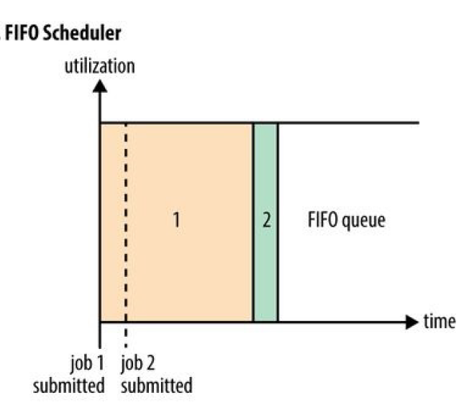
FIFO Scheduler
FIFO – First in first out
( very simple implementation.)

Slide 16
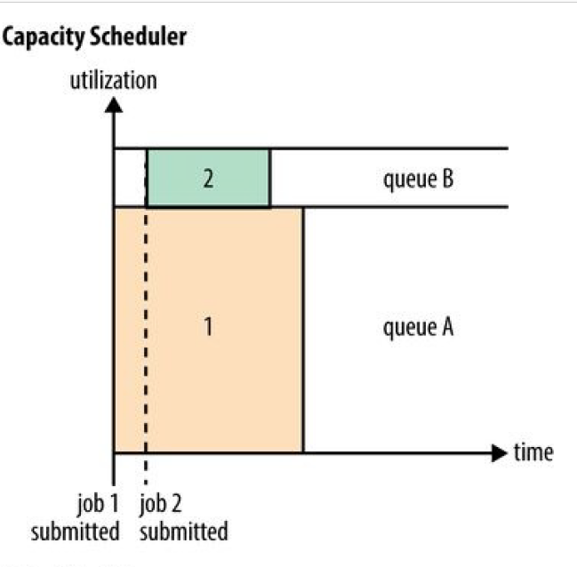
Capacity Scheduler
Capacity Scheduler – each type of job will
Have it dedicated queue capacity.
If the other queue is free it can be used
i.e ‘queue elasticity’

Slide 17
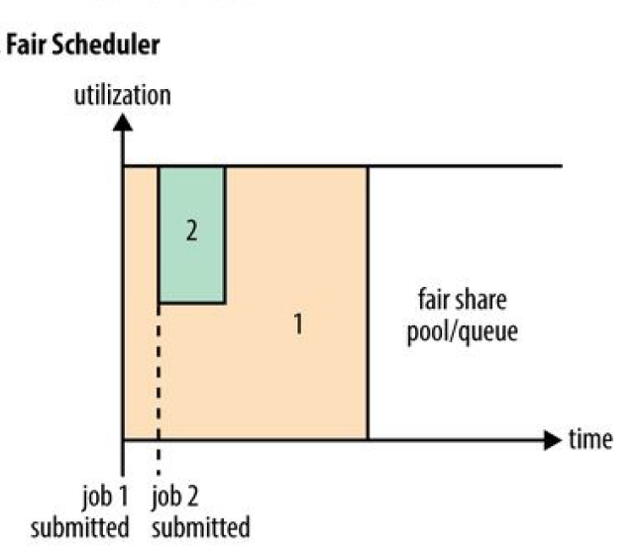
Fair Scheduler
Fair Scheduler dynamic balance of queue
Between small jobs and large jobs.

Slide 18

Fair Scheduler (contd..)
.
Delay Scheduling - waiting little bit to allocate
requested locality node.

Slide 19
Fair Scheduler (contd..)
Dominant Resource Fairness – using the
resources requested to calculate the fairness.
e.g: CPU hungry or memory hungry request.

Slide 20
References and sources
Hadoop: The Definitive Guide, 4th Edition - Author: Tom White - Publisher: O'Reilly Media
Transport for London – source of the poster

Slide 21



Questions?

