Slide 1
Map reduce – Internal Architecture
- Mathan raj Thangaraj

Slide 2
Agenda
Map to Reduce – Failure handling
Speculative execution
Shuffle and Sort
Sorting
Partial
Total sort
Secondary sort
Counters
Joins
Side data distribution
FAQ
Q & A

Slide 3
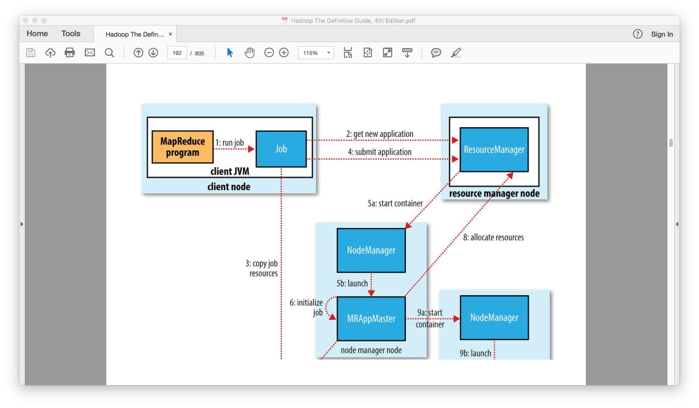
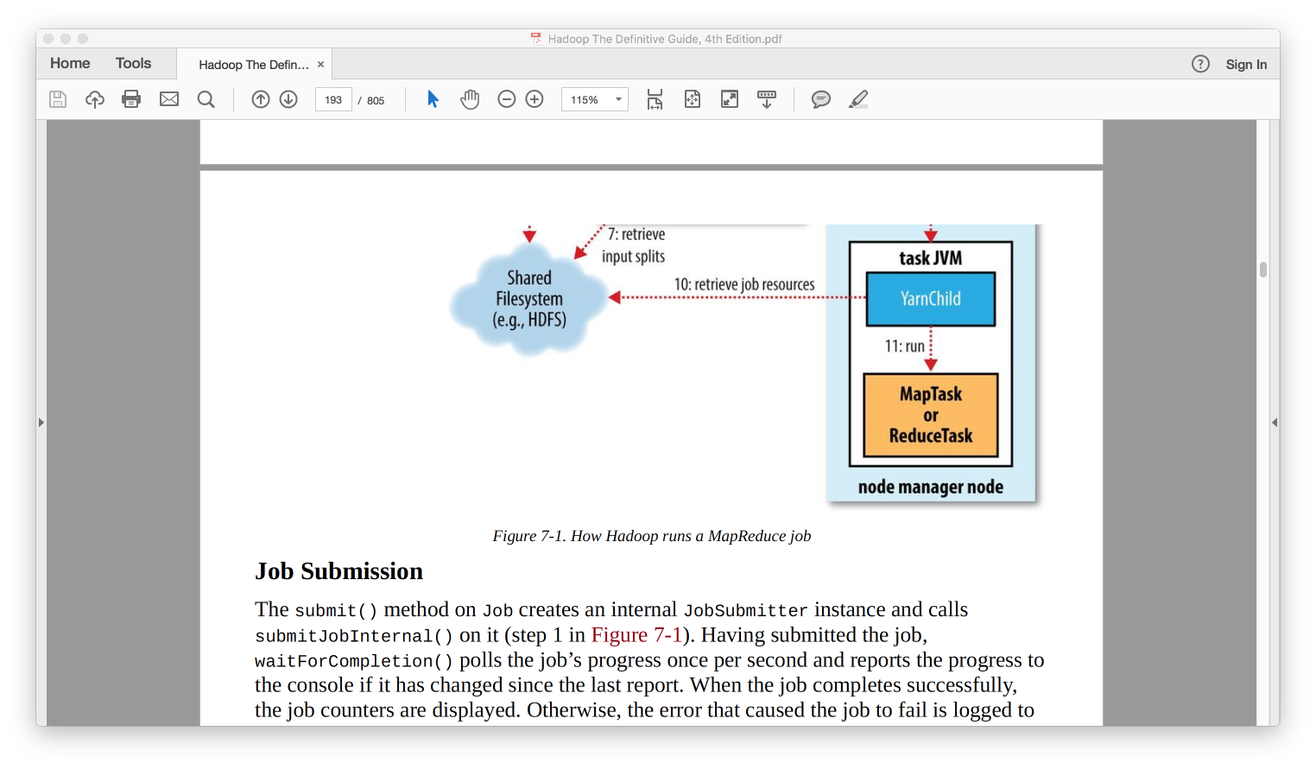
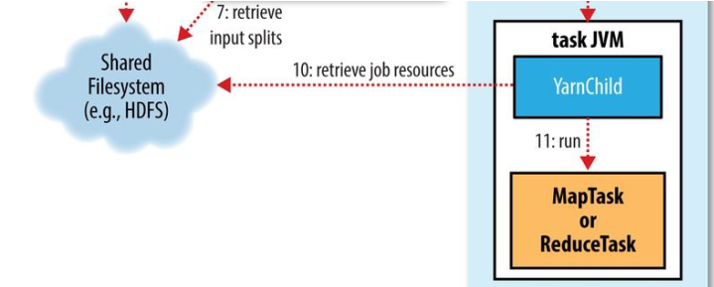
Anatomy of MapReduce Job

Slide 4
Task Failure
Failed due to exception in code: The JVM reports back to Application master which marks the task as failure and free up the resources.
Sudden exit of Task JVM: Node manager notices the problem and informs the Application master, which marks the attempt as failure. It will be re-tried in some other nodes. If a task fails for four* attempt the whole job is marked as failed.
Hanging task: If a task hangs for more than 10* minutes, it is marked a failed. The Application master kills the JVM after this time.
Killing duplicate task: Kill one of slow running duplicate tasks in speculative execution.
User initiated failing: User have the option to kill a task or whole job form command line and UI.
* - configurable

Slide 5
Application Master Failure
If application master fails twice* Resource manager will make the whole job as failed.
Application master sends periodic heartbeat to Resource manager. If the application master fails, Resource manager starts a new Application master.
The new Application master reads the state of the tasks already completed by the previous failed Application master from job history. So those task are not run again.
MapReduce client polls the Application master for the progress, if the application master has failed, the client wont get the response.
Then, MapReduce Client will call Resource manager to get the new Application masters address and caches it – so it won’t overload Resource manager.
* - configurable

Slide 6
Node Manager Failure
Node manager sends periodic heartbeat to Resource manager. If the heartbeats are not received for 10 minutes the Resource manager remove the node from the pool for scheduling the container.
Node manager may be running a Application master or task. It will be recovered as described before.
For incomplete job – the application master re-runs the map tasks (even it is completed successfully) in some other node intermediate since the intermediate output stored in failed node manager’s local filesystem may not be accessible to the reduce task. (what about Reduce tasks? Cue: think where the results are stored)
Node managers may be blacklisted, even it is healthy if the failures of the applications running in the Node managers are high.

Slide 7
Resource Manager Failure
If a Resource manager fails the jobs and task containers can not be launched.
For HA, it is necessary to run a pair of resource managers in an active-standby configuration .
Information about all the running applications (e.g: Application master) is stored in a highly available state store (backed by ZooKeeper or HDFS), so that the standby can recover the core state of the failed Resource manager.
The new Resource manager then restart all the application masters in the cluster.
Client and node managers should be configured to handle resource manager fail over. They try communicating to both standby resource managers until one become active.

Slide 8
Speculative Execution
If a task is running slower than expected, MapReduce framework doesn’t try to identify the problem and fix it.
Instead another equivalent task is launched. This is called speculative execution of tasks.
If one task gets completed first, the other task will be killed. This doesn’t count towards and attempt.
Speculative task is optimization not for reliability. If there are bugs in the code, We cannot rely on this feature as the same bug will affect the speculative task too.

Slide 9
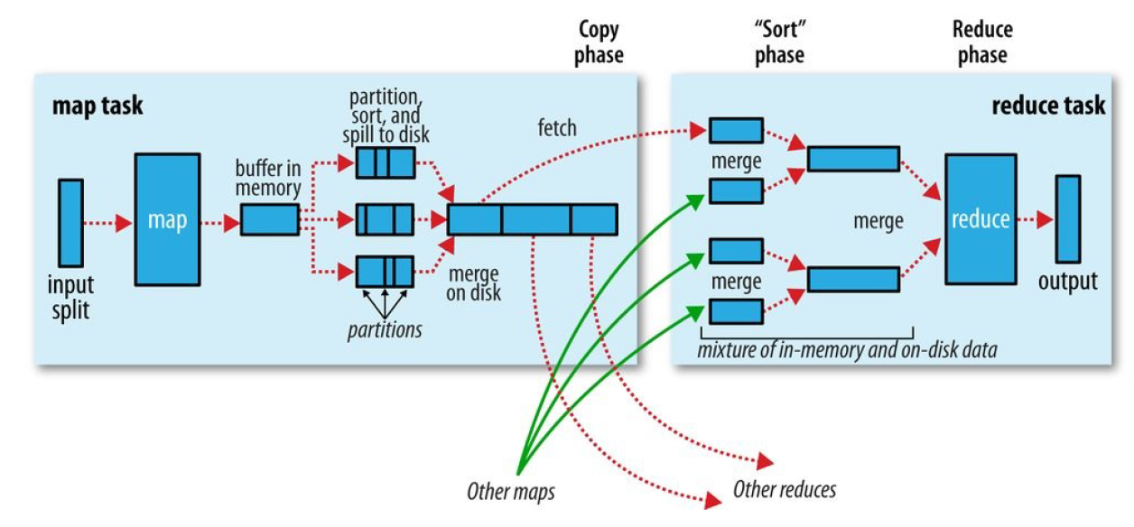
Shuffle and Sort

Slide 10
Shuffle & sort – Map Side
Before Map function writes to disk, the thread first divides the data into partitions for each reducers.
For each partition background thread performs an in-memory sort by key, and if there is a combiner function, it is run on the output of the sort.
Before the task is finished, the spill files are merged into a single partitioned and sorted output file.
The combiner may be run again before the output file is written

Slide 11
Shuffle & sort – Reduce Side
Copy phase : The reduce task starts copying their outputs as soon as each Mapper function completes.
Sort phase: A background thread merges the accumulated copies of files on the disk by merging them into larger, sorted files.
Reduce phase. This is the last merge which is done from a mixed input from of in-memory and on-disk segments.

Slide 12
Sorting – partial
If we are running 10 reducers, each will create a file sorted with the keys. (10 files in total)
However there is no guarantee that we can combine these files to get a globally sorted file.

Slide 13
Sorting – Total
With an better usage, it is possible to produce a set of sorted files. These files can be concatenated to create a large globally sorted file.
We can give the range of keys as a criteria to MapReduce programs. E.g: age range of employees: 18 -30, 30-40, 40-70.
Problem with this approach is the input data may not be evenly distributed. E.g: range 18-30 might have 70% of the data and it is not efficient as overall.
Samplers: Samplers help us to create these ranges with close to evenly distributed data. ( types: InputSampler, RandomSampler, IntervalSampler)

Slide 14
Sorting – Secondary
Is used in places when we want the Values also sorted.

Slide 15
Counters
Counters gives an insight on the additional information about the data being analyzed. eg: if a counter used to count the invalid record give larger than expected value, we can validate the data itself or the code to identify the reasons.
Built-in Counters:
Job counters
Task counters, etc.
User defined counters.

Slide 16
Joins
Joins can be done in MapReduce. However writing code to do joins is lot of effort and error prone.
There are higher-level frameworks which makes things easier: Pig, Hive, Cascading or Spark.

Slide 17
Side Data Distribution
Side data is the extra read-only data needed by a job to process the main dataset. (e.g: Lookup data to return the weather station name)
We can add small sized data (few KBs) as key-value pairs in Job Configuration.
For bigger size data it is recommended to use Hadoop’s Distributed Cache.

Slide 18
FAQ
Total Sort?
Speculative execution
Samplers?
Counters.

Slide 19
References and sources
Hadoop: The Definitive Guide, 4th Edition - Author: Tom White – Publisher: O'Reilly Media

Slide 20

Questions

