Slide 1
Hadoop Distributed File System

Slide 2
Outline
What is HDFS?
HDFS Architecture
Components of HDFS

Slide 3
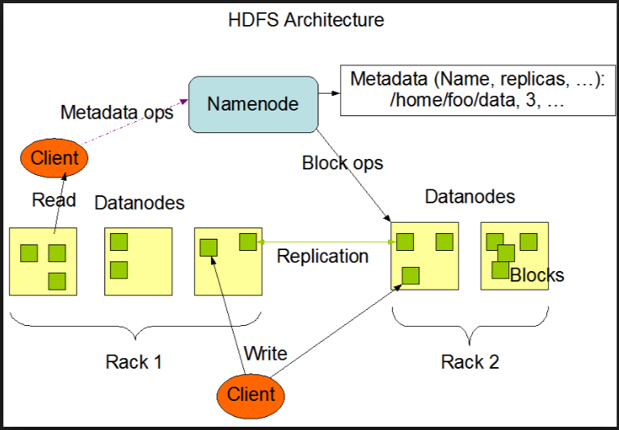
HDFS Architecture
Big data describes the large volume of data – both structured and unstructured that inundates a business on a day-to-day basis
Why Big data Matters?
It’s not the amount of data that’s important. It’s what organizations do with the data that matters.
Big data can be analyzed for insights that lead to better decisions and strategic business moves.

Slide 4
Components in HDFS
The major components are
Name Node
Secondary Name Node
Data Node
Checkpoint Node
Backup Node
File system Snapshots

Slide 5
Components of HDFS
Name Node
Name Node stores Metadata
Stores Mapping of file blocks to Data node
Like Location of files, file permissions, modification & access time stamps, namespace, disk space details in a data structure called inode
Image : In-memory inode data and the list of blocks belonging to each file comprise the metadata of the namespace.

Slide 6
Name Node…
Checkpoint : The persistent record of the image (stored in native files system).
Journal : Modification log of the image called the journal in the local host’s native file system.
During restarts the Name Node restores the namespace by reading the checkpoint and replaying the journal.

Slide 7
DataNodes
DataNode store actual application data.
Each data block in data node has two parts in separate files
Data itself and the metadata including checksums for the block data
The block’s generation stamp.
During start-up, each DataNode connects to the NameNode and performs a handshake to verify the namespace ID and the version of the DataNode.
If either does not match with the records present in NameNode, the DataNode automatically shuts down.

Slide 8
DataNode
After the handshake the DataNode registers with the NameNode and send it’s block report. A block report contains the block id, the generation stamp and the length for each block.
Block report is sent immediately after the DataNode registration. Subsequent block reports are sent every hour.
All data nodes send heartbeats to NameNode. The default heartbeat interval is three seconds. Name Node does not receive a heartbeat from a DataNode in ten minutes the NameNode considers the DataNode to be out of service. The NameNode then schedules creation of new replicas of those blocks on other DataNodes.
Heartbeats from a DataNode carry information about total storage capacity, fraction of storage in use, and the number of data transfers currently in progress. These statistic are used for the NameNode’s space allocation and load balancing decisions.

Slide 9
CheckpointNode
A CheckpointNode is usually another NameNode (hosted in different machine which not serve the clients directly).
Checkpoint Node downloads the current checkpoint and journal files from the NameNode, merges them locally, and returns the new checkpoint back to the NameNode.
NameNode store the new checkpoint and empty existing journal it has.

Slide 10
BackupNode
BackupNode is capable of creating periodic checkpoints. It maintains an in-memory, up-to-date image of the file system namespace that is always synchronized with the state of the NameNode. NameNode informs BackupNode about all the transactions in form of a stream of changes. As NameNode and BackupNode, both store all information in memory.
The BackupNode acts as a read-only NameNode. It holds the metadata information except of block locations. It can perform all operations of the regular NameNode that do not involve modification of the namespace or knowledge of block locations. It means when NameNode fails, all latest updates which have not been persisted until now, will not be persisted by BackupNode now.
BackupNode is not a Secondary NameNode (alternate NameNode if active NameNode fails), it does not entertain client requests for read/write files.

Slide 11
File System Snapshots
A snapshot is an image of whole cluster, which is saved to prevent any data loss in case of system upgrades. The actual data files are not part of this images, because it will result in doubling the memory area of whole cluster.
When an snapshot is requested by admin, NameNode pick exiting checkpoint file and merge all journal logs into it and store into persistent filesystem. Similarily, all DataNodes copy their directory information, and hard links to data blocks and store into them. This information is used in event of cluster failure.

Slide 12
References
https://hadoop.apache.org/docs/stable/hadoop-project-dist/hadoop-hdfs/HdfsUserGuide.html

Slide 13
Questions
?

