Slide 1
Map reduce – Introduction
- Mathan raj Thangaraj

Slide 2
Agenda
What is Map Reduce?
Map to Reduce Flow
Map function
Shuffle Sort
Combiner Function – optional
Reduce function
Terminologies
Map – data locality optimization
MapReduce – Data flow
MapReduce Job - Entities
Anatomy of MapReduce Job
Q & A

Slide 3
What is Map Reduce?
MapReduce is a simple programming model for processing big data.
Mapper
Reducer
Combiner (optional)
MapReduce programs are built to run in parallel, which enable to analyze very large-scale data with machines running on commodity hardware.
Can be written in any language. E.g Java, Scala, Ruby, Python

Slide 4
Example - Weather Dataset
Sample Weather data set. We need to find the maximum global temperature in each year.
0057
332130 # USAF weather station identifier
99999 # WBAN weather station identifier
19500101 # observation date
0300 # observation time
4
+51317 #latitude (degrees x1000)
+028783 # longitude (degrees x 1000)
FM-12
+0171 # elevation (meters)
99999
V020
320 # wind direction (degrees)
1 # quality code

Slide 5
Map function
Map extracts each record into desired format. Key – value pair.
Map function transforms. It is a good place to filter out unwanted records.
(1950, 0) # Year is the Key, Temperature is value
(1950, 22)
(1950, −11)
(1949, 111)
(1949, 78)

Slide 6
Shuffle Sort
The output of Map function is processed by MapReduce framework before sending to reduce. It sorts by key and groups by key.
Also called Shuffle-sort phase. MR Framework guarantees that every input to reduce is sorted by the key.
The Map functions output are intermitted results. Will be thrown away once Reduce uses them. So they are stored in local filesystem (not HDFS) for efficiency.
(1949, [111, 78]) # Year is the Key, Temperature List is value
(1950, [0, 22, −11])

Slide 7
Combiner Function - optional
Minimizes the data transfer between the Map and Reduce task by shrinking the output of Map tasks.
There is No guarantee how many times a combiner function will be called. Could be “0” or more.
The output from Reduce function should be same irrespective of the number of times the combiner is called.
Only used in places where order of operation or input size doesn’t matter. [e.g: for operator ‘#’ (a) # ( b # c) == (a # b) # ( c) == (a # b # c) ]

Slide 8
Reduce function
Reduce function uses the result from Map function as input. In this example it needs to iterate over the list to pick the maximum temperature.
(1949, 111) # Year is the Key, Temperature is value
(1950, 22)

Slide 9
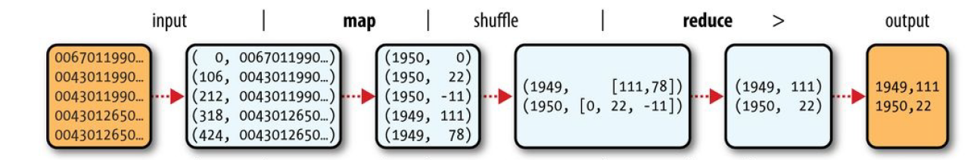
Map to Reduce Flow
The complete flow is shown here.

Slide 10
Terminologies
The input is divided into fixed-size pieces called split. Hadoop creates one map task for each split, which runs the user-defined map function for each record in the split.
A MapReduce job is a unit of work that the client wants to be performed:
Input data
MapReduce program
Configuration
Job is divided into multiple tasks. Two types are: Map task & Reduce task

Slide 11
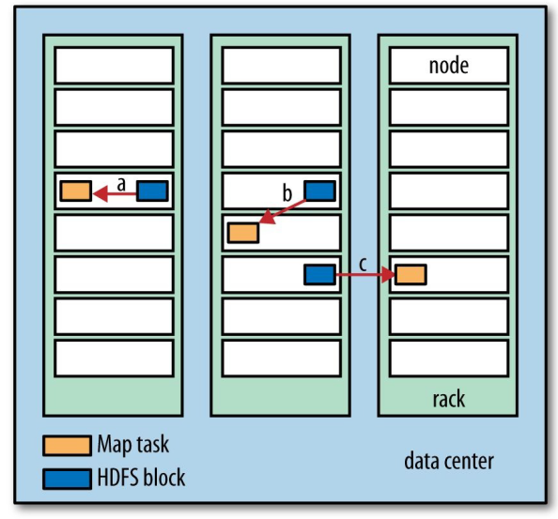
Map – data locality optimization
Hadoop tries to run the Map task in the same node as where input data resides. This makes it more efficient as it doesn’t use cluster bandwidth.

Slide 12
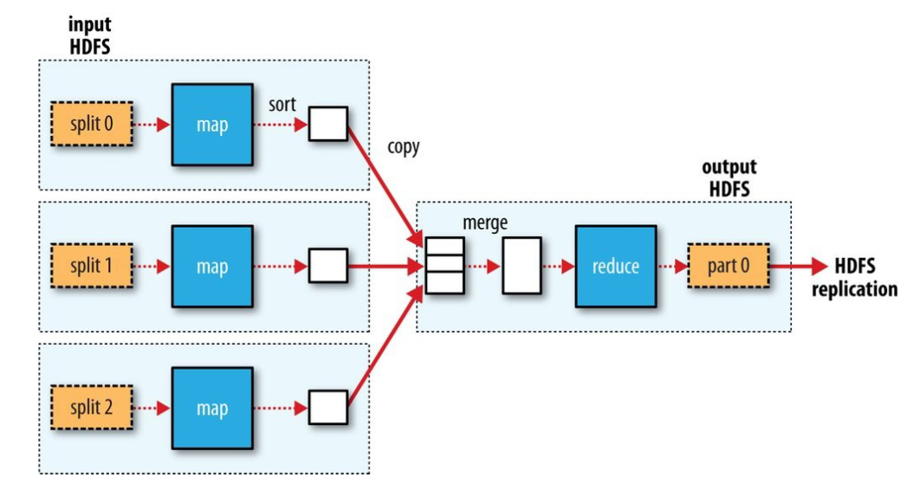
MapReduce – Data flow (single Reducer)
The below diagram shows the data flow for single reduce task

Slide 13
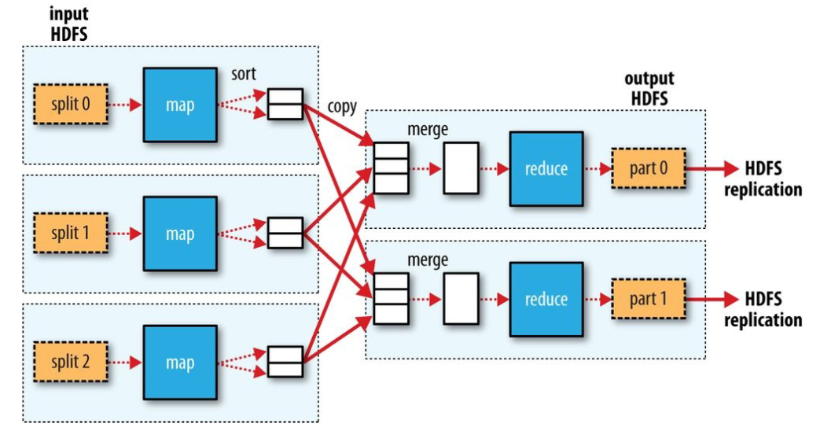
MapReduce – Data flow (many Reducers)
The below diagram shows the data flow for multiple reduce tasks

Slide 14
MapReduce Job - Entities
Client - submits the MapReduce job.
YARN Resource manager.
YARN Node managers.
MapReduce Application master - coordinates the tasks running MapReduce job.
Distributed filesystem (HDFS).

Slide 15
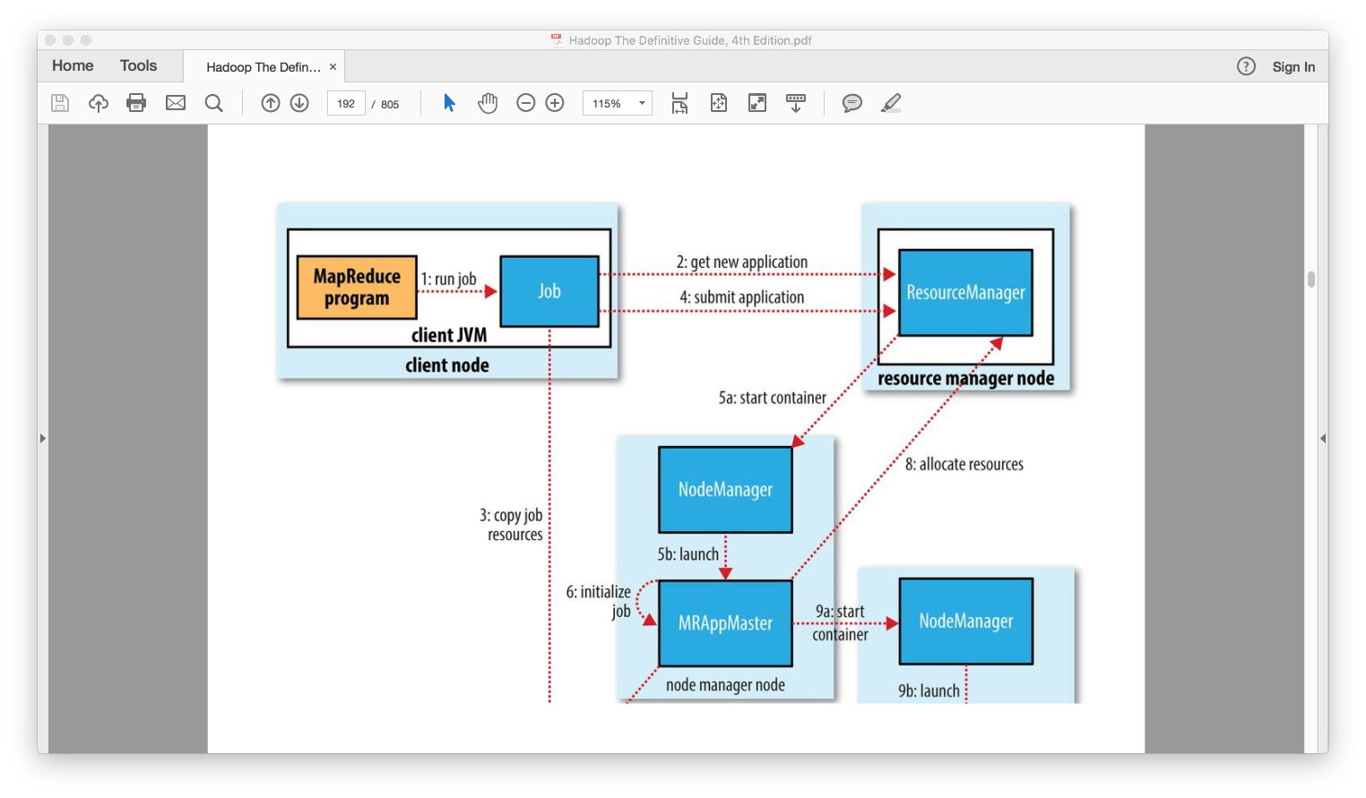
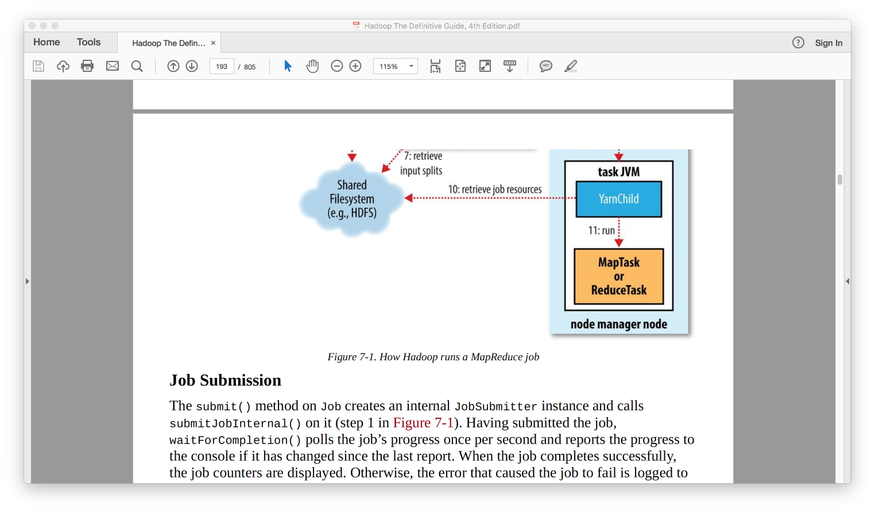
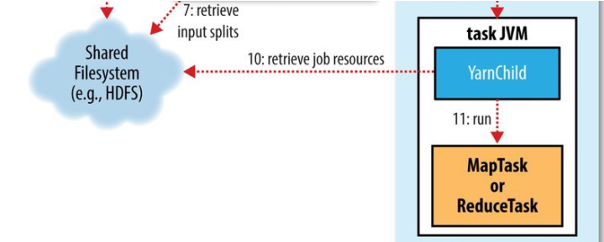
Anatomy of MapReduce Job

Slide 16
Job Submission
Step-2: Asks the resource manager for a new application ID
Checks the pre-conditions required for the job:
output directory already exists - error
splits cannot be computed - error
Step-3: Copy the resources to HDFS under directory with name of job ID
The job JAR file (code)
The configuration file, and
The computed input splits
Step-4: Submit the job to the resource manager.

Slide 17
Job Initialization
Steps 5a and 5b: YARN scheduler allocates a container, and the resource manager then launches the Application master’s process.
Step 6: Application master initializes the job and creates book-keeping objects to keep track of the job’s progress.
Step 7: Application Master retrieves the input splits computed in the client from the shared filesystem.
Uber task: If the job is small, the Application master can choose to run in same JVM as the overhead of allocating new JVM, running task and tracking the progress is more. These tasks which were chosen to run in sequence than parallel are called uberized task or an ubertask.

Slide 18
Task Assignment
Step 8: Application master ask for containers for Map and Reduce tasks. And assigns the tasks to them.
Reduce slow start: Application master will wait until 5% of the map tasks in a job to be completed before scheduling reduce tasks for the same job

Slide 19
Task Execution
Steps 9a and 9b: Resource manager’s scheduler will assign task to resources of a container. The application master contacts the node manager and starts the container.
Step 10: The task is executed by Yarn-Child ( a Java application). All the necessary resources for the task are localized.
Step 11: The map or reduce task is executed.
Commit protocol: Fully completed or fully failed. E.g: for file base committers, moving from temp folder to output folder.

Slide 20
Job Completion
Once the last task for a job is complete the application master sets the job status to “successful.”.
Cleanup: the application master and the task containers clean up their working state
Job information is archived by the job history server for future reference.

Slide 21
References and sources
Hadoop: The Definitive Guide, 4th Edition - Author: Tom White – Publisher: O'Reilly Media

Slide 22

Questions

