Slide 1



DEPARTMENT OF COMPUTER APPLICATIONS
Welcomes
MCA – 2023 -2024 Batch

Slide 2
Bridge Course
MCA 2023-2025 Batch

Slide 3
The Department
Started in the year 1999
Number of Faculty : 09
Number of Lab Staff : 03
Books in Dept. Library : ~ 1000
Number of Labs : 2
Extra Curricular Activities : CASA

Slide 4


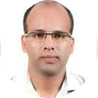

Members of Staff
Prof.Hyderali K
Balachandran KP
Dr. Geevar C Zacharias
Mr. Syed Feroze AhamedM
Associate Professor
And Head
Associate Professor
Assistant Professor
Assistant Professor

Slide 5




Members of Staff
Mr. Vasudevan T V
Mr. Muhammed
Jabir C
Ms. Priya J D
Ms. Febin Aziz
Assistant Professor
Assistant Professor
Assistant Professor
Assistant Professor

Slide 6

Members of Staff
Mr. Nowshad C V
Mr. Vasudevan T V
Assistant Professor
Assistant Professor
Group Tutor
MCA 2023-2025 Batch

Slide 7



Members of Staff
Ms. Rameela A
Mr. Bhagyesh A P
Mr. Jibeesh C M
Instructor
Instructor
Instructor

Slide 8
Genral Information
Working Hours : 09:30 AM to 12:30 PM and 01:30 PM to 04:30 PM (General)
09:30 AM to 12:15 PM and 02:00 PM to 04:30 PM (Friday)
Learning Management Systems (LMS)
: Linways System – Attendance, Assignments, Presentations, videos etc
Lab Hours : 08:30 AM to 08:00PM (On Demand)

Slide 9
Facilities
Central Library
Other Facilities
Total Number of Books : 68770
Total Number of Titles : 27473
Computer Science / MCA : 10068
E-Books for CS/MCA : 7000
Journals for CS/MCA : 29
IEEE APP/ J-Gate (Engg & Tech) : 4989
Bank : Punjab National Bank
: Thrikkanapuram Branch
IFSC : : PUNB0623200
Post Office : Thrikkanapuram South P.O
Via- Kaladi-MLP, Malappuram
Pin : 679582
Lab
Uniform
2 Labs : ~90 Computers
College Bus
Compulsory – See the students
1 Bus From Kuttippuram to College

Slide 10
ACADEMIC STRUCTURE
MCA 2022-2024 Batch

Slide 11
Duration
The duration of the MCA programme of the KTU will be two years consisting of four semesters
The maximum duration shall be, for MCA - four academic years spanning 8 semesters
Each semester shall have a minimum of 72 instruction days followed by the end semester examination.
The total contact hours are normally 30 hours per week. ( 6 Hours / 5 Days)
In case of prolonged illness or other personal exigencies, the university may allow a student who has earned credits for at least one semester, to extend the programme up to the maximum duration of four years

Slide 12
Academic Year
Every academic year shall have two semesters
Odd Semester : “1st July to 31st December”
Even semester : “1st January to 30thJune”.
The University shall publish academic calendar for each academic year

Slide 13
Course Structure
• Core courses
• Elective courses
• Laboratory courses
• Mini Projects
• Seminar
• Comprehensive Viva
• Main Project
• Non-credit courses
• One MOOC Course
• Bridge Course

Slide 14
Course Credits
Every Course comprises of specific Lecture-Tutorial–Practical (L-T-P) schedule.
The course Credits are as follows
1 credit for each lecture hour per week
1 credit for each tutorial hour per week
1 credit for 1 to 2 Hours Practical(P) per week
2 credits for 3 to 4 Hours Practical(P) per week
2 credits for the seminar
2 credits for the mini projects
6 credits for comprehensive viva
12 credits for the main project
Zero credit for non-credit courses

Slide 15
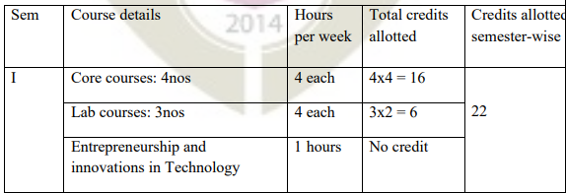
Credit Distribution
First Semester

Slide 16
Advisory Committee Meetings
Faculty Advisor / Group Tutor
Meetings with all students and class handling faculty
Parents Meetings
Shall preferably be convened:
Immediately after the commencement of the semester.
Immediately after announcing the marks of first internal evaluation test.
Grievances can be placed in this meeting

Slide 17
Course Registration and Enrolment
It is mandatory for students to register for the courses they want to attend in a Semester.
Students have to register for all courses offered in the first semester at the time of admission and for all courses offered in the second semester before the commencement of second semester. Similarly the students need to register for third and fourth semester.
A student will become eligible for enrolment only if he/she has registered for the previous semester.
In addition he/she has to clear all dues to the Institute up to the end of the previous semester and also he/she and should not have any pending disciplinary proceedings.

Slide 18
Examinations
The End Semester Examinations (ESE) shall be held twice in a year – May/June (for even semesters) and November/December (for odd semesters).
However, the End Semester Examinations of the third and fourth Semesters shall be conducted in both sessions.
The Comprehensive viva is to be done along with the fourth semester examinations

Slide 19
MOOC Courses
For MCA (2 years), the University will publish a list of MOOC Courses on IT introductory subjects every year.
The first-year students shall enroll and successfully complete a minimum of one MOOC course during the entire course period, before completing the fourth semester.
Submission of a ‘Successful Course Completion Certificate’ to the University is mandatory to publish the results of respective semesters.

Slide 20
Evaluations
Candidates in each semester shall be evaluated both by Continuous Internal Evaluation (CIE) and End Semester Examinations (ESE).
The ratio of Continuous Internal Evaluation (CIE) to End Semester Examinations (ESE) shall be as below:
1. Theory Courses : 1 : 1.5 (40-60)
2. Laboratory Courses : 1 : 1 (50-50)
3. Mini Projects : CIE only
4. Seminar : CIE only
5. Comprehensive Viva : ESE only
6. Main Project : CIE by Supervisors (30 marks) and a Committee (40 marks) separately and
ESE by External Expert (30 marks).

Slide 21
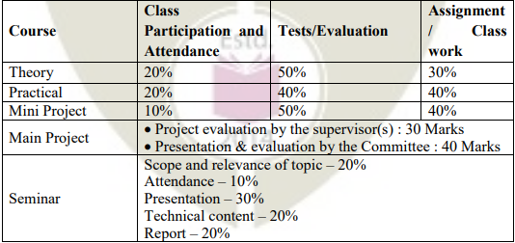
Continuous Internal Evaluation (CIE)
Continuous Internal Evaluation shall be on the basis of the day-to-day work, periodic tests (minimum two in a semester) and assignments (minimum two).
The faculty member (s) concerned shall carry out the Continuous Internal Evaluation (CIE) for the course allotted to him/her.
The CIE marks for individual subjects shall be computed by giving weightage to the following
8
20
12
10
20
20

Slide 22
CIE
There shall be minimum two internal evaluation tests, each of 2hrs duration.
Each test shall cover 50% of the syllabus and shall be for 50 marks.
Retest shall be permitted to the students who could not appear for the internal tests due to genuine grounds.
The CIE marks for the attendance for each theory, practical, and seminar shall be awarded in full, only if the candidate has secured 90% attendance or above in the subject.
If a student has attendance for a subject below 90%, a reduction in the marks for the attendance shall be made proportionally.

Slide 23
Attendance
Students are expected to attain 100% attendance for all courses.
However, under unavoidable circumstances they are permitted to avail leave.
Total leave of absence shall not exceed 25% of the academic contact hours for a course and 75% attendance is mandatory for registering to the end semester examination.

Slide 24
Pass Minimum
Pass minimum for a course shall be 40% for the End Semester Examination and 50% of CIE and ESA put together.
Letter grade ‘F’ will be awarded to the student for a course if either his/her mark for the End Semester Examination (ESE) is below 40 % or the overall mark [Continuous Internal Evaluation(CIE) + End Semester Examination (ESE)] is below 50 %.

Slide 25
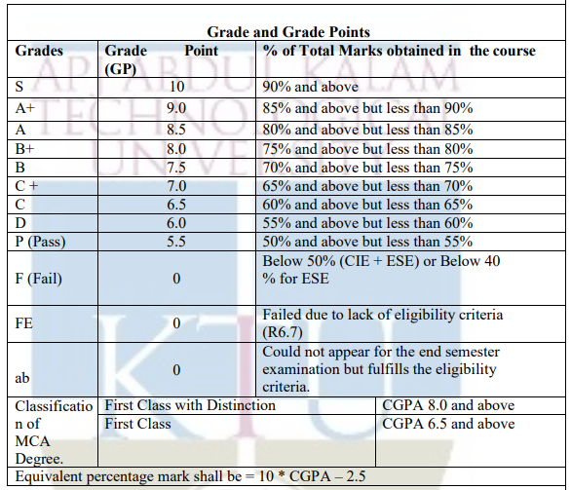
Grade and Grade Points

Slide 26
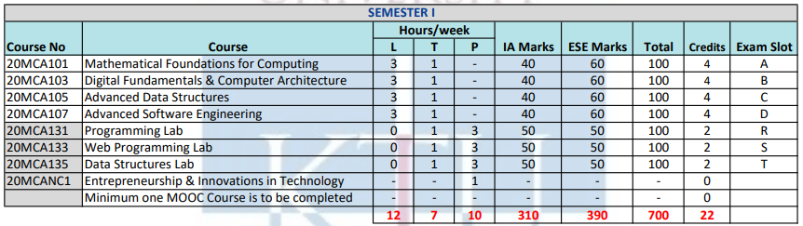
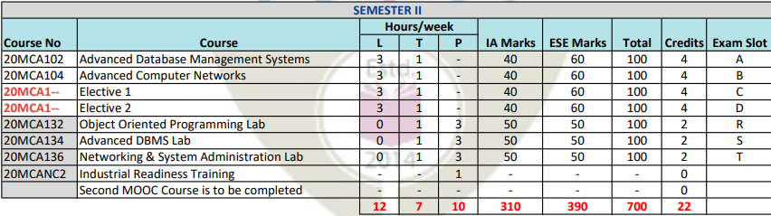
Curriculum
Semester I and II

Slide 27
Bridge Course Syllabus
Mathematics (Lecture - 25 Hours)
Review of basic single variable calculus: functions, limit, derivatives, integrals.
Essentials of Linear algebra: scalar vectors, linear combinations span and basis, linear independence. Matrices: matrix operations, scalar multiplication, vector multiplication, inverse and transpose, dot product, cross product, eigen values and eigen vectors.
Real Number System, Linear inequalities, Sets, Relations, Functions, Permutations and Combinations, Prime numbers, Polynomials.
Introduction to probability, experiments, outcome, events, sample space and probability, Random variables, probability distributions, binomial distribution, normal distribution, central limit theorem.
Reference Book:
1. Ian Jacques “Mathematics for Economics and Business”, Pearson Education Limited
Online Resources:
https://www.youtube.com/playlist? list=PLZHQObOWTQDMsr9Krj53DwVRMYO3t5Yr
https://www.youtube.com/playlist? list=PLZHQObOWTQDPD3MizzM2xVFitgF8hE_ab
https://www.youtube.com/watch? v=LYCwHcHRhCg&list=PLKc2XOQp0dMwj9zAXD5LlWpriIXIrGaNb
https://www.khanacademy.org/math/statistics-probability/probability-library
Mathematics

Slide 28
Bridge Course Syllabus
Digital Fundamentals and Basics of Computer Architecture (Lecture - 25 Hours) Introduction to number systems: Efficiency of number systems, Decimal, Binary, Octal, Hexadecimal number systems, conversion from one to another. Binary addition, subtraction, multiplication and division. Representation of signed numbers, BCD representation-BCD addition and subtraction.
Introduction to computers: Overview of PC architecture, Basic components of computer, Input output devices, Printers, Display devices, Scanners, Motherboard, Expansion Board, Secondary storage devices, Hard disk, Data storage in Hard disk, disk geometry, CD family, DVD.
Analog and Digital Signals: Periodic analog signals and its parameters, Digital signals and its characteristics, Transmission of digital signals, Transmission impairment, Network performance.
Reference Books:
Thomas L Floyd, “Digital Fundamentals”, 11th Edition, Pearson
M Moris Mano, “Digital Design”, 3rd Edition, Pearson
Behrouz A Forouzan, “Data Communications and Networking”, 4th Edition, (Chapter 3) McGraw-Hill
Online Resources:
https://www.youtube.com/watch?v=4ae9sJBBkvw
https://youtu.be/xOOiWK_Dcz4
https://youtu.be/saZhNTu_dDg
Digital Fundamentals and Basics of Computer Architecture

Slide 29
Bridge Course Syllabus
Operating Systems (Lecture - 20 Hours)
Overview of operating systems, functionalities and characteristics of OS.
Concept of a process, operations on processes, process states, concurrent processes, process control block, process context, processor scheduling, scheduling algorithms, problems of concurrent processes, critical sections, mutual exclusion, synchronisation, producer and consumer processes, deadlock.
Inter Process Communication (IPC), Memory organisation and management, Storage allocation, Virtual memory concepts.
File organisation: blocking and buffering, file descriptor, directory structure
Reference Book:
1. A. Silberchatz et.al., “Operating System Concepts”, 9th Edition Wiley (2015)
Online Resource:
1. https://www.coursera.org/learn/os-power-user
Operating Systems

Slide 30
Bridge Course Syllabus
Basics of C Programming & Data Structures (Lecture - 26 Hours, Lab – 24 Hours)
Algorithm, Pseudocode, Structured Programming, Introduction to C Language, Operators and expressions, Data input and output, Control statements, Functions, Arrays, Familiarity with Structures, Pointers, Linked List.
Introduction to Data Structures, Basic operations on different Data Structures: Stack, Queue & Tree, Basic Sorting and Searching techniques.
Reference Books:
Byron S Gottfried, “Programming with C”, Schaum’s outline, 3 rd Edition, McGraw Hill
Brian W Kernighan & Dennis Ritchie, “The C programming language”, 2nd Edition, Prentice Hall (2015)
Ellis Horowitz, Anderson-Freed, Sahni, “Fundamentals of Data Structures in C”, 2nd Edition, Universities Press
Online Resources:
https://www.edx.org/course/programming-basics-iitbombayx-cs101-1x
http://ocw.mit.edu/courses/electrical-engineering-and-computer-science/6-087- practical-programming-in-c-january-iap-2010/
https://www.geeksforgeeks.org/introduction-to-data-structures/
Basic Programming &
Data Structures
Lecture and Lab

Slide 31


