Slide 1
Beyond Source Selection
Detecting and resolving conditional knowledge conflicts in retrieval-augmented generation
Johann Shoni George
Guide: Dr G Naveen Sundar
Karunya Institute of Technology and Sciences
Notes:
One-line pitch: when an AI assistant reads two documents that seem to disagree, it usually picks one and throws the other away. For rules and exceptions that is wrong. We keep both, with the condition each applies under.

Slide 2
Why this is needed
AI assistants now answer questions by reading documents. This is called retrieval-augmented generation (RAG).
Many real documents state a general rule in one place and its exception in another.
In banking, immigration, insurance and healthcare, the exception decides what is correct for a particular person.
If the assistant keeps only one statement, the answer can be confidently wrong for exactly the people the exception was written for.
Our goal: an assistant that gives the answer that is correct for each reader.
Notes:
Set the stage in plain terms. People now ask AI assistants about fees, visas, insurance and medicine. The assistant reads documents and answers. Those documents are full of rules with exceptions.

Slide 3
The problem, with an example
Question: “Do I pay an international transaction fee?”
Document A: “International transactions incur a 3% fee.”
Document B: “Fees are waived for premium-tier cardholders.”
These do not contradict each other. Both are true, for different customers.
Today’s systems
What we build
“A 3% fee applies.”
“3% fee, waived for premium-tier cardholders.”
They treat A and B as a conflict and pick one. Premium cardholders are told the wrong thing.
Both statements kept, with the condition that decides which applies.
Notes:
Read the two passages out loud. Ask the room: do these contradict? No. Both are true. Then show what today's systems do and what we want.

Slide 4
Is this really a problem?
Question | Answer
Is it just a normal contradiction? | No. Both statements are true; they apply to different people. Choosing one is wrong by design.
Do existing systems handle it? | They detect disagreement, then rerank, filter or pick the most credible source. None has a “rule and exception” type.
Would we notice the loss? | Not with usual metrics. Accuracy checks the one answer given, not what was dropped.
Does it occur in real documents? | Yes. In 17 of 21 bank-terms pairs we examined, the rule and its exception sat in separate documents.
Who is harmed? | The readers covered by the exception: the premium customer, the patient with kidney disease, the hospitalised policyholder.
Notes:
Address the skeptic directly. Five questions an evaluator will ask. The 17 of 21 and 5 of 17 numbers come from our Tier-1 mining pilot on bank terms and gov.uk pages.

Slide 5
More examples
Domain | General rule | Exception | What picking one loses
Banking | 3% fee on international transactions | Waived for premium-tier cardholders | Premium customers are told they pay
Medicine | Take 500 mg twice a day | Halve the dose in kidney disease | A kidney patient gets an unsafe dose
Insurance | Claims must be filed within 30 days | 90 days if the person was hospitalised | A valid late claim is rejected
Immigration | Students may work 20 hours a week in term | Full-time work allowed in official holidays | The right to work is understated
Medicine, insurance and immigration rows are illustrative.
Notes:
The pattern is the same in every domain. The examples other than the bank one are illustrative, written to show the pattern.

Slide 6
How we solve it
Step | What it does | On the fee example
1 Detect | Find retrieved passages that appear to disagree | A and B are flagged
2 Relate scopes | Decide if it is a real contradiction or a rule and its exception | B narrows A: an exception, not a contradiction
3 Find the condition | Extract who or when the exception applies to | “premium-tier cardholders”
4 Compose | Write one answer that keeps every valid branch with its condition | “3% fee, waived for premium-tier cardholders.”
If the passages truly oppose each other, we fall back to choosing the more reliable source.
Notes:
Four steps, each shown on the bank example. The key idea: work out how the two scopes relate, and only fall back to picking a source when the passages truly oppose each other.

Slide 7
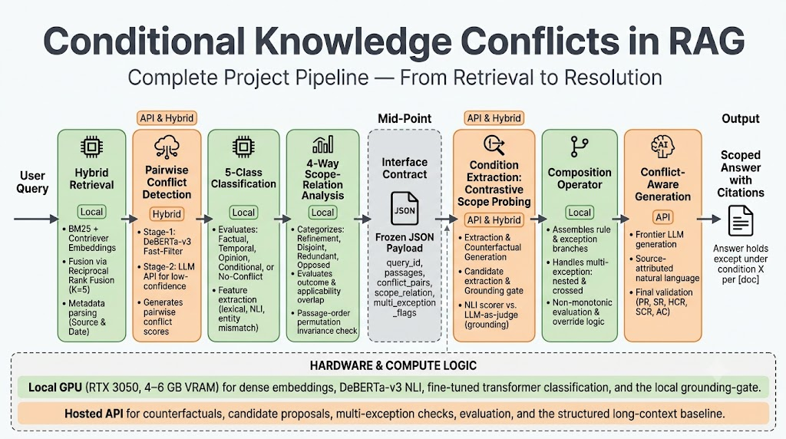
System architecture
Front end
Back end
Question
+ documents
A1 Retrieve
keyword + semantic search
Shared data record
B1 Find conditions
who or when each branch applies
A2 Detect conflicts
which passages disagree
B2 Compose
merge, flag complex cases
A3 Classify
five conflict types
B3 Generate
answer with every branch
Answer
A4 Relate scopes
rule + exception, or opposed?
The shared record carries the conflict type, the scope relation, and the flags the back end needs.
Notes:
Left to right. The front end decides what kind of disagreement it is. One agreed data record passes that decision to the back end, which finds conditions and writes the answer. The two halves were built in parallel by the two of us against that record.

Slide 8
What it is built with
Layer | Tools
Language and framework | Python 3.11, PyTorch, Hugging Face Transformers, scikit-learn
Retrieval | BM25 + Contriever (sentence-transformers), rank fusion
Conflict and condition models | DeBERTa-v3 MNLI cross-encoder, fine-tuned and zero-shot variants
Language models | gpt-oss models on Groq through the OpenAI SDK; Qwen 2.5 7B on Ollama as local fallback
Engineering | Pydantic JSON contract, SQLite request cache and cost log, pytest (501 tests)
Hardware | Laptop with NVIDIA RTX 4060, 8 GB VRAM
Notes:
Everything is open or free-tier. Local GPU does classification and scoring; generation goes through Groq-hosted open models with a local Ollama fallback. A cache makes repeat runs free.

Slide 9
How we will know it works
Suppression Rate
We compare against
The share of valid branches that the answer leaves out.
Standard RAG
Reranking and NLI filtering
Credibility-based selection
Chain-of-thought prompting
Full-context prompting
Conflict-type-aware prompting
A strong long-context model prompted to separate the branches
Valid branches: 2
(3% fee, premium waiver)
Picking one source: keeps 1
Suppression Rate = 50%
Our composed answer: keeps 2
Suppression Rate = 0%
Accuracy alone cannot show this loss.
The last one is the hardest test. If it matches us, we say so.
Notes:
The new metric is easy to explain with the fee example. Two valid branches, selection keeps one, so half the truth is gone. Then name the comparisons, especially the strong long-context baseline.

Slide 10
Data, status and plan
Benchmark (about 250 questions)
Status
Natural: rule and exception found in separate real documents (bank terms, gov.uk).
Constructed: one document’s rule and exception split in two, with distractors.
A pilot over 38 document pairings showed natural cases are rare, so the constructed set carries most of the data. The two are never mixed in results.
Full pipeline, baselines and metrics implemented and tested
Feasibility probe and data pilot completed
Literature review and positioning done
Remaining
Annotate the benchmark and report agreement
Run all comparisons on the full data
Write the journal paper
Notes:
We measured first whether natural cases are common enough. They are scarce, so half the benchmark is constructed in a controlled way and the two halves are reported separately. Software is built; annotation and final runs remain.

Slide 11
Summary
The problem | Assistants resolve “rule vs exception” by picking one source, which gives wrong answers to the people the exception covers.
Our approach | Detect it, work out how the scopes relate, extract the condition, and answer with every valid branch.
What is new | A conditional conflict type, condition extraction across documents, and Suppression Rate to measure what is dropped.
Deliverables | Working pipeline, a two-part benchmark, the metric, and a journal paper.
Notes:
Close on the one-line contribution. If asked what is new: the combination of a distinct conditional conflict type, condition extraction across documents, and a metric that counts what was dropped.

