Slide 1
EIDSPDB Architecture
EFEBLAW
CUID – PO BO
2019-11-05

Slide 2


Architecture High Level view
Development
ENVIRONMENT
WEB PROD & TEST
ENVIRONMENT
DB PROD & TEST
ENVIRONMENT
Environments
Application Layer
Interactive Clients
Infrastructure Layer
Compute
LINUX SERVER UBUNTU 2vCPU / RAM 4GB DISK 60 GB / SSD
LINUX SERVER UBUNTU 1vCPU / RAM 1GB DISK 40 GB / SSD
Site
VM Azure Cloud Singapore
Network

Slide 3
Existing Architecture High Level Description
Solution based on approved set up with separated Environments in the same Server
Development -> Test (UAT) -> Production
Production Environment hosted using third party: Azure Cloud Server.
Web Framework:
PHP
MySql
Code Igniter
Web Server : Apache 2/port 4000 reverse proxy from port 80 to 4000; https port 443

Slide 4



Existing Architecture DEV Environment
1. Customer Requirements
3. Infra
Requirements
2. Define agreeable milestone
5. Programming
6 UAT & Production
4. Apps Environment
EIDSPDB
Development workflow
Understand customer requirements
Define agreeable milestone
Infrastructure requirements
Application requirements
Programming
UAT & Go Live

Slide 5
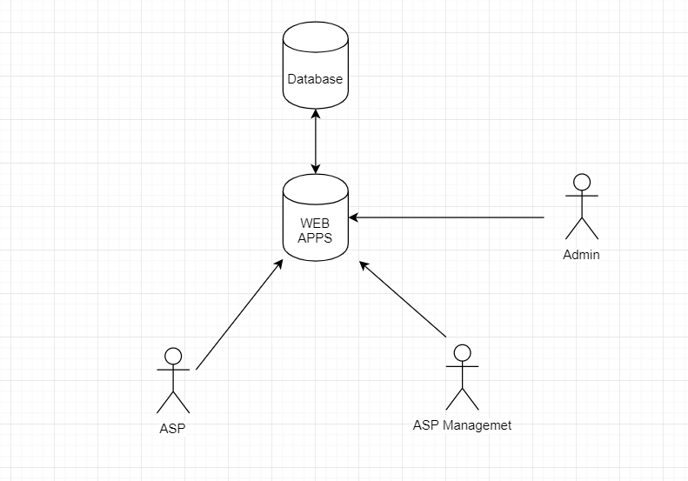
General Workflow

Slide 6
Functionality
Register ASP Member
Update Training Info
Deactivate Member

Slide 7
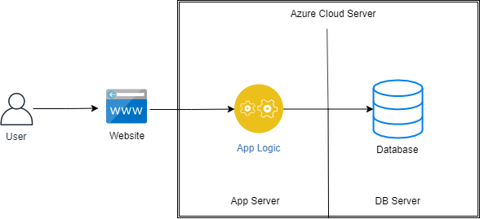
Architecture Net view (Intrastat)
Traffic Flow: 1
Purpose: Connection App Server to DB Server
Direction: Inbound/ Outbound
Protocols: HTTP
Port:5432
Traffic Flow: 2
Purpose: User Access to Application Logic
Direction: Inbound/outbound
Protocols: HTTPS
Port:443

Slide 8
Architecture Security
SSL are used for the application
Password is SHA 512 encryption
Separation of App Server & DB Server
Using Private Key for SSH

Slide 9
Architecture Access control
USER Registration
Register manually to web platform by inserting personal information and selecting role.
USER AUDIT
Admin are able to see the list of registered user within his roles group.
User will be update if:
Req from asp management

