Slide 1
The Researcher’s Toolkit 2015 D3.js
Northwestern
Alessandro Febretti
Sr. Interactive Visualization Specialist

Slide 2
Overview

Slide 3
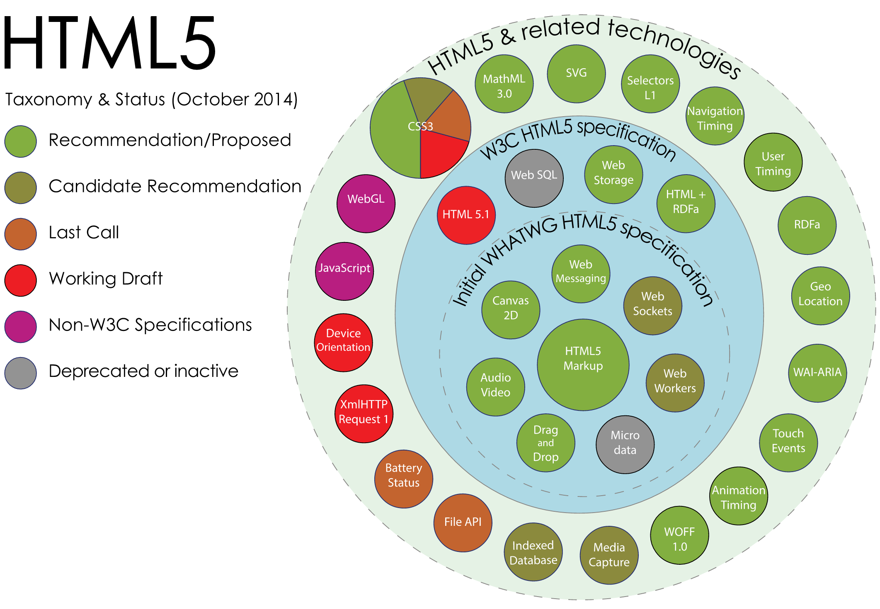
HTML5
Notes:
- t1-html

Slide 4
HTML
Markup language
Text-oriented elements (font, p, ul, …)
Multimedia elements (img, canvas, audio, video, …)
Non-content elements (style, script, input, …)
html
head
body
div
Attribute: style
Content: Hello World!
<!DOCTYPE html>
<html>
<head>
</head>
<body>
<div style="font-size: 40px;">Hello world!<div/>
</body>
</html>
Notes:
Markup language – hierarchical, has elements & attributes

Slide 5
CSS
Separate visual style from content
Attach style by element type, class or id
<div class="title">Hello world!</div>
<p>All paragraphs are styled like this except for</p>
<p id="special">this one</p>
Apply to class
.title
{
color: red;
font-size: 40px;
}
p
{
color: green;
font-size: 20px;
}
#special
{
color: blue;
font-size: 30px;
}
Apply to element type
Apply to id

Slide 6
Javascript
Add logic to page content
Javascript accesses content through the Document Object Model (DOM)
Main way to add logic: attach handler functions to DOM events
html
head
body
div
Attribute: style
Content: Hello World!

Slide 7
SVG

Slide 8
D3.js
What it is & isn’t

Slide 9
The Wealth & Health of Nations

Slide 10
Publishing your project

Slide 11
Other Resources
http://dl.heeere.com/swc/d3/

Slide 12

How we can help
First Step: Consultation
We learn about your research domain and your problem
Investigate existing solutions
Proof-of-concept / preliminary app
We start working with your data
Objective: working prototype + basic documentation
Source code
Moving Forward
We provide time / cost estimate for your project
Tiered estimates
Help Integrating visualization into your next grant
Notes:
35

Slide 13


Thanks!
alessandro.febretti@northwestern.edu
visualization.northwestern.edu
Notes:
38

