Slide 1
The Researcher’s Toolkit 2016 Interactive Visualization with D3.js
Northwestern
Alessandro Febretti
Sr. Interactive Visualization Specialist

Slide 2

Overview
HTML5 Technologies
Introduction to D3
Example Project
Additional Resources
https://github.com/febret/intro2D3

Slide 3
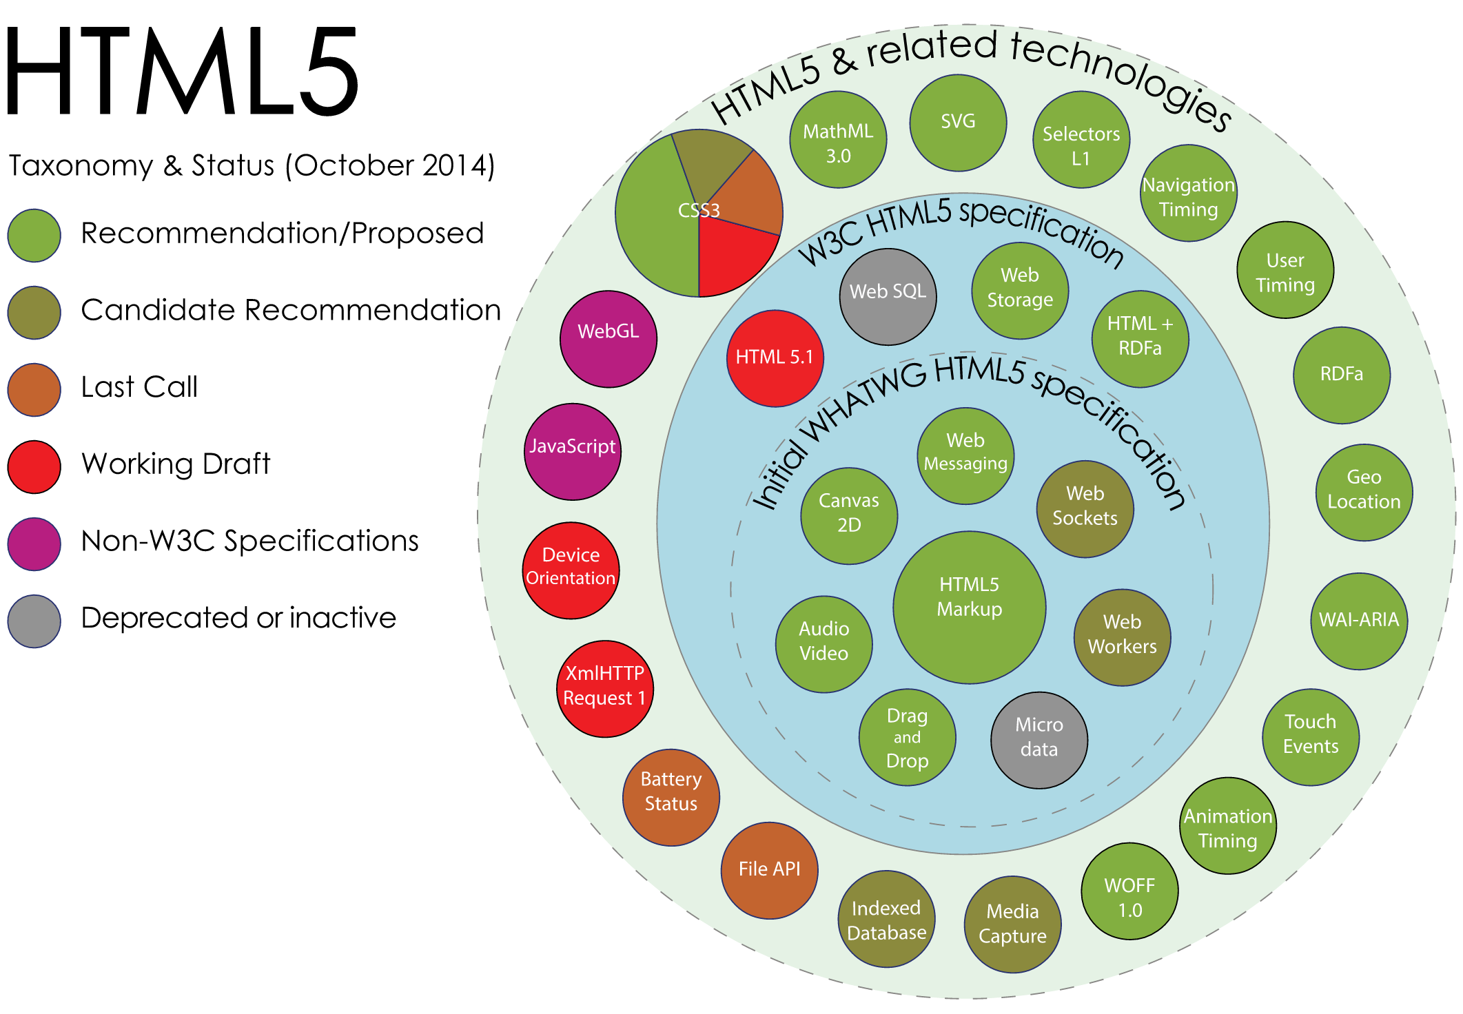
HTML5
Notes:
- t1-html

Slide 4
HTML
Markup language
Text-oriented elements (font, p, ul, …)
Multimedia elements (img, canvas, audio, video, …)
Non-content elements (style, script, input, …)
html
head
body
div
Attribute: style
Content: Hello World!
<!DOCTYPE html>
<html>
<head>
</head>
<body>
<div style="font-size: 40px;">Hello world!<div/>
</body>
</html>
Notes:
Markup language – hierarchical, has elements & attributes

Slide 5
CSS
Separate visual style from content
Attach style by element type, class or id
<div class="title">Hello world!</div>
<p>All paragraphs are styled like this except for</p>
<p id="special">this one</p>
Apply to class
.title
{
color: red;
font-size: 40px;
}
p
{
color: green;
font-size: 20px;
}
#special
{
color: blue;
font-size: 30px;
}
Apply to element type
Apply to id

Slide 6
Javascript
Add logic to page content
Javascript accesses content through the Document Object Model (DOM)
Main way to add logic: attach handler functions to DOM events
<div class="title">Hello world!</div>
<p>All paragraphs are styled like this except for</p>
<p id="special">this one</p>
<script>
var a = document.getElementById("special");
a.addEventListener("mousedown",function(){
alert('hello world!')
},false);
</script>

Slide 7
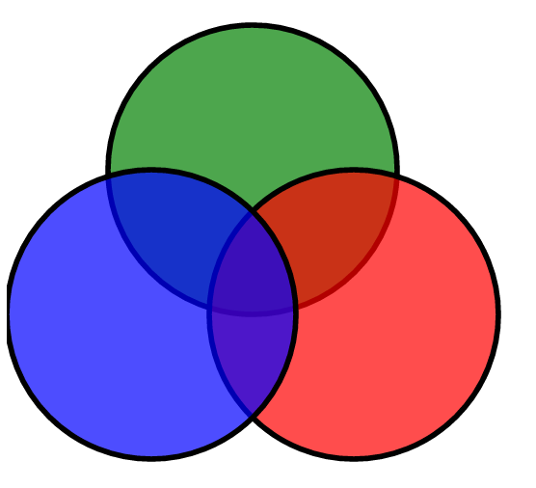
SVG
Scalable Vector Graphics
XML format for 2D graphics, embeddable in HTML
Elements are part of DOM and can be styled with CSS
<svg width="12cm" height="12cm">
<g width="12cm" height="12cm" class="circles">
<circle style="fill:green" r="100px" cx="170px" cy="150px"/>
<circle style="fill:red" r="100px" cx="240px" cy="250px"/>
<circle style="fill:blue" r="100px" cx="100" cy="250px"/>
</g>
</svg>

Slide 8
D3.js
Data-driven Documents → Manipulate DOM based on data
D3 is not just a plotting library
D3 makes it easier to create page content procedurally based on data sources & user inputs
What ‘content’ is is up to you! (html elements, svg, canvas graphics, …)
D3 provides functions to deal with
Data stream-in
Transitions
Basic plot elements (scales, axes, …)
Getting D3:
download from http://d3js.org/
OR import online version directly:
<script src="http://d3js.org/d3.v3.min.js">

Slide 9
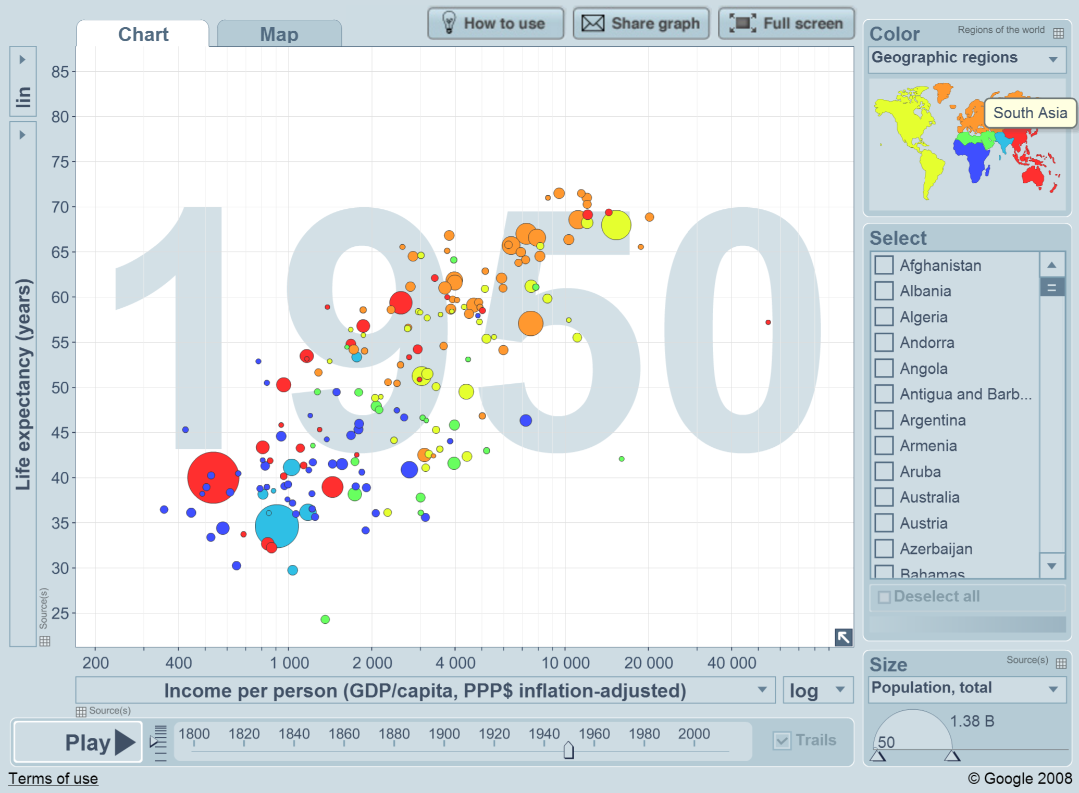
The Wealth & Health of Nations
Life vs GDP/capita over time
Color = region
Circle size = population

Slide 10
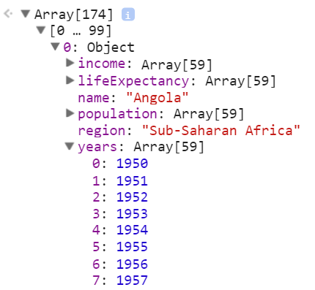
Source Data
JSON format
Pure javascript data notation (data is valid javascript)
174 Nations
Income, life expectancy, population
1950 – 2009
~30K values

Slide 11

Coding Time!
https://github.com/febret/intro2D3
Notes:
38

Slide 12
Tasks
1 – Basic page setup
D3 JSON loading
D3 selection
2 – Loading data and printing content
selectAll and enter
The data function
3 – SVG drawing and Axes
Scales
The call function
4 – Plotting data
5 – Adding and removing points
d3.map
d3.on
6 - animation

Slide 13
Other Resources
Software Carpentry: http://dl.heeere.com/swc/d3/
Same tutorial
Some info on publishing your project
API Reference: https://github.com/mbostock/d3/wiki/API-Reference
Libraries that use D3 http://mikemcdearmon.com/portfolio/techposts/charting-libraries-using-d3
Workshop material: https://github.com/febret/intro2D3

Slide 14

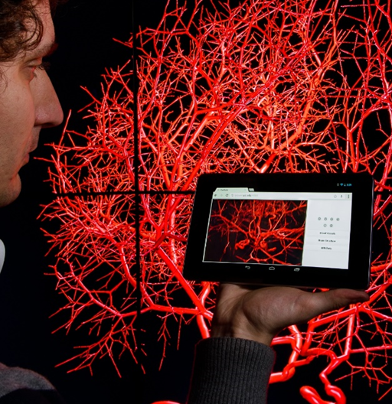
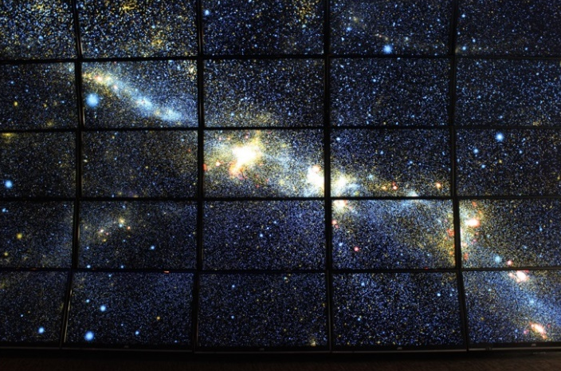
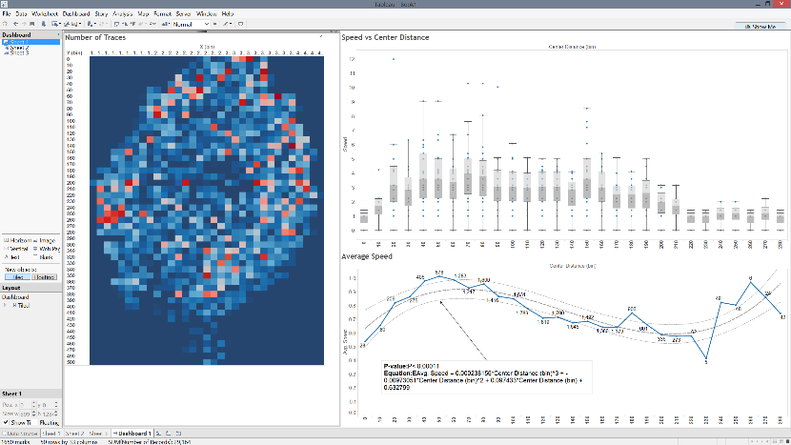
Northwestern|Visualization
Part of Research Computing Group
Illustration, Animation & Interactive Visualization Services
We work with every School at Northwestern
Activities:
Consultation
Design & Development
Training
Notes:
35

Slide 15

Thanks!
alessandro.febretti@northwestern.edu
visualization.northwestern.edu
Notes:
38

