Slide 1
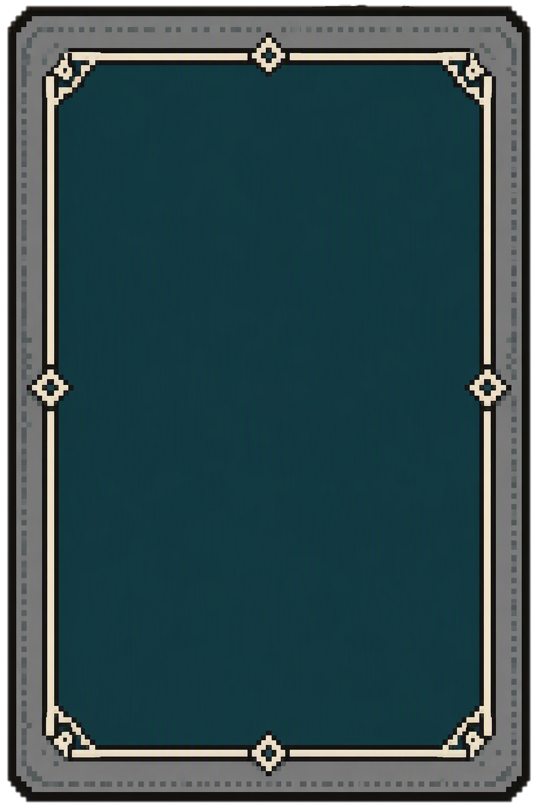
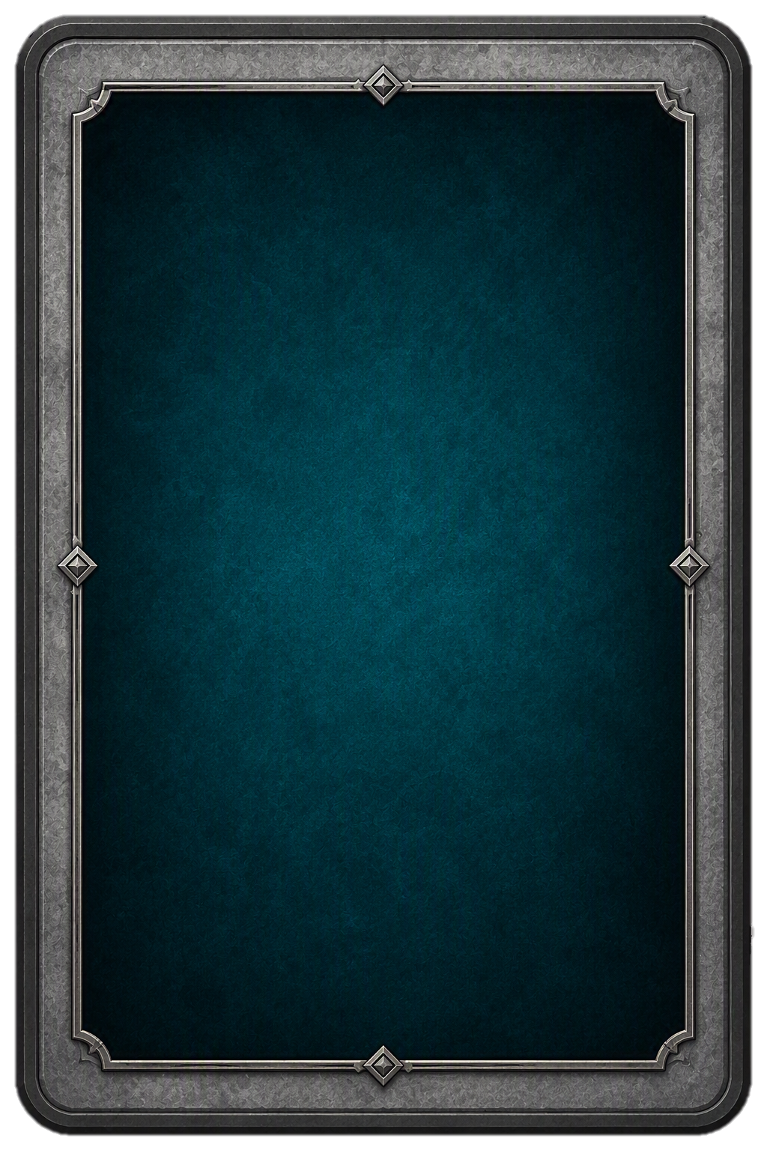
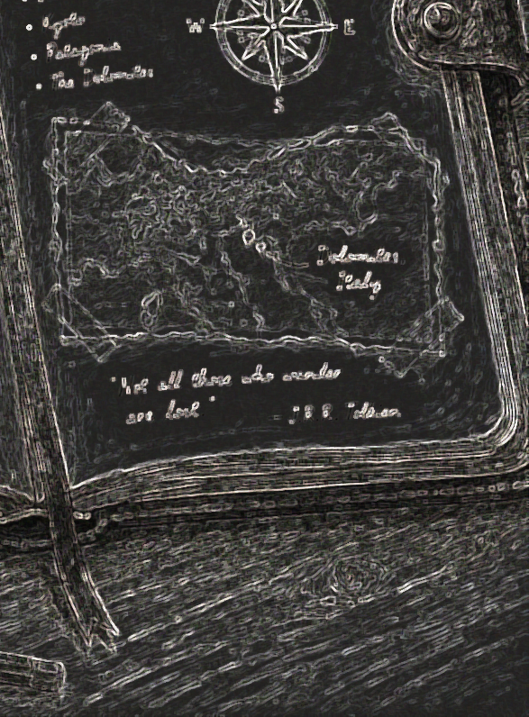
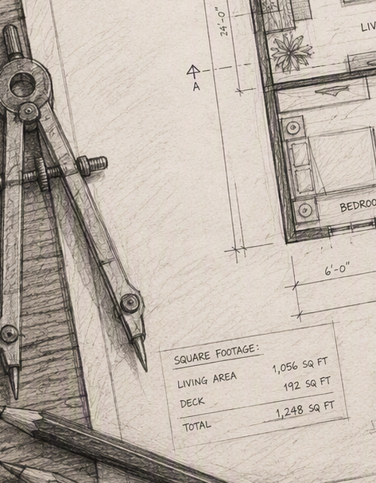
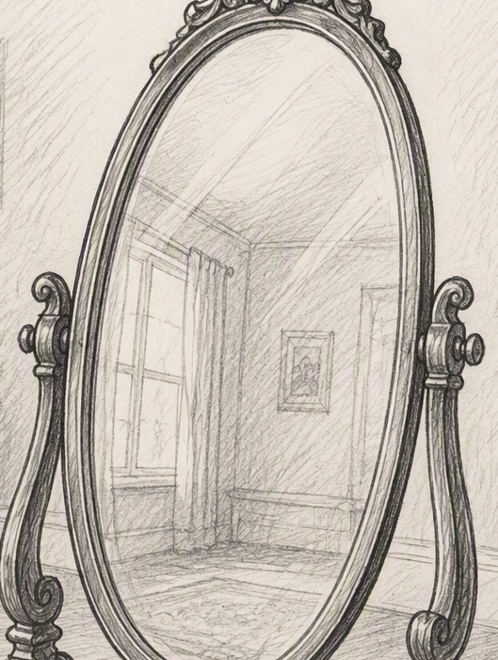
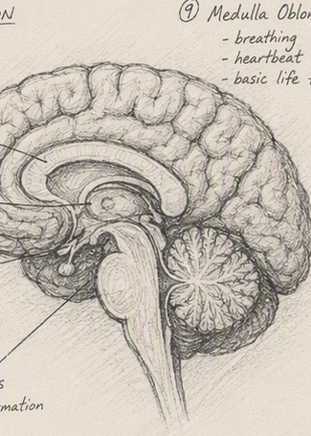
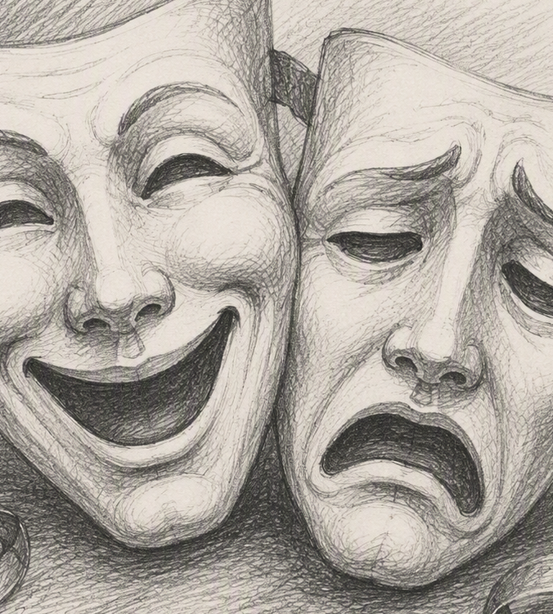
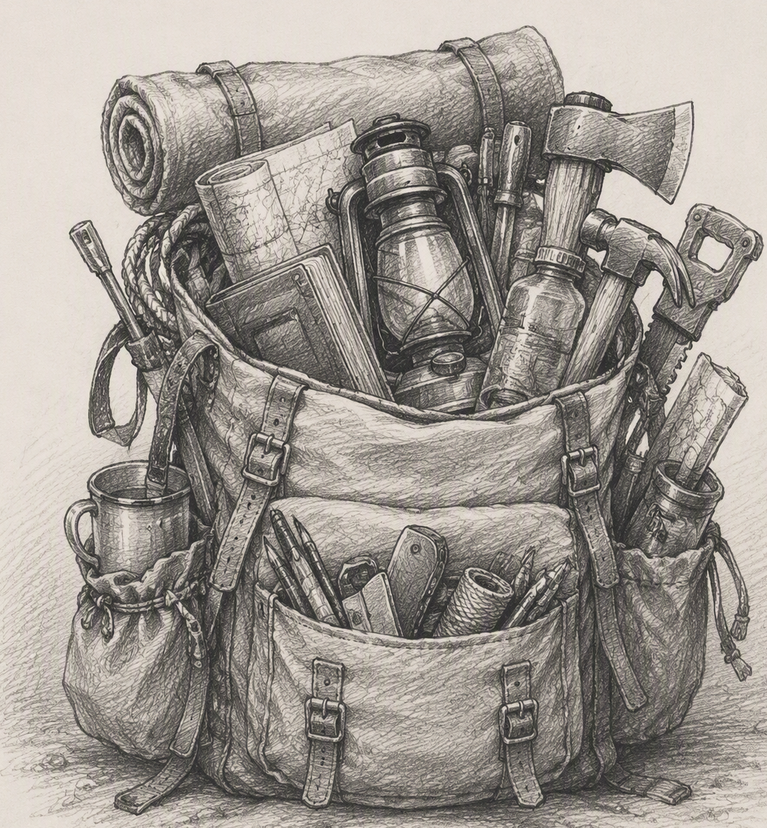
Card Face Designs – Core Cards
Journal
Edit Room
Room
Skills
Emotes
Inventory

Slide 2


Emotes
Base Emote Cards
😀
😡
Smile
Growl
🙄
🤪
Sigh
Goof

Slide 3
Items
Cards used by the tinyrooms tutorial world – Other
🦭
🦭
🔦
🧃
Lucille
A Clean Seal Plushie
Hand Light
Juicy Drink
🥫
🩰
🥪
👛
Tomato
Sauce
Ballet
Shoes
Tasty Toast
Fancy Wallet

Slide 4


Items
Cards used by the tinyrooms tutorial world – litter box quest
💩
Poop
Plastic Bag
💩
Pooper
Scooper
Poop
In a Bag

Slide 5
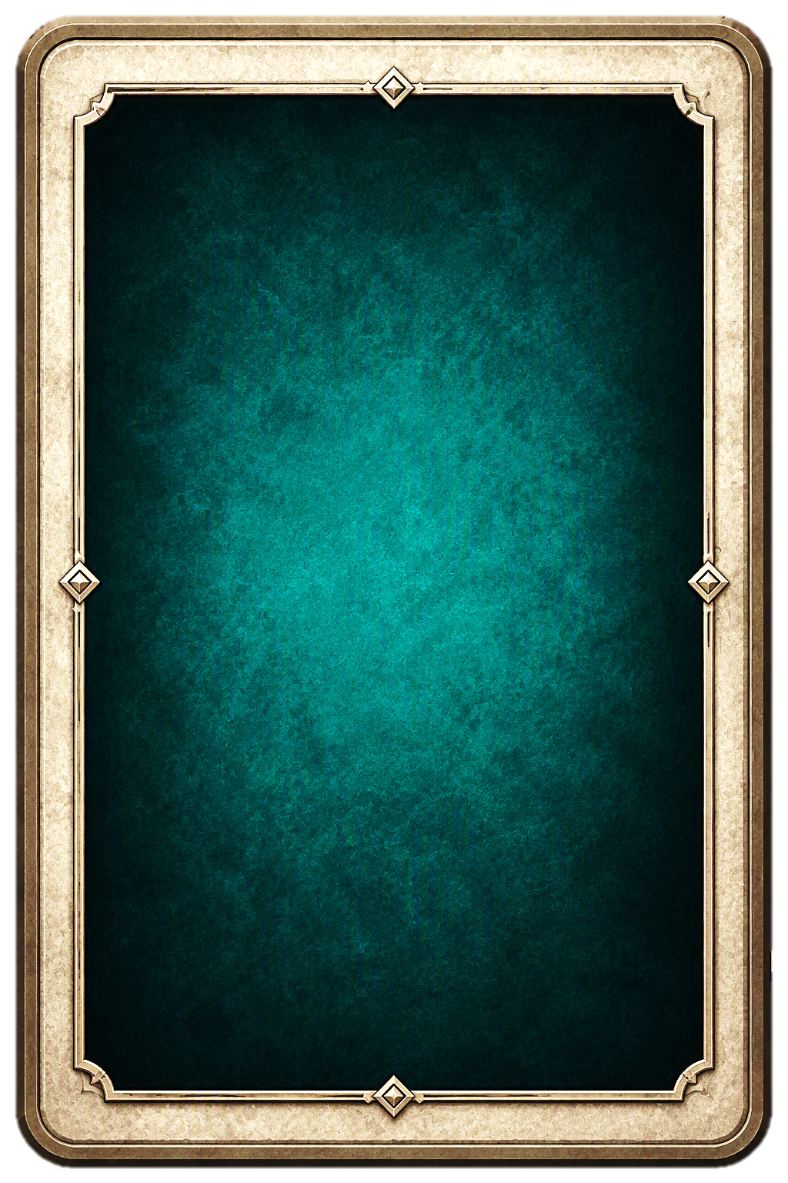


Skills
Base Skill Cards
Sturdy
CON +1

Slide 6
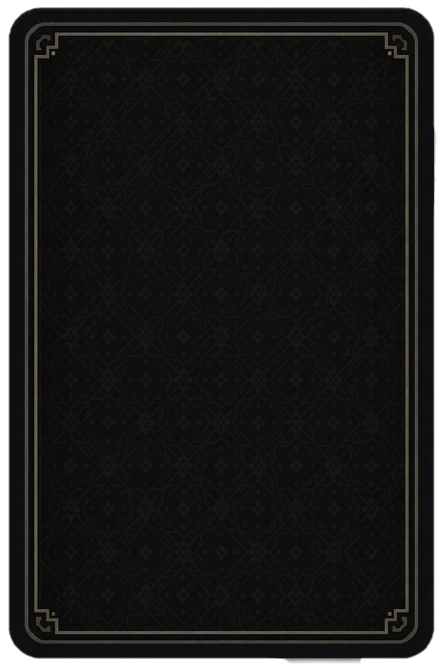
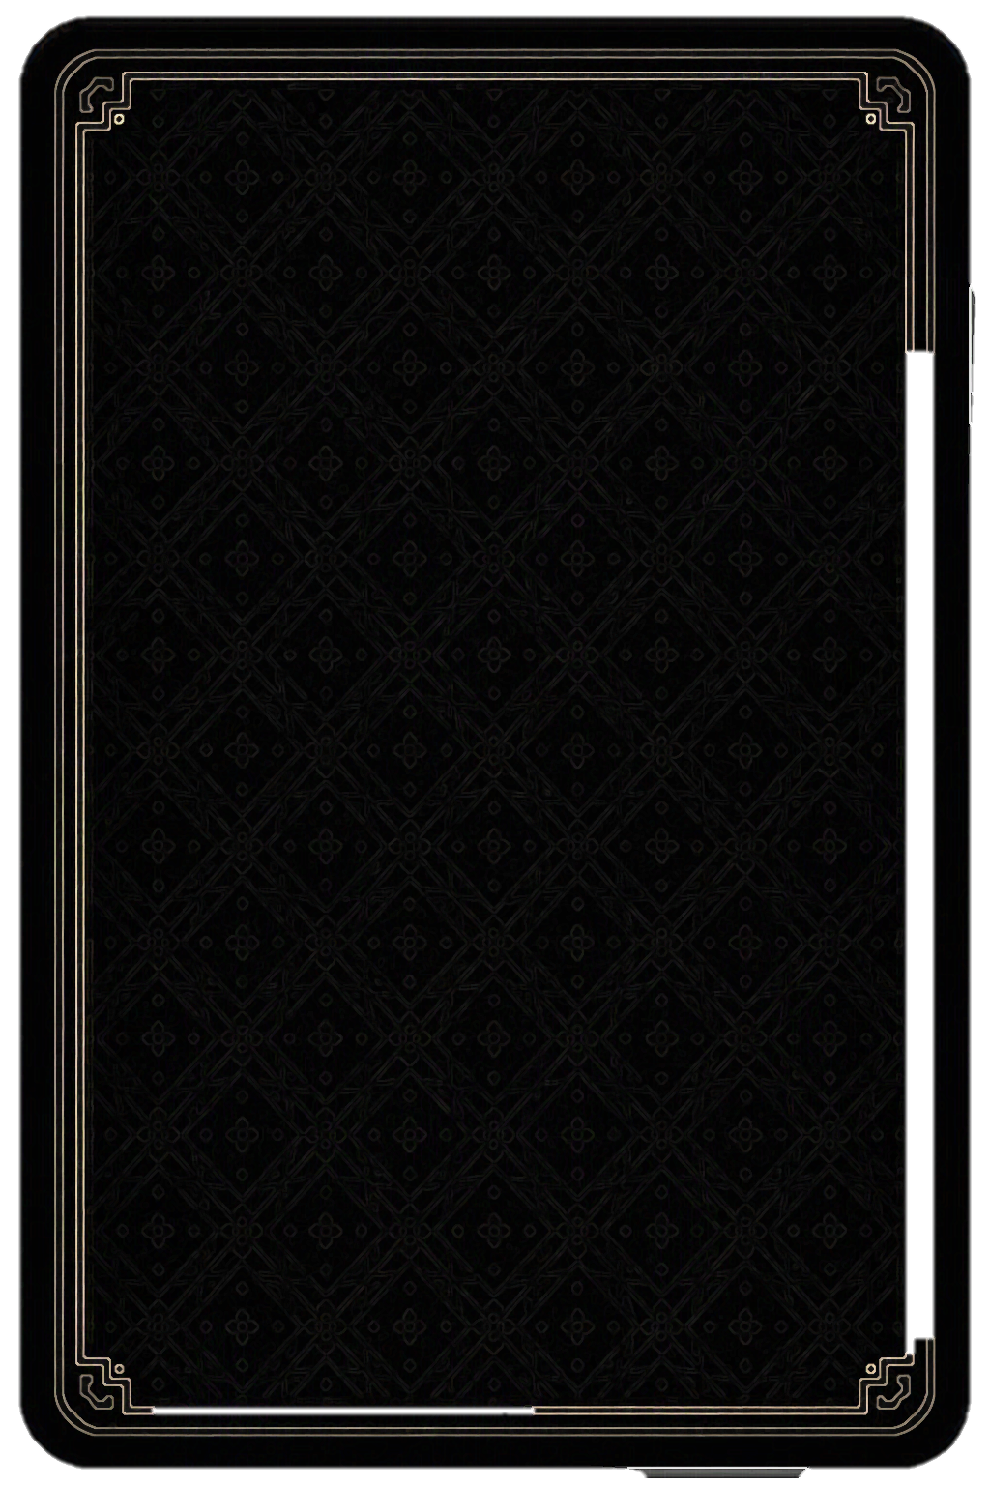
Card Pack Back
Tinyrooms
Base Pack

Slide 7
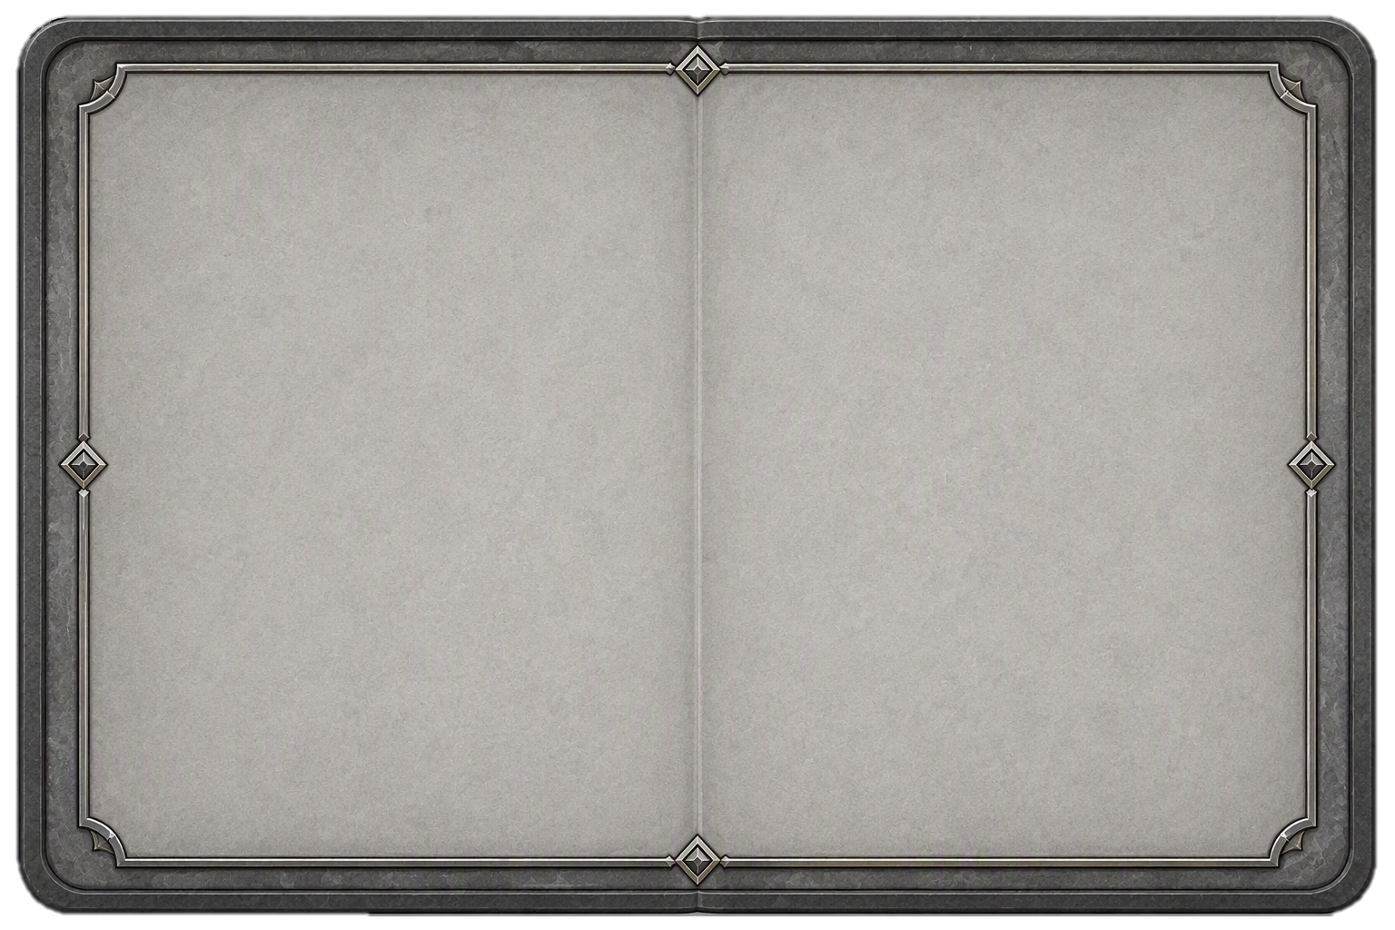
Open Card Design

Slide 9
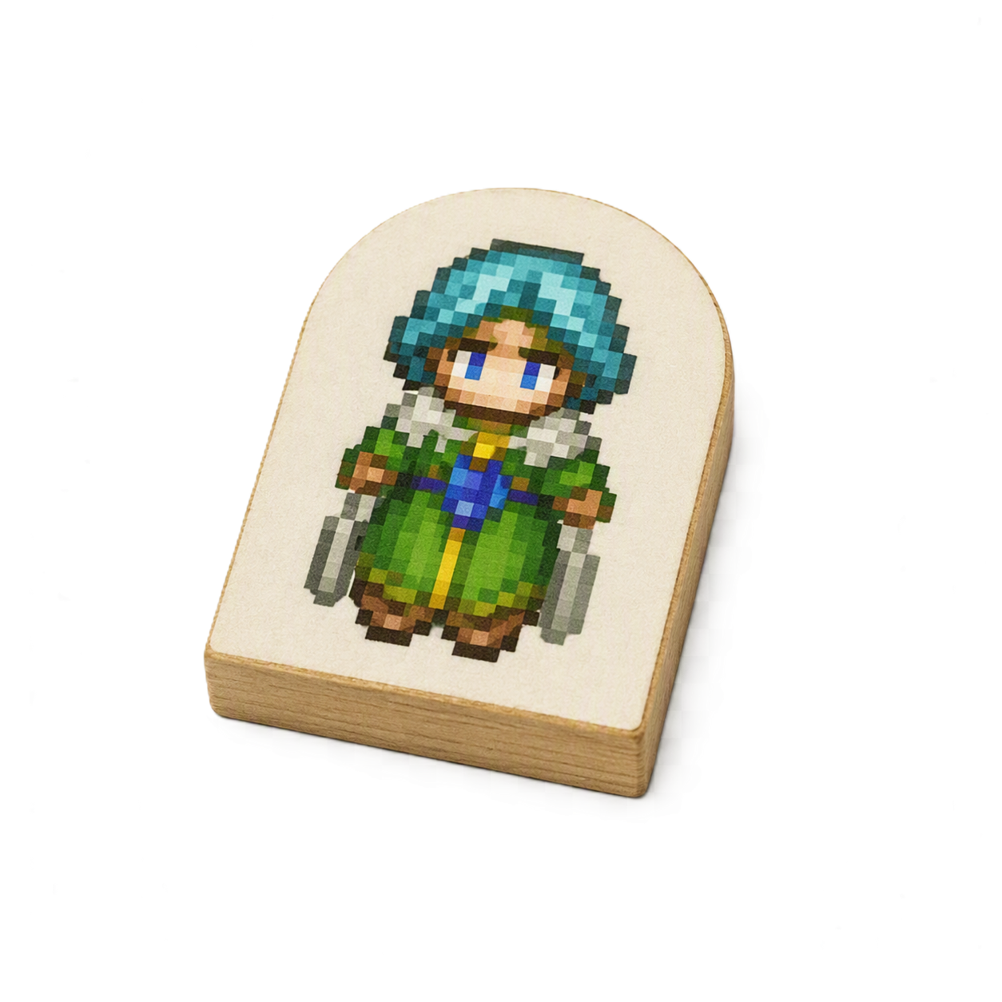
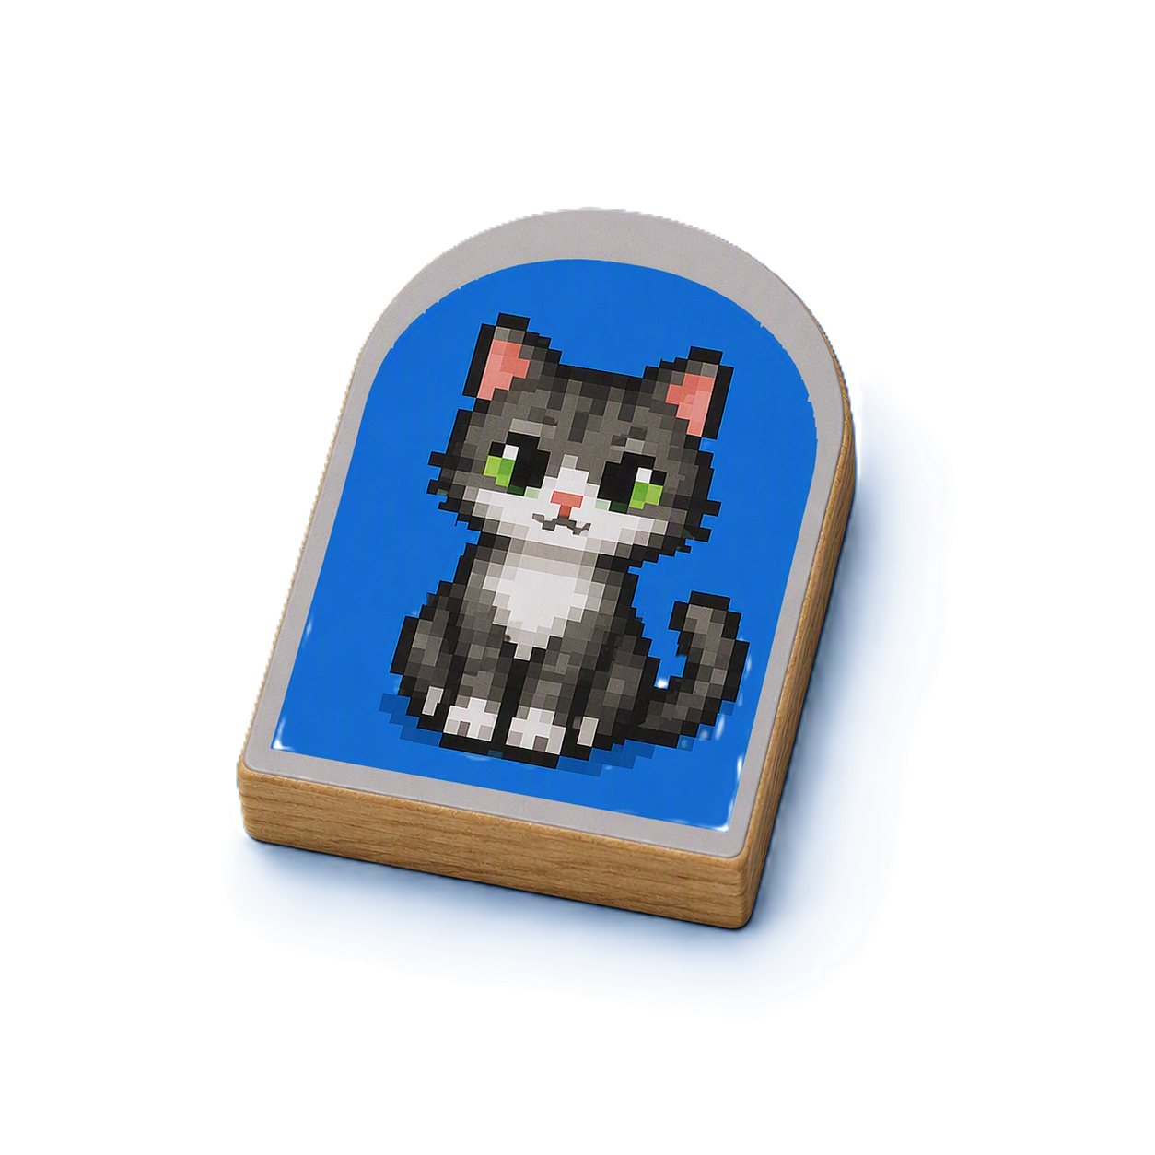
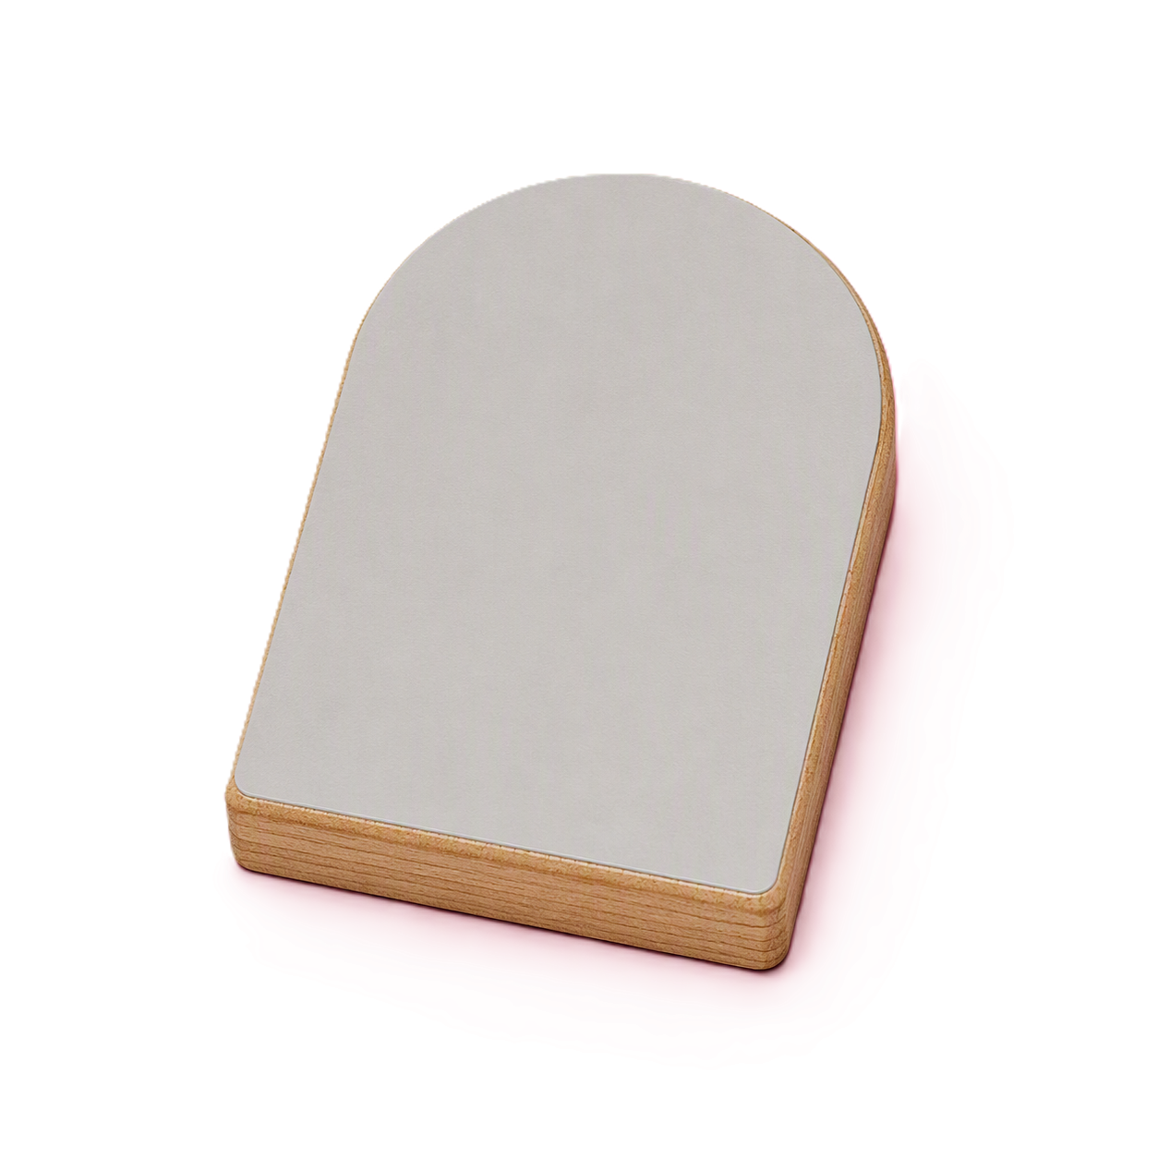
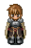
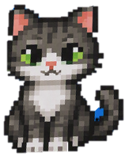
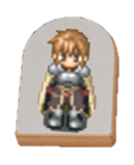
Peeps
Bases and Text Bubbles

