Slide 1


Slide 2
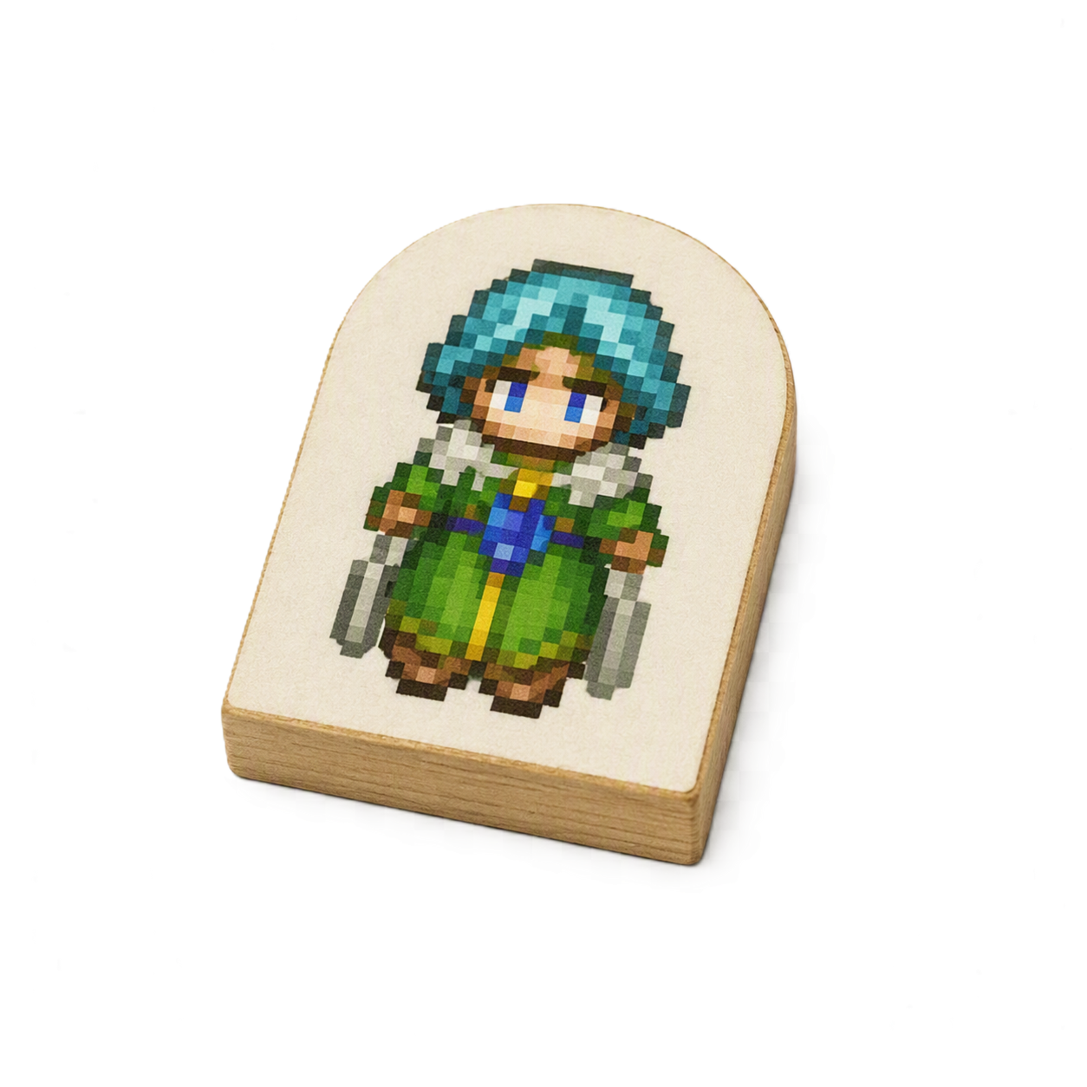
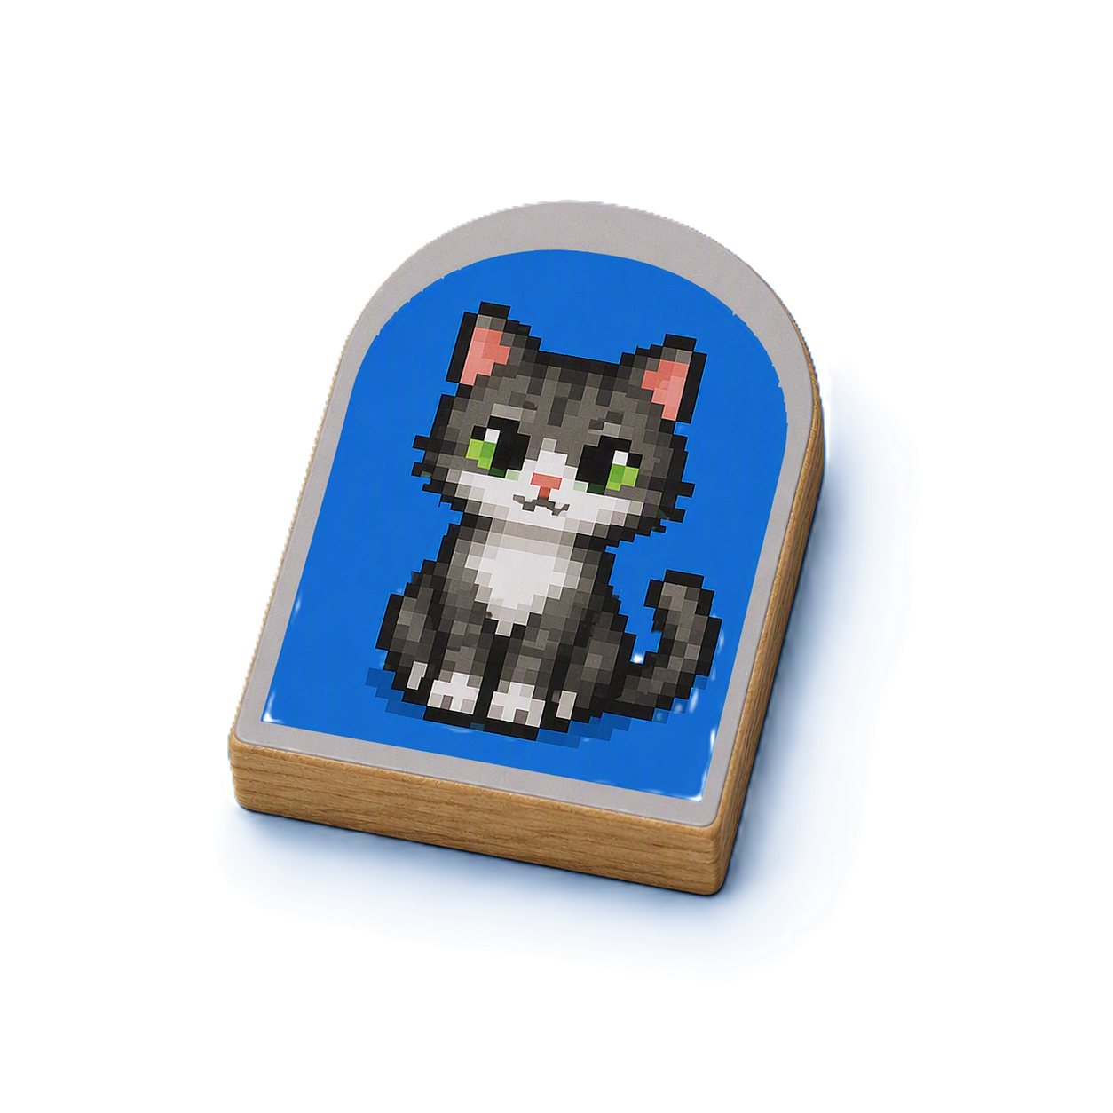

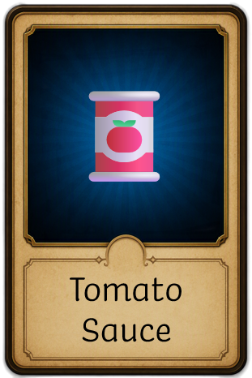
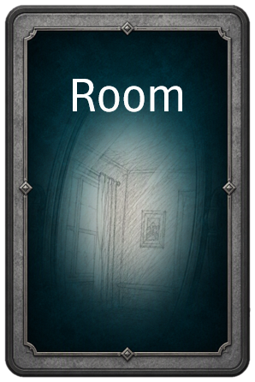

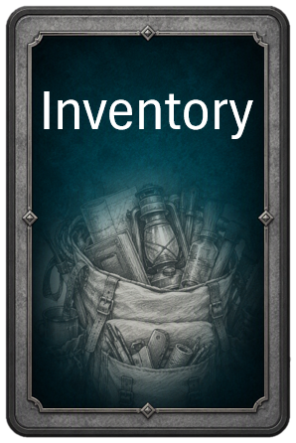

⚙️
Emilia (You)
Molly
The Backroom
This room is a bit stinky…
Go upstairs
Go outside
Inspect
...
Notes:
Main View, Favorite Core Cards, and Equipped Cards
Select ‘>’ to expand the Core Cards, group the Equipped Cards

Slide 3
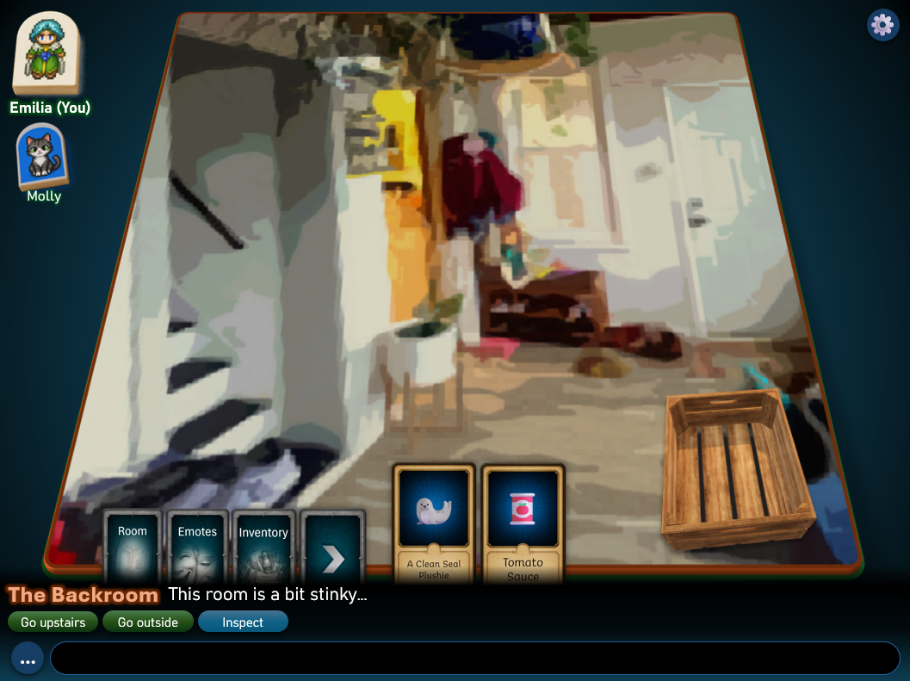
Peeps List
Room View
Card View
Look Bar
Quick Actions
Chat Bar

Slide 4

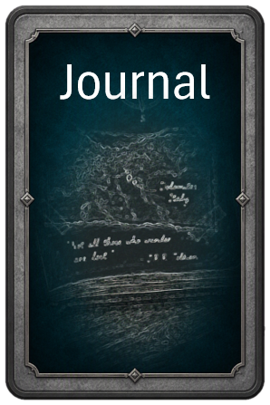
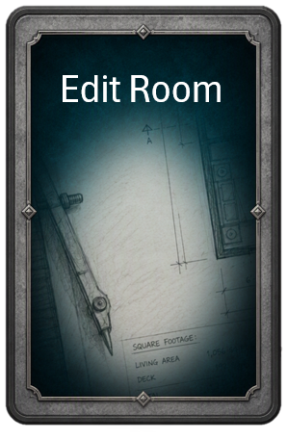
⚙️
Emilia (You)
Molly
The Backroom
This room is a bit stinky…
Go upstairs
Go outside
Inspect
...
Notes:
Expanding the Core Cards

Slide 5
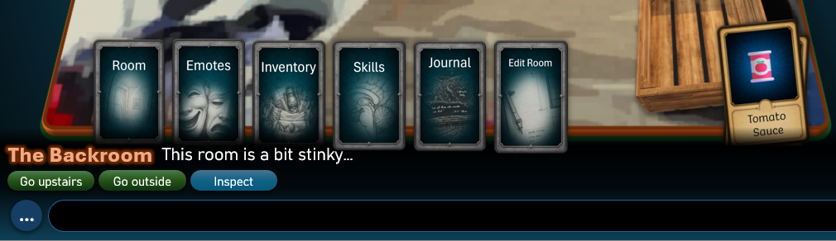
Expanded Core Cards
Equipped Cards (stashed)
Notes:
Expanded Core Cards

Slide 6
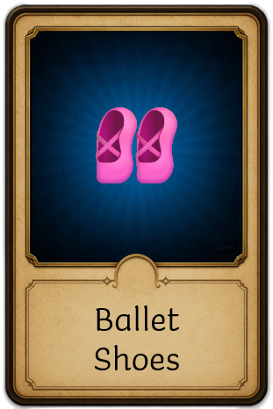

⚙️
You see these in The Backroom:
Emilia (You)
Molly
The Backroom
This room is a bit stinky…
Go upstairs
Go outside
Inspect
...
Notes:
Room Cards

Slide 7
⚙️
You see these in The Backroom:
Emilia (You)
Molly
Ballet Shoes
For the power dancer.
Pick Up
Inspect
...
Notes:
Room Cards – Selecting a Card

Slide 8
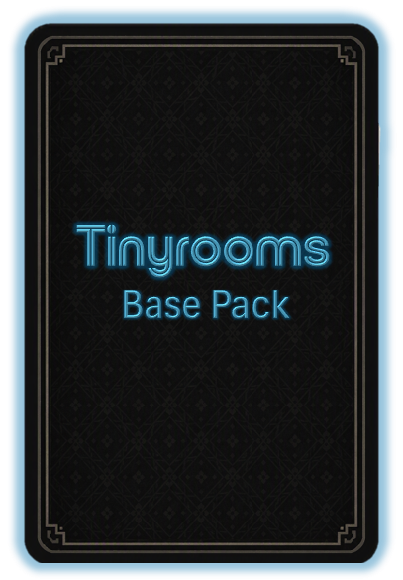

⚙️
You see these in The Backroom:
Emilia (You)
Ballet Shoes
For the power dancer
Molly
This is an item. It’s made of fabric. It’s pink and worth 2 bops.
When Equipped:
+1 Charisma, +2 Fanciness.
COMMON
Ballet Shoes
For the power dancer.
Pick Up
Inspect
...
Notes:
Card Details (Inspect)

Slide 9

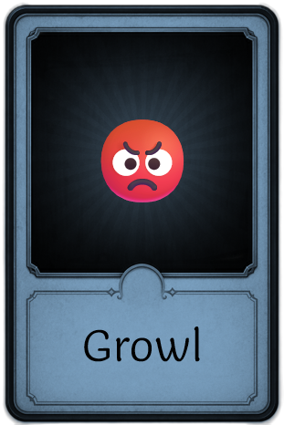


⚙️
Emotes: Expressions
Emilia (You)
Molly
Ballet Shoes
For the power dancer.
Pick Up
Inspect
...
Notes:
Emotes Screen

Slide 10
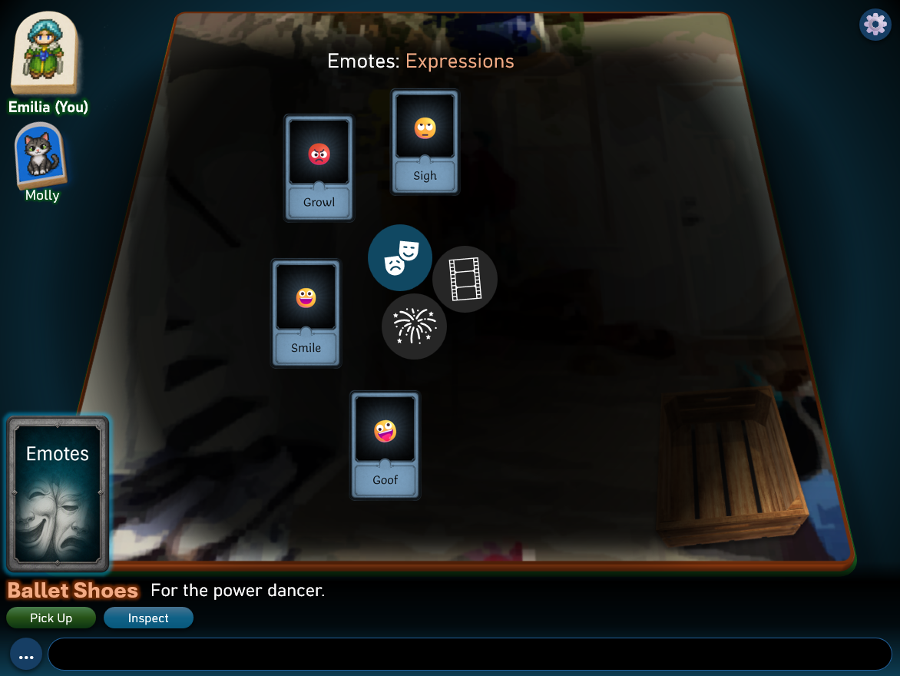
Emote Cards
Emote Categories

Slide 11
😀
⚙️
Meow. Meow
meo
mememeow,
purrrrr.
Emilia (You)
Molly
The Backroom
This room is a bit stinky…
Go upstairs
Go outside
Inspect
...
Notes:
Used Emote and Chat. Chat bubbles disappear when user ‘pops’ them.

Slide 12

⚙️
Emilia (You)
Molly
Molly
A small cat with the Zoomies.
Pet
Play
Chat
...
Notes:
Peep Selection

Slide 13

⚙️
Activity Window
Lazor Rush!
Round 3: 12s (record: 35s)
x
Emilia (You)
Move the laser pointer before Molly catches it!
Molly
Molly
A small cat with the Zoomies.
Pet
Play
Chat
...
Notes:
Activity: kitty play

Slide 14
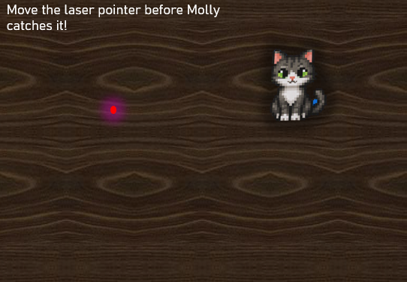

Slide 15


⚙️
Emilia (You)
Molly
Litter Box
A world of surprises awaits.
Smell
Clean up
Inspect
...
Notes:
Prop Selection. Some actions may be disabled if the user does not have the right cards on hand.

Slide 16
⚙️
Emilia (You)
Use Soup Can on Molly
Molly
Tomato Sauce
Soup in a can
Use
...
Notes:
Card target selection

Slide 17
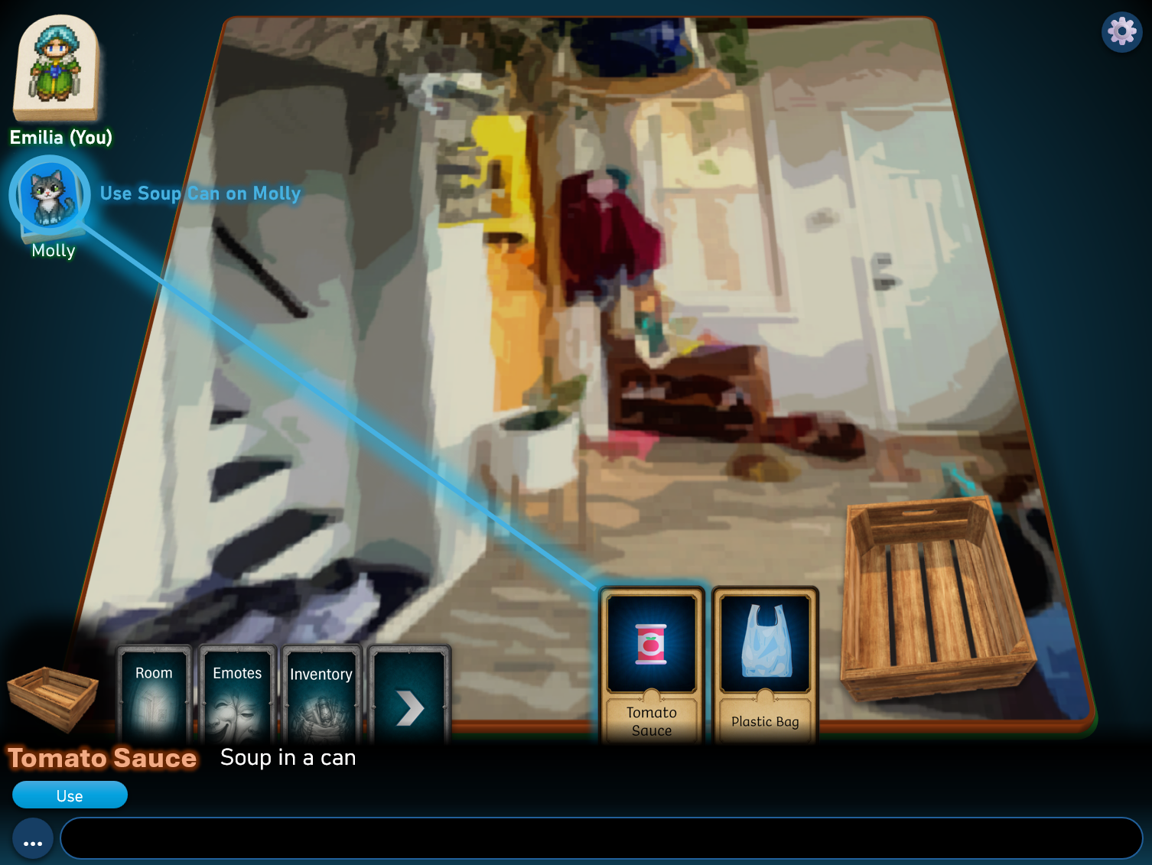

Slide 18

⚙️
🤢That was not a good idea…
Cleanliness -1
Emilia (You)
Molly
Litter Box
A world of surprises awaits.
Smell
Clean up
Inspect
...
Notes:
Prop Action (smell), Effect Notification

Slide 19
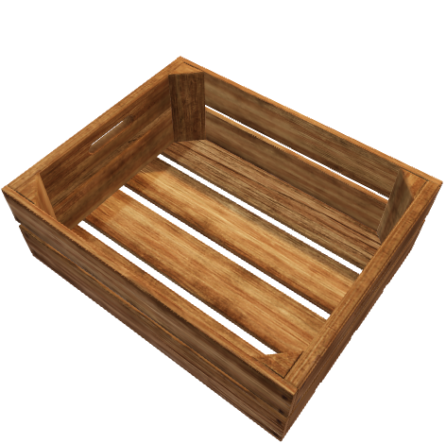
⚙️
Litter Box
A world of surprises awaits. You need a scooper to clean it up.
Emilia (You)
Molly
Litter Box
A world of surprises awaits.
Smell
Clean up
Inspect
...
Notes:
Prop Inspect

Slide 20
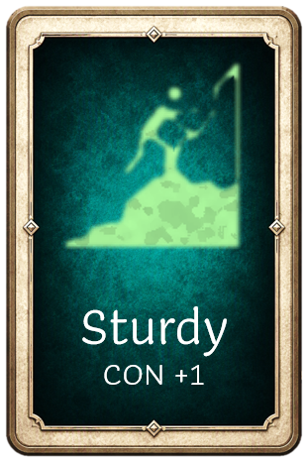

⚙️
Choose Your Skills Level 1 – 1/2 available
Rank
Emilia (You)
C
Script Kiddo
Molly
B
Hacker
A
Leet
Sturdy
You are never tired. Constitution +1
Remove
Inspect
...
Notes:
Skills Screen

Slide 21
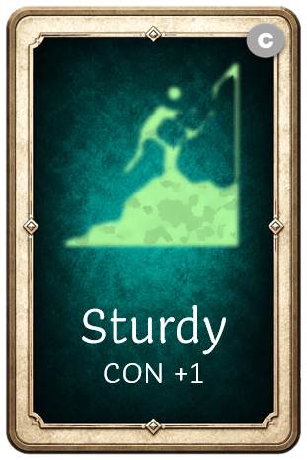




⚙️
Inventory - 🪙 122 Bops
Emilia (You)
All
Skills
Emotes
Items
Sort: Equipped
Molly
5️⃣
Ballet Shoes
For the power dancer.
Pick Up
Inspect
...
Notes:
Inventory Screen

Slide 22
⚙️
Emilia
You are Stinky, Tired
🫩🐷
Emilia (You)
Level 2
5 Kudos
to Next Level
Constitution: ⭐⭐
Fanciness: ⭐⭐⭐
Dexterity: 🌟⭐
Charisma: ⭐⭐⭐⭐
Molly
Health
100
Energy
5
Cleanliness
1
Concentration
300
Emilia
This is you. Level 2.
Self
Swap Sticker
...
Notes:
Inventory Screen

Slide 23
⚙️
Emilia’s Journal
Emilia (You)
Tasks
Memories
Show Completed
Clean the litterbox
💩
Leave the house
Get to level 2! 🤓
Molly
Leave the House
The doors are all locked…
Memories..
...
Notes:
Journal

Slide 24
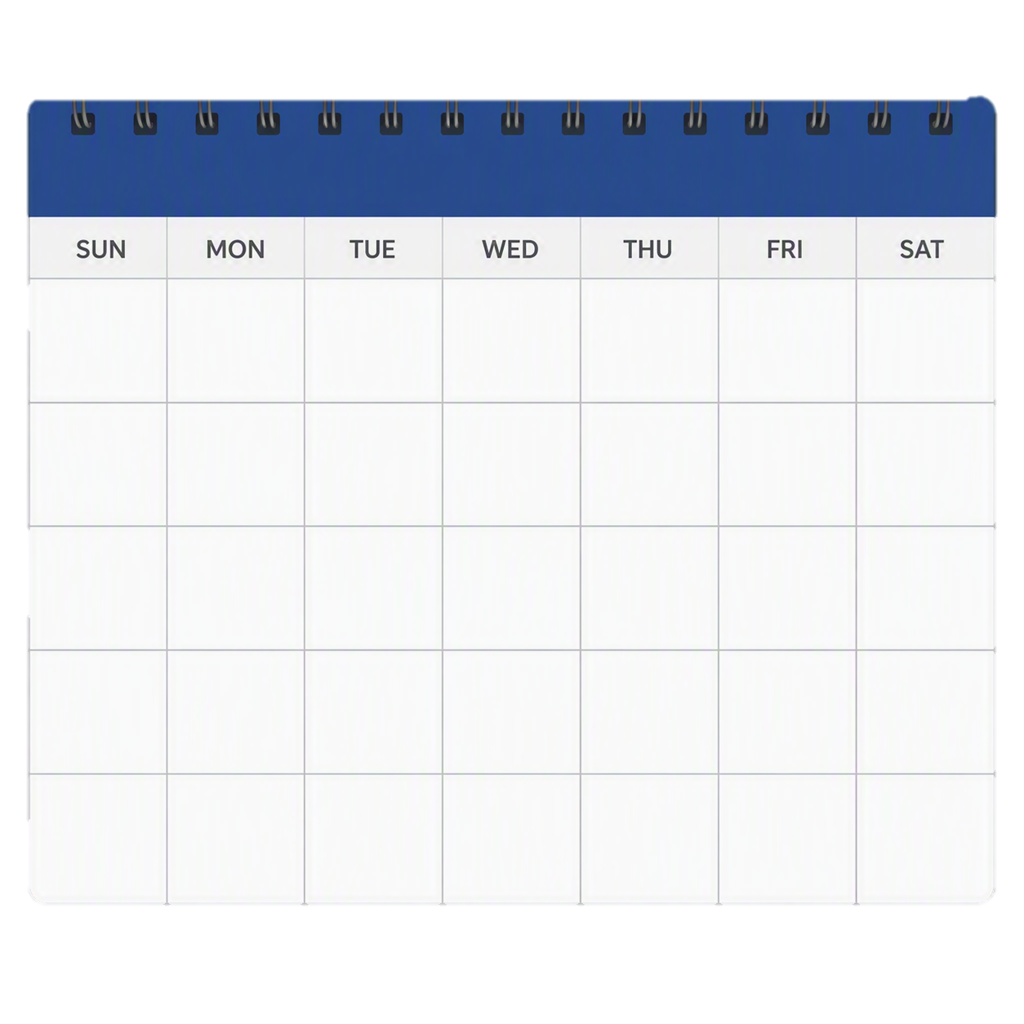
⚙️
Emilia’s Journal: Memories
Emilia (You)
Tasks
Memories
Filter: None
August 2026
New Cards: 10 ⭐record!
New Peeps: 1
Done Tasks: 0
2
Molly
1
4
August 5th: I met Molly! I need to clean the litter box.
August 12th: If I want to clean the litter box I must leave the house, but the doors are locked! I found maybe the keys are in the basement….
August 2026 Memories
Hint: Click new memory to register the current chat message as a memory
New Memory
...
Notes:
Journal

