Slide 1
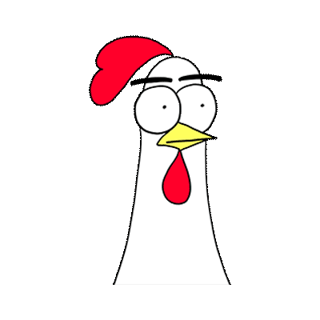
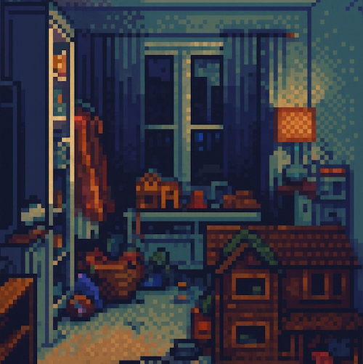

Babbo Happy, Tired, Hungry | 🗺️ World Info
Line 1
Line 2
Emilia says: hi! 😊
The Playroom
🪑a chair (3) 🪞a mirror ♨️ large fireplace
🧍‍♂️Emilia🧍‍♂️Babbo🧍Isy🧍‍♀️stranger🧙wizard🧜‍♀️mermaid
Exits: 🔼Upstairs 🪜downstairs
Look at (this box shows description of current selected action or other hints. Can be disabled.
@emi Hey hello!

