Slide 1
Local traffic-safety digital twin
SUMO-Cesium
traffic-safety digital twin
A local prototype that replays SUMO traffic simulation results in an interactive CesiumJS map.
SUMO outputs
Network, trajectories, TTC and braking events
CesiumJS dashboard
Localhost first. No Docker. No private Cesium token.
Local SUMO data: Data/Nanke/project/High precision
1

Slide 2
The idea is to make simulation results spatial and inspectable
Instead of reading XML files, users replay traffic movement on the road network and jump directly to events.
SUMO produces the run
The API prepares results
Cesium makes it visible
Vehicle movement, routes, collisions, trip information and SSM safety measures.
Local coordinates are converted to WGS84 and served as compact JSON.
Vehicles, roads, TTC markers, charts and event tables are synchronized.
The value is not visual realism. The value is faster inspection of where and when simulated risk appears.
Local SUMO data: Data/Nanke/project/High precision
2

Slide 3
Your Data folder is now one input to the workflow
The current prototype can load already-generated SUMO outputs, so the dashboard uses your Nanke project data.
1
2
3
4
5
Local Data folder
>
Coordinate conversion
>
Result import
>
FastAPI
>
Cesium playback
Network, route, FCD, SSM, collisions and tripinfo files
SUMO projection metadata is used to convert x/y into lon/lat
Trajectories, safety events and summaries are written into run storage
The browser receives JSON rather than raw SUMO XML
Vehicles and safety markers are replayed in the map
Imported dataset: Data/Nanke/project/High precision
The original Chinese folder name is kept in the app as Nanke / project / 高精.
Local SUMO data: Data/Nanke/project/High precision
3

Slide 4
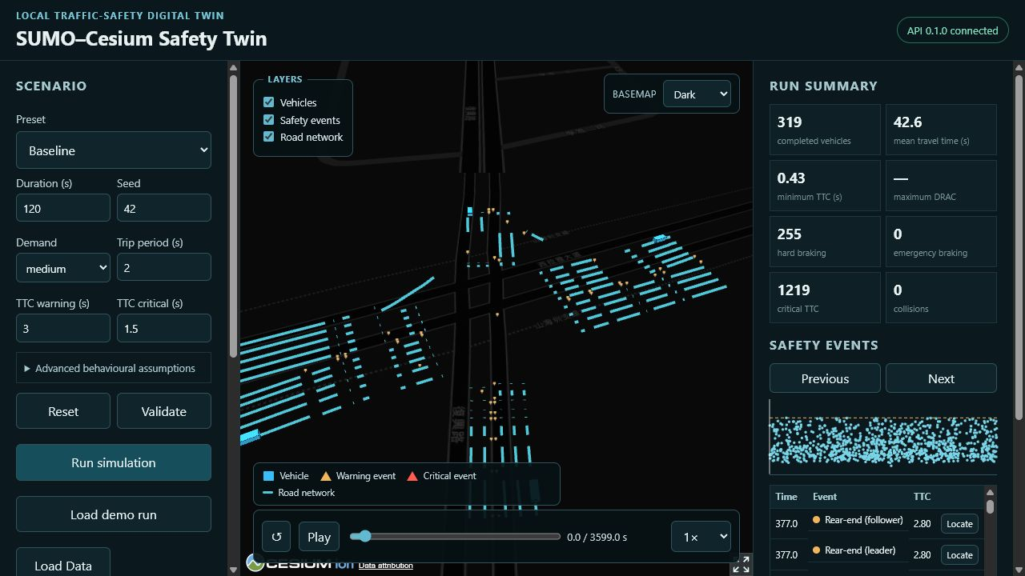
The dashboard combines scenario setup, Cesium playback and event review
This live capture shows the imported Nanke run loaded from the local Data folder.
Scenario setup
Controls the next run or documents the imported run.
Map view
Shows roads, moving vehicles, event markers and basemap.
Playback
Plays, pauses, scrubs and changes replay speed.
Results
Summarizes TTC, braking, collisions and event details.
Local SUMO data: Data/Nanke/project/High precision
4

Slide 5
Each dashboard menu has a specific review function
The menu guide helps non-technical viewers understand what each control is for.
Scenario panel
Layers and basemap
Select preset, duration, seed, demand, trip period and TTC thresholds.
Turn vehicles, safety events and road network on or off; switch the basemap style.
Advanced behavioural assumptions
Playback bar
Adjust car-following assumptions such as tau, decel, emergency decel and step length.
Restart, play, scrub the time slider and choose replay speed.
Reset, validate and run
Run summary
Reset values, check whether inputs are valid, then create a new SUMO simulation run.
Read completed vehicles, mean travel time, minimum TTC, braking and collisions.
Load demo run and Load Data folder
Safety events and selected vehicle
Open prepared runs or import the local Data folder outputs for replay.
Jump to events, locate them on the map, and inspect selected-vehicle speed and acceleration.
Local SUMO data: Data/Nanke/project/High precision
5

Slide 6
The imported Nanke run gives a concrete first playback dataset
These numbers come from the local run now loaded in the dashboard.
1,951
319
0.43 s
1,219
255
generated and routed vehicles
completed vehicles
minimum observed TTC
critical TTC events
hard-braking events
How to read this slide
The run is useful for visualization and exploratory review. It is not a calibrated traffic-engineering model, and the summary should be treated as evidence to inspect rather than a decision result.
Local SUMO data: Data/Nanke/project/High precision
6

Slide 7
The dashboard matches the source data for the main playback metrics
The comparison checks dashboard values against the original SUMO files in Data/Nanke/project/High precision.
Metric
Source folder
Dashboard
Result
Vehicles in FCD playback
1,951
1,951
Match
FCD trajectory samples
82,600
82,600
Match
Completed vehicles
319
319
Match
Mean travel time
42.58 s
42.58 s
Match
Minimum TTC
0.43 s
0.43 s
Match
Critical TTC events
1,219
1,219
Match
Collision records also match: source 0, dashboard 0.
Local SUMO data: Data/Nanke/project/High precision
7

Slide 8
The differences are processing choices, not a different dataset
The dashboard converts raw SUMO outputs into review-ready metrics, so a few values are not one-to-one raw counts.
Route demand
SSM conflicts
Braking events
Map features
random.rou.xml implies 2,405 nominal vehicles, but the dashboard counts the 1,951 vehicles that actually appear in fcd.xml.
ssm.xml has 2,706 conflict records. The dashboard shows 2,705 because one overlapping warning event is deduplicated.
There is no raw braking XML. The dashboard derives 255 hard-braking events and 0 emergency-braking events from FCD movement.
The source network has edges and lanes; the dashboard shows 228 GeoJSON display features for Cesium.
Best conclusion: the dashboard uses the local Nanke data, and the small differences come from import logic that makes the raw SUMO files easier to inspect.
Local SUMO data: Data/Nanke/project/High precision
8

Slide 9
Changing parameters changes either the run or the way it is read
For imported Data-folder runs, the dashboard shows existing files. For a new run, these values become part of the SUMO scenario.
Existing imported run
New simulation controls
Interpretation controls
Replays existing SUMO files. Parameter edits do not rewrite that result.
Duration, seed, trip period, tau, decel and step length affect the next SUMO run.
TTC warning and critical values only change how close calls are labelled.
Best practice: keep the seed fixed when comparing one parameter change.
Local SUMO data: Data/Nanke/project/High precision
9

Slide 10
The strongest scenario levers are demand, following gap and event thresholds
These controls are useful for exploring sensitivity, not for calibrated prediction.
Trip period
Tau
Emergency decel
TTC thresholds
Lower period inserts vehicles more often, which usually raises congestion, delay and close-call counts.
Lower tau reduces desired following time. Vehicles follow closer, so TTC warnings can increase.
In the braking preset, stronger emergency decel creates a sharper lead-vehicle stop and follower response.
Higher warning or critical thresholds classify more events; lower thresholds make the event list stricter.
Duration controls how long the simulation runs. Seed controls the random trip pattern. Step length controls simulation resolution and runtime.
Read parameter experiments as controlled what-if tests, not real-world safety forecasts.
Local SUMO data: Data/Nanke/project/High precision
10

Slide 11
TTC helps locate close calls, but it is still a surrogate measure
The safety layer is a screening tool for visual analysis, not an operational road-safety judgement.
TTC
DRAC
Braking events
Time-to-collision estimates how soon two vehicles would conflict if current motion continued.
Deceleration rate to avoid crash can add severity context when the output is available.
Hard braking is derived from trajectory acceleration and shown as another inspection cue.
Interpretation boundary
OSM network properties may be inferred, demand is synthetic, driver behavior is simulated, and TTC thresholds are analysis choices.
Local SUMO data: Data/Nanke/project/High precision
11

Slide 12
Future work can make the prototype a richer urban-environment twin
The next step is to add visual context and environmental indicators while keeping the safety limitations clear.
Low-poly cars
Buildings
Environment effects
SUMO backend
Use lightweight 3D car models instead of simple markers, without hurting playback performance.
Add building footprints or extruded 3D buildings to review events in urban context.
Represent weather, lighting, visibility and road-surface assumptions as scenario inputs.
Add emissions, energy, noise and exposure indicators for environmental review.
The visual upgrades make the replay easier to understand. The backend upgrades make each scenario more useful for comparing safety and environmental trade-offs.
These additions improve interpretation, but the model still needs validation before operational use.
Local SUMO data: Data/Nanke/project/High precision
13

Slide 13
ODD theory becomes useful when it is converted into scenario controls
The ODD paper frames risk through road environment, traffic context, road users, behavior models and scenario demand.
ODD / scenario basis
Dashboard control
How it would be implemented in SUMO
Road-environment limitation and situation demand
Traffic volume
Demand flows, departure rate, peak-period factor and route mix for low, medium and crowded conditions.
Road structure, junctions and traffic-control devices
Signal phase
Traffic-light programs, phase length, offsets and red-light timing for junction safety experiments.
Road users and behavior models
Motorcycle behavior
Motorcycle vehicle type, lateral movement, lane filtering, following gap and mixed-traffic interaction rules.
Scenario demand and behavior-assumption stressors
Driving error rate
Controlled probability of reaction mistakes, gap-judgement errors, red-light violations or risky maneuvers.
Paper basis: Czarnecki, Operational Design Domain for Automated Driving Systems: Taxonomy of Basic Terms, 2018; NHTSA ADS testable scenarios framework, 2018.
Local SUMO data: Data/Nanke/project/High precision
12

