Slide 1
House Value Prediction Using the Ames Assessor’s Office Data
A Case Study Using Linear Regression Analysis in R Boyko Amarov

Slide 2
Introduction
The Ames Assessor’s Office dataset provides detailed information about residential properties in Ames, Iowa between 2006 and 2010. https://jse.amstat.org/v19n3/decock/DataDocumentation.txt
The dataset contains 2930 observations and 82 variables.
In this presentation we explore a linear regression model for the prediction of house sales prices based on various features of the properties.

Slide 3
Research Question
What is the association between house sales prices and the following features of the properties?
Living area (in square feet)
Lot area (in square feet)
Year built (in years)

Slide 4
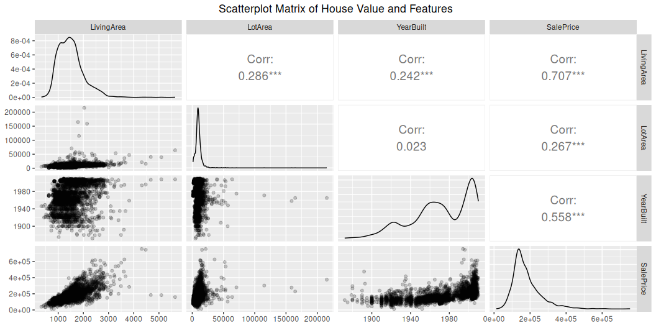
The Data

Slide 5
The Model
$$\begin{matrix}{\text{Price}}_{i} & =β_{0}+β_{1}{\text{LivingArea}}_{i}+β_{2}{\text{LotArea}}_{i}+β_{3}{\text{YearBuilt}}_{i}+e_{i}\end{matrix}$$
where $e_{i}$ are zero-mean, uncorrelated random terms with constant variance $σ^{2}$.
The model is estimated using the method of least squares.
The predictors are centered by subtracting their mean to improve the interpretability of the coefficients.
The sales price is divided by 1000 to avoid large coefficients.

Slide 6
Results
Variable | Estimate | Std. Error | p value
(Intercept) | 180.796 | 0.852 | 0
LivingAreaC | 0.092 | 0.002 | 0
LotAreaC | 0.001 | 0.000 | 0
YearBuiltC | 1.099 | 0.029 | 0

Slide 7
R squared: 0.6666943

Slide 8
Alternative Output
If you encounter difficulties with the table from the previous slide, just run the code below to get the summary of the model and paste it in your PowerPoint presentation.
Call: lm(formula = SalesPriceC ~ LivingAreaC + LotAreaC + YearBuiltC, data = dt) Residuals: Min 1Q Median 3Q Max -490.53 -25.99 -2.58 18.31 308.09 Coefficients: Estimate Std. Error t value Pr(>|t|) (Intercept) 1.808e+02 8.525e-01 212.082 < 2e-16 *** LivingAreaC 9.169e-02 1.816e-03 50.502 < 2e-16 *** LotAreaC 9.243e-04 1.130e-04 8.177 4.28e-16 *** YearBuiltC 1.099e+00 2.909e-02 37.781 < 2e-16 *** --- Signif. codes: 0 '***' 0.001 '**' 0.01 '*' 0.05 '.' 0.1 ' ' 1 Residual standard error: 46.14 on 2926 degrees of freedom Multiple R-squared: 0.6667, Adjusted R-squared: 0.6664 F-statistic: 1951 on 3 and 2926 DF, p-value: < 2.2e-16

Slide 9
Interpretation (I)
The estimated sales price for a house with an average year built, average lot area, and average living area is 180,796 USD.
Newer houses tended to be more expensive. A difference of 10 years is associated with about 10,990 USD price difference (for equal lot area and living area).
As expected: larger houses tend to be more expensive. A difference of 100 square feet is associated with about 9,200 USD higher price (for equal lot area and year built).

Slide 10
Interpretation (II)
Houses with larger lot areas tend to be more expensive.
All coefficients are statistically significant at the 0.05 level.

Slide 11
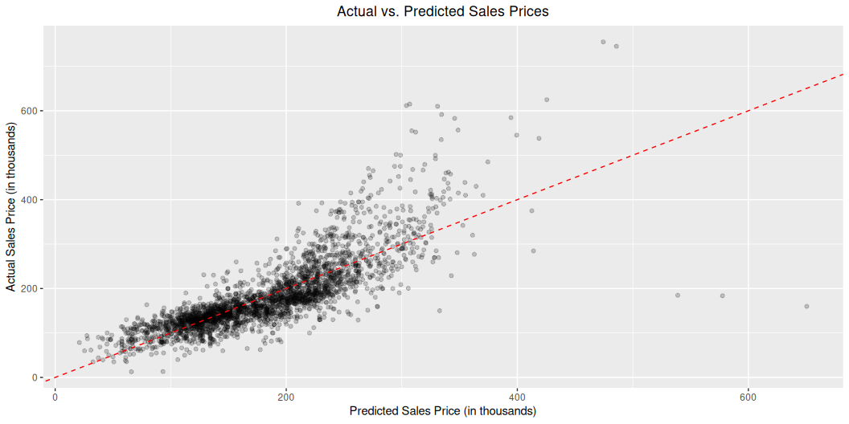
Goodness of Fit

Slide 12
Last Slide
Thank you for your attention!

