Slide 1
Modeling of the Electricity Spot Prices Using the Skew-Normal Distribution

Slide 2
The Case
This example shows how to simulate the future behavior of electricity spot prices from a time series model fitted to historical data.
Because electricity spot prices can exhibit large deviations, the example models the innovations using a skew-normal distribution.
The data set in this example contains daily electricity spot prices from January 1, 2010 through November 11, 2013.

Slide 3
Case Overview
The price of electricity is associated with the corresponding demand.
Changes to population size and technological advancements suggest that electricity spot prices have a long-term trend.
Also, given the climate of a region, the demand for electricity fluctuates according to the season.
Consequently, electricity spot prices fluctuate similarly, suggesting the inclusion of a seasonal component in the model.

Slide 4
Case Overview
During periods of high demand, spot prices can exhibit jumps when technicians supplement the current supply with power generated from less efficient methods.
These periods of high demand suggest that the innovations distribution of the electricity spot prices is right skewed rather than symmetric.

Slide 5
Steps for Creation
Determine whether the spot price series has exponential, long-term deterministic, and seasonal trends by inspecting its time series plot and performing other statistical tests.
If the spot price series exhibits an exponential trend, remove it by applying the log transform to the data.
Assess whether the data has a long-term deterministic trend. Identify the linear component using linear regression. Identify the dominant seasonal components by applying spectral analysis to the data.

Slide 6
Steps for Creation
Perform stepwise linear regression to estimate the overall long-term deterministic trend. The resulting trend comprises linear and seasonal components with frequencies determined by the spectral analysis. Detrend the series by removing the estimated long-term deterministic trend from the data.
Specify and estimate an appropriate autoregressive, moving average (ARIMA) model for the detrended data by applying the Box-Jenkins methodology.
Fit a skew-normal probability distribution to the standardized residuals of the fitted ARIMA model. This step requires a custom probability distribution object created using the framework available in Statistics and Machine Learning Toolbox™.

Slide 7
Steps for Creation
Simulate spot prices. First, draw an iid random standardized residual series from the fitted probability distribution from step 6. Then, back-transform the simulated residuals by reversing steps 1–5.

Slide 8
Trends Determination

Slide 9
Trends Determination
The spot prices exhibit:
Large spikes, which are likely caused by periods of high demand
A seasonal pattern, which is likely caused by seasonal fluctuations in demand
A slight downward trend
The presence of an exponential trend is difficult to determine from the plot.

Slide 10
Remove Exponential Trend

Slide 11
Remove Exponential Trend
The p-value is close to 0, suggesting that the monthly statistics are significantly positively correlated.
This result provides evidence of an exponential trend in the spot price series.

Slide 12
Remove Exponential Trend

Slide 13
Long-Term Deterministic Trend

Slide 14
Identify Seasonal Components of the Long-Term Trend
Remove the linear trend from the log spot prices.
Apply the Fourier transform to the result.
Compute the power spectrum of the transformed data and the corresponding frequency vector.

Slide 15
Identify Seasonal Components of the Long-Term Trend

Slide 16
Identify Seasonal Components of the Long-Term Trend
The dominant seasonal components correspond to 6-month and 12-month cycles.

Slide 17
Fit Long-Term Deterministic Trend
By combining the dominant seasonal components, estimated by the spectral analysis, with the linear component, estimated by least squares, a linear model for the log spot prices can have this form:
LogPrice=β0+β1t+β2sin(2πt)+β3cos(2πt)+β4sin(4πt)+β5cos(4πt)+ξt,
t is years elapsed from the start of the sample.
ξt∼N(0,τ2) is an iid sequence of random variables.
β2 and β3 are the coefficients of the annual components.
β4 and β5 are the coefficients of the semiannual components.

Slide 18
Fit Long-Term Deterministic Trend
The sine and cosine terms in the model account for a possible phase offset. That is, for a phase offset θ:
Asin(ft+θ)=(Acosθ)sinft+(Asinθ)cosft=Bsinft+Ccosft,
where B=Acosθ and C=Asinθ are constants.
Therefore, the inclusion of sine and cosine terms with the same frequency accounts for a phase offset.
Stepwise regression is used to select the important predictors.

Slide 19
Fit Long-Term Deterministic Trend
Estimated Coefficients:
Estimate SE tStat pValue
_________ _________ _______ __________
(Intercept) 3.8617 0.014114 273.6 0
t -0.073594 0.0063478 -11.594 9.5312e-30
cos(2*pi*t) -0.11982 0.010116 -11.845 6.4192e-31
sin(4*pi*t) 0.047563 0.0099977 4.7574 2.1629e-06
cos(4*pi*t) 0.098425 0.0099653 9.8768 2.7356e-22
Number of observations: 1411, Error degrees of freedom: 1406
Root Mean Squared Error: 0.264
R-squared: 0.221, Adjusted R-Squared: 0.219
F-statistic vs. constant model: 99.9, p-value = 7.15e-75

Slide 20
Fit Long-Term Deterministic Trend

Slide 21
Detrended Data
A detrended time series is formed by removing the estimated long-term deterministic trend from the log spot prices. In other words, extract the residuals from the fitted stepwise linear regression model.

Slide 22
Detrended Data

Slide 23
Detrended Data
The detrended data appears centered at zero, and the series exhibits serial autocorrelation because several clusters of consecutive residuals occur above and below y=0.
These features suggest that an autoregressive model is appropriate for the detrended data.
To determine the number of lags to include in the autoregressive model, apply the Box-Jenkins methodology. Plot the autocorrelation function (ACF) and partial autocorrelation function (PACF) of the detrended data in the same figure, but on separate plots.

Slide 24
Detrended Data

Slide 25
Detrended Data
The ACF gradually decays. The PACF exhibits a sharp cutoff after the first lag. This behavior is indicative of an AR(1) process.
ARIMA(1,0,0) (Gaussian Distribution):
Value StandardError TStatistic PValue
________ _____________ __________ ___________
Constant 0 0 NaN NaN
AR{1} 0.4818 0.024353 19.784 4.0787e-87
Variance 0.053497 0.0014532 36.812 1.1867e-296

Slide 26
Detrended Data

Slide 27
Detrended Data

Slide 28
Detrended Data (Q-Q plot)

Slide 29
Detrended Data (Q-Q plot)
The residuals exhibit positive skewness because they deviate from normality in the upper tail.

Slide 30
Skewed Residual Series
The epsilon-skew-normal distribution is a near-normal distribution family with location theta, scale σ, and additional skewness parameter ε .
The skewness parameter models any nonzero skewness in the data.
If ε=0, the epsilon-skew-normal distribution reduces to the normal distribution.

Slide 31
Skewed Residual Series
EpsilonSkewNormal distribution
theta = -0.421946
sigma = 0.972487
epsilon = -0.286248

Slide 32
Skewed Residual Series
Estimated parameter standard errors:
Parameter StandardError
___________ _____________
{'theta' } 0.0638
{'sigma' } 0.035606
{'epsilon'} 0.037877

Slide 33
Skewed Residual Series

Slide 34
Goodness of Fit
the goodness of fit of the epsilon-skew-normal distribution :
Compare the empirical and fitted (reference) cumulative distribution functions (cdfs).
Conduct the Kolmogorov-Smirnov test for goodness of fit.
Plot the maximum cdf discrepancy.

Slide 35
Goodness of Fit

Slide 36
Goodness of Fit
Kolmogorov-Smirnov test p-value is 0.85439.
The p-value of the test is large enough to suggest that the null hypothesis that the distributions are the same should not be rejected.

Slide 37
Goodness of Fit

Slide 38
Simulate Future Electricity Spot Prices
Simulate future electricity spot prices over the two-year horizon following the end of the historical data. Construct a model from which to simulate, composed of the estimated components of the time series:
Specify the dates for the forecast horizon.
Obtain simulated residuals by simulating standardized residuals from the fitted epsilon-skew-normal distribution, then scaling the result by the estimated instantaneous standard deviations.
Obtain simulated, detrended log prices by filtering the residuals through the fitted AR(1) model.

Slide 39
Simulate Future Electricity Spot Prices
Forecast values of the deterministic trend using the fitted model.
Obtain simulated log prices by combining the simulated, detrended log prices and the forecasted, deterministic trend values.
Obtain simulated spot prices by exponentiating the simulated log spot prices.

Slide 40
Simulated Paths

Slide 41
Simulated Paths
The Monte Carlo statistics is obtained from the simulated spot price paths by computing, for each time point in the forecast horizon, the mean and median, and the 2.5th, 5th, 25th, 75th, 95th, and 97.5th percentiles.

Slide 42
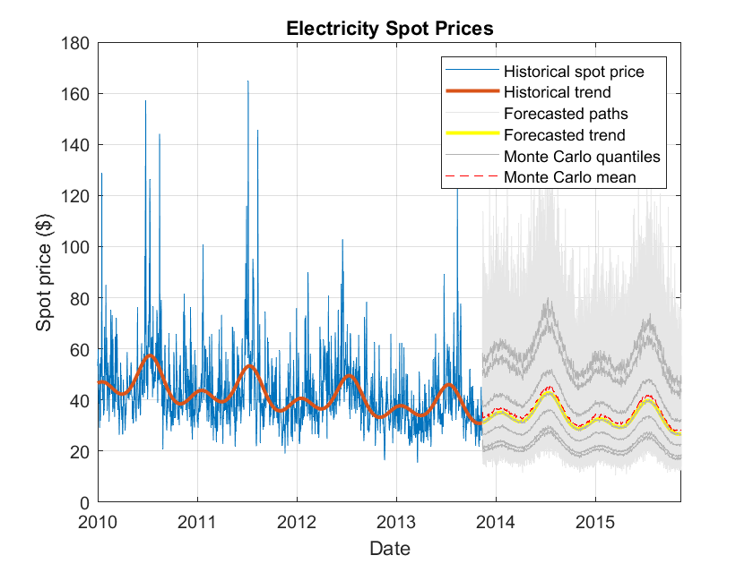
Simulated Paths

Slide 43
Simulated Paths
Assess whether the model addresses the large spikes exhibited in the historical data:
Estimate the monthly Monte Carlo moments of the simulated spot price paths.
Plot a line of best fit to the historical monthly moments.
Plot a line of best fit to the combined historical and Monte Carlo moments.
Visually compare the lines of best fit.

Slide 44
Simulated Paths

Slide 45
Simulated Paths
The simulated monthly moments are broadly consistent with the historical data.
The simulated spot prices tend to exhibit smaller spikes than the observed spot prices.
To account for larger spikes, you can model a larger right tail by applying extreme value theory in the distribution fitting step.
This approach uses an epsilon-skew-normal distribution for the residuals, but models the upper tail by using the generalized Pareto distribution.

Slide 46
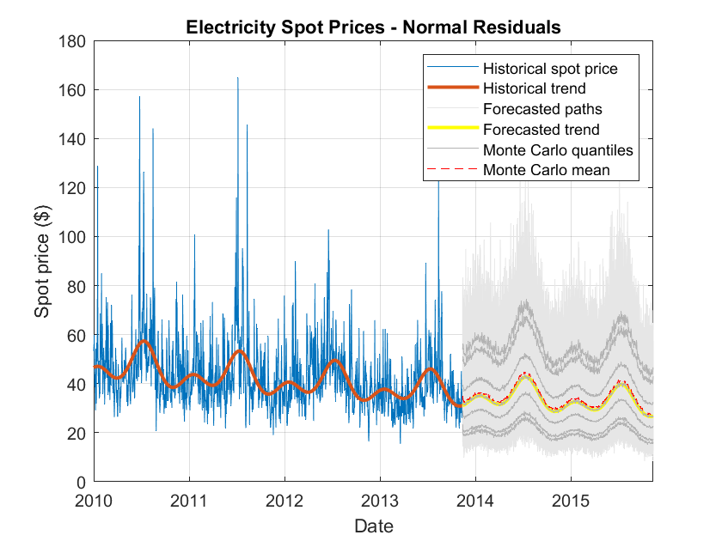
Compare Epsilon-Skew-Normal Results with Normal Distribution Assumption

Slide 47
Compare Epsilon-Skew-Normal Results with Normal Distribution Assumption

Slide 48
Compare Epsilon-Skew-Normal Results with Normal Distribution Assumption
Although the series of simulated maxima are correlated, the plot shows that the epsilon-skew-normal maxima are larger than the normal maxima.

