Slide 1

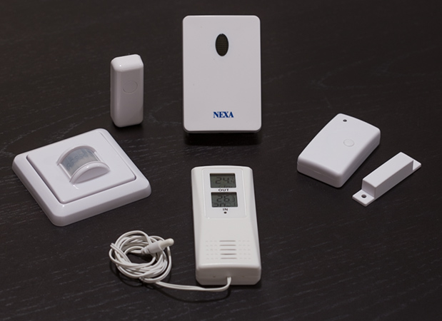
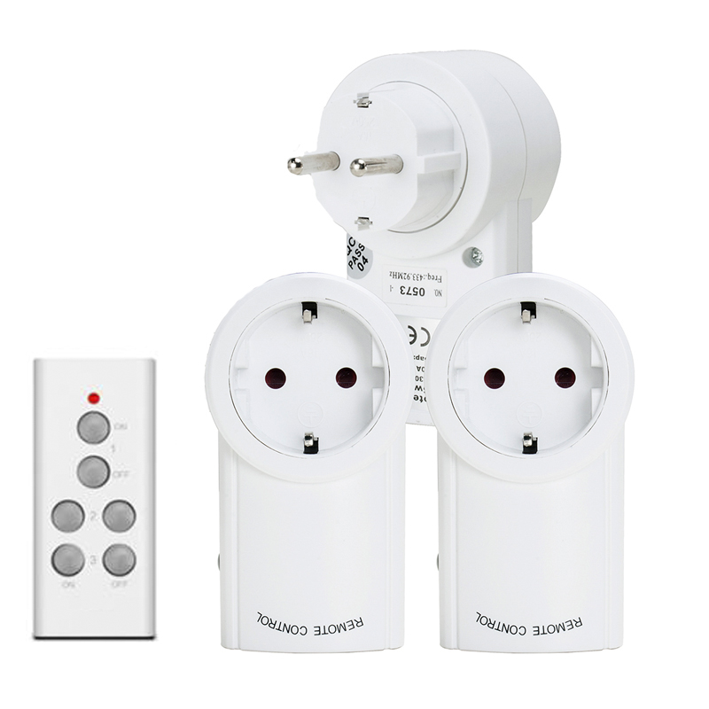

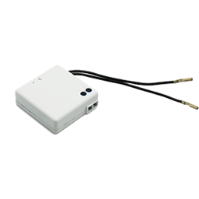
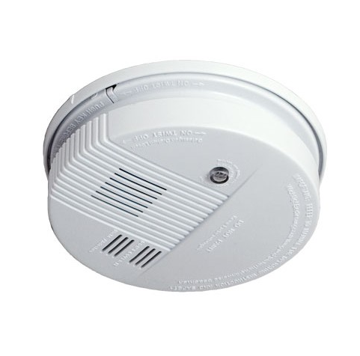


Connectivity
Typical 433mhz devices
Notes:
*Recently parts of the protocol became open source as of 2016: https://en.wikipedia.org/wiki/Z-Wave
**http://z-wave.sigmadesigns.com/wp-content/uploads/2016/08/Z-Wave-Security-White-Paper.pdf

Slide 2
Connectivity
433mhz is not the same as 433mhz…
• 433.42 mhz = RTS, specific brand Somfy
• 433.92 mhz = Standard, mostly used
Used in the USA, Australia, Europe, China
Notes:
*Recently parts of the protocol became open source as of 2016: https://en.wikipedia.org/wiki/Z-Wave
**http://z-wave.sigmadesigns.com/wp-content/uploads/2016/08/Z-Wave-Security-White-Paper.pdf

Slide 3
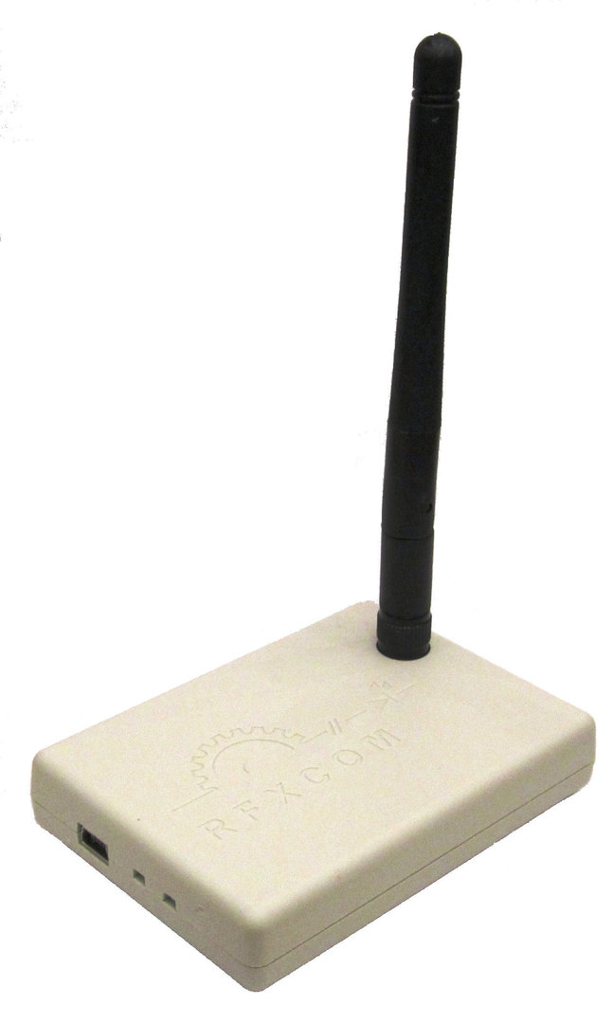
Connectivity
RFXCOM
• Made in the Netherlands
• CE certified
• Active firmware development
• High quality hardware
• Supports the largest set of devices
• Supported by all major
Home Automation systems
Notes:
*Recently parts of the protocol became open source as of 2016: https://en.wikipedia.org/wiki/Z-Wave
**http://z-wave.sigmadesigns.com/wp-content/uploads/2016/08/Z-Wave-Security-White-Paper.pdf

Slide 4
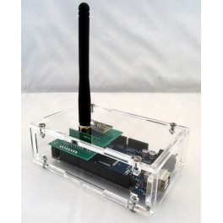
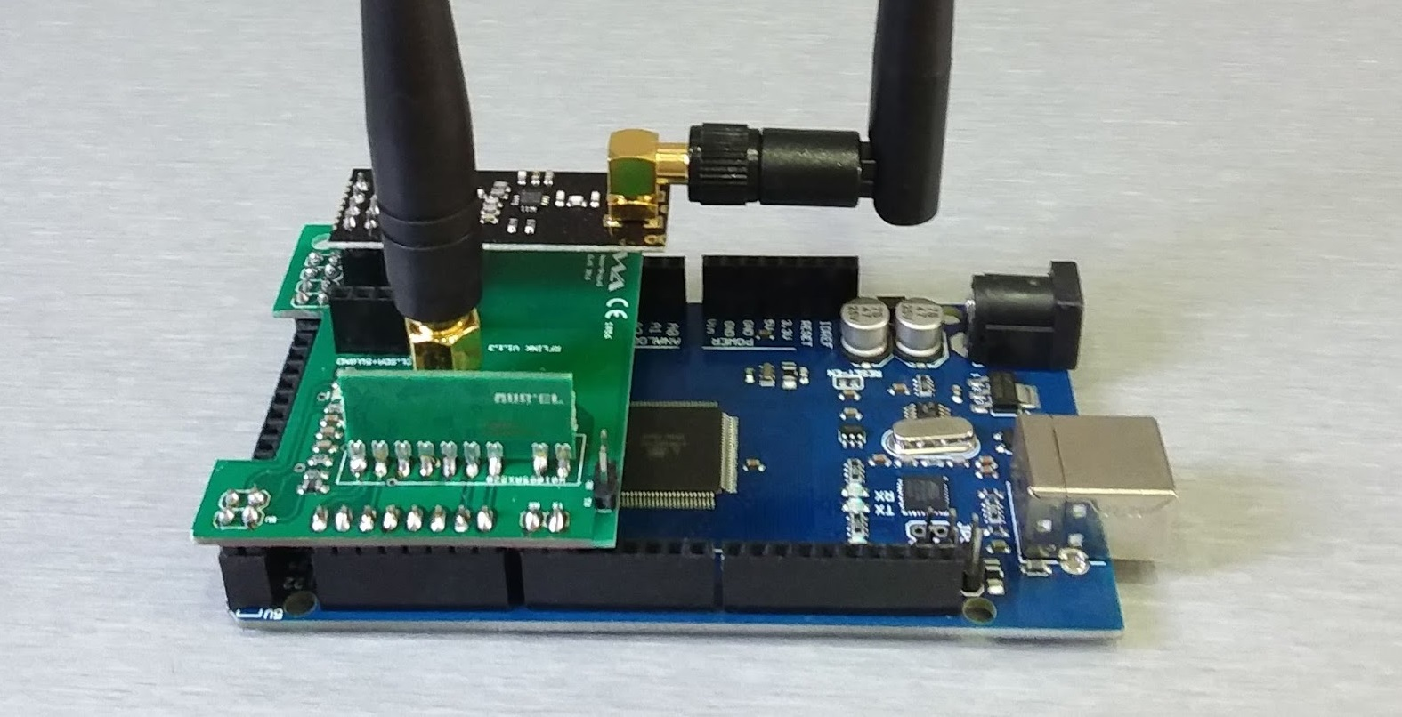
Connectivity
RFLink
• Made in the Netherlands
• Based on already available hardware
• Open-source
• More protocols than any other solution
• Multiple frequencies
(433mhz, 868mhz, 2.4Ghz)
• Multiple home automation platforms
• Less support for established brands
Notes:
*Recently parts of the protocol became open source as of 2016: https://en.wikipedia.org/wiki/Z-Wave
**http://z-wave.sigmadesigns.com/wp-content/uploads/2016/08/Z-Wave-Security-White-Paper.pdf

Slide 5
Connectivity
433 MHz Technology – Advantages
• Cheap end-devices
• Lower Frequency than other modules
• Operating at 315-434 MHz (mostly just 433Mhz)
• Low power and very low data rates (6.9 Kbps)
• One channel, modulation: ASK
• Good range, covers distance 300 meters (outdoor)
• Crowded spectrum (lots of interference)
Notes:
*Recently parts of the protocol became open source as of 2016: https://en.wikipedia.org/wiki/Z-Wave
**http://z-wave.sigmadesigns.com/wp-content/uploads/2016/08/Z-Wave-Security-White-Paper.pdf

Slide 6

Connectivity
433 MHz Technology – Disadvantages
• Cheap, mostly inferior quality technology
• RFXCOM is relative expansive
• RFLink alternative is cheaper…
• Crowded spectrum (lots of interference)
• No feedback
• Not reliable
Notes:
*Recently parts of the protocol became open source as of 2016: https://en.wikipedia.org/wiki/Z-Wave
**http://z-wave.sigmadesigns.com/wp-content/uploads/2016/08/Z-Wave-Security-White-Paper.pdf

Slide 7
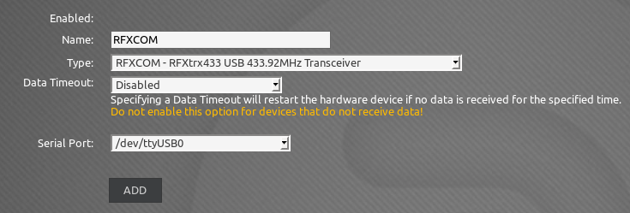
Connectivity
Connect the RFXCOM
• Connect the RFXCom to a free USB port
• Install it as a hardware device:
Notes:
*Recently parts of the protocol became open source as of 2016: https://en.wikipedia.org/wiki/Z-Wave
**http://z-wave.sigmadesigns.com/wp-content/uploads/2016/08/Z-Wave-Security-White-Paper.pdf

Slide 8
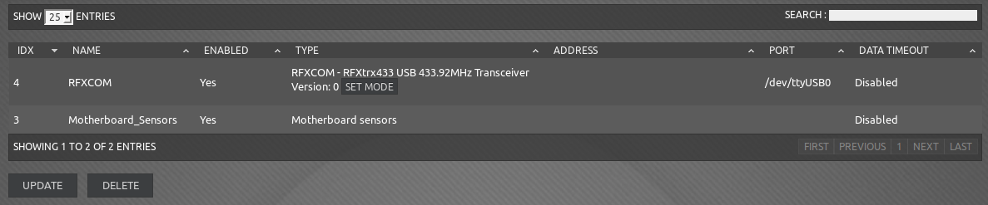
Connectivity
RFXCOM Connected
• Click on SET MODE to configure
Notes:
*Recently parts of the protocol became open source as of 2016: https://en.wikipedia.org/wiki/Z-Wave
**http://z-wave.sigmadesigns.com/wp-content/uploads/2016/08/Z-Wave-Security-White-Paper.pdf

Slide 9
Connectivity
Configure supported protocols / devices
• Click on SET MODE to configure
Notes:
*Recently parts of the protocol became open source as of 2016: https://en.wikipedia.org/wiki/Z-Wave
**http://z-wave.sigmadesigns.com/wp-content/uploads/2016/08/Z-Wave-Security-White-Paper.pdf

Slide 10
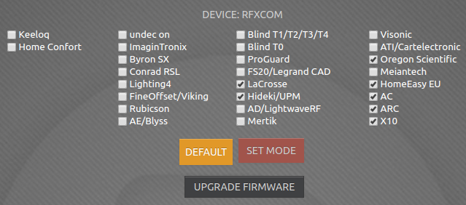
Connectivity
Configure supported protocols / devices
• Selected your desired protocols
(you can always change this)
Notes:
*Recently parts of the protocol became open source as of 2016: https://en.wikipedia.org/wiki/Z-Wave
**http://z-wave.sigmadesigns.com/wp-content/uploads/2016/08/Z-Wave-Security-White-Paper.pdf

Slide 11
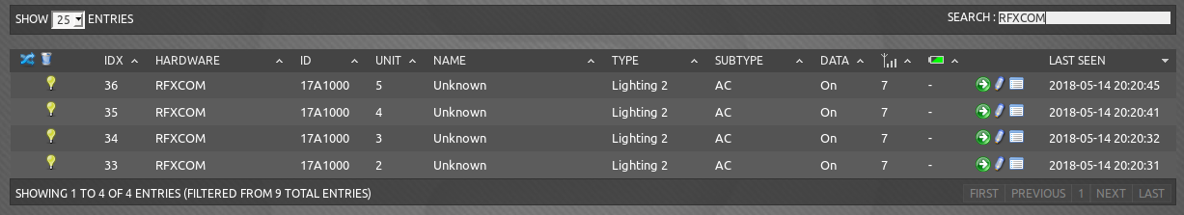
Connectivity
New devices being detected
& automatically added (in disabled state)
LAST SEEN = YOUR BEST FRIEND
Notes:
*Recently parts of the protocol became open source as of 2016: https://en.wikipedia.org/wiki/Z-Wave
**http://z-wave.sigmadesigns.com/wp-content/uploads/2016/08/Z-Wave-Security-White-Paper.pdf

Slide 12
Connectivity
New devices being detected
& automatically added (in disabled state)
ID = Unique Hardware ID
Notes:
*Recently parts of the protocol became open source as of 2016: https://en.wikipedia.org/wiki/Z-Wave
**http://z-wave.sigmadesigns.com/wp-content/uploads/2016/08/Z-Wave-Security-White-Paper.pdf

Slide 13

Connectivity
By default, Domoticz keeps adding everything it finds.
It is wise to configure disable “Accept new Hardware Devices” and use the “Allow for 5 minutes” button to add new devices.
Notes:
*Recently parts of the protocol became open source as of 2016: https://en.wikipedia.org/wiki/Z-Wave
**http://z-wave.sigmadesigns.com/wp-content/uploads/2016/08/Z-Wave-Security-White-Paper.pdf

Slide 14
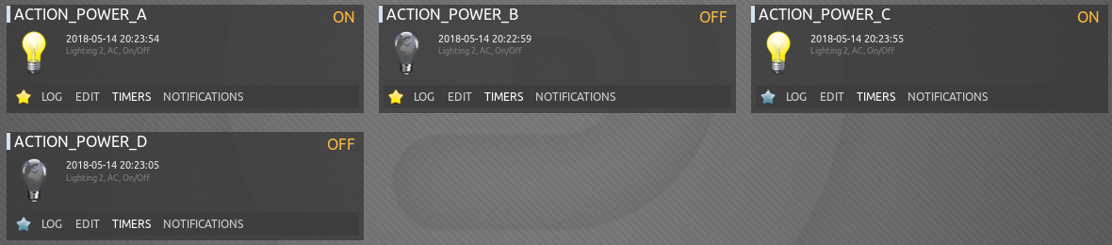
Connectivity
Once you enable new devices, you can find them in Domoticz.
With the RFXCOM, you can manage a lot of devices by default, without additional configuration.
Notes:
*Recently parts of the protocol became open source as of 2016: https://en.wikipedia.org/wiki/Z-Wave
**http://z-wave.sigmadesigns.com/wp-content/uploads/2016/08/Z-Wave-Security-White-Paper.pdf

