Slide 1


Connectivity
Z-wave biggest plusses:
• Low power and low data rate wireless system developed by Sigma Designs, Inc.
• It operates in ISM bands 868 and 908 MHz.
• Supports 9.6 Kbps, 40 Kbps and 100 Kbps data rates.
• Modulation: FSK and GFSK
• Covers distance of 30 meters (indoor) to 100 meters (outdoor).
Source: rfwireless-world.com
Notes:
*Recently parts of the protocol became open source as of 2016: https://en.wikipedia.org/wiki/Z-Wave
**http://z-wave.sigmadesigns.com/wp-content/uploads/2016/08/Z-Wave-Security-White-Paper.pdf

Slide 2
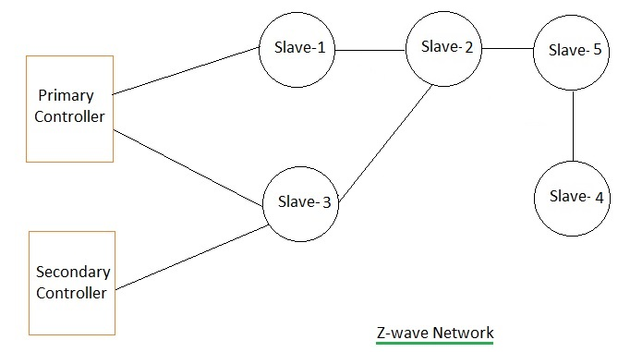
Connectivity
The z-wave network
Source: rfwireless-world.com
Notes:
*Recently parts of the protocol became open source as of 2016: https://en.wikipedia.org/wiki/Z-Wave
**http://z-wave.sigmadesigns.com/wp-content/uploads/2016/08/Z-Wave-Security-White-Paper.pdf

Slide 3
Connectivity
Advantages
• User friendly, nice for end-users
(although you still need to know what you are doing)
• Easy installation and configuration, including adding devise
• Low power consumption
• Plays ‘nicely’ with other Z-wave brands and products
(due to licensed standard)
• Secure using AES-128 encryption
• Backwards compatible with previous Z-wave standards
Source: rfwireless-world.com
Notes:
*Recently parts of the protocol became open source as of 2016: https://en.wikipedia.org/wiki/Z-Wave
**http://z-wave.sigmadesigns.com/wp-content/uploads/2016/08/Z-Wave-Security-White-Paper.pdf

Slide 4
Connectivity
Disadvantages
• Limited reach (but you can mesh!)
• Limited nodes, max 232 nodes per z-wave network
• Limited speed, max 100 kbps
• Not always secure due to backwards compatibility
(search on “EZ-Wave” if you are interested)
Notes:
*Recently parts of the protocol became open source as of 2016: https://en.wikipedia.org/wiki/Z-Wave
**http://z-wave.sigmadesigns.com/wp-content/uploads/2016/08/Z-Wave-Security-White-Paper.pdf

Slide 5

Connectivity
Brands in the market
Currently 300+ manufacturers working with Z-wave, including:
Notes:
*Recently parts of the protocol became open source as of 2016: https://en.wikipedia.org/wiki/Z-Wave
**http://z-wave.sigmadesigns.com/wp-content/uploads/2016/08/Z-Wave-Security-White-Paper.pdf

Slide 6
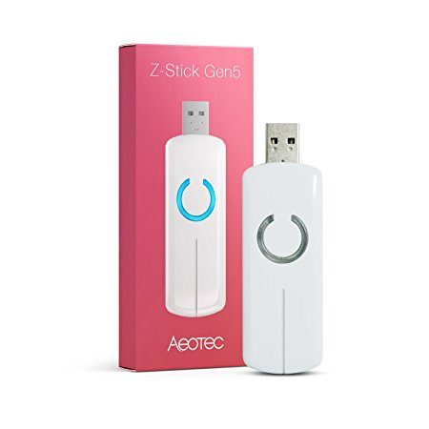
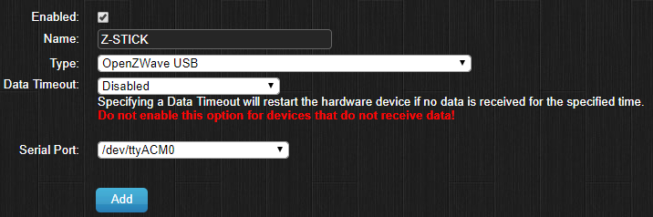
Connectivity
Connecting with Domoticz
Using the Aeon Labs
Aeotec Z-Wave Z-Stick, Gen5 (ZW090).
Add hardware in Domoticz:
Notes:
*Recently parts of the protocol became open source as of 2016: https://en.wikipedia.org/wiki/Z-Wave
**http://z-wave.sigmadesigns.com/wp-content/uploads/2016/08/Z-Wave-Security-White-Paper.pdf

Slide 7
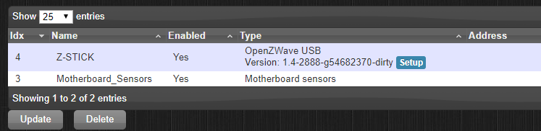
Connectivity
Connecting with Domoticz
Under hardware in Domoticz, click on Setup:
Notes:
*Recently parts of the protocol became open source as of 2016: https://en.wikipedia.org/wiki/Z-Wave
**http://z-wave.sigmadesigns.com/wp-content/uploads/2016/08/Z-Wave-Security-White-Paper.pdf

Slide 8
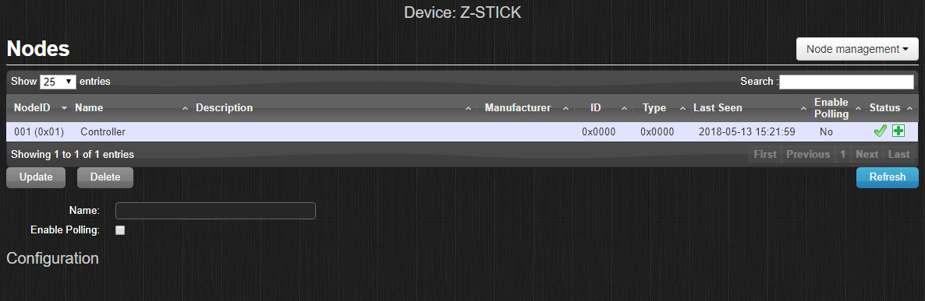
Connectivity
Connecting with Domoticz
Overview of devices ‘linked’ to
your Z-wave stick (the controller):
Notes:
*Recently parts of the protocol became open source as of 2016: https://en.wikipedia.org/wiki/Z-Wave
**http://z-wave.sigmadesigns.com/wp-content/uploads/2016/08/Z-Wave-Security-White-Paper.pdf

Slide 9
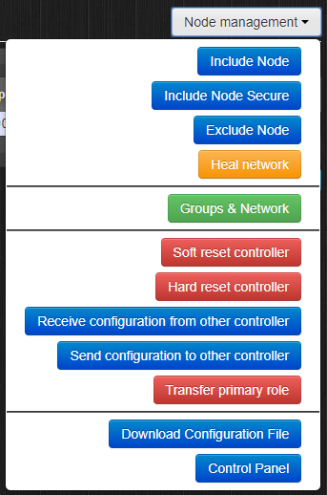
Connectivity
Node Management
• Include of Exclude node
= adding or removing a node
• Group & Networks
= Graphical overview of the network
• Control Panel
= Management interface of the
Z-wave stick itself.
Notes:
*Recently parts of the protocol became open source as of 2016: https://en.wikipedia.org/wiki/Z-Wave
**http://z-wave.sigmadesigns.com/wp-content/uploads/2016/08/Z-Wave-Security-White-Paper.pdf

Slide 10
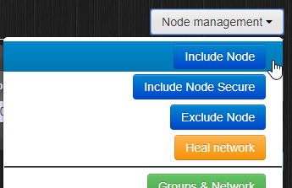
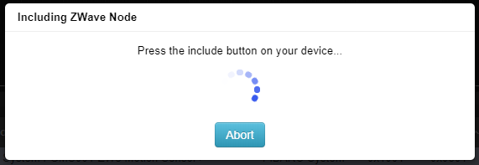

Connectivity
Connecting a node, option 1:
(with the Fibaro Motion sensor)
1. In Domoticz, under setup of the Z-Wave stick, click on Include node.
2. Put the device in learn mode.
3. Its connected!
Notes:
*Recently parts of the protocol became open source as of 2016: https://en.wikipedia.org/wiki/Z-Wave
**http://z-wave.sigmadesigns.com/wp-content/uploads/2016/08/Z-Wave-Security-White-Paper.pdf

Slide 11
Connectivity
Connecting a node, option 2:
(with the Fibaro Motion sensor)
1. Fibaro Motion sensor.
Remove battery paper
Klick 3 times (blue light = learn mode)
2. Z-Stick
Switch on (blinks blue = learn mode) and put it next to the
device.
3. Put the stick and the new device near each other.
4. Plug it back into your Raspberry Pi (reboot could help)
Notes:
*Recently parts of the protocol became open source as of 2016: https://en.wikipedia.org/wiki/Z-Wave
**http://z-wave.sigmadesigns.com/wp-content/uploads/2016/08/Z-Wave-Security-White-Paper.pdf

Slide 12
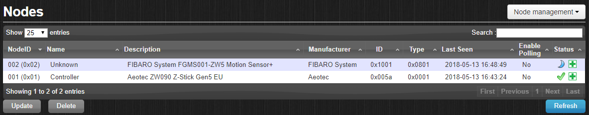
Connectivity
Connecting a node:
Whoop there it is under hardware, z-stick setup:
Notes:
*Recently parts of the protocol became open source as of 2016: https://en.wikipedia.org/wiki/Z-Wave
**http://z-wave.sigmadesigns.com/wp-content/uploads/2016/08/Z-Wave-Security-White-Paper.pdf

Slide 13
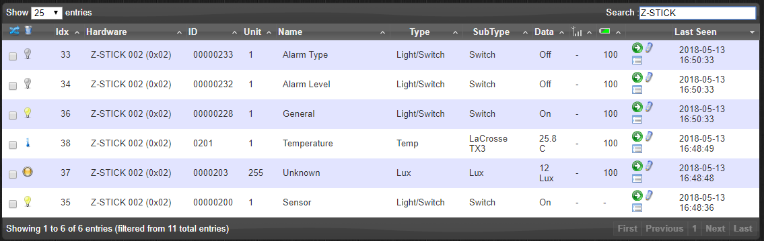
Connectivity
Connecting a node, devices are ready:
Notes:
*Recently parts of the protocol became open source as of 2016: https://en.wikipedia.org/wiki/Z-Wave
**http://z-wave.sigmadesigns.com/wp-content/uploads/2016/08/Z-Wave-Security-White-Paper.pdf

