Slide 1

By Febin George

Slide 2
About Columbia Asia Hospital
Columbia Asia Hospital is a well-known healthcare facility recognized for patient-centered care and medical expertise. With a global presence in several nations, the hospital is known for offering top-notch medical care supported by modern infrastructure and state-of-the-art medical technology. Its team of highly qualified and caring healthcare professionals focuses on providing complete and individualized healthcare solutions to meet the diverse needs of the communities it serves, while staying committed to excellent medical care and a healthy society.

Slide 3

Problem Statement
You have been hired as a consultant data analyst by Columbia Asia Hospital. The Hospital is looking for key insights for the following objectives:
Assess the hospital's revenue generation
Insights about suitable departments for new hires
Strategies suggestions for patient discounts
Your task is to perform data analysis and come up with a report in order to help the organisation with the mentioned objectives.

Slide 4
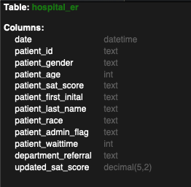
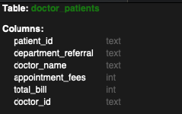
Data Overview
The data includes two tables:
doctor_patients_data: Details on doctors, patient visits, fees, and satisfaction scores.
hospital_er: Information on patient demographics, wait times, and referrals.

Slide 5

Methodology
Data Transformation & Integrity: Leveraged Power Query Editor in Power BI to perform complex data cleaning and shaping including sorting, filtering, and merging while resolving inconsistencies and missing values to maintain high data integrity.
Advanced Analytics: Developed sophisticated numerical measurements and business logic using DAX Functions, including CALCULATE, SUM, AVERAGE, IF, SWITCH, and various aggregation tools.
Interactive Reporting: Designed and deployed comprehensive Power BI dashboards, utilizing a variety of visualization formats such as charts, tables, and tabular views to deliver clear, actionable insights.

Slide 6
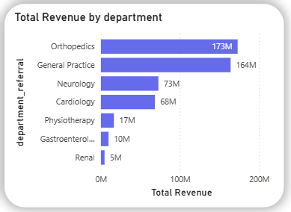
Total Revenue By Department
Orthopedics and General Practice are the primary contributors, generating 173M and 164M respectively. Together, they represent the vast majority of the hospital's total revenue.
Neurology and Cardiology form a second tier of revenue, contributing 73M and 68M.
There is a significant drop-off in revenue after the top four departments. Physiotherapy (17M), Gastroenterology (10M), and Renal (5M) contribute substantially less to the overall financial total.

Slide 7
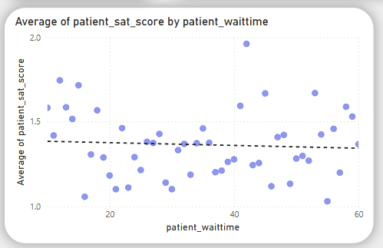
Patient Wait time Vs. Avg. Satisfaction Score
There is a clear negative relationship.As wait times increase, satisfaction scores generally decrease.
Satisfaction tends to stay stable for short waits but drops significantly once wait times exceed 30 – 40 minutes.

Slide 8
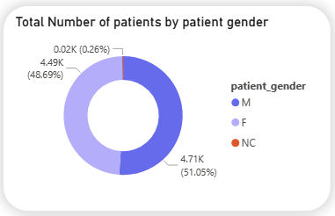
Total Visits by Patient Gender
Male patients have most visits of 4705 with 51%.
Female patients have 4487 visits with 48.6%.
In the data available 24 visits of patients have marked the gender not classified (NC).
In summary both male and female genders have almost equal visit counts.

Slide 9
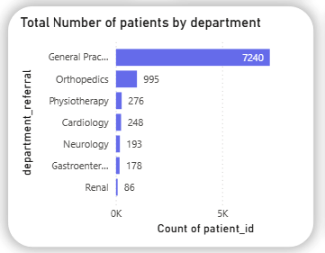
Total Visits by Department
The hospital has a total of 9,216 visits.
General Practice (7240) handles highest number of visits.
Following with Orthopedics (995) visits, all other departments handles significantly lower patients.
This indicates inefficiency in categorizing patients, and uneven distribution of patients.

Slide 10
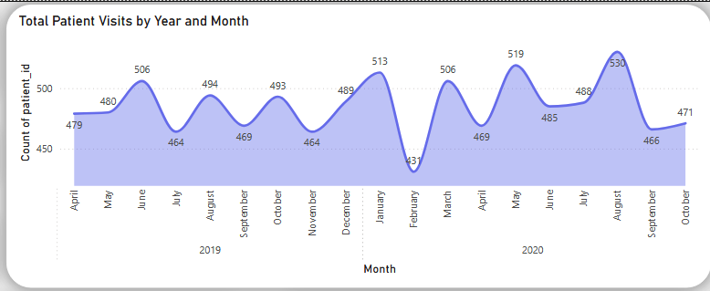
Volume Trend Analysis
ER visits reached a record high of 530 in August 2020, indicating a significant summer surge.
The data exhibits sharp peaks and valleys, with notable monthly fluctuations and periodic drops in February.
Every significant dip is followed by a steep increase, requiring the hospital to be prepared for sudden patient surges after quiet periods.
Volume remains consistently higher in the latter half of the year, suggesting the hospital is operating at an increased overall capacity over time.

Slide 11
Recommendations
Scale Underperforming Departments: Target low-revenue areas like Renal (5M) and Gastroenterology (10M) for growth through dedicated marketing or upgraded equipment to capture more market share.
Resource Planning for Peak Seasons: Implement a proactive staffing and resource model to prepare for the significant summer surge observed in August, ensuring the facility can handle peaks of up to 530 visits.
Infrastructure Expansion: Given that volume remains consistently higher in the latter half of the year, the hospital should evaluate long-term infrastructure expansion to accommodate this higher operating baseline.
Implement Dynamic Staffing Models: Since ER demand is highly volatile with sharp peaks and valleys, the hospital should transition to a flexible staffing model that can scale up quickly to meet sudden intake recoveries.

Slide 12
Recommendations
Strengthen Data Integrity and Capture Protocols: To overcome limitations caused by high levels of missing data in key columns, the hospital should prioritize standardizing data capture at the source. Improving these inputs will eliminate information gaps, enabling deeper analytical insights and more reliable data driven decision-making.
Optimize Discount and Retention Frameworks: Develop a tiered discount strategy that prioritizes age demographics and revenue contributions to ensure equitable access across all patient segments. Specifically, increasing discounts for elderly or lower-revenue groups can improve healthcare accessibility and patient engagement.
Strategic Doctor Allocation: Increase physician staffing in high-revenue and high-demand sectors, such as Orthopedics 173M and General Practice 164M to mitigate heavy workloads and maintain stable wait times, which currently average 35–37 minutes.

Slide 13
Recommendations
Targeted Expansion in Cardiology and Neurology: These departments already show a significant baseline revenue (68M–73M), targeted investment here could turn them into major revenue pillars alongside Orthopedics.
Enhance Referral Tracking: Since the data is categorized by department_referral, the hospital should analyze which sources are driving the high volume in Orthopedics and replicate those referral strategies for Gastroenterology and Renal services.
Preventative Care Campaigns in Q1: To address the recurring drops in volume during February, the hospital could launch elective procedure packages or health screening campaigns to stabilize revenue during typically quiet periods.

Slide 14
Conclusion
Robust Financial Performance: Columbia Asia Hospital demonstrates strong revenue generation, anchored primarily by the high patient volume and financial contributions of the Orthopedics ($173M) and General Practice ($164M) departments.
Operational Optimization: Significant opportunities exist to refine staffing by increasing physician presence in high-demand areas and reallocating resources from lower-volume departments, such as Renal ($5M) or Gastroenterology ($10M), to maximize efficiency.
Service Quality Enhancement: To maintain high standards, the hospital should prioritize a more consistent and engaging satisfaction tracking system, focusing on non-time factors like communication and care coordination that currently cause departmental variance in patient perception.
Data Integrity and Strategy: Strengthening data capture protocols to eliminate existing information gaps will be critical for enabling deeper future analysis and refining long-term strategic decisions.

Slide 15
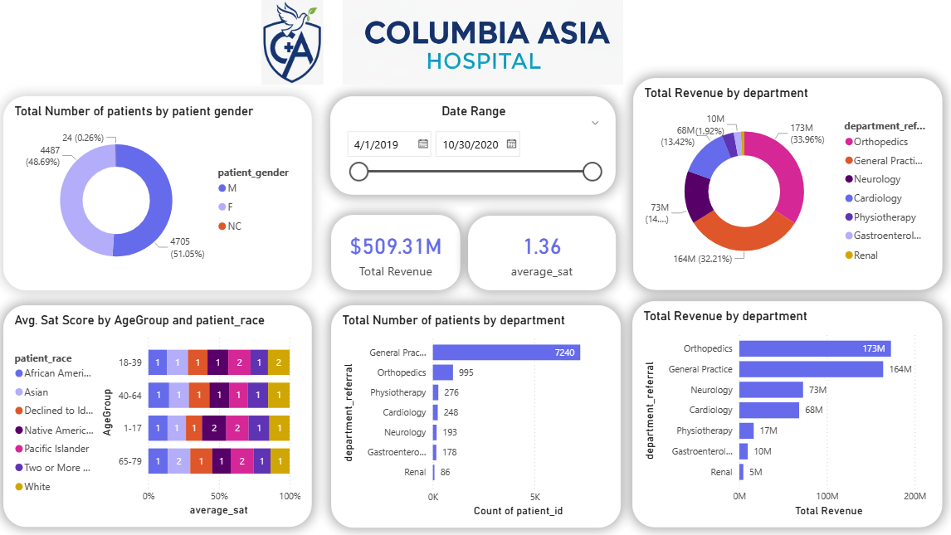
DASHBOARD – Main Tab

Slide 16
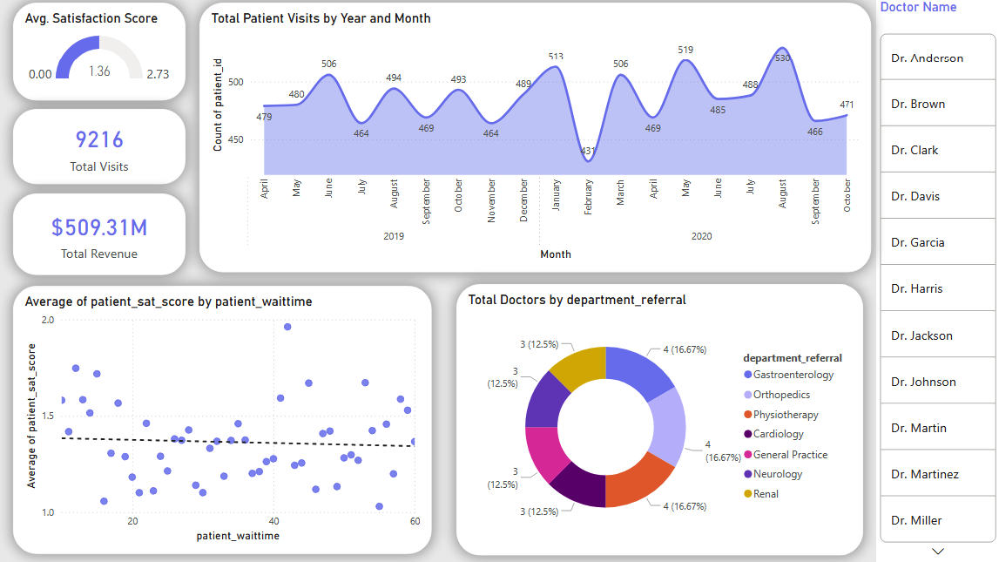
DASHBOARD – Doctor’s Tab

Slide 17
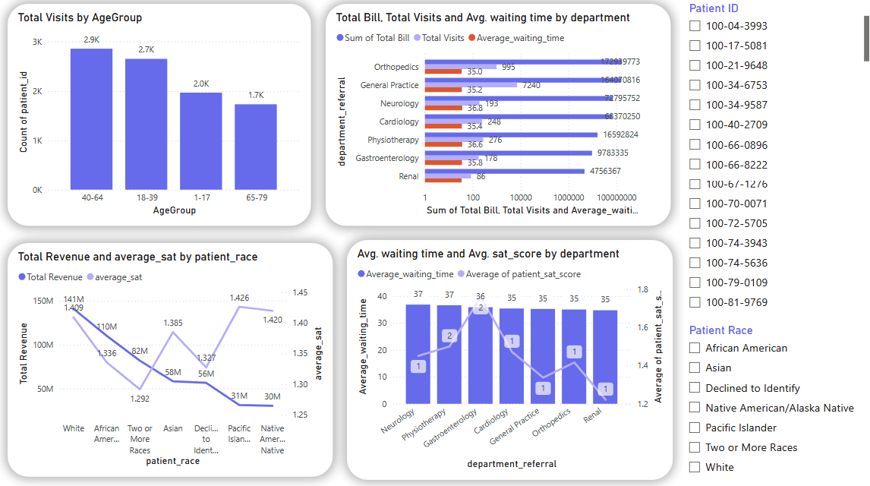
DASHBOARD – Patient Tab

Slide 18
Thank You

