Slide 1
Data Lake
Fei Yun, Guanlin Li
Notes:
https://www.slideshare.net/jamserra/data-lake-overview
https://www.slideshare.net/Dataversity/data-lake-architecture

Slide 2
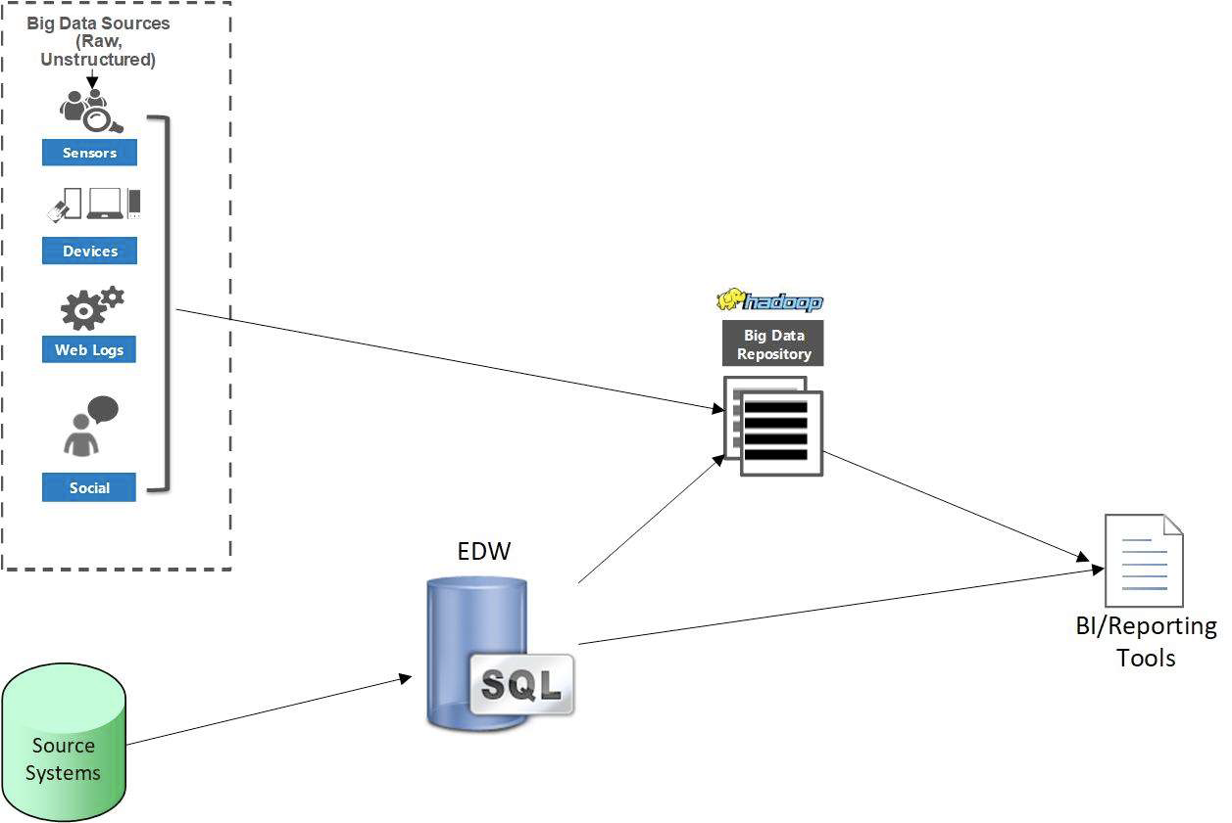
Big data structure
Enterprise data warehouse
Data warehouse can not deal with new data(e.g. No space, running out of performing, got some maintenance window…... )
Cons: It is difficult to handle data in two different data sets.
https://www.youtube.com/watch?v=vtAj35m-vzM&t=1353s

Slide 3
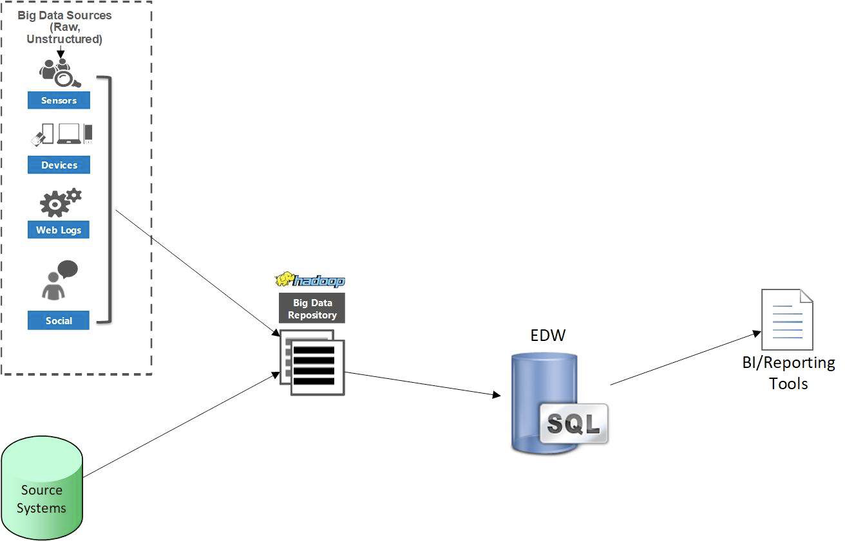
Big data structure
Big Data Repository Plus Enterprise data warehouse
Cons: data hub is temporary, no reporting/analyzing done with the data hub
https://www.youtube.com/watch?v=vtAj35m-vzM&t=1353s

Slide 4
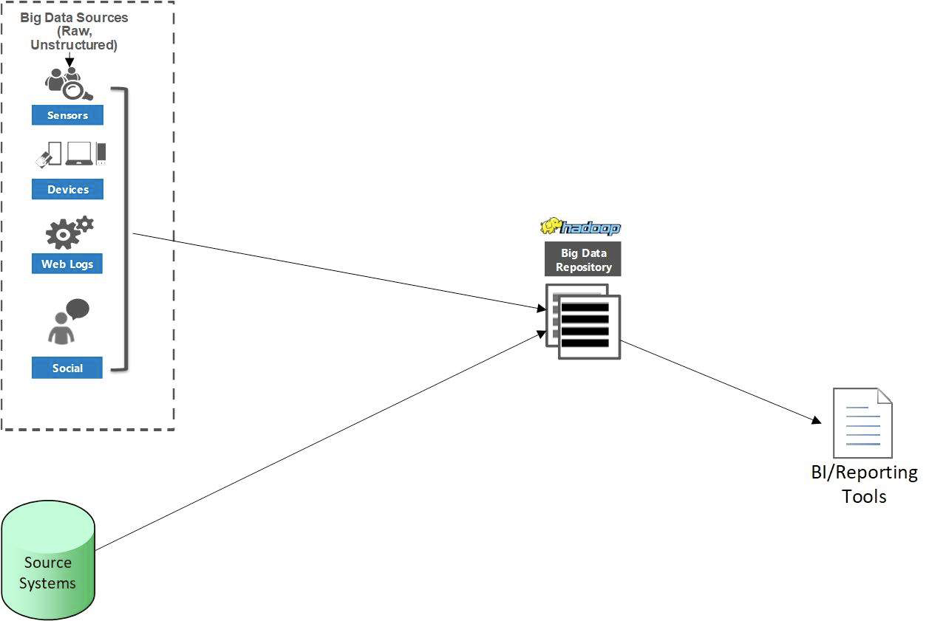
Big data structure
All-in-one
• Big Data repository is total solution, no EDW
• Cons: queries are slower, new
training for reporting tools, difficulty
understanding data, security
limitations

Slide 5
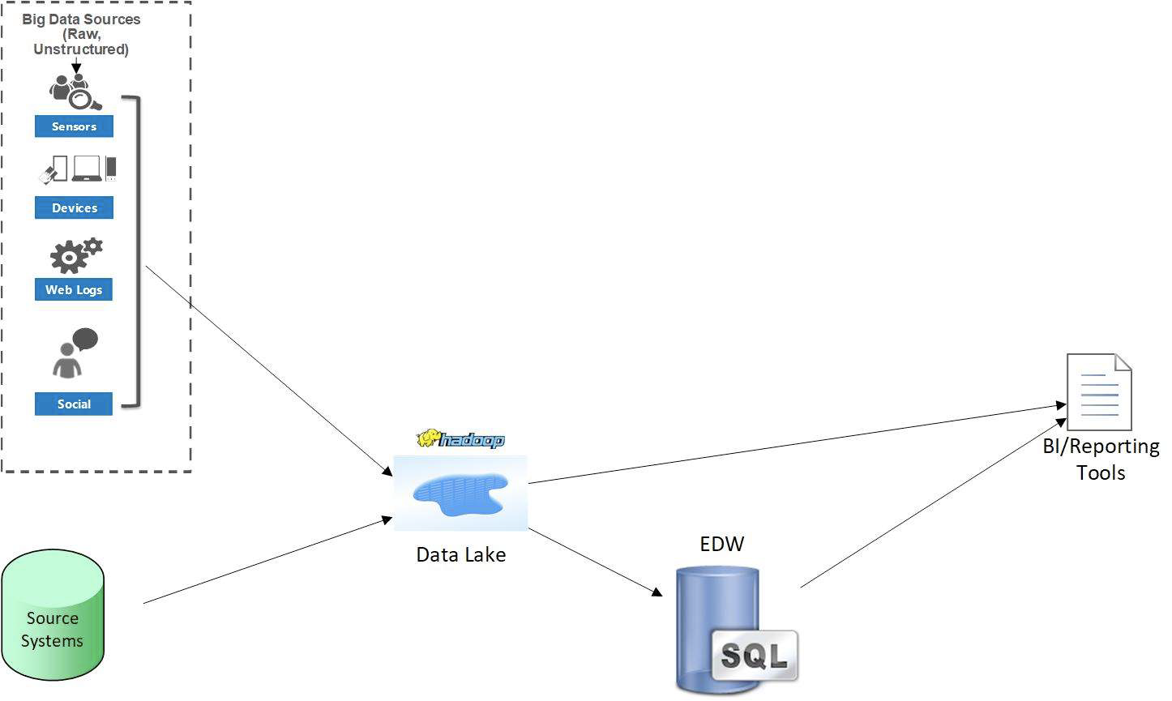
Big data structure
Modern Data warehouse
• Supports future data needs
• Data harmonized and analyzed in the data lake or moved to EDW for more quality and performance
https://www.youtube.com/watch?v=vtAj35m-vzM&t=1353s

Slide 6
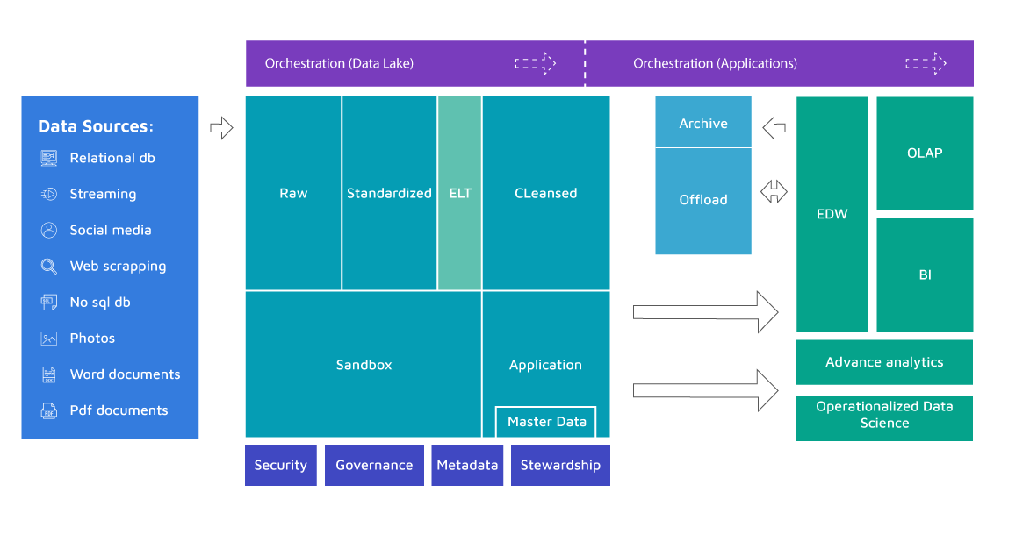
What is a Data Lake?
A storage repository, usually Hadoop, that holds a vast amount of raw data in its native format until it is needed.
https://lingarogroup.com/blog/data-lake-architecture/

Slide 7
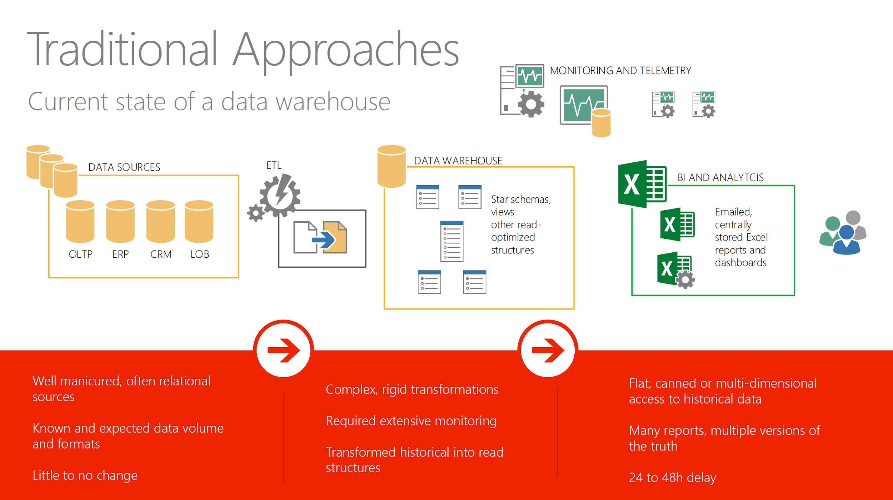
Difference between Data Lake and Data Warehouse
By James Serra

Slide 8
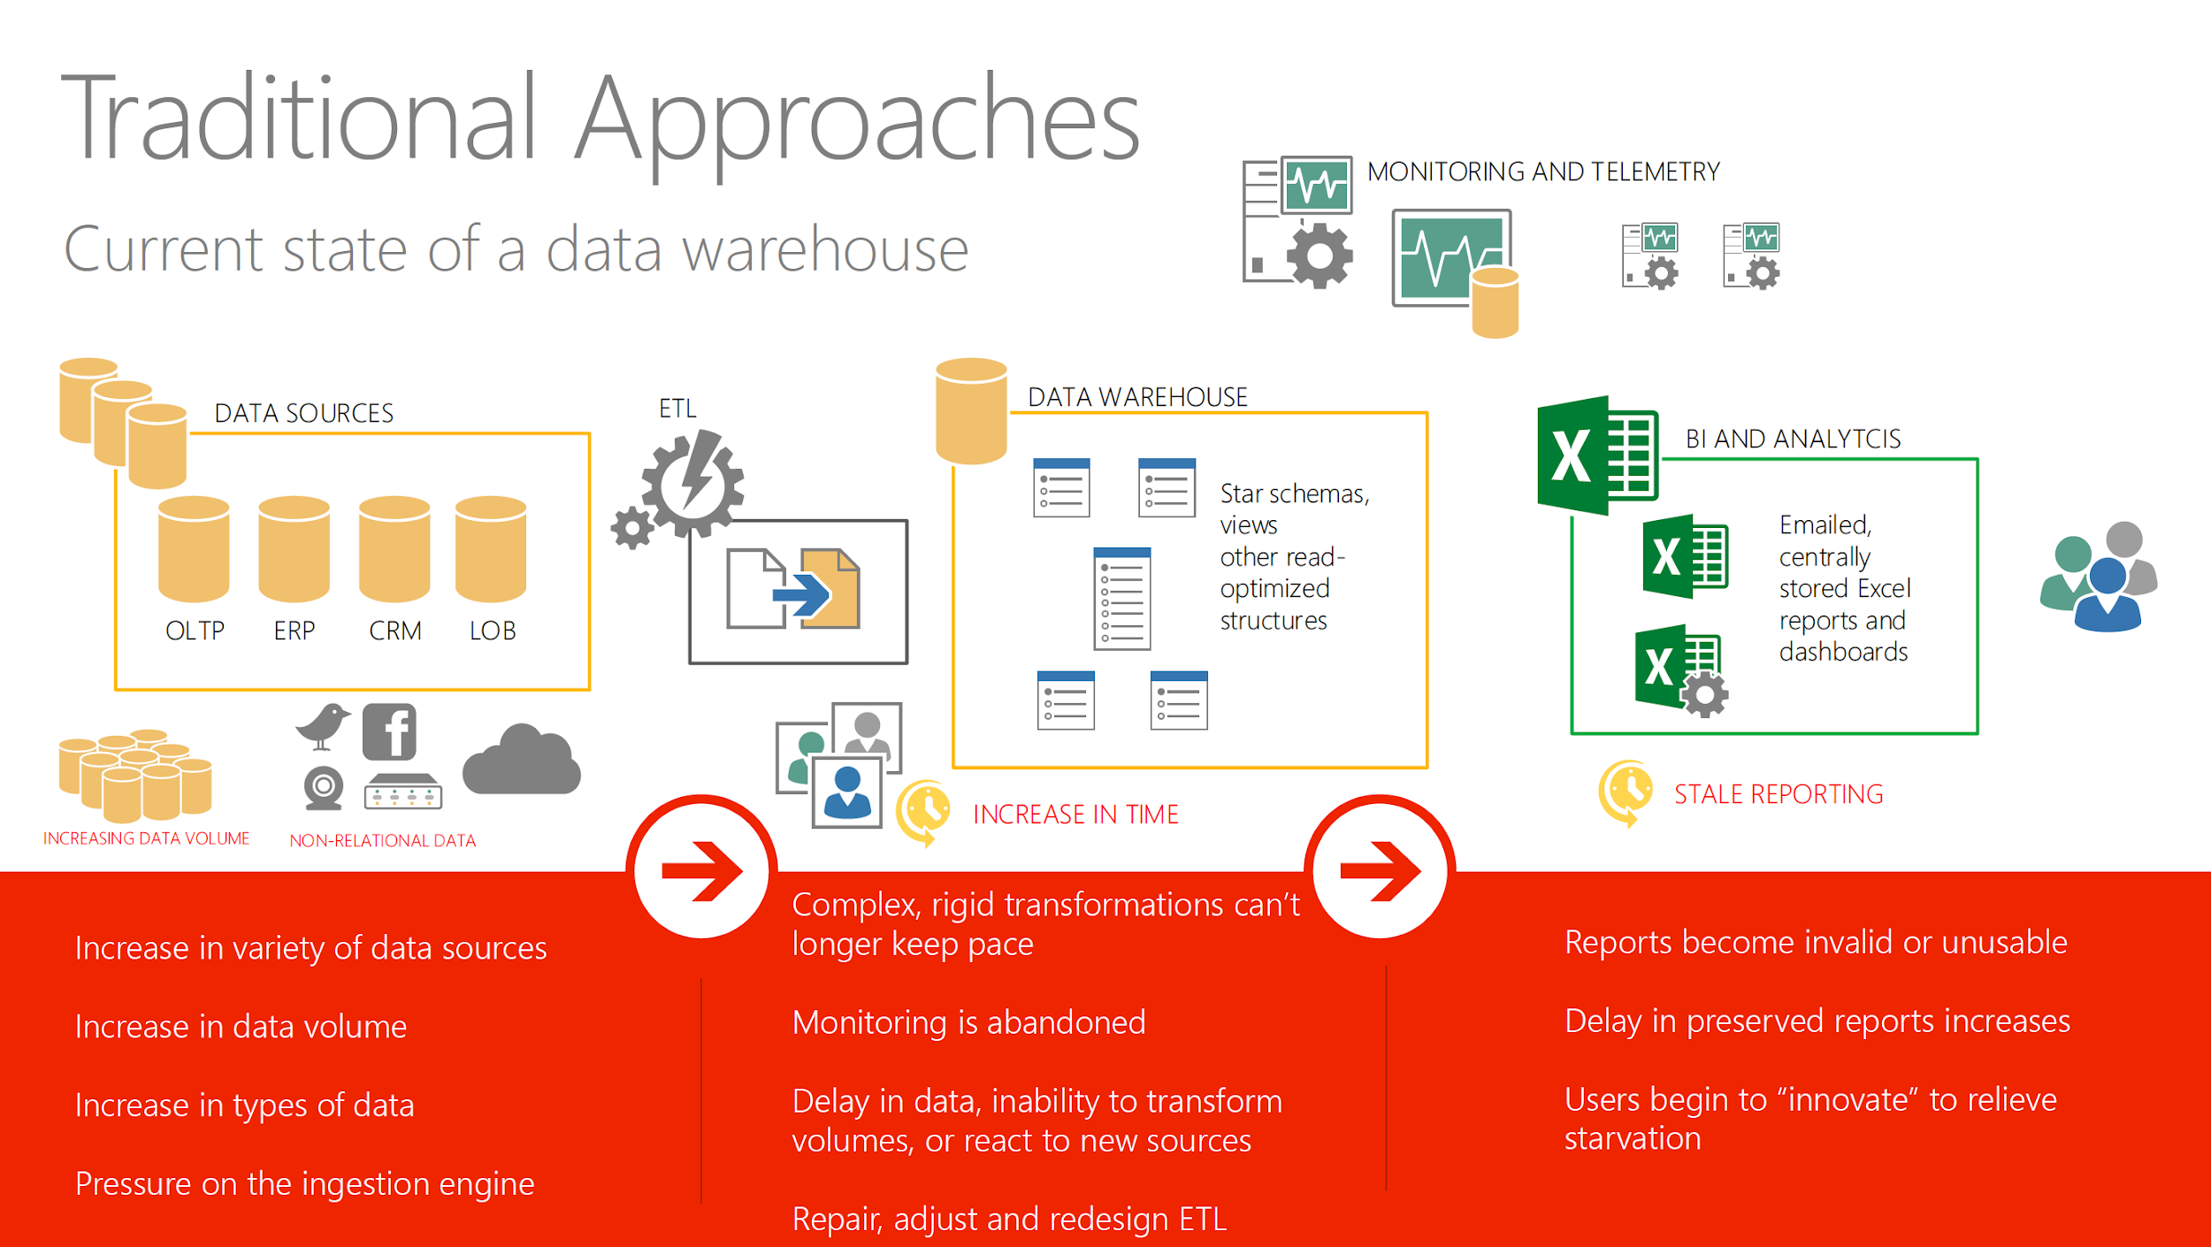
Difference between Data Lake and Data Warehouse
By James Serra

Slide 9
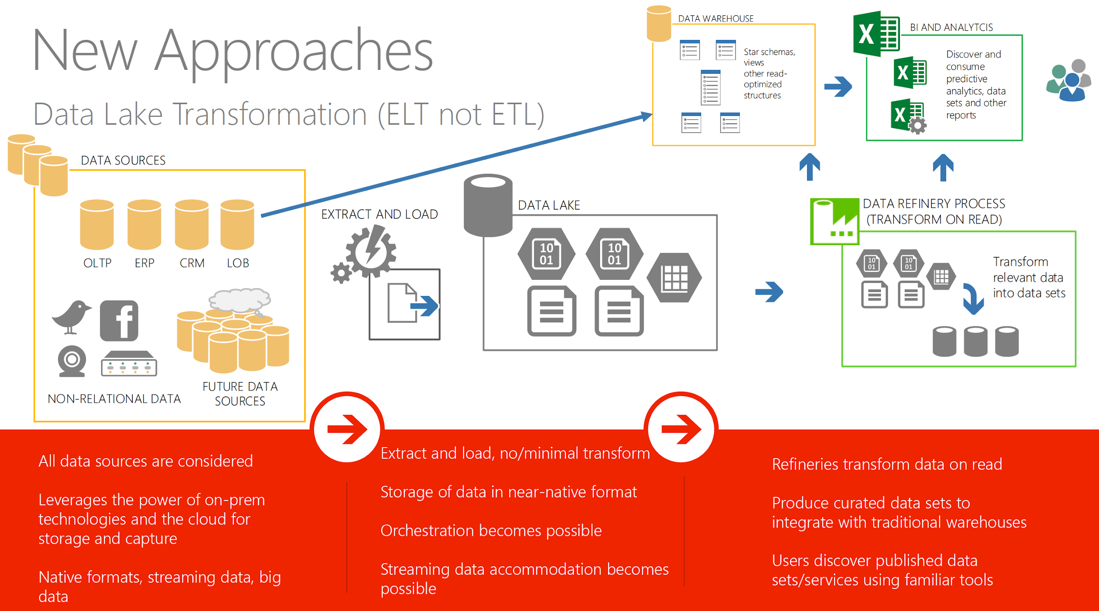
Difference between Data Lake and Data Warehouse
By James Serra

Slide 10
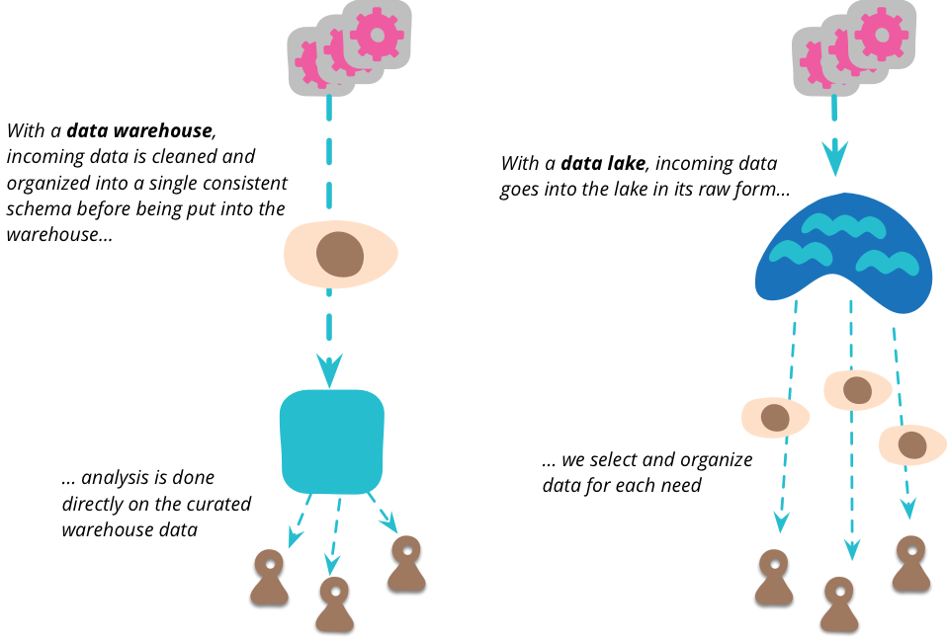
Difference between Data Lake and Data Warehouse
https://martinfowler.com/bliki/DataLake.html

Slide 11
Benefits and Risks to Data Lake
Benefits
Risks
Quickly adaptable to changes.
Offers value from unlimited data types.
Centralization of different content sources.
Flexible access to the data.
Security and access control.
After some time, Data Lake may lose relevance and momentum.
Sometimes data can be placed into a lake without any oversight.

Slide 12
Data Lake Architecture

Slide 13
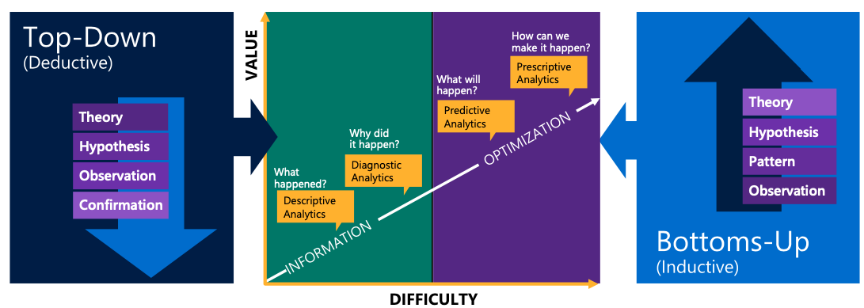
Two approaches to get value out of data
Know questions to ask
Build model first
Don’t know question to ask
Build model later
What happend
What will happen
https://www.slideshare.net/jamserra/data-lake-overview

Slide 14
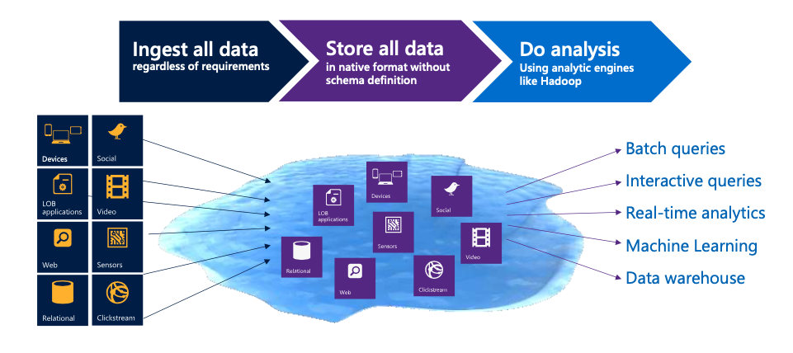
Data lake uses “Bottom-Up Approach”
Collecting and storing all data, analysing by needs
https://www.slideshare.net/jamserra/data-lake-overview

Slide 15
Data lake layers
Raw data
Standarlized data
Cleaned data
Application data
Sandbox data
Ready to use, connect to apps or models
Optional layer,independent for research and analyse
Just storage unprocessednot ready to use and not accessable
Optional layer, data stored and transform
Data transformed and orgnized by needs
Data storage
Data process
Data usage
Other source
Data analyze

Slide 16
Distribute File system is the basement of data lake
What is DFS
DFS is a file system that distributed on multiple file servers and locations, it allows program to access isolated file from any network or computer.
Advantage
It allows data to be shared remotely
It improves availability to the file, access time and network effectivity
Provide transparency of data even server fails
Allows multiple user to access or store the data

Slide 17








Use Case --- Ingestion a New file type
Data Lake
Preparatory file storage for multi-structured data
Raw Data
Exploratory analysis to determine value of new data types
Affords additional time for long-term planning while accumulating data
Exploratory Analysis
Data Science
Sandbox

Slide 18
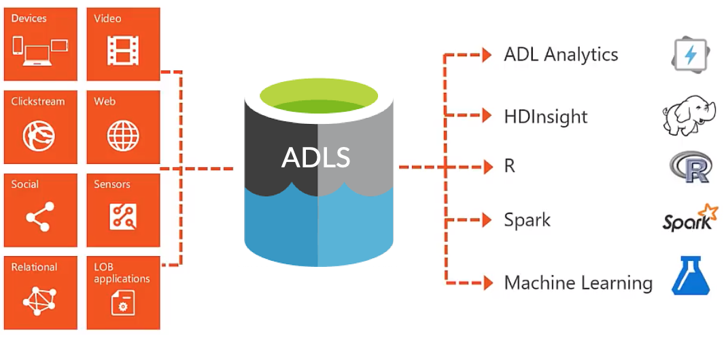
Azure Data lake
Data lake on cloud
Features:
Scalable to match demanding analytics workloads
Cost effective data storage
Low maintenance cost
https://www.dremio.com/data-lake/azure/

Slide 19
Advantage & Disadvantage of ADLS
Cost lower than in-demand
Scalability
Accessbility
up-to -date technology
Management complexity
Security weakness
Performance

Slide 20
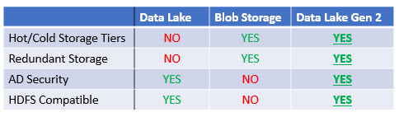
Next gen data lake
A data lake can be back-up
Reduce data damage or lost in data lake
Separates Hot storage and cold storage
Frequently used data access fast, archived data storaged low cost
https://docs.microsoft.com/en-us/azure/storage/blobs/data-lake-storage-introduction

Slide 21
Data lake in IoT
Machine to Dashboard
With data lake, machine can send formatted, ready to use data to analyst.
Machine to data
With data lake, machine do not need local storage to save data itself or device to change data types
Machine to Machine
With data lake, machine can collect enough data from data lake when other machine stored

Slide 22
Thank You
Q&A

