Slide 1

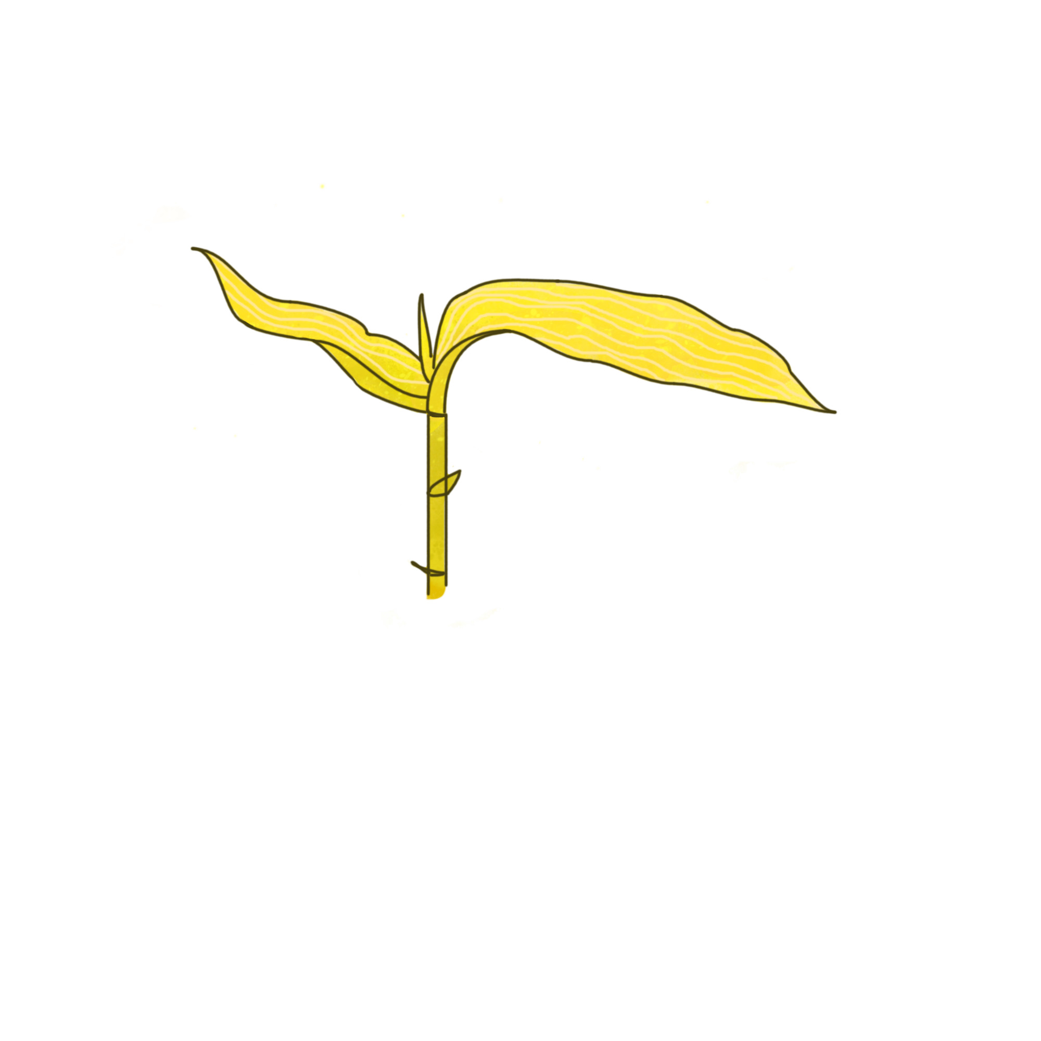
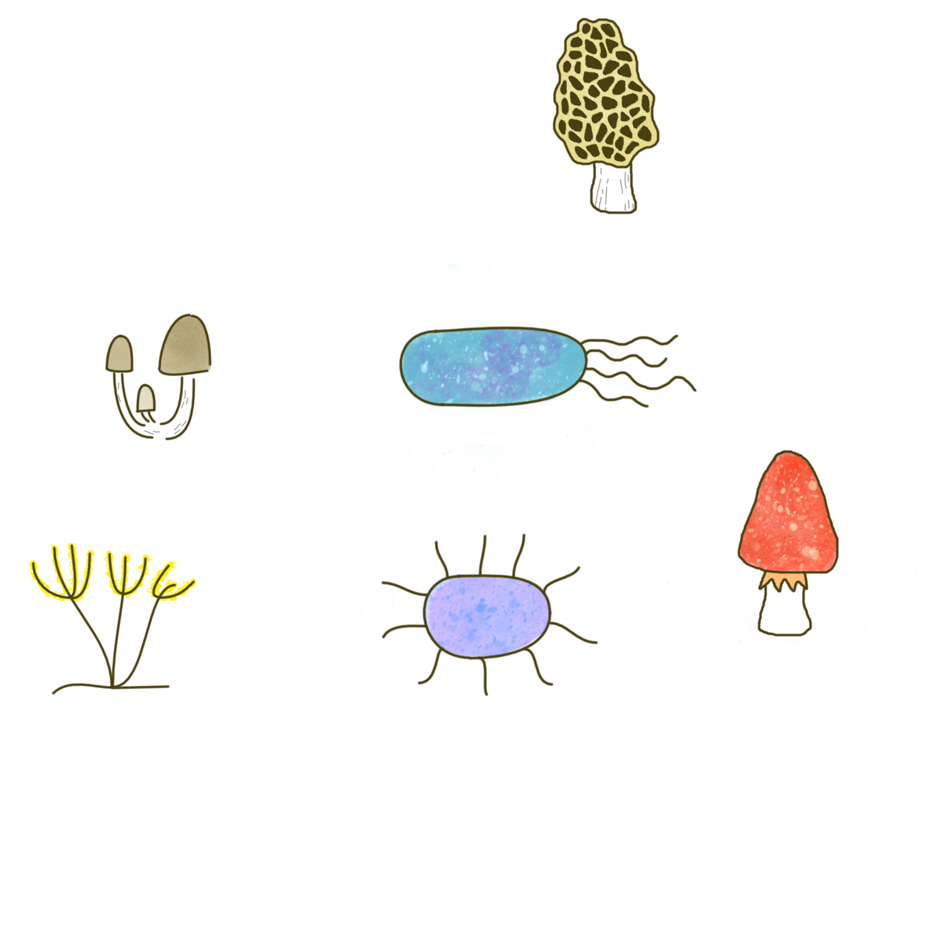
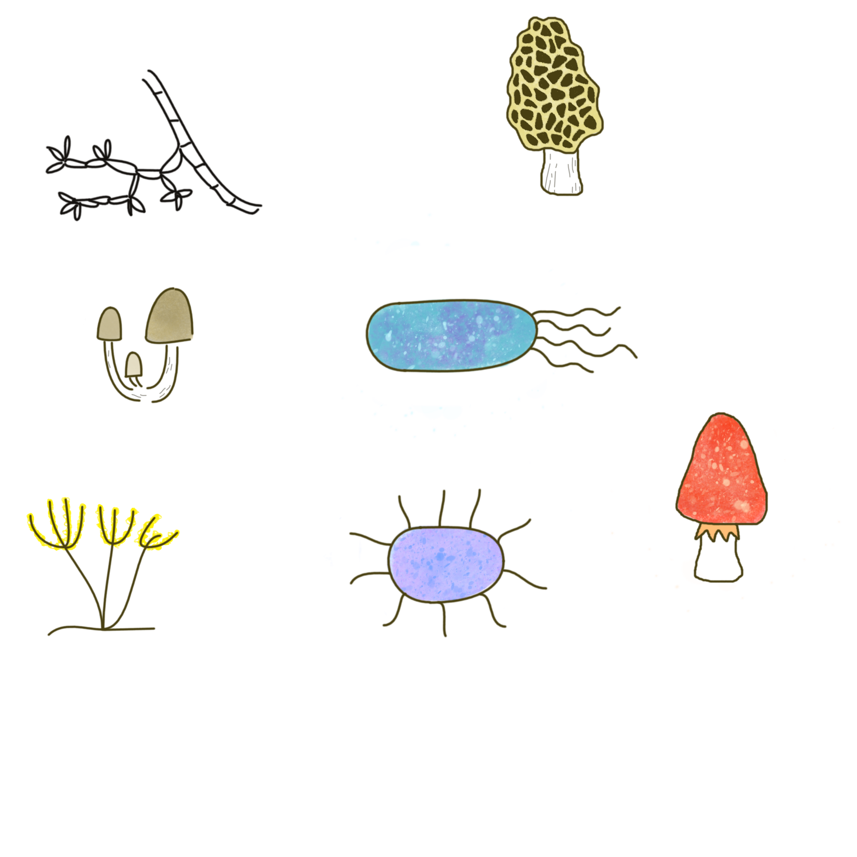
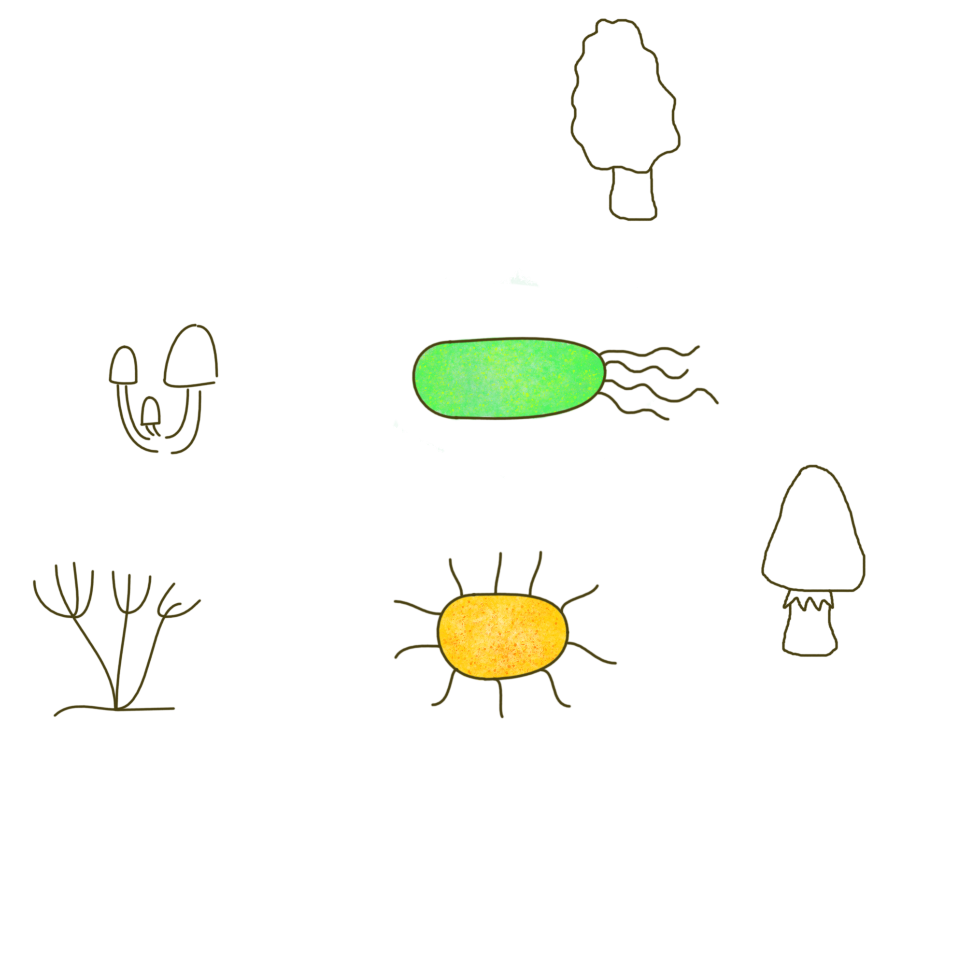
UVB
UVA
Blue-green
Direct sunlight effects
CO₂
CO₂
Photodegradation
Photofacillitation
Leaf litter microbiome
Fungi and Bacteria
Leaf litter
Photodegradation – mediated effects

