Slide 1
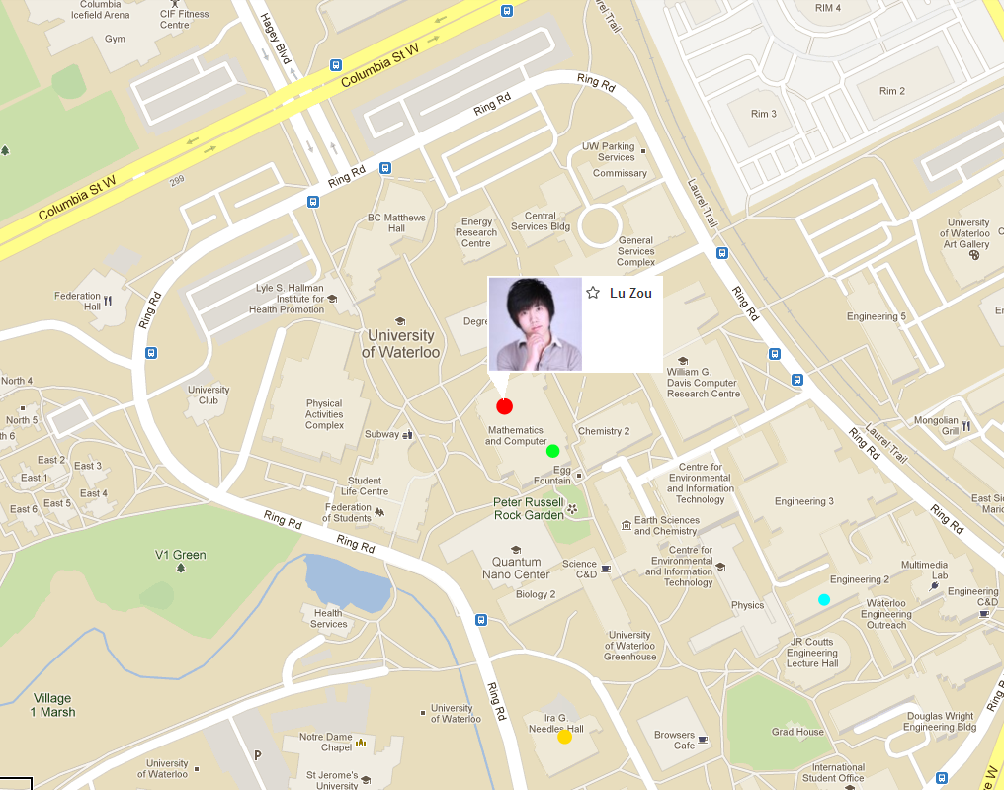
Friend Map

Slide 2

tracks the real-time location of friends
eliminates the need for text messages and phone calls to inquire your friend’s physical location
other uses: shopping, driving

Slide 3
Goals
Low bandwidth
Fast response using asynchronous events
Scalable up to 20 users on a map

