Slide 1
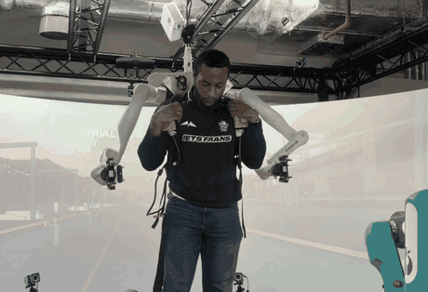
World-Stable Supernumerary Effectors for Human
Augmentation Under Locomotion-Scale Base Motion
Keeping a wearable robot's hands still while the wearer walks
Christian Akabueze
MSc Human and Biological Robotics
Imperial College London · MUVE Lab · 2026
github.com/fechachris4/msc_project
Watch the hands, not the elbows.
Notes:
[0:35 | 0:35] Imagine wearing two extra robot arms on your back and asking them to hold something still while you walk. Every step moves them six to seven centimetres. That was my MSc project at Imperial, in the MUVE Lab. I'm Christian Akabueze. In this clip the wearer twists about sixty degrees: the elbows swing, the hands stay close to where they were. I'll show you how it works, how well it works on real people, and what limits it.

Slide 2
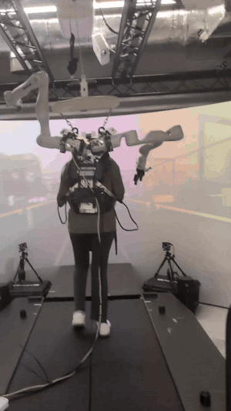
Every step moves your extra hands
PROBLEM
63–68 mm
hand motion if the arm were locked (RMS)
~1.8 Hz
how often steps come: fast, repeating motion
Walking on the treadmill, both arms on.
Notes:
[0:40 | 1:15] Here's a participant on the treadmill. The two arms are Kinova Gen3 robots, seven joints each, mounted on a backpack, which I'll call the mount. Vicon motion-capture cameras track the backpack in the room. The problem is walking. Every step moves the backpack, and everything attached to it. If the arms were simply locked, the hands would move 63 to 68 millimetres RMS, at every walking speed we tried. And steps come at roughly 1.8 per second, so this is fast, repeating motion, not slow drift.

Slide 3
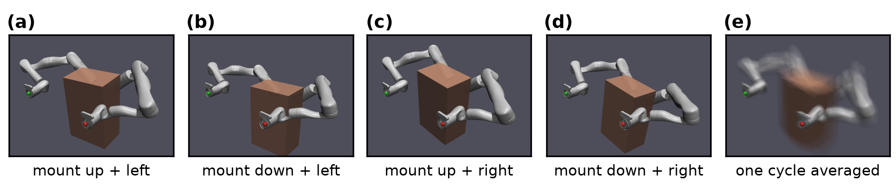
Goal: fix the hand in the room, not on the body
PROBLEM
(e) one cycle averaged: the backpack blurs, the hands stay sharp.
Simulation, controller on. Motion enlarged 3×.
Notes:
[0:30 | 1:45] So the goal is to hold each hand fixed in the room, not on the body. This is my simulation with the controller on: four positions of the backpack in one cycle, with the motion enlarged three times. Panel e averages the whole cycle. The backpack and upper arms blur, because they move. The hands stay sharp, because the controller cancels that motion.

Slide 4
Measure the backpack, cancel it through the arm
APPROACH & SOLUTION
World
(the room)
Backpack
(mount)
Arm base
Hand
(end-effector)
Vicon motion capture
measured live
Fixed mount offset
known
Joint angles → kinematics
computed
q̇ = J⁺_{λ} (K_{p}·e + K_{d}·ė) + (I − J⁺J)·q̇₀
K_{p}·e + K_{d}·ė
push the hand back to its spot in the room
J⁺_{λ}
→ joint speeds, damped near awkward poses
(I − J⁺J)·q̇₀
spare 7th joint drifts to mid-range
Notes:
[1:20 | 3:05] The approach is a chain of coordinate frames. Vicon measures the backpack's pose in the room. The arm base sits at a fixed, known offset on the backpack. The joint angles, through forward kinematics, place the hand relative to the base. Compose the three and I know where the hand is in the room, and how each joint moves it: the Jacobian. If you work in 3D, it's the same rigid-body maths as tracking a camera on a moving rig. Then the law. The part in brackets is a PD controller, proportional plus derivative, on the error in the room frame: how far the hand is from its spot, and how fast it is drifting. A damped pseudo-inverse of the Jacobian turns that into joint speeds, and the damping keeps it calm near awkward poses. The spare seventh joint drifts toward mid-range without moving the hand. A safety filter can also override a command that would bring the arm too close to the wearer. It was switched off in the simulation runs I'll show.

Slide 5
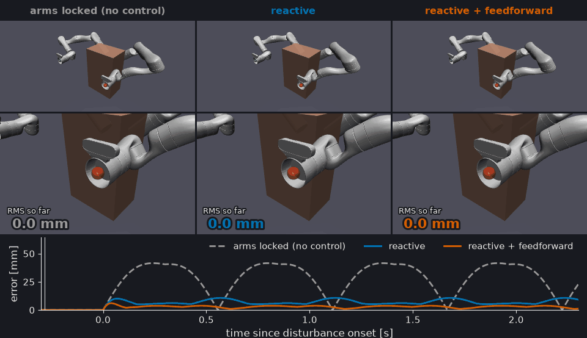
Simulation first: my controller in a physics engine
APPROACH & SOLUTION
Hand error over 8 s (RMS)
31.0 mm
Arms locked
6.7 mm
Controller
2.6 mm
+ feedforward
Same motion (1.8 Hz), three controllers. Watch the red target, middle row.
Notes:
[0:55 | 4:00] Before hardware, I tested my controller in MuJoCo, a physics engine. The backpack follows a walking-like motion at 1.8 hertz. Same motion three times: arms locked, my controller, and the controller plus feedforward. Watch the red target sphere in the middle row. Over eight seconds, locked arms leave 31 millimetres of error. The controller brings it to 6.7. Feedforward, which tells the controller how the backpack is moving, gets it to 2.6. In these runs the safety filter was switched off, so the numbers show the controller alone. The counters on the clip only cover the first two seconds, so they differ a little. Keep in mind: feedforward needs the backpack's velocity on time.

Slide 6
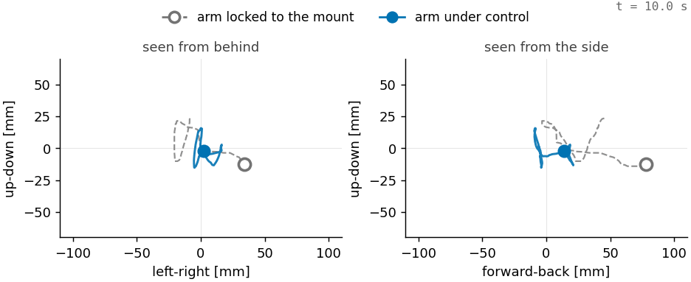
7 people: about two-thirds of walking motion removed
APPROACH & SOLUTION
Trials ran the lab's 400 Hz controller (Kalman-filtered Vicon). The analysis is mine.
Grey: where the hand would go if the arm were locked. Blue: where it went.
Mean of 6 people (4 at 1.5 m/s) · 128 trials, mostly one arm
Notes:
[1:15 | 5:15] Then real people. Seven participants wore the arms on an instrumented treadmill at 0.5, 1 and 1.5 metres per second. To be precise about who did what: these trials ran the lab's existing controller, at 400 hertz. It estimates the backpack's pose and velocity from Vicon with a Kalman filter. It has no feedforward. My own C++ controller wasn't used in these trials. The analysis is mine. On the left, one trial replayed: grey is where the hand would have gone with the arm locked; blue is where it went. To score a trial, I compare the two. I checked the locked model on arms that weren't being controlled: it's right to within half a percent. On the right: 71 percent of the motion removed at slow walking, 63 at normal speed, 56 at fast, means over six participants. That's over 128 walking trials, mostly one arm at a time. And on a platform that pitched and swayed, it removed 78 percent.

Slide 7
Trade-off: planning can never block the 2 ms loop
TRADE-OFFS & CHALLENGES
REAL-TIME PATH · EVERY 2 ms
Vicon thread
100 Hz
Wait-free
slot
500 Hz control core
Kortex cyclic
exchange
Both
arms
Kinematics
Control law
Clamp + integrate
plan request
checked trajectory
PLANNER THREAD
NOT REAL-TIME
GPMP2 planner
Validator
Trajectory mailbox
Gain: the 2 ms loop never waits on Vicon or the planner.
Cost: a new plan starts later, only after it passes the validator.
My C++ controller (HumanSL_MAIN); a MuJoCo twin runs the same core.
Notes:
[1:05 | 6:20] The lab's controller isn't public, so I wrote my own real-time controller in C++, in the HumanSL_MAIN repository. The trade-off I designed around: planning is slow and unpredictable, but the control loop has to run every 2 milliseconds without fail. So Vicon arrives at 100 hertz on its own thread and is handed over through a wait-free slot; the loop never waits on a lock. The 500 hertz core runs the kinematics and the law, clamps and integrates the joint speeds, and hands the commands to Kinova's real-time interface for both arms. Planning, with GPMP2, runs on a separate worker thread, and every plan passes one validator before it can run. A MuJoCo twin runs the same core, so I can test it without the robot. The cost: a new plan arrives a little later, because it has to pass the validator first.

Slide 8
Turning up the gain barely helped
TRADE-OFFS & CHALLENGES
38%
vs
9%
predicted drop near 1 Hz
measured drop near 1 Hz
Pilot, one wearer: velocity gain Kd raised 0.8 → 2.6
The velocity term was barely acting. Why?
Notes:
[0:45 | 7:05] Back to the trials, and the main challenge. Slow sway was mostly cancelled, but the bounce of each step was harder. The obvious fix: turn up the velocity gain. In a pilot with one wearer I raised it from 0.8 to 2.6. The model predicted the response near 1 hertz would fall by 38 percent. It fell by 9. And across six people, the measured amplitude matches a model with no velocity term at all. So the velocity term was barely acting. More tuning would not fix that; I needed to know why.

Slide 9

The cause: the velocity arrives 61–71 ms late
TRADE-OFFS & CHALLENGES
Kalman filter 36–46 ms
sensing
~10 ms
joints
~15 ms
= 61–71 ms
share of velocity left uncancelled = 2·sin(ωd/2)
ω: step rate · d: delay
Steps at 1.8 Hz, 60 ms late: the velocity is off by two-thirds of its own size.
Measured delay, nothing fitted: the model matches the hardware better in 6 of 6 people.
Notes:
[1:20 | 8:25] I traced the velocity signal end to end. The Kalman filter's estimate of the backpack's velocity lags the real motion by 36 to 46 milliseconds. The measurement is already about 10 milliseconds old when it arrives, and the joints take about 15 to respond. In total, the controller acts on a velocity that is 61 to 71 milliseconds late. Why does that matter so much? A late estimate has the right size but the wrong timing, so subtracting it does not cancel the true velocity. What's left over is two times the sine of half the phase lag, and the phase lag is omega times d. Steps come at 1.8 hertz. At 60 milliseconds late, the velocity is off by two-thirds of its own size. And this is not a fit: with the measured delay and nothing fitted, the model matches the hardware better than the no-velocity model in six of six people. In simulation, past about 30 milliseconds of delay, the velocity term does worse than none.

Slide 10
Impact, and what comes next
IMPACT
2/3
Next: faster velocity estimate → feedforward on the real arms (sim: 6.7 → 2.6 mm)
Lesson: measure the latency budget before tuning gains
of walking motion removed on real arms, worn by 7 people
56–71%, by walking speed
Notes:
[0:45 | 9:10] So, the impact. On real arms worn by seven people, the arm removes about two-thirds of walking motion: 56 to 71 percent, depending on speed. When tuning stopped helping, I found the cause in the data: a 61 to 71 millisecond delay. That sets the next step. First a faster velocity estimate, then feedforward on the real arms. In simulation, with no delay, feedforward cut the error from 6.7 to 2.6 millimetres. Confirming the delay directly means changing the estimator on hardware, which is the next experiment. The lesson that transfers beyond robotics: measure the latency budget before you tune the gains.

Slide 11


Thank you. Questions?
Results, simulation, figures
C++ real-time controller
github.com/fechachris4/msc_project
github.com/fechachris4/HumanSL_MAIN
fecha412@gmail.com
Notes:
[0:10 | 9:20] Thank you. Everything is on GitHub: results, simulation and figures in msc_project, and the C++ controller in HumanSL_MAIN. Happy to take questions.

Slide 12
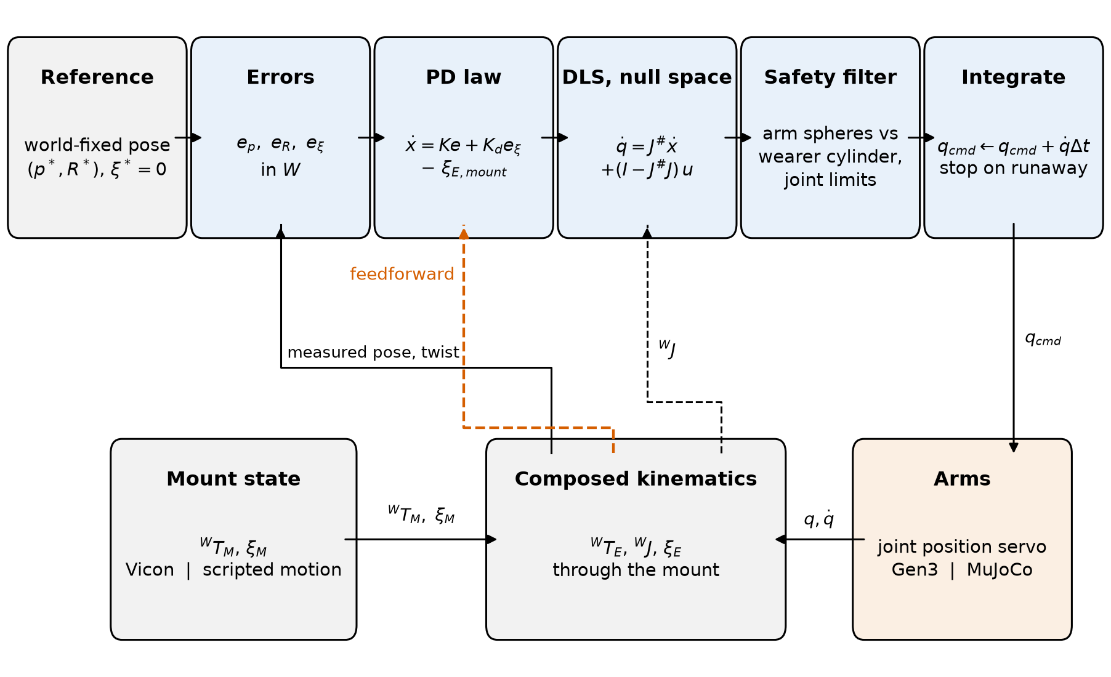
Backup: the control loop (simulation)
Per cycle, every 2 ms in simulation. Orange dashes: feedforward (simulation only).
Notes:
[backup, only if asked] The per-cycle loop as implemented in simulation, 500 times a second. Dashed orange is feedforward, simulation only. The safety-filter step keeps 13 spheres per arm outside a cylinder around the wearer; it was inactive in the reported runs.

Slide 13
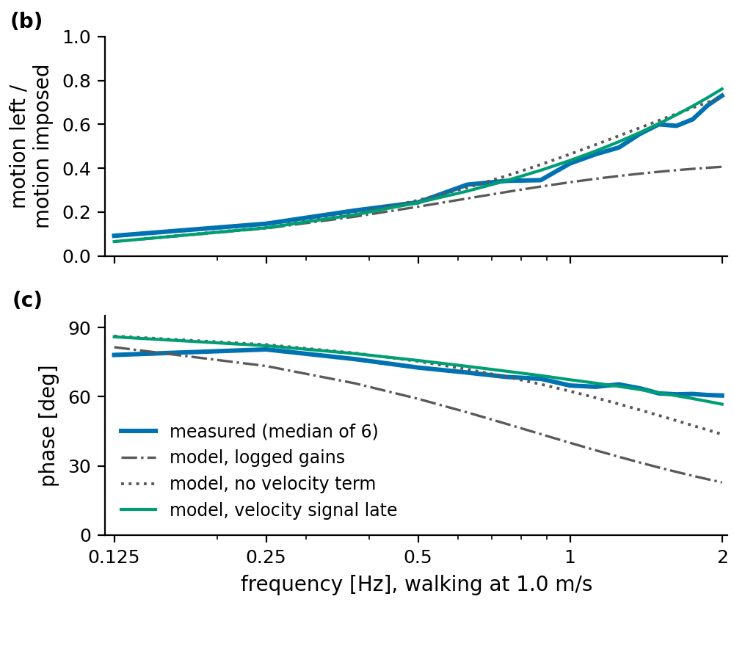
Backup: frequency response, 1.0 m/s
Median of 6 people. In amplitude (top), measured follows the no-velocity model (dotted). Green: late-velocity model. Lower = more removed.
Notes:
[backup, only if asked] Frequency response at 1 metre per second, median of six participants. Blue is measured. The dotted model with no velocity term sits on it; the dash-dot model with the logged gains predicts more rejection than the arm reached; green adds a late velocity signal with the delay fitted per person, 65 to 90 milliseconds; plugging in the measured 61 to 71 instead gives almost the same curve.

Slide 14
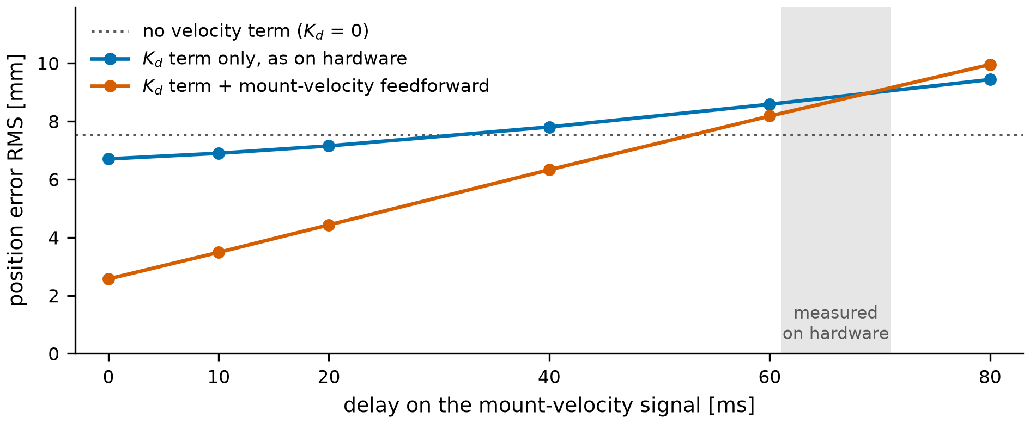
Backup: simulation, error vs delay
Velocity signal delayed on purpose, 1.8 Hz. Grey band: the delay measured on hardware.
Notes:
[backup, only if asked] Simulation, right arm at 1.8 hertz, with the backpack-velocity signal delayed on purpose. Each 10 milliseconds of delay costs the feedforward about 1 millimetre. Past about 30 milliseconds the velocity-gain term alone is worse than no velocity term; at 60 milliseconds both sit at 8.2 to 8.6 millimetres. Grey band: the 61 to 71 milliseconds measured on hardware. The simulation's gains are stiffer than the hardware's, so compare the trend, not the millimetres.

Slide 15
Backup: limits the data showed
Re-planning
12 of 128 trials: the planner moved the target > 100 mm; those had the most hand motion → a planner setting
Joint speed
at 1.5 m/s a joint at its limit 32% of the time, mostly wrist (~10% at slower walking speeds)
Fixed offset
constant 18–21 mm from the goal follows model-vs-Vicon disagreement → calibration
Notes:
[backup, only if asked] Three limits from the trial data. In 12 of 128 walking trials the motion planner moved the reference more than 100 millimetres from the target, and those trials had the most hand motion, so that is a planner setting. At 1.5 metres per second a commanded joint speed was at its limit 32 percent of the time, mostly in the wrist, against about 10 percent at slower speeds. And the hand sat a constant 18 to 21 millimetres from its goal; that offset follows the disagreement between the arm's kinematic model and Vicon, so it is calibration.

Slide 16
Backup: pitching and swaying platform
78%
Locked arm → hand, RMS
Pitch: 94 mm → 14 mm
Sway: 81 mm → 17 mm
of platform motion removed (5 people)
Notes:
[backup, only if asked] Five participants also stood on the treadmill platform while it pitched and swayed. The arm removed 78 percent of the motion. Pitch steps moved the locked point 94 millimetres RMS and the hand 14; sway steps 81 and 17.

Slide 17
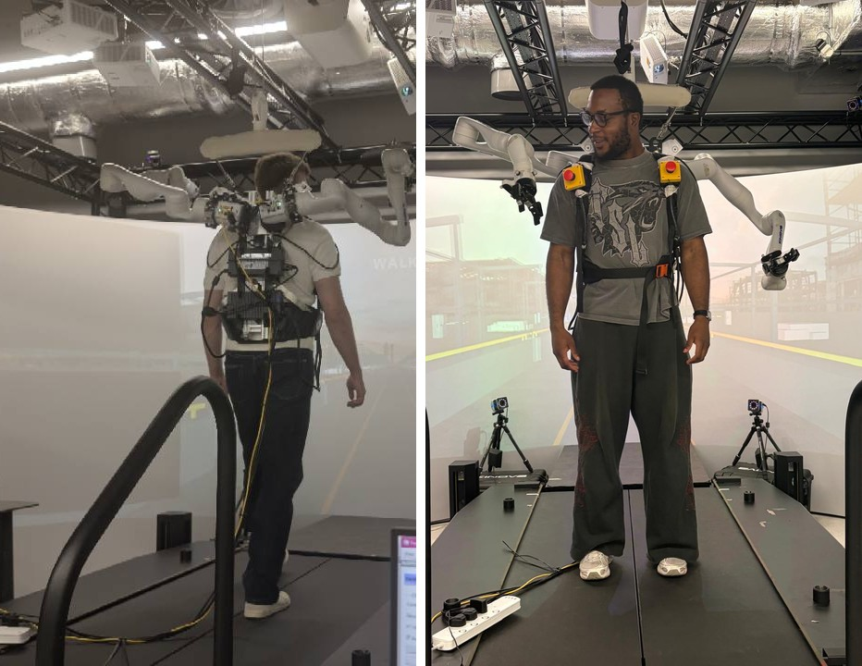
Backup: the rig
Two Kinova Gen3 arms on a backpack (mount); Vicon cameras around the treadmill.
Notes:
[backup, only if asked] The rig: two Kinova Gen3 seven-joint arms on a backpack, with Vicon cameras around the instrumented treadmill.

