Slide 1


Blockchains for Industrial IoT - A Tutorial -
15th International Conference on Network and Service Management Halifax, Canada
21-25 October 2019
Pál Varga,
Ferenc Nándor Janky
Budapest University of Technology and Economics

Slide 2
Overview
Motivation: using Blockchains for Industrial IoT
Generic considerations
IoT security: a brief overview on issues and solutions
Special features of Blockchains to be utilized by IIoT
When is it beneficial to use BCT for IIoT?
Blockchain-related concepts
Blockchain
A sample workflow of Blockchain-related processes; Distributed Ledgers;
Cryptographic Hash Function; Mining; Consensus algorithms; Merkle Tree
Smart Contracts
Introduction to the demo Environment: Ethereum and S.C.
Demo: Power-bidding game
Programming for the advanced: Number Guessing game

Slide 3
Motivation: using Blockchains for Industrial IoT

Slide 4
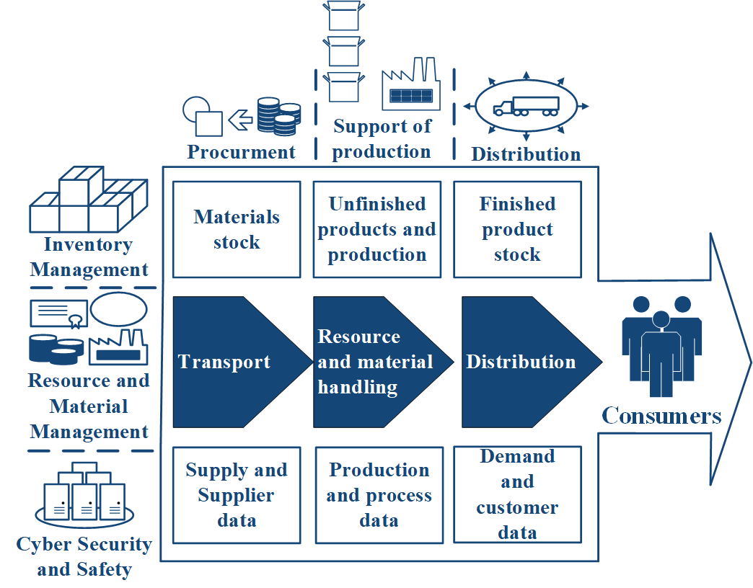
Blockchains for Industrial IoT: General considerations
Requirements for IIoT:
real-time operation,
security and safety,
high reliability,
complexity,
engineering efficiency,
return of investment,
trust
Multi-player, heterogeneous environments
Blockchain with Smart Contracts can offer transactions to be:
fast, secure, safe, trusted, validated and immutable

Slide 5
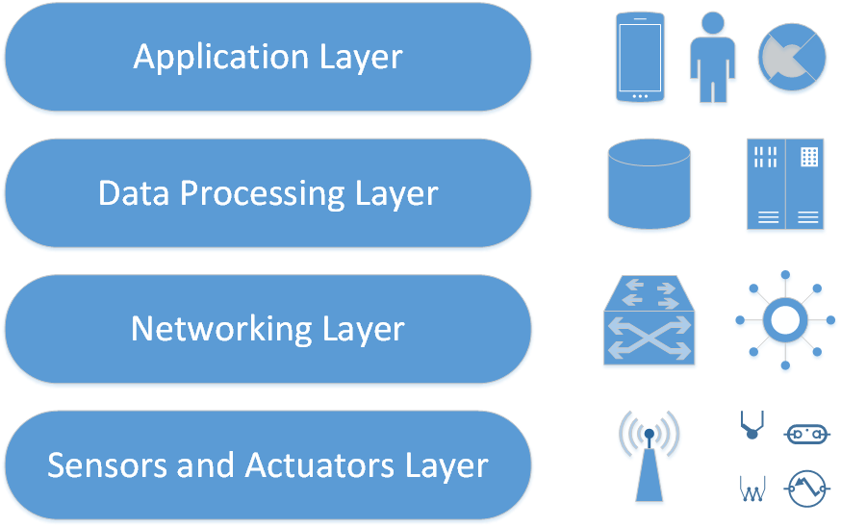
IoT security: a brief overview

Slide 6
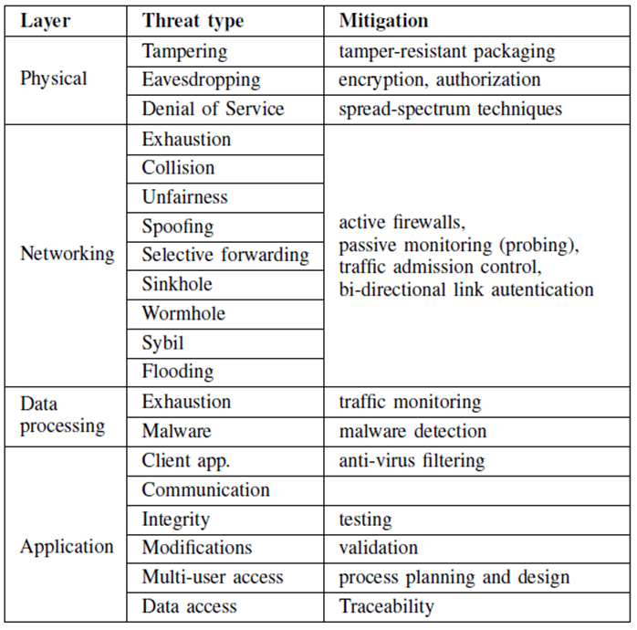
IoT security: a brief overview

Slide 7
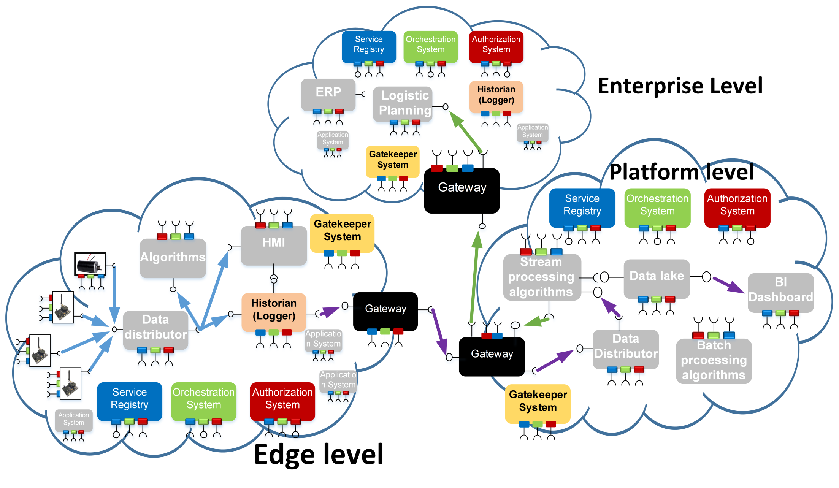
Spec. features of Blockchains to be utilized by IIoT: interoperability across IoT devices, IoT systems and industrial sectors
The Arrowhead Framework
Service Oriented Architecture
Local IoT Clouds
Inter-Cloud communication

Slide 8
Special features of Blockchains to be utilized by IIoT
Traceability and Reliability of IoT data
Traceability is the capability of tracing and verifying the spatial and temporal information of a data block saved in the blockchain
timestamping
nonce
Reliability is the quality of IoT data being trustworthy
the integrity is enforced by crytographic mechanisms
asymmetric encryption algorithms
hash functions
digital signature

Slide 9
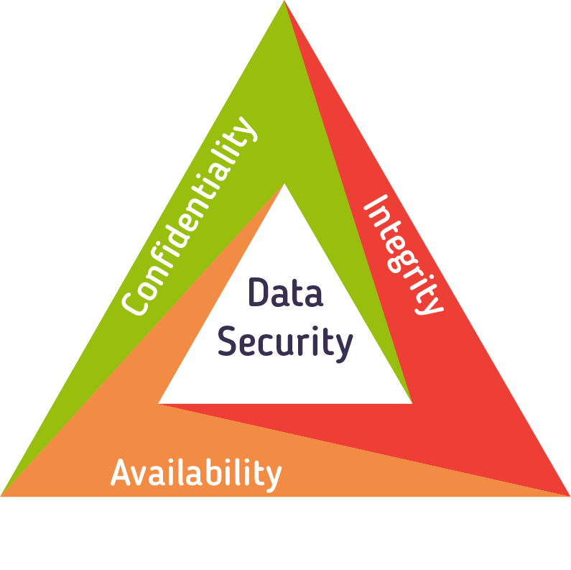
Special features of Blockchains to be utilized by IIoT
Improved Security of IoT system-of-systems through blockchains
Confidentiality
Public Key Infrastructure (PKI)
hashing functions
digital signature
Integrity
securing against tampering
securing against modifications
protecting for traceability
Availability
distributed ledger

Slide 10
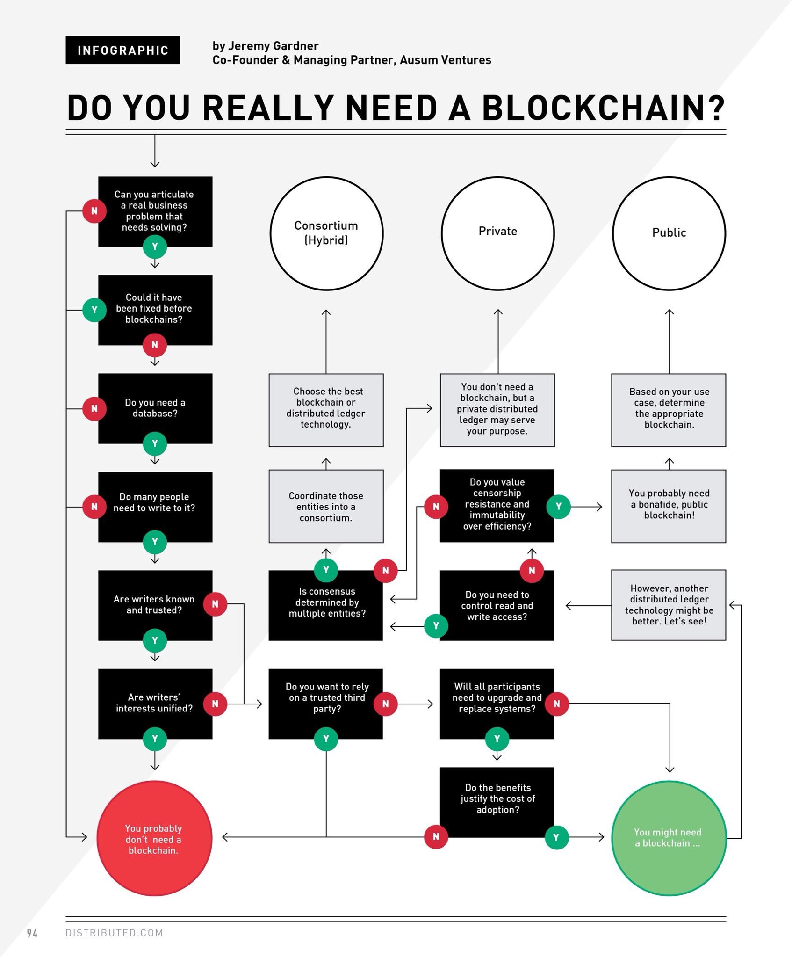
When is it beneficial to use BCT for IIoT?
Do You Need to use Blockchains? (by Jeremy Gardner, 2018)

Slide 11
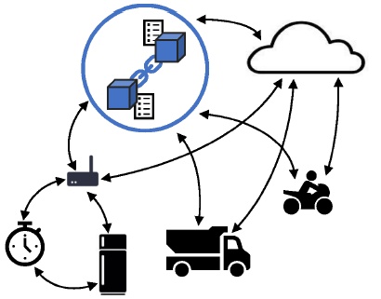
Precautions for Blockchain usage
Ledgers as distributed and trusted databases
Anonymity
Accelerated transactions,
Security Solutions
Data privacy,
Trust, etc.
Micropayments,
Cost reductions by removing middlemen
Number of transactions per sec.
Resource constrained devices?!
Mixed usage of private and public blockchains are not clearly solved in practice
Security Vulnerabilities
51% attack,
race attack,
finney attacks,
bugs in smart contracts, etc.
Legal issues
A. Reyna, C. Martín, J. Chen, E. Soler, M. Díaz, “On blockchain and its integration with IoT challenges and opportunities,” Future Generation Computer Systems, 2018.

Slide 12
Blockchain-related concepts

Slide 13
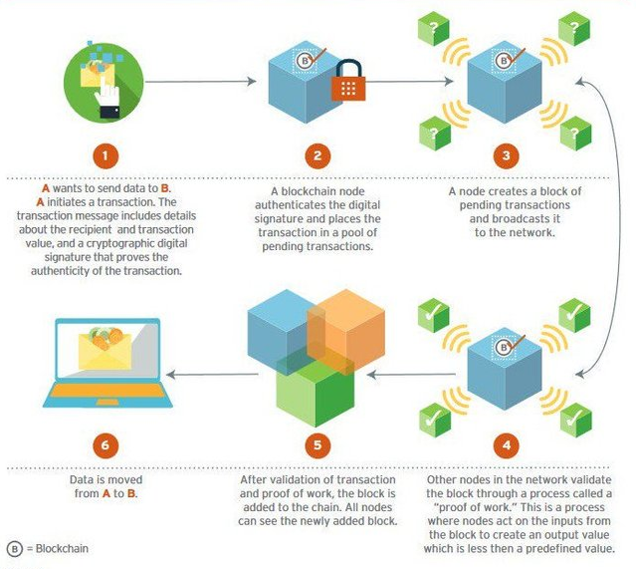
A sample workflow of Blockchain-related processes
https://steemit.com/blockchain/

Slide 14
Distributed Ledger Technology
The distributed ledger database is spread across several nodes (devices) on a peer-to-peer network,
where each replicates and saves an identical copy of the ledger and updates itself independently.
The primary advantage is the lack of central authority.
When a ledger update happens, each node constructs the new transaction,
and then the nodes vote by consensus algorithm on which copy is correct.
Once a consensus has been determined, all the other nodes update themselves with the new, correct copy of the ledger.
Difference between: Public, Private and Hybrid ledgers
R. Maull, P. Godsiff, C. Mulligan, A. Brown, and B. Kewell, “Distributed ledger technology: Applications and implications,” Briefings in Entrepreneurial Finance, vol. 26, no. 5, pp. 481–489, 2017

Slide 15
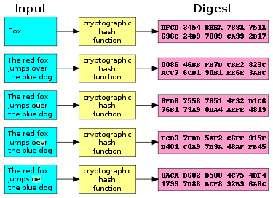
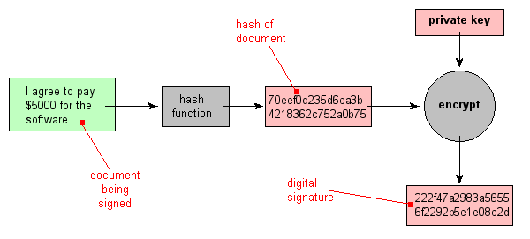
Cryptographic Hash Function
Steve Friedl's Unixwiz.net Tech Tips
An Illustrated Guide to Cryptographic Hashes
http://www.unixwiz.net/techtips/iguide-crypto-hashes.html

Slide 16
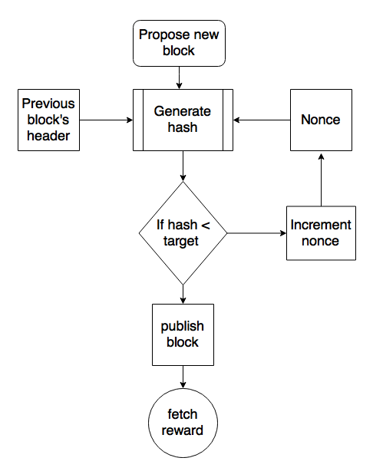
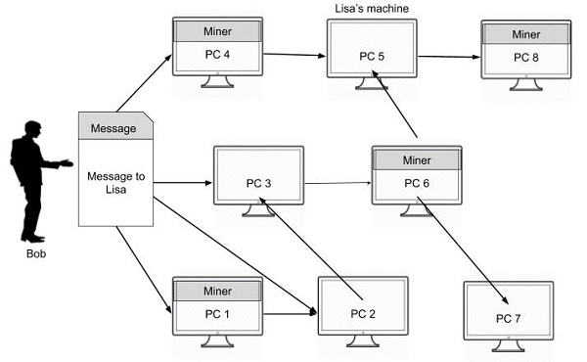
Mining
The primary purpose of mining is to set the history of transactions in a way that is computationally impractical to modify by any one entity.
By downloading and verifying the blockchain, the nodes are able to reach consensus about the ordering of events.
The mining process at the nodes
The message gets broadcasted to the entire network – including miner nodes.
https://www.tutorialspoint.com/blockchain/bitcoin_mining.htm
https://www.codeproject.com/Articles/1257601/Introducing-the-Process-of-Mining-in-Blockchain

Slide 17
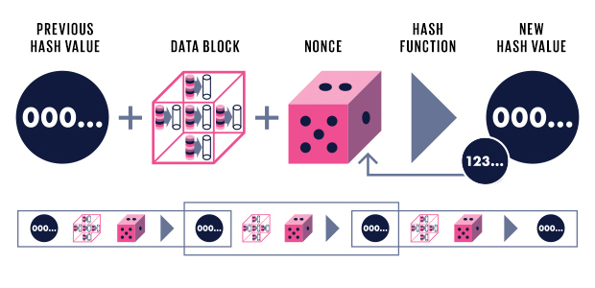
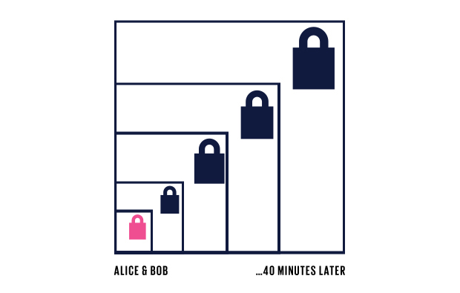
Consensus algorithms: Proof of Work
How Blockchains Work
Illustrated from transaction to reward
By Morgen E. Peck - IEEE Spectrum
https://spectrum.ieee.org/computing/networks/how-blockchains-work

Slide 18
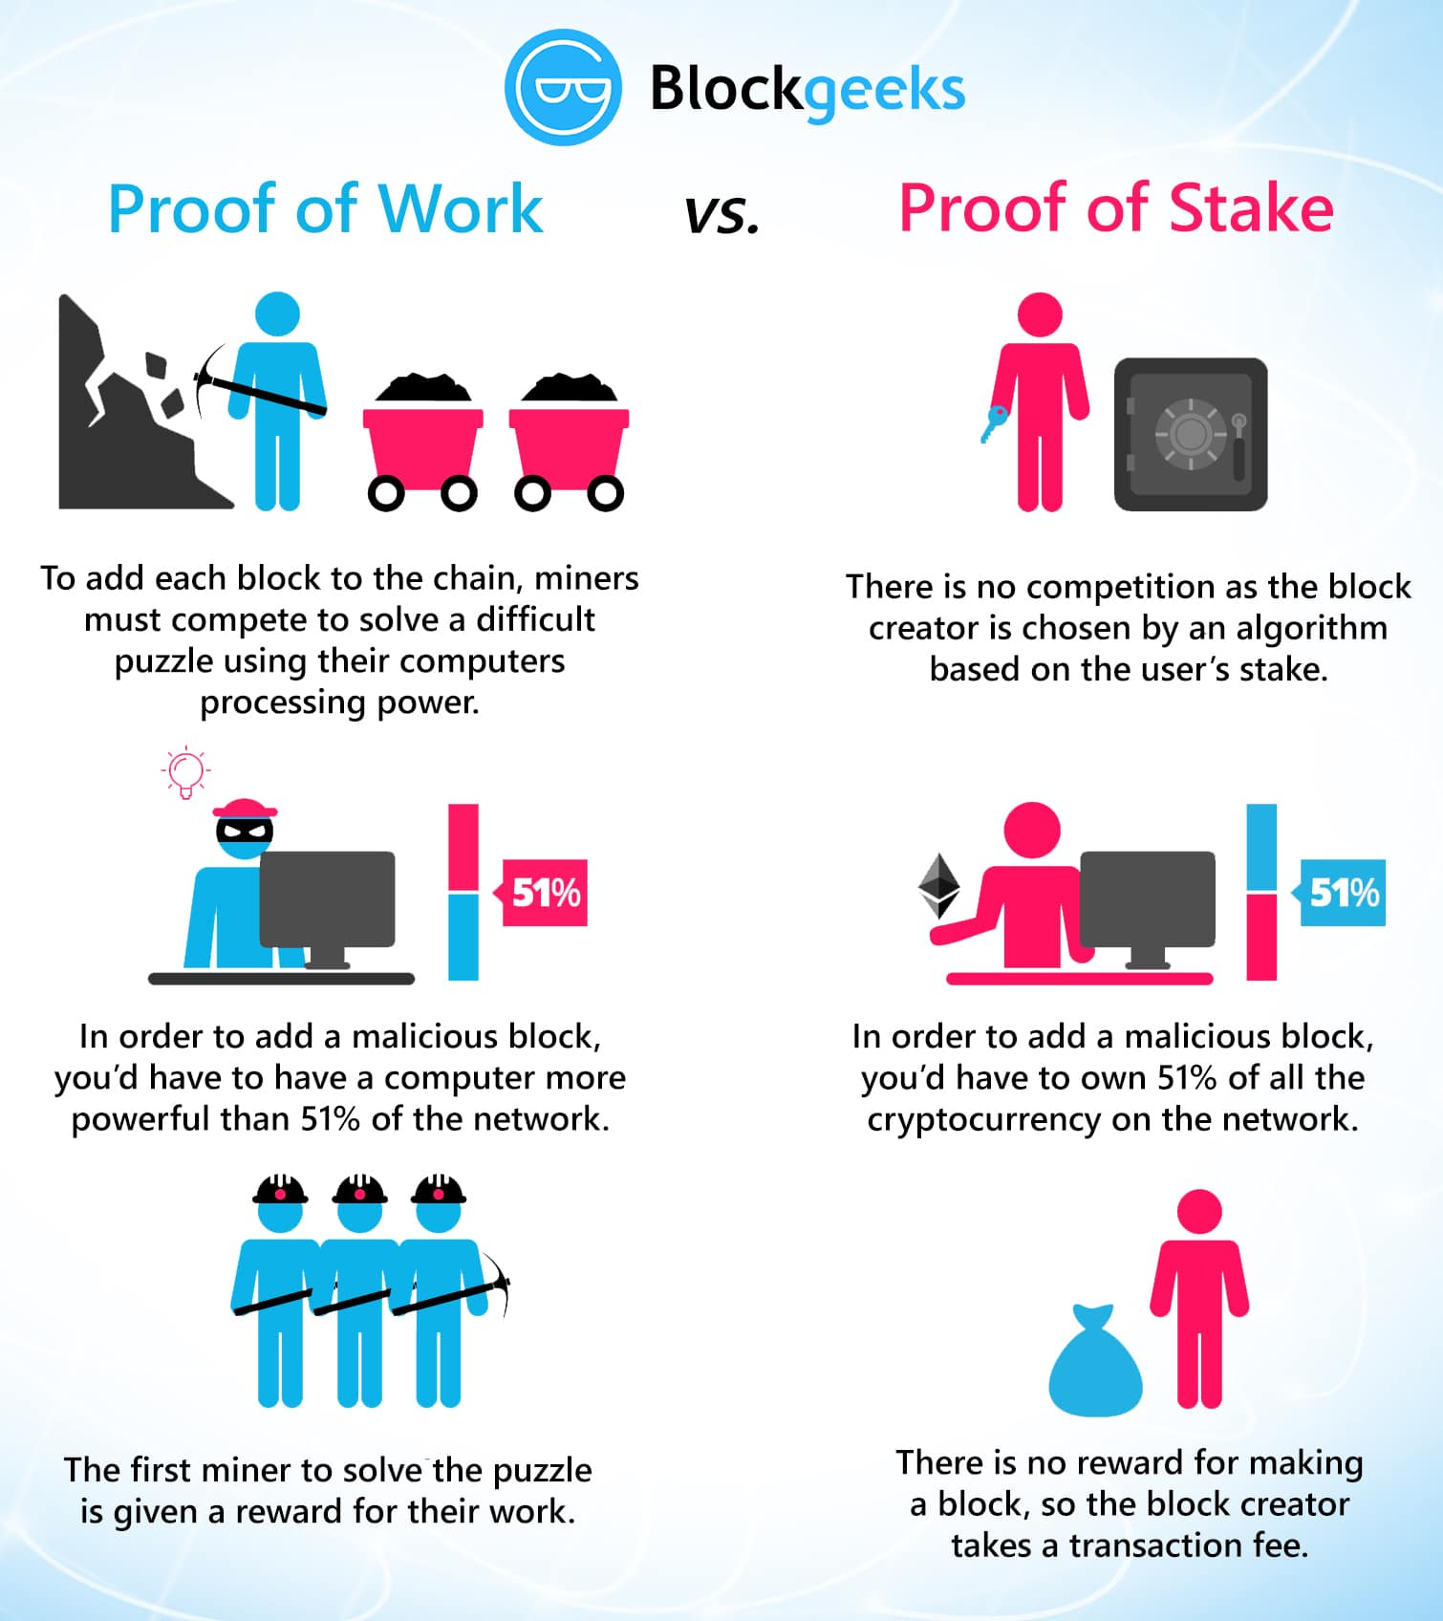

Slide 19
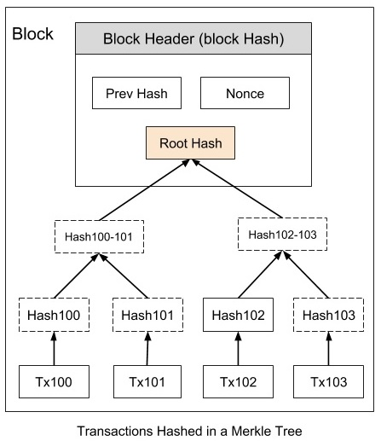

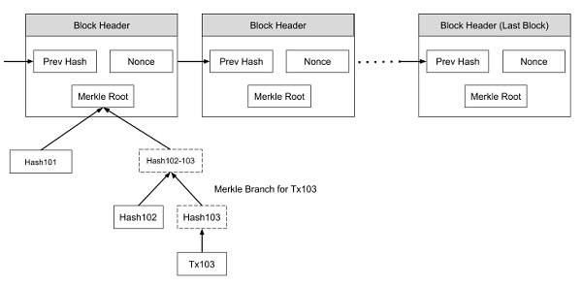
Merkle Tree
https://www.tutorialspoint.com/blockchain/blockchain_merkle_tree.htm

Slide 20
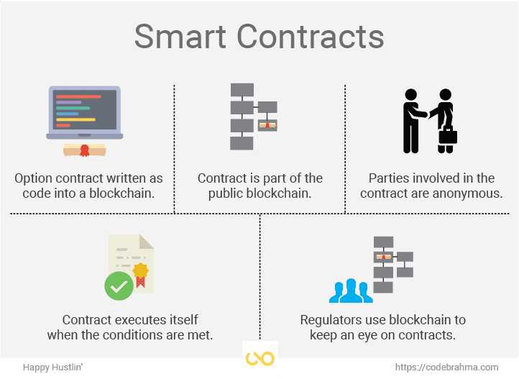

Slide 21
…and then Smart Contracts among all the players go into blockchains

Slide 22
The Demo

Slide 23
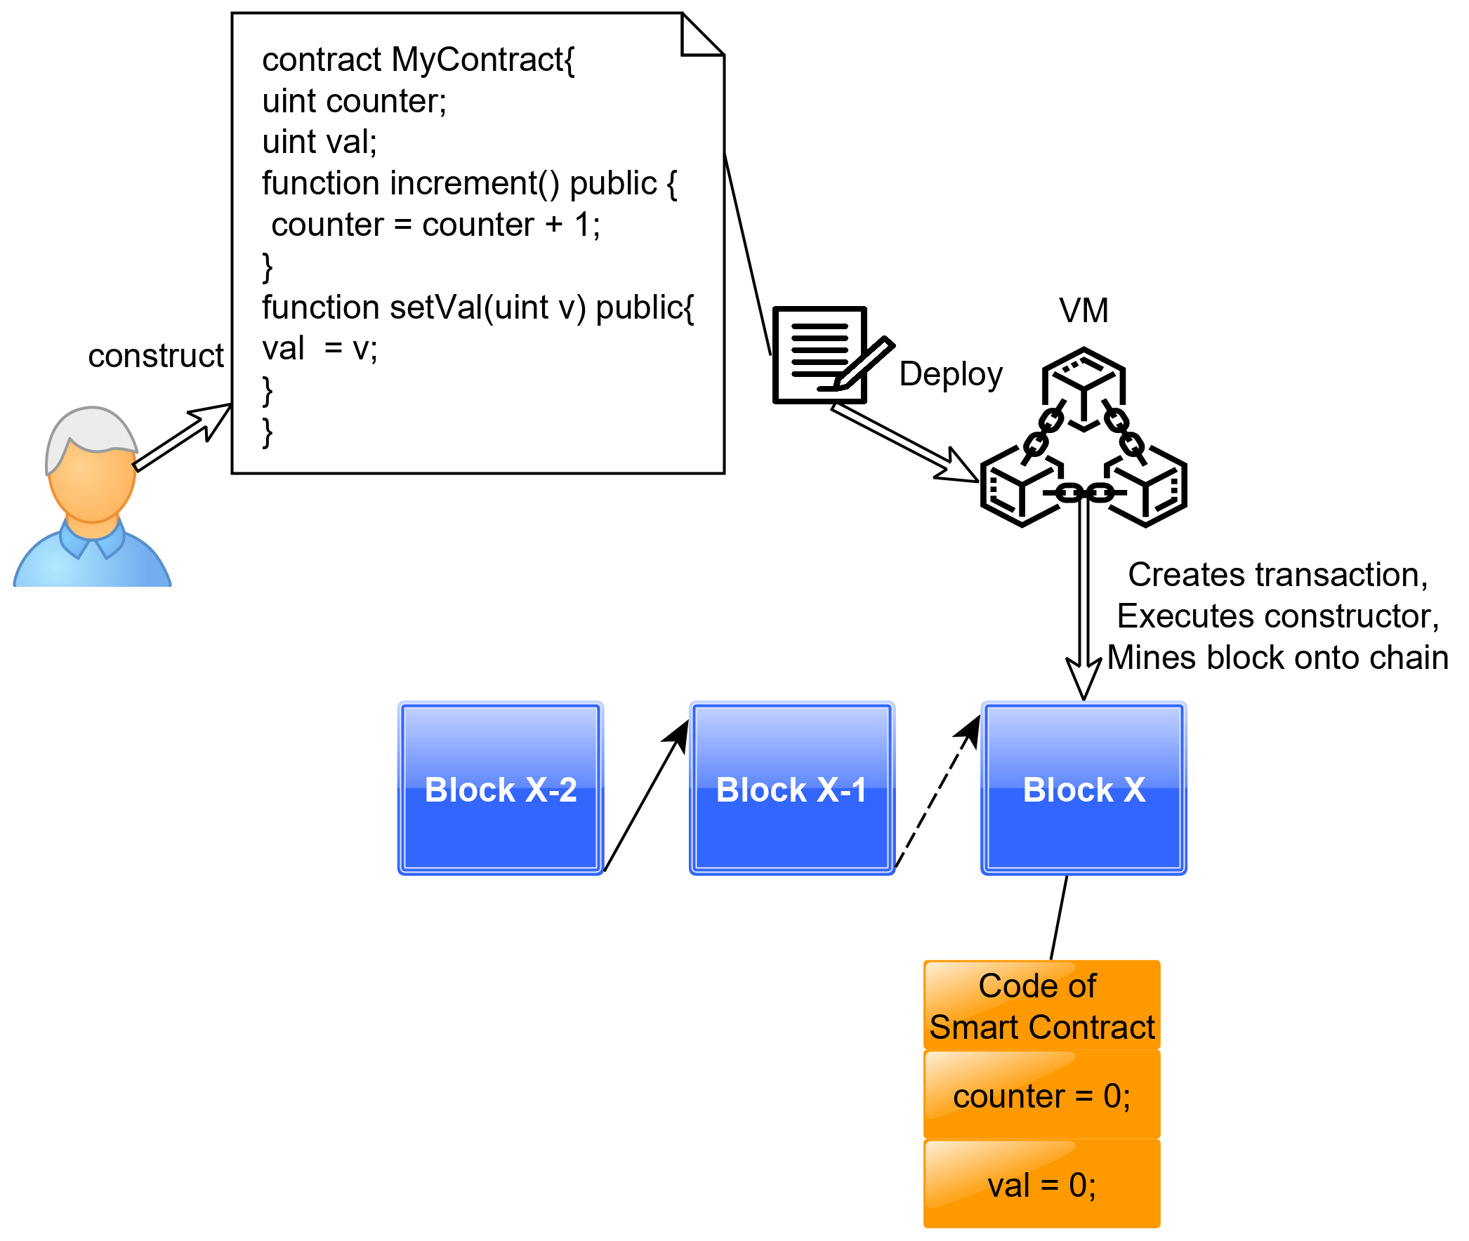
Smart Contracts using Ethereum
User constructs smart contract, VM deploys it onto the chain

Slide 24
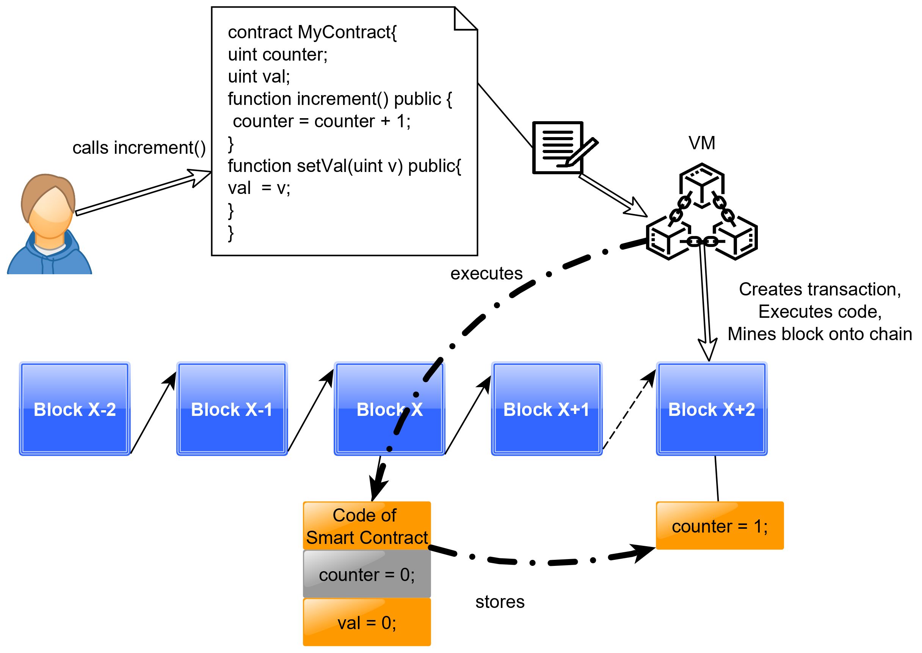
Smart Contracts using Ethereum
User calls a function of the smart contract, VM executes code, creates transaction, mines block onto the chain

Slide 25
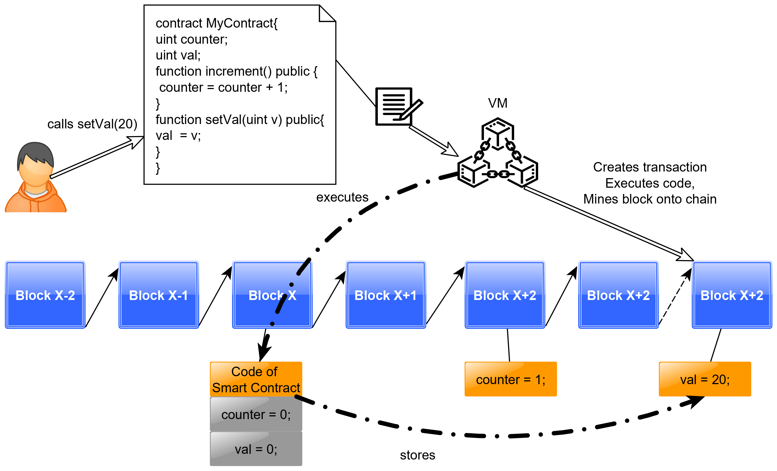
Smart Contracts using Ethereum
Another user calls a different function, at every point of time, orange data members indicate a valid state of the contract object

Slide 26
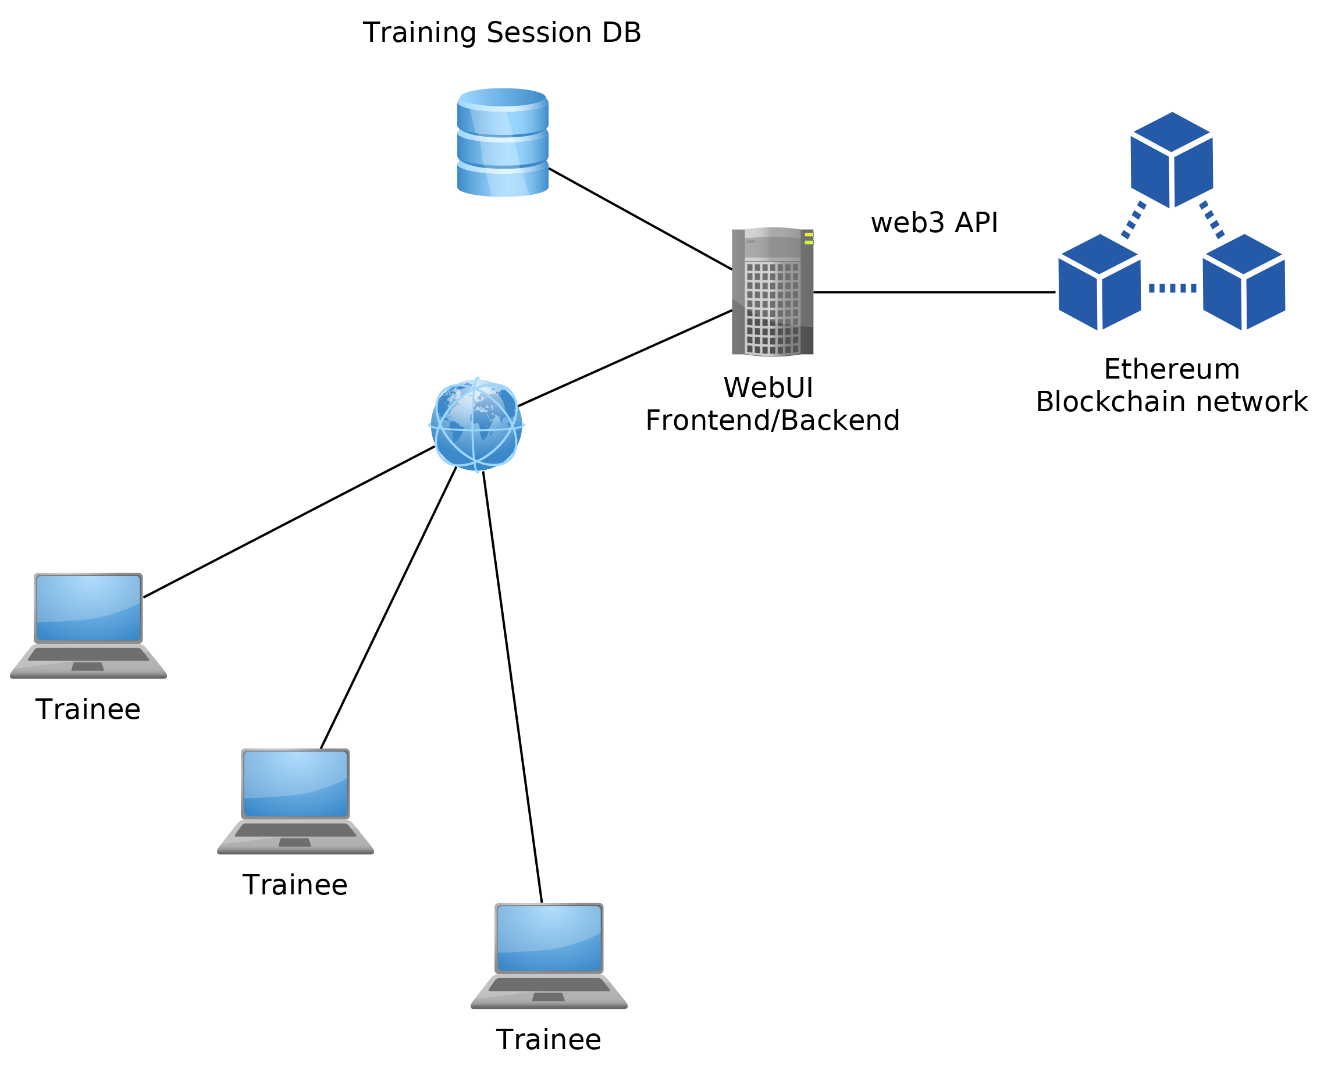
The Demo Environment

Slide 27
Tutorial Exercises
Verify Logins
Transactions using the console
PowerBid game
Description of the contract
Deployment, bidding and evaluation
Summary
Implement a number guessing game

Slide 28
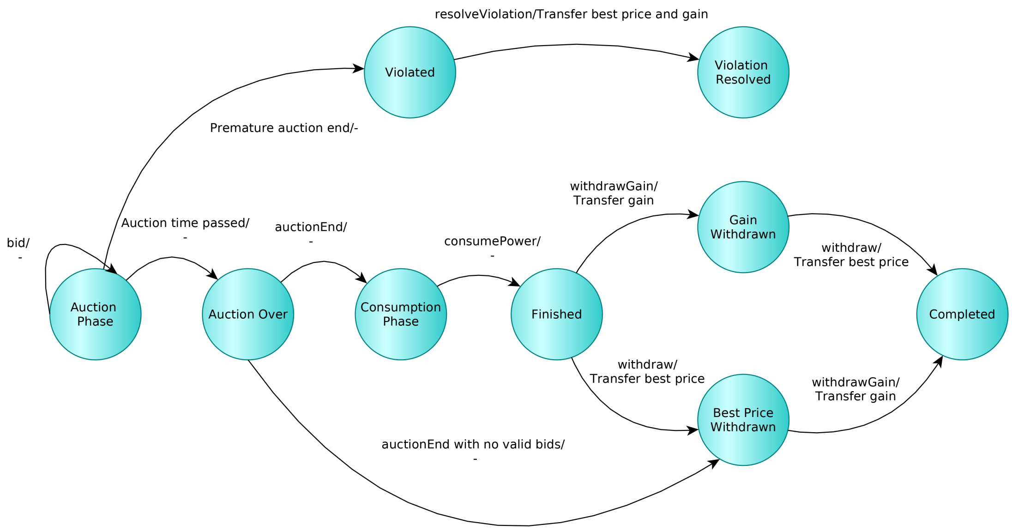
PowerBid game

Slide 29
And now: let’s go for the hands-on demo!
Pal Varga
pvarga@tmit.bme.hu
Ferenc Nándor Janky
janky@tmit.bme.hu

