Slide 1

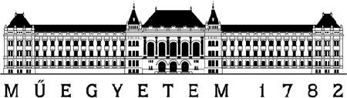
Blockchains for Industrial IoT - A Tutorial -
15th International Conference on Network and Service Management Halifax, Canada
21-25 October 2019
Pál Varga,
Ferenc Nándor Janky
Budapest University of Technology and Economics

Slide 2
Overview
Motivation: using Blockchains for Industrial IoT
Generic considerations
IoT security: a brief overview on issues and solutions
Special features of Blockchains to be utilized by IIoT
When is it beneficial to use BCT for IIoT?
Blockchain-related concepts
Blockchain
A sample workflow of Blockchain-related processes; Distributed Ledgers;
Cryptographic Hash Function; Mining; Consensus algorithms; Merkle Tree
Smart Contracts
Introduction to the demo Environment: Ethereum and S.C.
Demo: Power-bidding game
Programming for the advanced: Number Guessing game

Slide 3
Motivation: using Blockchains for Industrial IoT

Slide 4
Blockchains for Industrial IoT: General considerations
s

Slide 5
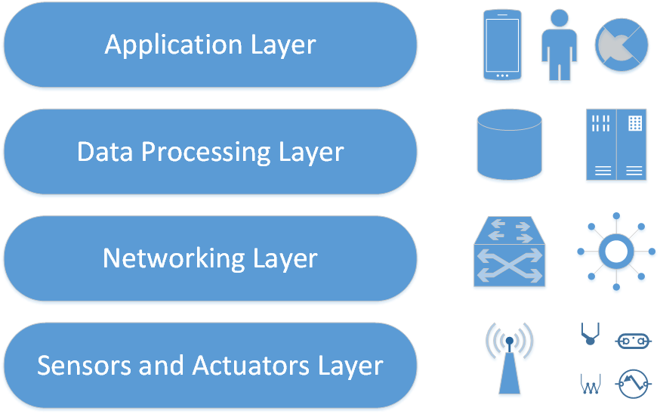
IoT security: a brief overview

Slide 6
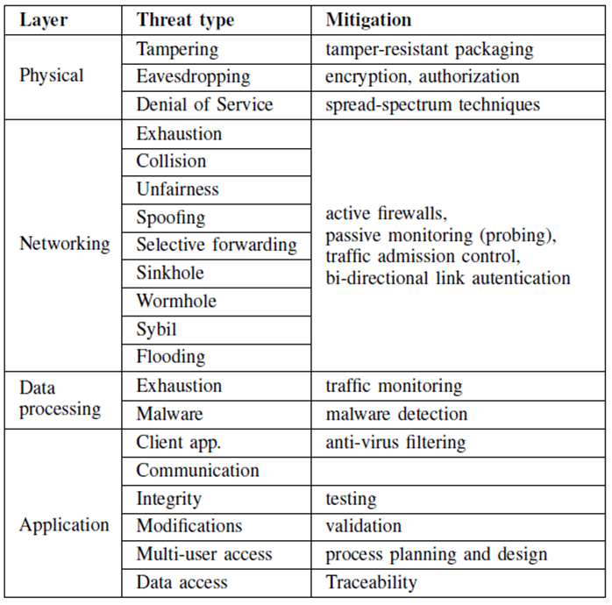
IoT security: a brief overview

Slide 7
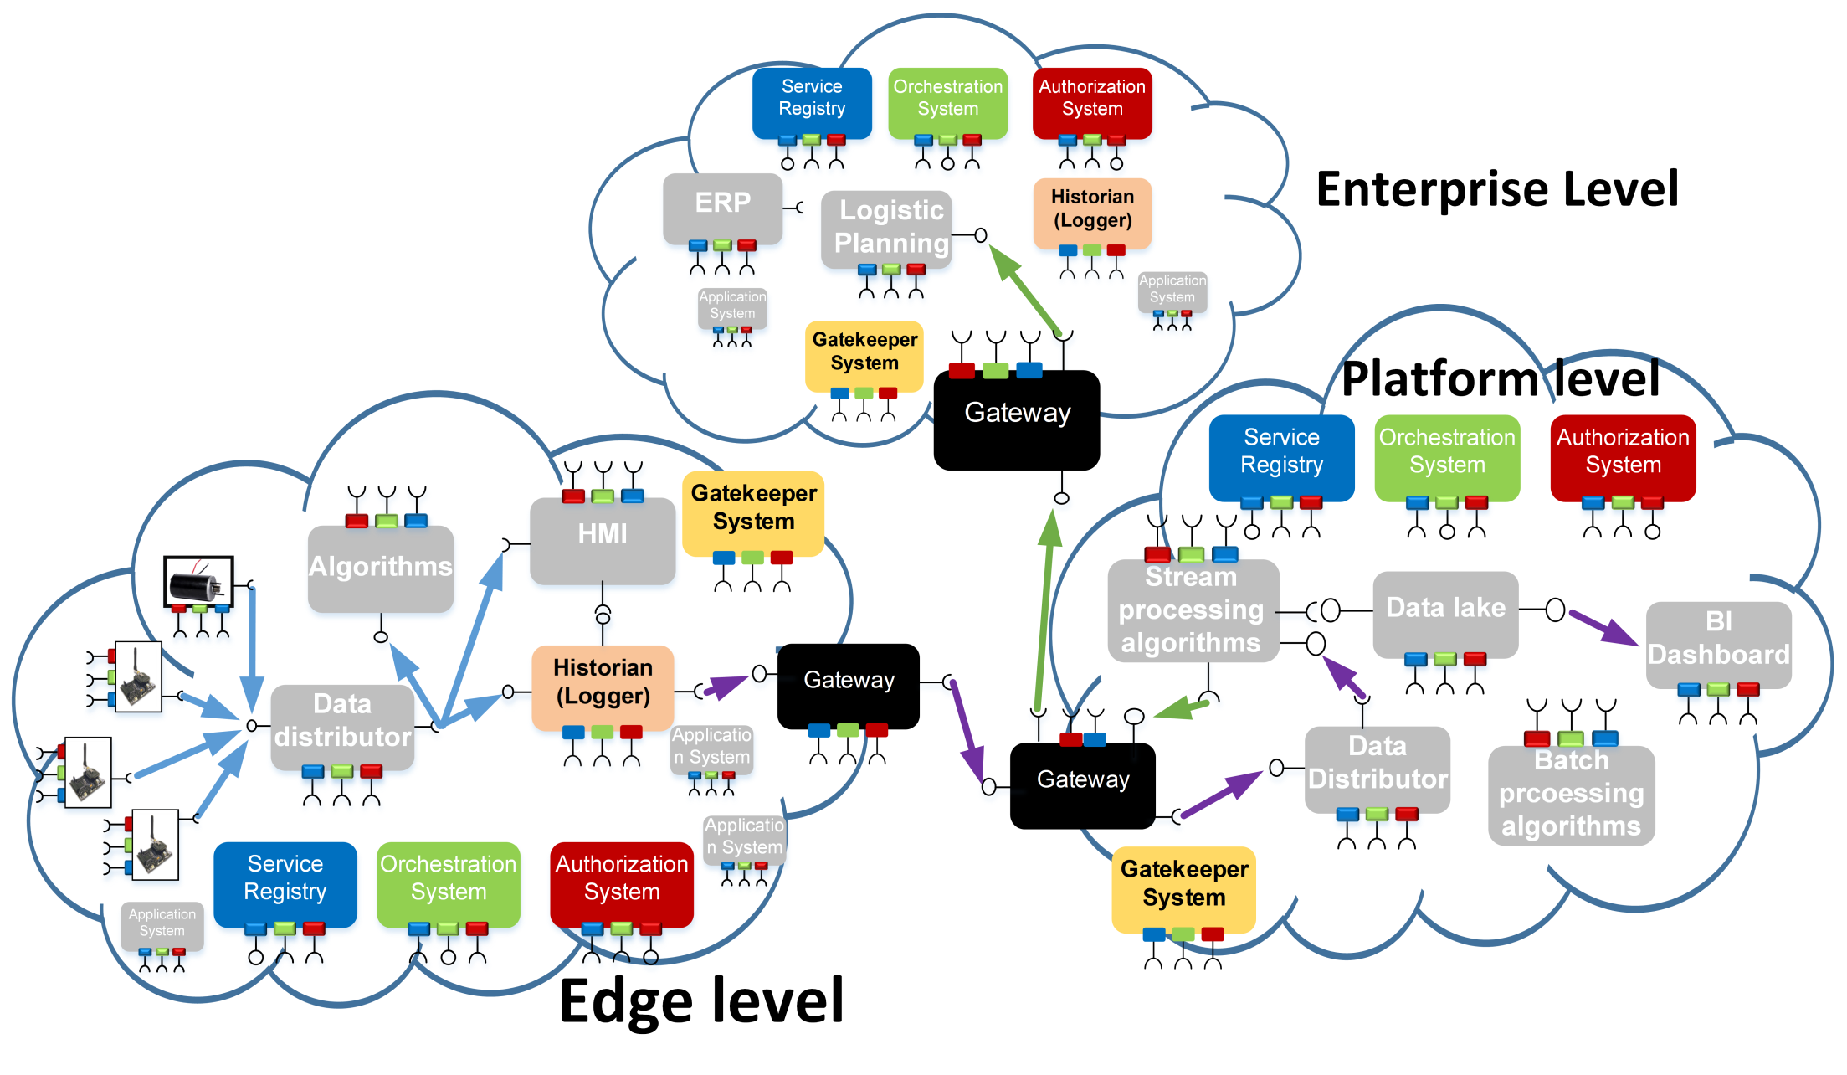
Spec. features of Blockchains to be utilized by IIoT: interoperability across IoT devices, IoT systems and industrial sectors
The Arrowhead Framework
Service Oriented Architecture
Local IoT Clouds
Inter-Cloud communication

Slide 8
Special features of Blockchains to be utilized by IIoT
Traceability and Reliability of IoT data

Slide 9
Special features of Blockchains to be utilized by IIoT
Improved Security of IoT system-of-systems through blockchains

Slide 10
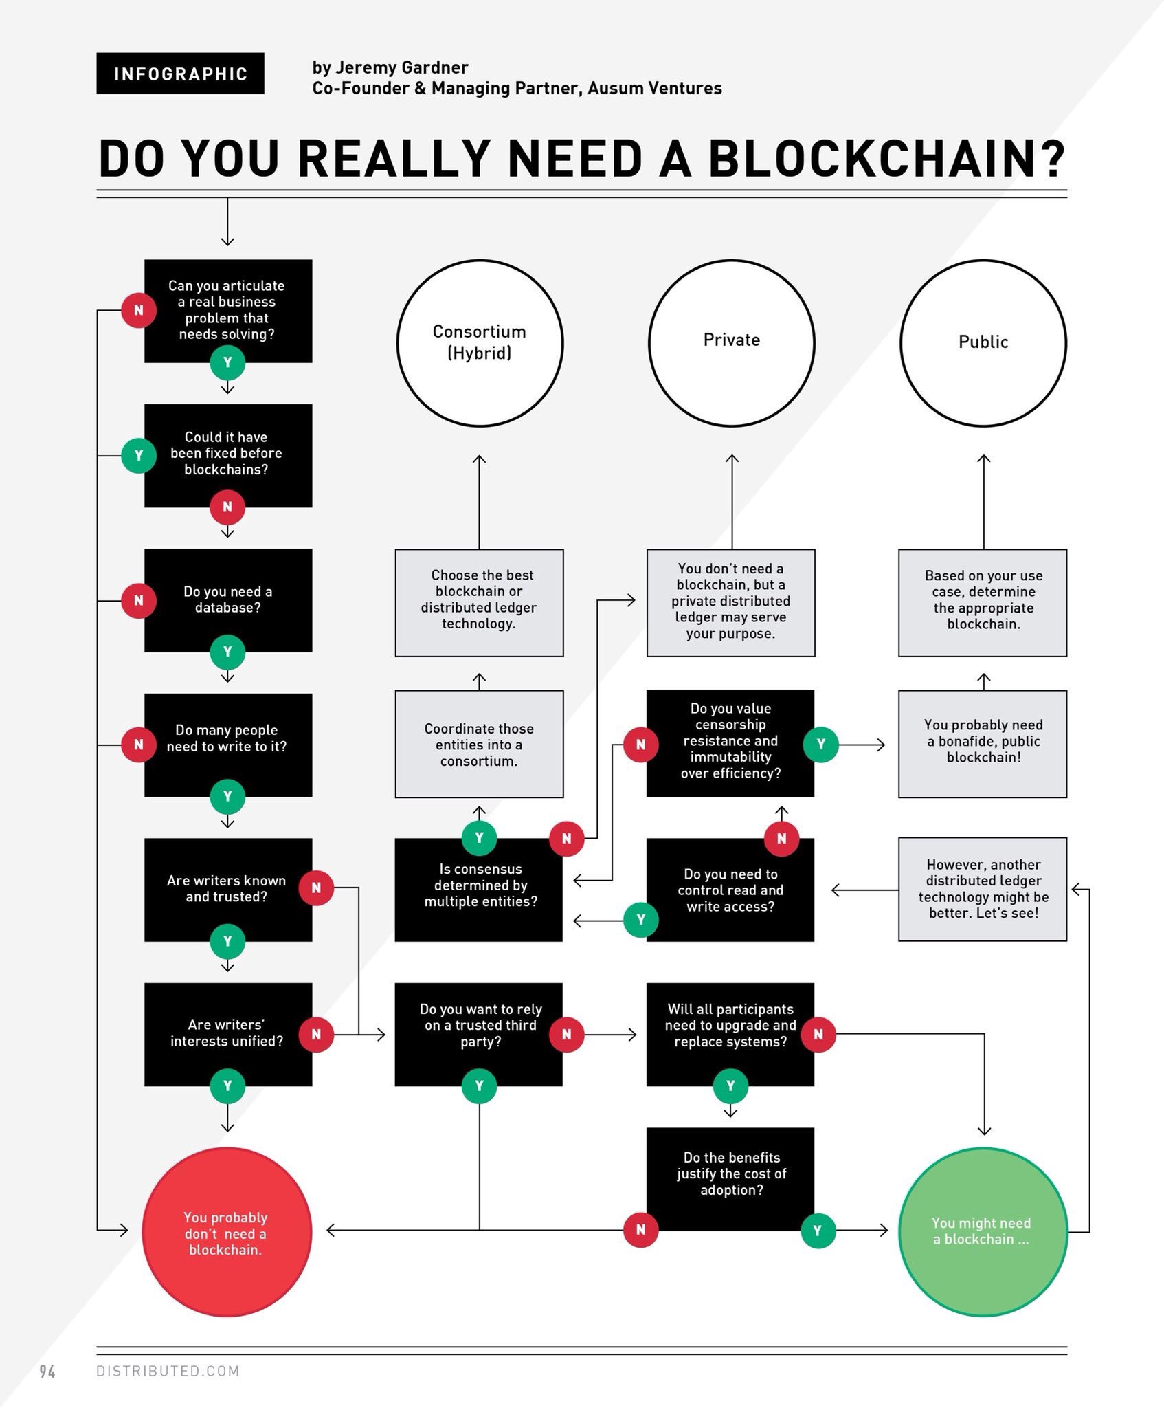
When is it beneficial to use BCT for IIoT?
Do You Need to use Blockchains? (by Jeremy Gardner, 2018)

Slide 11
Precautions for Blockchain usage
I…

Slide 12
Precautions for Blockchain usage
I…

Slide 13
Blockchain-related concepts

Slide 14
Blockchain
I…

Slide 15
A sample workflow of Blockchain-related processes
I…

Slide 16
Distributed Ledger Technology
I…

Slide 17
Cryptographic Hash Function
I…

Slide 18
Mining
I…

Slide 19
Consensus algorithms
I…

Slide 20
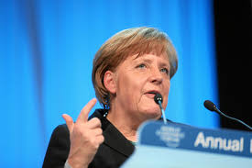
Merkle Tree
I…

Slide 21
Smart Contracts
I…

Slide 22
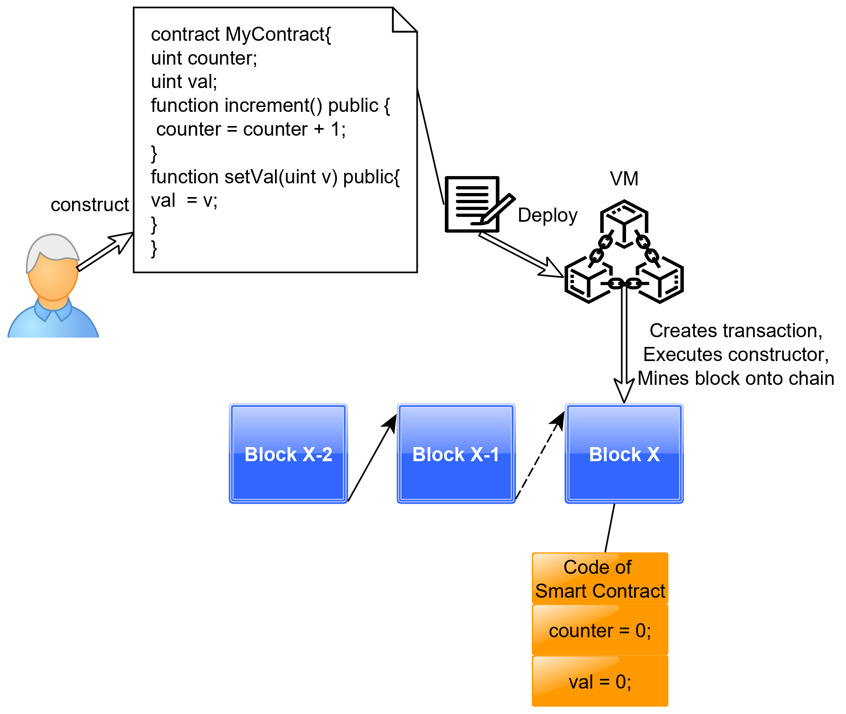
Smart Contracts using Ethereum
User constructs smart contract, VM deploys it onto the chain

Slide 23
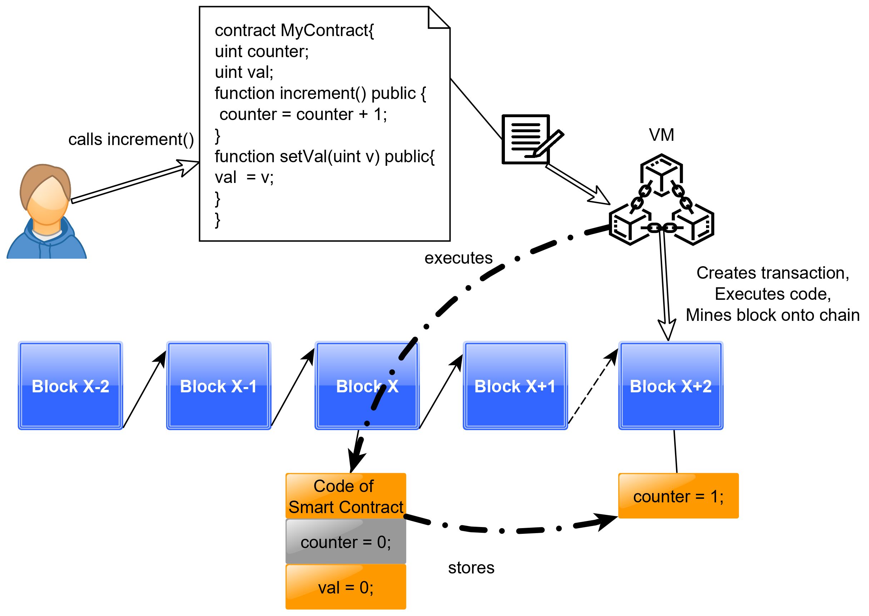
Smart Contracts using Ethereum
User calls a function of the smart contract, VM executes code, creates transaction, mines block onto the chain

Slide 24
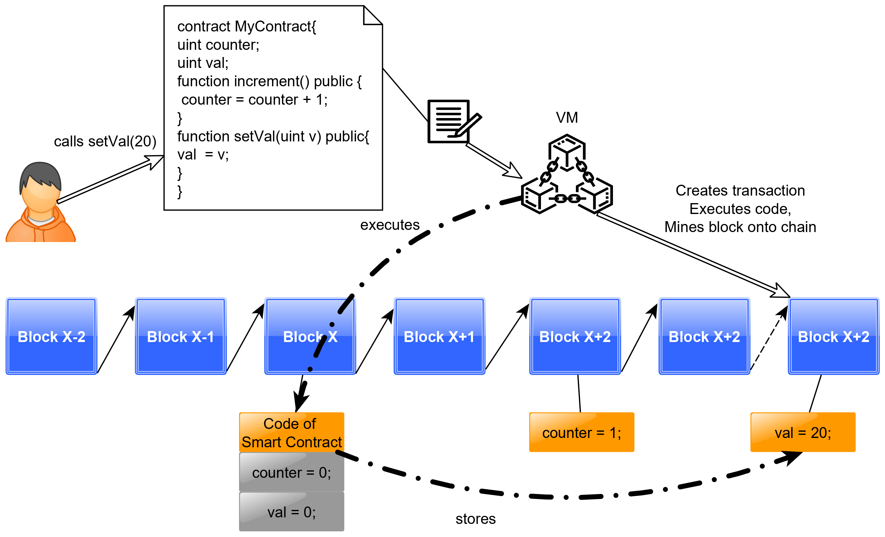
Smart Contracts using Ethereum
Another user calls a different function, at every point of time, orange data members indicate a valid state of the contract object

Slide 25
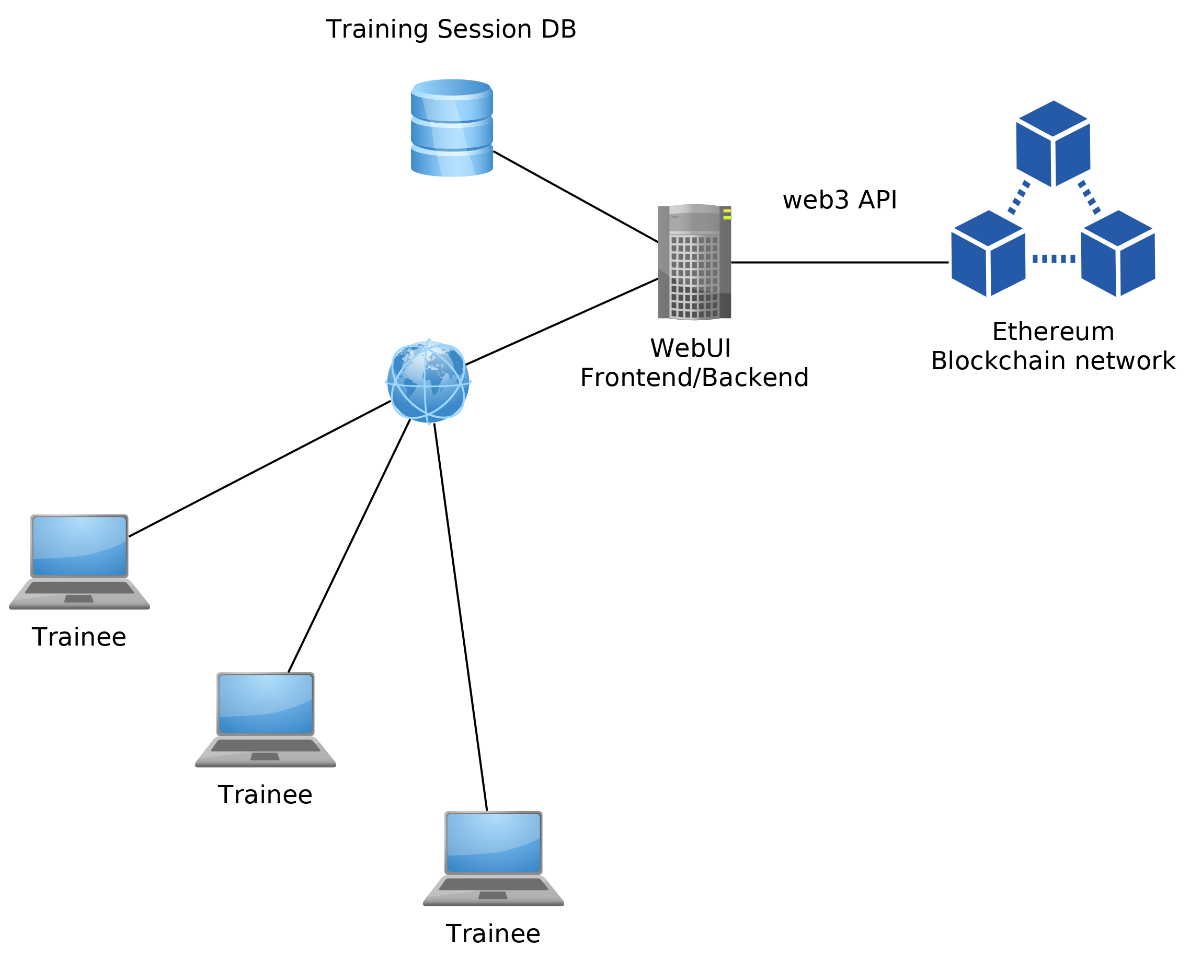
The Demo Environment

Slide 26
Tutorial Exercises
Verify Logins
Transactions using the console
PowerBid game
Description of the contract
Deployment, bidding and evaluation
Summary
Implement a number guessing game

Slide 27
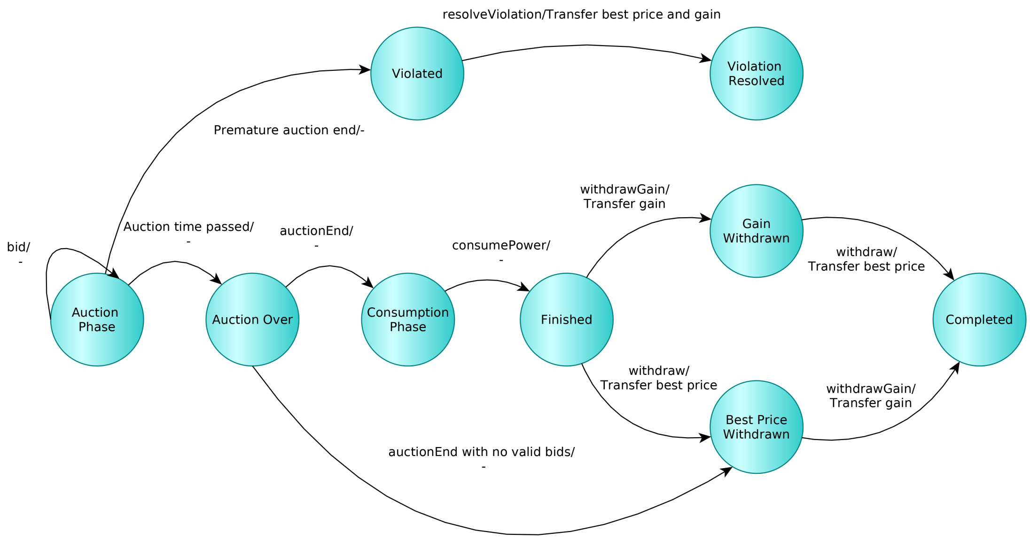
PowerBid game

Slide 28
And now: let’s go for the hands-on demo!
Pal Varga
pvarga@tmit.bme.hu
Ferenc Nándor Janky
janky@tmit.bme.hu

