Slide 1
Notejam
Sample Project for Toptal
Fernando Teixeira
fecotex@gmail.com

Slide 2
Project specs:
Design a scalable and secure continuous delivery architecture for a full-stack web application
The architecture needs to be broken down into the relevant tiers (application, database, etc…).
The architecture should be completely provisioned via Chef/Puppet/Ansible/similar.
The deployment of new code and execution of tests should be completely automated.
The database and any mutable storage need to be backed up at least daily.
All relevant logs for all tiers need to be easily accessible.
You should fork the repository and use it as the base for your system.
You should be able to deploy it on one major Cloud provider: AWS / Google Cloud / Azure / DigitalOcean / RackSpace.
The system should present relevant historical metrics to spot and debug bottlenecks

Slide 3
Expected delivery bundle:
Solution overview:
An architectural diagram / PPT to explain your architecture during the interview.
All the relevant configuration scripts (Chef/Puppet/cfengine/ansible/cloud formation).
All the relevant runtime handling scripts (start / stop / scale nodes).
All the relevant backup scripts (start / stop / scale nodes).
The forked version of the app you are going to use.
Cloud provider: AWS
Provision: CloudFormation
CI/CD: CodePipeline/CloudBuild with github/S3 integration
App: Elasticbeenstalk
Database: RDS
Monitorig: Cloudwatch
Logs: Cloudwatch For Logs and S3

Slide 4
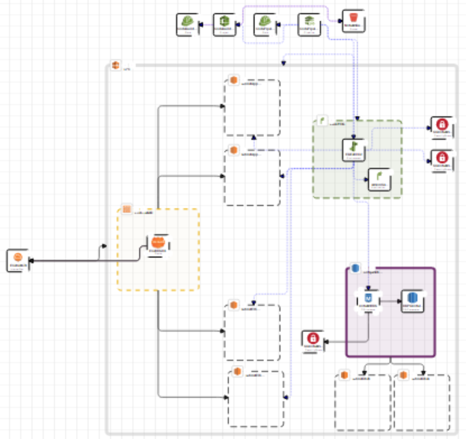
Architecture diagram
Application Stack
LoadBalancing
ElasticBeanstalk
Application
ElasticBeanstalk
Database
RDS
CI/CD Stack
Github
S3
CodePipeline
Codebuild
ElasticBeanstalk

Slide 5
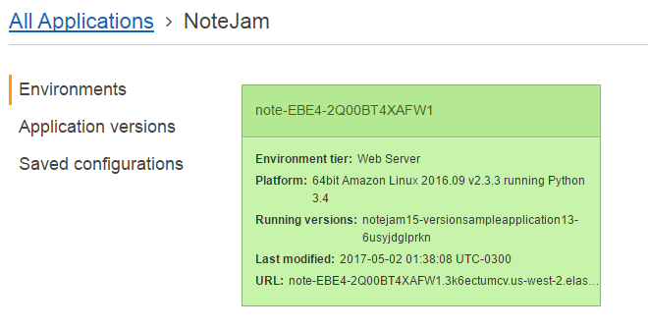
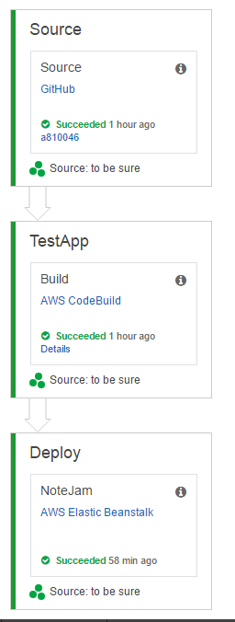
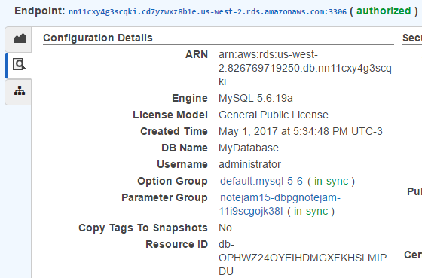
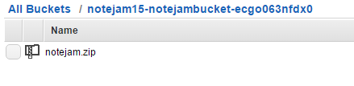
Provisioning
CloudFormation Template
App
Without SSL
CI/CD
Github Source
S3 (Third Party CI)

Slide 6

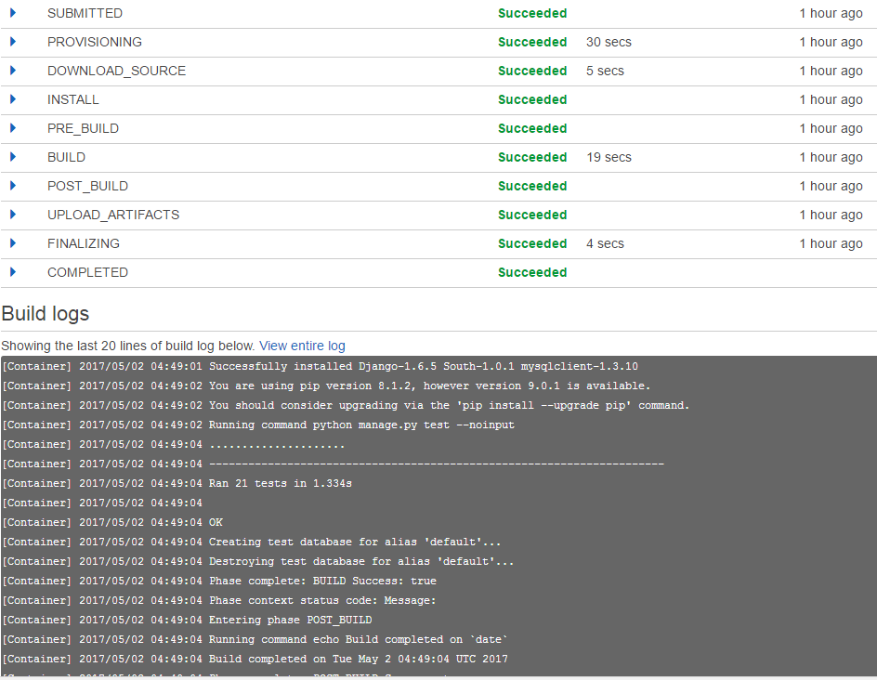
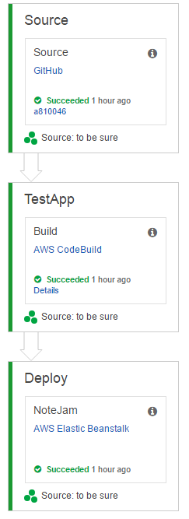
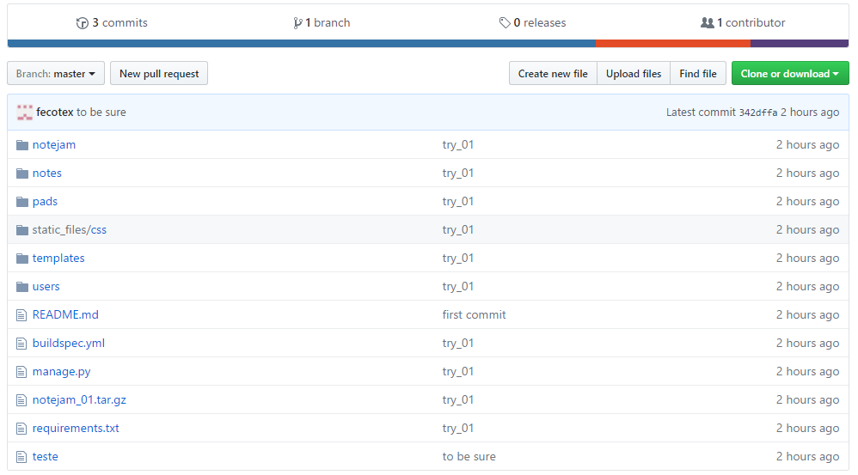
Deployment
Cloudformation CI/CD
Github Source
S3 (Third Party CI)

Slide 7
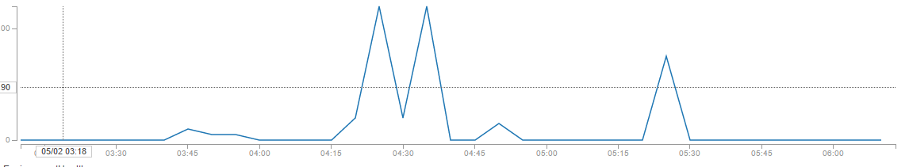
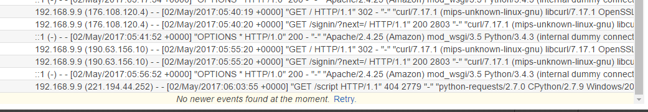
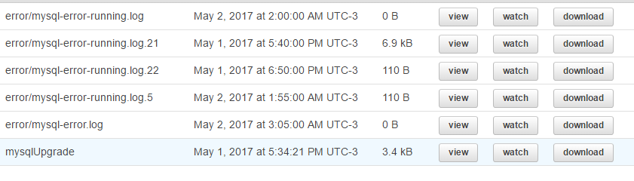
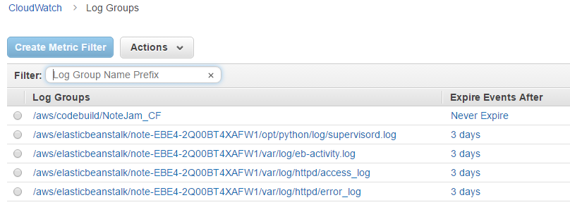
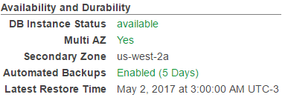
Backup
Logs
Metrics
Daily
5 days retention
RDS service
Stream NRT
3 days retention
S3 Storage for ever
Polling 5 min
14 days retention

