Slide 1
Final Project Azure Log Analytics in Operations Management Suite
Khushu, Ruchit
Deep Azure@McKesson
Dr. Zoran B. Djordjević

Slide 2
Introduction
Infrastructure and Application monitoring are one of most critical requirements for any IT shop. It is impossible to think of a sound operational support model without the right kind of monitoring setup and tools .
Log Analytics is a crucial component of the Microsoft Azure Monitoring Solution. It is a service that helps us to monitor both our cloud as well as on-premise environments in order to maintain their availability and performance.
It provides us with lot of critical information about our workloads. It is not just a monitoring solution but also a collection of invaluable log data on which further analysis can be performed to ensure superior health and stability of our workloads.

Slide 3
Objectives of the Project
The first and foremost objective of this project is fairly simple. It is to set up a Log Analytics based monitoring for various Azure resources.
I have tried to demonstrate this whole process right from the scratch – Setting up OMS workspace, adding to it the various resources (virtual machines , KPI etc. ) that need to be monitored and subsequently setting up dashboards and alerts. I also have shown examples of how changes made to the resources populate data in Log Analytics.
End goal is to be provide a run-book for basic set up of Log Analytics..

Slide 4
Monitoring Options Available in Azure
Azure gives us plenty of monitoring options/solutions. Prominent ones are: -
Azure Monitor , Advisor and Service Health for Basic Monitoring.
Application Insights for Application Monitoring
Log Analytics, Management Solutions, Network watcher and Service Map for Infrastructure monitoring.
Log Analytics also allows us to quickly connect and collect log data from multiple sources which can then be queried using a highly expressive language and subsequently be used for deeply insightful analysis.

Slide 5
Log Analytics – Set up
Log Analytics is a standard service offered by Azure however Configuration work is needed .
We need to start with creation of an OMS workspace where all the data generated by monitored resource is collected. This is a simple step and can be done either using Azure Portal or through PowerShell commands.
Next we need to added resources to be monitored again something that can be done either using Azure Portal or through PowerShell commands.
Once this basic set up is done we can proceed with set up Alerts . The alerts can be for KPIs as well for items like Application service availability . This is followed by dashboard set up.

Slide 6
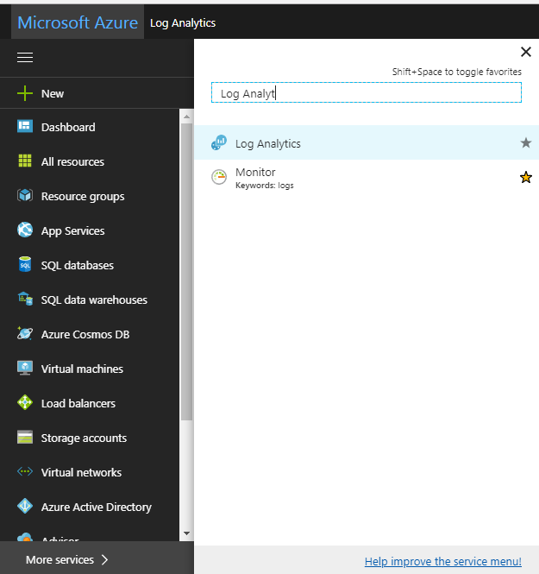
OMS Workspace-Basic Overview-I
An OMS workspace is essentially a container that includes account information and simple configuration information for the account.
The OMS workspace is related to a subscription .
To create OMS workspace through Azure portal select “More Service” and then type in “Log Analy…” .. Click on Log Analytics..

Slide 7
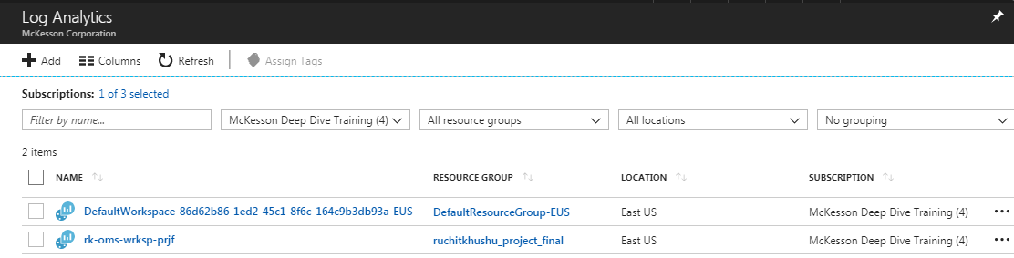
OMS Workspace-Basic Overview-II
On clicking on Log Analytics you will get the following screen that will depict the existing workspaces:
You can click on Add to create a new workspace and fill up the input fields in the subsequent fields.
Or you can use simple powershell cmdlet :- New-AzureRMOperationalInsightsWorkspace for this and create it programatically

Slide 8
Advanced configuration to the Workspace
Once the workspace has been created we next need to perform some critical configuration activities.
We can do this configuration either programmatically or through Azure portal/OMS portal. If creating the OMS workspace programmatically we can do a lot of the configuration work in the workspace creation script.
OMS portal is a dedicated portal for OMS activities.
As part of the configuration we can also deploy available solutions from OMS solutions gallery to OMS workspace. Few examples of these solutions are: Alert Management, Security , Update Management ,Agent health check etc.

Slide 9
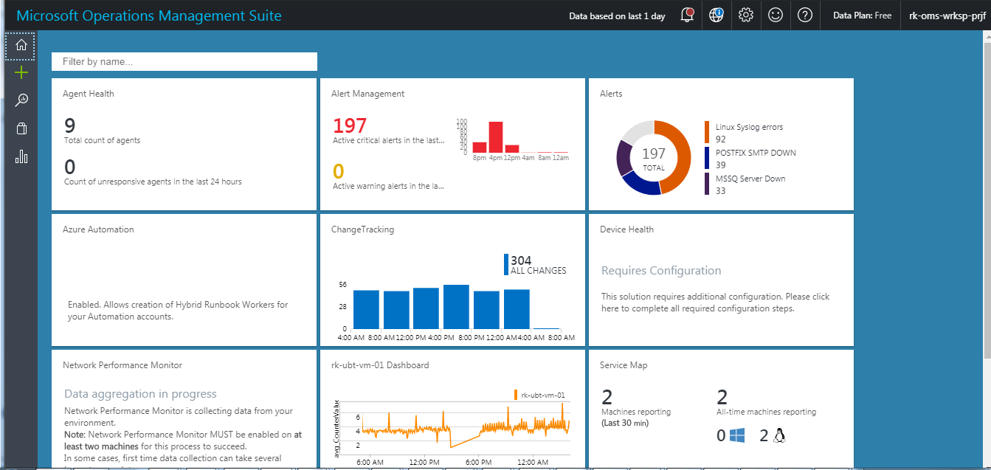
OMS Portal– A view
This is view of the OMS workspace portal built for the project:
Dashboard View Designer
Log Search
OMS Settings
Solutions Gallery

Slide 10
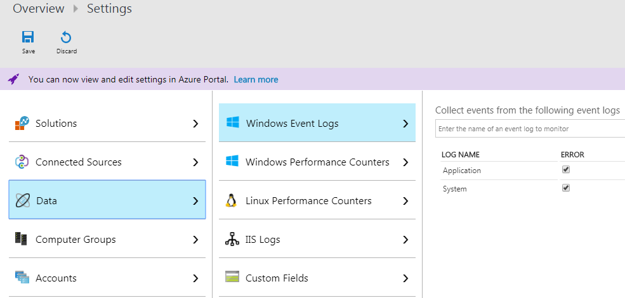
OMS Portal-Functionalities
We can do a whole lot of stuff within the OMS portal ranging from configuration to solution deployment. Some of these activities can be done in Azure portal as well.
We can go to Settings button in OMS portal and do configuration work. For example:
In the settings tab we can also define OMS workspace permissions under Accounts section.

Slide 11
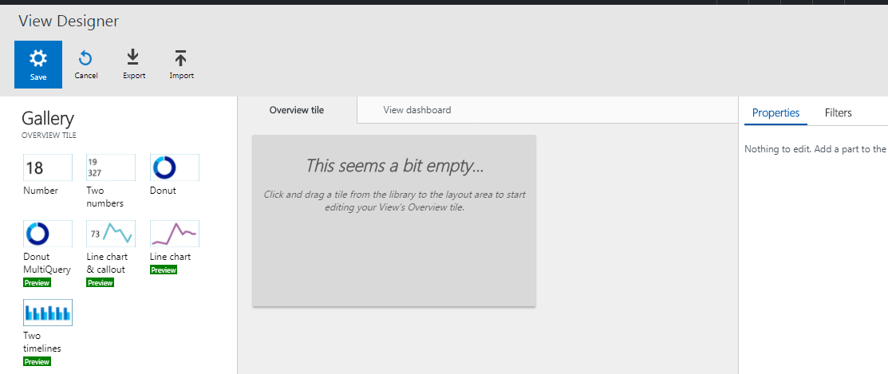
OMS Portal- Designer View
We can also create our own dashboards in the OMS portal using Dashboard view designer.
We can choose the dashboard type and then proceed to define the queries which would be visualized in the board.

Slide 12
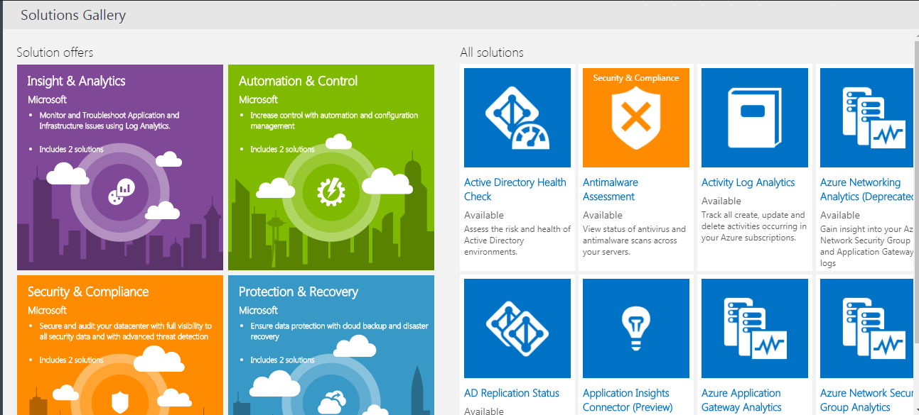
OMS Portal-Solution Gallery
We can also deploy solutions using solutions gallery with OMS portal.
We need to choose our solution and then follow the deployment instructions. There could be certain post deployment configurations also .

Slide 13
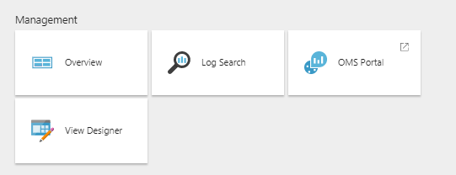
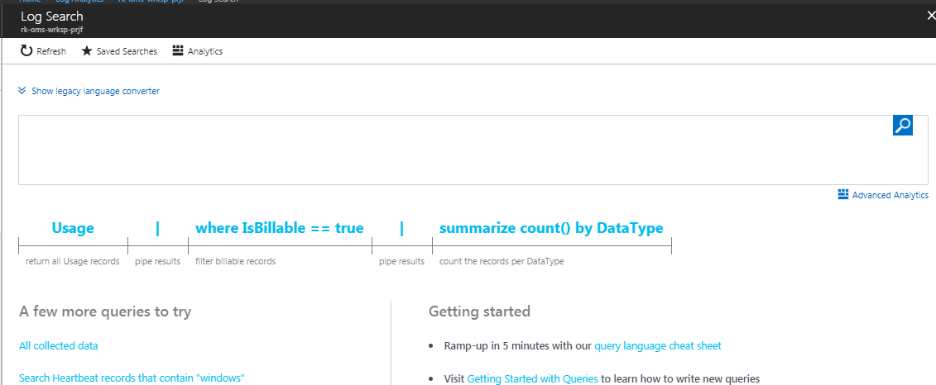
Log Search
Log query is a powerful way for searching the logs.
We can access Log search from either the Overview section for the OMS workspace in Azure portal or with in the OMS portal.
Clicking on Log search will open up the following tool where we can input our queries

Slide 14
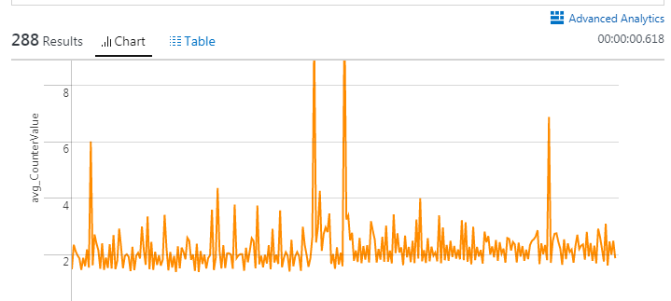
Log Search
One of the biggest advantages of Log Analytics is ease of ability to query logs and draw meaningful information from them..Here is an example.
Perf | where ObjectName=="Processor" and CounterName=="% Processor Time"| where ( Computer == "rk-win-vm-01" ) | summarize avg(CounterValue) by Computer, bin(TimeGenerated, 5min)|render barchart

Slide 15
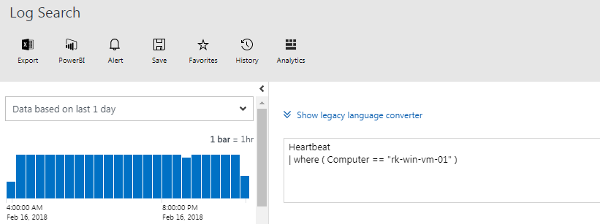
Alerts
We can set up Alerts for pro-active monitoring purposes. Alerts help us in identifying any threshold breaches.
They are useful for informing concerned teams about any service or infrastructure outages as well as for any performance related issue (for example continous CPU spikes/over utilization!!)
Alerts can be created from OMS portal or from Azure portal (Alert preview section under the OMS workspace)
To create ALERTS in OMS we need to go log search and fire a query for which Alert is sought there and execute it.. On the result screen it will give us an option to create an alert

Slide 16
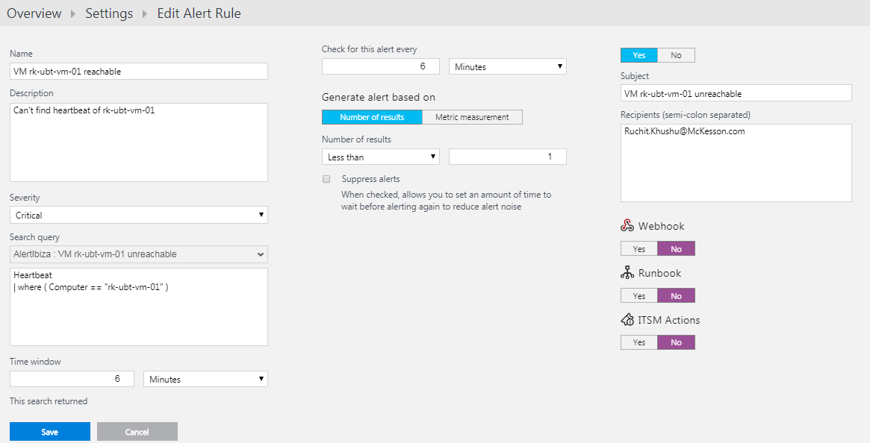
ALERT
On the next screen you need to fill in important details about the Alert we can to create:
In this case if there is not a single VM heartbeat available in log over the last “6” minutes then an Alert would be triggered and an email received.

Slide 17
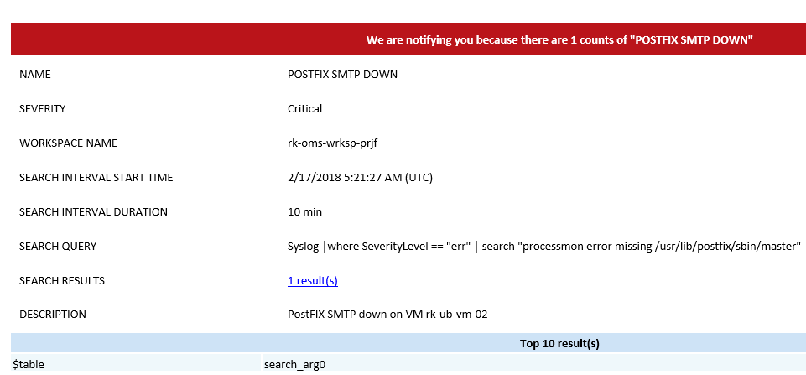
Alert
Here is an example of the e-mail Alert.

Slide 18
Pros and Cons
PROS :
Power analytical tool for searching and analyzing.
Fairly easy to set up and configure and add VMs for monitoring
Comes with dedicated OMS portal.
Supports On-Premise servers along with Azure VMs.
Log query language has been upgraded recently. There is however a legacy language converter also available in Log search that is very useful for converting legacy queries/commands into new version
CONS
Documentation not very well organized. Can be better structured. Documentation often suggests legacy commands.
Not sure why you can configure the same things in both Azure as well as OMS portal.. Ideally it should be a single window.

Slide 19
Summary
As part of the project I created an OMS workspace and then proceeded to configure it
Next I added a bunch of VMs to it (total count being 9) . These were windows as well Linux both
I imported solutions from Solution Gallery in OMS portal
Ran several log search queries and understood how they work
Built Alerts and Dashboards using log queries.
Created custom scripts wherever needs to write log data to syslog or event log.

Slide 20
YouTube URLs, GitHub URL, Last Page
Two minute (short): https://youtu.be/tEIv9lbLDZg
15 minutes (long): : https://www.youtube.com/watch?v=Zk3SMEc0Cn4 [1st part]
https://www.youtube.com/watch?v=bIOPC_rgrPI [2nd part]
GitHub Repository with all artifacts: https://github.com/ruchitkhushu/Azure-Log-Analytics-OMS

