Slide 1


Practical Project on Distributed Data Centric Networks The price of validity in dynamic networks
Brunetti Jacopo, Carmignani Federico, Caruso Paolo
Dependable Distributed Systems
Academic year: 2022/2023

Slide 2

Peer-to-peer networks and sensor networks
Massive-scale
Self-administration
Dynamic
Full of shorted-lived hosts
Distributed
Data-centric

Slide 3

The goal of the paper
Compute aggregate queries through an in-network approach
Past approaches
Best-effort
Probabilistic
we want precise guarantees
Correctness condition
A query result is «single-site» valid if equivalent to a legal failure-free computation

Slide 4



The solution
2-phases protocol: Broadcast ConvergeCast
Past choice
Spanning Tree
Now
WildFire
5X costs for count and sum queries
The price of validity

Slide 5
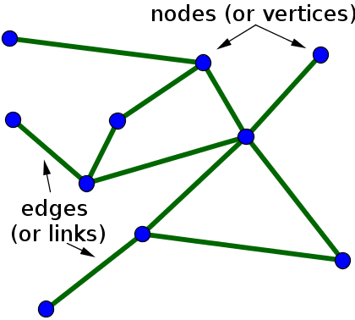
Problem setting
V = q (H)
Each host has a (k,v) pair
Model
Undirected graph in relaxed asynchronous model
Dynamism
Aggregate queries
New hosts
Failures Partitions
One-time queries

Slide 6
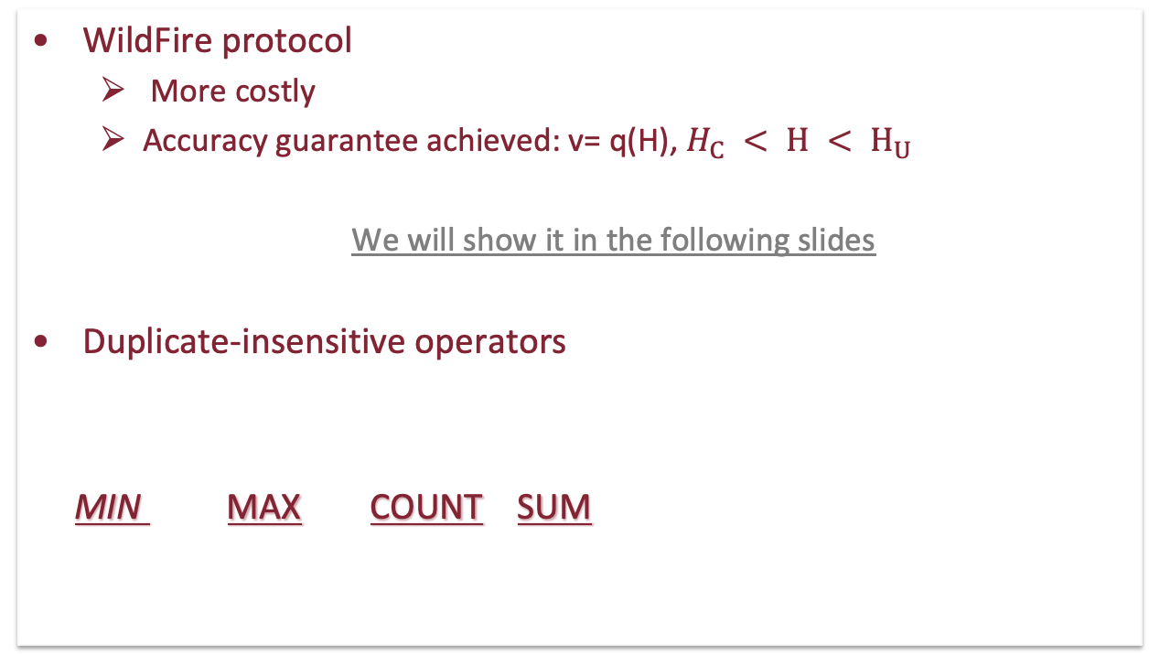
Achieving single-site validity
WildFire protocol
More costly
Accuracy guarantee achieved: v= q(H), $H_{C} < H < H_{U}$
We will show it in the following slides
Duplicate-insensitive operators
MIN MAX COUNT SUM
Distributed Flajolet-Martin
Algorithm
Logical “OR” operation

Slide 7

Paper’s empirical evaluation
Gnutella
Random
PowerLaw
Grid
Each network has a number between 10K and 40K hosts
Evaluations are done on count and sum queries

Slide 8
Metrics
Computational cost ( max #msg in one host)
Time cost
Communication cost (total #msg among all hosts)
WildFire on «count» query gives
on average an higher cost in
exchange for a precise accuracy guarantee
We will see this cost in our experiments

Slide 9
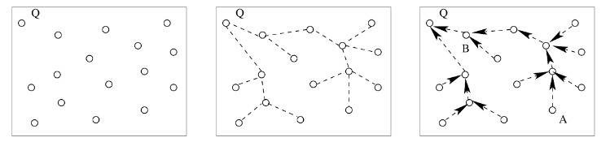
WildFire algorithm
QUERY
BROADCAST
CONVERGECAST

Slide 10
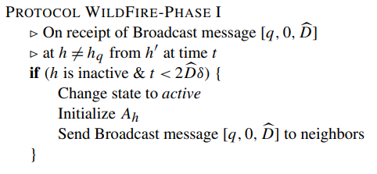
WildFire Algorithm

Slide 11
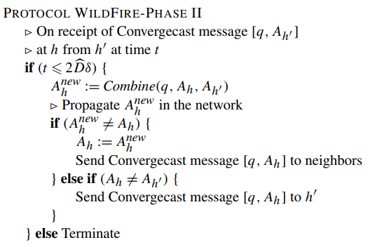
WildFire Algorithm

Slide 12
Dependability Evaluation
Performance evaluation
The communication cost of the protocol: number of messages exchanged.
The computation cost of a host: the maximum number of messages managed by a host.
The time cost of the protocol: the time to perform the query.

Slide 13


Other Dependability Properties
Availability: readiness of correct service
Reliability: continuity of correct service
Fault Tolerance: avoid service failures in the presence of faults.
Crashes: a host in the system fails
Byzantine failures: a host in the system
alters his behaviour
but… ⇒ Single-Site Validity.

Slide 14



Limitations
Limitation on systems
Limitation on communication
Limitation on algorithm

Slide 15
Development environment
Network Structure on Docker where each container represents a node
Python Notebook to build the Docker compose in which are defined the Nodes and their properties
Nodes are able to communicate each other by using RabbitMQ queues

Slide 16
Study cases
Network Topology:
Power-Law
Random
Protocols:
Spanning Tree
WildFire
Each topology – protocol pair is tested with both presence and absence of failures and for the representative <<count>> query
Metrics for experiments evaluation:
Communciation cost
Computation cost
Time cost

Slide 17
First tests
Evaluate the metrics when the number of vectors stored in the nodes changes, two cases:
C = 8
C = 12
We assume to use a certain number of repetitions (c) in FM algorithm suitable w.r.t our number of hosts.
For each vectors number value, some query are started over the node with the maximum number of neighbours and some other over the one with the minimum number of neighbours
Following the graphics where are plotted the obtained results.

Slide 18
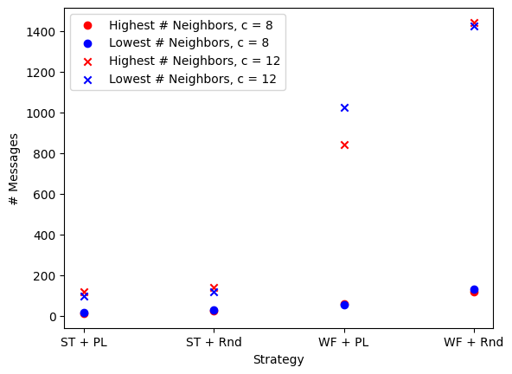
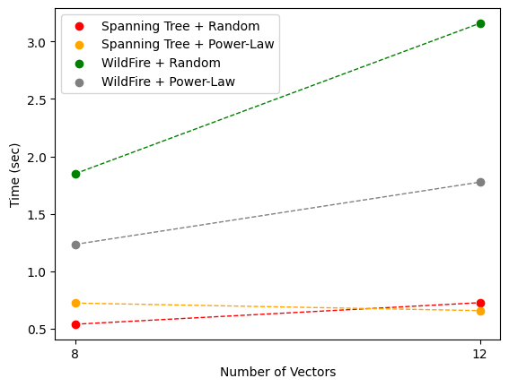
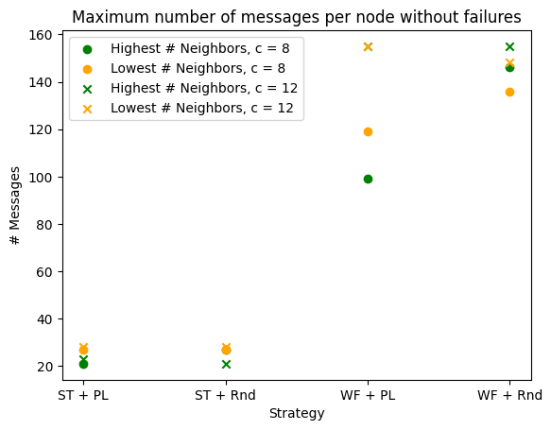
Graphics
Total number of messages
Maximum number of messages per node
Computation Time

Slide 19
Graphics without Failures

Slide 20
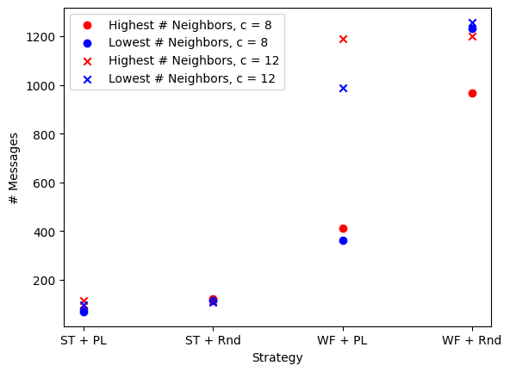
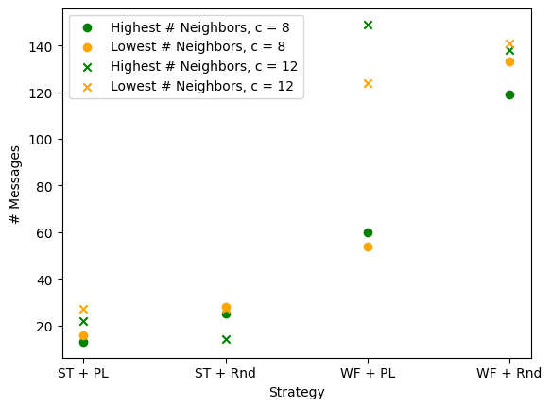
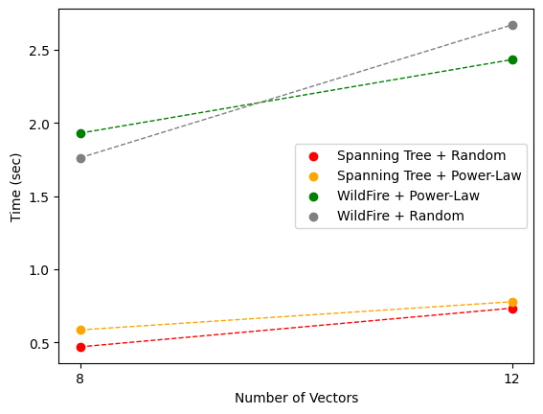
Graphics in presence of Failures

Slide 21
Second tests
Evaluate the metrics when the number of nodes in the topology changes, three cases:
|H| = 19
|H| = 15
|H| = 10
In this case the tests start from a random node in the topology
Following the graphics where are plotted the obtained results.

Slide 22
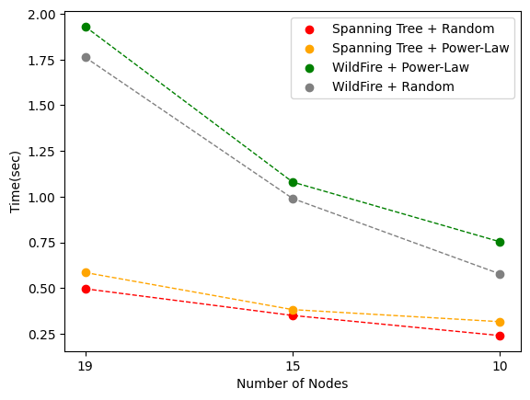
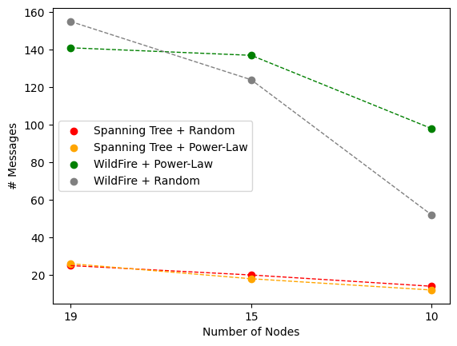
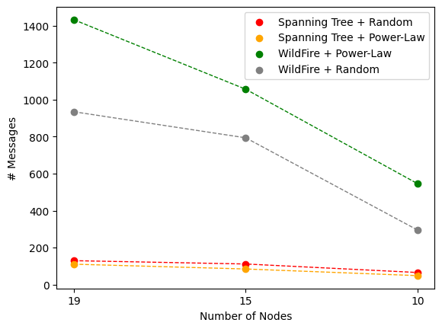
Graphics
Total number of messages
Maximum number of messages per node
Computation Time

Slide 23
Graphics without Failures

Slide 24
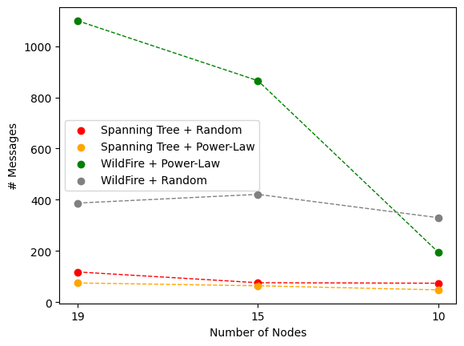
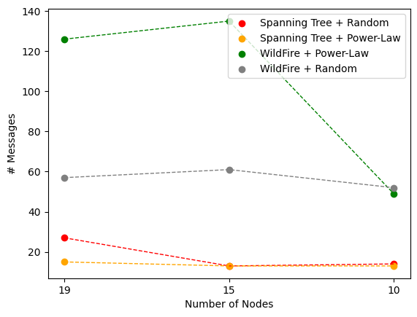
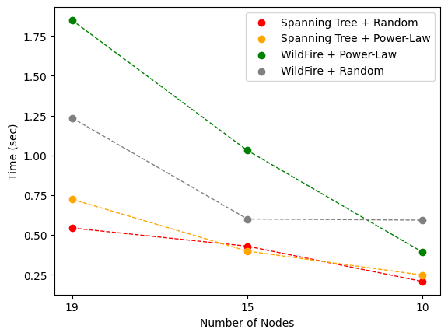
Graphics in presence of Failures

Slide 25
Conclusion
GitHub link: https://github.com/fed21/the-price-of-validity/
Instructions to run the application
Code
Project Report
Paper Reference: https://www.sciencedirect.com/science/article/pii/S0022000006001115?via%3Dihub

Slide 26
Thanks for your attention!
Brunetti Jacopo, Carmignani Federico, Caruso Paolo
Dependable Distributed Systems
Academic year: 2022/2023

