Slide 1
APIs
Data Science Usage and examples

Slide 2
What is an API?
API stands for Application Programming Interface
It’s the interface that allows communication between products or services
It also allows access to data from outside the firewall

Slide 3
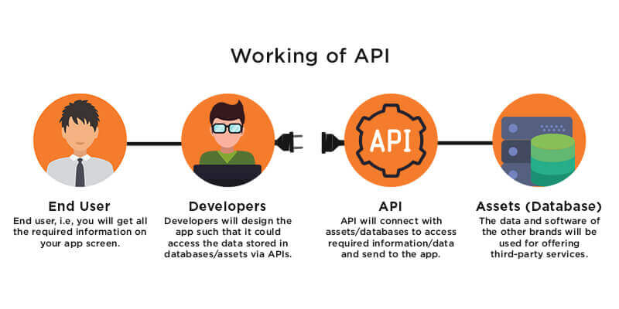
Simply put …
Source: https://appinventiv.com/blog/wp-content/uploads/2018/05/What-are-APIs-Learn-How-API-Works.jpg

Slide 4




Example
API

Slide 5
Some more examples?
Food Delivery
Shopping
Social Media
Games
Paystubs
Attendance
Learning Center
External
Where do APIs come into play?
Internal

Slide 6
I have been hearing about Open API …?
Say you have a online retail store
You list all your products on your website
You also allow other people to promote your products on their website (affiliate)
How does that happen?

Slide 7
How do we use it as Data Scientists?
Data Science solutions are nothing but model(s) working together
Example – Self driving car
Let’s breakdown the steps of one cycle (think of how would you make it)
Start vehicle
Input destination
Capture image using camera
Identify image
Choose best driving action (steering angle, acceleration, gear, etc.)
Do it!
Repeat
Where do APIs come into play?

Slide 8
Some more Data Science API examples?
Can you think of some more?
Heart Attack Predictions
Insurance Claim Decisions
BitBite (https://www.youtube.com/watch?v=qU2w_qiP4Ck)

Slide 9
What data can we get from here?
https://developer.translink.ca/
https://developer.github.com/v3/
https://openweathermap.org/api
https://www.alphavantage.co/
https://rapidapi.com/apicloud/api/facerect
More - https://rapidapi.com/collection/list-of-free-apis

Slide 10
Structure of an API
https://api.translink.ca/rttiapi/v1/stops/50624?apikey=Your_API_Key&lat=49.187706&long=-122.850060
A key (registration and authentication)
Parameter keys
Parameter values
Output: JSON, XML, or csv, usually JSON
Key: BwvmKTKZ7XMPDV2y0AqD

Slide 11
JSON
Java Script Object Notation – open standard file format in key-value pairs.
{ "name":"John",
"age":30,
"car":null,
"transit_history": {"monday": true,
"tuesday": false,
"wednesday": true,
"thursday": true,
"friday": false,
"saturday": true,
"sunday": true}
}

Slide 12
XML
Extensible Markup Language is a markup language that defines a set of rules for encoding documents in a format that is both human-readable and machine-readable.
<note>
<to>Tove</to>
<from>Jani</from>
<heading>Reminder</heading>
<body>Don't forget me this weekend!</body>
</note>

Slide 13
Push and Pull APIs
When information is pushed, it means you’re putting it into another system. You’re pushing information into the mailbox. A great example is notifications.
When information is pulled, that means you’re retrieving information. A great example is http requests on internet.

Slide 14
HTTP (Hypertext Transfer Protocol) Requests
HTTP is a protocol which allows the fetching of resources, such as HTML documents.
It is the foundation of any data exchange on the Web and it is a client-server protocol, which means requests are initiated by the recipient, usually the Web browser.
A complete document is reconstructed from the different sub-documents fetched, for instance text, layout description, images, videos, scripts, and more.
Clients and servers communicate by exchanging individual messages (as opposed to a stream of data). The messages sent by the client, usually a Web browser, are called requests and the messages sent by the server as an answer are called responses.
More Info - https://developer.mozilla.org/en-US/docs/Web/HTTP/Overview
https://www.codecademy.com/articles/http-requests

Slide 15
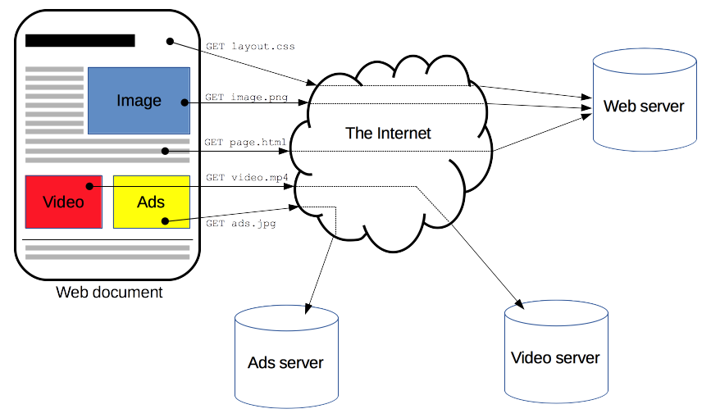
HTTP

Slide 16
HTTP Status Codes
Common HTTP status codes:
200 OK
400 Bad Request
401 Unauthorized
404 Not Found

Slide 17
Demo - Postman
https://www.postman.com/downloads/
Easy to use GUI which stores your API key, parameter keys etc.

Slide 18
Demo - Terminal
curl https://api.translink.ca/rttiapi/v1/stops/50624?apikey=BwvmKTKZ7XMPDV2y0AqD
More on curl (https://linuxacademy.com/guide/13852-understanding-curl-and-http-headers/)
Key is like a password, so obscure it via – (Linux Commands)
export Bus_API=Your_API_Key
echo $Bus_API
curl https://api.translink.ca/rttiapi/v1/stops/50624?apikey=$Bus_API
For Windows (current instance only)
SET Bus_API=Your_API_Key
echo %Bus_API%
curl https://api.translink.ca/rttiapi/v1/stops/50624?apikey=$Bus_API

Slide 19
Python
Refer Jupyter Notebook

Slide 20
Questions?
Thank you!

