Slide 1

Loan predictions
Mini-project IV

Slide 2
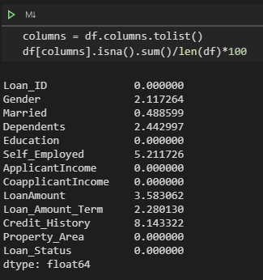





Handling of missing values
Imputation by:
Most_frequent:
[Married, Self_Employed, Loan_Amount_Term]
Constant:
[Gender = ‘unknown’, Credit_History = 0, …
Dependents = [0 if CoapplicantIncome == 0 else 1]]

Slide 3
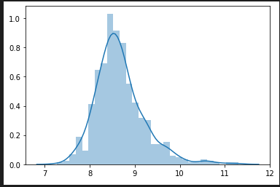
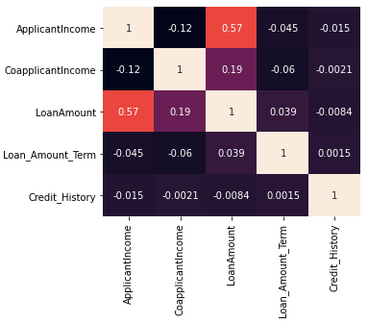
Handling of missing values
Imputation by:
LDA to predict missing LoanAmount with ApplicantIncome and CoapplicantIncome

Slide 4
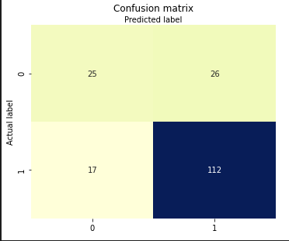
Baseline model
LogisticRegression()
 | Baseline model
Accuracy score | 0.761
F1 score | 0.839

Slide 5
Baseline model
Potential issues:
No handling of outliers
Scaling?
Feature selection
Hyper-parameter tuning
Other models?

Slide 6
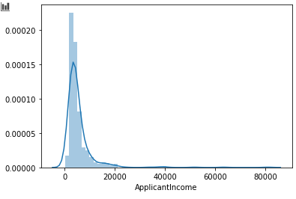
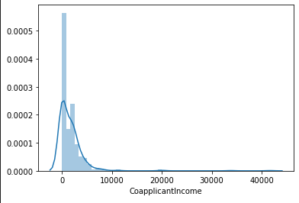
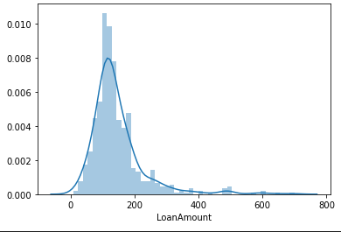
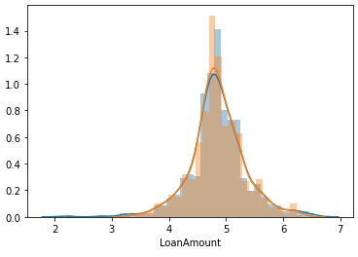
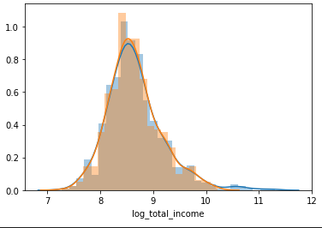
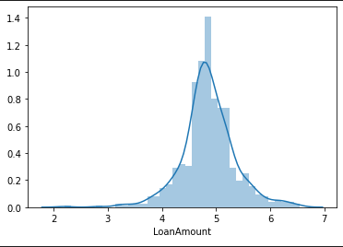
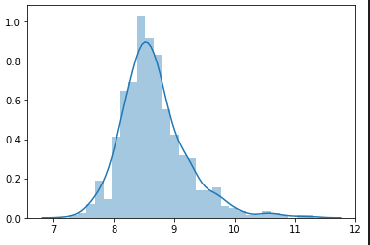
Outliers
ApplicantIncome
CoapplicantIncome
LoanAmount
Notes:
Each independently removed 9 rows, but 2 were common

Slide 7
Preprocessing pipeline
Imputing methods
OneHotEncoder(), PCA = (n_components = 3) on cat. variables
[Married, Self_Employed, Gender, Education, Property_Area]
StandardScaler(), SelectKBest(k = 3) on num. variables

Slide 8
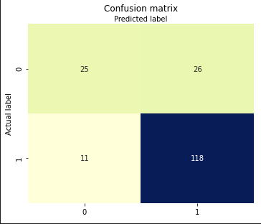
LogisticRegression() 1.1
Default parameters
solver = ‘liblinear’
 | Baseline model | LogisticRegression 1.1
Accuracy score | 0.761 | 0.794
F1 score | 0.839 | 0.864

Slide 9
LogisticRegression() 1.2
GridSearchCV()
SelectKBest(k), PCA(n_components)
LogisticRegression(C, Solver, tol)
 | Baseline model | LogisticRegression 1.1 | LogisticRegression 1.2
Accuracy score | 0.761 | 0.794 | 0.750
F1 score | 0.839 | 0.864 | 0.829

Slide 10
RandomForestClassifier()
Preprocessing pipeline
GridSearchCV()
SelectKBest(k), PCA(n_components)
RandomForestClassifier(n_estimators, criterion, max_depth, max_samples, min_samples_leaf)
 | LogisticRegression 1.1 | RandomForest
Accuracy score | 0.794 | 0.767
F1 score | 0.864 | 0.842

Slide 11
XGBoost()
Preprocessing pipeline
GridSearchCV()
SelectKBest(k), PCA(n_components)
XGBoostClassifier(alpha, booster, colsample_bytree, eta, max_depth)
 | LogisticRegression 1.1 | RandomForest | XGBoost
Accuracy score | 0.794 | 0.767 | 0.761
F1 score | 0.864 | 0.842 | 0.838

