Slide 1
Deep Learning
Neural Networks | libraries | backpropagation

Slide 2
The Progression
MIS
Predictive Analytics
Prescriptive Analytics
Data Mining
Data Analytics
Machine Learning
Data Science
BI
Artificial Intelligence

Slide 3
Going forward
The most important tool that you will have is –
Common Sense / Logic

Slide 4

Six Thinking Hats for a Data Scientist

Slide 5
Which hat to wear?
White Hat: with this thinking hat, you focus on the available data. Look at the information that you have, analyze past trends, and see what you can learn from it. Look for gaps in your knowledge, and try to either fill them or take account of them.
Black Hat: using Black Hat thinking, look at a decision's potentially negative outcomes. Look at it cautiously and defensively. Try to see why it might not work. This is important because it highlights the weak points in a plan. It allows you to eliminate them, alter them, or prepare contingency plans to counter them.
Blue Hat: this hat represents process control. It's the hat worn by people chairing meetings, for example. When facing difficulties because ideas are running dry, they may direct activity into Green Hat thinking. When contingency plans are needed, they will ask for Black Hat thinking.

Slide 6
Which hat to wear?
Green Hat: the Green Hat represents creativity. This is where you develop creative solutions to a problem. It is a freewheeling way of thinking, in which there is little criticism of ideas.
Yellow Hat: this hat helps you to think positively. It is the optimistic viewpoint that helps you to see all the benefits of the decision and the value in it. Yellow Hat thinking helps you to keep going when everything looks gloomy and difficult.
Red Hat: "wearing" the Red Hat, you look at problems using your intuition, gut reaction, and emotion. Also, think how others could react emotionally. Try to understand the responses of people who do not fully know your reasoning.

Slide 7
Which hat to wear? – The Answer
Black Hat thinking helps to make your plans "tougher" and more resilient. It can also help you to spot fatal flaws and risks before you embark on a course of action. It's one of the real benefits of this model, as many successful people get so used to thinking positively that they often cannot see problems in advance. This leaves them under-prepared for difficulties.

Slide 8
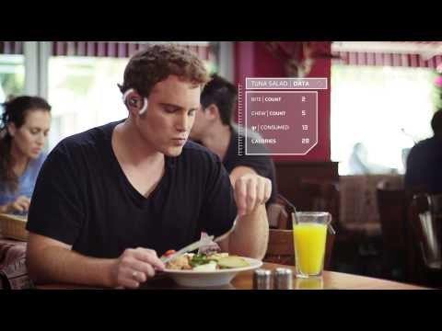
Examples of AI Systems - BitBite
https://www.youtube.com/watch?v=qU2w_qiP4Ck

Slide 9

Examples of AI Systems - Pillo
https://www.youtube.com/watch?v=GfjGPTKBFB4

Slide 10
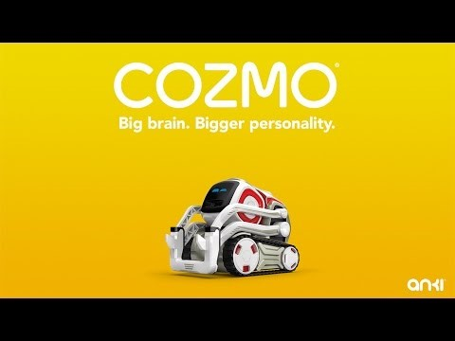
Examples of AI Systems - Cozmo
https://www.youtube.com/watch?v=cjFA531qJNE

Slide 11
AI – where the world stands today
Self Driving Car … https://www.youtube.com/watch?v=aaOB-ErYq6Y
Relaunchable Rockets … https://www.youtube.com/watch?v=1sJlFzUQVmY
Hyperloop - https://www.youtube.com/watch?v=u5V_VzRrSBI
Self Balancing Bike Honda … https://www.youtube.com/watch?v=VH60-R8MOKo
AI Car … https://www.youtube.com/watch?v=lItIyxGZUZQ
Facebook … https://www.youtube.com/watch?v=-CRJLam3BNc
Amazon Key … https://www.youtube.com/watch?v=wn7DBdaUNLA

Slide 12
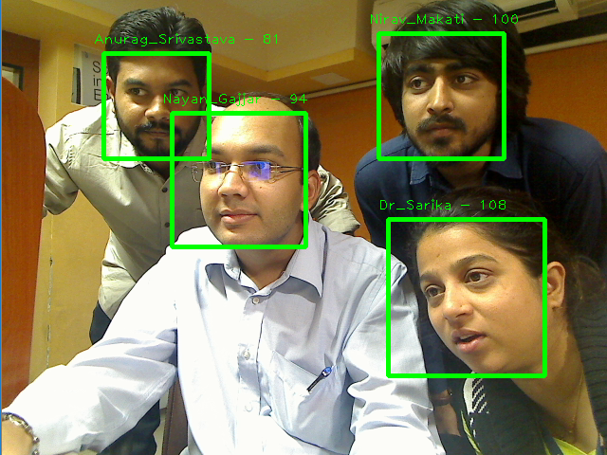
AI in Application

Slide 13
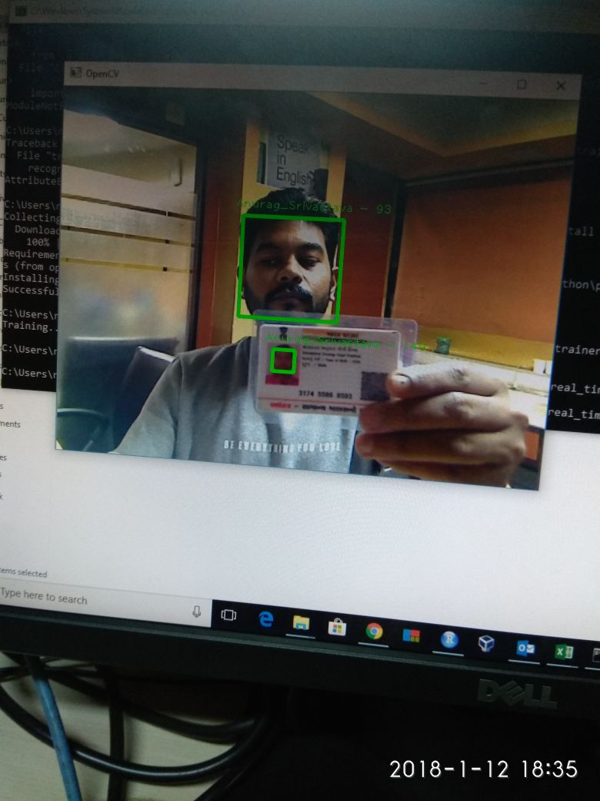

AI in Application

Slide 14
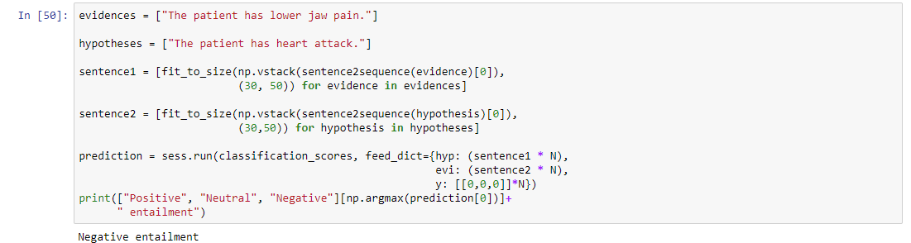
AI in Application

Slide 15
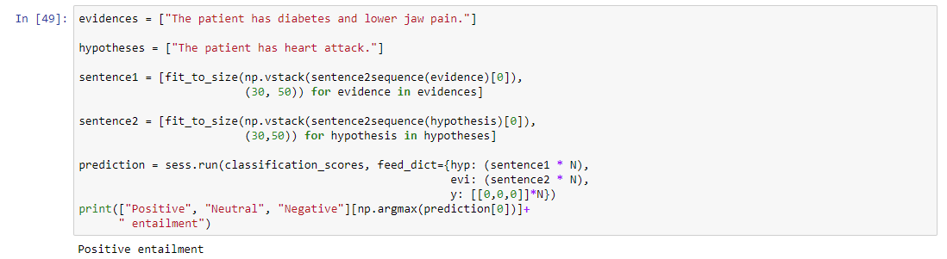
AI in Application

Slide 16
AI in Application
Reading Handwritten Digits
Chatbot
Recognizing Images

Slide 17
History of AI
It was born in 1950s.
“the effort to automate intellectual tasks normally performed by humans”.
For a fairly long time, many experts believed that human-level artificial intelligence could be achieved by having programmers handcraft a sufficiently large set of explicit rules for manipulating knowledge. This approach was known as symbolic AI.
Symbolic AI – intractable to figure out explicit rules for tasks such as – speech recognition, NLP, Image classification etc.
Hence came – AI.
Alan Turing – 1950 – Turing Test.

Slide 18
History of AI

Slide 19
History of AI
Trending in 1990s – large datasets and hardware (CPU to GPU to TPU)
A lot of statistical analysis and rules
The birth of Deep Learning
3 parameters required for Deep Learning –
Input data points—For instance, if the task is speech recognition, these data points could be sound files of people speaking. If the task is image tagging, they could be picture files.
Examples of the expected output—In a speech-recognition task, these could be human-generated transcripts of sound files. In an image task, expected outputs could tags such as "dog", "cat", and so on.
A way to measure whether the algorithm is doing a good job—This is necessary in order to determine the distance between the algorithm’s current output and its expected output. The measurement is used as a feedback signal to adjust the way the algorithm works. This adjustment step is what we call learning.

Slide 20
History of AI
The objective is to learn useful representations of the input data at hand—representations that get us closer to the expected output.
But wait! What is a representation?
A different way to look at data – to represent or to encode.
Example –
Colors – RGB or HSV
Select all red pixels – RGB
Reduce saturation - HSV

Slide 21
Let’s classify
Input – Coordinates of the points
Expected Output – Colors
Measurement - % of points that are correctly classified

Slide 22
Let’s Classify

Slide 23
So what is Machine Learning?
All machine-learning algorithms consist of automatically finding such transformations that turn data into more useful representations for a given task.
Learning, in the context of machine learning, describes an automatic search process for better representations.

Slide 24
Model vs Network
Set of algorithms defined to perform a task – model.
Computational data graphs – network.

Slide 25
Then what is Deep Learning?
It is not deeper understanding of the system.
It is not the depth to which a system goes to understand.
It is – the number of layers in a network (neural network).
Simply, it is the answer to this question –
How many layers contribute to a model of the data?

Slide 26
Neural Networks

Slide 27
Neural Networks

Slide 28
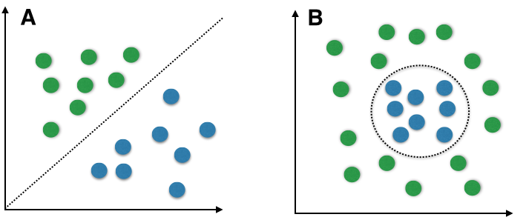
Algorithms of ML
Naïve Bayes
A type of Probabilistic Modeling – for classification.
Not many classification targets.

Slide 29
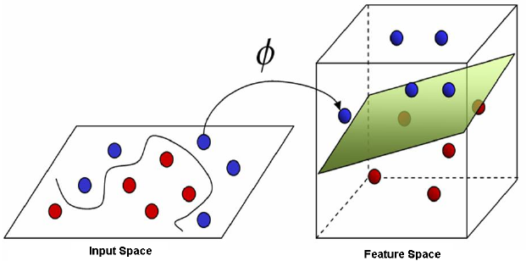
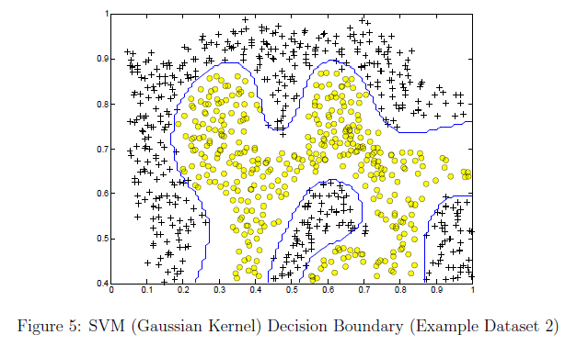
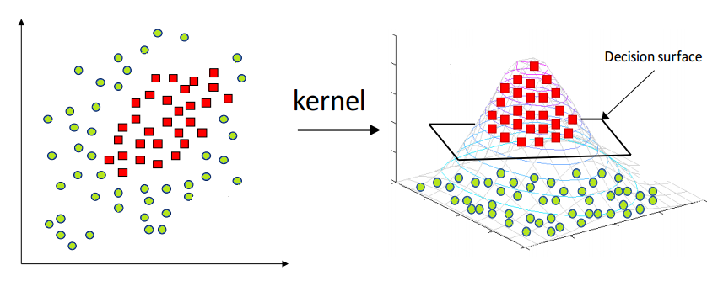
Algorithms of ML
Kernel Methods
SVM (Support Vector Machines) – Creating decision boundary
Brittle on large datasets
Manual determination of boundary, separation is created by the system.

Slide 30
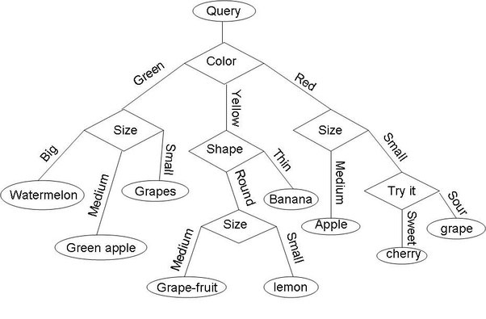
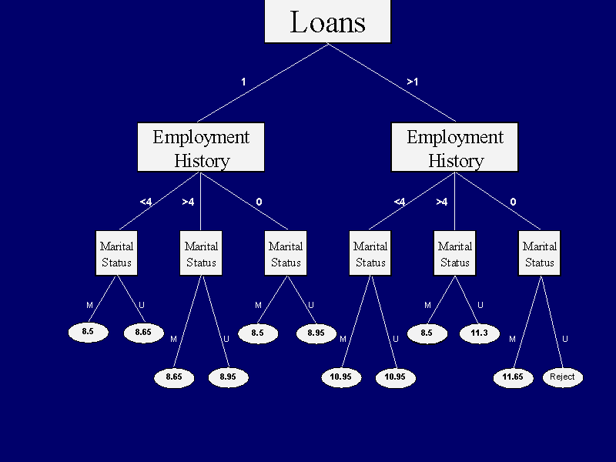
Algorithms of ML
Decision Trees, Random Forests, Gradient Boosting Machines
Shallow Learning (not many aspects)
Mostly rules are pre-determined

Slide 31
Algorithm of AI
Neural Networks
Noticed in 2010.
ImageNet Challenge – 2012 – Classify high resolution images into 1000 categories by learning from 1.4 Million images!
Machine Learning Accuracy – 74.3%.
Neural Networks Accuracy – 83.6%.
Neural Networks Accuracy in 2015 – 96.4%.

Slide 32
Why Deep Learning / Deep Nets?
Better Performance.
Feature Engineering Elimination (determination of layers of representation).
Example – Cat – Ears, Nose, Skin, Fur, Color, Texture, Size, Shape etc.
Instead – look and learn – all at once.

Slide 33
Hardware Evolution
CPU
GPU – 350 times a CPU
TPU – 10 times a GPU
In both computation and energy efficiency
NVIDIA Titan X, a gaming GPU, can deliver a peak of 6.6 TLOPS in single precision: that is, 6.6 trillion float32 operations per second.

Slide 34
Data Evolution
Big Data
Volume
Veracity
Velocity

Slide 35
AI Evolution
2011 – USD 19 Million.
2013 – USD 394 Million.
Very fast growing.
Earlier – C++ and CUDA expertise.
Today – Simple R and Python scripts.

Slide 36
Understanding Neural Networks
Jargons
Inputs
Weights
Biases
Perceptrons
Hidden Layers
Activation Functions
Back Propagation
Output
Epochs

Slide 37
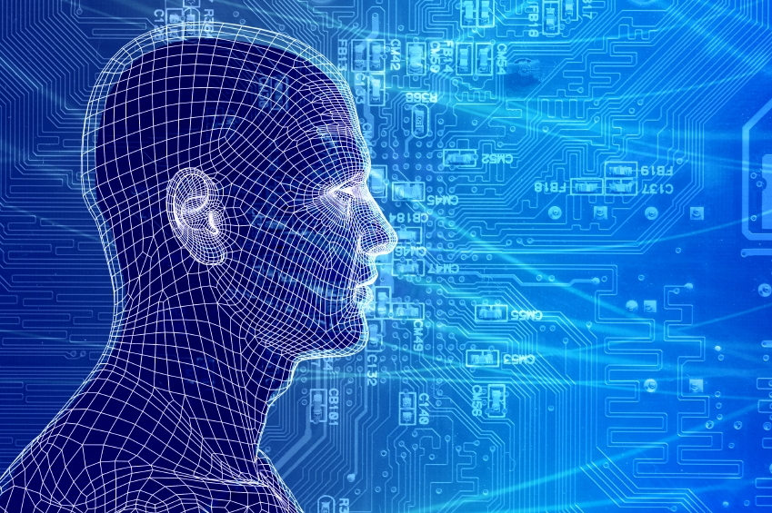
How do our brains work?
The Brain is A massively parallel information processing system.
Our brains are a huge network of processing elements. A typical brain contains a network of 10 billion neurons.

Slide 38
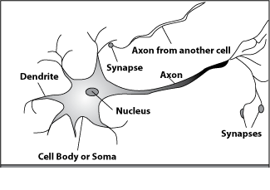
How do our brains work?
A processing element

Slide 39
How do our brains work?
A neuron is connected to other neurons through about 10,000 synapses

Slide 40
How do our brains work?
A neuron receives input from other neurons. Inputs are combined.

Slide 41
How do our brains work?
Once input exceeds a critical level, the neuron discharges a spike ‐ an electrical pulse that travels from the body, down the axon, to the next neuron(s)

Slide 42
How do our brains work?
The axon endings almost touch the dendrites or cell body of the next neuron.

Slide 43
How do our brains work?
The Neurotransmitters are chemicals which are released from the first neuron and which bind to the Second creating a spike.

Slide 44
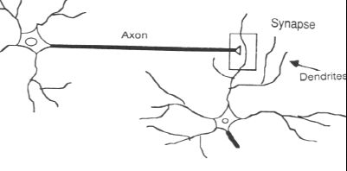
How do our brains work?
This link is called a Synapse.

Slide 45
Hawkins’ Quotes
“Your brain constantly makes predictions about the very fabric of the world we live in, and it does so in a parallel fashion. It will just as readily detect an odd texture, a misshapen nose, or an unusual motion. It isn’t obvious how pervasive these mostly unconscious predictions are, which is perhaps why we missed their importance.”

Slide 46
Hawkins’ Quotes
“Suppose when you are out, I sneak over to your home and change something about your door. It could be almost anything. I could move the knob over by and inch, change a round knob into a thumb latch, or turn it from brass to chrome….When you come home that day and attempt to open the door, you will quickly detect that something is wrong.”

Slide 47
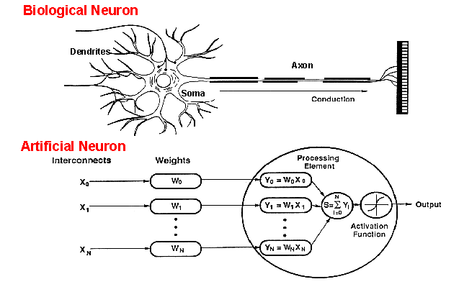
How do ANNs work?
Imitation of human neuron.

Slide 48
How does an ANN look like?
1
I1
2
O1
I2
3
4
I3
5
O2
I4
6
Perceptron / Neuron / Node

Slide 49
Inside an ANN
weights
1
I1
2
weights
3
∑
F(x)
I2
weights
4
I3
weights
weights
5
I4
6

Slide 50
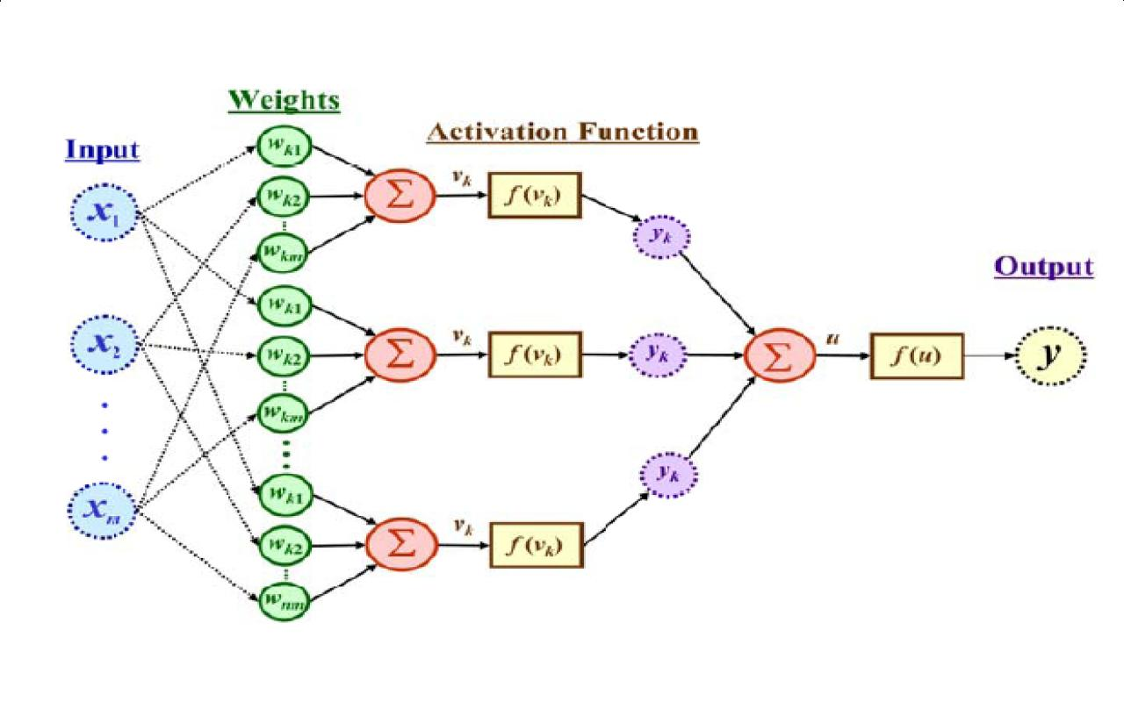
Inside an ANN

Slide 51
The simple ANN Equation
Input X Weights = Output

Slide 52
Inside an ANN
Backpropagation
At each step, it checks if the desired output is achieved. If not …

Slide 53
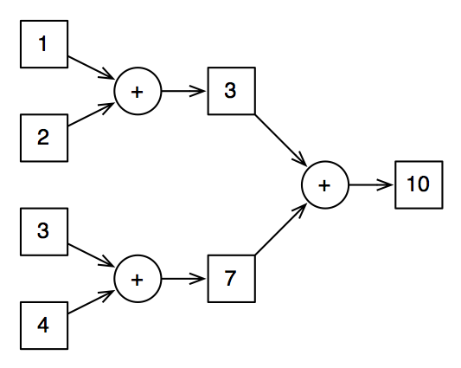
Inside an ANN (backpropagation)

Slide 54
Inside an ANN
Biases (random numbers)
Sometimes weights can be 0. But maybe the input is important to get the desired output. Then what?

Slide 55
The simple ANN Equation … perfected
Input X Weights + Biases = Output

Slide 56
Neural Mantra
Input times Weights,
add Bias and then
Activate!

Slide 57
Hidden Layers
1
Hidden Layer / Black Box
I1
2
O1
I2
3
4
I3
5
O2
I4
6

Slide 58
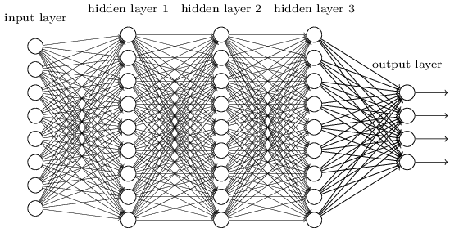
Hidden Layers

Slide 59
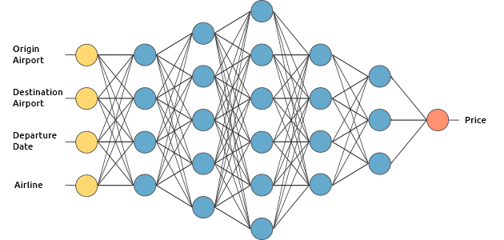
Hidden Layers

Slide 60
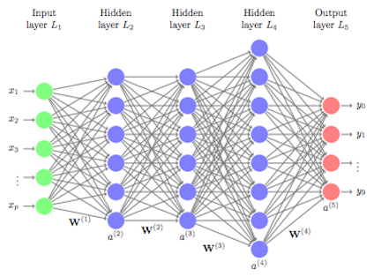
Hidden Layers

Slide 61
Key functions of any NN
Activation Function – to get as close to the output as possible – mathematical equation
Cost or Loss Function – minimizing the loss or penalty
Optimization Function - to identify best representation of the data – pattern

Slide 62
Hyperparameters
Number of nodes
Epochs (1 feed forward + 1 backpropagation)
Batch Size
Loss function / Activation Function
Number of Hidden Layers

Slide 63
Gradient Descent & Overfitting
Gradient descent is a first-order iterative optimization algorithm for finding the minimum of a function.
To find a local minimum of a function using gradient descent, one takes steps proportional to the negative of the gradient (or approximate gradient) of the function at the current point.

Slide 64


Gradient Descent & Overfitting

Slide 65
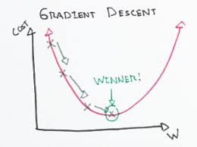
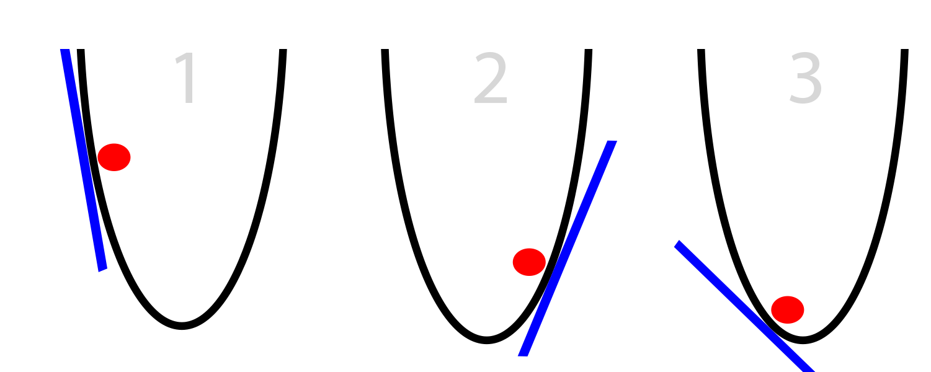
Gradient Descent & Overfitting

Slide 66
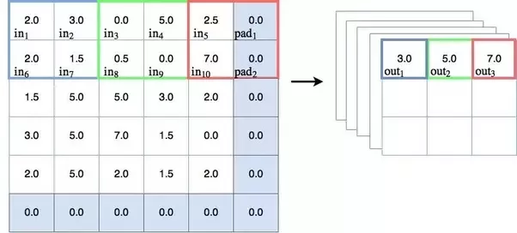
Maxpooling
Sample based discretization process
Objective is to down sample the representation by reducing its dimensionality
Avoids over fitting
Reduces computational cost (time)

Slide 67
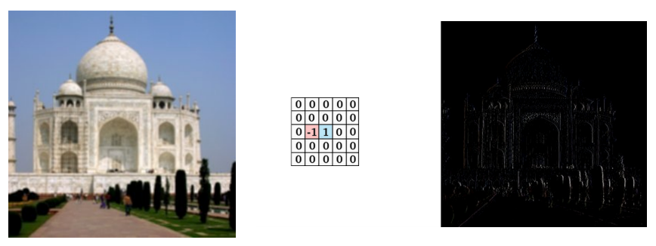
Maxpooling

Slide 68
The Diamond Model of Learning
Converge
Converge
Diverge
Diverge

Slide 69
Activation Functions
They add non-linear properties to the model to get the desired output.
Simply putting, activation functions help the networks understand patterns better.
So after Input X Weights + Biases – the activation function is applied.
Why non-linear properties?
We need a Neural Network Model to learn and represent almost anything and any arbitrary complex function which maps inputs to outputs.
Neural-Networks are considered Universal Function Approximators. It means that they can compute and learn any function at all.

Slide 70
Activation Functions - Types
Sigmoid (Logistic)
Range between 0 and 1
Slow convergence
Vanishing gradient problem
Tanh (Hyperbolic Tangent)
Range between -1 and 1
Easy optimization
Vanishing gradient problem
ReLu (Rectified Linear Units)
Higher convergence rate
Resolves vanishing gradient problem
Used for binary classification of output layer.
Ideal for hidden layers.

Slide 71
Activation Functions - Types
Softmax Function
Deals well with multi-classification problem
Calculates probabilities between 0 and 1
Easy to interpret

Slide 72
Why MLP? Why not Single Perceptron?
True
False
AND (A&&B)
OR (A||B)
True | False
False | False
True
False
True
False
True | True
True | False
True
False

Slide 73
Why MLP? Why not Single Perceptron?
True
False
XOR (Exclusive OR)
False | True
True | False
True
False

Slide 74
MLP Calculations (with backpropagation)
Variable | Value
I1 | 0.05
I2 | 0.10
B1,B2 | 0.35
B3,B4 | 0.60
W1 | 0.15
W2 | 0.20
W3 | 0.25
W4 | 0.30
W5 | 0.40
W6 | 0.45
W7 | 0.50
W8 | 0.55
b1
∑
F(x)
H1
O1
(0.01)
W1
I1
W3
W2
W4
H2
O2 (0.99)
I2
b2
H1 = I1*W1 + I2*W2 + b1 = 0.3775
H2 = I1*W3 + I2*W4 + b2 = 0.3925
Out H1 = sigmoid(H1) = 0.593269992
Out H2 = sigmoid(H2) = 0.596884378

Slide 75
MLP Calculations (with backpropagation)
Variable | Value
I1 | 0.05
I2 | 0.10
B1,B2 | 0.35
B3,B4 | 0.60
W1 | 0.15
W2 | 0.20
W3 | 0.25
W4 | 0.30
W5 | 0.40
W6 | 0.45
W7 | 0.50
W8 | 0.55
b1
H1
W5
O1
(0.01)
W1
I1
W3
W7
b3
W2
W6
W4
H2
W8
O2 (0.99)
I2
b2
b4
O1 = Out H1*W5 + Out H2*W6 + b3 = 1.105905967
O2 = Out H1*W7 + Out H2*W8 + b4 = 1.2249214
Out O1 = sigmoid(O1) = 0.75136507
Out O2 = sigmoid(O2) = 0.77292846

Slide 76
MLP Calculations (with backpropagation)
Variable | Value
I1 | 0.05
I2 | 0.10
B1,B2 | 0.35
B3,B4 | 0.60
W1 | 0.15
W2 | 0.20
W3 | 0.25
W4 | 0.30
W5 | 0.40
W6 | 0.45
W7 | 0.50
W8 | 0.55
b1
H1
W5
O1
(0.01)
W1
I1
W3
W7
b3
W2
W6
W4
H2
W8
O2 (0.99)
I2
b2
b4
E1 = [ (T1-O1)² ] / 2 = 0.274811083
E2 = [ (T2-O2)² ] / 2 = 0.023560026
Etotal = E1 + E2 = 0.298371109

Slide 77
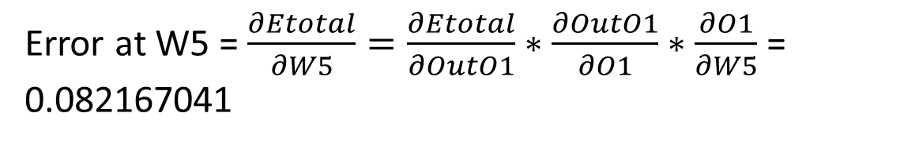
MLP Calculations (with backpropagation)
Variable | Value
I1 | 0.05
I2 | 0.10
B1,B2 | 0.35
B3,B4 | 0.60
W1 | 0.15
W2 | 0.20
W3 | 0.25
W4 | 0.30
W5 | 0.40
W6 | 0.45
W7 | 0.50
W8 | 0.55
b1
H1
W5
O1
(0.01)
W1
I1
W3
W7
b3
W2
W6
W4
H2
W8
O2 (0.99)
I2
b2
b4
Error at W5 = $\frac{∂Etotal}{∂W5}=\frac{∂Etotal}{∂OutO1}∗\frac{∂OutO1}{∂O1}∗\frac{∂O1}{∂W5}$ = 0.082167041

Slide 78
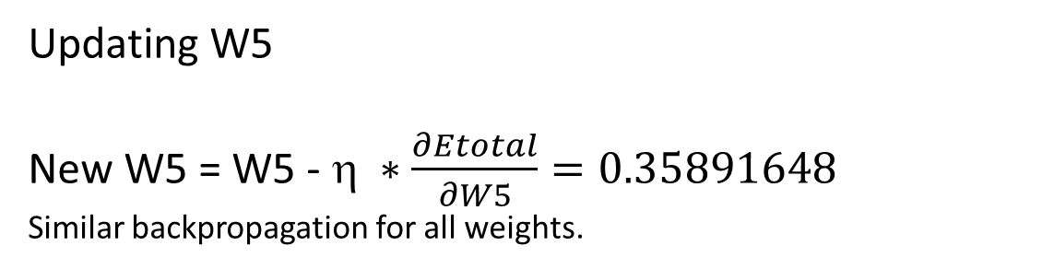
MLP Calculations (with backpropagation)
Variable | Value
I1 | 0.05
I2 | 0.10
B1,B2 | 0.35
B3,B4 | 0.60
W1 | 0.15
W2 | 0.20
W3 | 0.25
W4 | 0.30
W5 | 0.40
W6 | 0.45
W7 | 0.50
W8 | 0.55
b1
H1
W5
O1
(0.01)
W1
I1
W3
W7
b3
W2
W6
W4
H2
W8
O2 (0.99)
I2
b2
b4
Updating W5
New W5 = W5 - $ ∗\frac{∂Etotal}{∂W5}=0.35891648$
Similar backpropagation for all weights.
η = 0.5

Slide 79
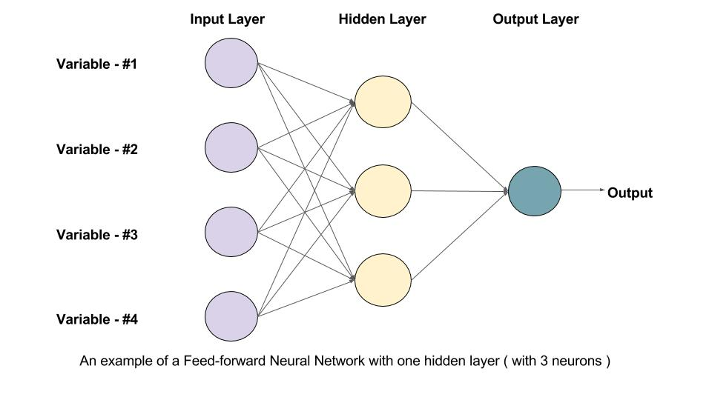
Types of Neural Networks
Feed Forward NN (FF)
Simplest
Input travels in one direction only – forward
May or may not have multiple layers
No backpropagation
Mainly used for image classification
Simple to operate and maintain

Slide 80
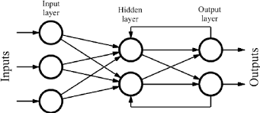
Types of Neural Networks
Recurrent NN (RNN) – LSTM (Long Short Term Memory)
Has multiple layers
Remembers output of one layer
Feeds it back to the input layer
Acts like a memory shell – has some information to begin processing
Better backpropagation output
Used in Text to Speech, Human like speech, NLP (Summary generation)

Slide 81
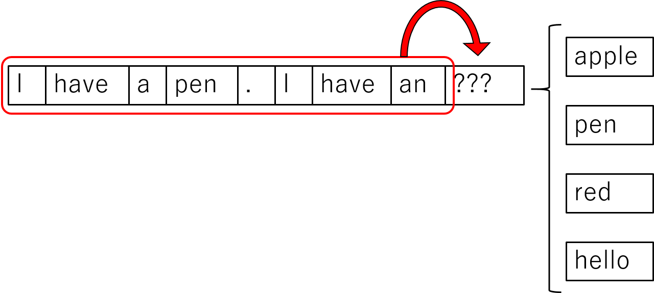
RNN (LSTM) Example

Slide 82
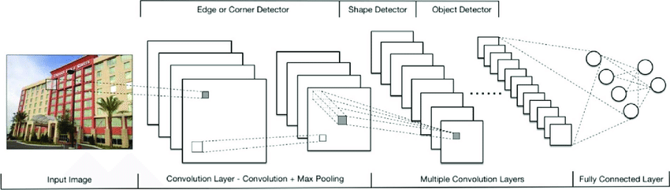
Types of Neural Networks
Convolutional NN (CNN)
Similar to FF
Takes a chunk of input (batch input)
Higher accuracy
Used in Image Recognition, Computer Vision and Signal Processing (Prediction of agriculture yield using satellite image)

Slide 83
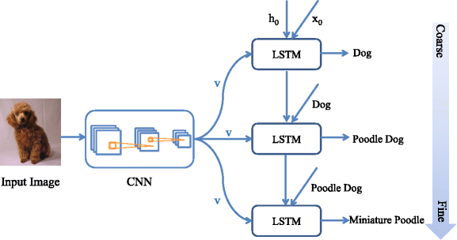
Types of Neural Networks
Modular NN (MNN)
More than 1 NN
Connected by an intermediary
Divide and Conquer principal
Breaks large problems down into more viable parts
Simpler NNs handled in conjunction

Slide 84
AI Libraries / APIs
Keras
Keras is an open source high-level neural networks API, written in Python
It was developed by Francois Chollet with a focus on enabling fast experimentation
All other libraries integrate with Keras – fast, abstractive, intuitive
TensorFlow
TensorFlow™ is an open source software library for high performance numerical computation
Developed by Google
Theano
Python library that allows you to define, optimize, and evaluate mathematical expressions involving multi-dimensional arrays efficiently
Open Source and developed by University of Montreal, Canada

Slide 85
AI Libraries / APIs
CNTK – Microsoft Cognitive Toolkit
Developed by Microsoft
Less popular
Complex to learn
Partly open source

Slide 86
Shall we look at some code?
Thank you!

