Slide 1
Design and Implementation of a Cloud-Native Reactive Architecture
The Smart Travel Platform Case Study
Candidate: Federico Palazzi
Supervisor: Prof. Giovanni Malnati
Notes:
Good morning to the commission and to my supervisor, Professor Malnati.
Today I will present my thesis work: the Design and Implementation of a Cloud-Native Reactive Architecture.
To test how these architectural patterns behave in practice, I developed a concrete case study: the Smart Travel Platform, a microservice-based e-commerce application.
Over the next few minutes, I will walk you through the technical choices behind this platform and show how this approach can help to solve the scalability and data consistency problems typical of traditional travel booking systems.

Slide 2

Requirements and User Roles
Full-stack e-commerce web application for purchasing travel packages (flights, hotels, activities).
Requirements
Public access to the travel catalog and search for individual components.
Purchase management and order status tracking.
Integration with external services (e.g., online payment gateways).
Email notifications for purchase confirmations.
User Roles
CUSTOMER – Browse catalog and buy travel packages.
TRAVEL AGENT – Create, publish and archive packages.
ADMIN – Manage user accounts.

Slide 3
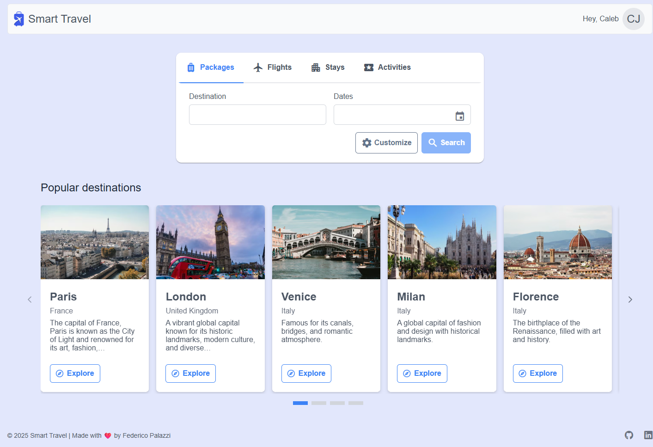
Smart Travel – Homepage

Slide 4
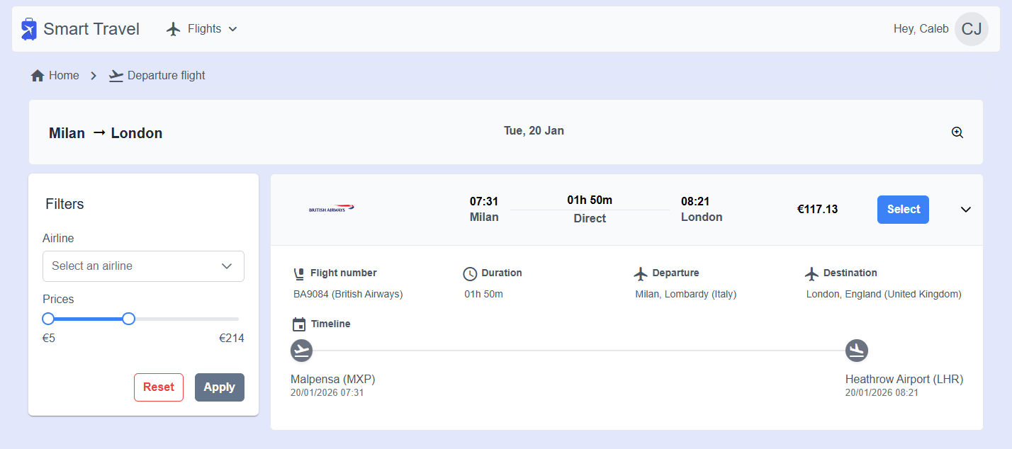
Smart Travel – Flight Search

Slide 5
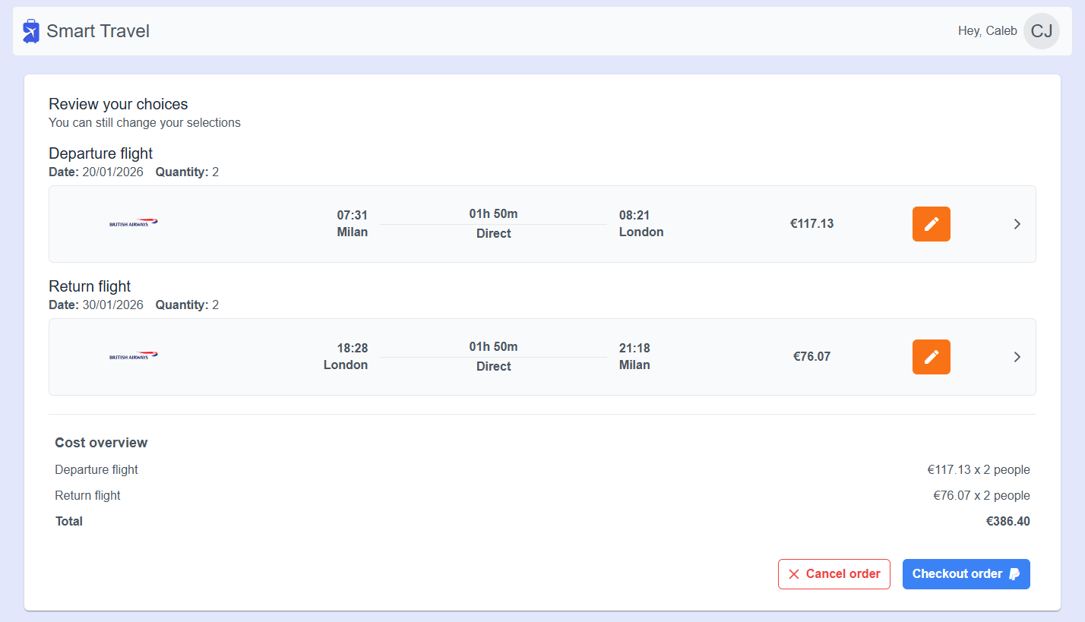
Smart Travel – Checkout

Slide 6
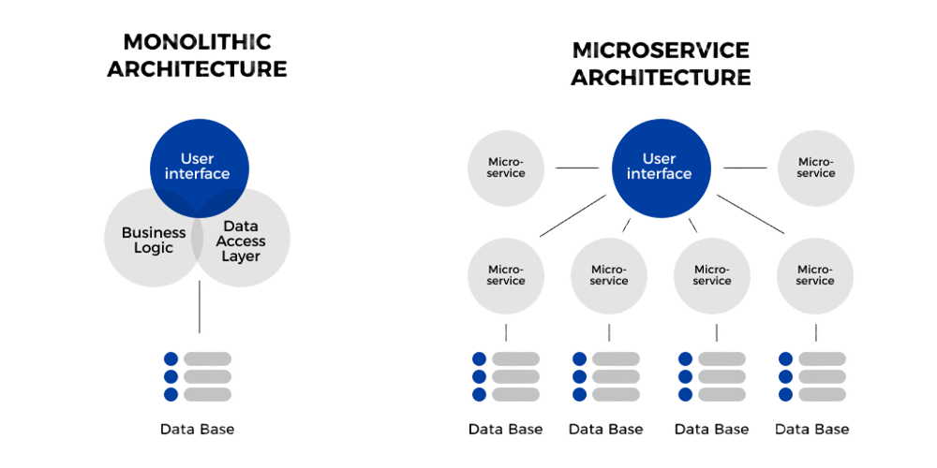
Why Cloud-Native? From Monoliths to Microservices
MONOLITHIC ARCHITECTURE
MICROSERVICE ARCHITECTURE
❌ Single point of failure
❌ Hard to scale under heavy traffic
❌ Slow release cycles
✅ Simpler to build and deploy
✅ Fault isolation (If one fails, the rest survive)
✅ Scale only what is needed
✅ Independent deployments
❌ High operational complexity
Notes:
Before diving into the architecture of the platform, it is important to understand why I chose a cloud-native approach over a monolithic architecture.
Cloud-native means designing the application specifically to leverage cloud infrastructure.
Traditionally, enterprise applications were built as Monoliths — meaning the user interface, the business logic, and the data access were all bundled into one massive application, sharing a single database.
While this is easy to build initially, it creates severe problems. For example, if we catch a bug in a particular module of the application, it can crash or affect the entire system.
If there is a massive spike in web traffic, we have to duplicate the entire heavy application just to handle the load.
To solve this, the industry has shifted to Microservices. By breaking the system down into small, independent domains we gain three advantages:
Fault Tolerance. If one microservice crashes, the functionalities provided by the other ones can still be accessed by users.
Scalability. If one microservice gets heavy traffic, we can scale it without touching the other services.
Agility. We can deploy new features multiple times a day without taking the system offline.
Cloud-Native
To achieve it I did the following:
Containerization & Immutability: I packaged every microservice into a Docker image. This guarantees that the code runs the same on any kind of execution environment.
Statelessness via JWT: The microservices do not store user sessions in memory, instead they use stateless JSON Web Tokens validated by the BFF. By doing this, we can safely destroy or duplicate any Pod/container at any time without losing data.
Declarative Orchestration: Instead of manually starting servers, I wrote OKD Deployment manifests to tell OKD, for example, "I want 2 replicas of the Order API running," and the cluster's control plane constantly monitors and adjusts the system to maintain that state.

Slide 7
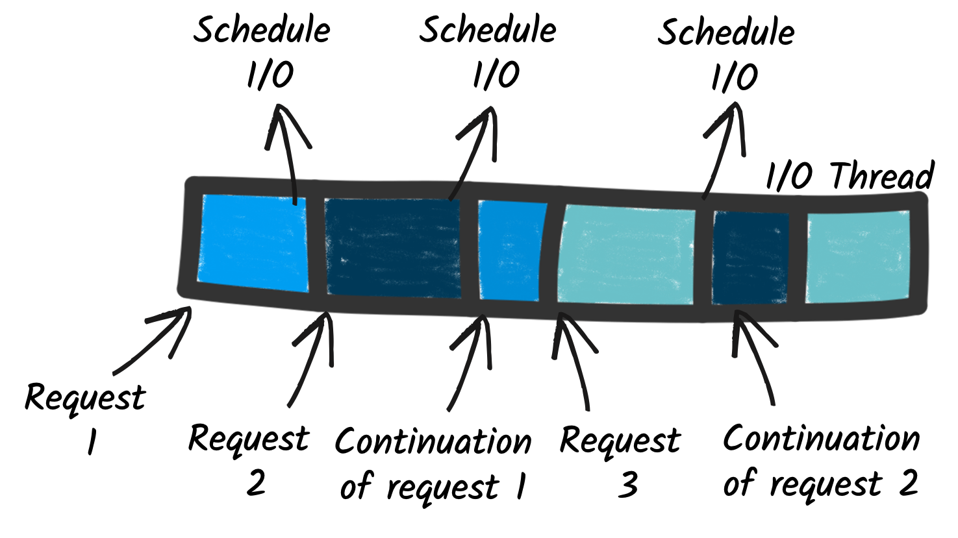
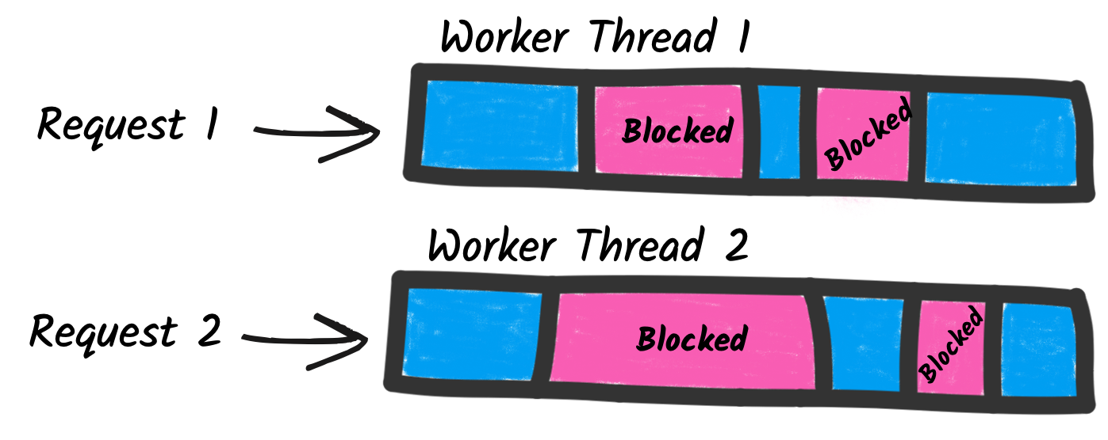
Why Reactive? From Imperative to Reactive Model
IMPERATIVE MODEL
REACTIVE MODEL
❌ One dedicated thread per request (worker thread)
❌ Blocking I/O operations (thread waits for response)
❌ Limited scalability (higher resources usage)
✅ Simpler programming model (sequential code)
✅ One thread can handle multiple requests (I/O thread)
✅ Non-blocking I/O operations (thread is released)
✅ High concurrency (reduced resources usage)
❌ Programming based on continuations (callbacks)
Notes:
Imperative model
Each request is handled by a dedicated thread, which remains occupied until processing is complete (worker thread).
Blocking I/O operations: the thread remains idle while waiting for a response from a database or external service.
Limited scalability: more requests = more threads = high memory and CPU consumption.
Simpler programming model and sequential code.
Reactive model
A small number of threads can handle multiple concurrent requests (I/O thread).
Non-blocking I/O operations: the thread is released while waiting for the response, allowing it to process other tasks.
High concurrency: the same thread can handle multiple requests in parallel, drastically reducing memory and CPU impact.
Programming is based on continuations (callbacks, reactive streams, reactive libraries).

Slide 8
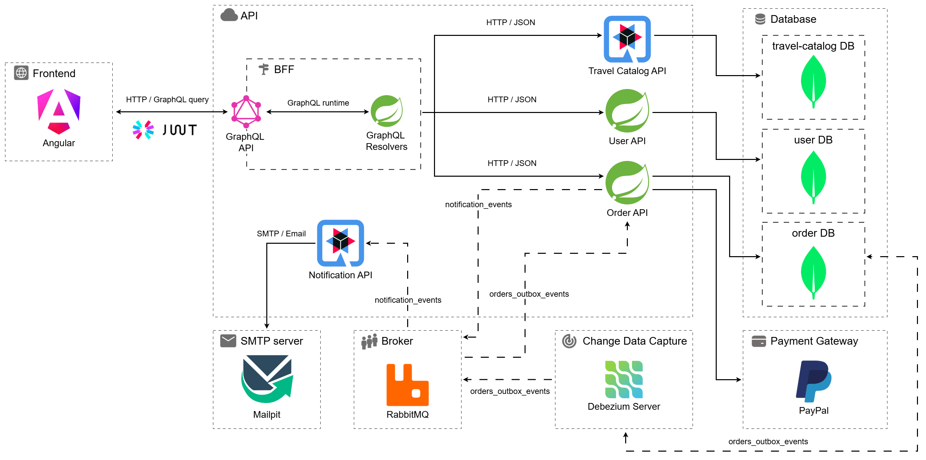
System Architecture
Notes:
This diagram represents the complete topology of the Smart Travel platform. Let’s break it down into its core components.
[1. Core Microservices]
At the center of the architecture, we have the core business logic decomposed into four distinct microservices:
the Travel Catalog API built with Quarkus,
the User API and Order APIs built with Spring Boot.
The Order API
To guarantee strict isolation and fault tolerance, each of these services manages its own dedicated MongoDB database. This ensures that a heavy load on the catalog doesn't impact our ability to process orders.
[2. BFF, GraphQL, and Frontend]
Moving to the left, we have the client side. To connect our Angular frontend to these distributed backend services, I implemented a Backend-For-Frontend (BFF). Instead of the client making dozens of REST requests to different services, it simply sends a single GraphQL query to the BFF. The BFF acts as an API Gateway, dynamically fetching and aggregating only the requested data from the downstream microservices. This effectively eliminates network latency and frontend over-fetching.
[3. JWT Authentication]
Furthermore, this BFF serves as the system’s primary security perimeter. All incoming traffic is intercepted here and authenticated using stateless JSON Web Tokens (JWT). The BFF verifies the cryptographic signature and enforces strict Role-Based Access Control before any request is allowed inside the internal network. This keeps the downstream microservices secure and strictly focused on their business logic.
[4. Payment Flow, Debezium, and RabbitMQ]
Finally, at the bottom of the diagram, we have the event-driven layer. The most complex challenge I faced here was the famous dual-write problem during the checkout phase.
When a user completes a payment, the Order API needs to do two things: save the updated order to MongoDB and publish a notification event to RabbitMQ. Because these are two separate systems, they cannot share a single transaction.
If we simply execute them sequentially, we risk data inconsistency. If the MongoDB transaction succeeds but a network glitch prevents the message from reaching the broker, the message is lost forever.
Conversely, if we publish to the broker first, but the database transaction rolls back, the system sends a confirmation email for an order that doesn't exist.
To guarantee absolute data consistency, I implemented the Transactional Outbox Pattern. The Order API atomically saves the order and an 'event record' into MongoDB in a single, local transaction.
Then, a standalone Debezium service continuously tails the database logs, detects this atomic insertion, and securely publishes the payload to RabbitMQ.
This decoupled architecture guarantees at-least-once message delivery, ensuring that temporary broker failures never compromise the integrity of the financial transaction.

Slide 9


Dual-Write problem and Outbox Pattern
“The dual-write problem occurs when two external systems must be updated in an atomic fashion.”
Without Outbox Pattern
Database failure
Broker failure
1
2
Save order event
Save order event
Order API
MongoDB
Order API
MongoDB
Publish order event
Publish order event
RabbitMQ
RabbitMQ

Slide 10
Dual-Write problem and Outbox Pattern
“The dual-write problem occurs when two external systems must be updated in an atomic fashion.”
With Outbox Pattern
Save order outbox event
Publish outbox event
Order API
MongoDB
Debezium
RabbitMQ

Slide 11




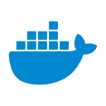

Continuous Integration / Continuous Delivery
Code Development
1
Push code (branch ”deploy”)
Developer
Gitlab
Trigger Webhook
Continuous Integration
2
Start pipeline
Compile & Package JAR
Jenkins
Maven
Docker
Build & Push
Docker Image
Continuous Delivery
3
OKD ImageStreams

Slide 12
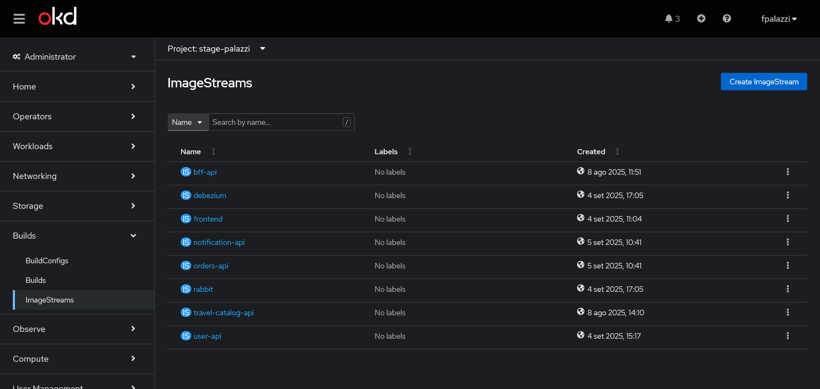
OKD – ImageStreams View
Notes:
OKD
Distribuzione open source di OpenShift (basato su Kubernetes).
Cluster di nodi che permette di orchestrare e gestire applicazioni containerizzate in maniera scalabile e resiliente.
Include funzionalità avanzate come gestione di deployment, networking, storage e sicurezza.
Pod
Unità minima di esecuzione all’interno di Kubernetes / OKD.
Può contenere uno o più container che condividono storage, rete e configurazioni.
I pod vengono creati e gestiti tramite Deployment.
Deployment
Definisce come creare, aggiornare e scalare i pod all’interno del cluster.
Garantisce che lo stato desiderato dell’applicazione sia mantenuto automaticamente (es. numero di repliche).
File principali per il deployment di un’applicazione
Secrets: gestiscono dati sensibili (password, token, chiavi).
ConfigMap: contengono configurazioni non sensibili per l’applicazione.
Deployment: definisce la creazione, l’aggiornamento e la scalabilità dei pod.
Service: espone i pod e li rende raggiungibili all’interno del cluster.
Route: espone i servizi all’esterno del cluster tramite URL pubbliche.

Slide 13
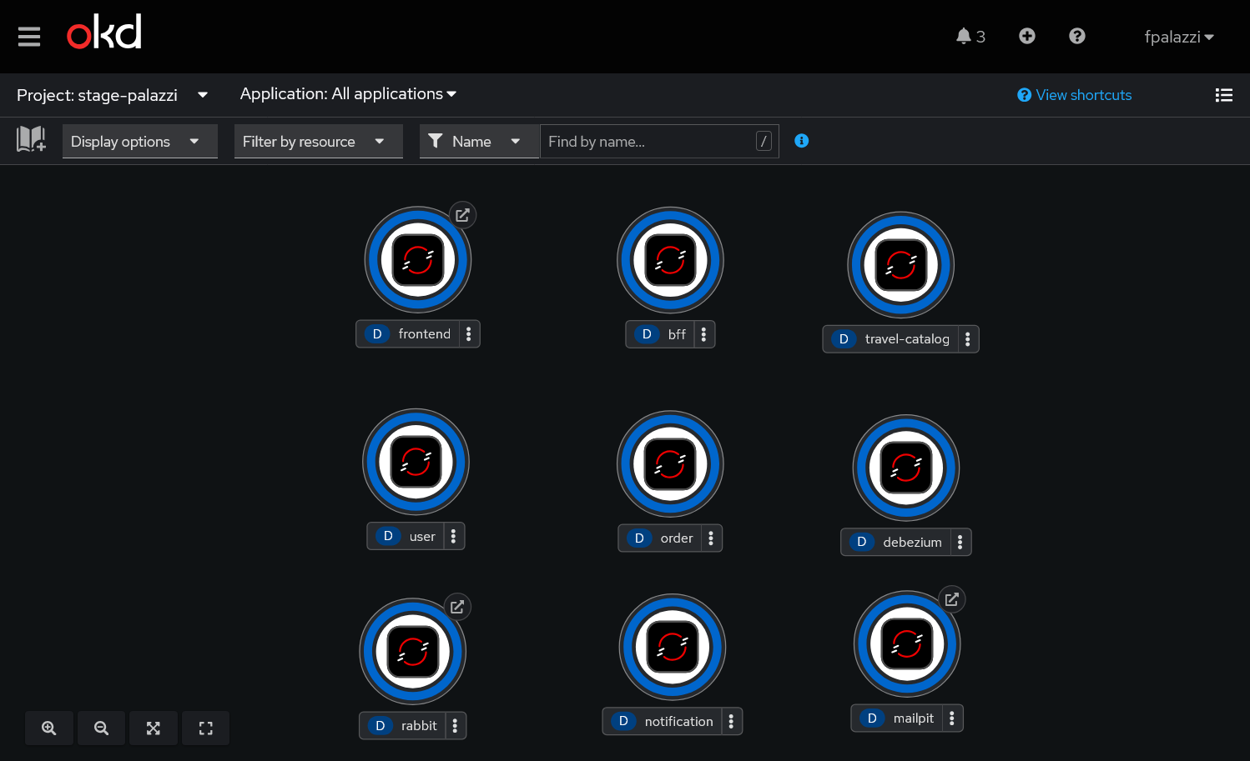
OKD – Topology View
Notes:
OKD
Distribuzione open source di OpenShift (basato su Kubernetes).
Cluster di nodi che permette di orchestrare e gestire applicazioni containerizzate in maniera scalabile e resiliente.
Include funzionalità avanzate come gestione di deployment, networking, storage e sicurezza.
Pod
Unità minima di esecuzione all’interno di Kubernetes / OKD.
Può contenere uno o più container che condividono storage, rete e configurazioni.
I pod vengono creati e gestiti tramite Deployment.
Deployment
Definisce come creare, aggiornare e scalare i pod all’interno del cluster.
Garantisce che lo stato desiderato dell’applicazione sia mantenuto automaticamente (es. numero di repliche).
File principali per il deployment di un’applicazione
Secrets: gestiscono dati sensibili (password, token, chiavi).
ConfigMap: contengono configurazioni non sensibili per l’applicazione.
Deployment: definisce la creazione, l’aggiornamento e la scalabilità dei pod.
Service: espone i pod e li rende raggiungibili all’interno del cluster.
Route: espone i servizi all’esterno del cluster tramite URL pubbliche.

Slide 14
Conclusions – What did I learn?
Reactive Microservice Development: Designed and implemented non-blocking backend services using Spring WebFlux and Quarkus Mutiny to handle high concurrency with minimal resource footprint.
API Gateway & Security: Built a GraphQL Backend-For-Frontend (BFF) to optimize client data fetching, secured by stateless JWT authentication and role-based access control.
Distributed Data Consistency: Solved the dual-write problem by implementing the Outbox Pattern, integrating Debezium (CDC) and RabbitMQ for reliable, asynchronous event streaming.
Cloud Deployment & DevOps: Created automated CI/CD pipelines using Jenkins and deployed the containerized microservice infrastructure onto an OKD (Kubernetes) cluster.
Thank you for your attention. Are there any questions?

